Slide 1
Project Status Report
Ian Bird
LHCC Referees’ meeting;
CERN, 3rd March 2015

Slide 2
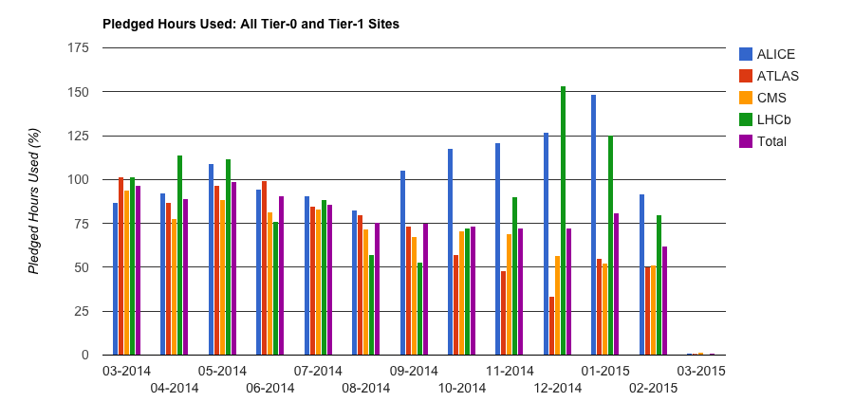
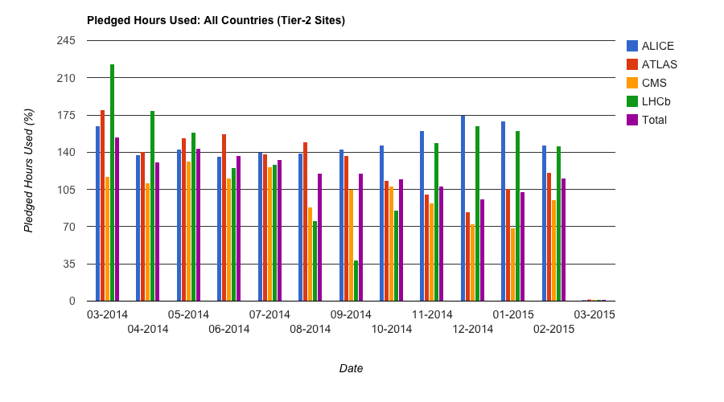
Pledge usage

Slide 3
New Tier 1s, providing significant contributions
Nov 2014 – Feb 2015

Slide 4
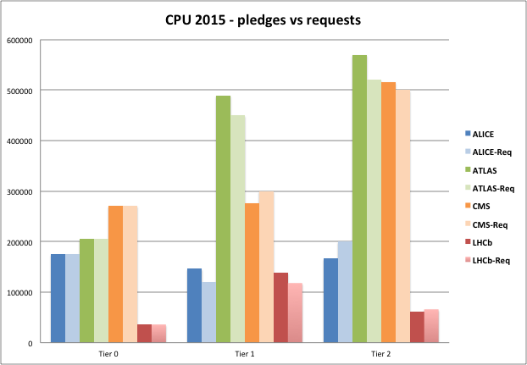
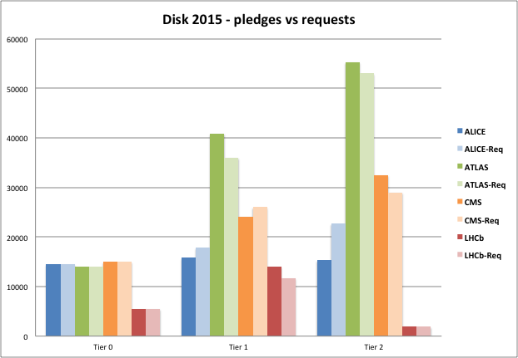
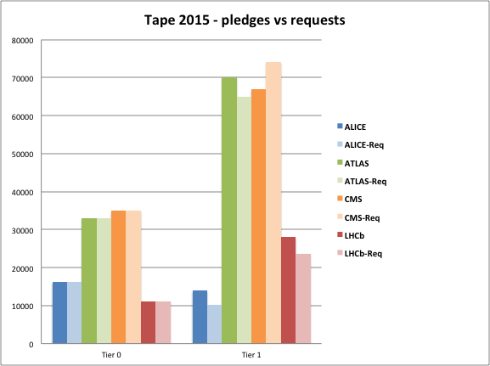
Pledges vs requests for 2015

Slide 5
Resource installation
Mostly on track to be in place for April
One or two exceptions
  But expected by ~June
Not a real problem for 2015, given LHC startup schedule

Slide 6
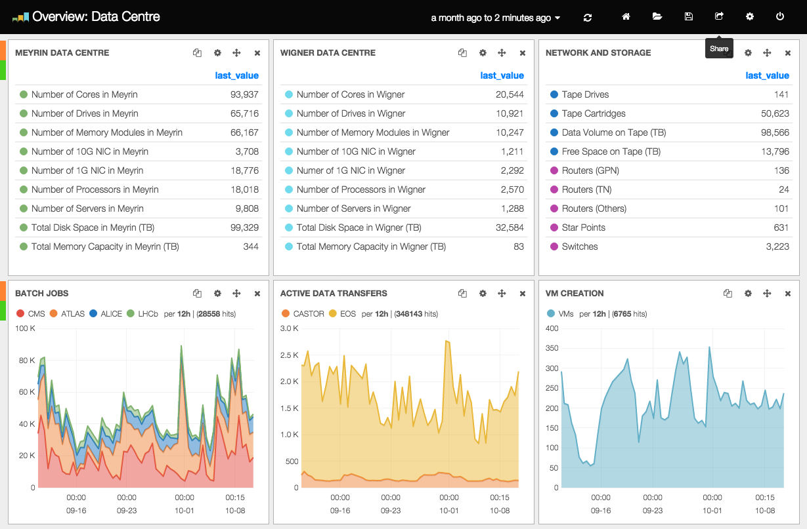
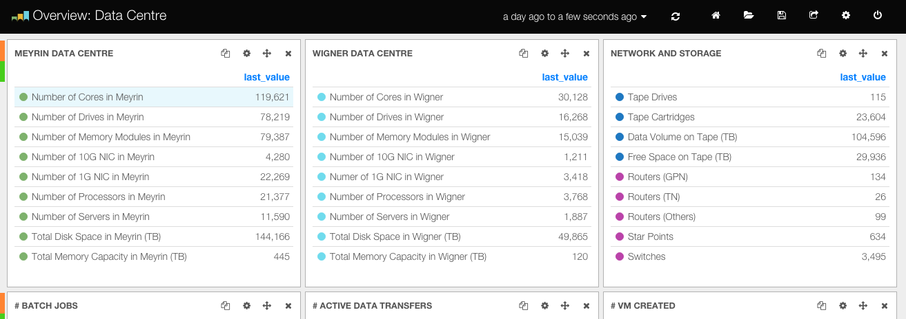
Tier 0
2015 capacity
  50 PB disk, 750 kHS06 (36 k cores)
    2/3 in Wigner, 1/3 in Meyrin

Slide 7
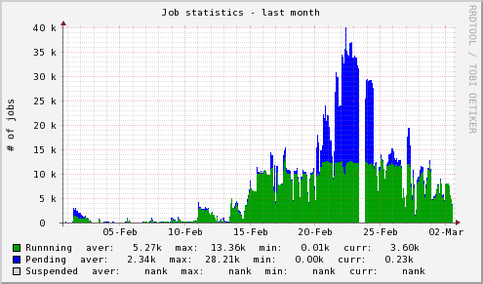
Resource installation
Mostly on track to be in place for April
One of two exceptions
  But expected by ~June
Not a real problem for 2015, given LHC startup schedule
Tier 0 had high priority request from AMS for 8000 cores for
~1 month (13 Feb),
able to satisfy with just
installed Tier 0 capacity
AMS@Tier0

Slide 8
HEP Software Foundation

Slide 9
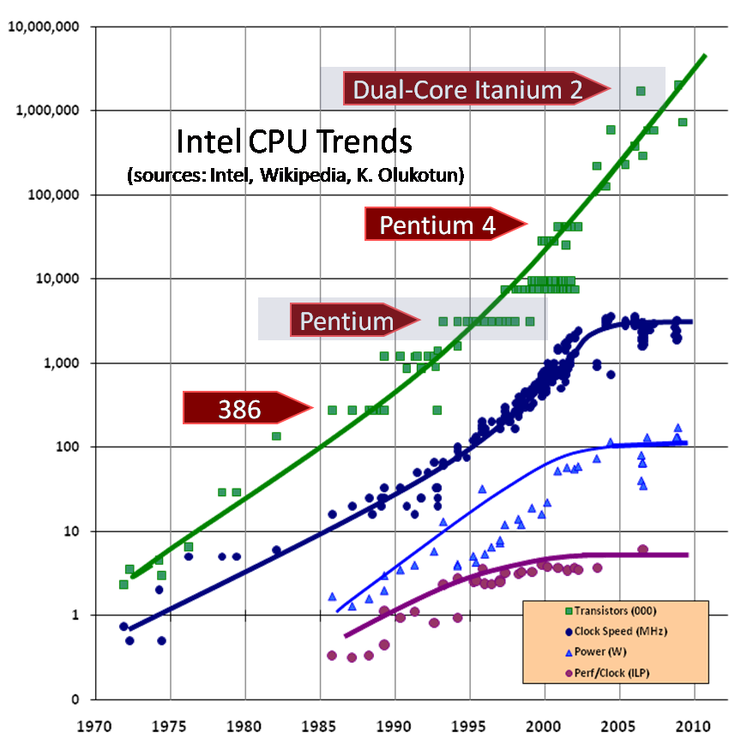
HEP Software challenge
Must make more efficient use
of modern cores, accelerators,
etc.
  And better use of the memory
Implies:
  Multi-threading, parallelism at all
  levels, optimisation of libraries,
  redesign of data structures, etc.
Requires:
  significant re-engineering of frameworks, data structures, algorithms, …
  investment of effort to develop expertise in concurrent programming
© 2009 Herb Sutter

Slide 10
HEP SW foundation: Goals
Goals of the initiative are to:
  better meet the rapidly growing needs for simulation, reconstruction and analysis of current and future HEP experiments,
  further promote the maintenance and development of common software projects and components for use in current and future HEP experiments,
  enable the emergence of new projects that aim to adapt to new technologies, improve the performance, provide innovative capabilities or reduce the maintenance effort
  enable potential new collaborators to become involved
  identify priorities and roadmaps
  promote collaboration with other scientific and software domains.

Slide 11
HSF - timeline
April 2014:
  Initial workshop – to initiate discussions
    Resulted in a 12 whitepapers to explore what/how
Summer 2014:
  Startup team put in place: led by Pere Mato (CERN), Torre Wenaus (BNL)
    Consolidated whitepaper input – draft of goals etc
    Set up dissemination – web, mail lists, etc,
    Gathered a lot of input from interested projects, experiments, etc
January 2015:
  2nd workshop at SLAC
    Ratify the goals and next steps
CHEP 2015 (April) Okinawa
  Opportunity to inform the broader HEP community and encourage participation

Slide 12
HSF SLAC workshop
January 20-21 at SLAC
  ~100 people attended (20 remotely)
  Good representation of HEP labs, experiments, software projects, and other interested communities
Goal to validate the ideas consolidated by the startup team from the whitepapers
  And agree a path forward
Input from other software initiatives
  Apache software foundation
  UK Software Sustainability Inst. (esp on training aspects)
  NSF on building scientific software communities – lessons learned
Statements from experiments, software projects, institutes
  All positive and encouraging
  Many buying into the concept and offering help, or to become guinea pig software projects
  Common themes:
    Software knowledge base/catalogue to increase reuse, consultancy for new projects, SWAT teams, build/test infrastructures, teaching, licensing
    Technical fora, technical discussions with other projects
    Common software and expertise – avoid reinventing what already exists (e.g. in HPC), help with convergence of solutions and sustainability – community building

Slide 13
Next steps
Technical forum
  Place for technology discussion and dissemination of experiences
  Publish technical notes
  Help build expertise in the community
  Concurrency forum – continue as prototype
Training
  Consensus that is important initially
    Several suggestions and volunteers to work with existing schools etc
    Learn from experience of the UK SSI
    Working group set up
Set up SW Knowledge Base
  Prototype exists
  Initially try and gather/catalogue software in use and available – provide ability to comment and cross-ref usage
  Important that community contributes to this
Build/test/integration infrastructure
  Mentioned by several groups; examples exist in labs and projects
  Under consideration
Under consideration:
  Licensing issues – must be open source - recommendations needed?
  Consultancy/SWAT teams – ready to start some activities here – to be better defined and scoped

Slide 14
H2020 project submissions
EINFRA-7-2014
  AARC
    Authentication & Authorization for Research & Collaboration – framework for federated identity platform (eduGAIN)
EINFRA-1-2014
  DPINFRA
    Data preservation services infrastructure, for big-data science
  EGI-Engage
    Evolution of EGI
  INDIGO-DataClouds
    Building a data/computing platform and tools for science, provisioned over hybrid (public+private) e-infrastructures & clouds
  RAPIDS
    Shareable science-domain workflows and services (SaaS) over e-infrastructures to hide complexity; involvement of several EIRO labs
  ZEPHYR
    Prototyping & modelling of Zettabyte-Exascale storage systems for future science data
✔
✗
✔
✔
✗
✗

Slide 15
Middleware support
Concern over lack of support for such key pieces of software
  ARGUS (security infrastructure)
Workshop held at the end of 2014
  Plan for support and development agreed
  Community support: Nikhef, INFN, EGI
    Potential new partners
  This is the model that has been used for DPM etc.

Slide 16
Data privacy
Changes in EU laws on protection of personal information
  “user consent” is no longer sufficient
Need to review and update our AUP and data protection policies
BUT:
  Currently some of our (WLCG and experiment) information publication is potentially (now) illegal in many European countries
  Recent issue affecting xrootd (and sending of monitoring information to sites in US)
    Technical steps were taken to remove personal information, relocate end-point to CERN (or EU)
  Potential risk of breaking services if sites are required to stop services, data publication, etc.
We need to be proactive and address this:
  New data protection policy being drafted
  Service developers – middleware and experiment – must be aware of this issue and address it correctly
    Will need to rapidly follow up when problems seen
  But, sites should also not be too precipitous in reaction –
    without some discussion of the issue or concern

