Slide 1
SRR - SPS : LSS3 for upgrade of the 200MHz RF system of the SPS during LS2

Slide 2
Modified half periods
Half period 31410-31510 (SPSLNINS0017)
Half period 31510-31610 (SPSLNINS0018)
Half period 31610-31710 (SPSLNINS0019)
Half period 31710-31810 (SPSLNINS0020)
Half period 31810-31910 (SPSLNINS0021)
Half period 31910-32010 (SPSLNINS0022)
Half period 32010-32110 (SPSLNINS0023)
Half period 32110-32210 (SPSLNINS0024)

Slide 3
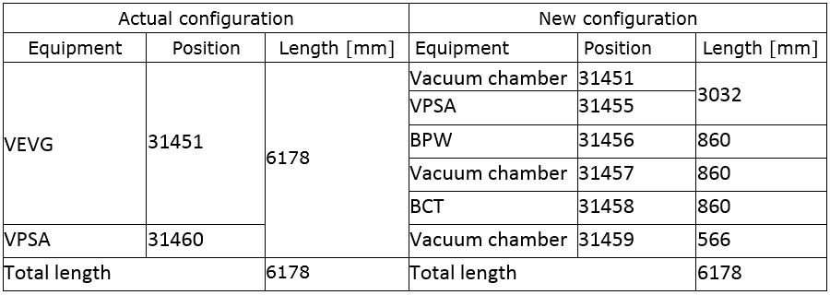
Half period 31410-31510
(BCTF.31451)

Slide 4
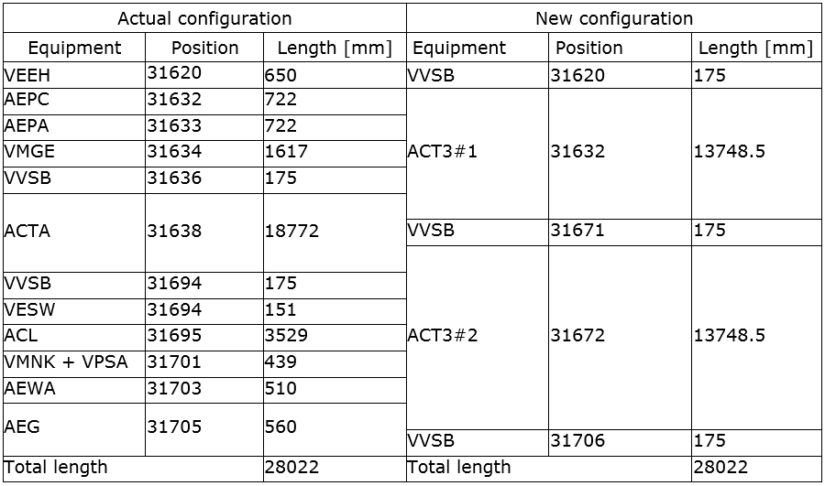
Half period 31610-31710

Slide 5
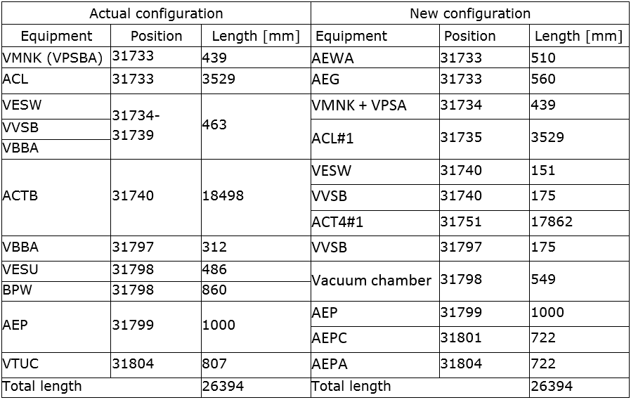
Half period 31710-31810

Slide 6
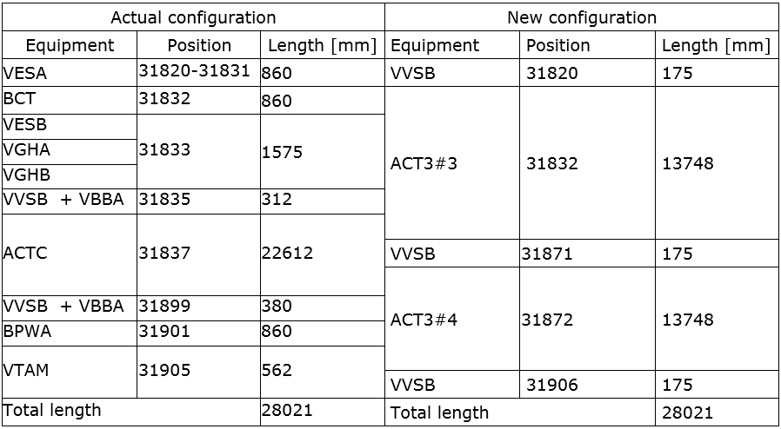
Half period 31810-31910

Slide 7
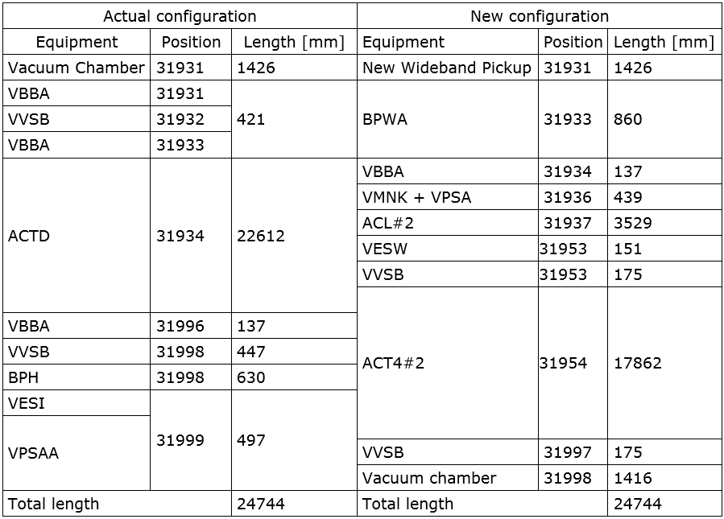
Half period 31910-32010

Slide 8
Special Thanks
Sonia Bartolome
Fred Galleazzi

Slide 9
11/3/2015

