Slide 1

The High Rapidity Shower Counters for LHCb
Kazu Akiba – CERN/UFRJ-Brazil
On behalf of the Herschel team:
V. Coco , P. Collins , P. Dziurdzia , R. Dumps , R. Dzhelyadin, R. Jacobsson, C. Joram, D. Lacarrere
R. McNulty , L. Roy , H. Schindler , S. Stevenson , C. Thomas , G. Wilkinson

Slide 2
Outline
LHCb Detector and CEP
  Physics results by D. Johnson on Friday.
Motivation to extend LHCb coverage
  CEP physics and beyond
The Herschel Project
  Detector Design
  First results
Status and Prospects

Slide 3
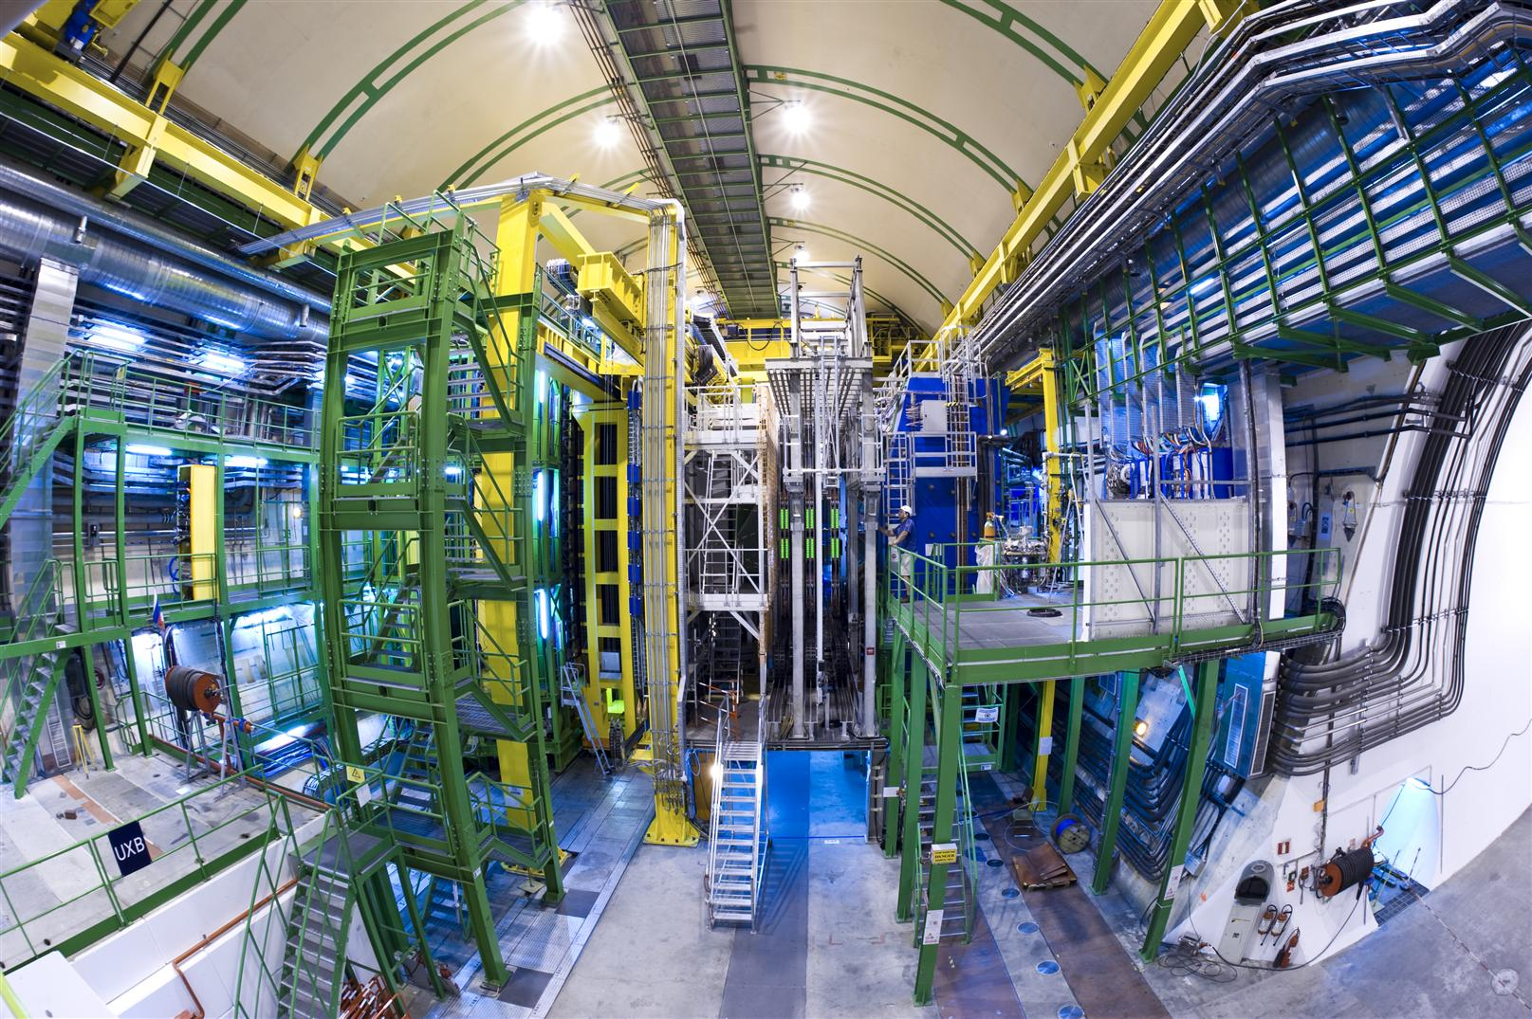
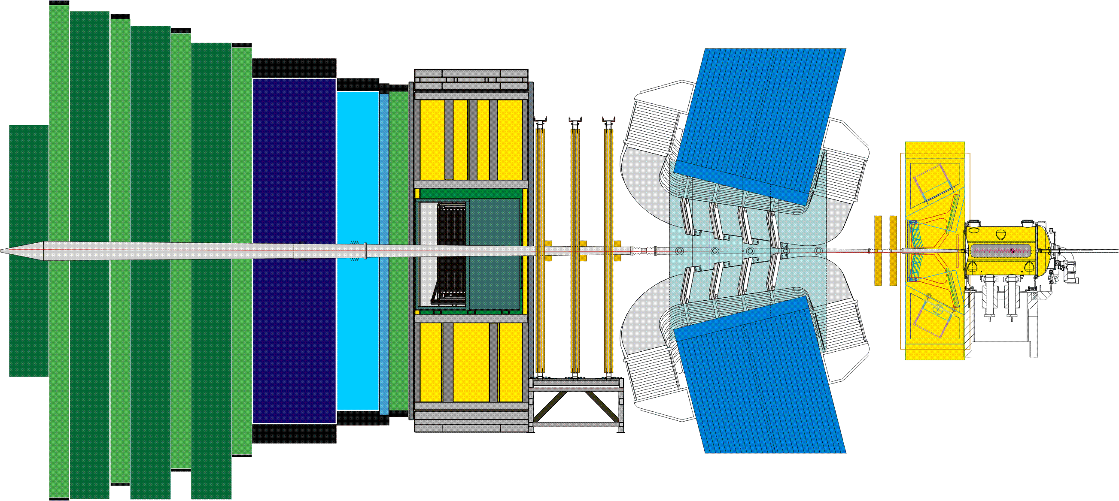
The LHCb Experiment
RICH2
Outer Tracker straw Tubes
TT
Si
HCAL
ECAL
Magnet
Zoom in the vertex region
VELO&PU
Si
Backwards
planes for trigger
Open during injection
Closes for physics
Muon
MWPCGEM
+ Trigger
Hard & Soft
Inner Tracker
Si
RICH1
Large Hadron Collider beauty Experiment
for CP violation and Rare B Decays.
3

Slide 4
The LHCb Experiment
RICH2
Outer Tracker straw Tubes
HCAL
ECAL
Magnet
TT
VELO
backwards tracks
with -3.5 < η < -1.5
Forward region:
Efficient track reconstruction ~2<η<5
1 MHz output to trigger farm
Fully instrumented: momentum, PID
Muon
MWPCGEM
+ Trigger
Hard & Soft
Inner Tracker
RICH1
Large Hadron Collider beauty Experiment
for CP violation and Rare B Decays.
4

Slide 5
The LHCb Experiment
RICH2
Outer Tracker straw Tubes
HCAL
ECAL
Magnet
TT
VELO
backwards tracks
with -3.5 < η < -1.5
HERSCHEL
Forward region:
Efficient track reconstruction ~2<η<5
1 MHz output to trigger farm
Fully instrumented: momentum, PID
HERSCHEL
Muon
MWPCGEM
+ Trigger
Hard & Soft
Inner Tracker
RICH1
Large Hadron Collider beauty Experiment
for CP violation and Rare B Decays.
5

Slide 6
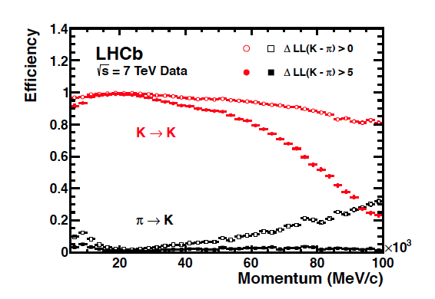
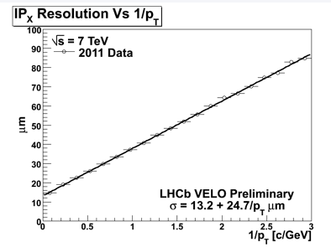
CEP@LHCb
LHCb very well suited to studies of CEP production
Access to high rapidities
  2 < η < 5 acceptance for forward tracking;
  good complementarity with ATLAS/CMS
  Some sensitivity to backwards tracks
  with -3.5 < η < -1.5
Relatively low pileup
  Analysis greatly simplified by using single interaction events
Trigger
  First level trigger output rate of 1 MHz
  muon/calo + some VELO information available
  Flexibility available at second level trigger with full event information
Excellent particle ID
  Possibility to distinguish CEP decays to K,p,μ,π final states
Sensitivity to low p and low p_{T} particles
  both at trigger stage, and for precise reconstruction
RICH Particle ID performance
VELO impact parameter resolution

Slide 7
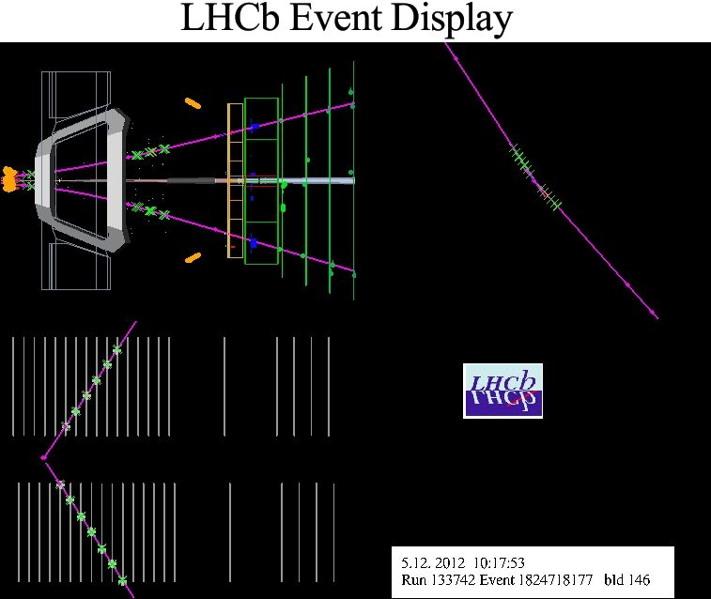
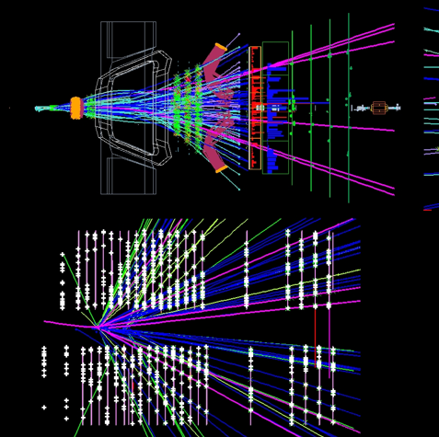
CEP Trigger at LHCb
Typical events: Many tracks + high Pt objects
Picked up with high efficiency by standard LHCb triggers
CEP events
No other activity in event; low P_{T}
Dedicated high efficiency trigger (e.g. for muons)
Level 0: 1μ (p_{T}>400 MeV) or 2μ (p_{T}> 80 MeV)
+ low multiplicity calorimeter signature
High Level Trigger: di-μ candidate with p_{T}<900MeV

Slide 8
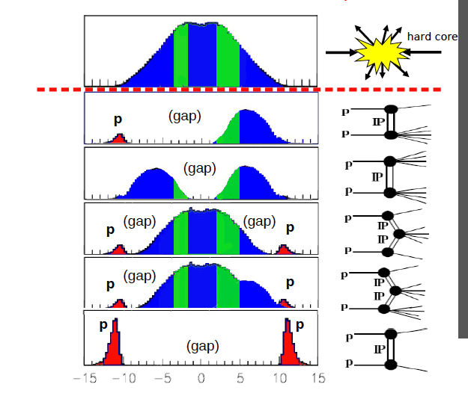
CEP Events and Backgrounds
LHCb coverage (approximate)
Single Diffraction
CEP events:
Trigger on and reconstruct
a handful of particles
(muons, hadrons, photons..)
Double Diffraction
Central Exclusive
(elastic)
Central Exclusive
(inelastic)
CEP backgrounds:
reject events with
additional particles,
usually very forward
Elastic Scattering
After D. d’Enterria arxiv 0806.0883 and http://cern.ch/dde

Slide 9
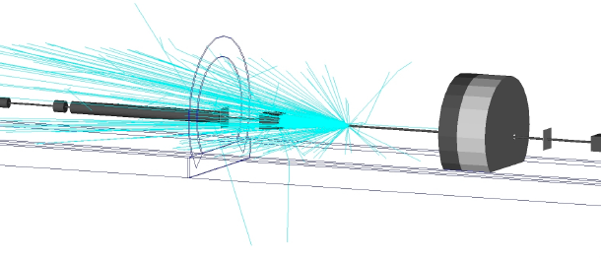
Eliminating Backgrounds
Idea of Herschel is to install scintillators in the tunnel where the beam pipe is accessible
  Detect showers from high rapidity particles interacting with beam pipe elements
  In addition to enhancing Central Exclusive Physics, it will also act as general rapidity gap detectors and will identify very forward showers in low mass diffractive excitation
  LHCb readout also offers potential to incorporate signals into trigger at L0 (40 MHz) trigger
  Other topics such luminosity measurement and understanding of machine backgrounds may also benefit from an improved LHCb hermeticity
The irreducible backgrounds to the analyses are dominated by inelastic backgrounds: undetectable events where the proton breaks up in the forward direction

Slide 10
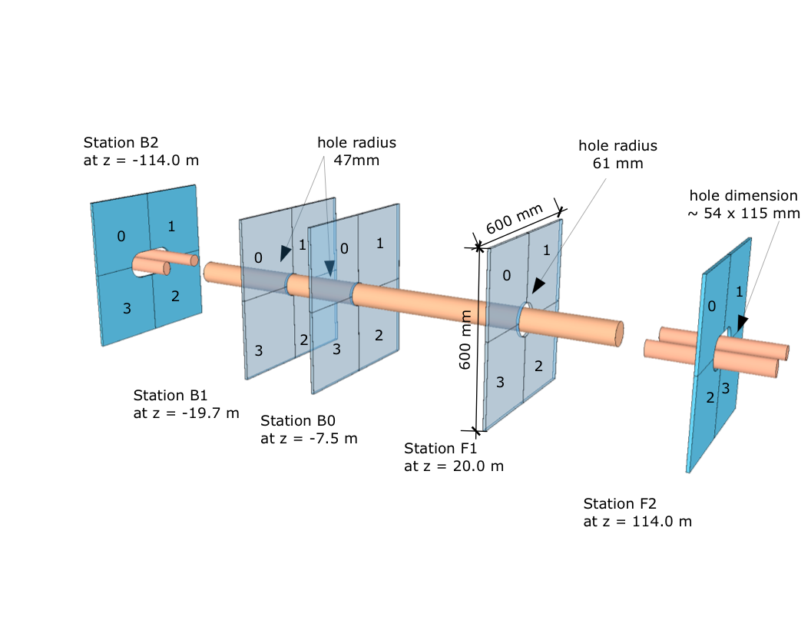
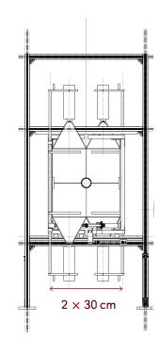
Detector Layout
Each station consist of 4 plastic scintillator plates, 20 mm thick,
glued to “fishtail” light guides
Two different radii of inner cut-out depending on beam pipe layout

Slide 11
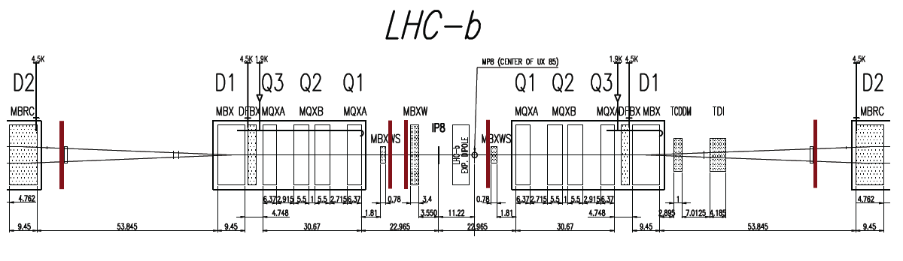
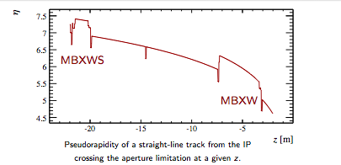
Position of Herschel Stations
Left/Backwards/Upstream
z ~ -7.5m (after MBXW)
z ~ -19m (before MBXWS)
z ~ -114m (after BRAN)
Right/Forwards/Downstream
z ~ 20 m (close to MBXWS)
z ~ 114m (after BRAN)
B side
F side
Dictated by:
Availability of free space
Vicinity to aperture limiting machine elements
Stations after BRAN give view of high rapidity neutrals

Slide 12
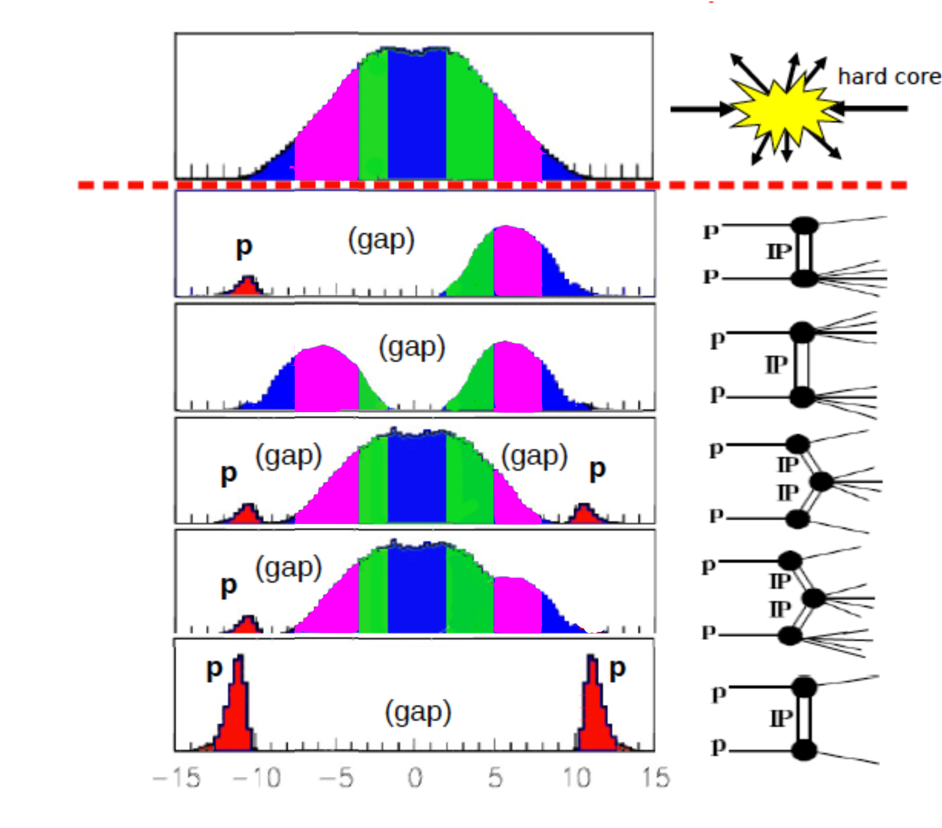
CEP events and backgrounds
LHCb coverage (approximate) + Herschel extension
η ~ from 5 to 8
Single Diffraction
CEP events:
Trigger on and reconstruct
a handful of particles
(muons, hadrons, photons..)
Double Diffraction
Central Exclusive
(elastic)
Central Exclusive
(inelastic)
CEP backgrounds:
reject events with
additional particles,
usually very forward
Elastic Scattering
η

Slide 13
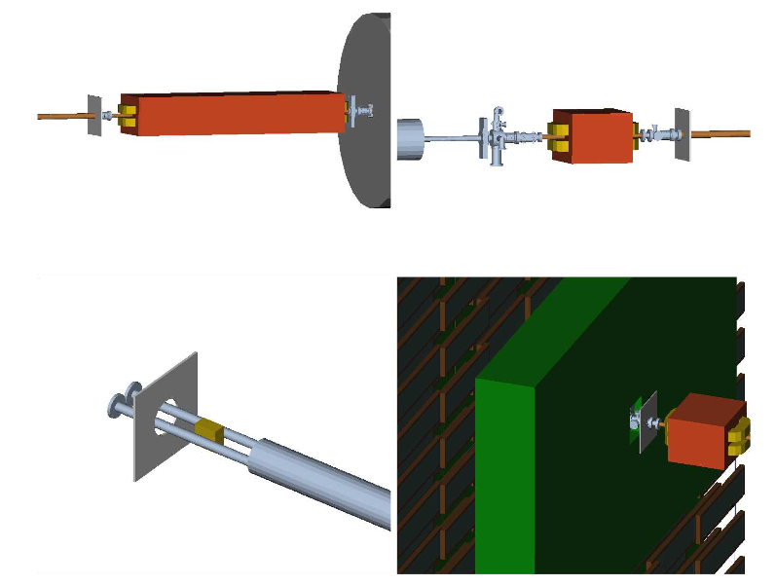
Simulations
Particles from CEP-like
background can still be seen and used to reject events.
CEP-like
Minimum bias
B1
B1
Beam elements and
Magnetic fields are well described up to +/-120 m
Additional integration of few final elements of the beam line and proper treatment of the intact protons are under development
CEP-like events in F2

Slide 14
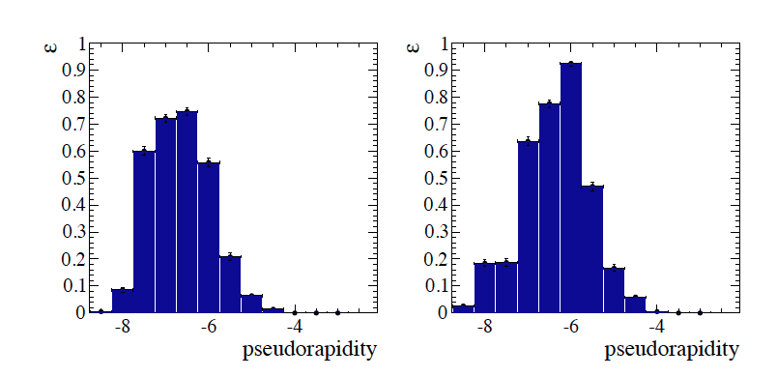
Simulation – Efficiencies
Checked with particle gun, down to very low p_{T} values
Efficiency to detect 5 or more hits extends beyond nominal pseudorapidity coverage, due to showering

Slide 15
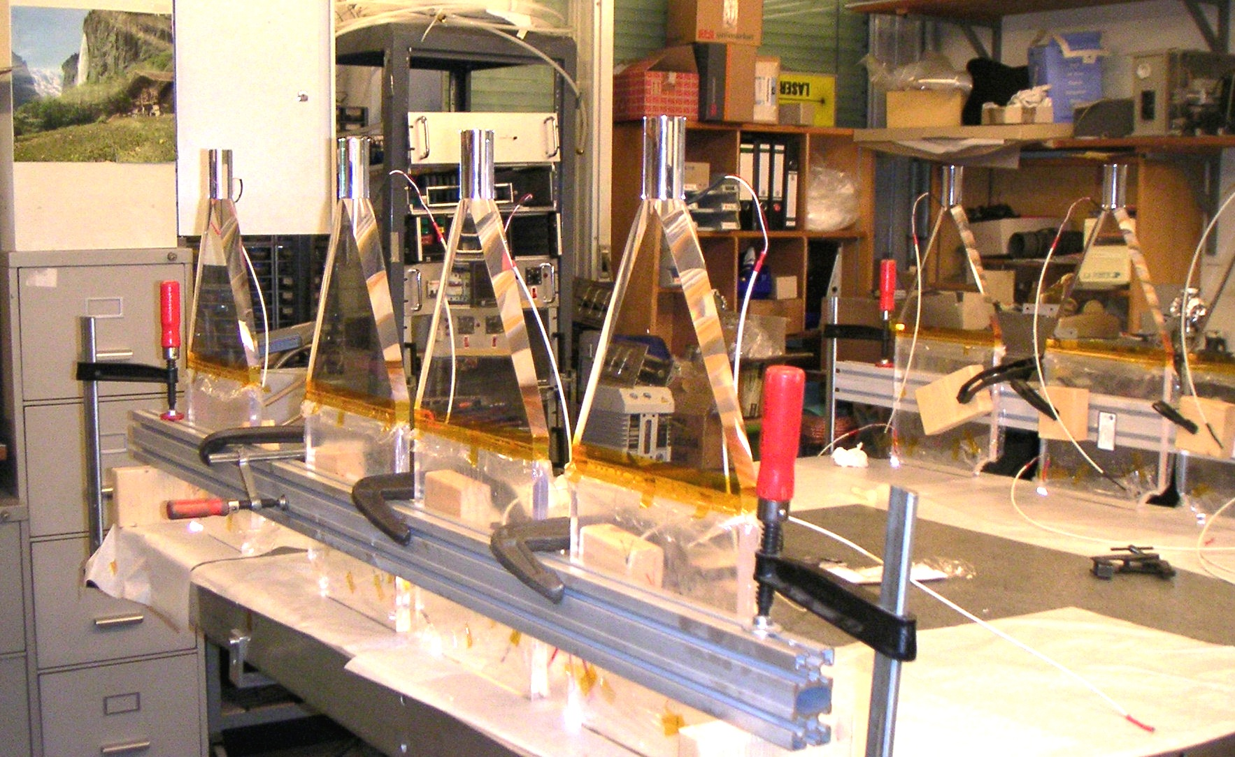
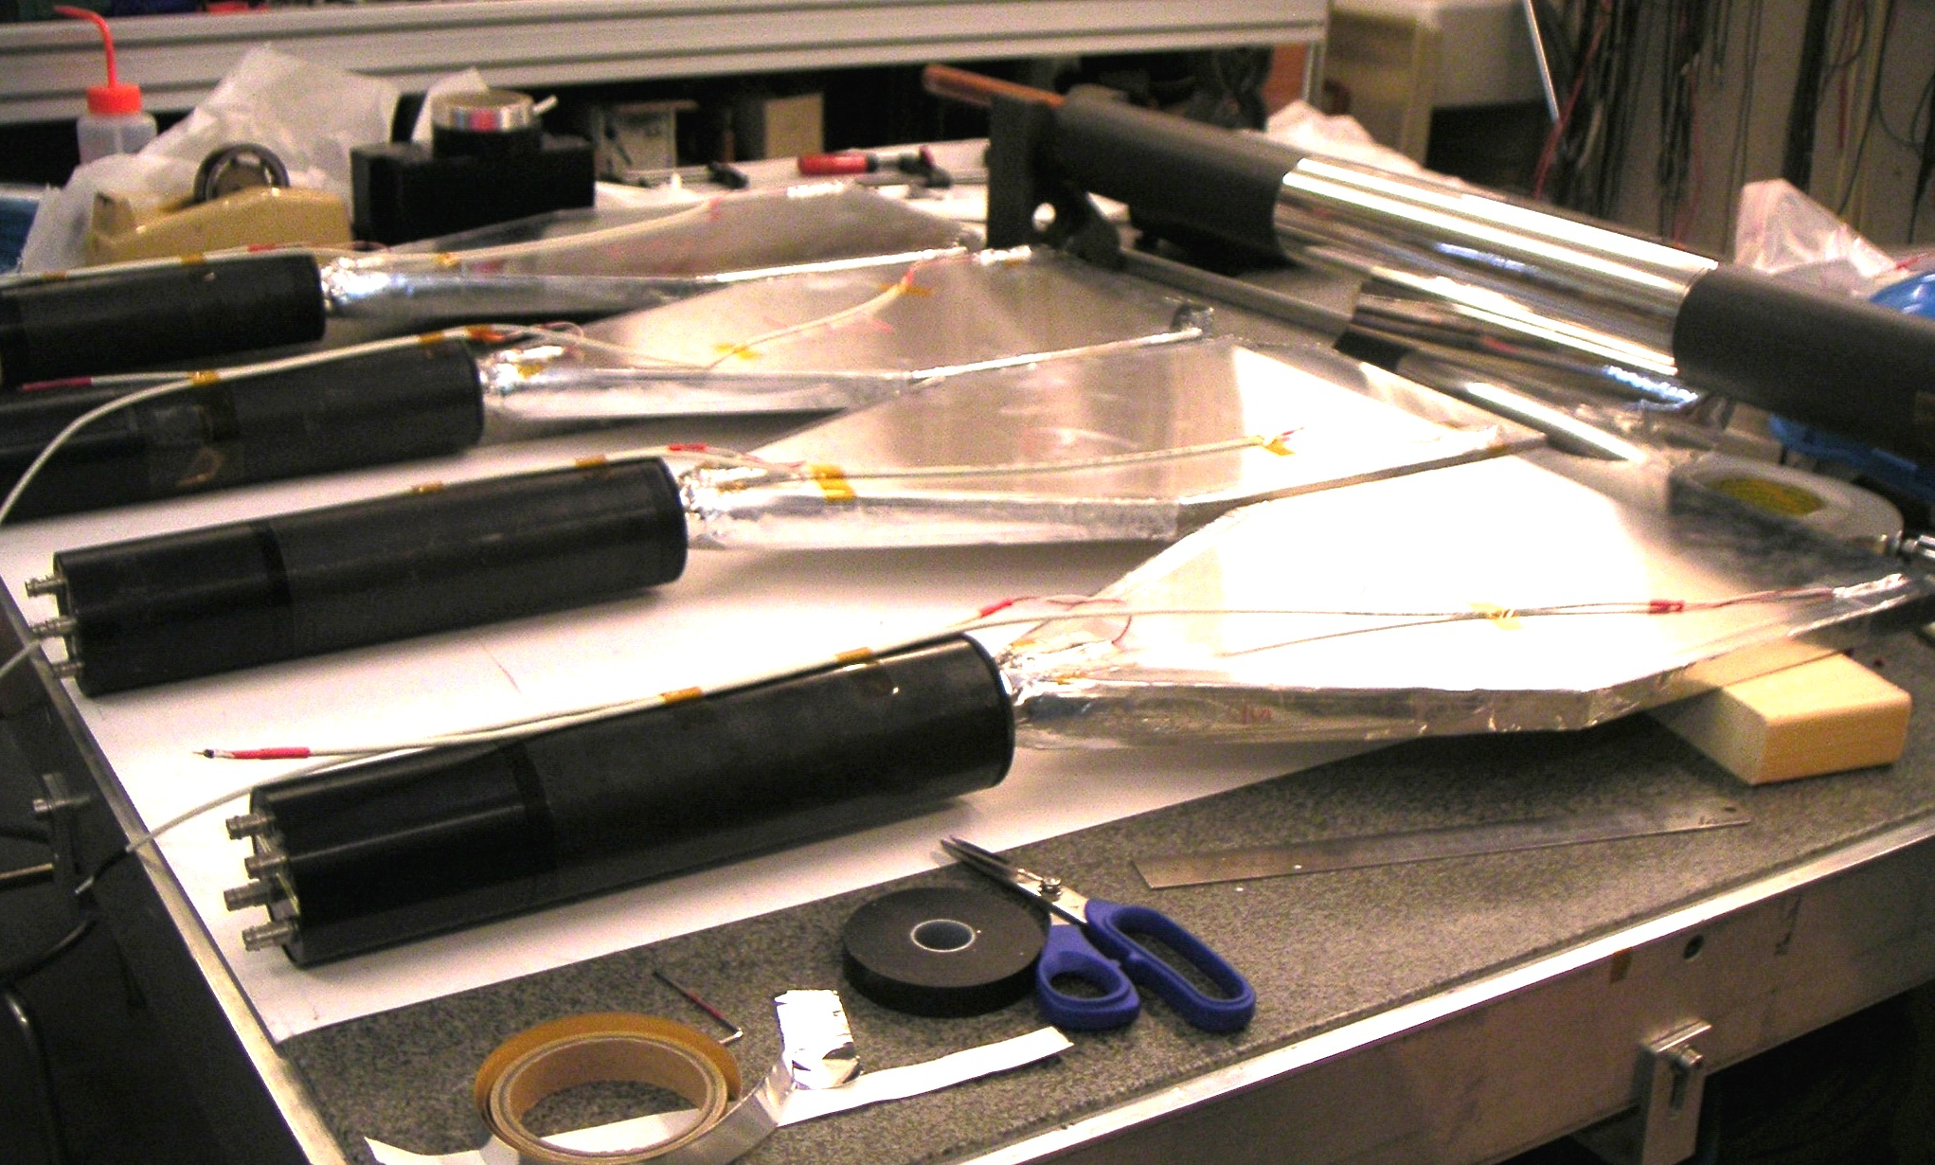
Detector Construction
Detectors were constructed and mounted at CERN,
They have integrated LEDs in two regions to monitor radiation damage.
After construction they were tested and pre-calibrated with cosmic rays.

Slide 16
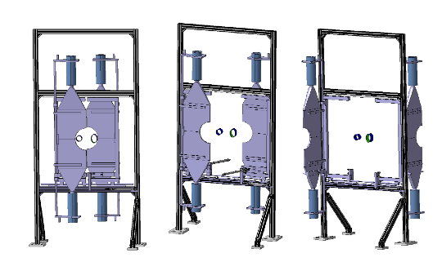
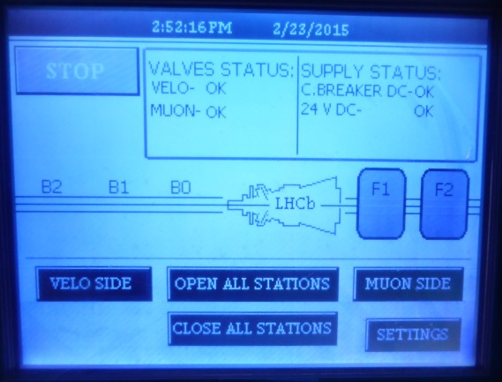
Station support structures
Support frame of station at +20 m is attached to shielding wall between muon system and LHC tunnel
Supports for other stations are bolted to tunnel floor
Pneumatic motion system to retract scintillators from high fluence region if data taking is not possible for extended time periods

Slide 17
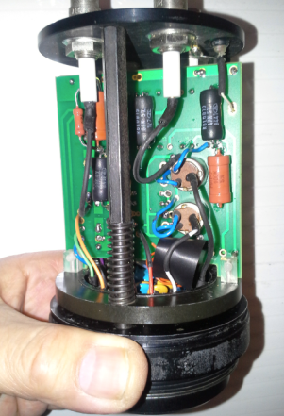
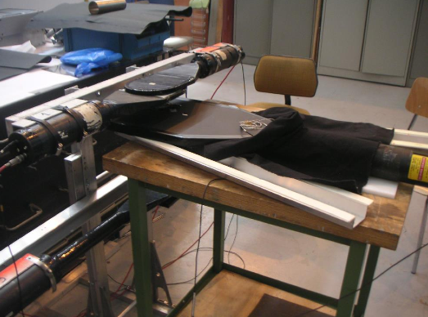
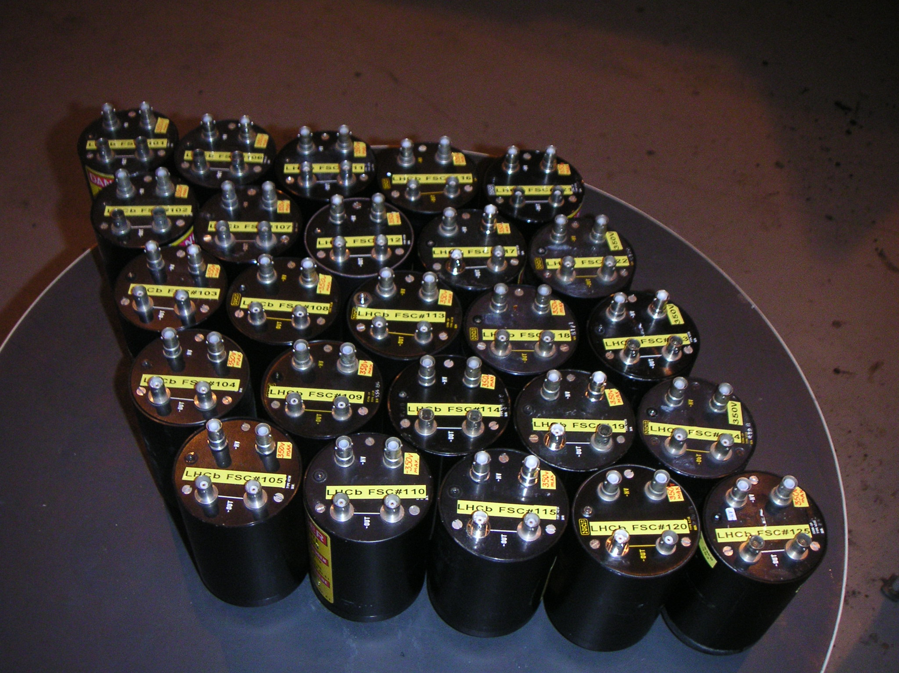
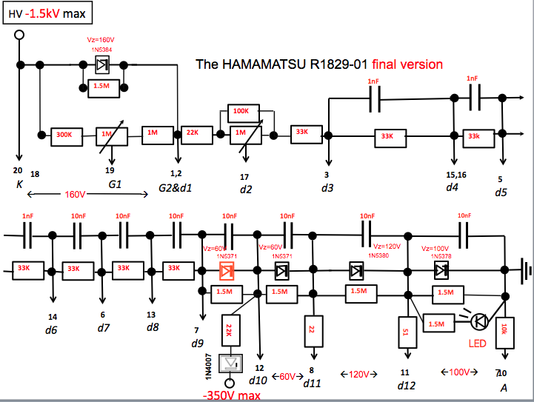
PMT + Base
PMT performance requirements:
Cope with a huge flux of photons
  Even with a reduced gain anode currents will be very high
  Large range in gain still needed for commissioning
Distinguish small CEP signals above the minimum ionising (and other) background
25 ns running – which gives huge CEP yields – places additional constraints on pulse speed
PMT choice: HPK R1828-01 2” diameter.
Maximum anode average current up to 200 uA
Fast signal response 1.3 ns rise time
Large gain adjustment
Divider – in house design
must drain 2-4 mA -> extra bias current
zener diodes to stabilise operation
(Previous LHCb experience for Beam Loss Scintillators)
Cosmic stand
All pmt bases
circuit

Slide 18
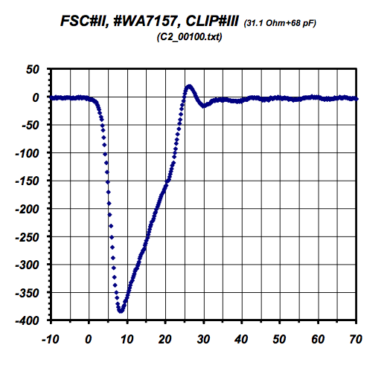
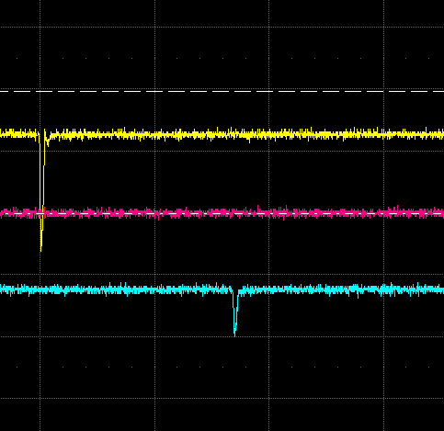
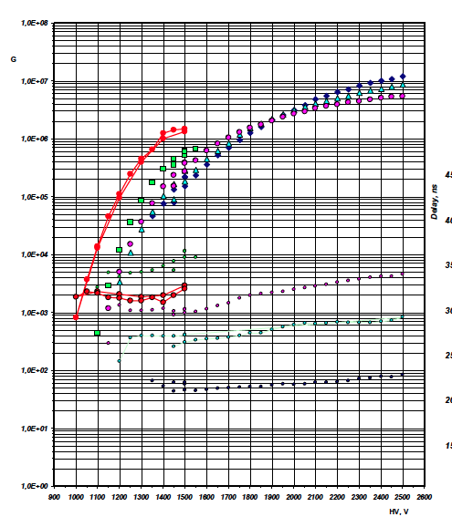
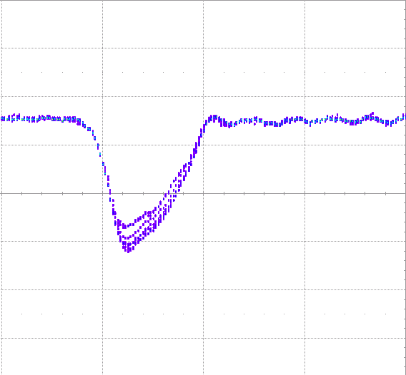
Photon signals
Cosmic stand results indicate light yield of ~200 p.e.
B0
850ns
B2
Individual gain of
Each detector measured
With the cosmic
Stand setup
Data taken with installed setup shows the predicted behaviour

Slide 19
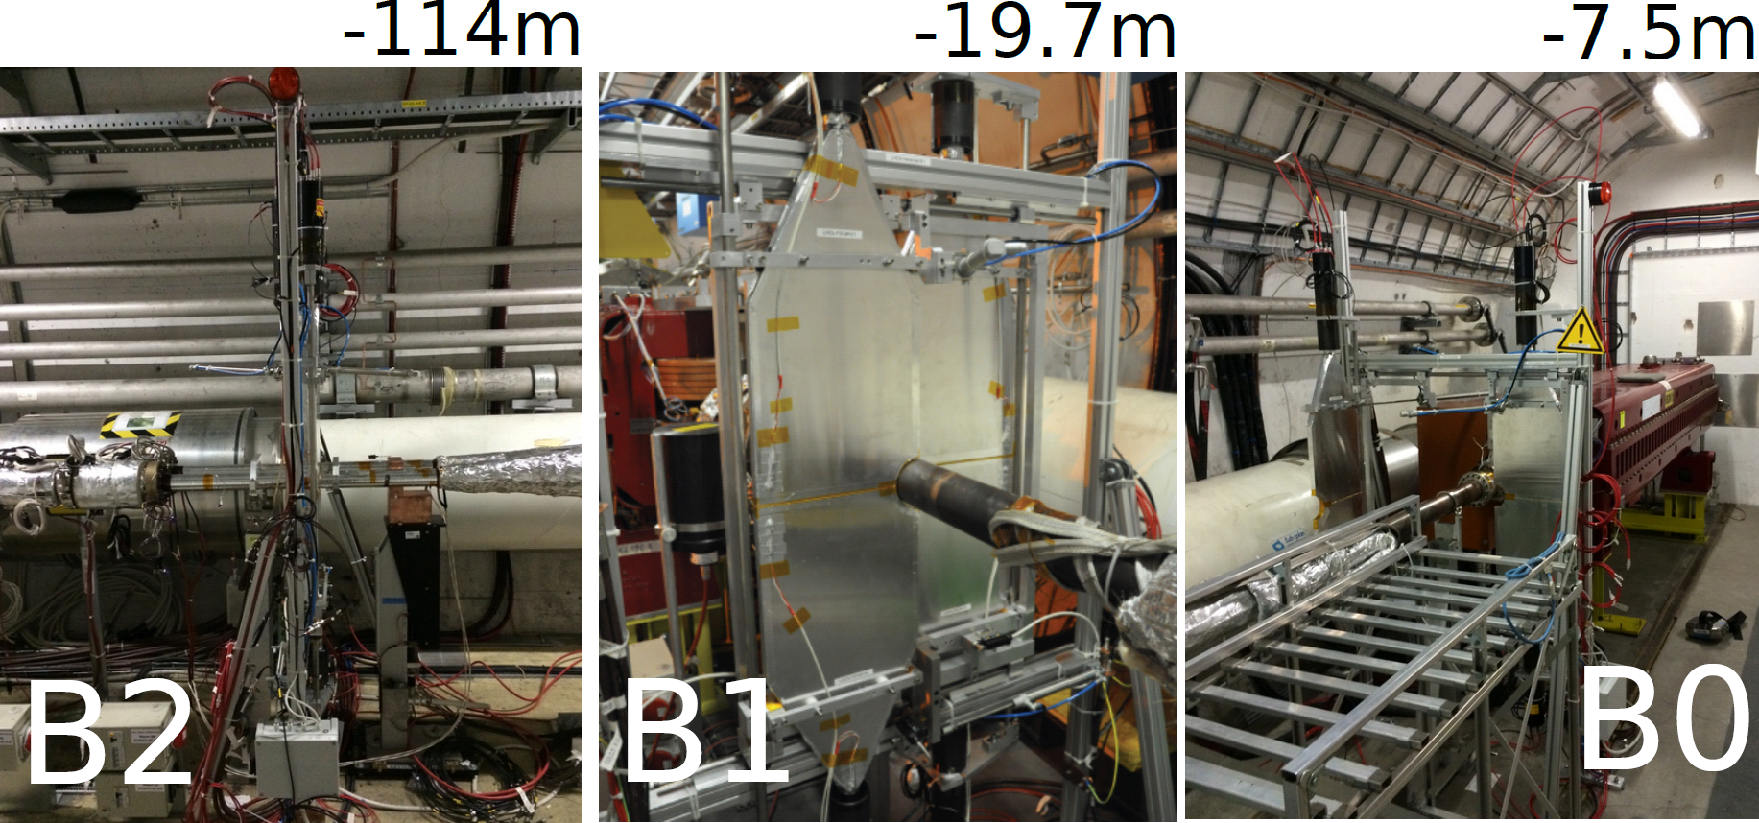
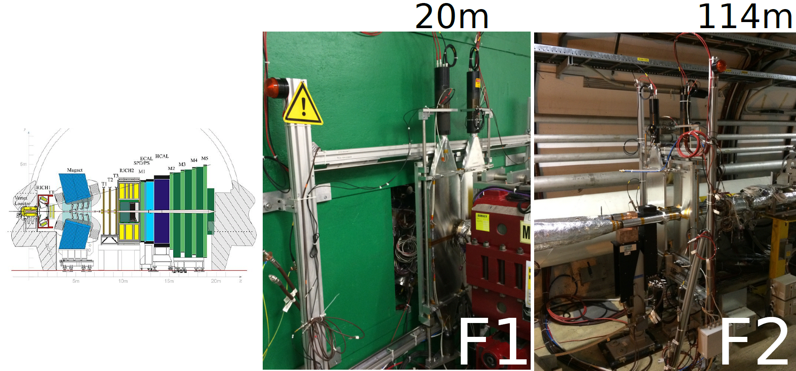
Installation
Detectors installed since
December.
All cabling installed.
HV and LV systems installed
Final installation of Readout

Slide 20
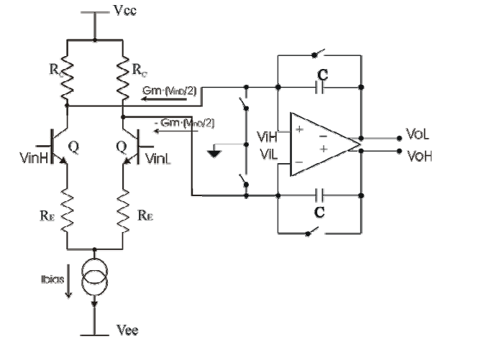
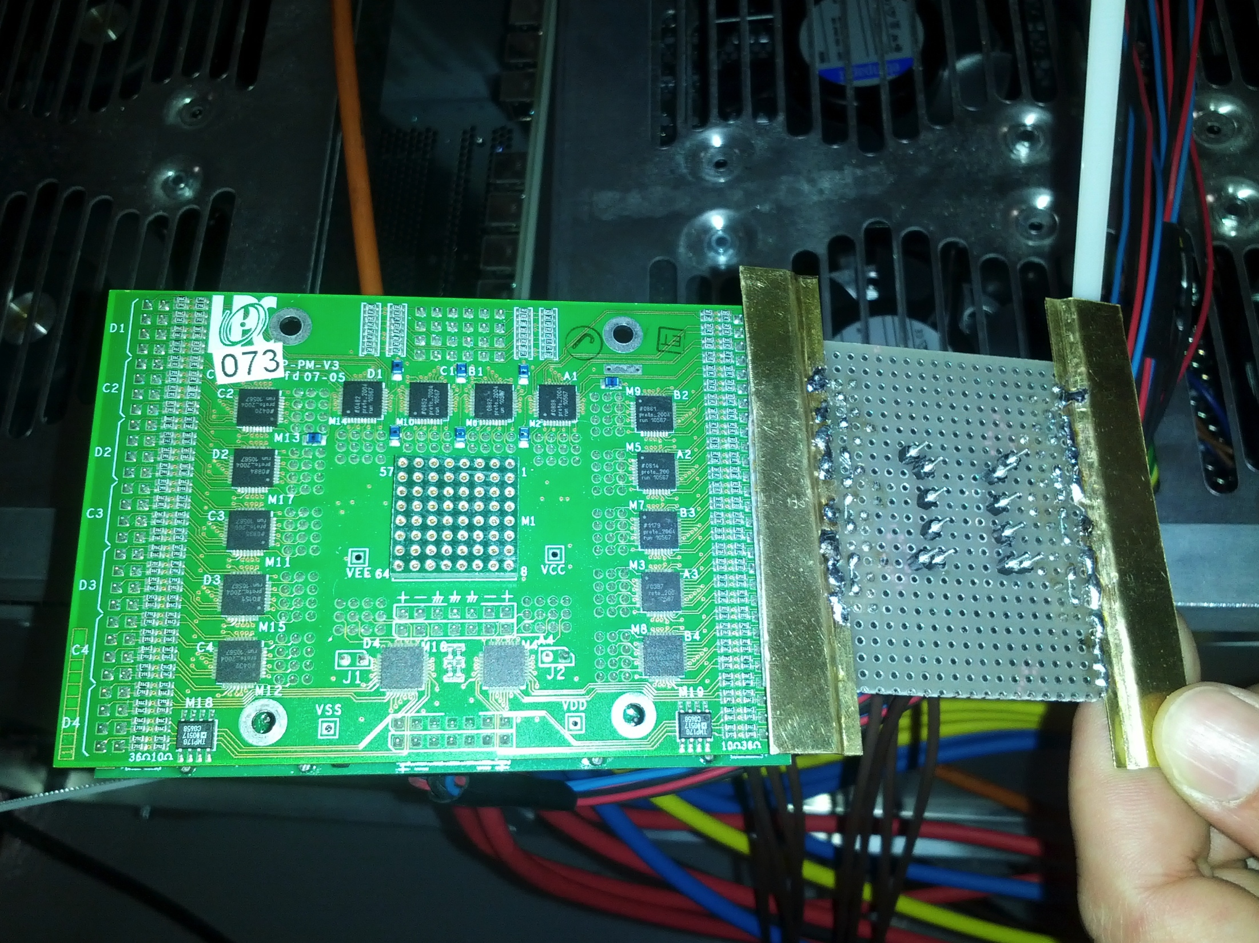
Electronics
Using existing electronics from LHCb – SPD-PS.
2 switching integrator circuits allow to take data at the very high signal rate ~30 MHz @ 25 ns.
Front-end boards + selection board combine the information per side and can participate in L0 Trigger
20 channels in total: little increase in overall LHCb bandwidth
Very-Front end board

Slide 21
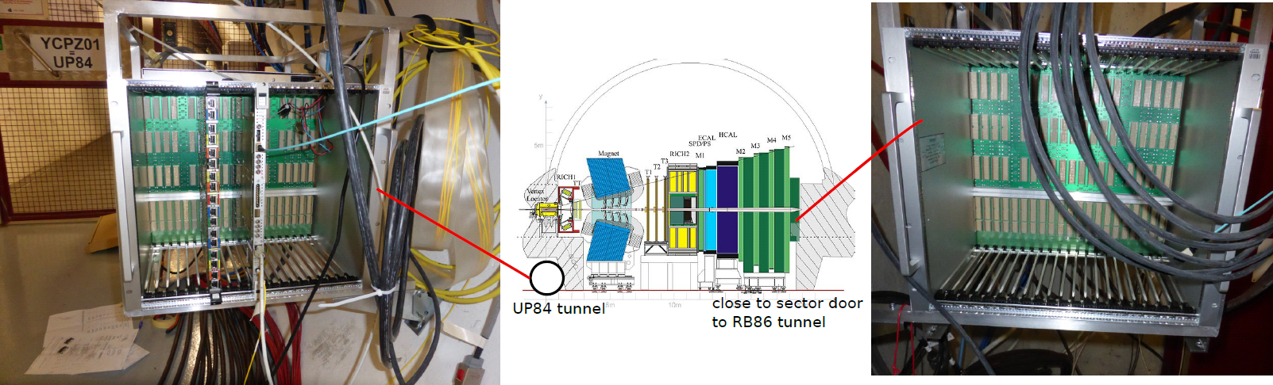
Commissioning
Electronic crates installed and operational
System already integrated into the LHCb detector
Very-Front-End adaptor cards to be replaced for full speed

Slide 22
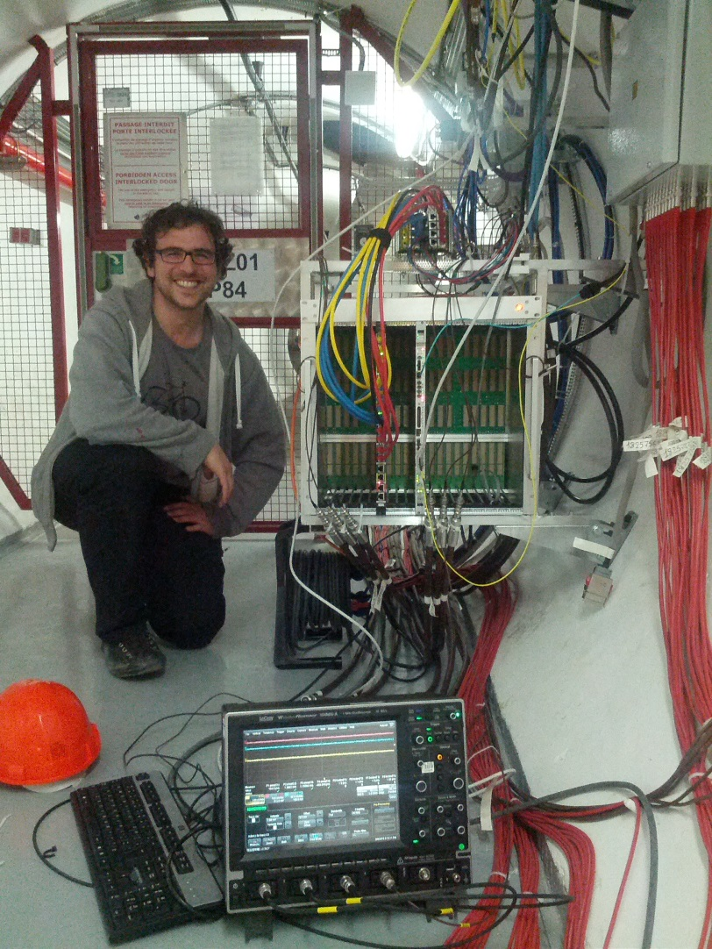
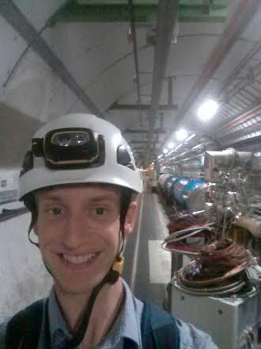
Commissioning
Electronic crates installed and operational
System already integrated into the LHCb detector
Very-Front-End adaptor cards to be replaced for full speed

Slide 23
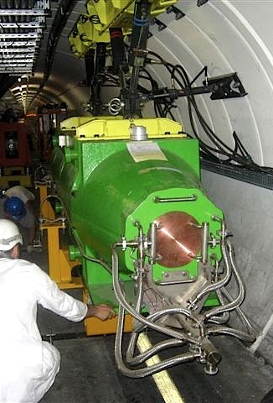
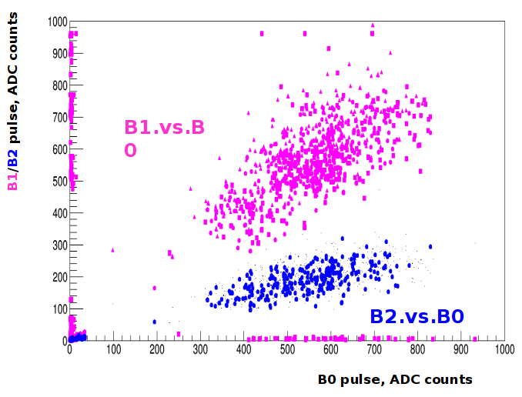
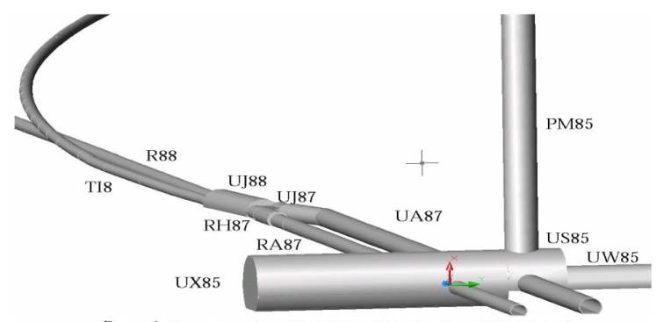

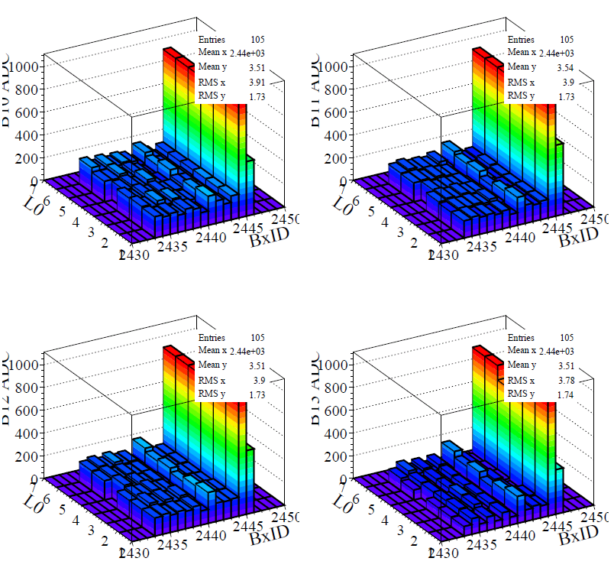
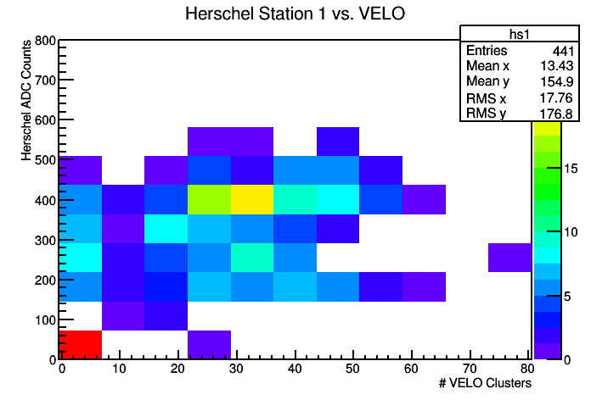
Sector tests: TED Run
Correlation between stations
Shows that the detectors
are working well
TI8
LHC
Consistent signal
On many TED shots
Clear correlation
with the VELO

Slide 24
Current Status
Finalize commissioning with beam
Commission the LED system integrated to the LHCb readout
Install trigger electronic system to integrate to central trigger (using existing LHCb boards)
  Should be done by the LHC technical stop in June.
Implement the required trigger logic in the front-end PGA chips.

Slide 25
Conclusions
The Herschel project is almost ready!
  Extend LHCb coverage with very forward scintillators in LHC tunnel upstream and downstream of experiment
  Improve selection of and triggering on events with large rapidity gaps and interpretation of central exclusive and single diffractive analyses
Will participate in the data taking of 2015
  Integrated to LHCb
  should acquire >5 fb⁻¹ of data with low pileup of run II.
Detector Installation is finished.
Final commissioning of readout and trigger electronics

Slide 26
The LHCb Experiment
RICH2
Outer Tracker straw Tubes
HCAL
ECAL
Magnet
TT
VELO
Muon
MWPCGEM
+ Trigger
Hard & Soft
Inner Tracker
RICH1
Large Hadron Collider beauty Experiment
for CP violation and Rare B Decays.
26

