Slide 1

Impedance considerations on the aC coating of the LHC beamscreen
C. Zannini, B. Salvant
Acknowledgments: N. Biancacci, S. Calatroni, E. Métral, G. Rumolo

Slide 2
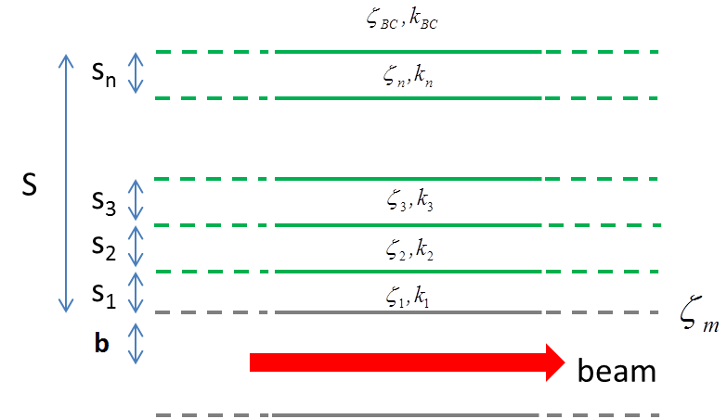
Impedance model for analytical calculation
Case with aC coating
  5 layer structure
    1st layer (aC)
    2st layer (Ti)
    3st layer (Cu)
    4st layer (StSt)
    5st layer (Vacuum)
Case without aC coating
  3 layer structure
    1st layer (Cu)
    2st layer (StSt)
    3st layer (Vacuum)
Material | σ_{el} [S/m] | ε_{r} | Thickness [µm]
aC coating | 400 | 5.4 | 0.5
Titanium coating | 10⁶ | 1 | 0.1
Copper | 10⁹ | 1 | 50
Stainless steel | 1.35 10⁶ | 1 | 1000
Vacuum | 0 | 1 | Infinity

Slide 3
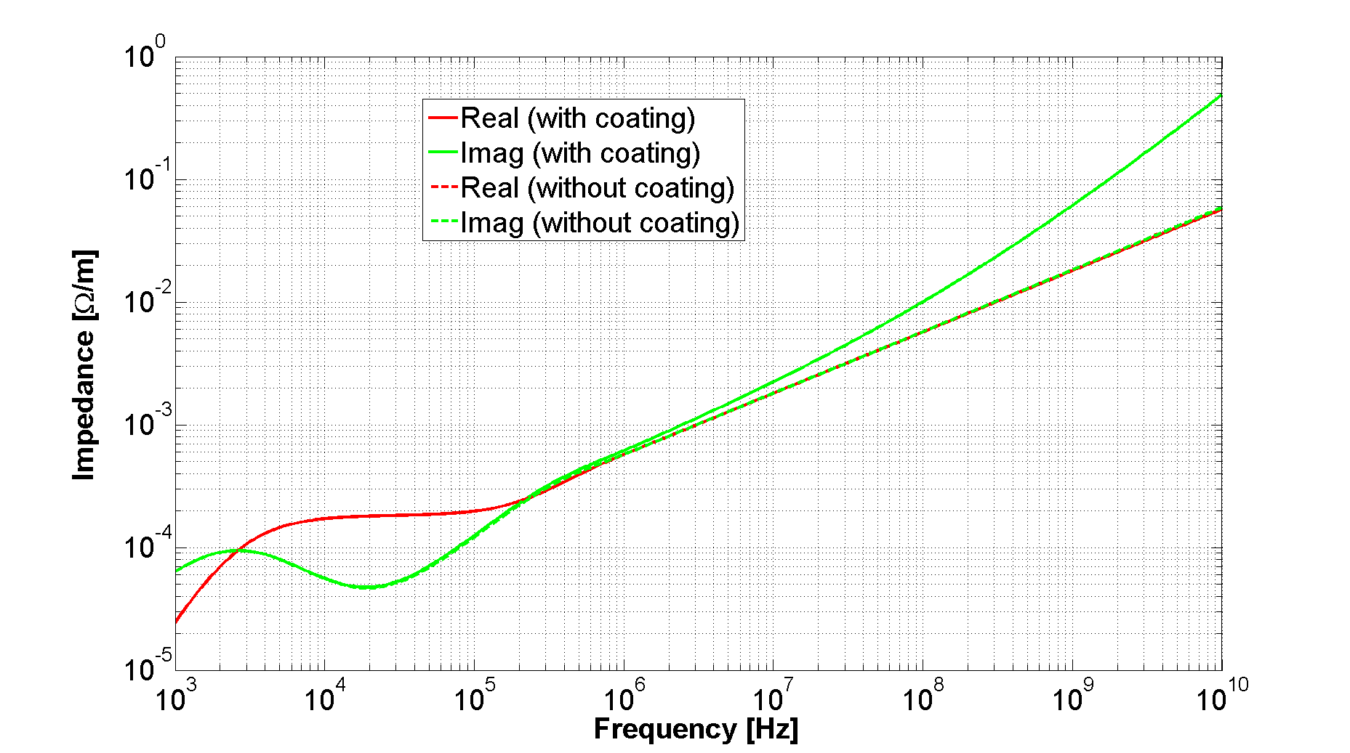
Longitudinal impedance: effect of aC coating
Significant effect on the imaginary part
The effect on the real part is negligible
No effect on beam induced heating (single beam)
Two beams heating
First order longitudinal impedance due to the weld
No impact of aC coating (3D CST simulations)

Slide 4
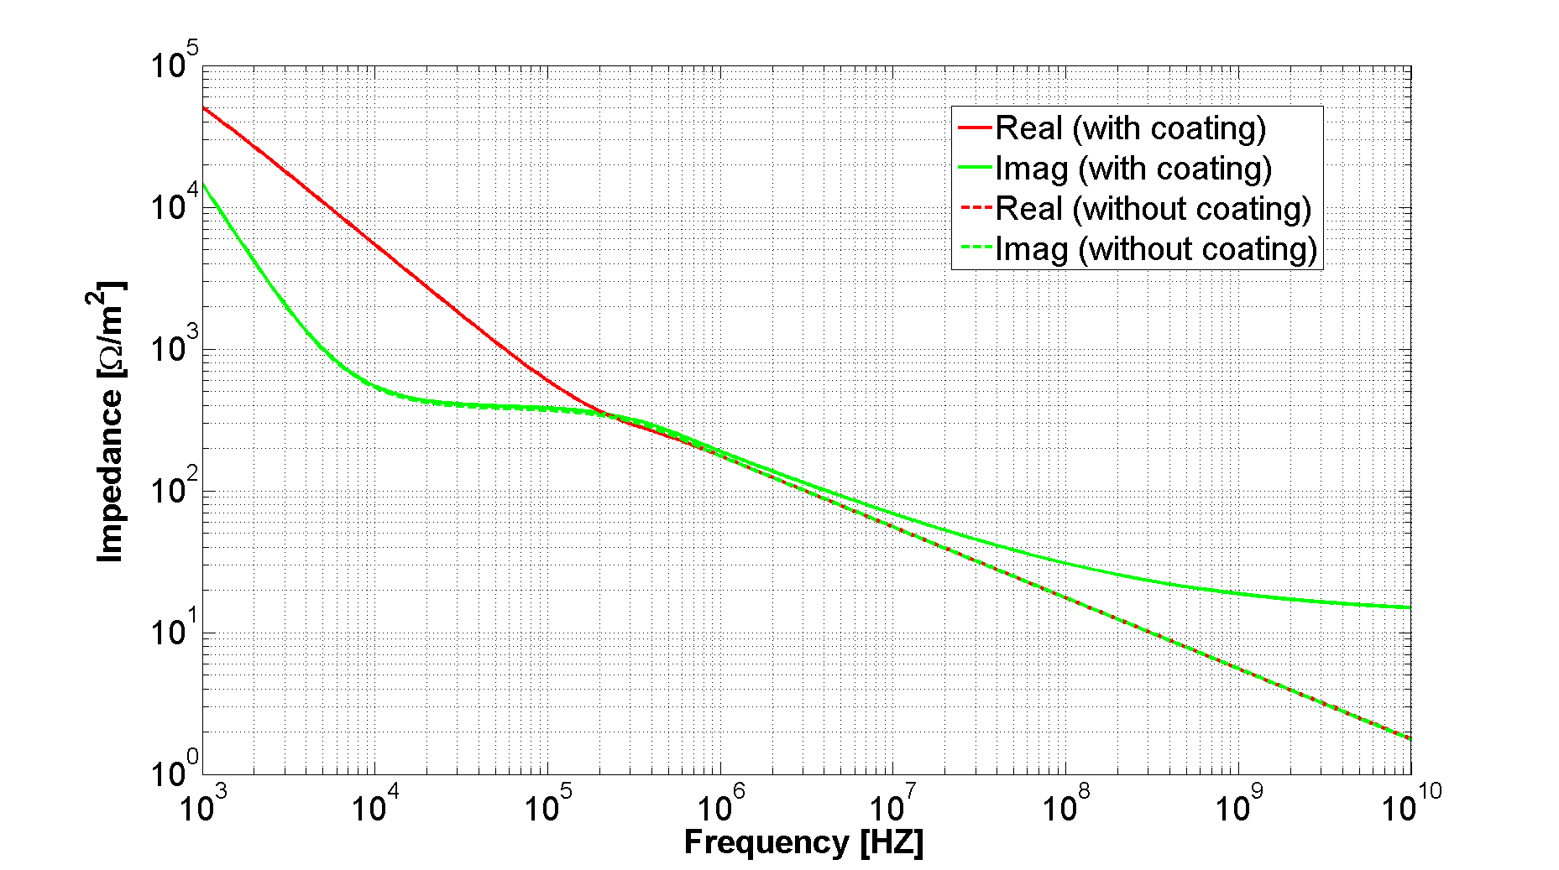
Transverse impedance: effect of aC coating
Significant effect on the imaginary part
Coherent tune shift, TMCI thresholds
The effect on the real part is negligible

Slide 5
Why the imaginary part depends on the aC coating?
Case without aC coating
  1 layer structure
    1st layer (Cu)
Case with aC coating
  2 layer structure
    1st layer (aC)
    2st layer (Cu)
From transmission line theory one can derive the surface impedance seen by the beam
Coating thickness
The aC coating introduces an additional contribution to the imaginary impedance

Slide 6
Summary
The aC coating, where applied, is expected to increase significantly the imaginary part of the resistive wall beam coupling effective impedance per unit length (about a factor 2)
  The effect on the full LHC longitudinal impedance is expected to be below 0.1 % (about 0.05%)
  The effect on the full LHC transverse impedance is expected to be well below 1% (about 0.2% in the worst case scenario)
No impact is expected on the beam induced heating

Slide 7
Thank you very much for your attention

