Slide 1

Github-Zenodo Integration:
First Year Review and Future Plans
Tibor Simko
(obo Lars Nielsen, Tim SMITH
At AAHEP8 meeting

Slide 2
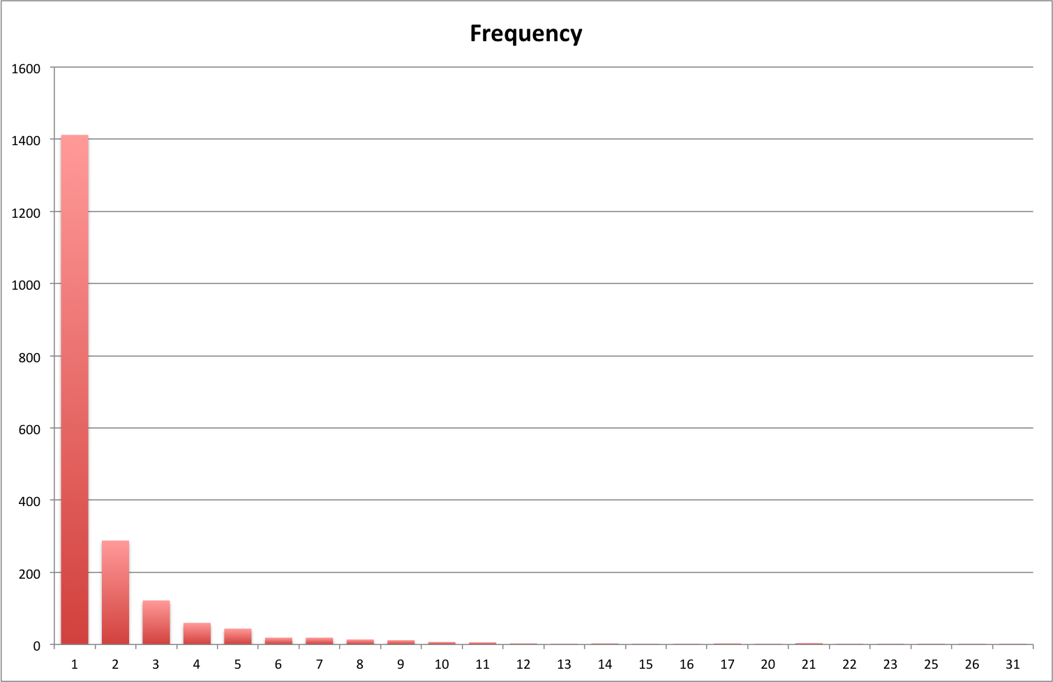
SW Records
4161 SW records
  315 Simple upload (usually zip)
  3846 Github
    2026 repositories
      1983 active
      43 github version deleted
    1302 repository owners
Multiple Versions

Slide 3
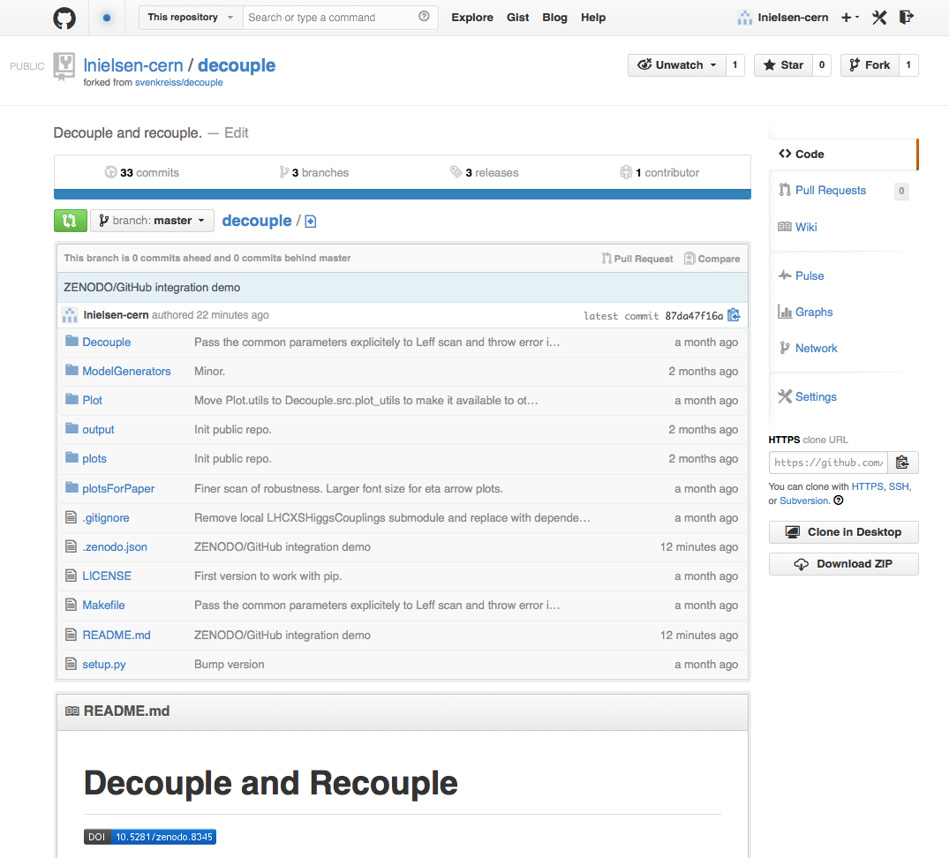
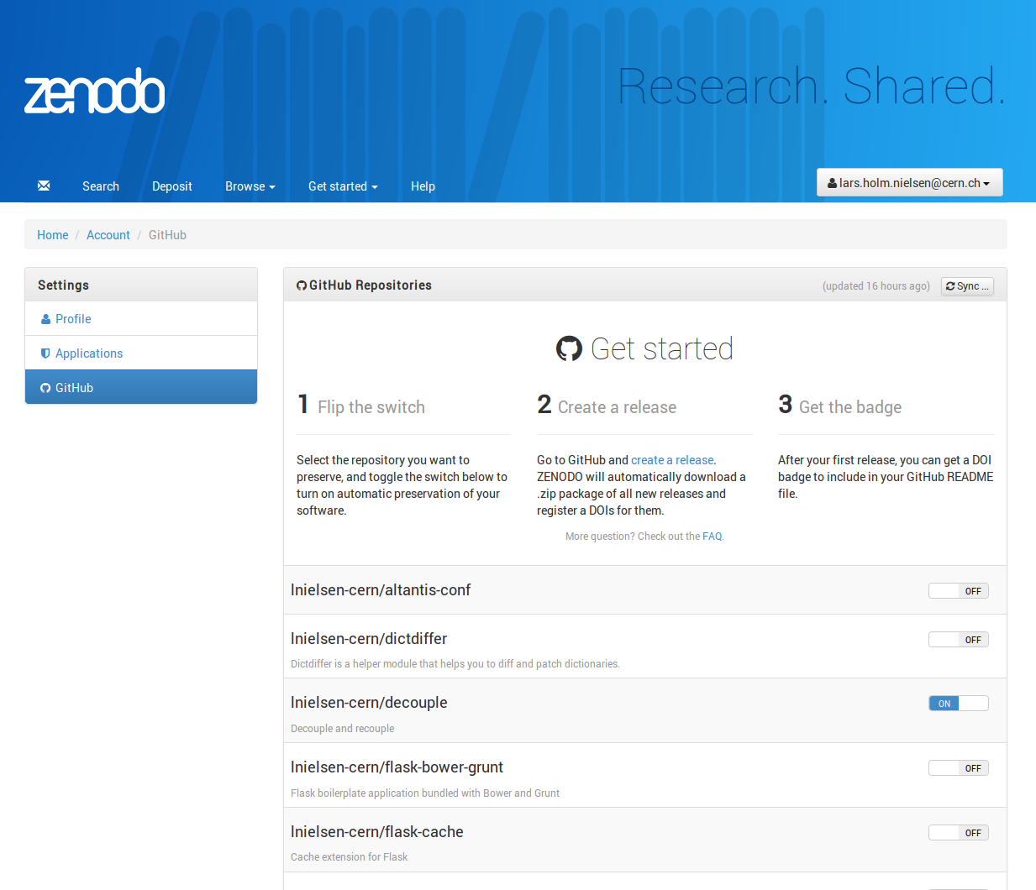



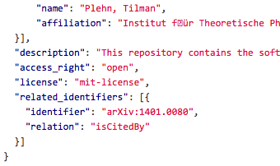




Zenodo – GitHub bridge
.zenodo.json

Slide 4
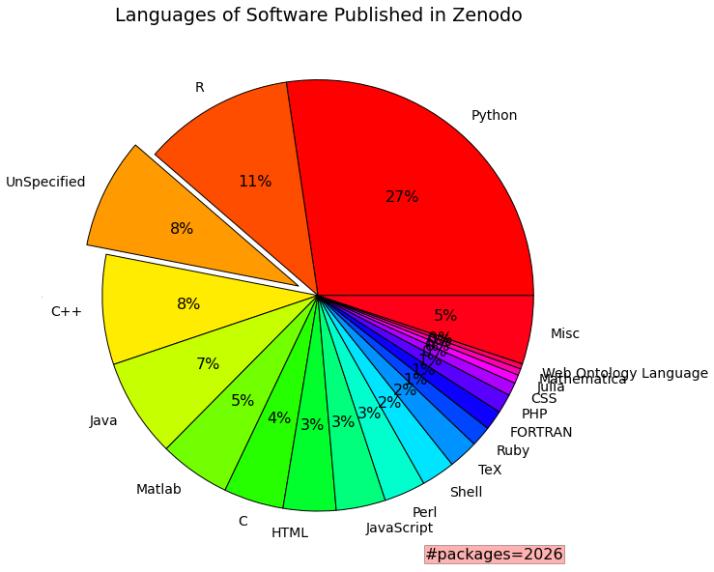
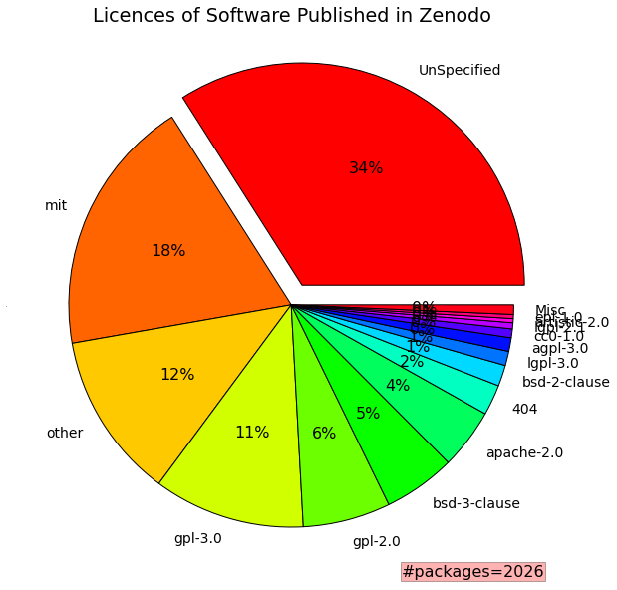
Characteristics

Slide 5
Related Identifiers
65 cites
60 isCitedBy
12 isIdenticalTo
52 isNewVersionOf
3 isPartOf
19 isPreviousVersionOf
4000 isSupplementTo
33 isSupplementedBy

Slide 6
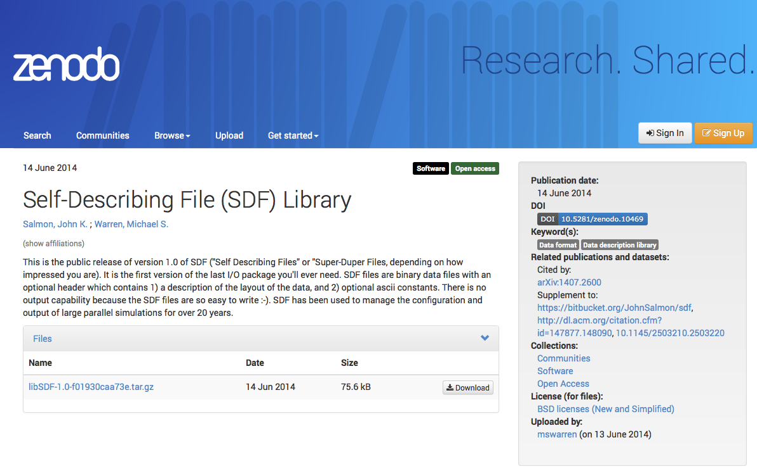
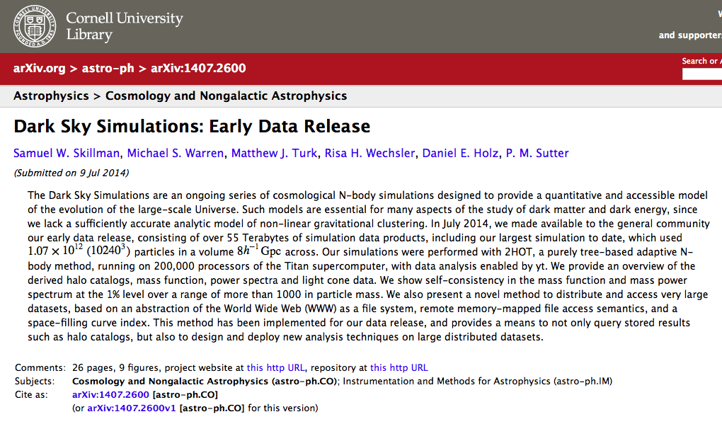
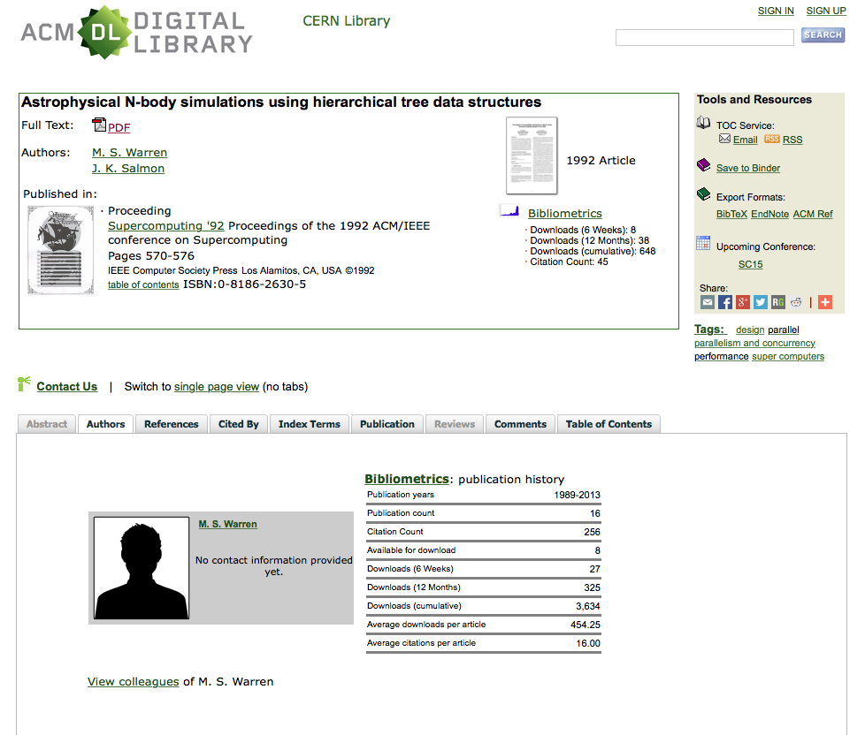
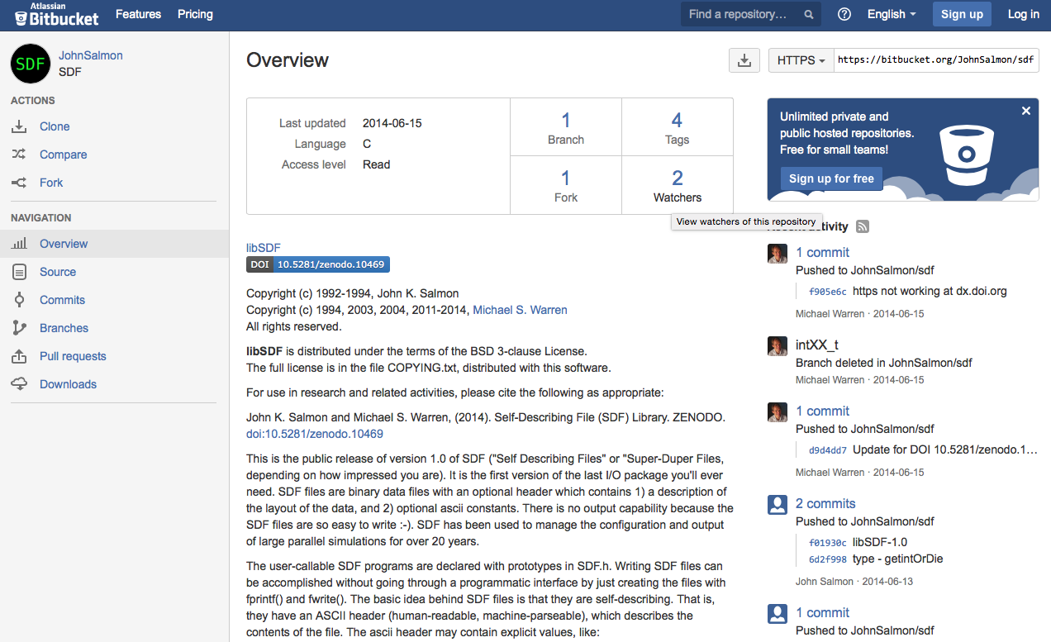
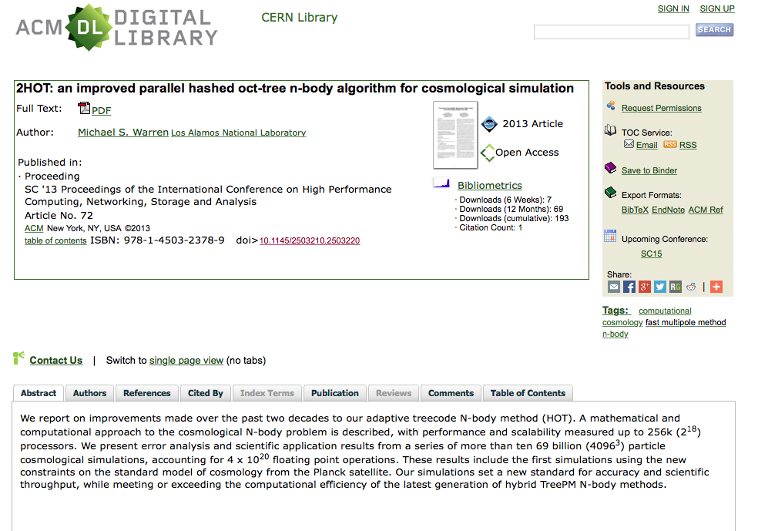
Example
isCitedBy
isSupplementTo
isSupplementTo

Slide 7
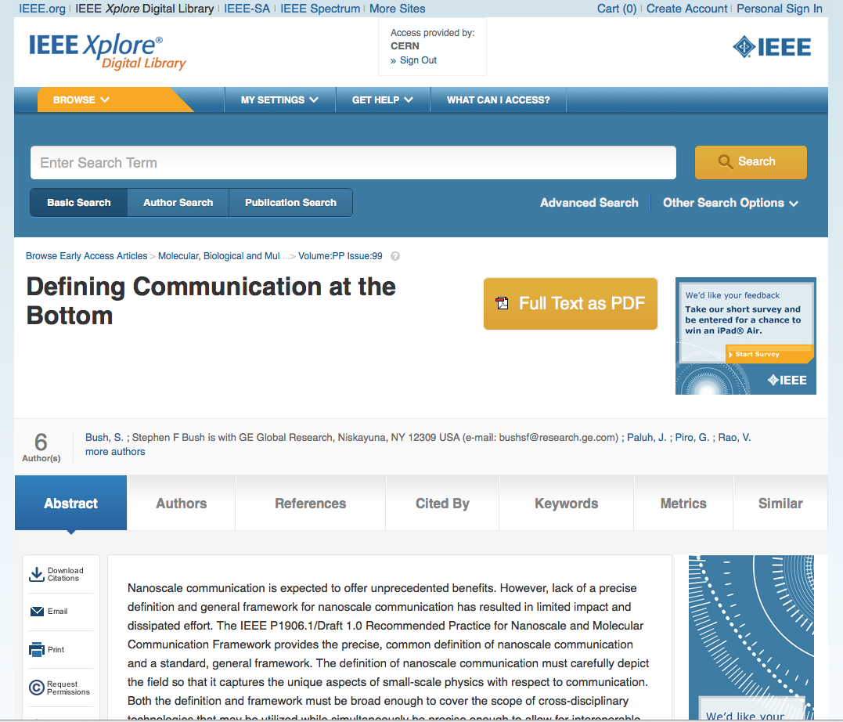
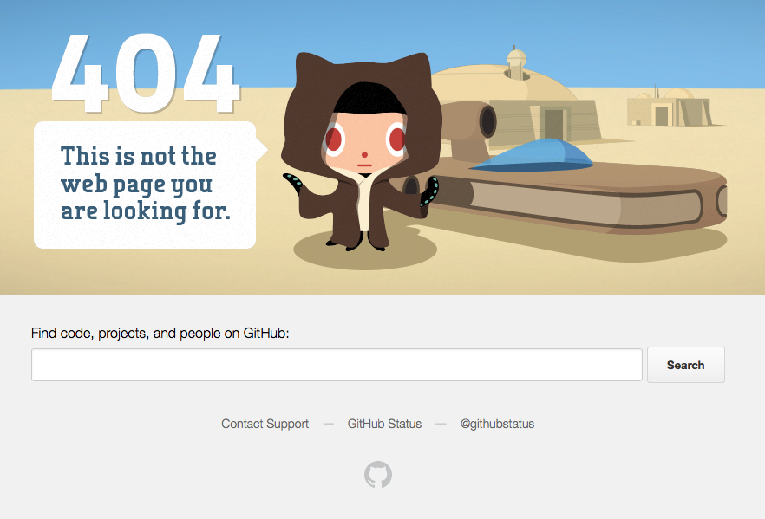
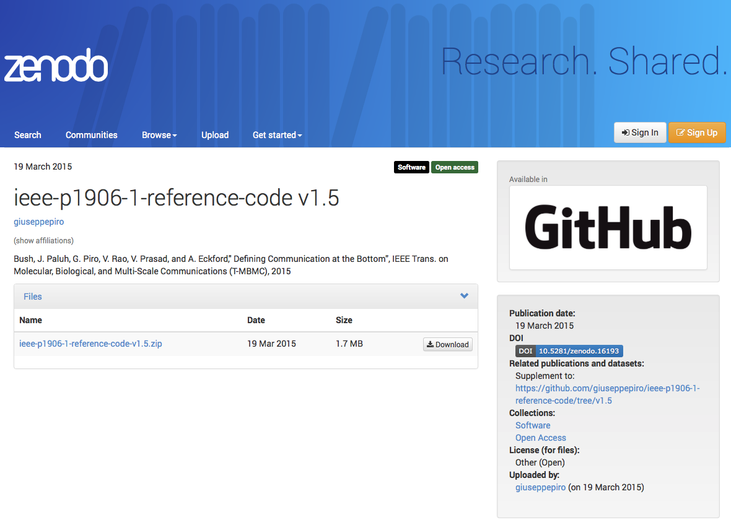
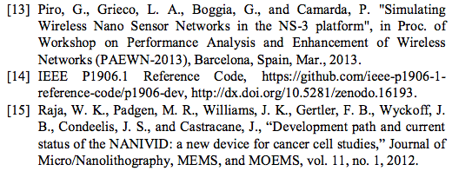
In Safe Hands?

Slide 8
Future Plans
Automation
  Travis style view of progress through workflow
  Notifications of progress, and errors
MetaData
  Automation of change syncs
  Standardization between repositories?
Versioning
  Grouping and sub-identifiers

Slide 9




Lars.Nielsen@cern.ch
Tim.Smith@cern.ch
http://www.cern.ch
http://zenodo.org
@zenodo_org

