Slide 1
ActiLab Closing Meeting
ActiLab Activities at INFN
Stefano Corradetti
and Alberto Andrighetto
SPES Target Group

Slide 2
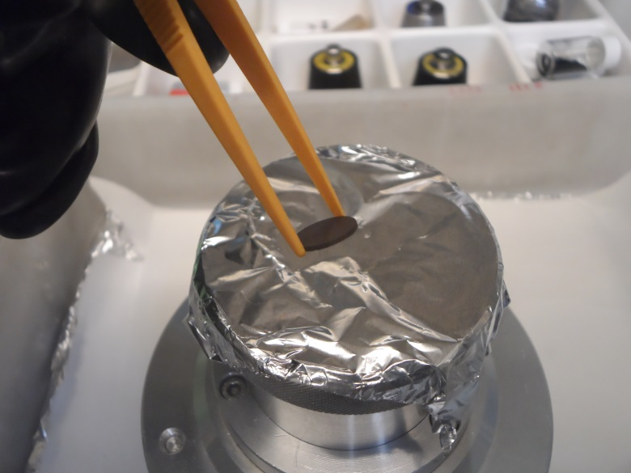
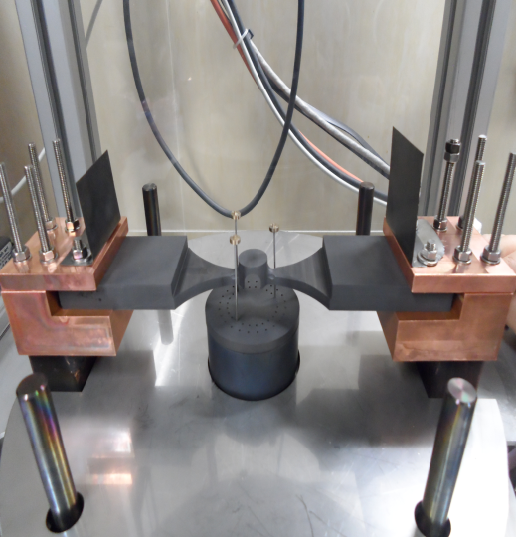
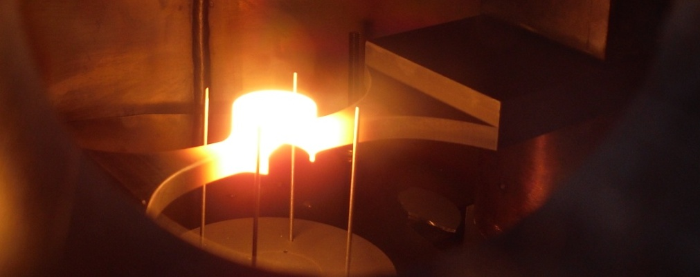
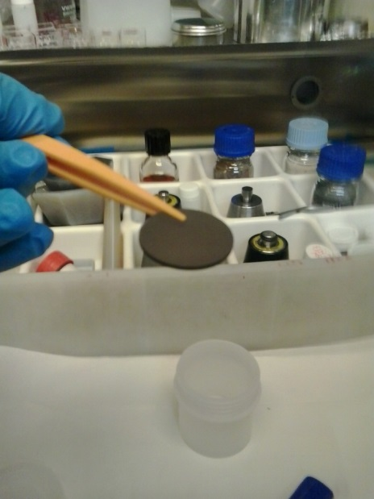
Outline
UC_{x} synthesis (Task #1): 2013 activity
UC_{x} thermal characterization (Task #2): 2014 activity

Slide 3
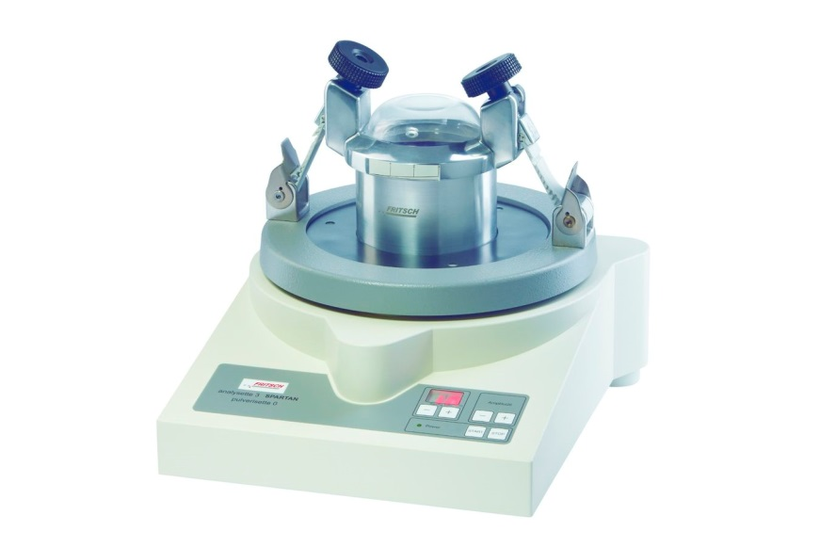
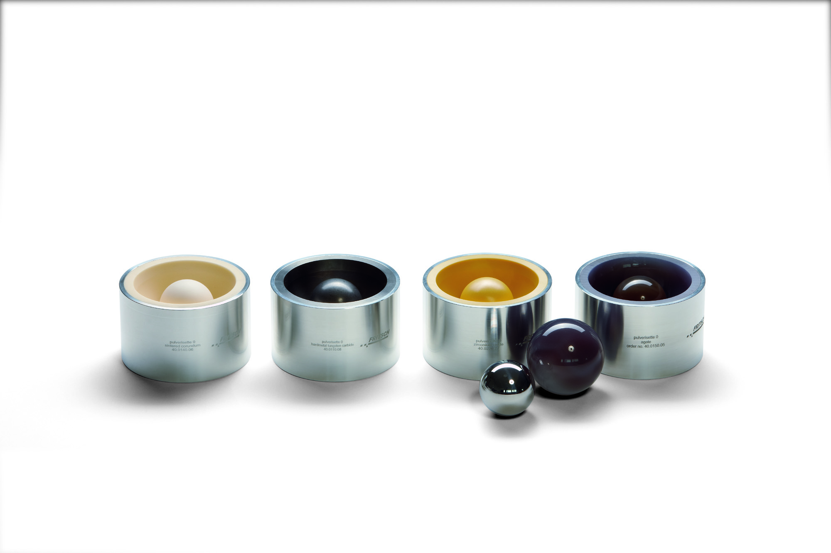
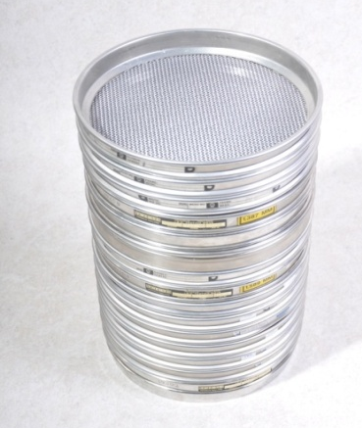
UC_{x} synthesis
New equipment (purchased in Jan ‘13)
- Reduce and homogenize the grain size of oxide and carbon source → selection and control of the precursors (as defined in ActiLab SC May 2012, strategy for UC_{X} production at INFN)
- Vibratory micromill and sieves purchased at UNIPD lab (grain size down to few μm) to treat small quantities of precursors

Slide 4
UC_{x} synthesis
Milling and sieving → UO₂ particle size control
‘Original’ UO₂ batch: ~ 20 g
First milling → ~ 5 g of UO₂

Slide 5
UC_{x} synthesis
Subsequent millings to produce enough UO₂ for 10 UC_{x} pellets
Final particle size population
Sieves below 10 μm mesh also available (Nylon mesh) and tested
Small amount of powder ground to < 10 μm size in reasonable time
< 20 μm ("10-20 μm") was selected as a precursor size to produce 10 pellets, sent to IPNO for off-line characterization and irradiation tests

Slide 6
UC_{x} synthesis
Pellets production → 10 UC_{x} discs
“Green” UO₂ + C pellets
% wt. UO₂ | % wt. C | % wt. binder | Weight (g) | Diameter (mm) | Thickness (mm) | Density (g/cm³)
77.60 | 20.30 | 2.10 | 0.57 | 13.01 | 0.95 | 4.50
Thermal treatment:
2°C/min up to 1250°C (binder decomposition occurs)
8 hours at 1250 °C, then 2 °C/min up to 1350 °C (carburization)
8 hours at 1350 °C, then 1.5 °C/min up to 1730°C (carburization)
6 hours at 1730 °C
UC₂ + 2C pellets after carburization (UO₂+6C→UC₂+2C+2CO)
Weight (g) | Diameter (mm) | Thickness (mm) | Density (g/cm³) | Total porosity (%) | Weight loss (%) | Theoretical weight loss (%)
0.47 | 12.66 | 0.86 | 4.33 Similar to SPES standard | 58.90 | 17.57 | 16.90
Expected composition of the samples: UC₂, graphite and a minor amount of UC

Slide 7
UC_{x} synthesis
Pellets production → 10 UC_{x} discs
CO, carburization
H₂O, binder decomposition

Slide 8
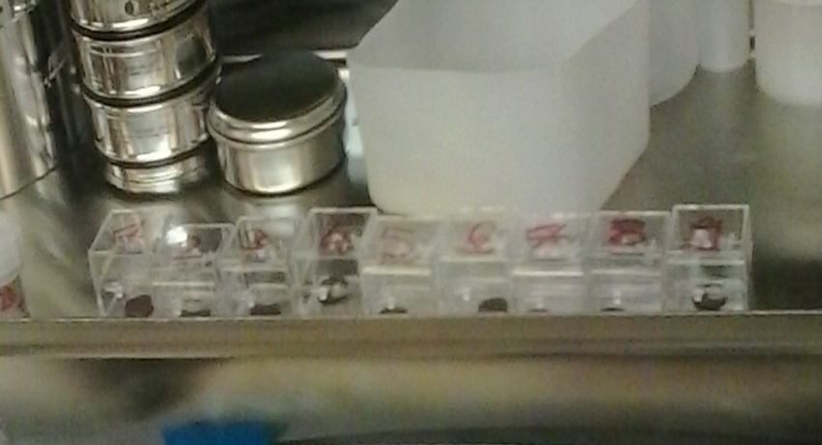
UC_{x} synthesis
Pellets production → 10 UC_{x} discs
Disc | Weight (mg) | ρ (g/cm³) | Thickness (mm)
1 | 466 | 4.31 | 0.86
2 | 476 | 4.36 | 0.87
3 | 467 | 4.37 | 0.86
4 | 466 | 4.31 | 0.86
5 | 475 | 4.31 | 0.87
6 | 473 | 4.38 | 0.86
7 | 476 | 4.29 | 0.88
8 | 473 | 4.42 | 0.85
9 | 457 | 4.37 | 0.83
10 | 474 | 4.22 | 0.89
Sample before treatment
Samples after treatment

Slide 9
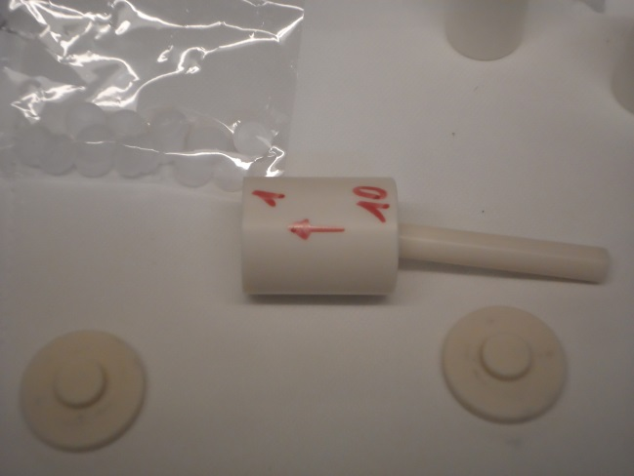
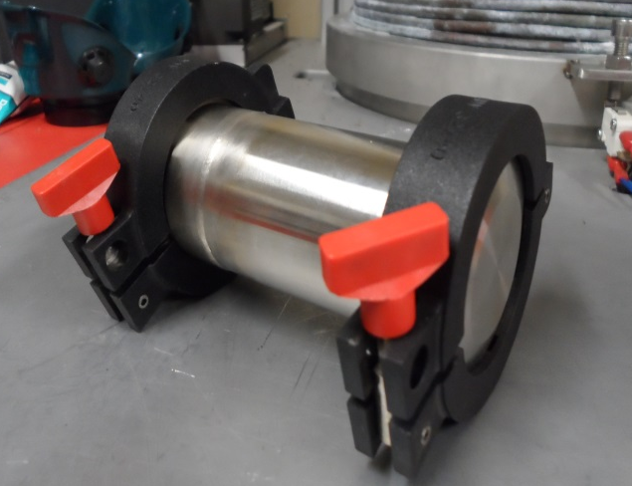
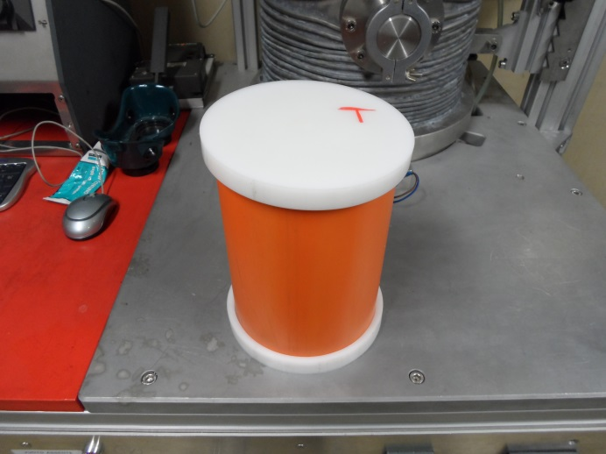
UC_{x} synthesis
Shipping of the pellets to IPNO
Authorization from IPNO to send the samples took 3 – 4 months
2) Shipping to Orsay (September 2013) took less than
two weeks (Cost: ~ 1k€)
INFN (UNIPD) →→→→ IPNO OK

Slide 10
UC_{x} characterization
Thermal conductivity
Original setup – INFN/LNL
Newly developed setup (Padova)
Allowing measurements for samples of smaller sizes (down to ∅ ̴30 mm)
Creation of a thermal gradient on the tested disc by means of irradiation from a heated graphite crucible
M. Manzolaro et al., Rev. Sci. Instr. 84 (2013) 054902.

Slide 11
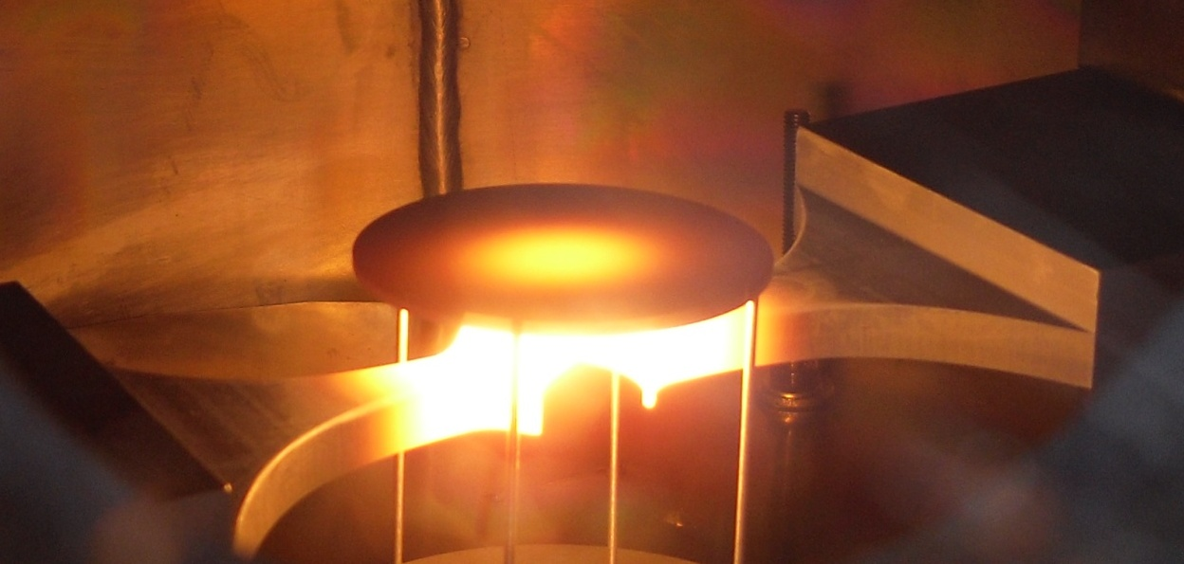
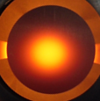
UC_{x} characterization
Thermal conductivity
M. Manzolaro, S. Corradetti, A. Andrighetto, L. Ferrari, Rev. Sci. Instrum. 84, 054902 (2013)
Creation of thermal gradients in the disc caused by irradiation from the crucible
A low temperature pyrometer (range 600 ÷ 1400 °C) is used to monitor temperature in the disc center and periphery (repeated cycles of heating)
Inverse analysis → k (T) (tipically in 600 ÷ 1200 °C range)

Slide 12
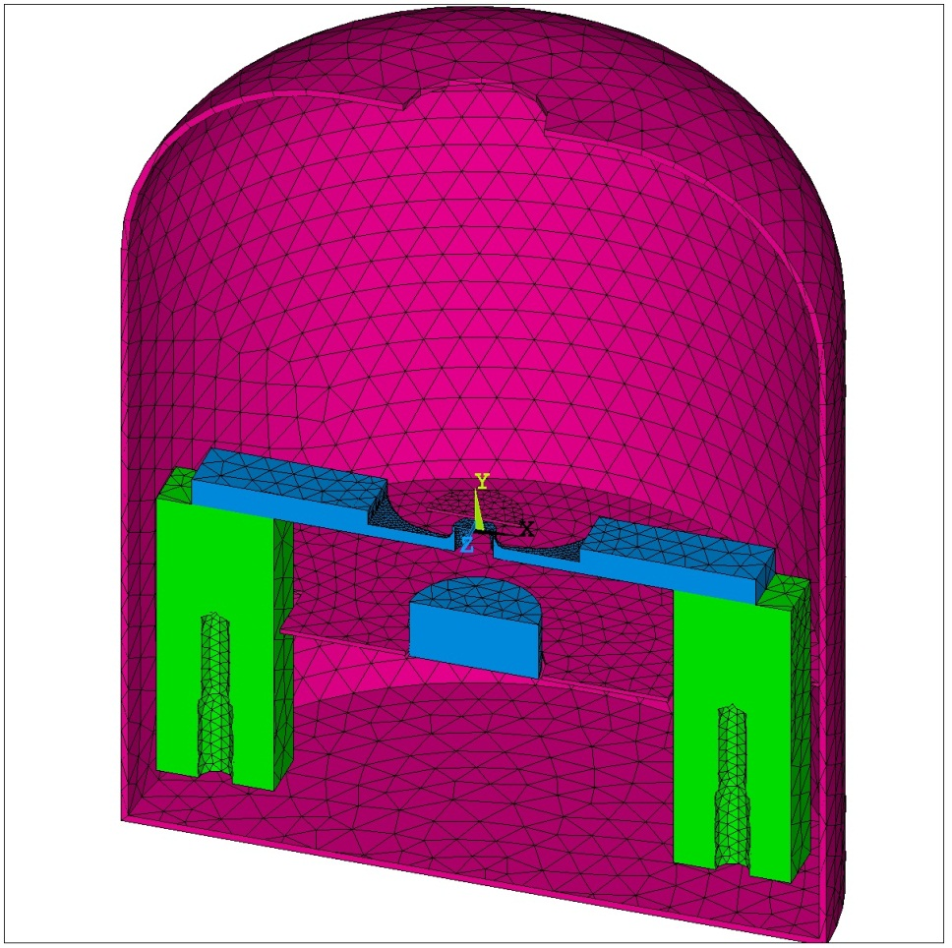
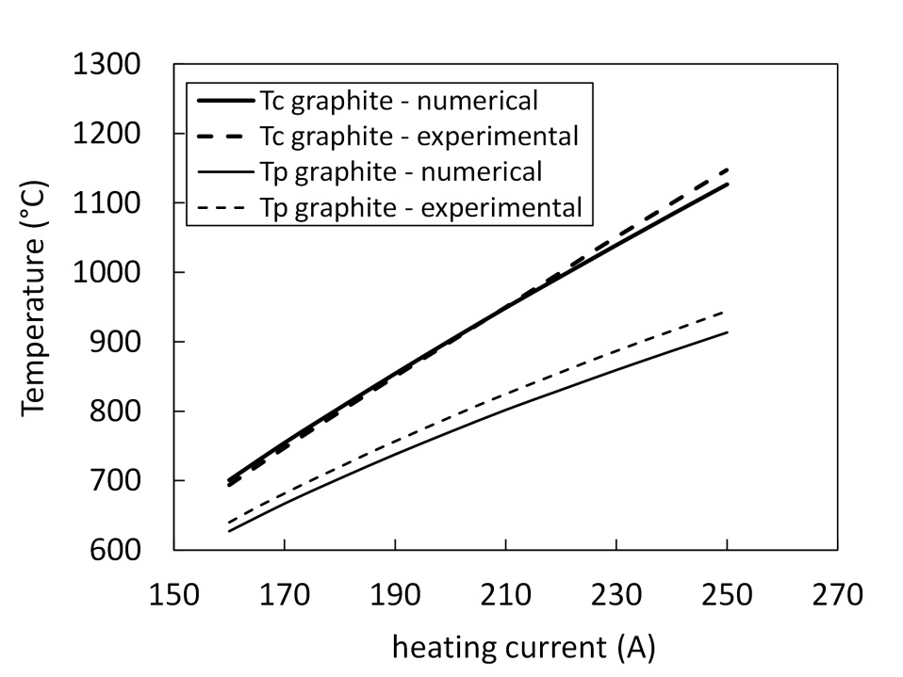
UC_{x} characterization
Thermal conductivity
FEM model of the chamber – crucible – disc system
ΔT between center and peryphery: comparison between numerical and experimental
k (T) is obtained minimizing the differences between the ΔTs
k (T) = C₀+C₁*T (average T)

Slide 13
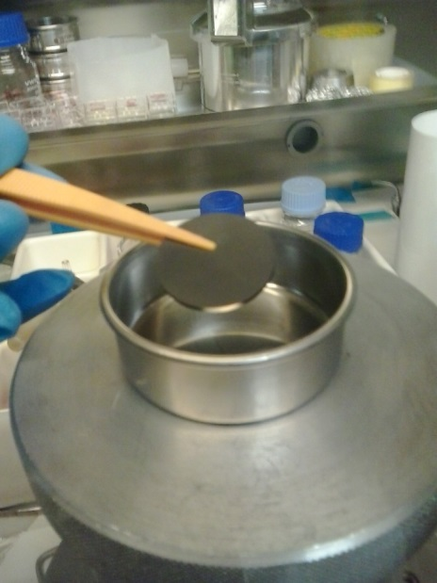
UC_{x} characterization
Thermal conductivity
φ 30 mm samples produced
Treatment
UO₂ + C + binder, UO₂ < 20 μm → same material sent to IPNO (only this was tested)
UO₂ + C + binder, 20 μm < UO₂ < 40 μm
UO₂ + C + binder, 40 μm < UO₂ < 71 μm
Mat. | Weight (g) | ρ (g/cm³) | Thickness (mm)
1 | 3.51 | 3.87 | 1.38
2 | 3.57 | 3.85 | 1.40
3 | 3.58 | 3.48 | 1.54

Slide 14
UC_{x} characterization
Thermal conductivity
Calibration of the system with a graphite disc
Temperature [°C] measurements
vs. numerical data
Inverse analysis gives
Thermal conductivity [W/m°C]
UNIPD Corradetti 2014
LNL Manzolaro 2013

Slide 15
UC_{x} characterization
Thermal conductivity
Measurements on UC_{x} discs
Temperature [°C] measurements
vs. numerical data
Inverse analysis gives
Thermal conductivity [W/m°C]

Slide 16
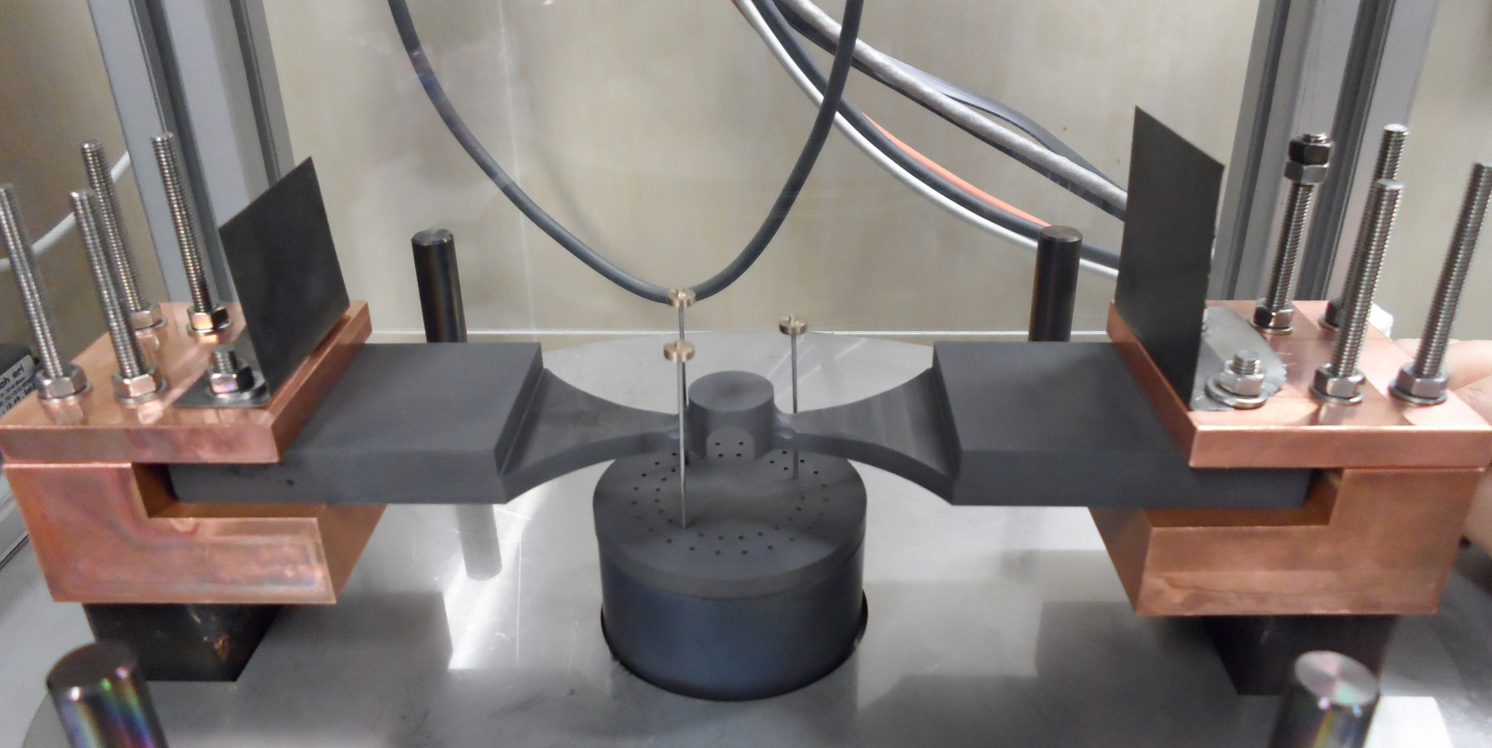
UC_{x} characterization
Emissivity
Measurement of the thermal emissivity of a sample placed on a heated
graphite crucible by means of a dual-frequency pyrometer
Pyrometer (Kodial viewport in the vacuum chamber)

Slide 17
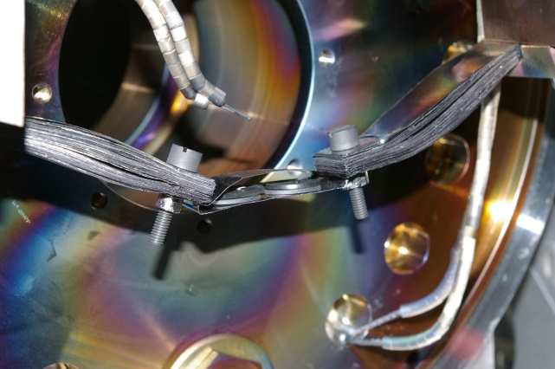
UC_{x} characterization
Emissivity
Pellets shipment from IPNO
pellet | n° | mass (g) | main phase | mass of U (g) | diameter (mm) | thickness (mm)
GATCHINA | 299 | 1.80 | UC | 1.71 | 13.17 | 1.03
PARRNe894 | 3 | 0.82 | UC₂ | 0.74 | 12.95 | 1.92
OXA | 1 of the 7 | 0.61 | UC | 0.70 | 7.40 | 1.87
PARRNeBP | 7 | 0.87 | UC₂ | 0.79 | 12.63 | 1.53
COMP30 | 4 | 0.68 | UC₂ | 0.62 | 8.28 | 2.51
TOTAL |  | 4.78 |  | 4.57
    Selected samples from the batch tested in March 2013 at IPNO (unirradiated)
    Authorization to send requested in summer 2013
    Samples received at UNIPD in July 2014
    IPNO →→→→ INFN (UNIPD) ~OK

Slide 18
UC_{x} characterization
Emissivity
SPES UC_{X} (φ 30 mm) with <20 μm UO₂
IPNO UC_{X} by U₃O₈ + C
Designed to obtain UC, but result is UC₂ + minor am. C
HD UC

Slide 19
UC_{x} characterization
Emissivity
Instability in emissivity can be related to reaction with the graphite crucible (both UC-based samples, Gatchina and OXA, were found sticked on the crucible)?

Slide 20
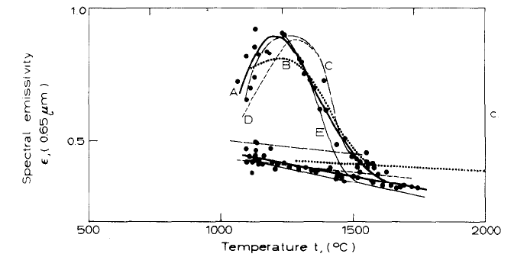
UC_{x} characterization
Emissivity
UC-based samples
De Coninck, 1975

Slide 21
UC_{x} characterization
Emissivity
pure UC₂-based sample
De Coninck, 1976

Slide 22
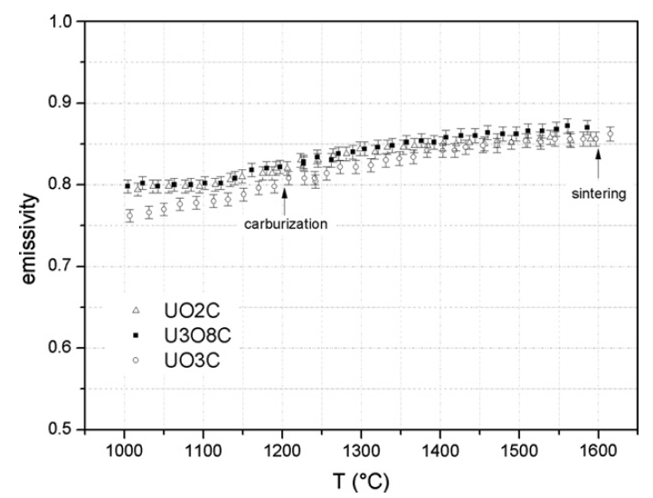
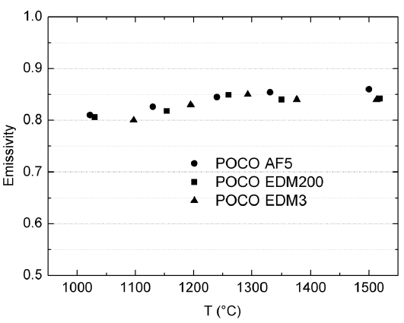
UC_{x} characterization
Emissivity
UC_{x}-based samples
Biasetto 2010 - UC_{x}
Biasetto 2008 - graphite

Slide 23
UC_{x} characterization
Conclusions
Consistency of the thermal conductivity setup with the previous one verified (graphite test samples)
Among the first results of ISOL-like UC_{x} materials thermal conductivity obtained
Numerical model still to be improved (non-linear behavior for high temperatures, reduction of differences between experimental and numerical leading to narrower confidence bands)
Temperature spectrum to be widened to explore more realistic operating conditions
Emissivity correlation to structure and phases → useful in defining parameters for thermo-electrical simulations

Slide 24
Thank you for your attention

