Slide 1


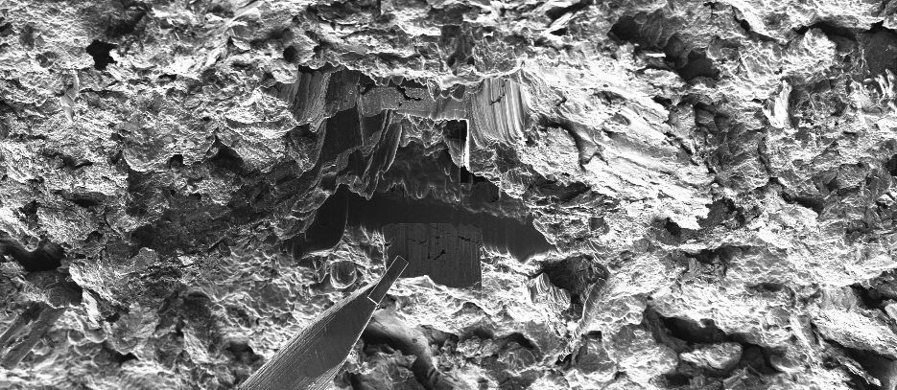
Bye Bye ActILab
The CERN ActILab Highlights
Alexander Gottberg (CERN)

Slide 2
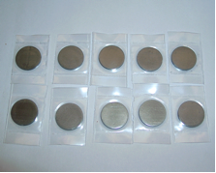
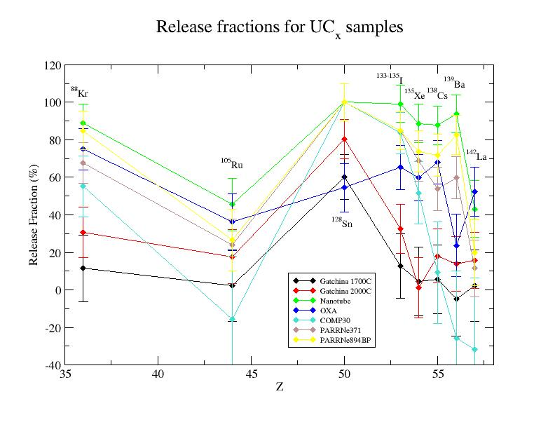
Nominal Density Uranium Carbide (Task 4)
Release fractions from Rabbit samples, ALTO 2013
[1] V. N. Panteleev, et al.,
Eur. Phys. J. A 42,
495-501 (2009)
[2] V. N. Panteleev, EMIS-15,
June 25, (2007)

Slide 3
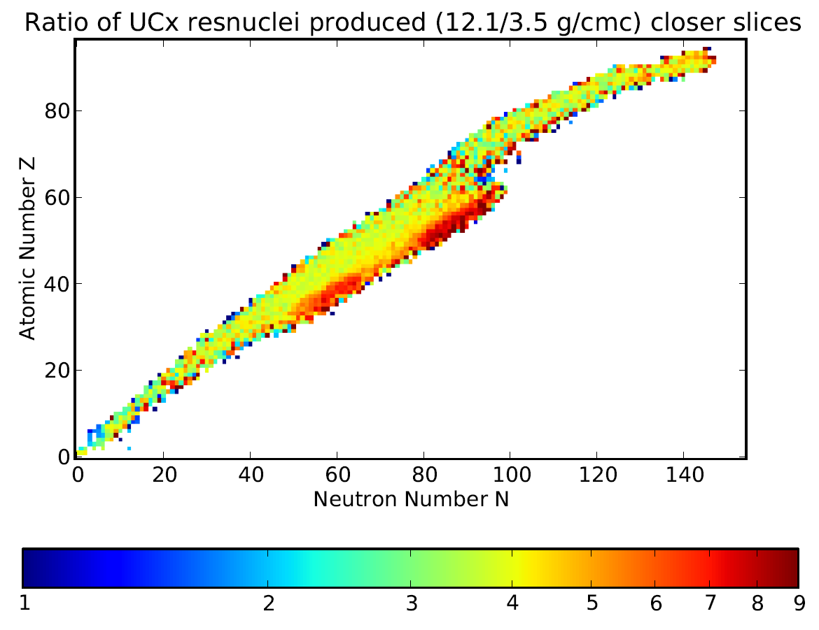
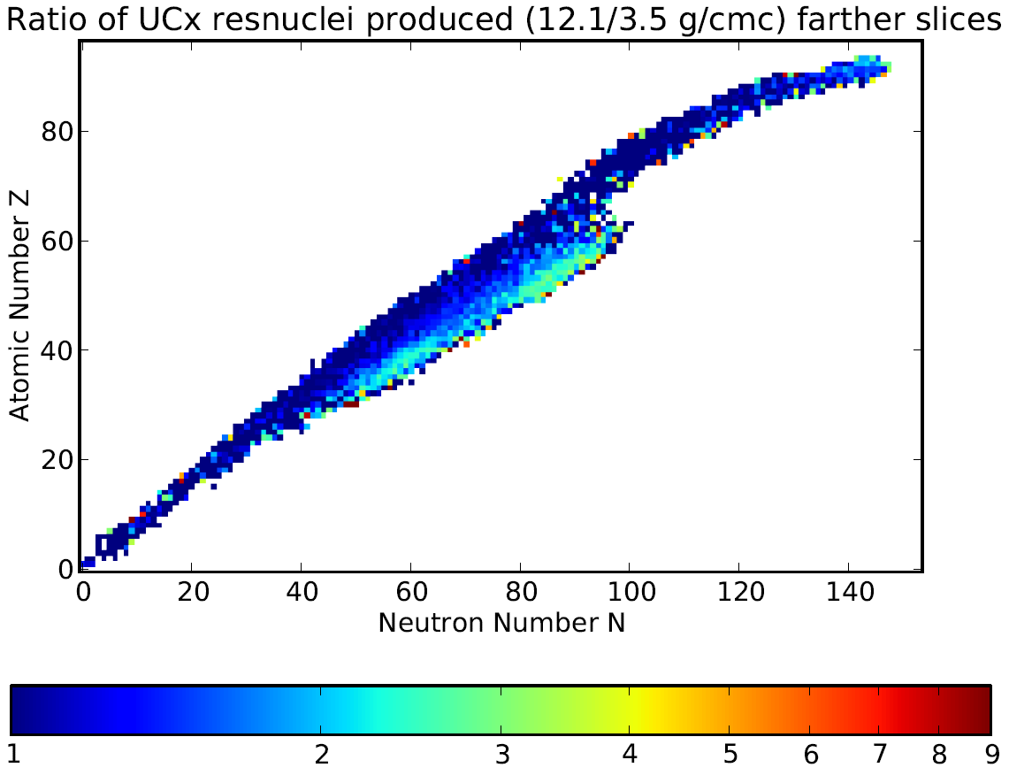
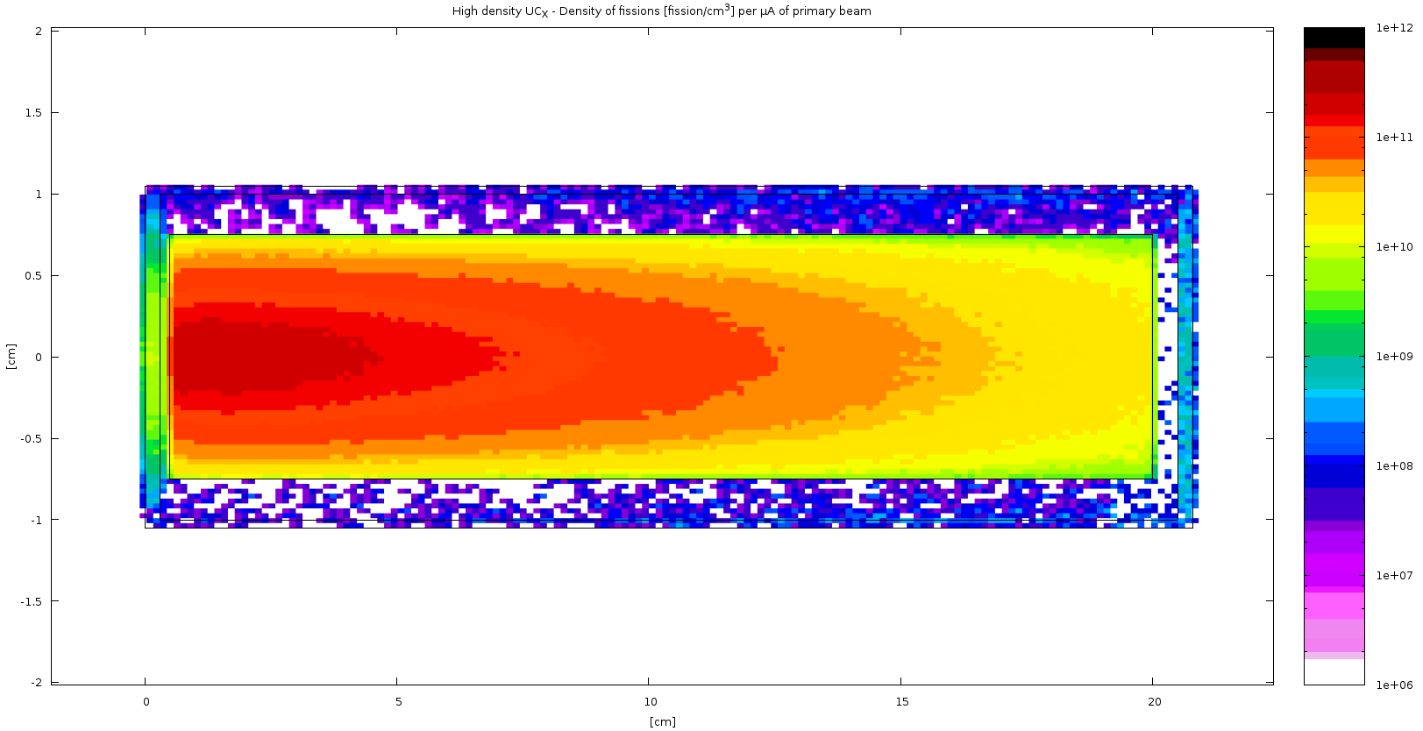
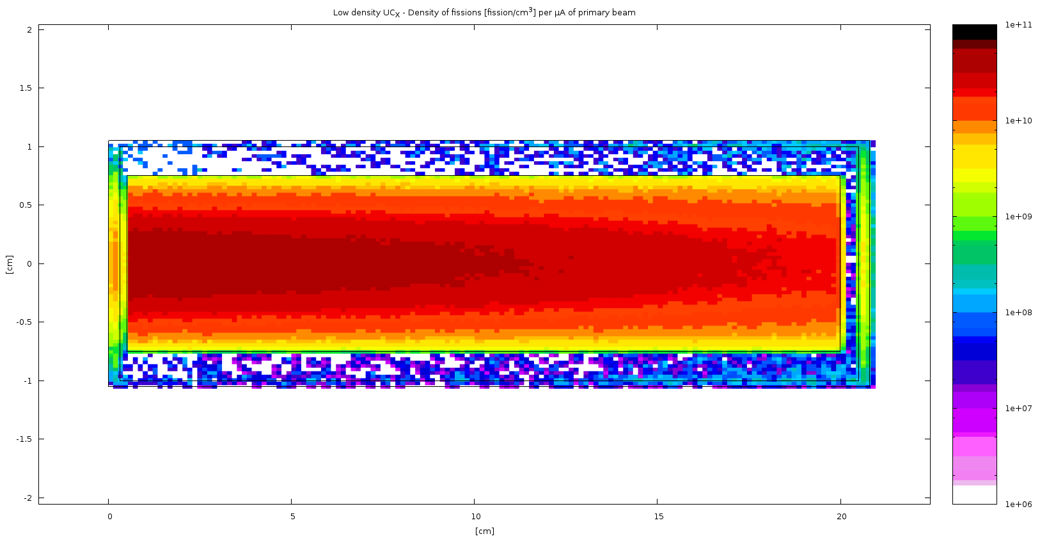
Nominal Density Uranium Carbide (Task 4)
Production yield ratio HD : LD in first pellet
Production yield ratio HD : LD in last pellet
fission rate 12.1 g·cm⁻³ [cm⁻³·µA⁻¹]
fission rate 3.5 g·cm⁻³ [cm⁻³·µA⁻¹]
10¹²
10¹¹
10⁶
10⁵

Slide 4
Nominal Density Uranium Carbide (Task 2 + 4)
Li
Na
K
Rb
Cs
Fr

Slide 5
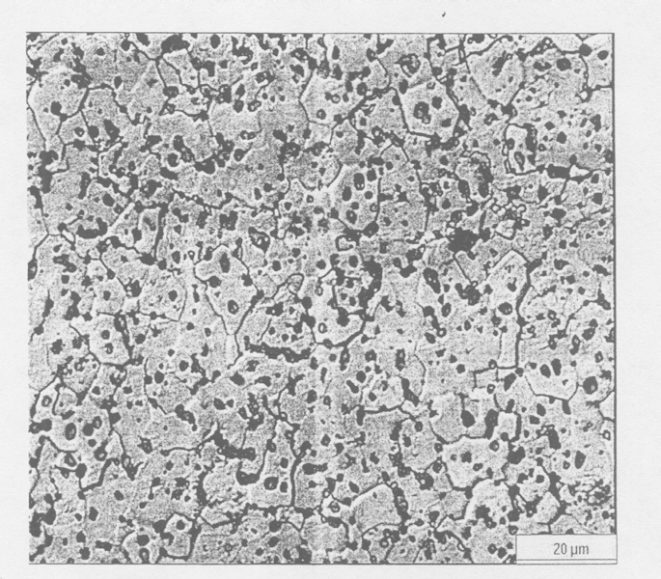
Nominal Density Uranium Carbide (Task 2 + 4)
Porosity from picnometry in IPNO (tbc): less than 1%
Geometrical porosity: 0%
But microscopic morphology more complex than anticipated

Slide 6
Characterization of UC_{X}
Task 2

Slide 7
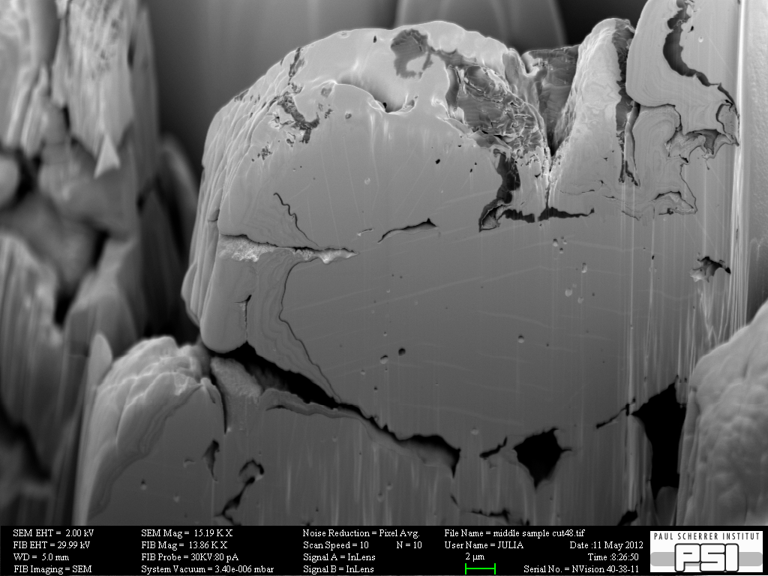
Oxidation on Microscopic Level
As prepared (stored under argon)
Stored in air
5 µm
5 µm
U oxide
1.7 µm
UC₂
K. Hallam et al., University of Bristol, UK
Oxidation process without thermodynamic activation is slow (in conventional UC_{x}) and follows a surface to bulk mode.

Slide 8
Material Investigation at PSI/SLS (non irradiated)
10µm
2µm
as prepared
(≤1850◦C)
2µm
200nm
as operated
(2100◦C for
5 days)

Slide 9
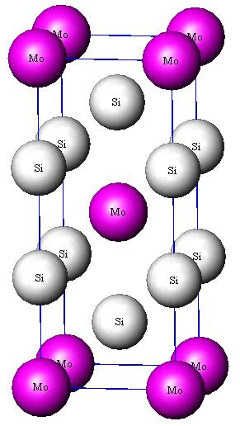
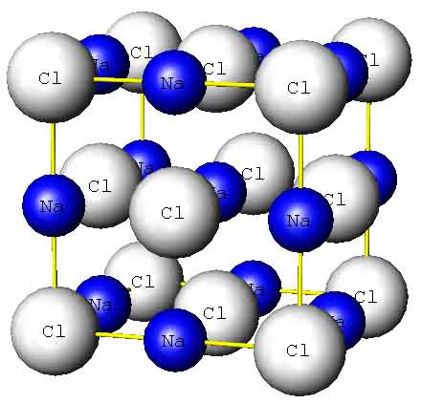
EXAFS for indirect identification of uranium valence at PSI/SLS
Valence-induced shift of adsorption edge is very small and hart to resolve
Change in lattice are causing major changes in EXAFS oscillatory features
UC (Fm-3m) as NaCl
UC₂ (I4/mmm) as MoSi₂

Slide 10
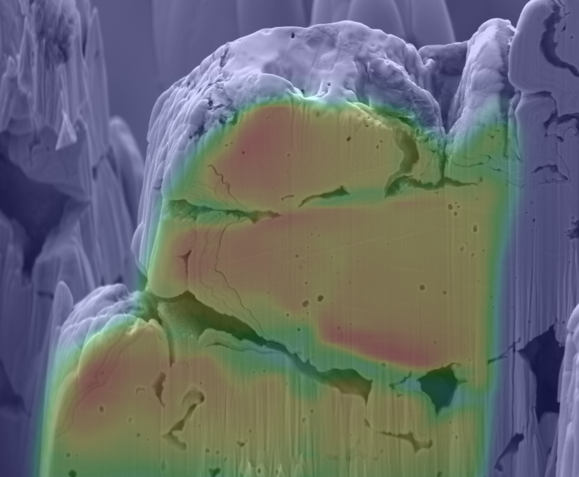
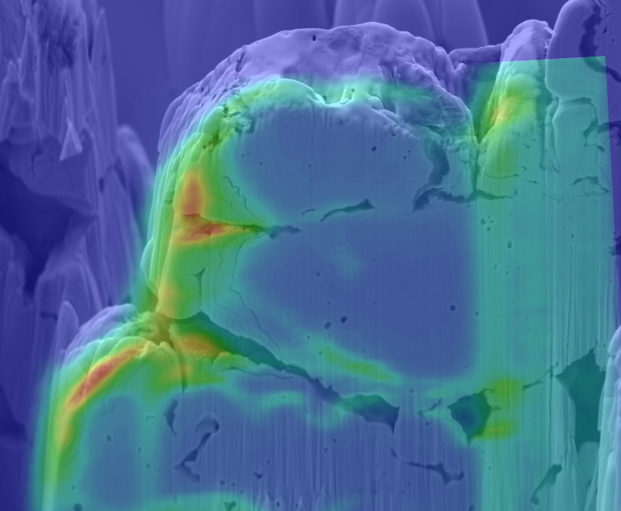
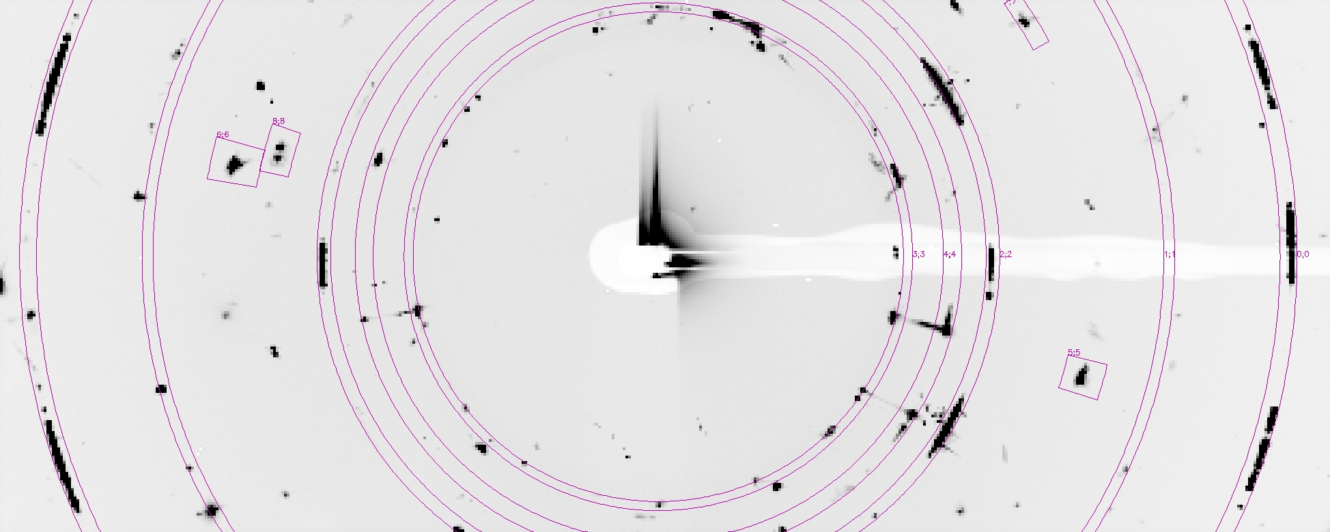
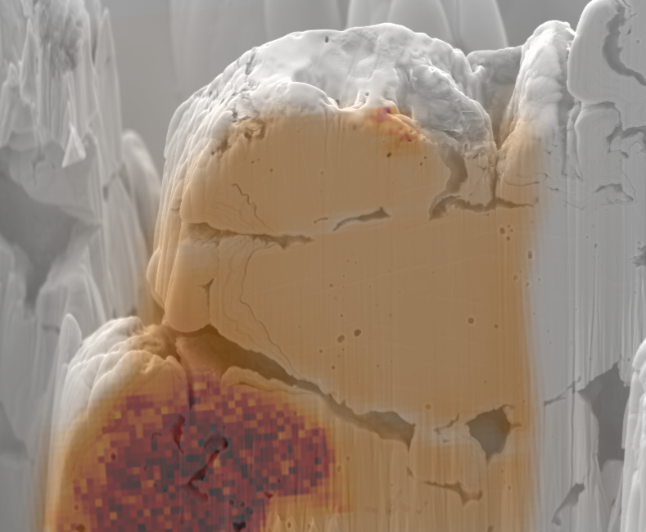
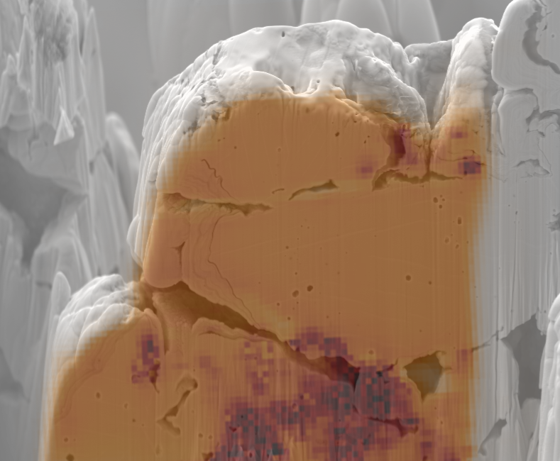
Material Investigation at PSI/SLS (non irradiated)
SEM Uranium
20µm
µ-spot X-ray fluorescence mapping
Uranium
Gallium
UC₂ reflex 1
UC₂ reflex 3
3
4
2
7
1
0
8
6
5
µ-spot X-ray diffraction

Slide 11
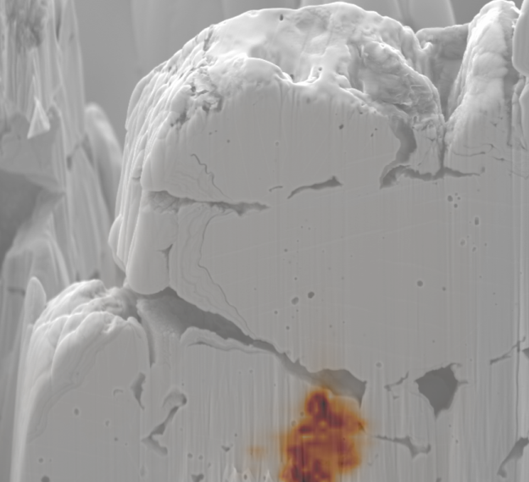
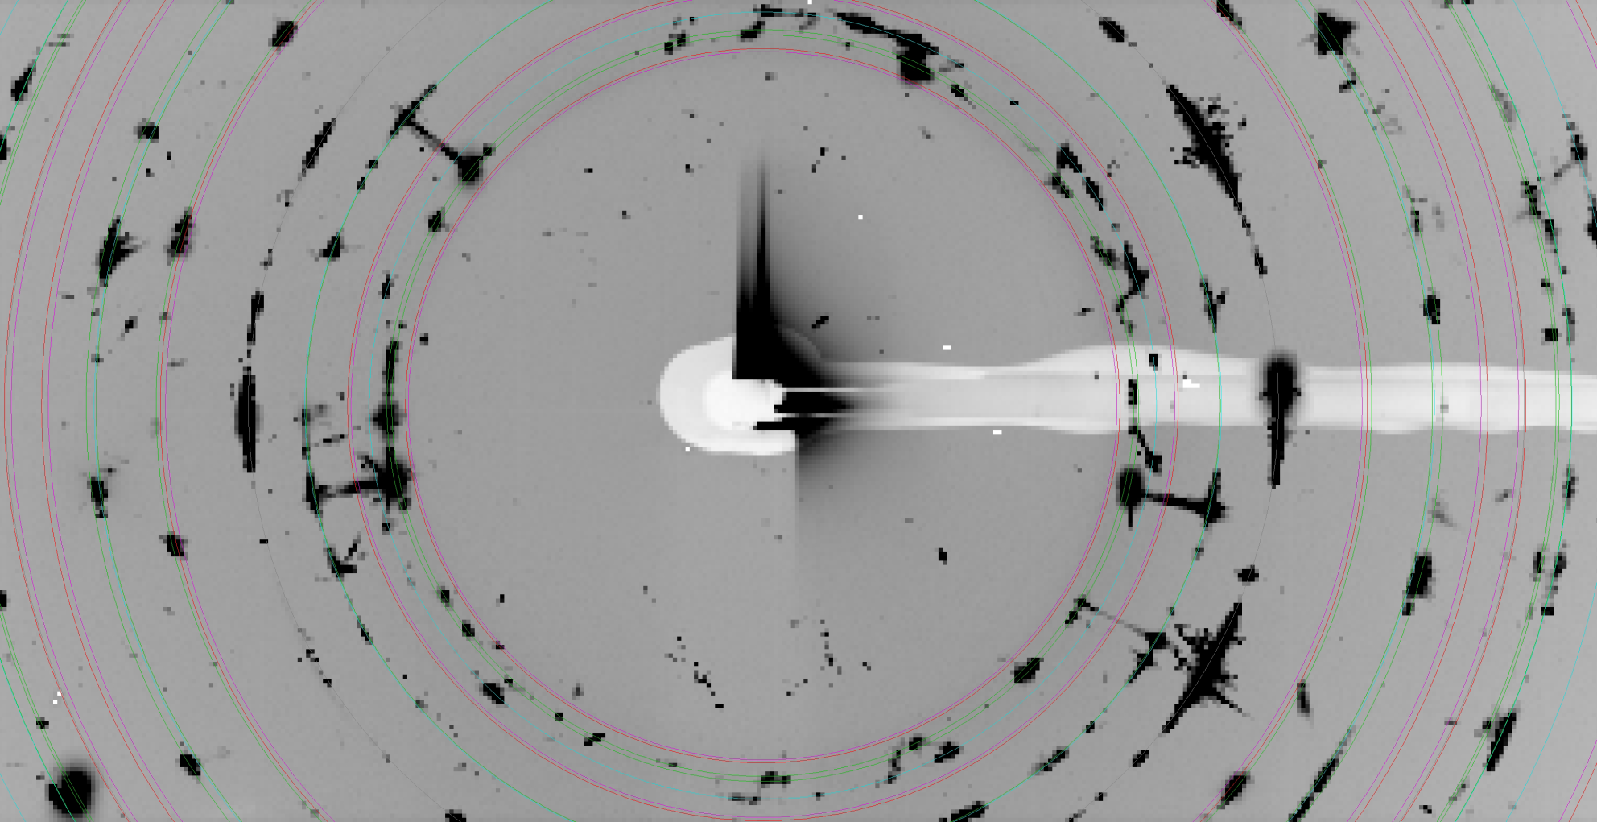
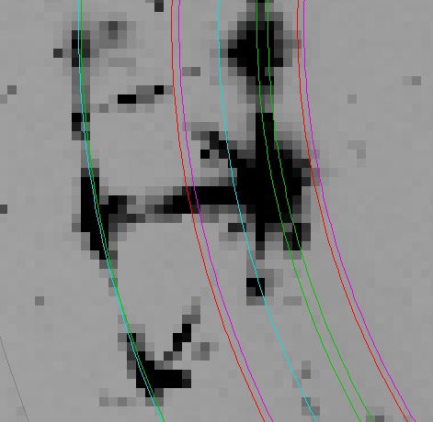
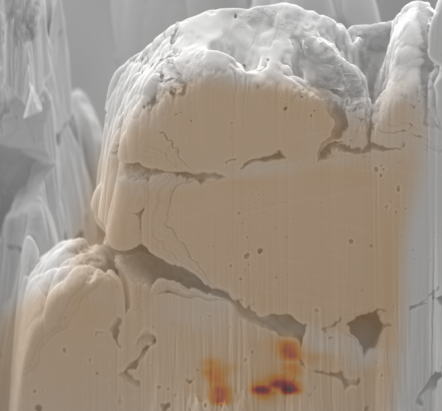
Why is UC_{x} such successful target material?
UC (200)
α-UC₂(002)
10 µm

Slide 12
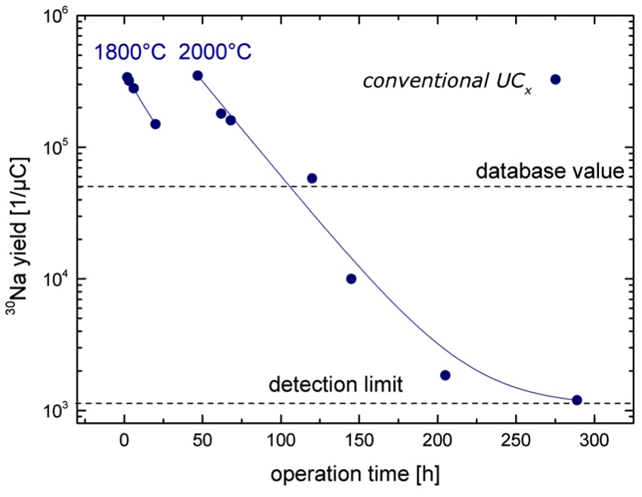
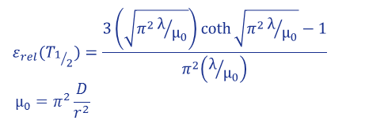
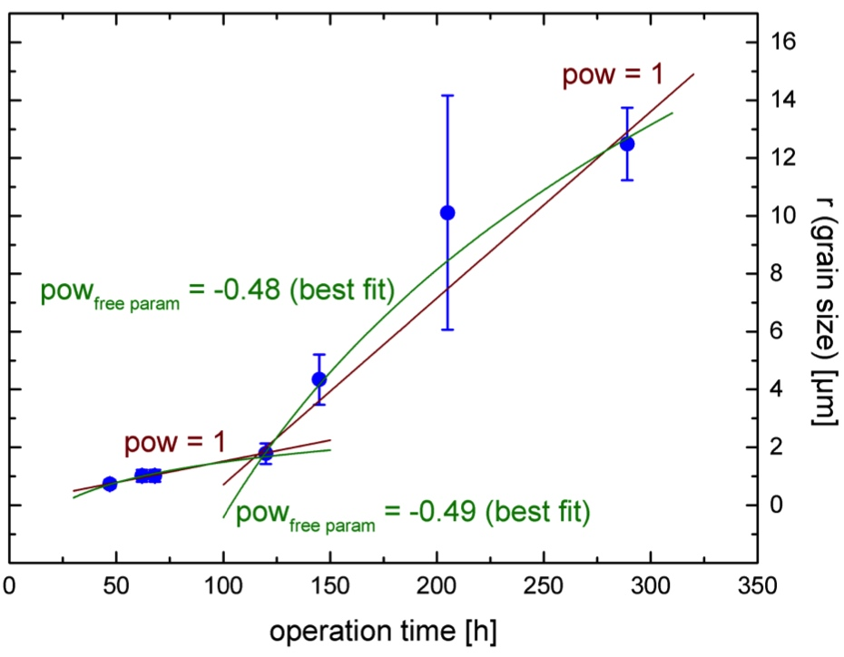
UC_{x} Diffusion Study
For pure diffusion and short half life:
R. Kirchner, NIM B, B70, 186-199 (1992)
→ r² / D,
diffusion constant D(T) from initial particle size measurements: D(2300 K) = 6· 10⁻¹¹ cm²/s
2 µm

Slide 13
Post-Irradiation Studies
Task 3

Slide 14
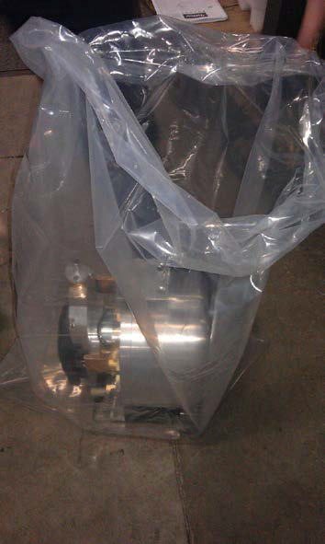
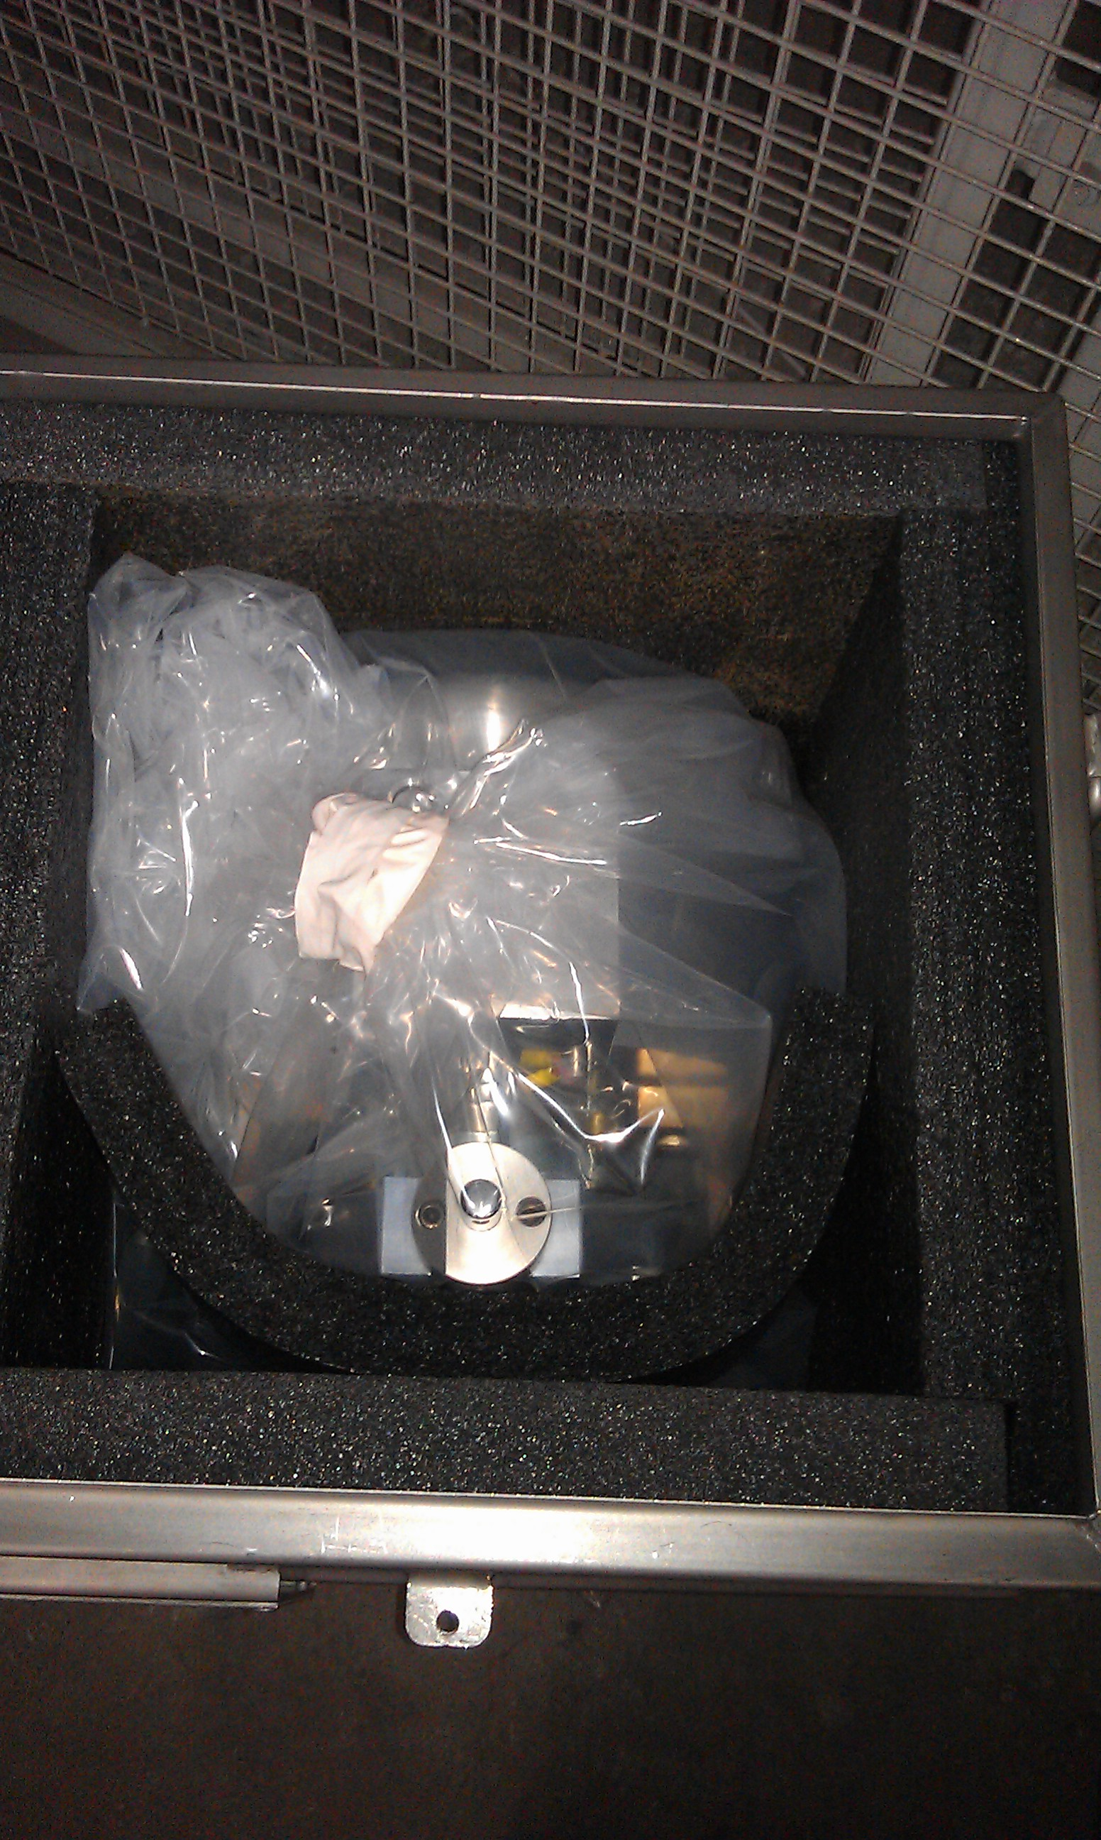
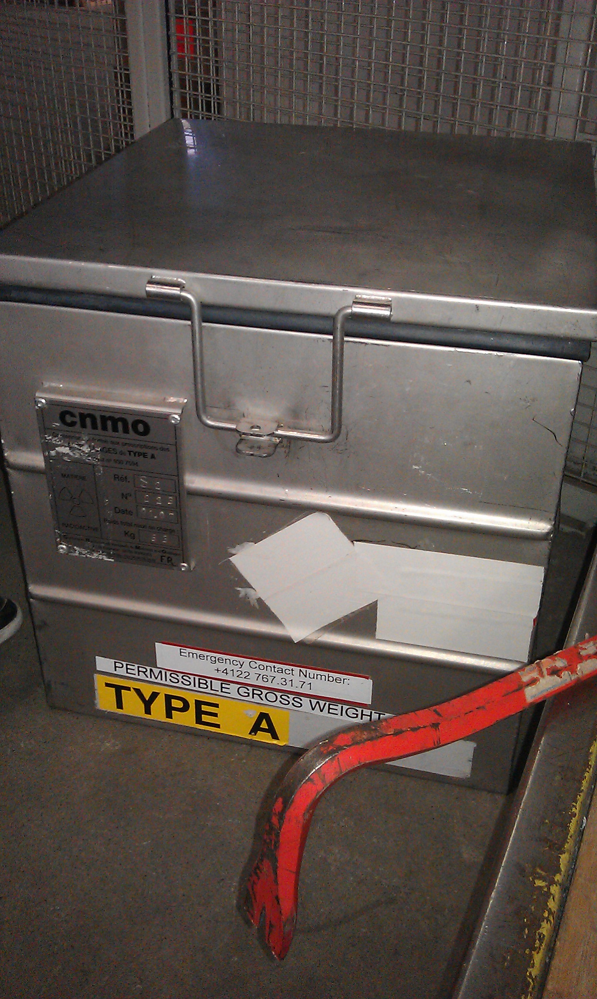
Irradiated UC_{x} Target Unit 466
      Irradiation in October + November 2011 on both front ends
      total of 8.8·10¹⁸ protons of 1.4 GeV
      Road transport in January 2013 from CERN to Paul Scherrer Institute (270 km)
      4 mSv/h on contact with parcel

Slide 15
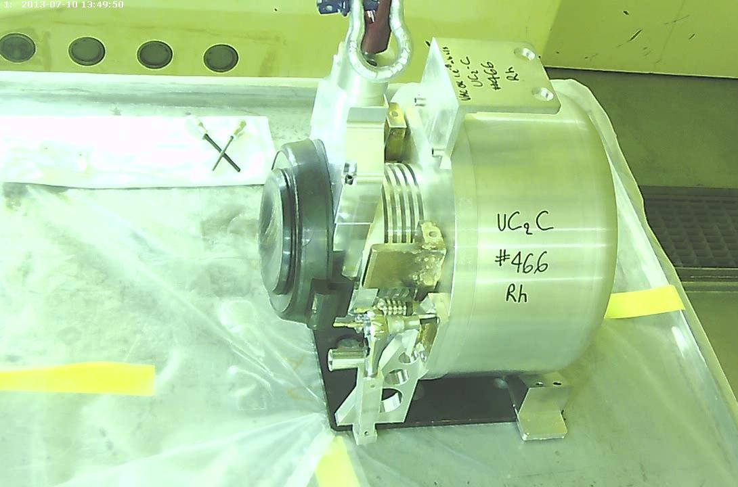
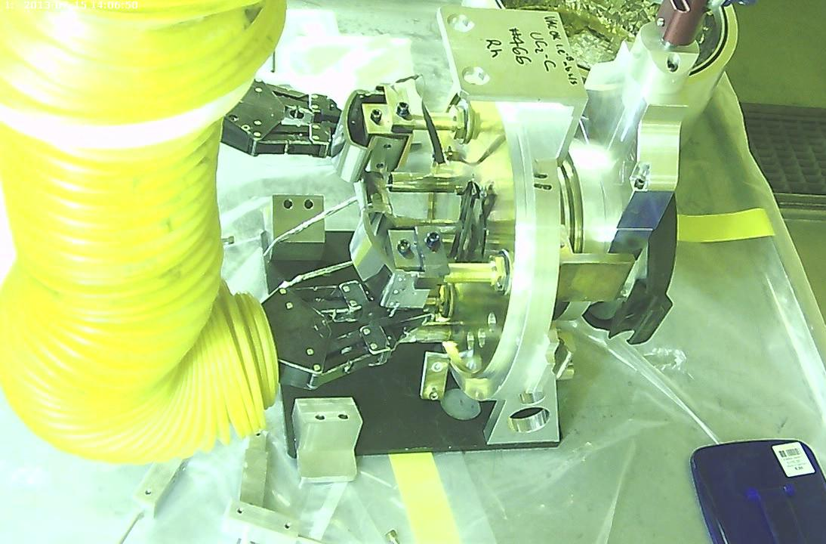
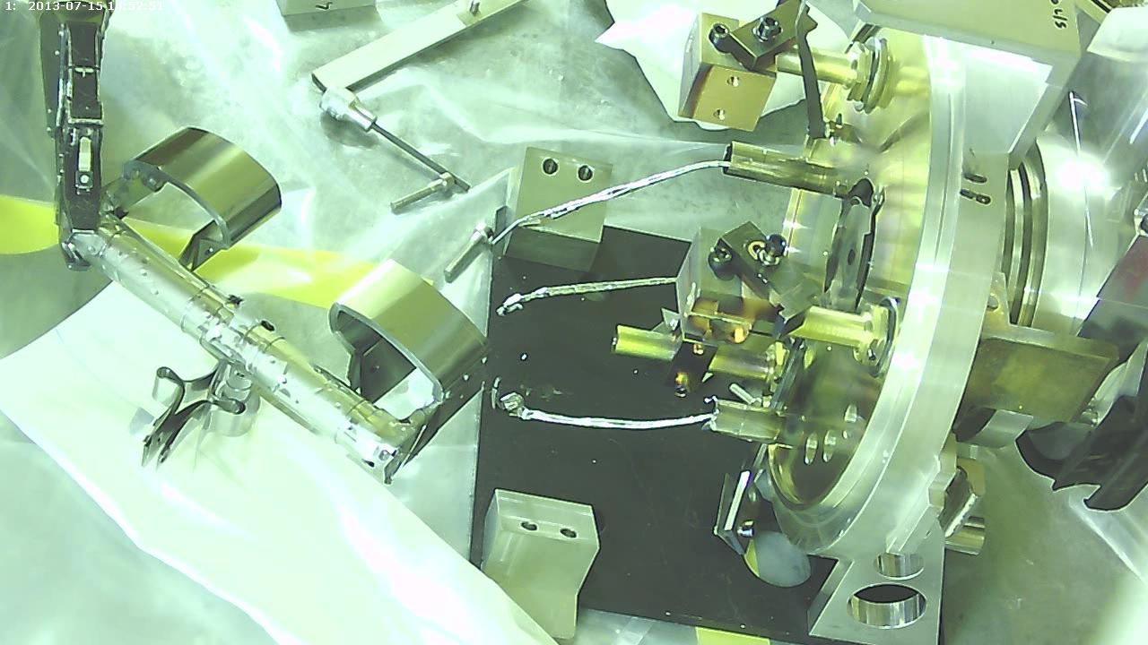
Dismantling UC_{x} Target Unit 466
      Opening target vessel in hot cell chain in air (6 mSv/h on contact with Al beam window)
      Extraction of tantalum container (19 mSv/h on contact with Ta proton beam window)
      Sealing of ion source and mass marker outlet with epoxy glue to prevent oxidation of carbide material

Slide 16
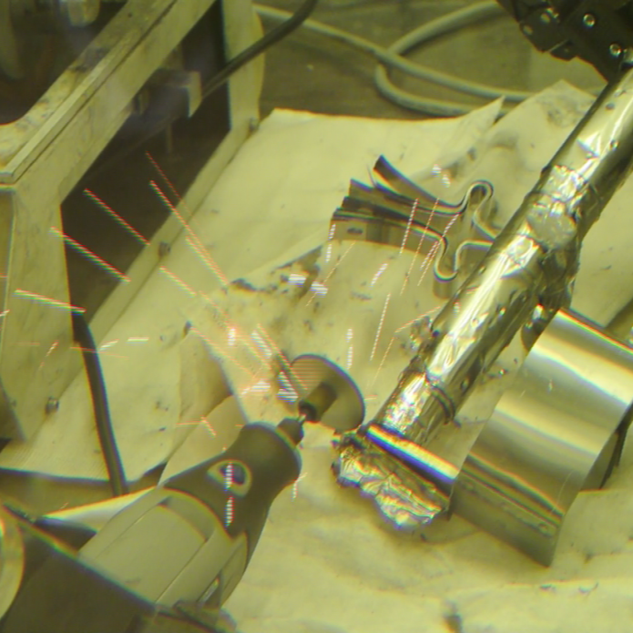
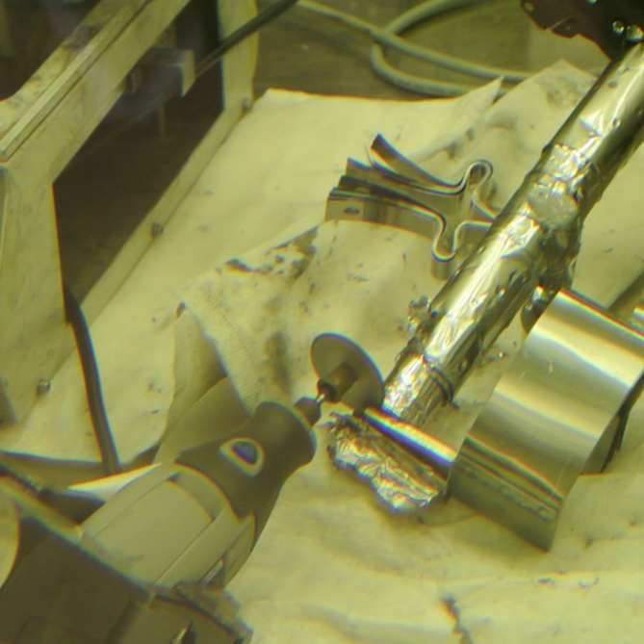
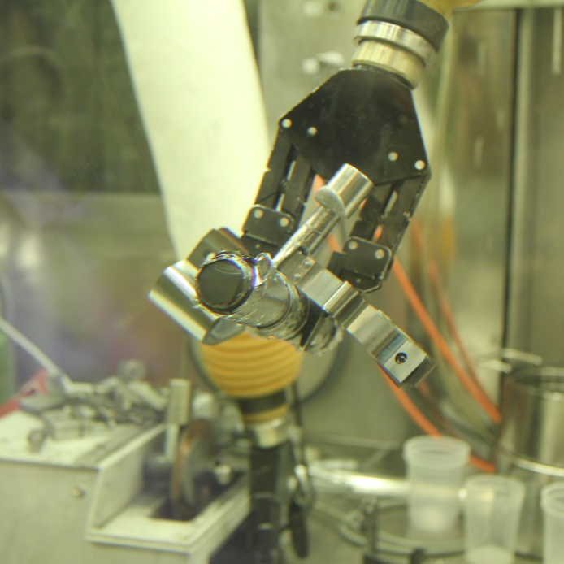
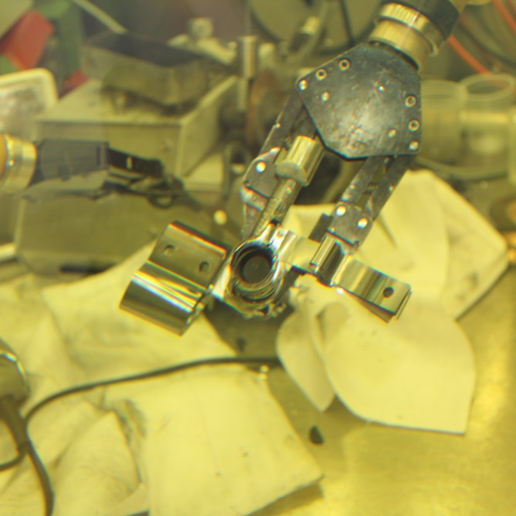
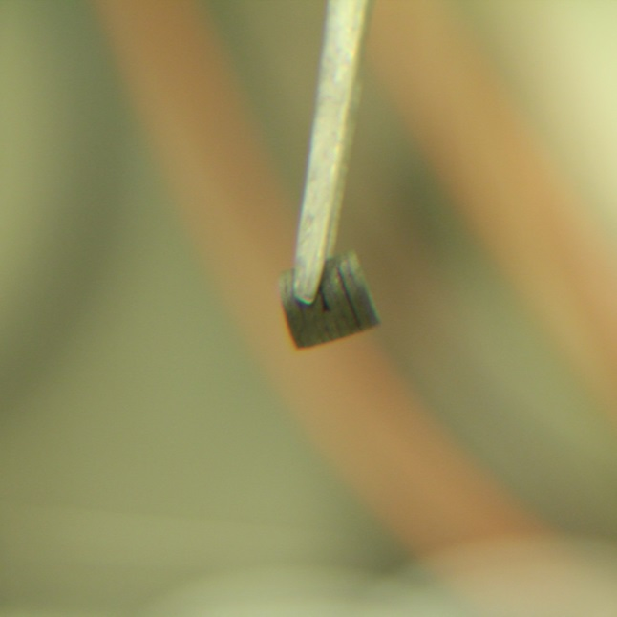
Opening Ta Container of UC_{x} Target Unit 466
      Transfer of Ta container with UC_{X} into inert-gas hot cell
      Cutting of sealed container
      Extraction of UC_{x} for further investigations (500 µSv/h on contact with single pellet)

Slide 17
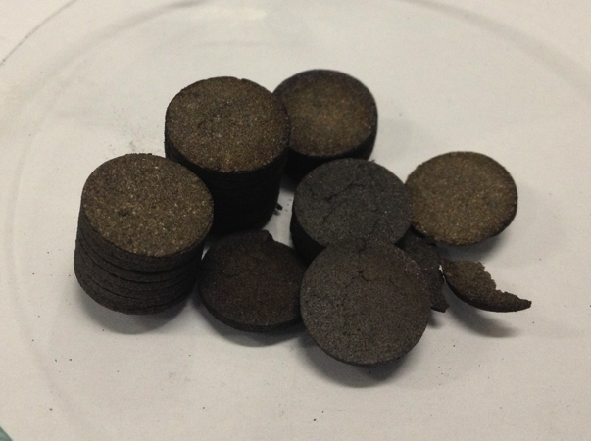
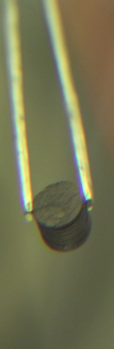
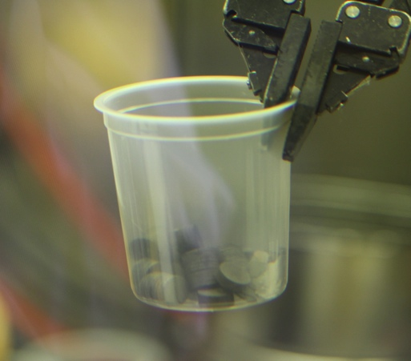
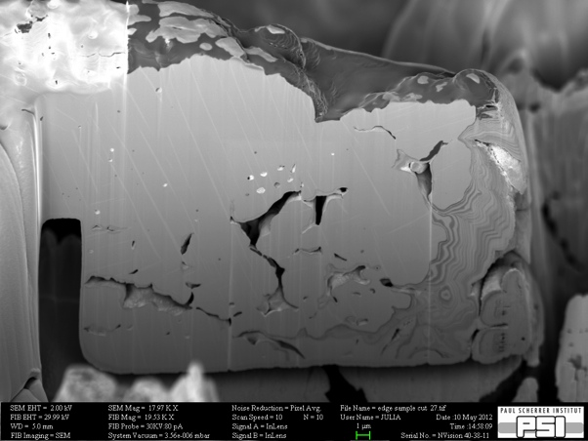
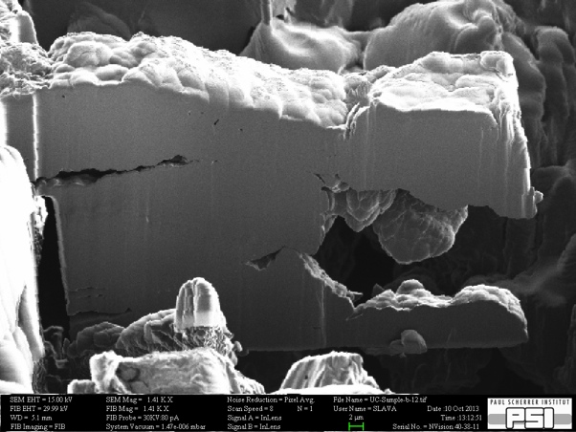

UC_{x} Post-Irradiation Studies at PSI
Post-irradiation analysis:
Pellets appear macroscopically unchanged
Microscopic evolution of pore distribution and grain size under irradiation observed
Synchrotron data only partially analyzed
before irradiation
after irradiation
2µm

Slide 18
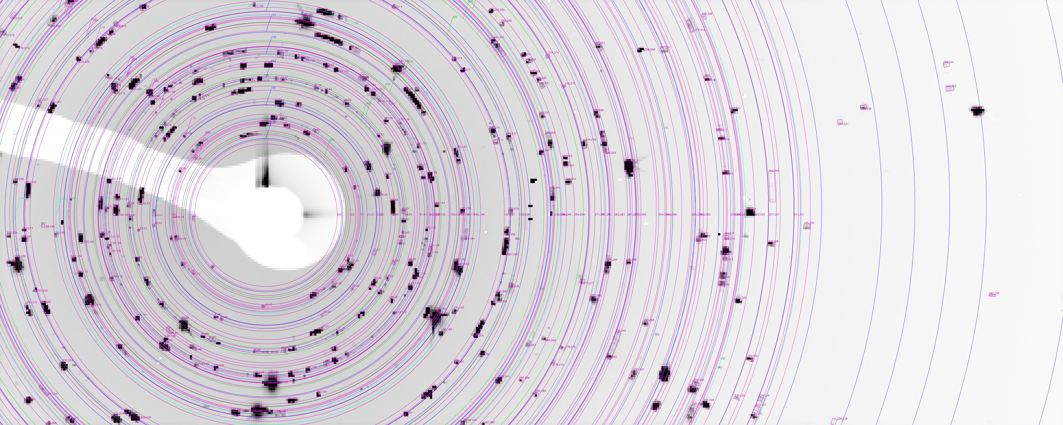
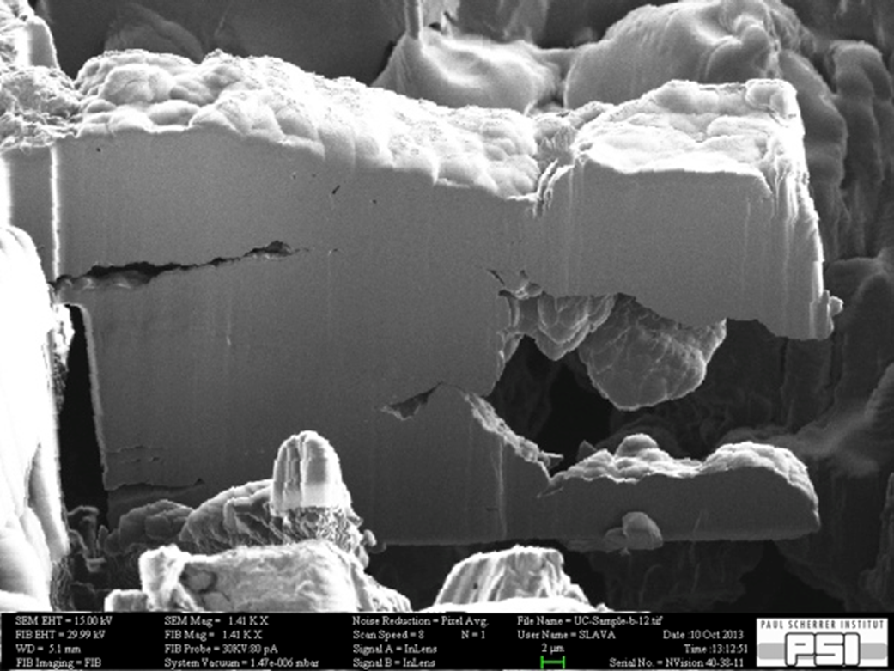
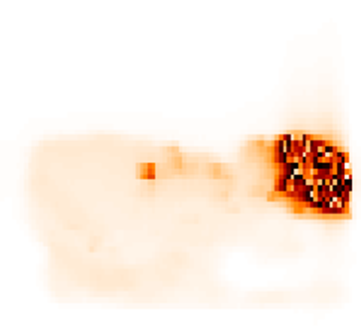
UC_{x} Post-Irradiation Studies

Slide 19
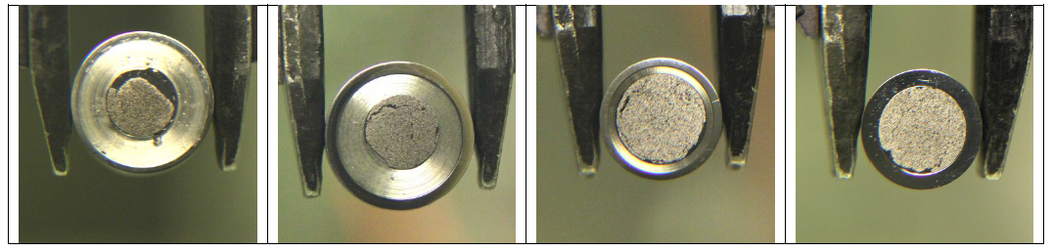
Electron Probe Micro Analysis at PSI
Preparation (polishing) of samples in nitrogen atmosphere
Non-irradiated reference
Proton beam entrance
From container center
Proton beam exit
Extensive EPMA data set still under analysis
Fission product concentration below detection limit
Confirmation of zones with varying carbon concentration causing UC₂-UC phase competition
Uranium
Carbon
Chlorine
2µm

Slide 20
Material Synthesis
Task 1

Slide 21
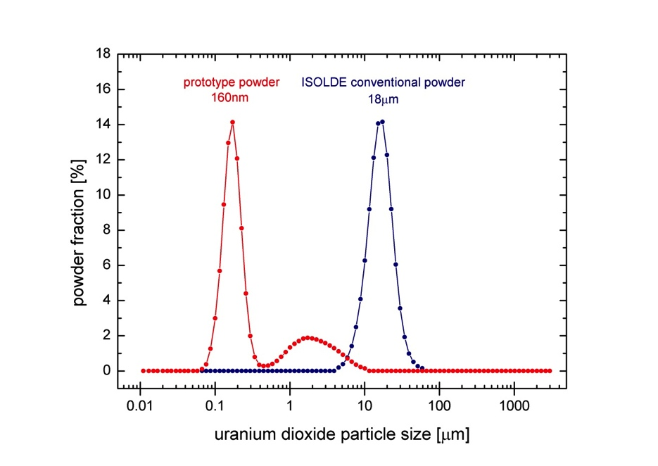
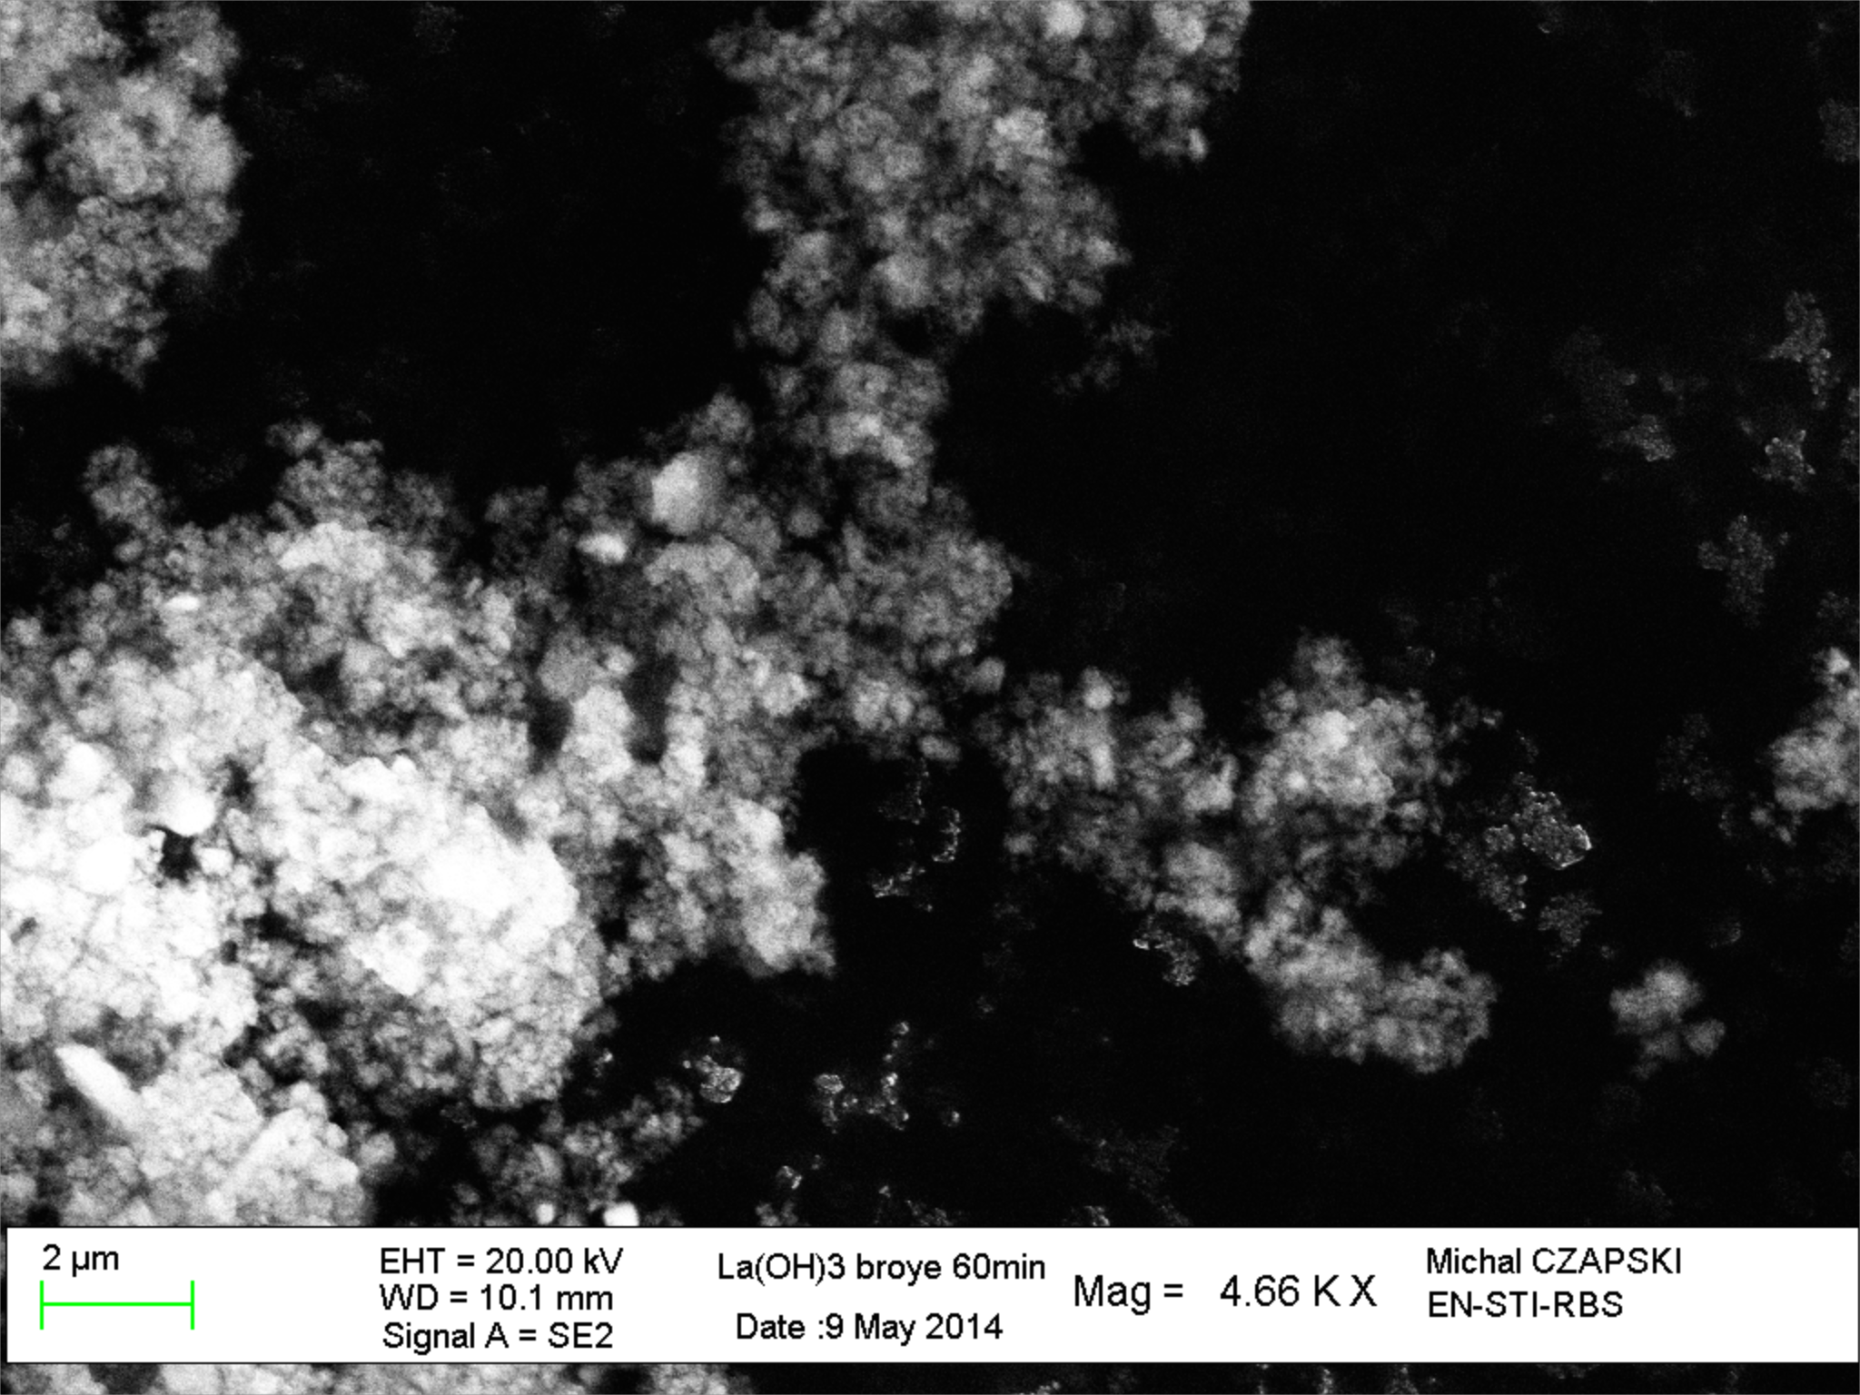
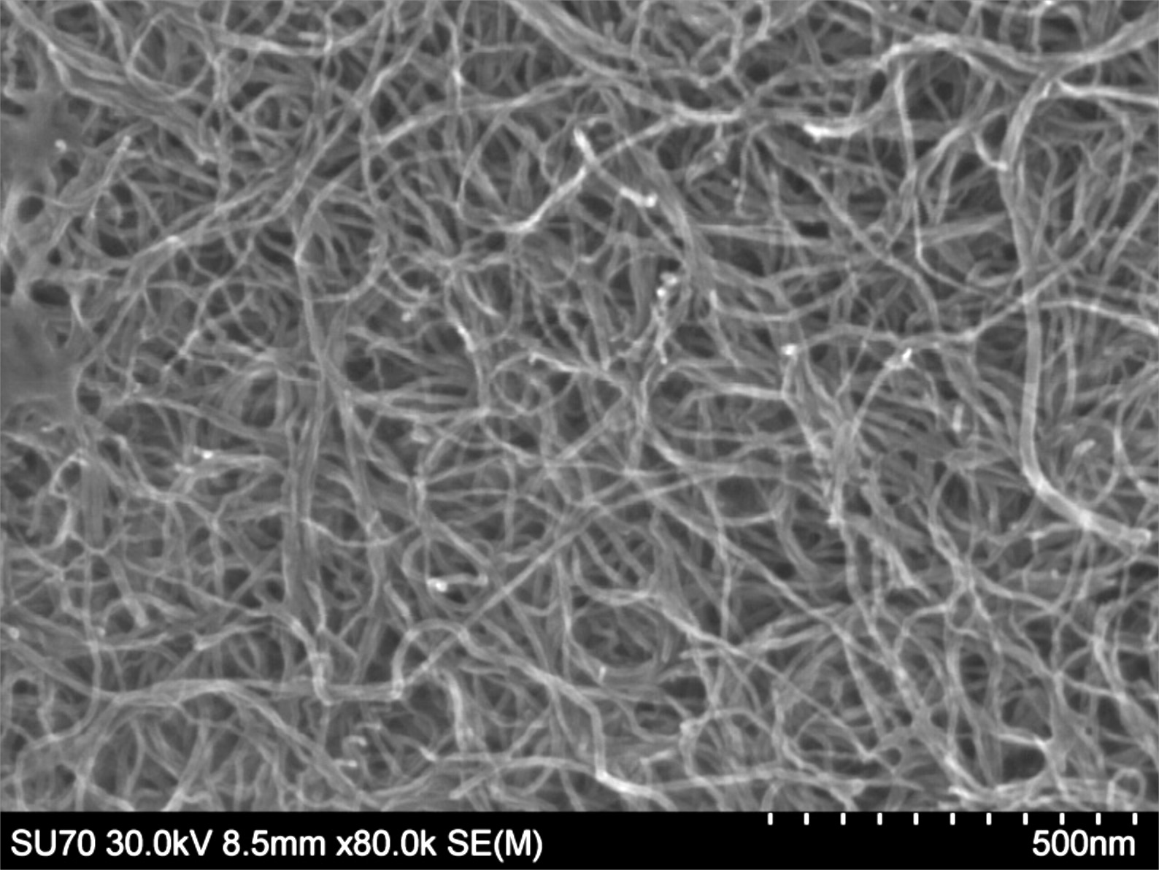
Composing a Recipe for Nano-Grained UO₂
Synthesis of de-novo designed uranium carbide matrixes:
Different microstructures, densities, grain sizes, crystal structures
tested → tailor-made matrix:
Suspension grinding of UO₂ powder to 160 nm
average particle size
Wet-mixing with multi-walled carbon nanotubes
Ultrasound drying of mixture and pressing to 1.6 g/cm³ pellets
Fast reactive sintering to mixed uranium carbide in carbon
nanotube matrix
two orders
of magnitude
LaC₂-MWCNT Nano Composite (After Carbo-Thermal Reduction)
Lanthanum Hydroxide Nanopowder
Ultrasound-Dispersed Multi-Walled Carbon Nanotubes
2 µm
500 nm
2 µm
200 µm
After 10 days at 1900°C
After 10 days at 1900°C
Microstructure investigations of UC₂-MWCNT nano composite currently in preparation

Slide 22
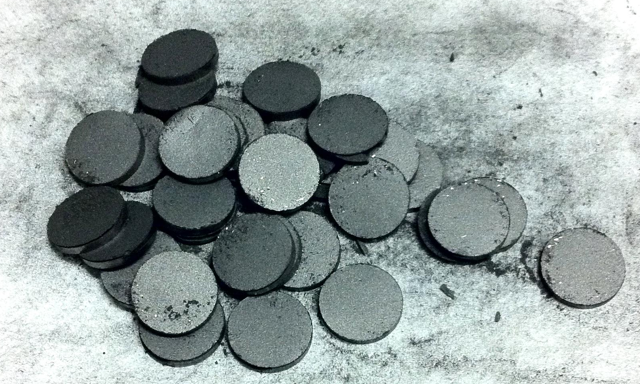
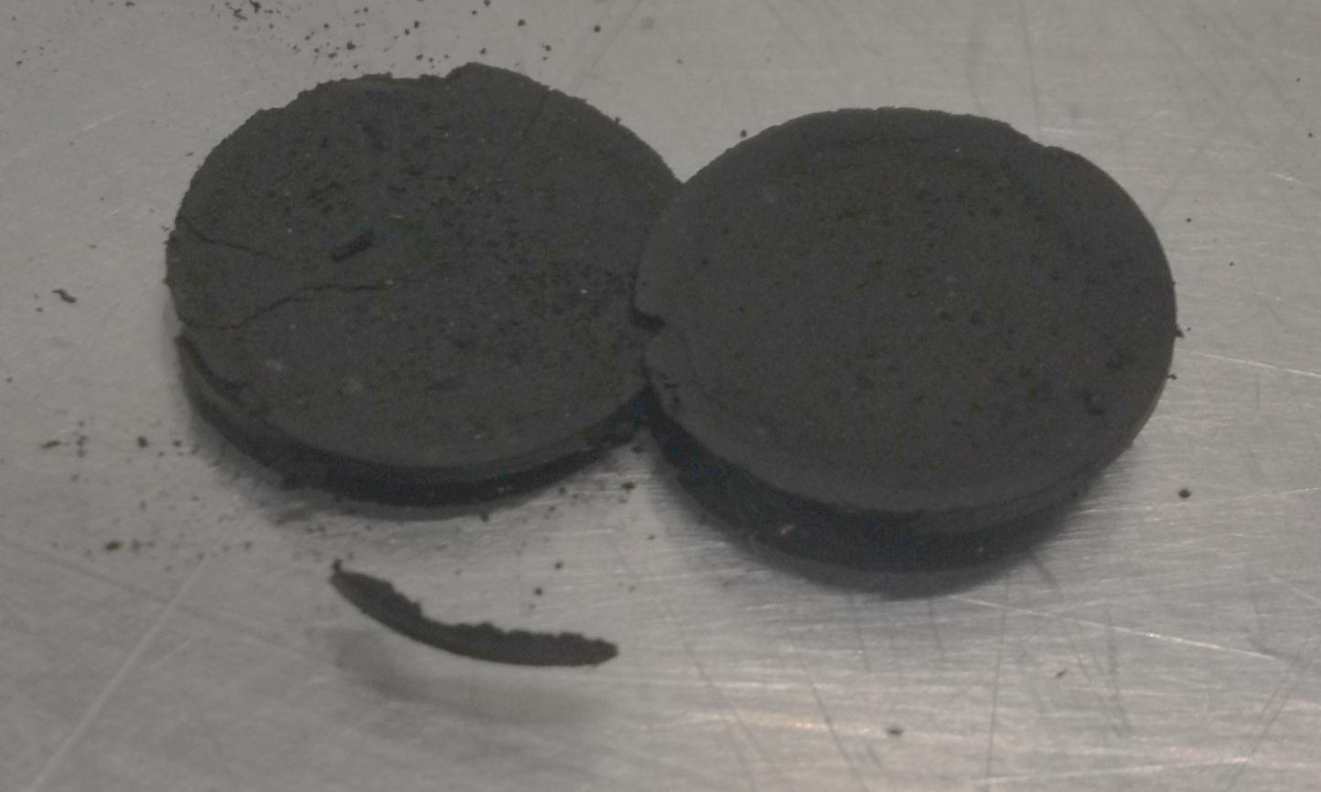
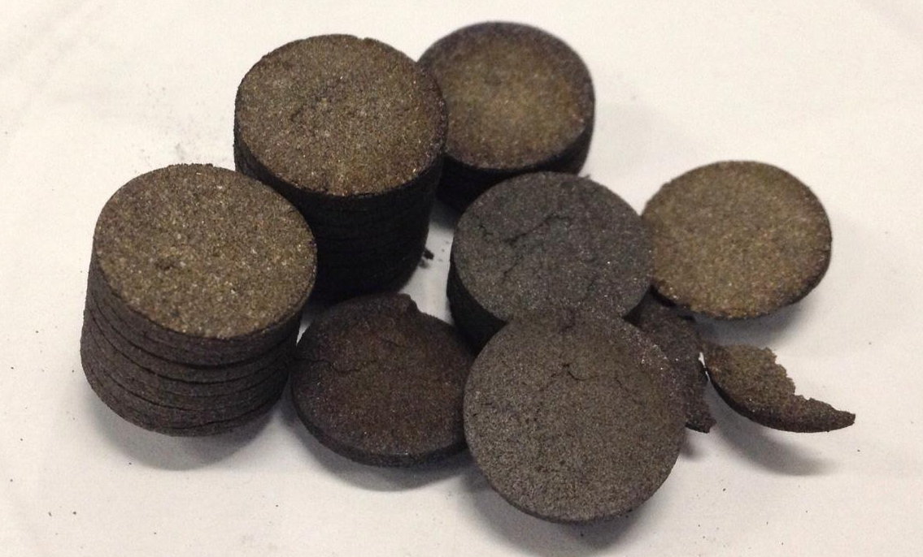
Some few Material Characteristics
 | ISOLDE conventional |  |  |  | 2014 Nano |  |  |  | UC HD
 | graphite | UO₂ | UO₂ + 6C pellet | UC₂ + 2C pellet | graphite CNT | UO₂ | UO₂ + 5C pellet | UC + 2C pellet | UC pellet
particle size [µm] | 28 | 16 |  |  | 0.01 x 10 | 0.21
SSA [m²/g] | 3.6 | 4.9 | 5.2 | 0.1 | 287 | 16 | 30 | 221 | 2.20
diameter [mm] |  |  | 14 | 12.3 |  |  | 15 | 14.1 | 13.2
thickness [mm] |  |  | 1.6 | 1.45 |  |  | 1.04 |  | 1.00
density [g/cm³] |  |  | 4.50 | 3.67 |  |  | 1.89 | 1.95* | 13.20
reduced U fraction |  |  |  | 0.999 |  |  |  | ≈0.95* | 1.000
UC₂ phase fraction |  |  |  | 0.295 |  |  |  | 0.149* | 0.941
C phase fraction |  |  | 0.309 | 0.147 |  |  | 0.190 | 0.082* | 0.059
UO₂ phase fraction |  |  | 0.222 | 0.000 |  |  | 0.136 | 0.009* | 0.000
porosity |  |  | 0.469 | 0.558 |  |  | 0.674 | 0.760* | 0.000
total target mass [g] |  |  | 110 | 94 |  |  | 51.49 | 39.63 | 361.8
 |  |  |  | 100.00% |  |  |  | 42% | 414.07%
* Property needs to be confirmed
UO₂ + 6(5)C pellets
UC₂ + 2C pellets

Slide 23
Online Tests at ISOLDE
Task 4
unit #498 on HRS in 2012 – difficult, but ¹¹Be and ³⁰Na yield evolution studied
unit #525 on GPS in 2014 – tests successful

Slide 24
ENSAR-ActILab: Nano Uranium Carbide at ISOLDE

Slide 25
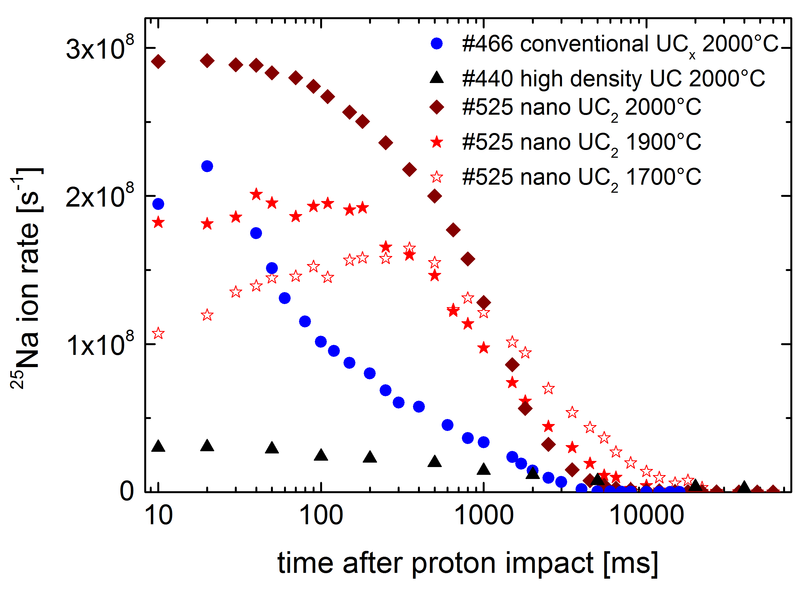

Nano Uranium Carbide Online at ISOLDE
isotope | half life | yield [μC⁻¹]
⁸Li¹ | 840 ms | 2.8·10⁷
⁹Li¹ | 178 ms | 1.9·10⁷
²⁵Na^{1,5} | 59.6 s | 2.8·10⁹
²⁶Na^{1,5} | 1.07 s | 9.2·10⁸
³⁰Na² | 48 ms | 1.4·10⁵
⁴⁶K^{1,4} | 115 s | 3.9·10⁸
⁵⁰K^{1,2,4} | 472 ms | 8.6·10⁴
⁵⁰Ca² | 13.9 s | 6.8·10⁴
⁴¹Sc^{1,5} | 596 ms | 1.1·10⁵
⁶⁸Cu^{2,7} | 30 s | 9.6·10⁸
^{68m}Cu^{1,7} | 3.8 min | 3.4·10⁸
⁷⁶Ga² | 32.6 s | 2.9·10⁷
⁸¹Ga² | 1.22 s | 1.1·10⁶
^{81m}Rb² | 30.3 min | 2.2·10⁷
⁸⁸Rb^{1,4} | 17.8 min | 8.0·10⁹
⁹³Rb^{1,4} | 5.84 s | 2.6·10⁸
⁹⁶Rb^{1,5} | 199 ms | 1.5·10⁷
¹¹⁴Ag^{2,8} | 4.5 s | 1.4·10²
^{116m}Ag^{2,8} | 8.2 s | 9.0·10²
¹¹⁷Ag^{2,8} | 72.8 s | 1.6·10³
¹¹⁸Ag^{2,8} | 3.7 s | 6.2·10⁴
¹²⁰Ag^{2,8} | 1.17 s | 2.3·10⁴
¹²²Ag^{2,8} | 0.52 s | ≤1.3·10³
¹³²In^{1,2} | 0.20 s | 1.7·10⁴
¹³⁹Cs^{1,4} | 9.3 min | 2.6·10⁹
¹⁴²Cs¹ | 1.68 s | 1.1·10⁹
¹⁴⁸Cs^{1,4} | 158 ms | 1.7·10⁴
²⁰⁷Fr³ | 0.148 s | 8.5·10⁷
²³⁰Fr^{1,4} | 0.596 s | 7.1·10⁵
A = 225⁶ |  | 1.1·10⁹
¹assessed through β detection with release curve integration
²assessed through γ detection
³assessed with scintillator, assuming 50% α detection efficiency
⁴beam composition assessed through γ spectroscopy
⁵beam composition assessed through half-life measurement
⁶faraday cup measurement
⁷resonant laser ionized
⁸extracted in its 2+ state
⁹assuming 100% branching into investigated γ transition

Slide 26

Nano Uranium Carbide Online at ISOLDE
New material:
  Seems increases isotope yield of most investigated elements
  (Li, Na, K, Ca, Cu, Ga, Rb, In, Ra, Fr)
  reduced ageing effects (reduction of yield over time)
  reduces actinide waste by 60%
  chemically unstable
  Resource-intense to synthesize (additional development needed)
  Rich in synthesis-induced contaminations

Slide 27
What has ActILab brought us? (my perspective)
  A healthy collaboration between several European institutes leading to results that where out of reach before
  Paving the way for easier access to infrastructure between the labs
  Blowing breaches into Europe’s shipment channels for actinide materials
  Extension of collaborative effort into other materials (Julien Guillot)
  Deep insights to conventional UC_{X} properties, dynamics, ageing mechanisms
  At least one new and promising target material
  LOTS OF FUN

