Slide 1
SPS RESTARTING AFTER LS1
05/03/2015
Stéphane Cettour Cavé

Slide 2
OUTLINE
Main modifications in the SPS during LS1
SPS commissioning, check out
Summary

Slide 3
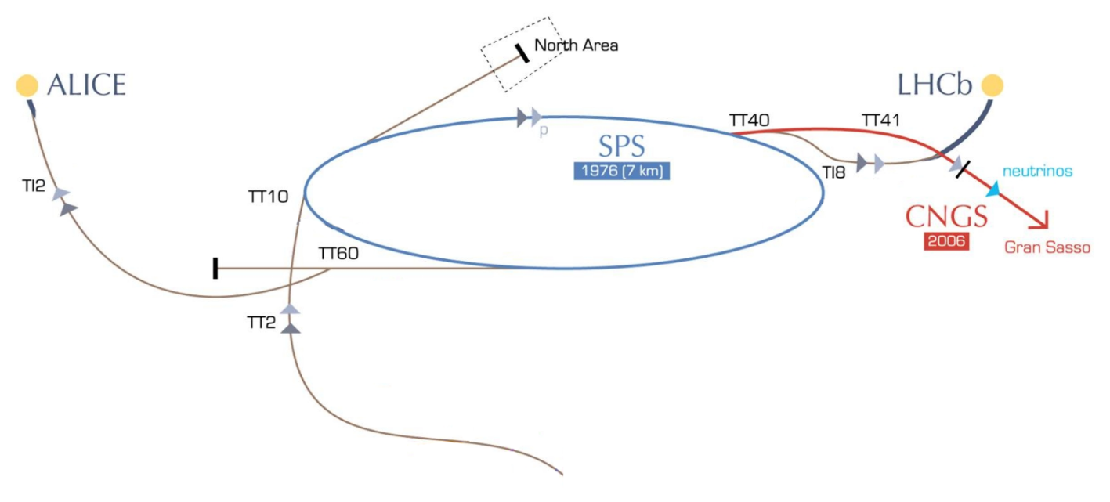
Main modifications in the SPS during LS1
SPS Ring
  On the Main power supplies we changed:
    -18 kV transformers
    -18 kV cables between BA’s and BE
    -firing cards
    -thyristor racks
  On all power supplies we changed:
    -the function generator (ROCS replaced by FGC)
    -removed the legacy timing, pulse start, pulse stop
    -with the FGC we implemented a new coast, a new trim in the coast, a new economy system
  New RF power control
  New RF low level control
  BA6 vertical realignment (+~4mm)
  LSS1 completely uninstalled for recabling
  Etc..
Transfer line
  TT10 uninstalled to consolidate the tunnel structure
  TDC2 uninstalled splitters and collimators for recabling
  Etc..

Slide 4
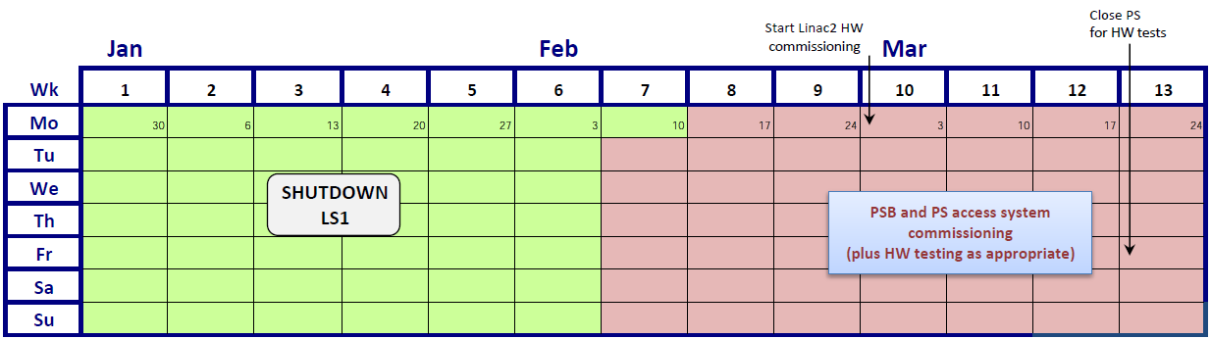
SPS commissioning, check out
In March
Test of the new timing system for SPS
  -check all events
  -check if the machine mode works
  -check the if the events are dependent on the machine mode
Cleaning of old settings from the data base
Generation of new cycles to see if all the functions were correctly generated
Initial application testing and debugging

Slide 5
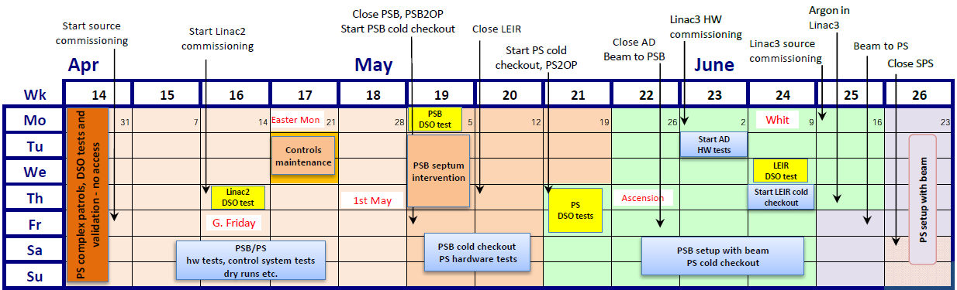
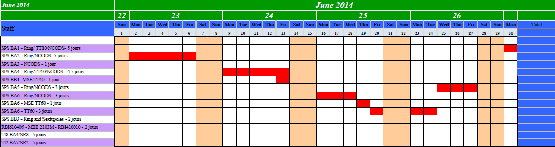
SPS commissioning, check out
Planning test SPS AUX

Slide 6
SPS commissioning, check out
In April, May
FGC in simulation mode
  -test all the power converters with a new cycle generated in simulation
  -test dynamic economy, full economy, ddest economy in simulation
Test of the new timing for COAST
  -check if all the power converters start in coast prepare
  -check coast mode
  -check coast recover
  -check return to cycling mode
Creation of additional applications to have more diagnostics on the FGC
Increased the speed of the signal to trigger the dynamic economy
In June
Power converter AUX (BA2, BA4, BA5, BA6) ready for test
  -checking if PCs working correctly
  -polarity check available power converters
Patrol and close SPS complex
Follow up of the RF low level, control and RF power recommissioning
Modification and verification that SIS (software interlock system) takes into account the new philosophy with the FGC and timing
Checking in normal mode (PCs ON) dynamic economy, full economy, ddest economy, mode coast

Slide 7
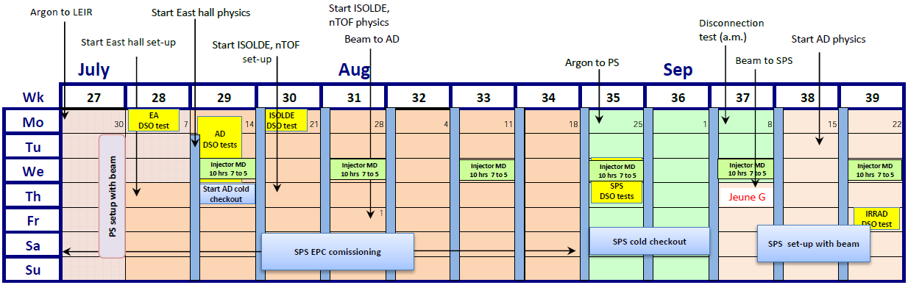
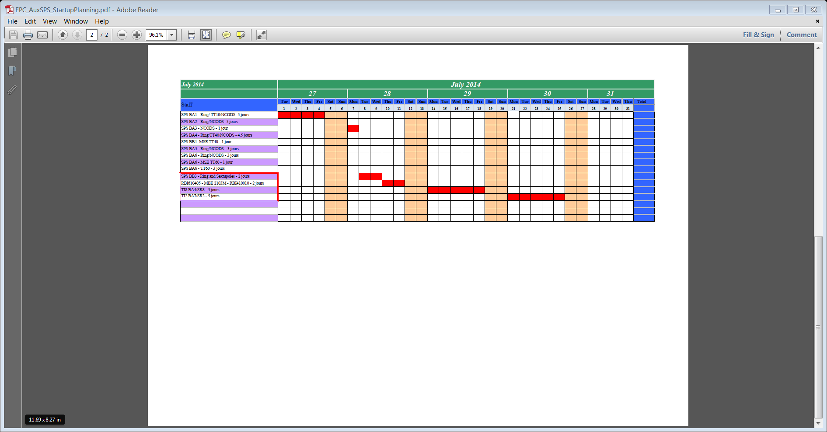
SPS commissioning, check out
Planning test SPS AUX

Slide 8
SPS commissioning, check out
In July, August
Beginning of the daily morning meeting at 8h30 in CCC with an expert for each system
  -with this meeting we manage the activity in the SPS because now the ring is closed.
  -activities are prioritized
  -we manage the necessary access such that they take place either before 8H30, between 12h00 and 14h00, after 17h30, or in the case of multiple access requests we can organise a dedicated period for access
  -this meeting is very important to know the progress of all the systems
Power converter AUX (BA1, TT10, BA3, BB3, TT20, TI2, TI8)
  -checking if PCs working correctly
  -polarity checks for these power converters
Control
  - verification of the new applications allowing greater diagnostics on the FGC
  - verification of all applications to control the accelerators
Instrumentation
  -checking stepping motors and if the software values correspond with the hardware in the tunnel
  -outin system, camera, screen, sem grid, miniscan
8h30 meeting checking the progress of the septas, kickers conditionning, RF low level, RF control power
Interlocked machine protection
  -test all BIC inputs (BLM, PCs state, vaccum valve interlock, etc..)
  -test all the SIS functionality
  -test the time to fire the beam dump by the BIC if the MPS tripped
  -check if all the interlock system are OK for beam (BIS, SIS)
Main power supplies
  -checking the repetability of the MPS, the ripple, application of hardware compensation
  -checking if it can pulse for extended periods without issue
  -checking the cooling temp
DSO test preparation
  -checking if all EIS work correctly

Slide 9
Summary
Starting SPS
Polarity checks
  -check the polarity with a portable hall probe inside the magnet
  -polarity faults identified before injecting beam to avoid any doubt during the beam steering
Op involved in the working group to implement the FGC and timing system
  -OP can follow the evolution of the system
  -OP involved in commissioning to identify earliest possible opportunities to start partial testing
  -OP began the timing tests step by step as and when the various elements became available
Op crew
  -OP must be involved in all modifications to keep control of all systems
  -it is very useful to know the systems and rewarding for op
  -op started testing often even before the system was fully available to reduce overall commissioning time
Very useful diagnostic tools
  -SIS
  -BIS
The first BEAM injected in the SPS without major problem

Slide 10
Thanks for your attention

