Slide 1
11T Dipole – New Baseline
HL-LHC Parameter and Layout Committee
2015-03-12
F. Savary on behalf of the WP11 team
Input from V. Baglin, D. Ramos

Slide 2
Outline
Background information
New baseline
By-pass cryostat for collimator integration
Recent news

Slide 3
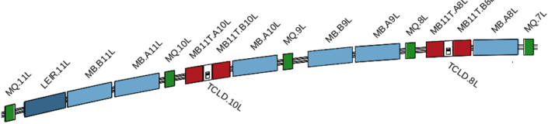
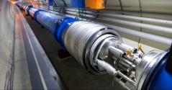
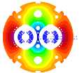
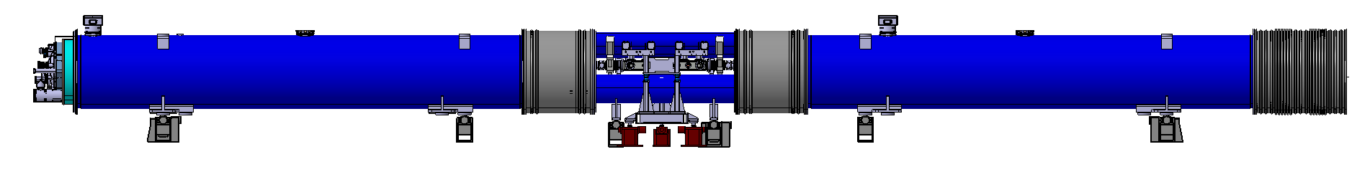
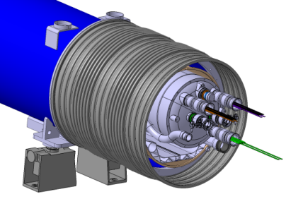
Background information
Create space in the dispersion suppressor regions of LHC, i.e. a room temperature beam vacuum sector, to install additional collimators (TCLD), which are needed to cope with beam intensities that are larger than nominal, such as in the High Luminosity LHC (HL LHC)
Replace a standard MB by a pair of 11T dipoles (a pair of MBH’s)
Produce an integrated field of 119 Tm
at 11.85 kA
Connection cryostat
15660 mm
11 T dipole magnet
Interconnect
Collimator

Slide 4
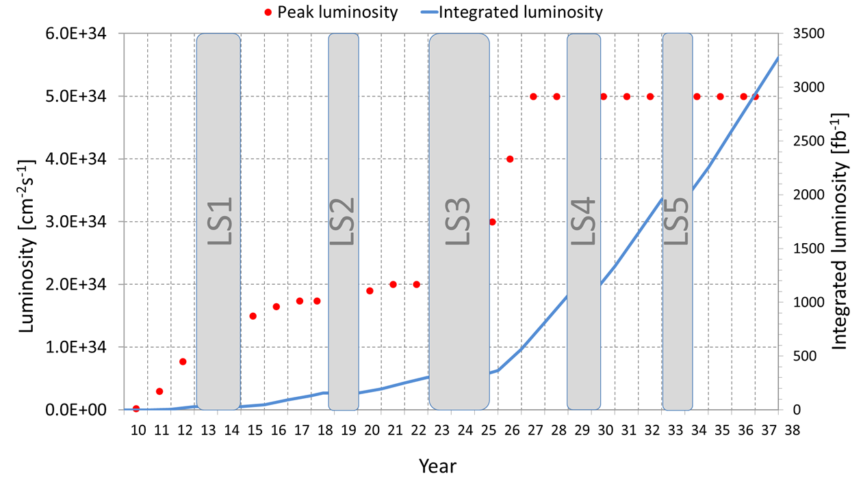
Two phases
IP2: 2 cryo-assemblies for installation
1 spare assembly
IP7: 4 cryo-assemblies for inst.^{n}
IP1-5: 4 cryo-assemblies
2 spare assemblies
1 spare assembly
New baseline
TODAY
Graph showing nominal upgrade parameters - 3000 fb⁻¹ would be reached in 2036
Courtesy L. Rossi

Slide 5
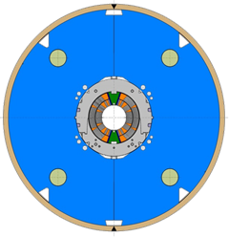
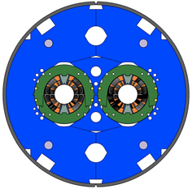
Scope in numbers
 | Phase 1 - LS2 [all RRP] | Phase 2 – LS3 | Remark
Models | 4 single aperture / 1-in-1 2 double aperture / 2-in-1 | PIT (new X-section): 4 single aperture / 1-in-1 2 double aperture / 2-in-1 RRP (new X-section): 2 single aperture / 1-in-1 1 double aperture / 2-in-1 | New X-section is necessary for PIT conductor (suffering from excessive degradation when the current keystone angle is used)
Prototypes | P1: MBH_P001 | P2: MBH_P002 [PIT] P3: MBH_P003 [RRP] | 1 prototype cryostat
Series baseline | IP2 2 x (2 MBH__ + 1 BPC*) | IP7 4 x (2 MBH__ + 1 BPC)
Series spares | 1 x (2 MBH__ + 1 BPC) | 1 x (2 MBH__ + 1 BPC)
Option | - | IP1-IP5 Max. 8 x (2 MBH__ + 1 BPC) | Exact number and installation time t.b.d. later
*BPC stands for by-pass cryostat

Slide 6
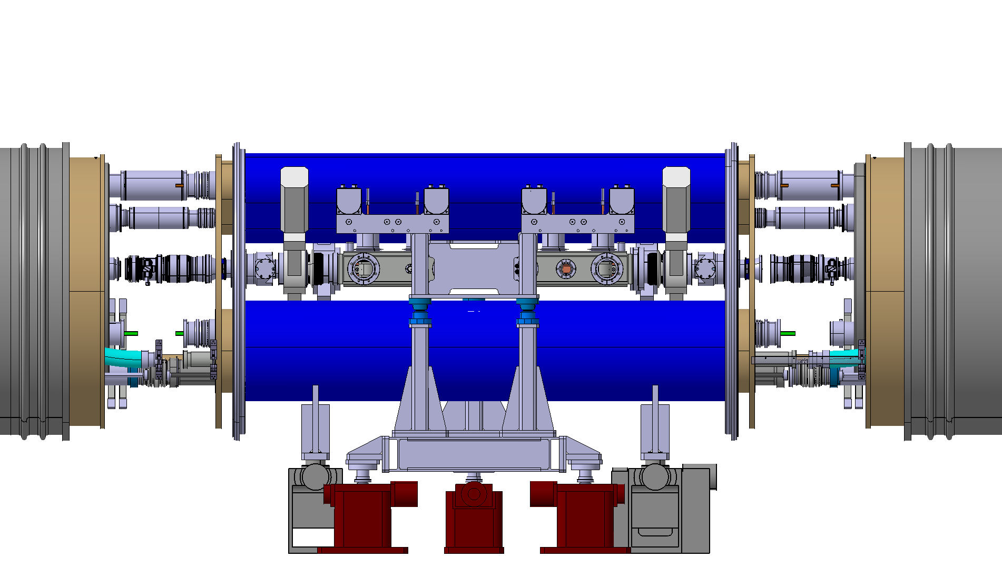
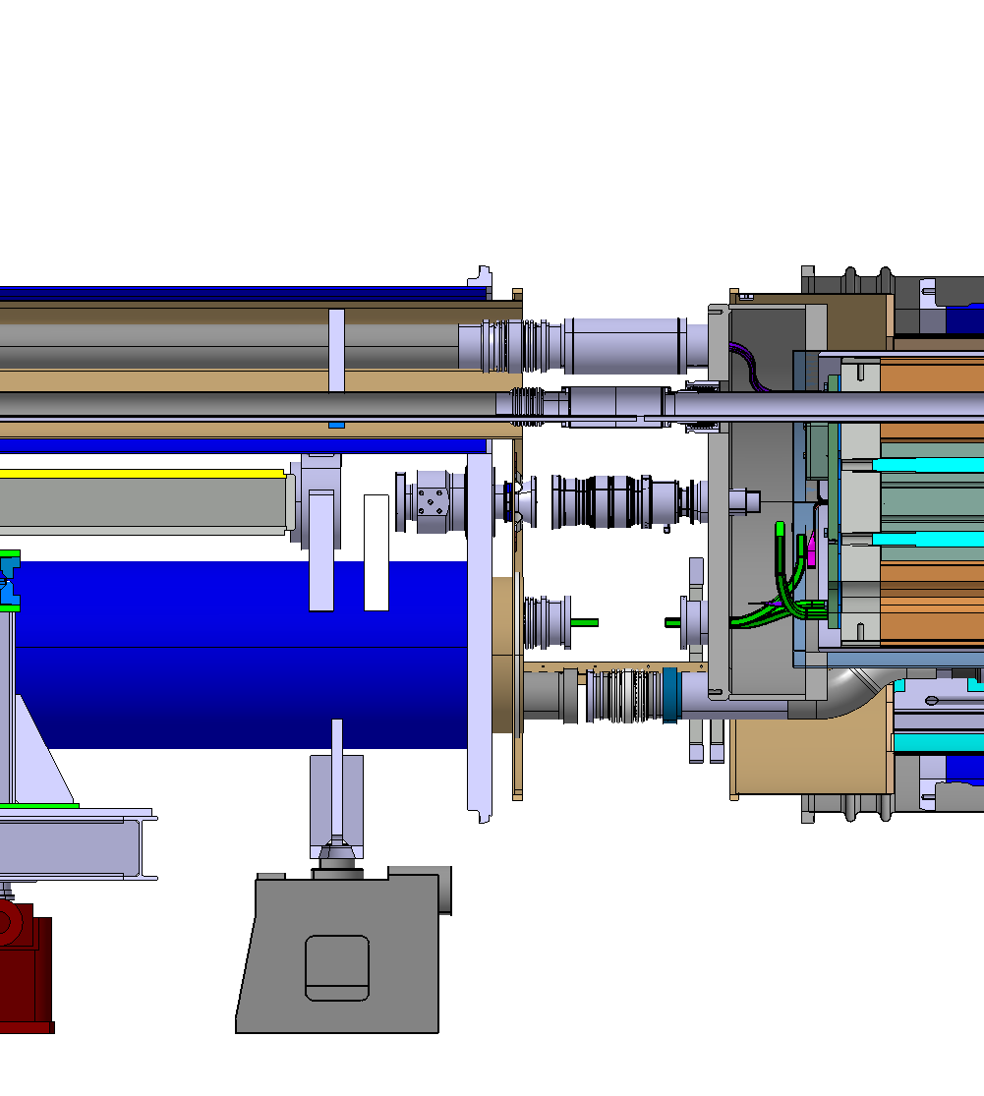
By-pass cryostat for collimator integration
Courtesy D. Ramos
Cold mass enlarged to Ø750 on the collimator side
Constant LHC arc outer flange diameter: Ø1055
Flexible interconnects for alignment independency and thermal contraction
Interconnects use standard components and tooling despite the new compact layout
  Busbar routing is in the shadow of the beam screens and CWT!
Collimator support jacks
Cryostat support jacks

Slide 7
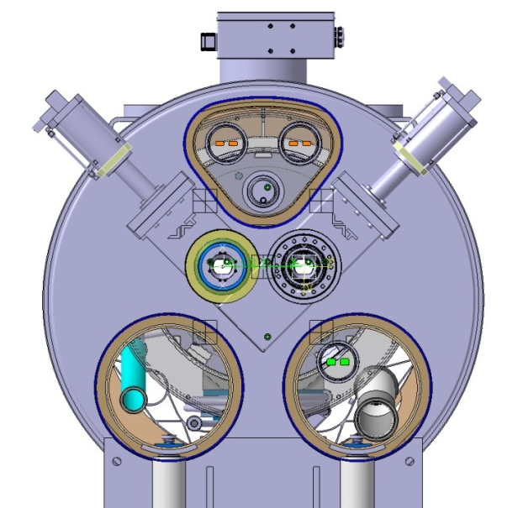
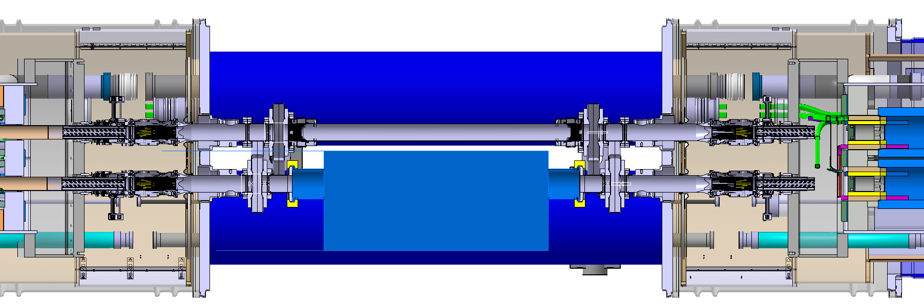
Beam vac. & Collimator length (1)
Courtesy D. Ramos
Warm drift vacuum chamber
600 mm Collimator
Transitions needed to allow installation of sector valves
Very tight integration

Slide 8
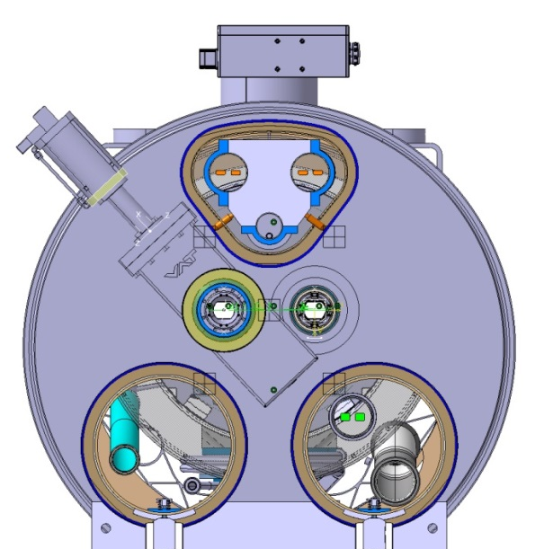
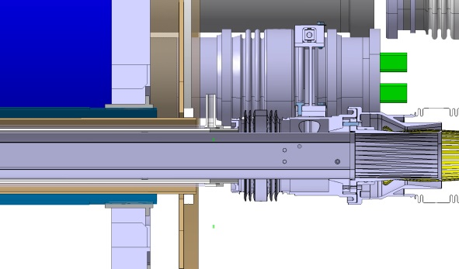
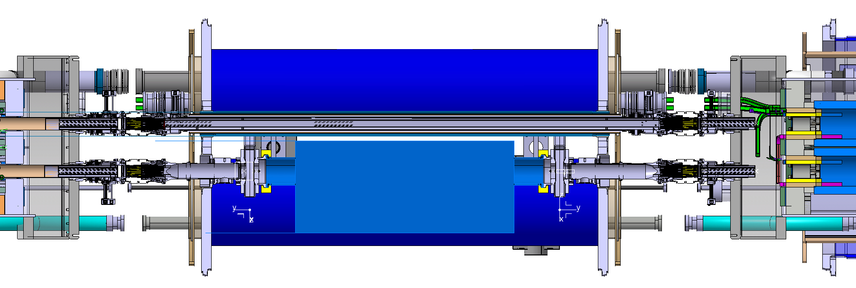
Beam vac. & Collimator length (2)
Courtesy D. Ramos
Work to make a mock-up
by-pass cryostat has started
Interconnects become longer because of the beam screens
Very compact cold line because of the sector valve RF shielding
Cold drift vacuum chamber – Preferred
650 mm Collimator
600 mm Collimator
Transitions avoided because there is no sector valve on the other beam line
Following the 51st Collimation Upgrade Specification Meeting held on Jan. 30, 2015
ColUSM #51

Slide 9
Recent news on the models @ CERN
Model # | Coil # | Status / plan
MBHSM101 | 101-105 | Tested [coil 101 made of copper]
MBHSP101 | 106-107 | Tested
MBHSP102 | 106-108 | Coils available, test in April/May 2015
MBHSP103 | 109-111 | Coils in production, test in June/July 2015
MBHDP101 | SP102-SP103 | Assembly to start in Sept. 2015, Test in Nov. 2015
MBHSP104 | 112-113 | Coil production to start in April/May 2015
MBHSP105 | 114-115
MBHDP102 | SP104-SP105
MBHSP106 | 202-203 | Coil production to start in second half of 2015
MBHSP107 | 204-205
MBHDP103 | SP106-SP107
Collaring imminent
RRP
PIT
Not an end here!

Slide 10
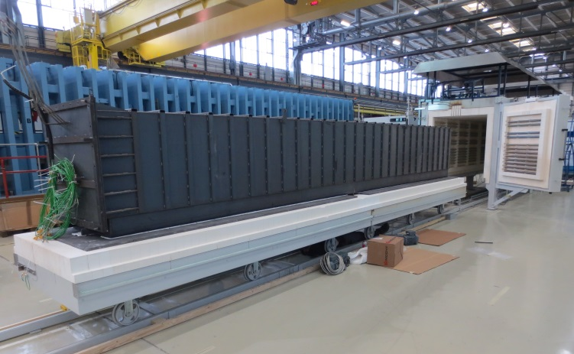
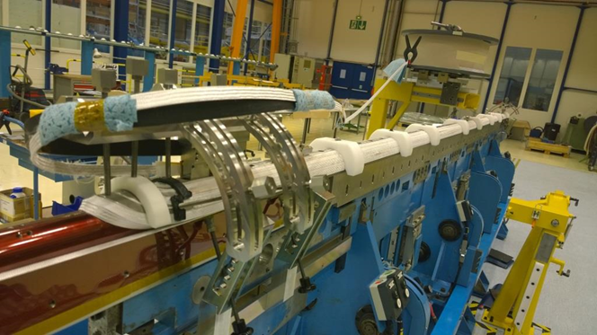
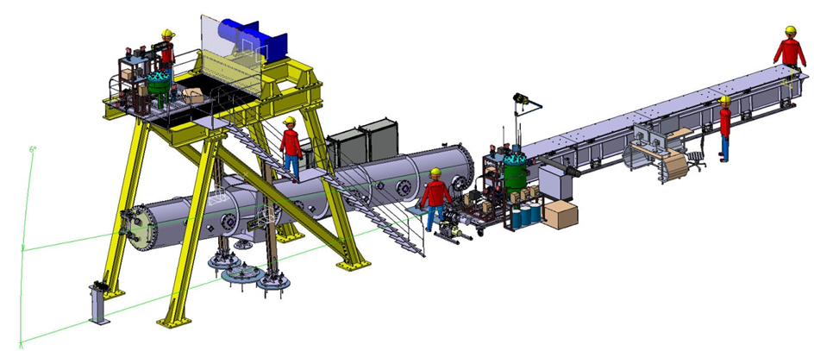
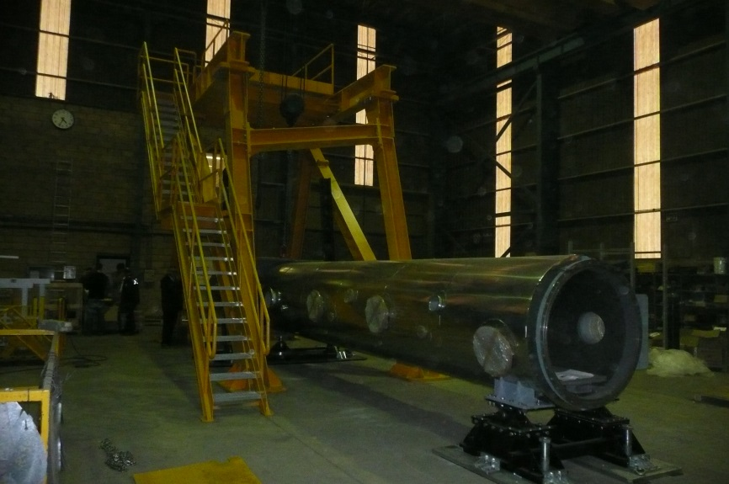
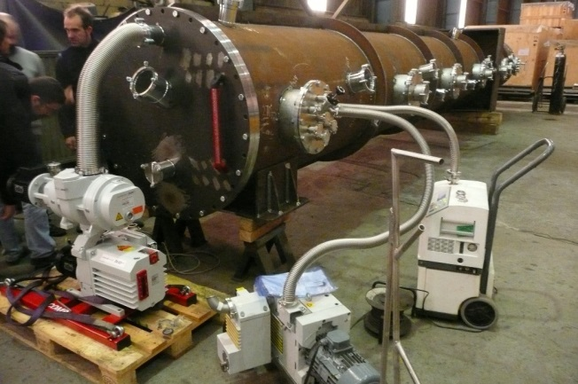
Tooling for full-length MBH @ CERN
Start winding first low grade sc cable in the middle of April 15

Slide 11
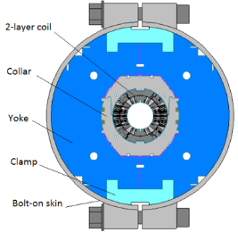
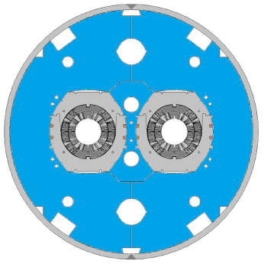
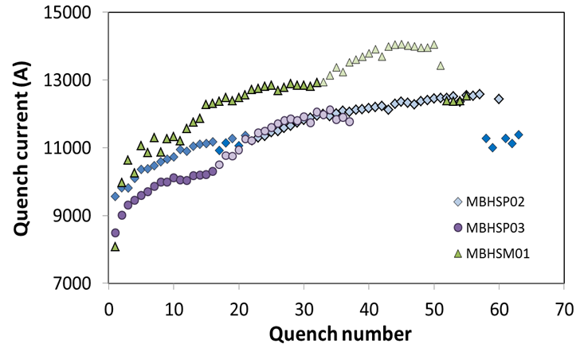
And on the side of FERMILAB
MBHSP03:
Bmax = 11.7 T at 1.9 K
97.5% of Bdesign = 12 T
no holding quenches
Target current in LHC
First two-in-one MBHDP01:
Bmax = 11.5 T at 1.9 K
after 36 quenches

Slide 12
Thank you for your attention

