Slide 1
Review HL-LHC triplet layout
G. Arduini, R. De Maria, M. Giovannozzi
Acknowledgment P. Fessia, T. Lefevre, E. Todesco

Slide 2
Conclusion on triplet lengths
We took into account the new constraints Ezio set for triplet lengths and gradients:
  L<=4.2 m for Q1/Q3
  triplet gradient allowed to exceed 130T/m by ≈1-2%
We found layout and optics solutions that are compatible with:
  triplet gradients <132.6 T/m and L* of 23 m or 24 m
  updated interconnection lengths
  with degraded (5-10%) β* reach and ≈1-2% integrated luminosity loss
  and with he magnetic lengths of:
  L=4.2 m for Q1a/Q1b and Q3a/Q3b
  L=7.15 m for Q2a/Q2b
Need definition of L* in order to finalize the layout and define new position of the BPM (coordinated by integration, instrumentation and coll./exp. interface).
The final optics and triplet strengths will be optimized and finalized once the layout is frozen.
For more information see the following contribution: indico.cern.ch/event/371767/contribution/3/material/slides/1.pptx

Slide 3
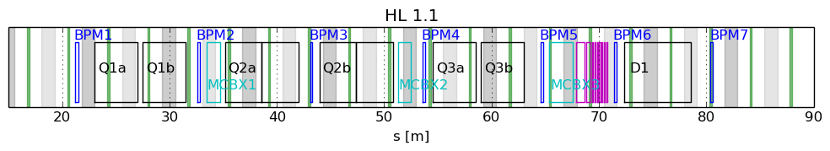
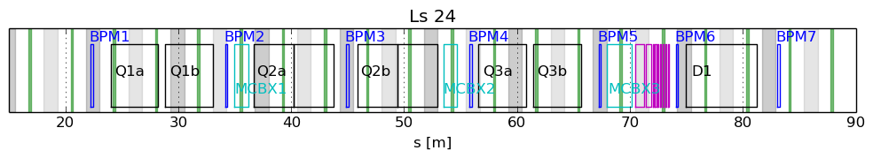
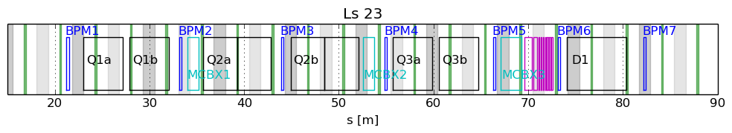
Layouts sketches
Forbidden areas ±60 cm, assuming best conceivable electronics.
Ideal bpm positions
Both layouts, in particular the one for L*=24 m, degrade BPM distance from LR encounters.
BPMs need more than ±60 cm (up to ±1.5 m with LHC electronics) to cope with bunch trains thus impacting the effectiveness of any IP orbit feedback relying on BPMs.

Slide 4
Backup

Slide 5
Integrate Luminosity vs β*
β* acts on virtual luminosity and HL-LHC scenarios are most sensitive to levelled luminosity and beam currents (burn-off and levelling times dominates).
E [TeV] | N [10¹¹] | L_{lev} [10³⁴ cm⁻²s⁻¹] | L_{virt β*=15cm} [10³⁴ cm⁻²s⁻¹] | L_{int}/day _{β*=15cm} [fb⁻¹] | L_{virt β*=18cm} (-13.3%) [10³⁴cm⁻²s⁻¹] | L_{int}/day β*=18cm
7 | 2.2 | 5 | 20.1 | 3.17 | 17.4 | -1.73%
7 | 2.2 | 7.5 | 20.1 | 4.07 | 17.4 | -2.88%
7 | 1.9 | 5 | 15.0 | 2.93 | 13.0 | -2.55%
7 | 1.9 | 7.5 | 15.0 | 3.63 | 13.0 | -4.3%
β* not very sensitive for L_{int} with nominal parameters, at the same time:
relatively risk free and
relative impact of β* on L_{int} increases for lower beam current.

Slide 6
Layout variants and β* reach
Case | L* [m] | G_{Q1} [T/m] | G_{Q2} [T/m] | G_{Q3} [T/m] | l_{Q1/3} [m] | l_{Q2a/b} [m] | β*_{pre} [cm] | β*_{max} at β*_{15cm}
HL1.1 | 23 | 139.8 | 139.8 | 139.3 | 4.0 | 6.8 | 44 | +0%
L* 24 | 24 | 128.9 | 130.2 | 130.4 | 4.2 | 7.15 | 48 | +8.2%
L* 23 | 23 | 132.1 | 130.5 | 130.6 | 4.2 | 7.15 | 48 | +4.3%
Ls 24 split¹ | 24 | 132.2 | 129.4 | 129.6 | 4.2 | 7.15/2 | 49 | +12%
Ls 23 split¹ | 23 | 132.3 | 129.3 | 129.6 | 4.2 | 7.15/2 | 48 | +7.8%
¹ Backup plan for Q2a and Q2b for which 65cm inter-distance is assumed. Not considered to be likely.
The gradient values will be still fine tuned in the range of ±0.3 T/m for the final layout to optimize crab cavities voltage and D2-Q4 aperture.
If needed l_{Q2} can be chosen to 7.2m to approach the old target of 130 T/m at cost <1% in β*_{max} .

Slide 7
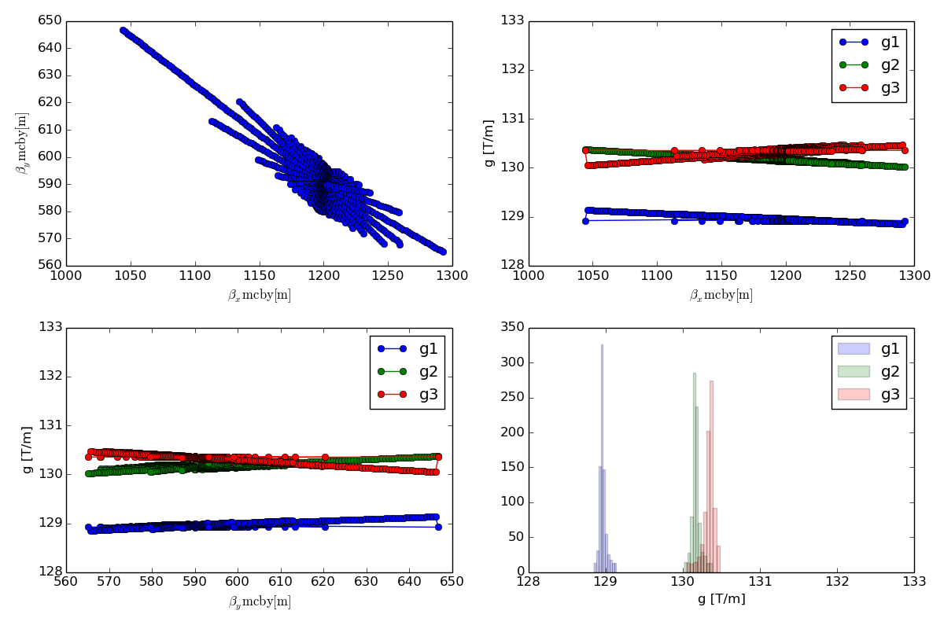
Tunability in Q4: L*=24m option

Slide 8
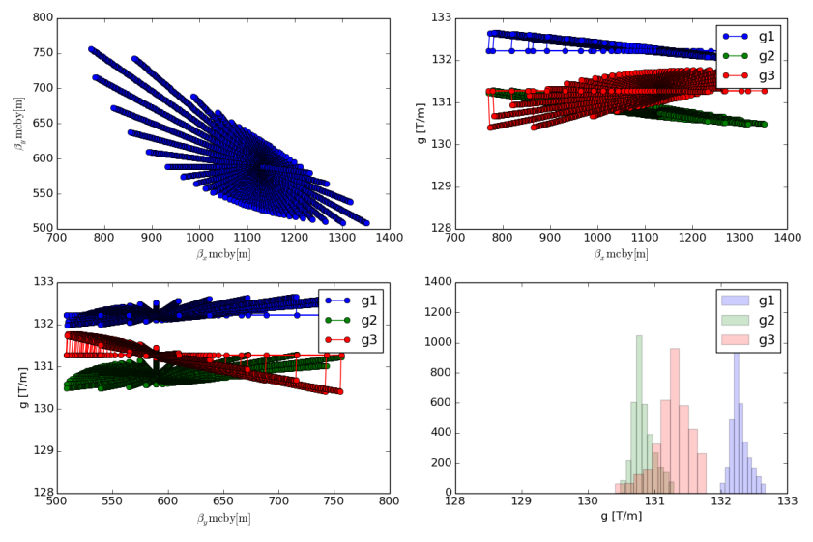
Tunability in Q4: L*=23m option

Slide 9
BPM specifications for orbit and optics
Aperture diameter [mm] | >98 (Q1) / >118 (others)
Precision in orbit mode | < 1.5 µm
Accuracy for finding collisions with 1% Luminosity | < 30 µm
Longitudinal alignment accuracy | 1 mm
Maximum linearity error after calibration in turn-by-turn mode | <0.5 %
Maximum non-reproducibility of the triplet and correctors transfer functions | <10⁻⁴
Bunch population range [p/bunch] | 10⁹ – 2.2×10¹¹
Optimum position w.r.t. parasitic encounters | Sensitivity to missing BPM | Suggested locations for optics measurements | Beta function (β­_{x,y},β­_{y,x})[km] (for impendence effects)
D1downstream (best position) | TAS-Q1a (highest sensitivity) | Q2a-Q2b (most critical) | TAS-Q1a (3.1, 3.1) (smallest beta, smallest effect)
Q1b-Q2a | Q1b-Q2a | Q3b-CP | Q1b-Q2a (4.6, 10)
CP-D1 | Q2a-Q2b | TAS-Q1a | Q2b-Q3a (13.5,13.5)
Q2a-Q2b | Q2b-Q3a | Q1b-Q2a | D1 downstream (16.6, 7.1)
TAS-Q1a | Q3b-CP | Q2b-Q3a | CP-D1 (18.8, 7.5)
Q3b-CP | CP-D1 | CP-D1 | Q2a-Q2b (20.4, 5.3)
Q2b-Q3a (worst position) | D1 downstream (lower sensitivity) | D1 downstream (least critical) | Q3b-CP (20.6, 7.9) (larger beta, largest effect)
See WP2 TL meetings on 23/5/2014 at
https://indico.cern.ch/event/315532/material/minutes/1.docx

