Slide 1
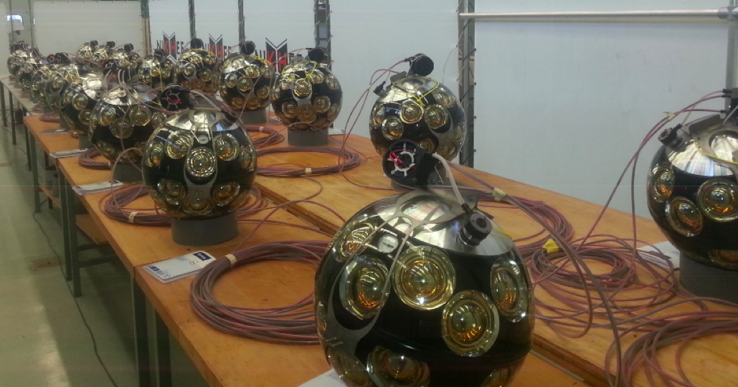


KM3NeT/ORCA Status and Plans
Dorothea Samtleben
Leiden University

Slide 2
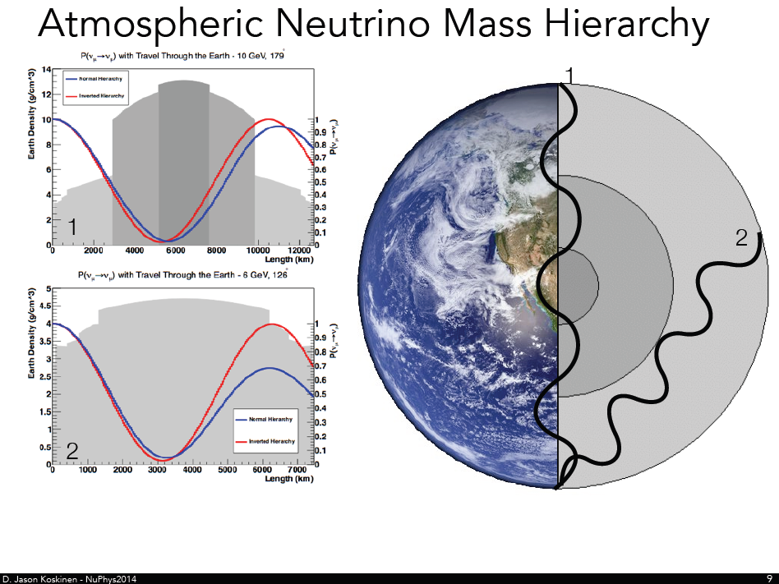
Matter Effects and Neutrino Mass Hierarchy (NMH)
Neutrinos change flavour on their way from the atmosphere to the detector (oscillations)
Due to matter effects (MSW) different mass orderings lead to different oscillation probabilities
Exact pattern depends on the mass hierarchy
Oscillation pattern for neutrinos in NH similar to oscillation pattern for anti-neutrinos in IH -> Ratio neutrinos/antineutrinos determines strength of signature

Slide 3
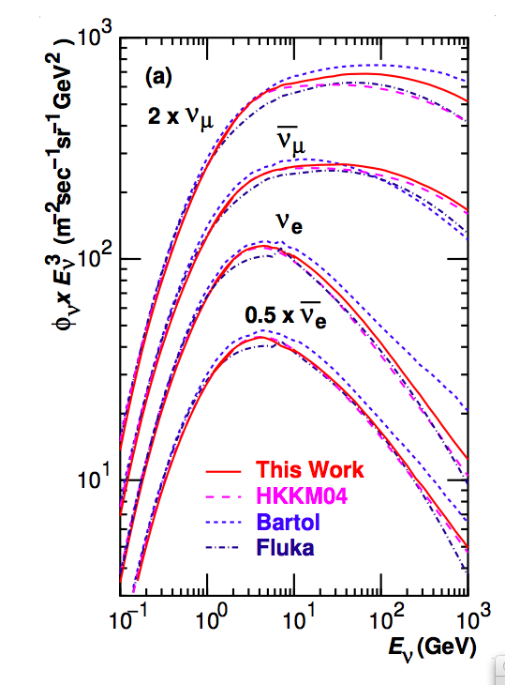
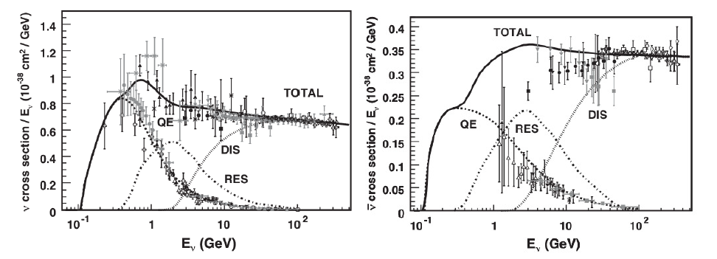
Atmospheric neutrino flux
+
Interaction cross sections
neutrinos
anti-neutrinos
Neutrino cross section ~2x higher than
for antineutrinos
Honda et al, Phys. Rev. D75, 043006 (2007)

Slide 4
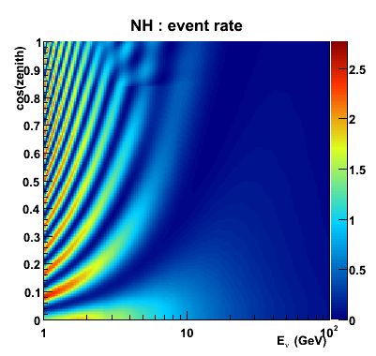
Ideal oscillation pattern for
νμ -> νμ
Interesting region at cos(θ) >0.5 and energies
3-10 GeV

Slide 5
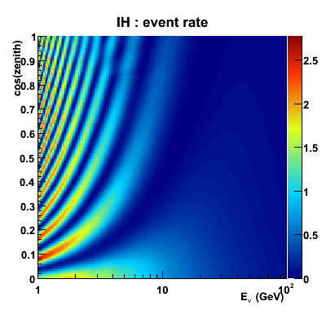
Ideal oscillation pattern for
νμ -> νμ
Interesting region at cos(θ) >0.5 and energies
3-10 GeV

Slide 6
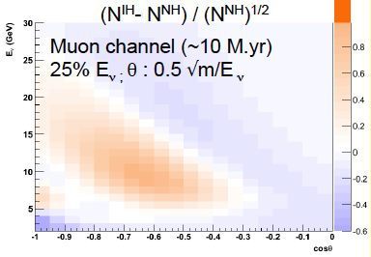
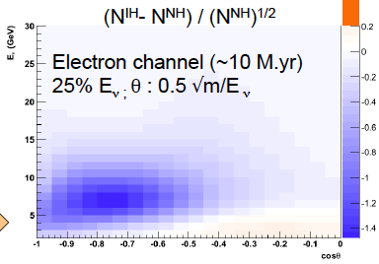
Reconstruction of neutrino events in the detector smears out the pattern
→ energy uncertainty
→ direction uncertainty
→ misidentification (not included in the figure)
Additionally the distinction will be impacted by background (misreconstructed muons), systematic uncertainties in the detector response, flux, cross section, oscillation parameters

Slide 7
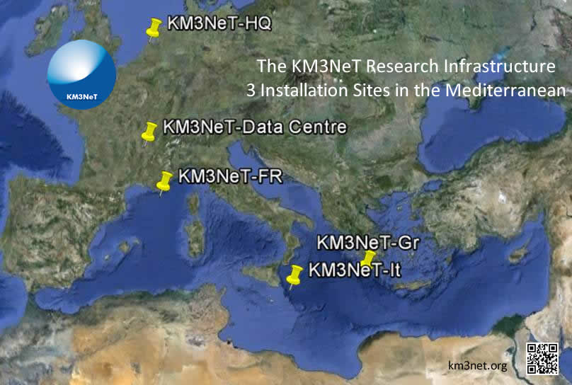
KM3NeT: Next generation Neutrino Telescope in the Mediterranean Sea
Distributed research infrastructure with 2 main physics topics:
Low-Energy studies of atmospheric neutrinos – High-Energy search for cosmic neutrinos
☞
Low-Energy
(ORCA)
( )
High-Energy
(ARCA)

Slide 8
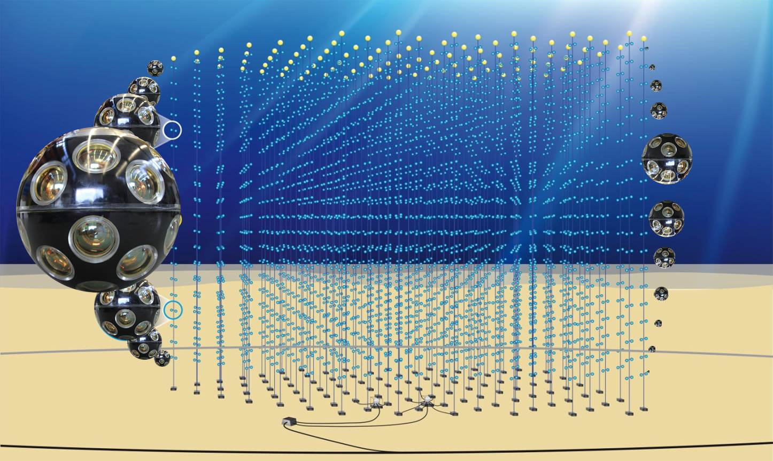
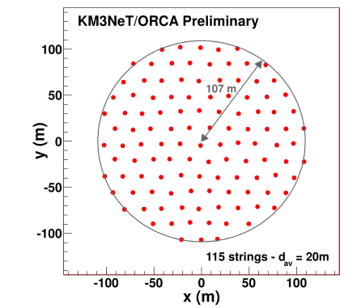
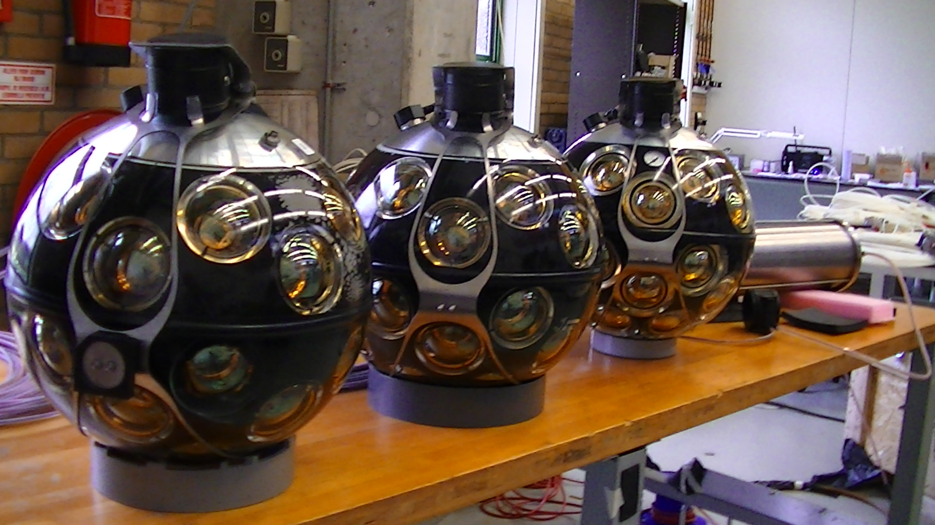
31 3” PMTs per Digital Optical Module (DOM)
more photocathode than
1 ANTARES storey
Digital photon counting
Directional information
Reference design:
115 lines, 20m spaced
18 DOMs/line 6m spaced
-> Instrumented volume ~3.8 Mt,
2070 DOMs
Optical background (⁴⁰K decay)
10kHz/PMT & 500Hz coincidence

Slide 9
Ingredients for NMH measurement
Efficient and high purity trigger algorithm
+ Exploit excellent photon counting of multi-PMT DOM
+ Use causality of direct photons
→ water almost scattering free for visible photons
Reconstruction of cascade and track topologies
  + High efficiency down to relevant energies
  + Good resolution in energy and zenith angle
Topology Identification (track ←→ cascades)
Atmospheric muon rejection (no hardware veto)
Inclusion of systematics
Simulations to evaluate the potential
Reconstructions evaluated in Monte Carlo simulations
based on GENIE and GEANT4, ‘Bartol’ flux
MUPAGE atmospheric muon generator Comp. Phys. Comm 179 (2008) 12:915
Optical background 5-10 kHz/PMT (8kHz measured), 500 Hz 2-fold coincidence rate
Sensitivity estimation using pseudo-experiments

Slide 10
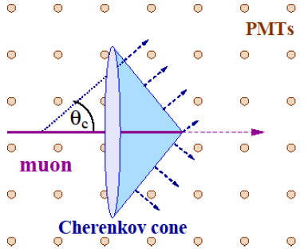
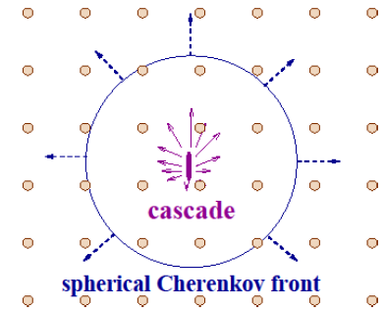
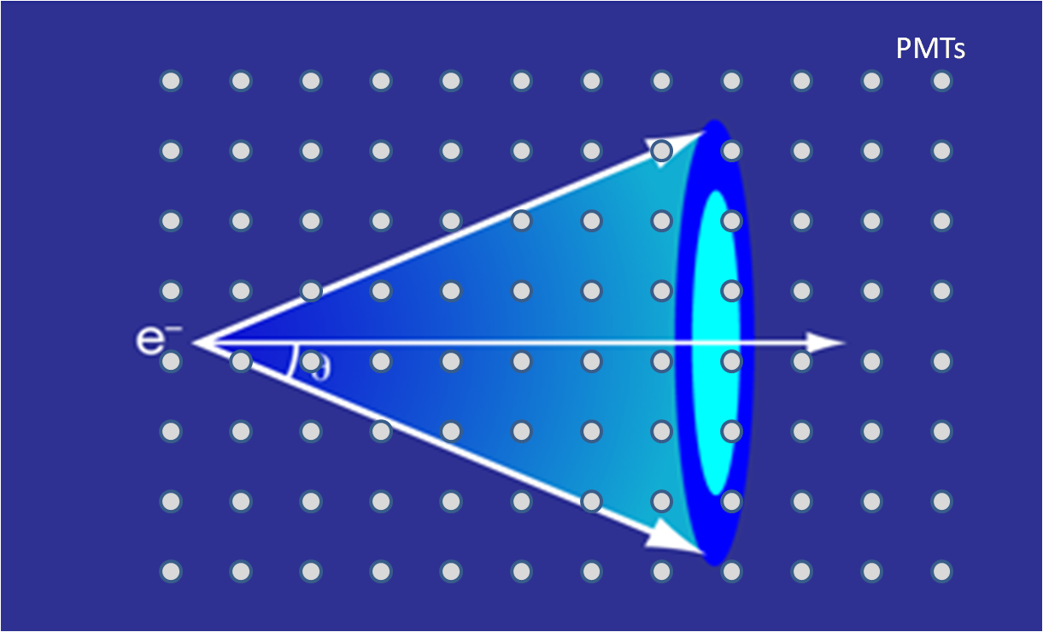
Reconstruction Methods
Different flavours and interactions lead to different signatures in the detector:
ν_{μ}^{CC}
ν_{e/τ}^{CC,}
ν_{X}^{NC}
Water preserves
Cherenkov cone
Energy loss ~0.2GeV/m -> 50m length for 10 GeV
Dedicated methods for tracks and cascades have been developed
8 parameters are determined:
Time, position (3), direction (2), energy, inelasticity
Step by step procedure
- Hit selection (time correlations)
  - Vertex & Directional fit (timing)
  - Energy & inelasticity fit (light yield & direction/vertex)

Slide 11
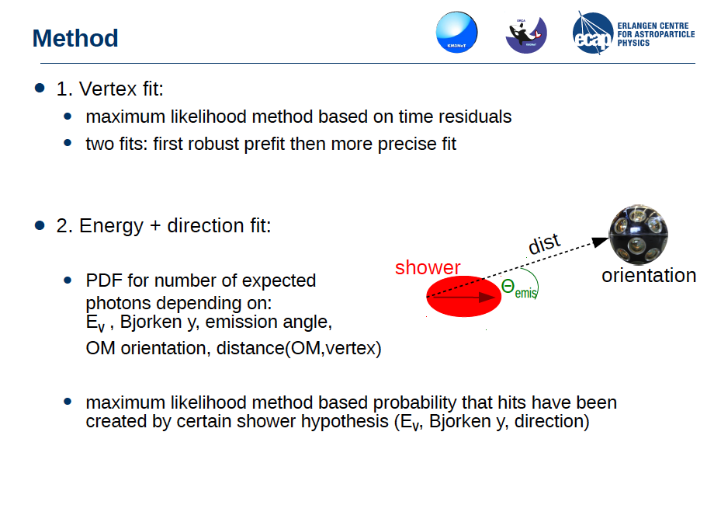
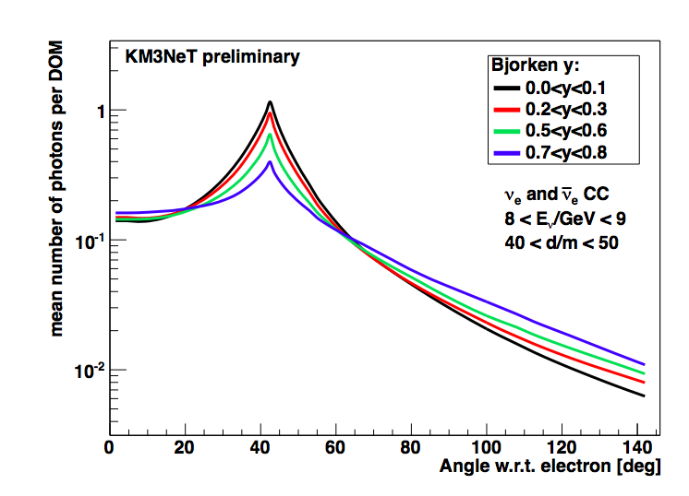
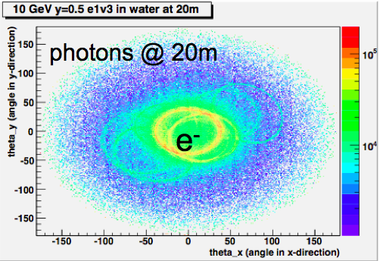
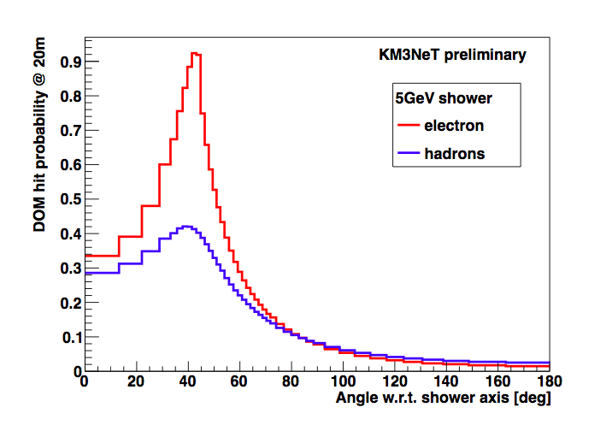
Cascade reconstruction
Vertex fit
Maximum likelihood method, based on time residuals
Stepwise improvement of fit (robust prefit, refinement), σ=0.5-1m
2) Energy and direction fit
PDF for #expected photons
(depends on energy, inelasticity, emission angle,
OM orientation, distance to vertex)
Maximum likelihood method based on
probability given a certain shower analysis
(energy, inelasticity, direction)
Simulated ν_{e}^{CC} event with E=10GeV, y=0.5

Slide 12
Cascade reconstruction performance
Energy reconstruction
Directional reconstruction
Directional uncertainty dominated by kinematics
Energy resolution better than 25%

Slide 13
Track reconstruction performance
Energy reconstruction
Maximum likelihood method, based on time residuals
linear prefit,
scan over sky (3deg grid)
with ‘M-estimator’, max likelihood fit
final max likelihood fit using best candidate
Energy estimation from both track length and associated hits
Directional reconstruction
Directional uncertainty dominated by kinematics
Energy resolution better than 25%

Slide 14
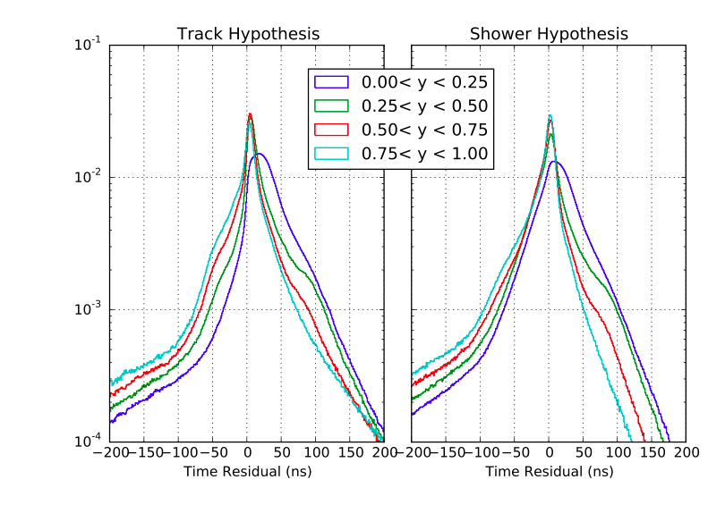
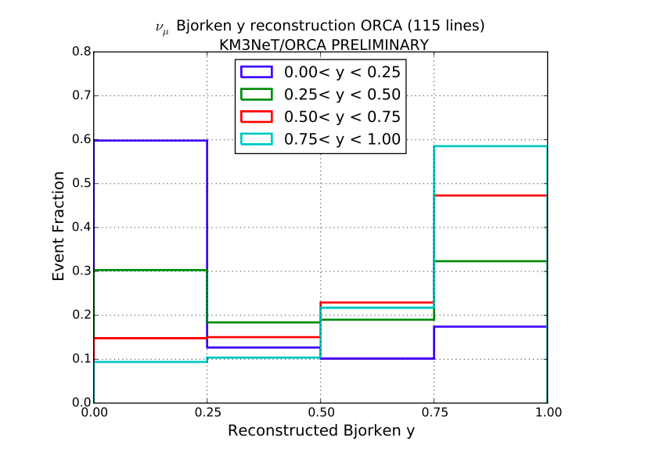
Inelasticity reconstruction for
track reconstruction
Differences in time residuals for
different inelasticities exploited
Inelasticity helps to
distinguish
neutrinos/antineutrinos
Not yet used n sensitivity evaluation, improvement
Expected

Slide 15
Effective Mass
Cascades/Tracks similar
>10 GeV reaching instrumented volume

Slide 16
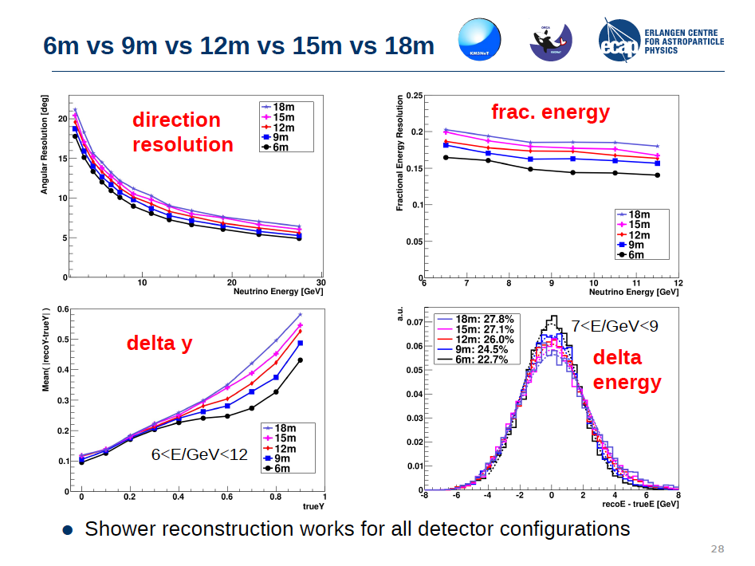
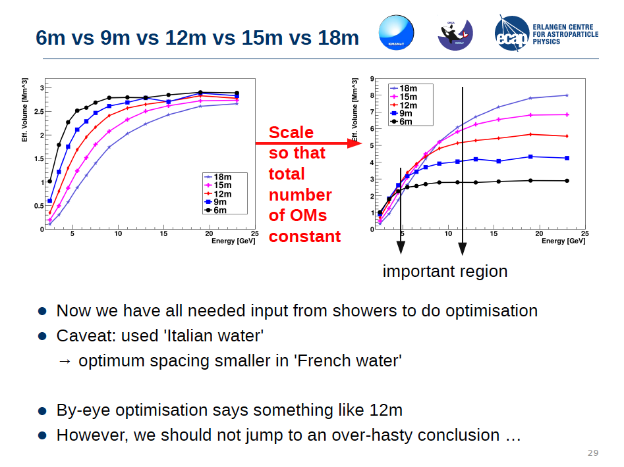
ORCA Layout Optimization
20m interline spacing imposed by line deployment (sea operations)
Vertical spacing open : 6,9,12,15m spacing inter-DOM shown
PRELIMINARY
Cascades
Resolution impacts also particle identification
-> combined assessment of all relevant
quantities required for evaluation
of optimal configuration

Slide 17
Flavour (mis)-identification
Discrimination of track-like ( ν_{μ}^{CC} ) and cascade-like ( ν^{NC}, ν_{e/τ}^{CC} ) events
Classification uses “Random Decision Forest”
Better than 80% above 10 GeV for all channels but ν_{μ}^{CC}
_
<- CC ν_{μ}
<- CC ν_{μ}
Difference due to different inelasticities
<- CC ν_{e}

Slide 18
Atmospheric muon rejection
Atmospheric μ
Vertex position
from track
reconstruction
Atmospheric
ν (E<20 GeV)
Simulation based on MUPAGE
( Astropart. Phys. 25 (2006) 1)
at depth 2475 m
Rejection criteria:
Reconstructed as upgoing
Track quality cut
Vertex within certain radius
BDT
Few % contamination
with little signal loss
upgoing quality vertex BDT

Slide 19
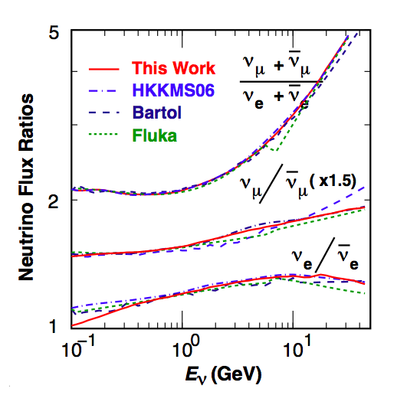
Systematic Effects
Various systematic effects taking into account
  Oscillation parameters
    Δm², θ_{12,} θ₁₃ fixed;
    ΔM², θ₂₃, δ_{CP} → fitted unconstrained
  Flux, cross section , detector related
  average fluctuation w.r.t. nominal
    Overall normalisation 2.0%
    ν/v ratio 4.0%
    e/μ ratio 1.2%
    NC scaling 11.0%
    Energy slope 0.5%
    →fitted unconstrained
Model differences
Honda et al, Phys. Rev. D75, 043006 (2007)

Slide 20
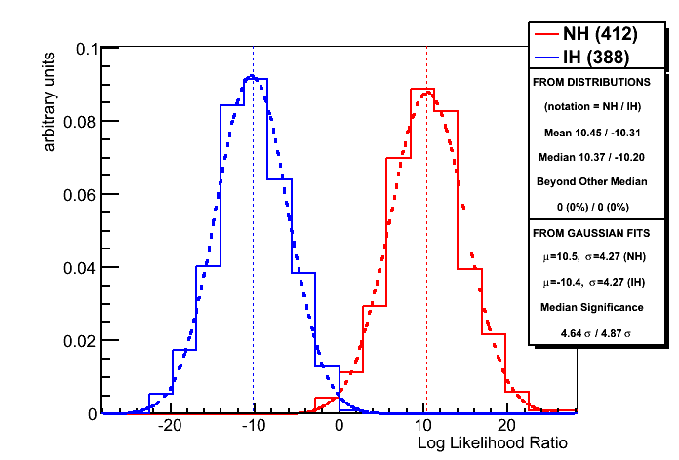
Sensitivity determination
Pseudo-experiments created using
• atmospheric neutrino flux (Honda for Frejus site)
• neutrino cross sections (GENIE based)
• 3-flavour earth matter oscillations
(checked against GLOBES)
• track vs shower event classification
• full MC detector efficiency / resolution response matrices including misidentified and NC events
• atmospheric muon contamination
To optimally distinguish between IH and NH:
likelihood ratio test with nuisance parameters
1) Fit parameters assuming NH
2) Fit parameters assuming IH
3) Compute ΔlogL = log( L(NH)/L(IH) )

Slide 21
Sensitivity to Neutrino Mass Hierarchy
Dependence of sensitivity on time for fixed θ₂₃ values
δ_{CP} fixed to zero for easy comparison with other experiments
Full simulated detector response matrices including identification
Atmospheric muon contamination
Various Systematic uncertainties
Notes:
Each type of events
(determined by neutrino flavour, interaction type and particle ID) now has
dedicated resolutions.

Slide 22
Sensitivity to Neutrino Mass Hierarchy
Dependency of sensitivity on θ₂₃ for 3 years
NH easier to determine than IH
Second octant easier than first octant
When fixing δ_{CP} to zero sensitivity increases by ~0.5σ
Full simulated detector response matrices including identification
Atmospheric muon contamination
Various Systematic uncertainties
Notes:
Each type of events
(determined by neutrino flavour, interaction type and particle ID) now has
dedicated resolutions.

Slide 23
Sensitivity to Neutrino Mass Hierarchy
Dependency of sensitivity on θ₂₃ and δ_{CP} for NH and 3 years
Best case : large θ₂₃ and δ_{CP} = 0º
Worst case : small θ₂₃ and δ_{CP} = 180º
Notes:
Each type of events
(determined by neutrino flavour, interaction type and particle ID) now has
dedicated resolutions.

Slide 24
Sensitivity to PMNS parameters
ΔM² – unconstrained fit in conjunction to mass hierarchy hypothesis testing
→ Significant improvement of precision achievable
PDG 2014
Notes:
The above figure shows the precision with which theta23 can be measured by
ORCA. Note that a 2 degree prior has been included, so this does not include a
determination of the octant.

Slide 25
Sensitivity to PMNS parameters
θ₂₃ – unconstrained fit in conjunction to mass hierarchy hypothesis testing
→ World best measurement after a few years of data taking
PDG 2014
Notes:
The above figure shows the precision with which theta23 can be measured by
ORCA. Note that a 2 degree prior has been included, so this does not include a
determination of the octant.

Slide 26
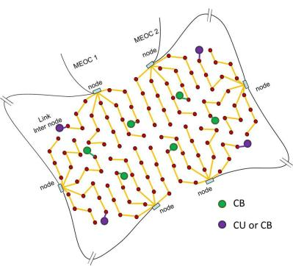
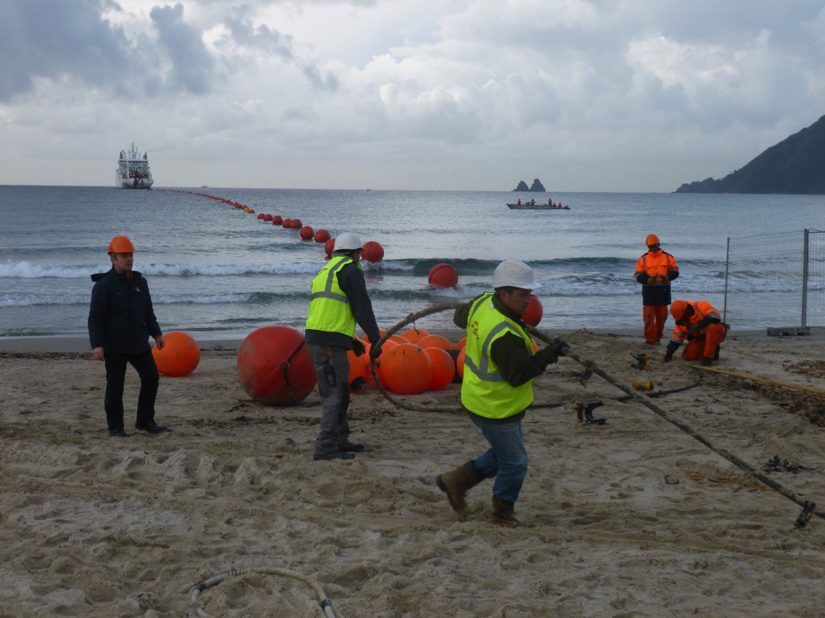
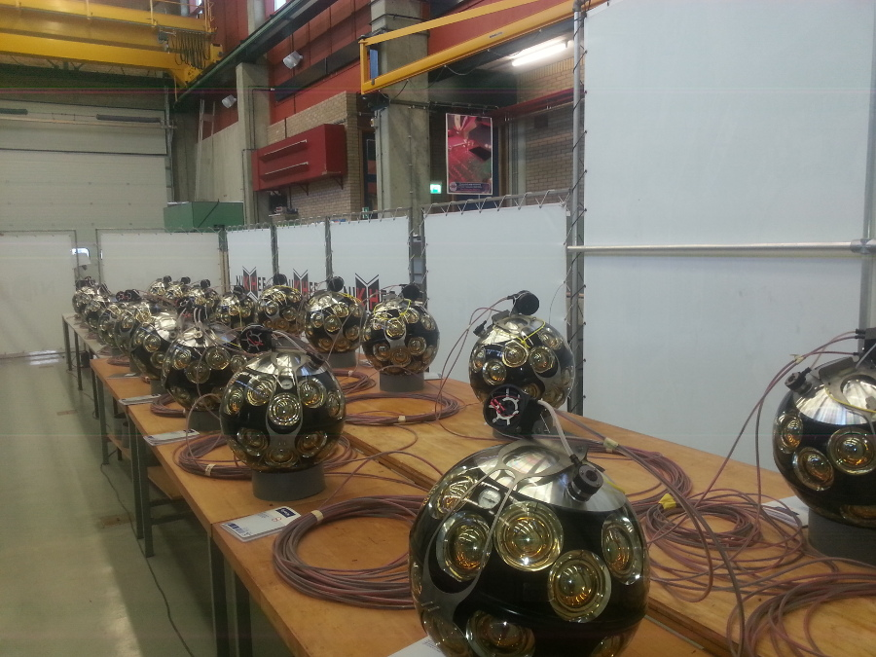
ORCA costs & timeline
Modular ring of up to 6 nodes with double connection
to shore for up to 120 detection units
+ Sea Science instruments
Possibility to redirect the ANTARES cable to ORCA
Phase 1 (funded and spent) :
Deploy a 6-7 string array in the ORCA configuration to demonstrate detection method in the GeV range.
Phase 2 (~40 M€ wo contingency) :
2017 deploy 1 building block 115 strings in French KM3NeT site.
Completion by 2020
Requested funds

Slide 27
Summary
Mass hierarchy measurement will be pursued using a KM3NeT building block of 115 densely instrumented strings: KM3NeT/ORCA
Excellent optical water properties and multi-PMT design allow for powerful event reconstruction, topology identification and background rejection
Systematics incorporated in sensitivity estimates
Sensitivity within 3 years ranges from 2.5-6 σ depending on octant and hierarchy scheme
High precision measurements of θ_{23,} ΔM² achievable
First 6 strings to be deployed 2016, completion aimed for 2020

