Slide 1
USBpix Test System
Overview of Upgrade Options

Slide 2
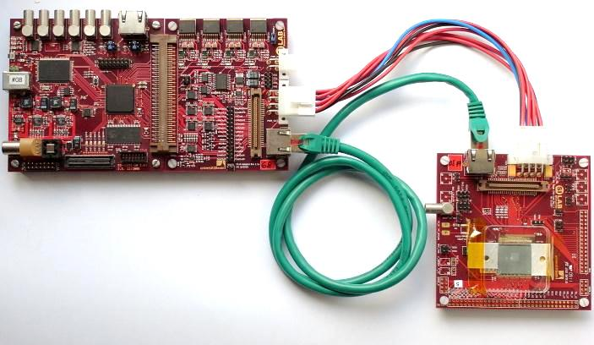
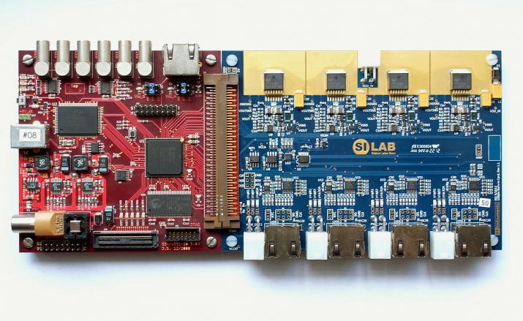
USBpix Hardware (old system)
FE-I4 Single Chip
  More than 100 systems produced
  and distributed
IBL Module Burn-In Card
  Single / double chip IBL module
  Quad FE-I4 module
MultiIO Board
FE-I4 Adapter
Single Chip Card
MultiIO Board
Burn-In Card
  http://icwiki.physik.uni-bonn.de/twiki/bin/view/Systems/UsbPix

Slide 3
USBpix Upgrade for FE-I4
Previous USBpix system
  USB 2.0
  ~15MByte/s transfer
  Spartan 3 FPGA
New USBpix system
  USB 3.0
  >200 Mbyte/s
  Kintex 7 FPGA
MultiIO
Board
FE-I4 Adpt.
or
Burn-In Card
FE-I4 SCC
IBL s/d mod.
Quad mod.
USB
Dig. IO
Analog & Dig. IO
NEW
compatible
Multi-IO
Board 3.0
FE-I4 Adpt.
or
Burn-In Card
FE-I4 SCC
IBL s/d mod.
Quad mod.
USB
Dig. IO
Analog & Dig. IO

Slide 4
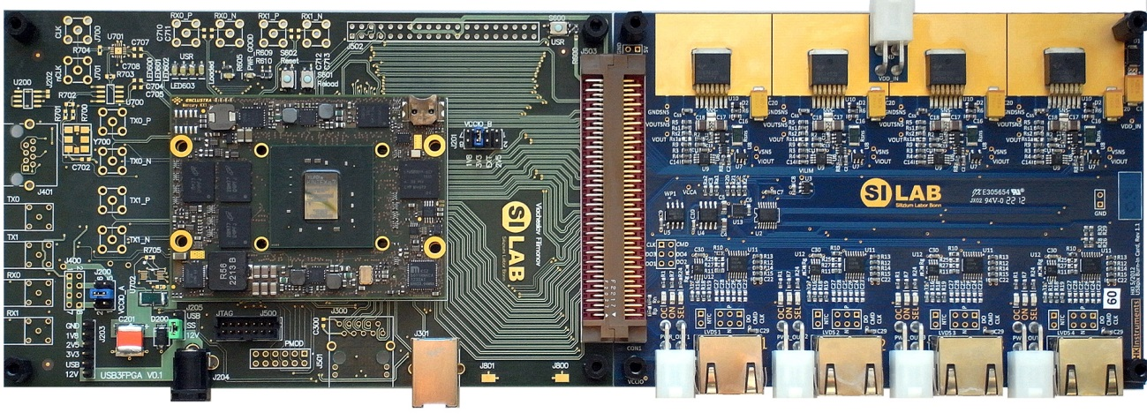
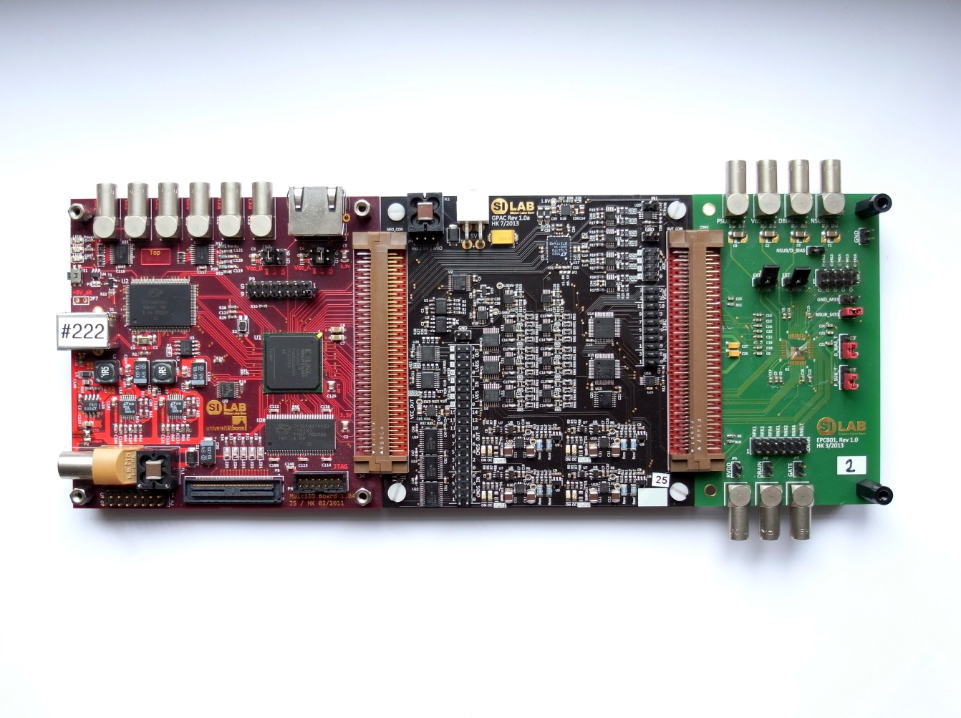
USBpix Hardware (new system)
Upgrade of the Multi-IO board ➔ MIO3
  Compatible with
  FE-I4 adapter card
  Burn-In card
  GPA card
FE-I4 Adapter
Card
Burn-In Card
Multi-IO Board 3.0 (MIO3)
General purpose analog card

Slide 5
USBpix Upgrade Options for FE-I4
New Multi-IO Board (MIO3) + existing Burn-In or Adapter cards
Alternative: MIO3 board variant (MMC3) including the Burn-In card functionality
MultiIO
Board 3.0
FE-I4 Adpt.
or
Burn-In Card
FE-I4 SCC
IBL s/d mod.
Quad mod.
USB
Dig. IO
Analog & Dig. IO
single
or multi chip modules
single
or multi chip modules
MMC 3
Board
single
or multi chip modules
single
or multi chip modules
USB
Power & Dig. IO

Slide 6
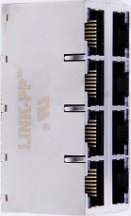
Alternative USBpix3 Hardware for Multi-chip Modules/Staves
MIO3 card with integrated multi chip support ➔ MMC3
  Compatible with Ethernet cable based FE-I4 setups
  Up to 16 (or more) FE-I4 chips: single chip cards, single/double chip IBL modules, quad modules
  Not compatible with GPAC, Burn-In card, or old FE-I4 Adapter Card
Four switched power lines
with current sensing
Eight RJ-45 connectors
Multi-chip Module Card (MMC3) based on Multi-IO Board 3.0

Slide 7
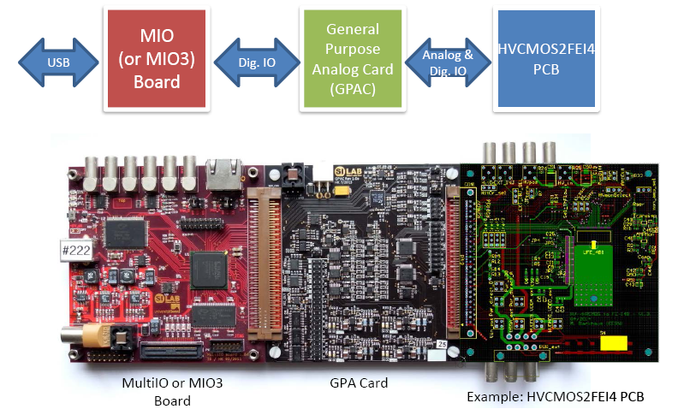
USBpix for CPIX – Hardware Structure
Combined hardware interface for FE-I4 and CMOS active pixel sensor
  Power supplies (from GPAC or external) + analog support for CMOS active pixel sensor (CCPD and others)
  Digital interface in single FPGA (FE-I4 + CPIX serial interface)
→ Mandatory for combined operation of active sensor and FE-I4
(convoluted scan/calibration routines)
Two common control software packages (STcontrol and pyCPIX)
Cable adapter boards between GPAC and DUT carrier available

Slide 8
General Purpose Analog Card
Features analog interface
  4 power channels
  12 current sources
  4 voltage sources
  LVCMOS & LVDS level translators
  Injection pulse generator
  Fast four channel ADC
Power Supply
4 Channels
Current Sources
12 Channels
I²C
Voltage Sources
4 Channels
MultIO Board
Injection Pulse Generator
DUT
LVCMOS LS
16 out / 8 in
FPGA
LVDS
4 out / 4 in
Fast 14 Bit ADC
4 Channels
https://silab-redmine.physik.uni-bonn.de/documents/6

Slide 9
USBpix for CPIX – Software
C++
Python
STcontrol
pyCPIX
pyBar
USBpixdll
Basil

Slide 10
Test System Configuration
CMOS Active Pixel Demonstrator test system
  Re-use the old Multi-IO Board MIO (existing users) or buy new MIO3 board
  Either MIO or MIO3 (with adapter) connect to GPAC
Quad FE-I4 module & multi module stave test system
  Re-use the old Multi-IO Board MIO (existing users) or buy new MIO3 board with BIC (four data channels)
  Alternative: MMC3 (up to 16 data channels, combines MIO3 and BIC functionality for FE-I4 multi-modules)
We cannot distribute the old MIO any longer
New users should get their MIO3 or MMC3 boards

Slide 11
HW Status & Component Availability
GPAC: few cards on stock → new production (30 pcs.)
MIO3: prototype tested → production (20 pcs.)
MMC3: prototype designed → waiting for PCB & test → production (50 pcs.)
GPAC (850€), MIO3, and MMC3 (price tbd.) will be distributed by Bonn via CERN TID or invoice (contact Fabian)
New boards available ~Feb/Mar 2015
Only very few BIC left
No more Adapter cards
No more MIO boards

Slide 12
Glossary
USBpix | Test system for FE-Ix, based on three HW modules: Digital card(MultiIO card) Support card with level shifter and power supplies (FEI4-Adapter or Burn-In Card) FE-I4 support card (Single Chip Card, IBL single/double Module, Quad Module)
MIO | MultiIO Board: Digital card with USB 2.0 interface and Spartan 3 FPGA (interface to DUT, TLU, and external IO signals). Connects to FE I4 Adapter Card Burn-In Card (Quad FE-I4 module) General Purpose Analog Card (GPAC)
FE-I4 Adapter Card | Connects to MultiIO Board and adds FE-I4 specific analog functions (power supplies, monitoring ADC, level shifter etc.)
GPAC | General Purpose Analog Card: Connects to MultiIO Board and adds analog functions (power supplies, voltage& current sources, fast ADC, level shifter etc.)
BIC | Burn-In Card, support of up to four FE-I4 chips (IBL single/double + quad modules)
MIO3 | Upgrade of the MultiIO board (quad module r/o) USB 3.0 interface Larger FPGA & memory resources Compatible to all USBpix adapter cards (FE-Adapter, Burn-In, GPA Card)
MMC3 | Combines the functionality of the MIO USB 3.0 upgrade and the Burn-In card with support of up to four quad modules USB 3.0 interface Larger FPGA & memory resources Support of up to four quad modules Not compatible to USBpix adapter cards (FE-Adapter, Burn-In, GPA Card)

Slide 13
Backup Slides

Slide 14
Test System for Active Pixel Sensor Developments
More analog functionality for new CMOS Active Pixels Sensor test chips needed: power rails, bias generators, level shifters
➔ General Purpose Analog Card
Compatible to digital interface card (MIO and MIO3)
MultiIO
Board
General Purpose Analog Card
(GPAC)
CMOS APS
(DMAPS, HVCMOS,
etc.)
USB
Dig. IO
Analog & Dig. IO
MultiIO Board
GPA Card
DUT Carrier PCB

Slide 15
General Purpose Analog Card
Features
  4 power channels
  12 current sources
  4 voltage sources
  LVCMOS & LVDS level translators
  Injection pulse generator
  Fast four channel ADC
Power Supply
4 Channels
Current Sources
12 Channels
I²C
Voltage Sources
4 Channels
MultIO Board
Injection Pulse Generator
DUT
LVCMOS LS
16 out / 8 in
FPGA
LVDS
4 out / 4 in
Fast 14 Bit ADC
4 Channels
https://silab-redmine.physik.uni-bonn.de/documents/6

