Slide 1
CaRIBOu Hardware Design and Status
Hucheng Chen, Hongbin Liu
Brookhaven National Laboratory
03/31/2015

Slide 2
Motivation
Develop a modular readout system for HVCMOS sensor
  Easily adapted to sensors under development
  Module design tailored to the specific readout chip (e.g. FEI4)
  Carefully defined interface to make the effort of design revision minimum
  Zynq FPGA with embedded ARM processor to simplify the firmware and software development
  Versatile interface to DAQ PC (e.g. GbE, PCIe)
Open architecture welcomes contribution from collaboration
  New module development is possible
  Interface to official ATLAS TDAQ system (e.g. FELIX) is possible
  Make better use of different expertise (e.g. hardware, firmware, software)

Slide 3
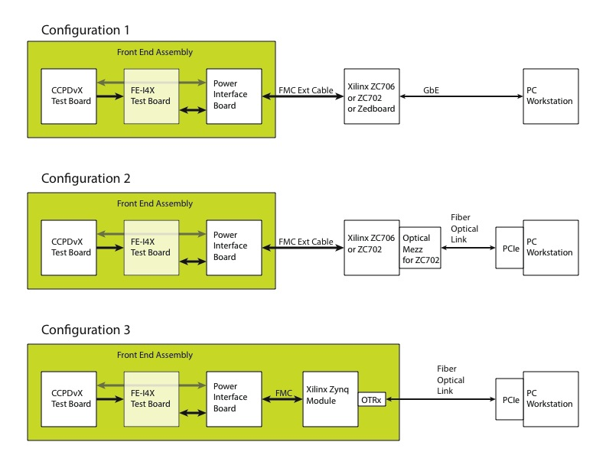
Possible Configurations
Start development from configuration 1

Slide 4
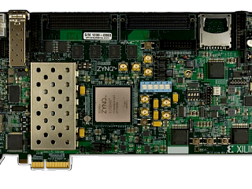
System Overview
PCIE MINI
PCIE MINI
Board 3: CCPD Board
RJ45
CCPD Board
RJ45
CCPD Board
CCPD
CCPD
FEI4
FEI4
Board 2: FEI4 Board
SEAF160
SEAF160
Board 1: CaR (Control and Readout) Board
5 Boards Will be Designed
CaR Board
Powers Rails, LVDS Receiver/ Transmitter, Level Translators, DAC;
FEI4 Board
HV Input, Bonding Pads for FEI4, Circuits for FEI4 and CCPD
CCPD Board
Only include Bonding pads, capacitors and resistors for CCPD
VHDCI Adapter Board X 2
FMC LPC (Male) to VHDCI
VHDCI to FMC LPC (Female)
FMC HPC
FMC LPC
DAQ Board

Slide 5
System Block Diagram
CaR Board
#1
FEI4 Board #1
CCPD Board
#1
DAQ Board
FMC/VHDCI
Adapter
Card
VHDCI Cable
VHDCI/FMC
Adapter
Card
FEI4 Board #2
CCPD Board
#2
CaR Board
#2
FEI4 Board #3
CCPD Board
#3
FMC/VHDCI
Adapter
Card
VHDCI/FMC
Adapter
Card
VHDCI Cable
FEI4 Board #4
CCPD Board
#4
One DAQ board can test up to 4 CCPDs at the same time;
All signals go through VHDCI cable are differential;
Can be tested without adapter card, with one CaR Board can plug into the DAQ board directly
Compatible DAQ boards
ZC706, ZC702, ZedBoard;
Any FPGA board with a FMC connector which is compatible with VITA 57.1 standard can be used as DAQ board

Slide 6
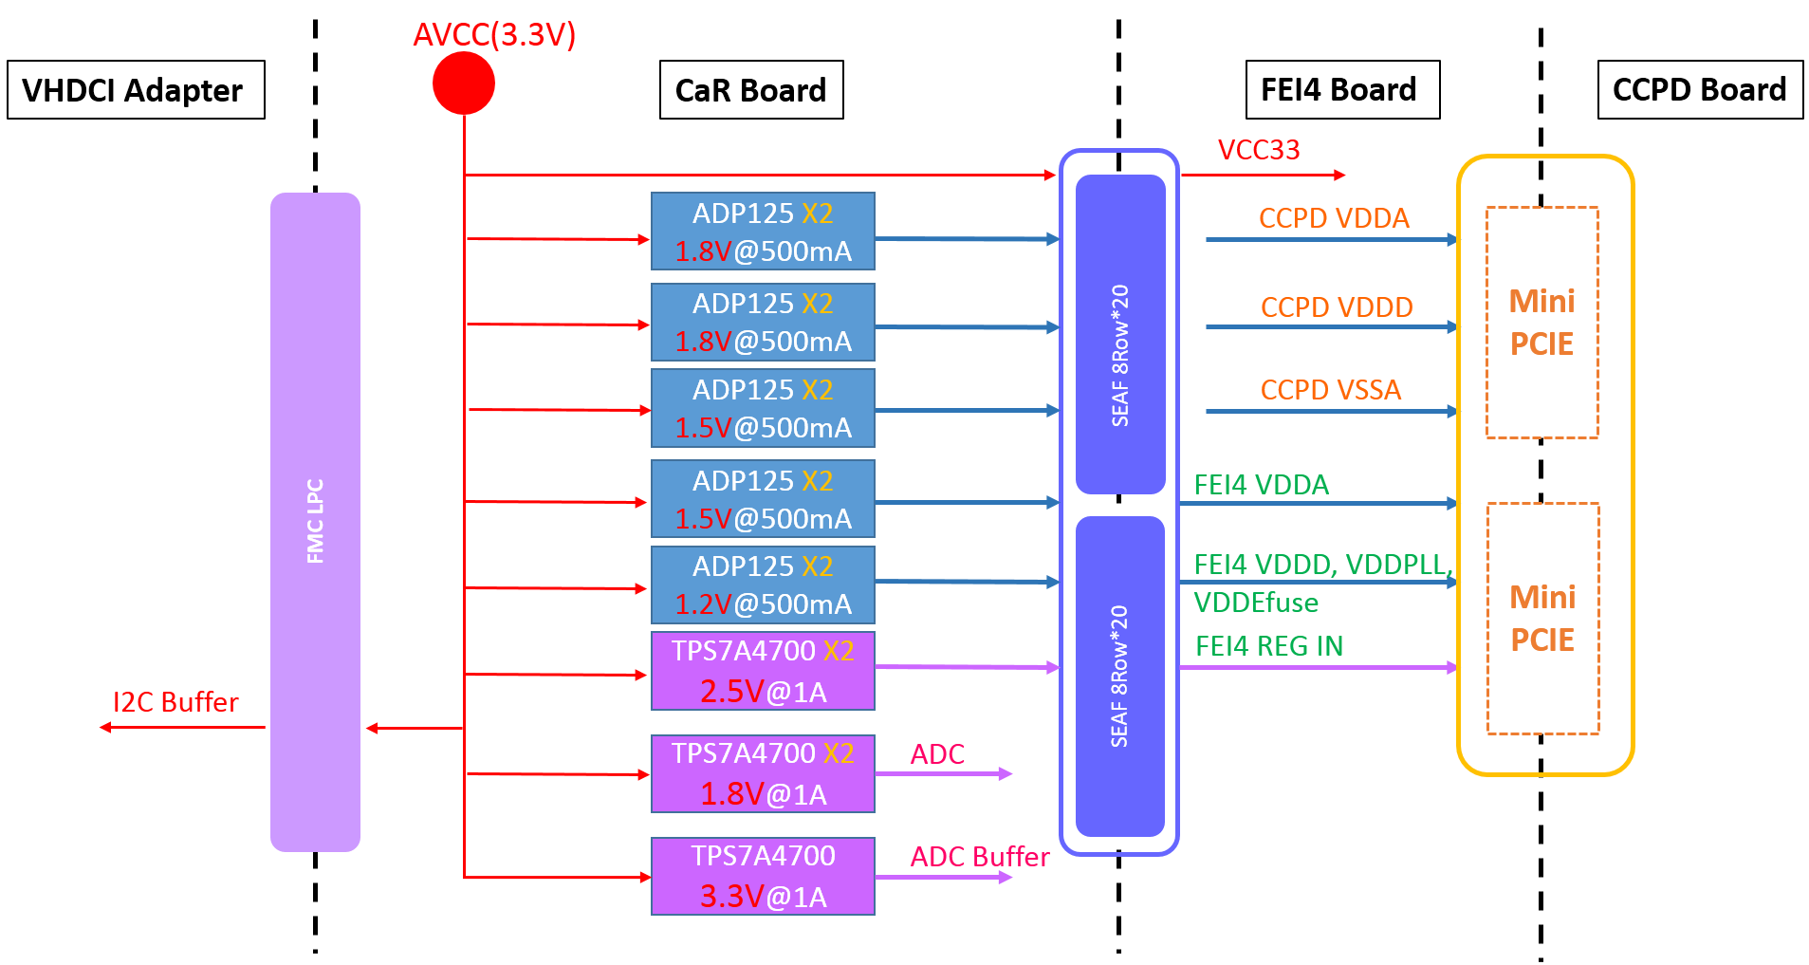
System Power Distribution
15 LDO implemented
10 ADP125 for CCPD&FEI4, with current monitoring and control
2 TPS7A4700 for the internal regulators of two FEI4, digital and analog regulator share the same power rail. This two rails can be monitoring as well.

Slide 7
CaR Board
Power Modules
12 Power Rails for FEI4 Board
1.TPS74A470*2, 1A Max, For FEI4 REG IN;
2.ADP125*10, 500mA Max, For FEI4 and CCPD;
3. Current of 12 power rails are monitored by I2C low speed ADC;
4. All 12 channels can be en/disable through I2C;
5. Designed for two FEI4 board, each have 6 power rails.( 1 for FEI4 REG, 2 for FEI4 separate, 3 for CCPD)
PWR SWITCH
AVCC
IIC EXPANDER
I2C
I2C BUS REPEATER
DAC*4
Voltage Refs
I2C
I2C BUS
X10
MON
EN
INJ CTR
X2
CTR
X12
X12
X10
SEAF 8Row*20
Power Modules X 12
Power Rails
LDO
I2C
ADC
X12
FMC LPC
Injection
Control
Injection
X2
X2
LVDS
LVDS
X2
X6
LVDS
LVDS Receiver
CMOS33
Level Translator
LVCMOS18
X10
X8
X8
SEAF 8Row*20
LVDS
LVDS Transmitter
CMOS33
LVCMOS18
X6
X6
X4
LVCMOS12
LVDS
X2
X8
Analog Input
ADC
ADC Buffer
X6
I2C SPI
Converter
SPI

Slide 8
CaR Board
Power Modules
12 Power Rails for FEI4 Board
1.TPS74A470*2, 1A Max, For FEI4 REG IN;
2.ADP125*10, 500mA Max, For FEI4 and CCPD;
3. Current of 12 power rails are monitored by I2C low speed ADC;
4. All 12 channels can be en/disable through I2C;
5. Designed for two FEI4 board, each have 6 power rails.( 1 for FEI4 REG, 2 for FEI4 separate, 3 for CCPD)
Level Translators
SN65LVDS386 as receiver;
SN65LVDS389 as transmitter;
TXB0304 used for CMOS33 to LVCMOS translator;
PWR SWITCH
AVCC
IIC EXPANDER
I2C
I2C BUS REPEATER
DAC*4
Voltage Refs
I2C
I2C BUS
X10
MON
EN
INJ CTR
X2
CTR
X12
X12
X10
SEAF 8Row*20
Power Modules X 12
Power Rails
LDO
I2C
ADC
X12
FMC LPC
CMOS33
Injection
Control
Injection
X2
X2
LVDS
LVDS
X2
X6
LVDS
LVDS Receiver
CMOS33
Level Translator
LVCMOS18
X10
X8
X8
SEAF 8Row*20
LVDS
LVDS Transmitter
CMOS33
LVCMOS18
X6
X6
X4
LVCMOS12
LVDS
X2
X8
Analog Input
ADC
ADC Buffer
X6
I2C SPI
Converter
SPI

Slide 9
CaR Board
Power Modules
12 Power Rails for FEI4 Board
1.TPS74A470*2, 1A Max, For FEI4 REG IN;
2.ADP125*10, 500mA Max, For FEI4 and CCPD;
3. Current of 12 power rails are monitored by I2C low speed ADC;
4. All 12 channels can be en/disable through I2C;
5. Designed for two FEI4 board, each have 6 power rails.( 1 for FEI4 REG, 2 for FEI4 separate, 3 for CCPD)
Level Translators
SN65LVDS386 as receiver;
SN65LVDS389 as transmitter;
TXB0304 used for CMOS33 to LVCMOS translator;
Voltage reference generator
Four 12Bit/8-channels DACs on board;
Output voltage up to 2.5V;
10 output channels are routed to FEI4 board;
PWR SWITCH
AVCC
IIC EXPANDER
I2C
I2C BUS REPEATER
DAC*4
Voltage Refs
I2C
I2C BUS
X10
MON
EN
INJ CTR
X2
CTR
X12
X12
X10
SEAF 8Row*20
Power Modules X 12
Power Rails
LDO
I2C
ADC
X12
FMC LPC
CMOS33
Injection
Control
Injection
X2
X2
LVDS
LVDS
X2
X6
LVDS
LVDS Receiver
CMOS33
Level Translator
LVCMOS18
X10
X8
X8
SEAF 8Row*20
LVDS
LVDS Transmitter
CMOS33
LVCMOS18
X6
X6
X4
LVCMOS12
LVDS
X2
X8
Analog Input
ADC
ADC Buffer
X6
I2C SPI
Converter
SPI

Slide 10
CaR Board
Power Modules
12 Power Rails for FEI4 Board
1.TPS74A470*2, 1A Max, For FEI4 REG IN;
2.ADP125*10, 500mA Max, For FEI4 and CCPD;
3. Current of 12 power rails are monitored by I2C low speed ADC;
4. All 12 channels can be en/disable through I2C;
5. Designed for two FEI4 board, each have 6 power rails.( 1 for FEI4 REG, 2 for FEI4 separate, 3 for CCPD)
Level Translators
SN65LVDS386 as receiver;
SN65LVDS389 as transmitter;
TXB0304 used for CMOS33 to LVCMOS translator;
Voltage reference generator
4 8-channels DAC on board;
Output voltage up to 2.5V;
10 output channels are routed to FEI4 board;
ADC for analog monitor signals
ADS5292 8CH/80MHz(Max)/12Bit/LVDS
THS4522 as ADC buffer
PWR SWITCH
AVCC
IIC EXPANDER
I2C
I2C BUS REPEATER
DAC*4
Voltage Refs
I2C
I2C BUS
X10
MON
EN
INJ CTR
X2
CTR
X12
X12
X10
SEAF 8Row*20
Power Modules X 12
Power Rails
LDO
I2C
ADC
X12
FMC LPC
CMOS33
Injection
Control
Injection
X2
X2
LVDS
LVDS
X2
X6
LVDS
LVDS Receiver
CMOS33
Level Translator
LVCMOS18
X10
X8
X8
SEAF 8Row*20
LVDS
LVDS Transmitter
CMOS33
LVCMOS18
X6
X6
X4
LVCMOS12
LVDS
X2
X8
Analog Input
ADC
ADC Buffer
X6
I2C SPI
Converter
SPI

Slide 11
CaR Board
Level Translators
SN65LVDS386 as receiver;
SN65LVDS389 as transmitter;
TXB0304 used for CMOS33 to LVCMOS translator;
Voltage reference generator
4 8-channels DAC on board;
Output voltage up to 2.5V;
10 output channels are routed to FEI4 board;
ADC for analog monitor signals
ADS5292 8CH/80MHz(Max)/12Bit/LVDS
THS4522 as ADC buffer
Injection Module
Voltage level is controlled by DAC;
Falling edge to GND is issued by an analog switch controlled by FPGA;
PWR SWITCH
AVCC
IIC EXPANDER
I2C
I2C BUS REPEATER
DAC*4
Voltage Refs
I2C
I2C BUS
X16
MON
EN
INJ CTR
X2
CTR
X12
X12
X10
SEAF 8Row*20
Power Modules X 12
Power Rails
LDO
I2C
ADC
X12
FMC LPC
CMOS33
Injection
Control
Injection
X2
X2
LVDS
LVDS
X2
X6
LVDS
LVDS Receiver
CMOS33
Level Translator
LVCMOS18
X10
X8
X8
SEAF 8Row*20
LVDS
LVDS Transmitter
CMOS33
LVCMOS18
X6
X6
X4
LVCMOS12
LVDS
X2
X8
Analog Input
ADC
ADC Buffer
X6
I2C SPI
Converter
SPI

Slide 12
FEI4 Board
FEI4 Board
HV
HV
X2
High Voltage Input
SMA connectors in
2 HV inputs in order to be compatible with H18V4
3 Analog output channels
Intended for Mon, AmpOut;
H35V1 has three monitor output Mon(0..2), channel numbers are adequate as well.
8 Voltage Reference up to 2.5V
Compatible with H18V4
RJ45 is added for standalone readout;
Mini PCIE
Injection
Power Rails
X3
LVCMOS18
Voltage Refs
X4
X8
Analog Out
SEAF 8Row*20
X3
Power Rails
FEI4
X3
LVDS
LVDS
X1
X3
LVCMOS12
HitOr
RJ45
Ext Trigger
SMP

Slide 13
FEI4 Board
FEI4 Board
HV
HV
X2
High Voltage Input
SMA connectors in
2 HV inputs in order to be compatible with H18V4
3 Analog output channels
Intended for Mon, AmpOut;
H35V1 has three monitor output Mon(0..2), channel numbers are adequate as well.
8 Voltage Reference up to 2.5V
Compatible with H18V4
RJ45 is added for standalone readout;
Mini PCIE
Injection
Power Rails
X3
LVCMOS18
Voltage Refs
X4
X8
Analog Out
SEAF 8Row*20
X3
Power Rails
FEI4
X3
LVDS
LVDS
X1
X3
LVCMOS12
HitOr
RJ45
Ext Trigger
SMP

Slide 14
FEI4 Board
FEI4 Board
SMA
HV
X2
High Voltage Input
SMA connectors in
2 HV inputs in order to be compatible with H18V4
3 Analog output channels
Intended for Mon, AmpOut;
H35V1 has three monitor output Mon(0..2), channel numbers are adequate as well.
8 Voltage Reference up to 2.5V
Compatible with H18V4
RJ45 is added for standalone readout;
Mini PCIE
Injection
Power Rails
X3
LVCMOS18
Voltage Refs
X4
X8
Analog Out
SEAF 8Row*20
X3
Power Rails
FEI4
X3
LVDS
LVDS
X1
X3
LVCMOS12
HitOr
Ext Trigger
RJ45
SMP

Slide 15
FEI4 Board
FEI4 Board
SMA
HV
X2
High Voltage Input
SMA connectors in
2 HV inputs in order to be compatible with H18V4
3 Analog output channels
Intended for Mon, AmpOut;
H35V1 has three monitor output Mon(0..2), channel numbers are adequate as well.
8 Voltage Reference up to 2.5V
Compatible with H18V4
RJ45 is added for standalone readout;
Mini PCIE
Injection
Power Rails
X3
LVCMOS18
Voltage Refs
X4
X8
Analog Out
SEAF 8Row*20
X3
Power Rails
FEI4
X3
LVDS
LVDS
X1
X3
LVCMOS12
HitOr
Ext Trigger
RJ45
SMP

Slide 16
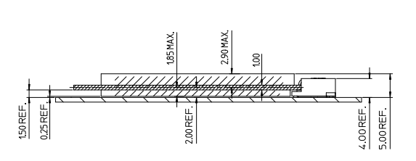
CCPD Board
Mini PCIE Goldfinger
No active component on this board
Only some capacitors and resistors will be placed;
Ease the replacement of board;
Mechanical specs will be defined soon
Should be 1mm thick;
Bonding height for CCPD will be 750um
2mm – 0.5mm(Half of the thickness of CCPD board) – 750um(FEI4)
Bonding Pads
for
CCPD
CCPD
CCPD Board
PCIE Mini Socket
FEI4 Board
FEI4
Cut out for bonding
Bonding wires for CCPD

Slide 17
VHDCI Adapter Cards
LVDS
LVDS
X32
VHDCI Extension Cable
X32
FMC LPC
VHDCI
VHDCI
FMC LPC
CMOS
Diff
Diff
I2C
Buffer
I2C Buffer
CMOS
X2
X2
X2
X2
Adapter Card #1
Adapter Card #2
Two adapter cards will be designed
Adapter Card #1 : FMC LPC(Male) to VHDCI
Adapter Card #2 : VHDCI to FMC LPC (Female)
I2C differentiation implemented on these boards;
I2C Buffer PCA9615 will be placed on both boards;
The differential I2C buffer is a black box for DAQ and CaR Board;

Slide 18
Firmware Requirements
Power Monitor and control;
Power Monitor: I2C read out of INA112
Power Control: DAC7678 configuration through I2C
Power EN/Disable: I2C expander configuration
ADC interface
LVDS data acquisition
ADC configuration through I2C
FEI4 Configuration;
CCPD Configuration;

Slide 19
Software Requirements
Software interface to ZYNQ
FEI4 readout through RJ45

Slide 20
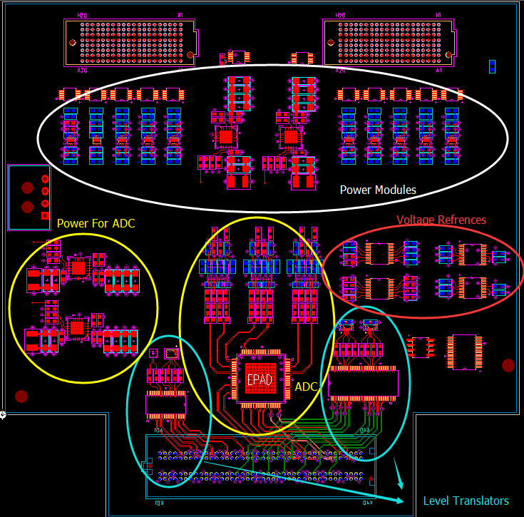
Current Status
Schematics of CaR is finished;
Layout of CaR board is being finalized;
5 inch X 5 inch
8 Layers
The design of other boards will start as soon as the layout of CaR is finished

Slide 21
Backup Slides

