Slide 1
PIC - FMCM
Commissioning status

Slide 2
PIC status
TEST | DESCRIPTION | STATUS
CRYO | Interlock validation between CRYO and PIC | DONE
UPS | Interlock validation between UPS and PIC | DONE
AUG | Interlock validation between Aug and PIC | DONE
Access vs Powering | Validation of Access Powering Interlocks to prevent powering when access | DONE
Current Leads | Validation of CL thermo-switch on RB.A45 (RR53) | DONE
Interface to BIS | Validation of interfaces between PIC and BIS | TO BE DONE

Slide 3
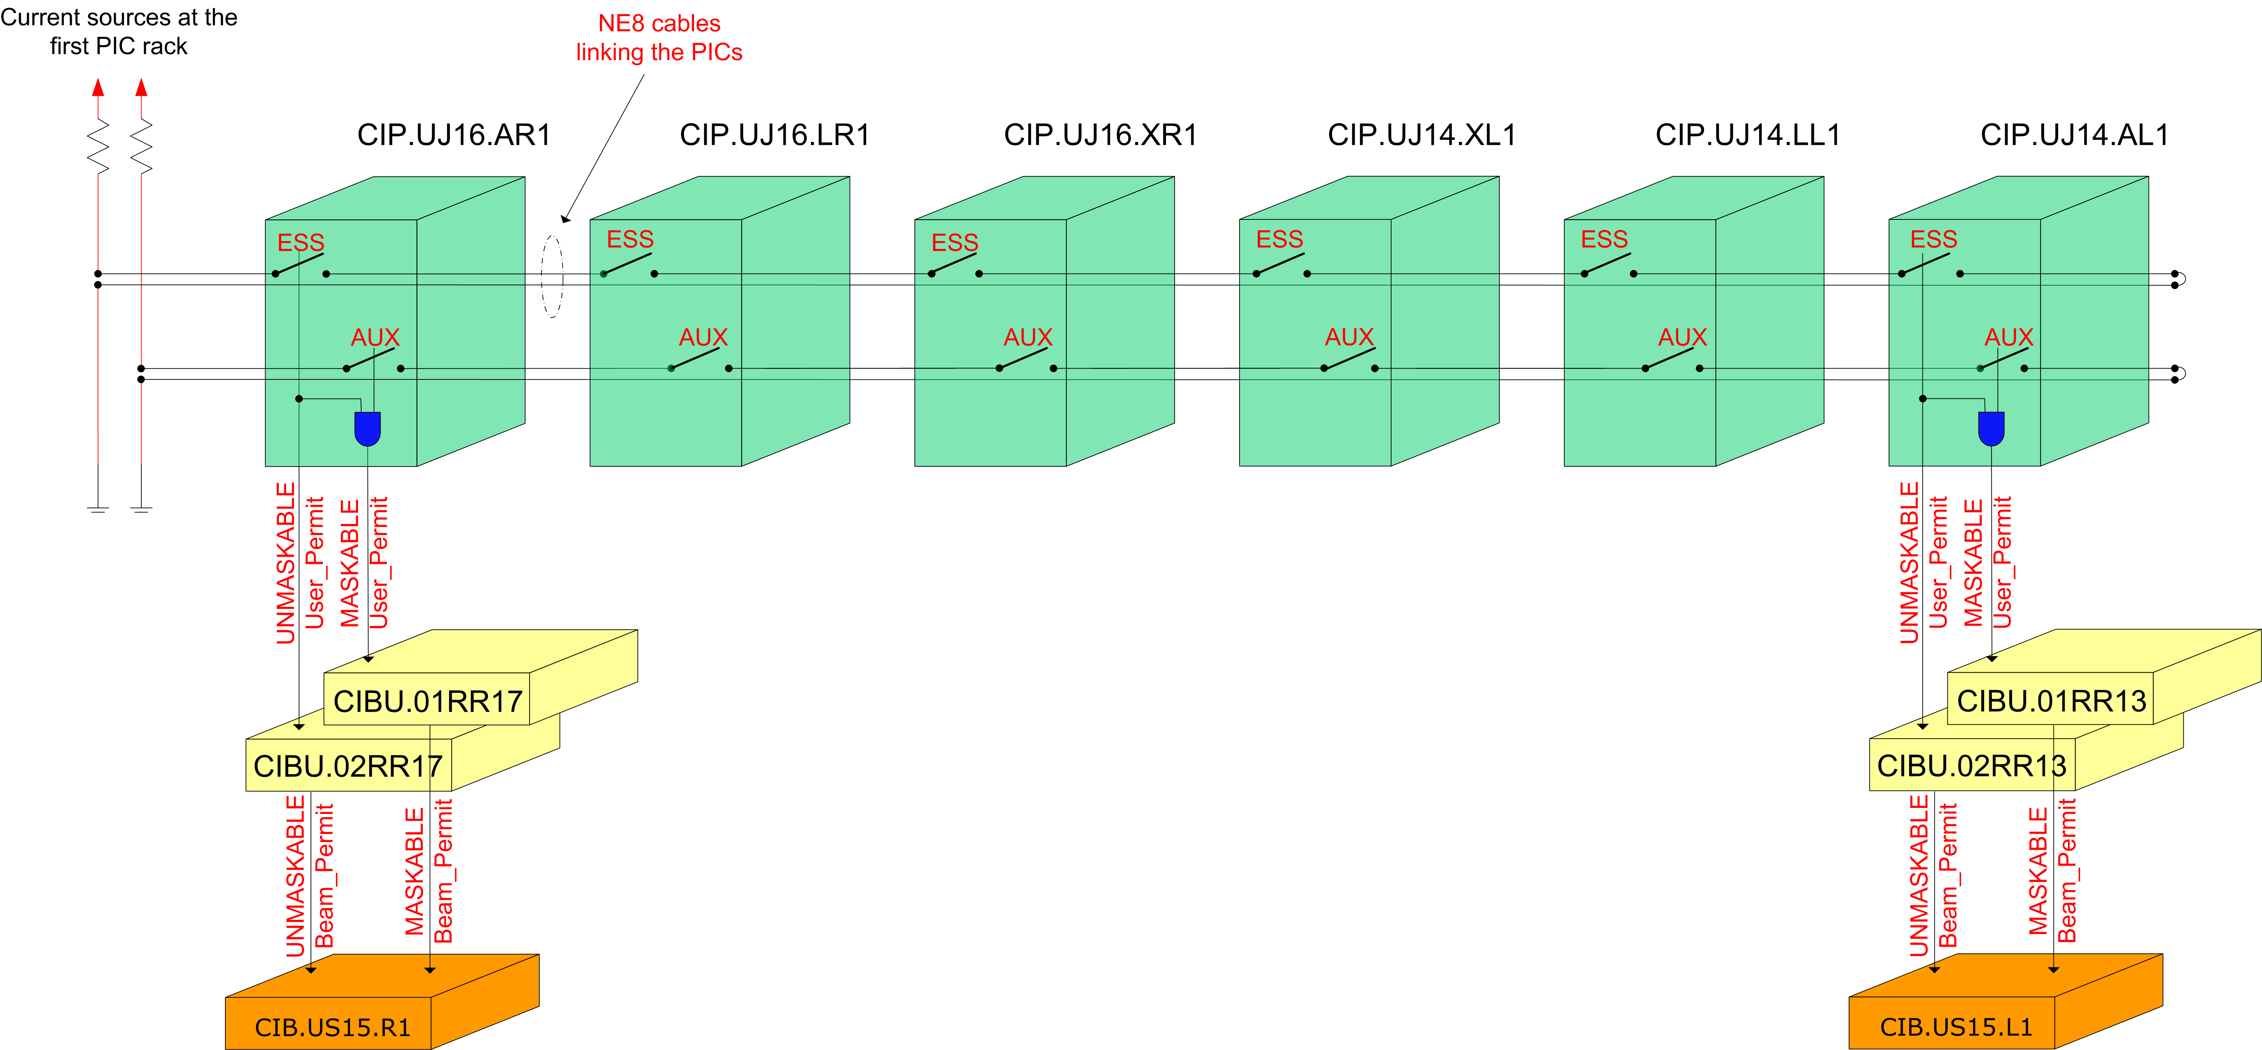
PIC to BIS interface
Validation of interfaces with the BIS (32 CIBUs-16 BICs)
Validation of PIC matrix for definition of Essential and Auxiliary circuits
Sequence in AccTesting to automatically provoke faults on individual circuits and check propagation to BIS
All electrical circuits must be fully commissioned before this test

Slide 4
PIC configuration
Current PIC configuration:
  RB, RQD, RQF, RQX, RD1-4, RQ4-RQ10 as unmaskable (essential for operation)
  RCS, RQT%, RSD%, RSF%, RCBXH/V and RCB% (except RCBCHS5.L8B1) as maskable (not essential with safe beam)
  RCD, RCO, ROD, ROF, RQS, RSS no impact
We will change to:
  RB, RQD, RQF, RQX, RD1-4, RQ4-RQ10 as unmaskable (essential for operation)
  RCS, RQT%, RSD%, RSF%, RQSX3, ROD, ROF, RCBXH/V and RCB% as maskable (not essential with safe beam)
  RCD, RCO, RQS.%, RSS no impact

Slide 5
Non conformities
Circuits still (or newly condemned) for Run2 and hence SUPERLOCKED and REMOVED from the PIC configuration:
  RCOSX3.L2
  RCOX3.L2
  RCSSX3.L2
  RCOSX3.L1
  RSS.A34B1 – new, but anyway defined as no impact!
Circuits which have been repaird during LS1 and which are to be put BACK as AUXILIARY/MASKBABLE:
  RCBCHS5.L8B1
Just for completion: Three more circuits have been repaired but are still considered as having no impact, so no change here:
  RCO.A12B2
  RCO.A81B2
  RQS.R3B1

Slide 6
FMCM status
TEST | DESCRIPTION | STATUS
TRIGGER and BIS | Validation of correct triggering and propagation to BIS | ONGOING
LHC => Commissioning without beam of all devices (12) is done
SPS TLs => Commissioning without beam will be done on Thursday (12th March). New control system is fully ready…

Slide 7
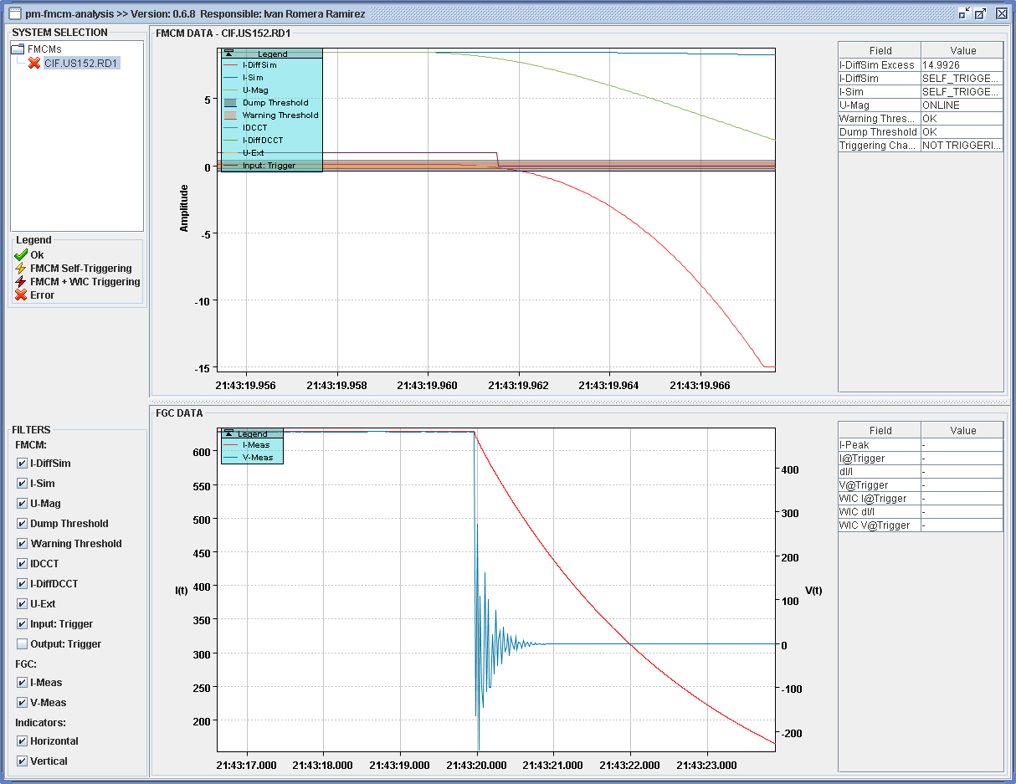
Trigger and BIS

