Slide 1
O² Project Roadmap
P. VANDE VYVRE

Slide 2

O2 Project: What’s Next ?
TDR close to its final state and
its submission to the LHCC
What’s next ?
Build the system !
We need a roadmap with
  Planning
    Work Breakdown Structure
    Major milestones with deliverables
    Identify technical decisions to be taken
    Review process
  Resources

Slide 3
Commissioning milestones
 | Target | Capabilities | Hardware
Q1 2017 | ITS half-layer test | Detector element read-out 10’s of GBTs, 1 or 2 CRUs QC core and detector module DDS, CCM Documentation | Dedicated 1 Server 1 FLP
TBD | - Other detector tests such as TPC chamber or sector test | Detector element read-out 100’s of GBTs, ~10 CRUs | Dedicated 1 Server Several FLPs 1 EPN
Q2 2018 | ITS surface test TPC surface test Cosmic | 1 full detector read-out Long period operation Standalone reconstruction possible | Dedicated or remote use of final system
Q4 2019 | ALICE Cosmic | Full capabilities at reduced performance Test with data injected in CRU | Final system ~10% EPN+DS
2019-20 | ALICE/IT data challenges | - Full chain including GRID | Final system
Q2 2020 | ALICE PbPb | - Full capabilities at full performance | 100% EPN+DS

Slide 4
Data Flow Software (1)
CRORC Read-Out (CRORC RO)
Data Recorder
Basic dataflow using common building blocks from Alfa
Control, Configuration, Monitoring
  DDS
  State machines and messages
QC
  Framework
  Detector-specific agent
Server
DDS
CCM
FLP
CRORC
RO
CRORC
RO
CRORC
RO
Merger
Recorder
QC

Slide 5
Data Flow Software (2)
O2 Internal milestone dates with corresponding functionalities
(FTE yr)
Sep ’15 (1.5)
  CRORC read-out
  Basic dataflow (use of common building blocks from Alfa to assemble the FLP dataflow)
  System monitoring (using MonaLisa)
  Reuse of the existing DATE infologger for information and error messages
  DDS
  Raw data format + conversion from existing Run1 data to Run3 format: (0.5)
Dec ’15 (1)
  Basic dataflow (FLP to EPN)
  Control (state machines and messaging)
  QC
  Reuse of the existing ALICE eLogBook
Dec ’15 Availability of a CRU prototype
Mar ’16 System integration and characterization (1)
Sep ‘16 Documentation (1)
Dec ’16 CRU firmware and read-out software (4)
Dec ’16 Release for the detector teams (e.g. ITS test of Q1 2017)

Slide 6
Complete synchronous chain for ITS and TPC (1)
(Input from Peter and Mohammad)
(FTE yr)
Apr ‘15:
  Full chain with TPC data of Run 1 and HLT algorithms with wrappers and without calibration
Dec ‘16: Full chain for Run 3
  Framework with example algorithms e.g. CA
  DDS: (2)
  FLP to EPN data transport: (0.5)
  Reconstruction @ EPN: (3)
  Calibration @ FLP: (3)
  CCDB (New OCDB database): (2)
  TPC calibration: (4)
  TPC compression: (1)
1 year: the HLT calibration could be added
2 years the CA in the new framework for GPU for a new person

Slide 7
Complete synchronous chain for ITS and TPC (2)
(Input from Peter and Mohammad)
(FTE yr)
Full chain for all detectors:
  Adding to the framework: 14 detectors x 1 = (14)
  (conversion of the Aliroot to the Alfa/O2 fw);
  MCHF+MTR+MFT to be developed
  FIT to be developed
  Calibration TRD: (0.5)
  Calibration TOF: (0.5)
MC simulation: (ITS has already been upgraded for the upgrade)
  Extract geometry
  Geant4 multithreading: (1)
  TPC geometry: (0.25)
  TPC compressed hits, digitisation, timeframes: (0.5)
  Other detectors: 14 detectors x 0.5 = (7)
  Validation of simulation: (1)

Slide 8
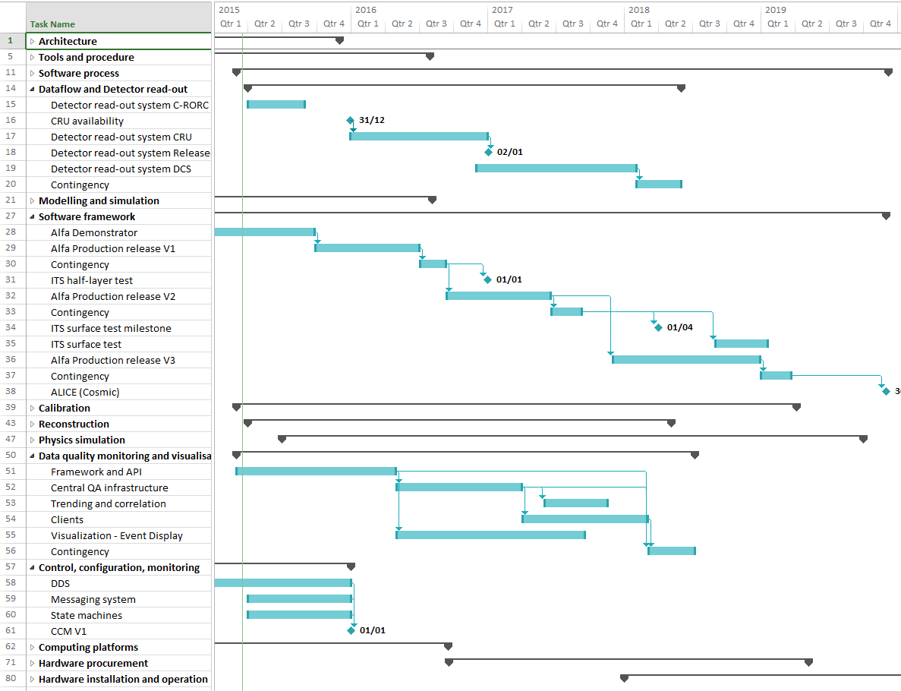
Project Schedule
Some Key Milestones (1)
Q4 2015 CRU Availability
Q1 2017
Software Framework V1
Detector read-out 1 CRU
QC
→ ITS half-layer test
Q2 2018
Software Framework V2
1 detector full read-out
Dedicated hardware
→ ITS or TPC surface test

Slide 9
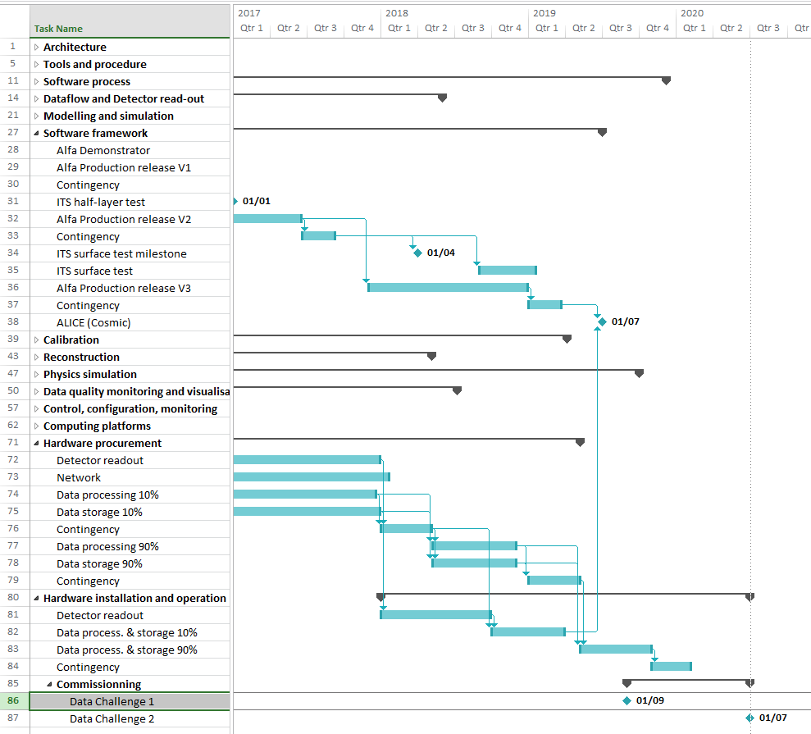
Project Schedule
Some Key Milestones (2)
Q2 2019
Software Framework V3
Full capabilities
Deployment of 10% EPN+DS
→ ALICE Cosmic
Q3 2019
Data challenge 1 with IT dept.
Q1 2020
Full deployment EPN+DS
→ ALICE with PbPb collisions
Q2 2020
Data challenge 2 with IT dept.

Slide 10
Next Steps
Refine the WBS and the list of milestones
  Finer grain tasks
  Document all commissioning and internal milestones
List the decisions to be taken and the process to reach them
Milestones tracking
  Create the corresponding lists of Jira issues with target dates
Review process
  Review the list of Jira issues during the O² plenary meetings

