Slide 1
Reconstruction status and plans
R.Shahoyan, 19/03/05, Offline Week

Slide 2
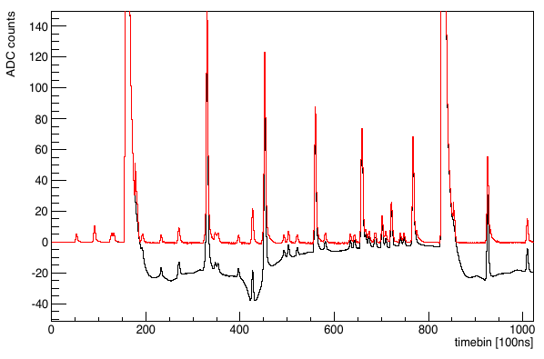
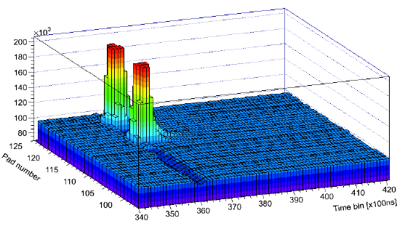
Ion-tail and cross-talk _{high IR}
Ion tail was not fully corrected in electronics (ALTRO chip)
Removal of capacitors on chambers → cross talk among pads
Lower baseline
Bias on cluster charge
→ dE/dx deteriorates
Correction in software
Final checks ongoing
Ready for p-Pb reprocessing
K.Schweda, 3/18/2015 MB

Slide 3
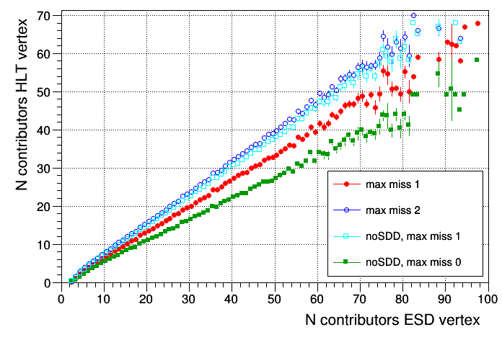
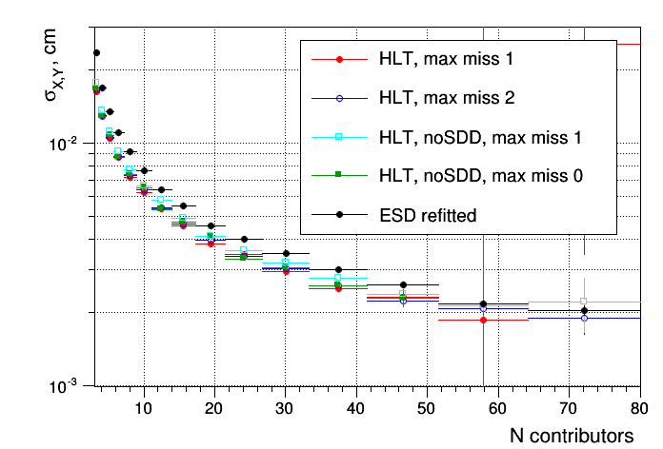
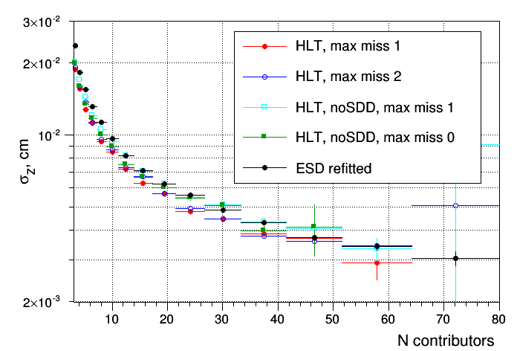
ITS Standalone tracker/vertexer for HLT
Needed for TPC calibration & LR determination
Rebuild SPD tracklets from HLT SPD vertex
Finds their extrapolation in full ITS.
Use found tracks to reconstructs primary vertex
By definition finds primary tracks only
Plan to implement vertexer also for offline code
Speed for p-p MC LHC14i2/192708 (i7-2600@3.4GHz)
full ITS max miss 1 5.0 kHz
full ITS max miss 2 4.8 kHz
no SDD max miss 0 6.7 kHz
no SDD max miss 1 6.0 kHz
Relative efficiency wrt
offline track finding
(global+SA)
σ_{X,Y}
σ_{Z}

Slide 4
Alignment for Run2
New TRD modules, new SPD modules (revived), lot of interventions -> need full realignment
Cosmic data collected (back-to-back with +- 3sectors difference; SPD touched in ~ 3 10⁻⁴)
~ 0.5% should have hit at least in SSD → would allow ITS – TRD/TOF global alignment w/o TPC.
Methods
Barrel:
ITS internal alignment with MillePede (cannot be directly extended to other detectors)
Kalman filter
Old framewrok for TRD alignment (needs reliable TPC tracks)
Global alignment with MillePede (in development)
Muon:
Existing MillePede framework, works both with Dipole:OFF and Dipole::ON data, but data with field alone will require more efforts to align (availability of field OFF data is not probable)
B | Runs | TOF+TPC+SSD(+SPD) 10⁶ | TOF+TRD+TPC+SSD(+SPD) 10⁶
0 | 42 | 10(8) | 5(3)
+ | 47 | 24(22) | 11(10)
- | 51 | 53(4) | 22(2)

Slide 5
Global alignment with Millepede
Currently ITS and TPC are aligned internally, then they are aligned globally one with respect to other
Outer detectors aligned relying on TPC tracks, w/o any feedback on TPC alignment/calibration
This affect TPC-dependent detectors alignment due to the residual TPC miscalibrations
TPC wants to change its calibration strategy: use interpolation of tracks from “perfectly” aligned ITS-TRD/TOF to TPC volume and process residuals wrt TPC clusters as distortions
Use global algorithm for simultaneous refitting of detector’s alignment (and calibration) parameters and tracks (Millepede - already used for ITS and Muon standalone alignment).
Framework will provide base classes to handle standard geometrical degrees of freedom (in AliAlignObj parameterization supporting TGeo conventions) – must be ready by beginning of Run2
Detectors which want to implement calibration simultaneously to alignment must implement corresponding degrees of freedom (derivatives of residuals vs DOF, initial values extraction from OCDB and interpretation of fit results) – will not be fast
Development was constantly delayed due to other priorities, now need to catch up…
parameters
to optimize
ITS
Detector-specific units derived
from generic detetctor class
Declare DOFs and calculates track-cluster residuals wrt these DOFs
ESD + ESDFriend
Central unit
TPC
Steering
tracks, clusters
geometry
OCDB
TRD
Millepede minimization
residuals + their derivatives
TRD
…

Slide 6

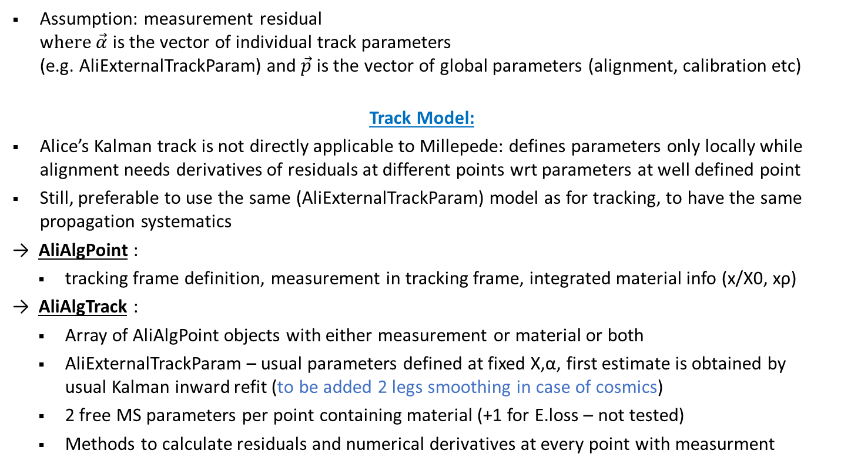
Global alignment with Millepede
$∆F\left(\vec{α},\vec{p}\right)=\frac{dF}{d\vec{α}} δ\vec{α}$ + $\frac{dF}{d\vec{p}} δ\vec{p}$
Assumption: measurement residual
w$here \vec{α}$ is the vector of individual track parameters
(e.g. AliExternalTrackParam) and $\vec{p}$ is the vector of global parameters (alignment, calibration etc)
Track Model:
Alice’s Kalman track is not directly applicable to Millepede: defines parameters only locally while alignment needs derivatives of residuals at different points wrt parameters at well defined point
Still, preferable to use the same (AliExternalTrackParam) model as for tracking, to have the same propagation systematics
→ AliAlgPoint :
tracking frame definition, measurement in tracking frame, integrated material info (x/X0, xρ)
→ AliAlgTrack :
Array of AliAlgPoint objects with either measurement or material or both
AliExternalTrackParam – usual parameters defined at fixed X,α, first estimate is obtained by usual Kalman inward refit (to be added 2 legs smoothing in case of cosmics)
2 free MS parameters per point containing material (+1 for E.loss – not tested)
Methods to calculate residuals and numerical derivatives at every point with measurment
AliAlgTrack
AliAlgPoint
meas + mat
AliAlgPoint
meas + mat
AliAlgPoint
mat
AliAlgPoint
meas + mat
AliAlgPoint
meas
AliAlgPoint
meas + mat

Slide 7
Global alignment with Millepede
AliAlgVol
Local2Global matrix
* Parent AliAlgVol
Alignment DOFs:
  Local Δ: [x,y,z,ϕ,θ,ψ] (local Euler angles)
  or
  Global Δ: [X,Y,Z, Φ,Θ,Ψ] (Euler angles wrt origin)
Provided by framework
Alignable volume
Volume with measurement
Full detector (root of hierarchy)
AliAlgDet: public AliAlgVol
Methods for
  undoing/applying detector calib.
  interpreting/writing minimization results
AliAlgSens : public AliAlgVol
Tracking2Local matrix
Methods for
  derivatives vs its own and parents DOF’s
  AliTrackPoints (friends) → AliAlgPoints conversion
Implemented for each detector
Calibration DOF’s (may be time/run dependent) and their derivatives calculation
Methods to cook matrices (if needed)
Methods to interpret results
Analysis Task
TRD Sectors
(supermodules)
TRD Stack
(optional)
TRD Chambers
:public AliAlgSens
AliAlgDetITS …
AliAlgVol
AliAlgVol
AliAlgTRDCh
AliAlgSteer
ESD processing
OCDB/geometry handling
IO with MillePede
AliAlgDetTRD
:public AliAlgDet
AliAlgTRDCh
AliAlgVol
AliAlgVol
AliAlgTRDCh
AliAlgVol
AliAlgVol
AliAlgTRDCh
AliAlgDetTOF…
AliAlgTRDCh
AliMillePede2
Or
MillePede II (external)
AliAlgTRDCh
Need few weeks to put together geometry part (calibration up to detectors)

Slide 8
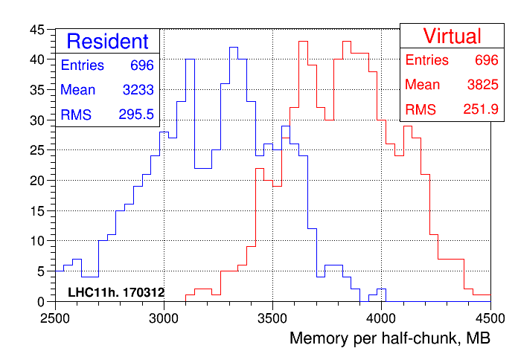
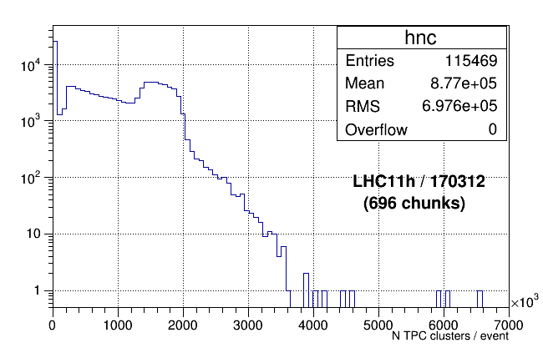
Memory consumption in PbPb
Example of LHC11h (run 170312, 696 half-chunks checked)
Main consumer: TPC clusters
1 TClonesArray for TPC clusters per pad-row (max 2500 clustesr/padrow)
→ asymptotically will reach 14.3M clusters once all arrays expanded to maximum
→ 80 Bytes/cluster → 1.1 GB
At least 20 Bytes per cluster are redundant (debug info pointer, Bool_t vs bit …) but modification will be backward incpompatible
Need to implement less greedy container

Slide 9
Dormant tasks
TPC related (collected under JIRA ATO-19):
  PWGPP-55: Improving TPC/ITS matching efficiency and its systematic error
  (seeding TPC by standalone ITS tracks)
  PWGPP-56: Improving double track resolution
  PWGPP-71: Filtering of outlier HM events – handling of laser triggers (?)
Including TRD in tracking (Jira PWG-PP-1):
  Coding part done, blocked by global alignment + TPC calibration
ITS related:
  ALIROOT-2493 Global tracking forces some pairs of tracks to have almost the same momentum: test production (PbPb) with 2 alternative patches is still pending.

