Slide 1


Grid operations in 2014
ALICE Offline week
20 March 2015
Latchezar Betev

Slide 2
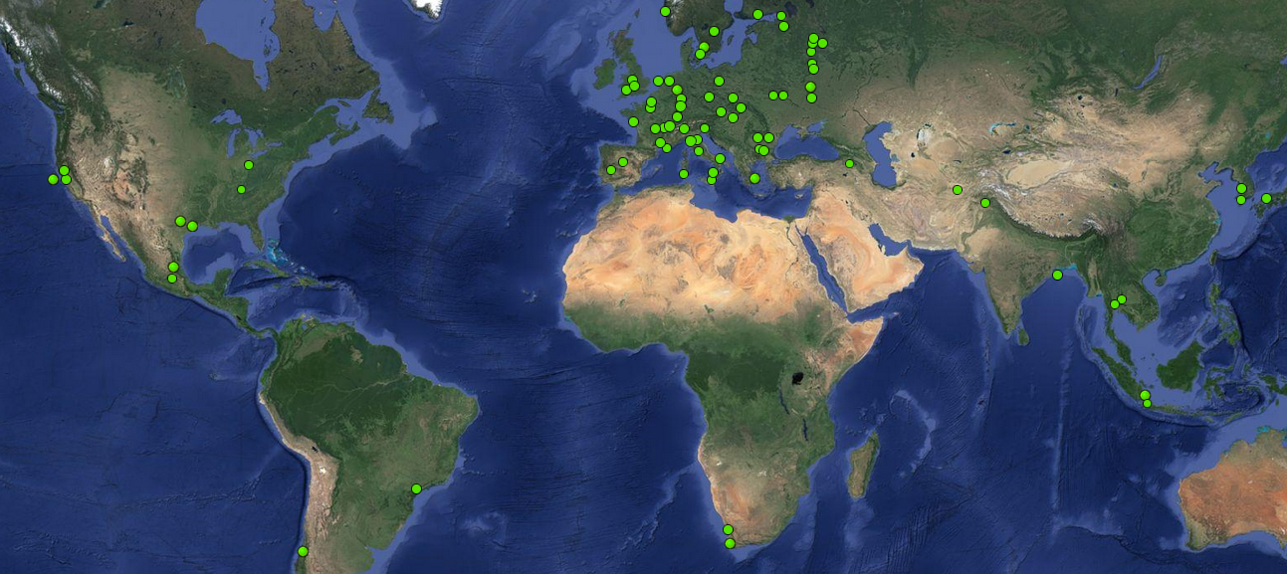
The ALICE Grid sites today
8 in North America
53 in Europe
RRC-KI T1
WUT
10 in Aisa
KISTI T1
UNAM
2 in Africa
Bandung
Cibinong
2 in South America
CHPC

Slide 3
New sites
KISTI – officially a T1 in WLCG
UNAM – MoU for T2 in November 2014, towards a T1
WUT (Poland) in production September 2014
RRC-KI T1 in production January 2014
ZA_CHPC x4 capacity in November 2014
Bandung and Cibinong in production September 2014

Slide 4
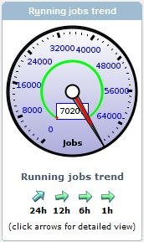
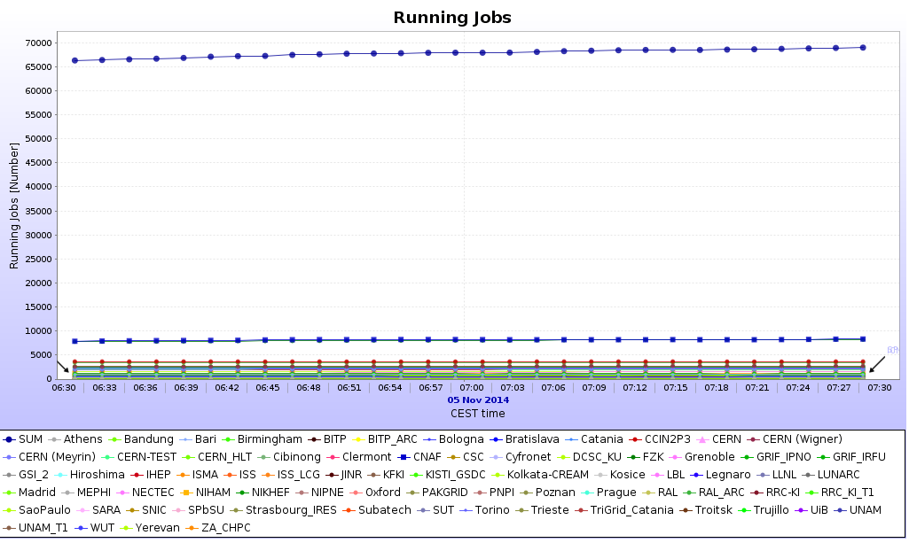
A new job record
November 2014 – 70K concurrent jobs
… and we are breaching 72K jobs every week since February

Slide 5
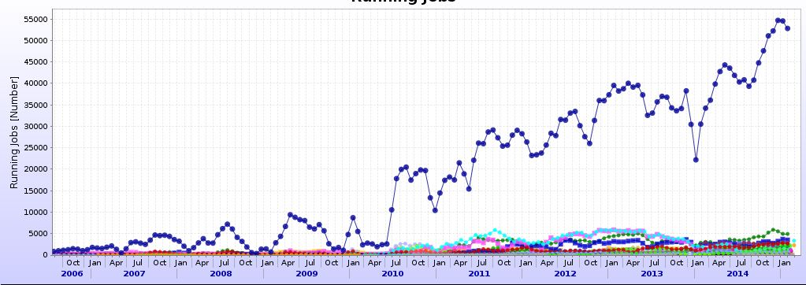
CPU resources evolution
45500
35000
31300
24230
12300
Year on year increase
+97%
+30%
+12%
+30%

Slide 6
Resources evolution
From 2011 to 2014 – 88% CPU increase
  @22% average per year – slightly above the WLCG projection
  Due to new sites (!) and above-flat budget capacity increase
Storage capacity is growing at ~15% per year
  Also slightly above flat-budget scenario
  Remains critical in terms of what we can store – timely cleanup and reviews must continue

Slide 7
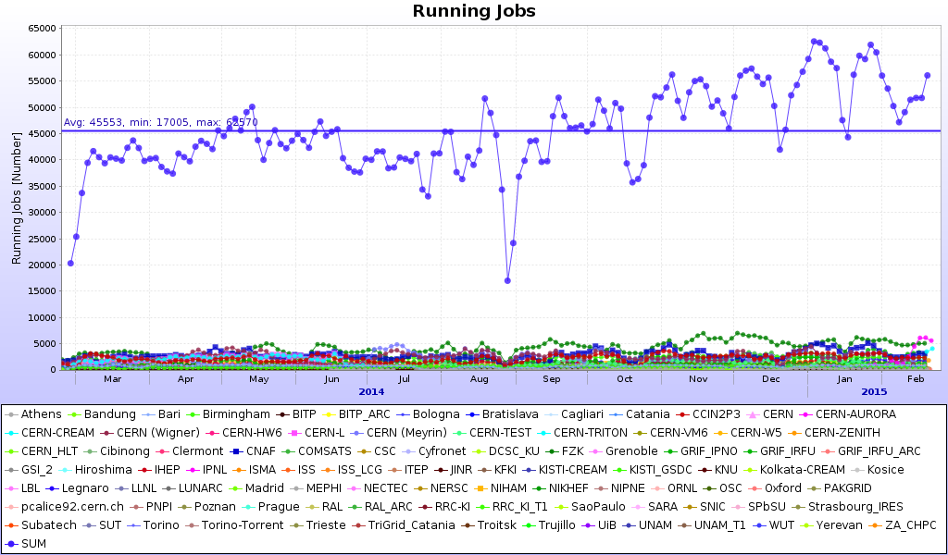
Yearly job profile
Out of productions
Opportunistic
resources

Slide 8
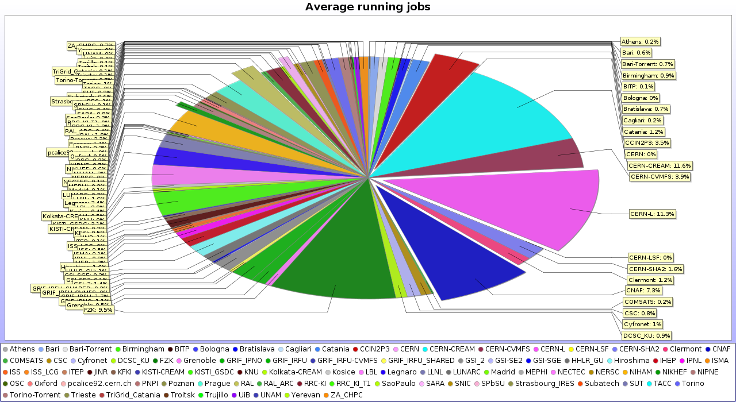
Resources distribution
Continuous and remarkable 50/50 share between large (T0/T1) and smaller computing centres

Slide 9
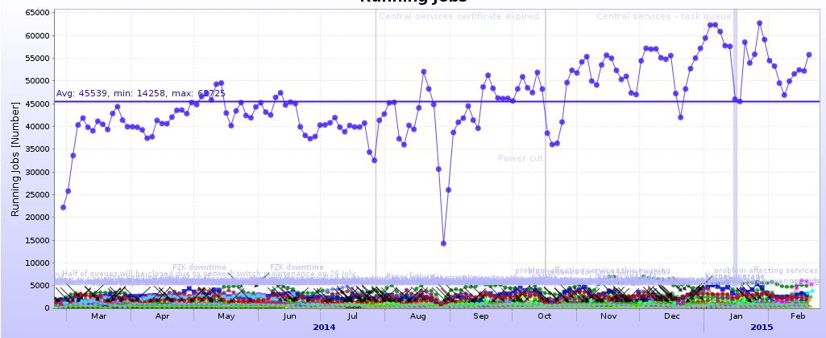
Central services operation
Certificate
Expiration
2h30m
Power cut
4h30m
TQ broken
36h
Total downtime 43 hours => 99.5% availability
The blue grass above sites profile – site updates announcements, see individual sites for details

Slide 10
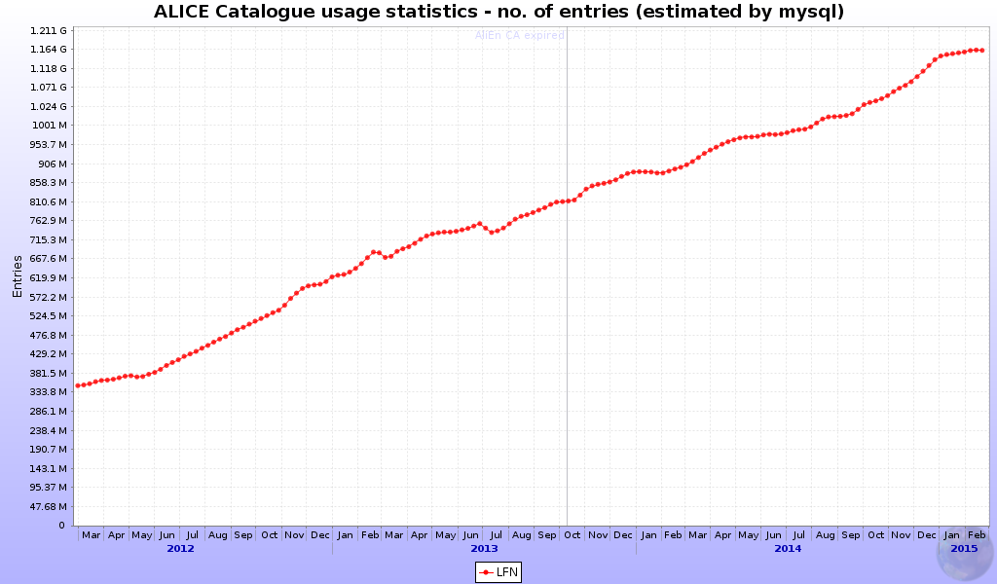
Catalogue stats
294 Mio new
entries
262 Mio new
entries
New generation servers (being ordered) can
still hold the entore catalogue in memory
342 Mio new
entries

Slide 11
Computing tasks and workflow
Centrally managed
PWG managed
Individually managed
RAW, MC productions
Organized analysis (trains)
Individual analysis
Priority 1
Priority 3
Priority 2
AliEn Central Task Queue
Computing centre
Computing centre
Computing centre
Computing centre
.....
Computing centre

Slide 12
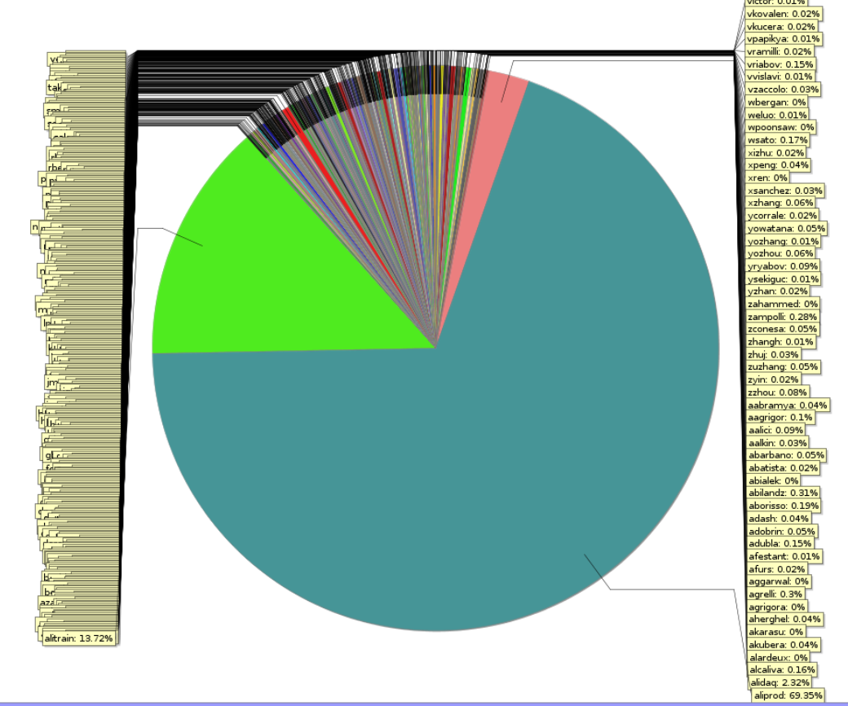
Wall time resources share 2014
Individual analysis: 12%
@all centres
432 users
RAW data processing: 3%
@ T0/T1s only
Organized analysis: 16%
@all centres
MC productions: 69%
@all centres

Slide 13
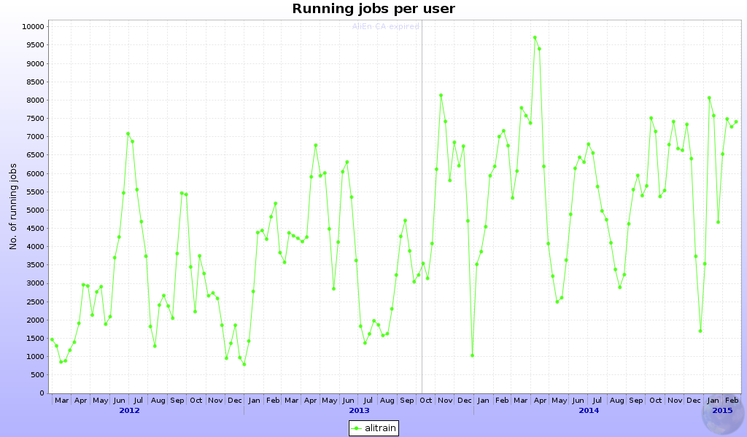
Organized analysis
5800 jobs
3000 jobs
4400 jobs
Year on year increase
+47%
+32%

Slide 14
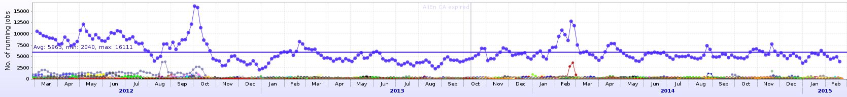
Individual analysis
6900 jobs
465 ind.users
4600 jobs
446 ind.users
4700 jobs
432 ind.users
Year on year increase
Individual analysis
-50%
+3%
Year on year increase
organized analysis
+47%
+32%

Slide 15
Analysis evolution
From 2012 to 2014 the individual user analysis has decreased by 50%
  It has remained at the same level of resources utilization between 2013 and 2014
The organized analysis fully compensated the ‘loss’ of individual already in 2013
Since 2013, the amount of resources used by analysis has grown by 35%, all of it organized
The number of individual users has remained steady at ~445
There is still ample room to increase the share of the organized analysis

Slide 16
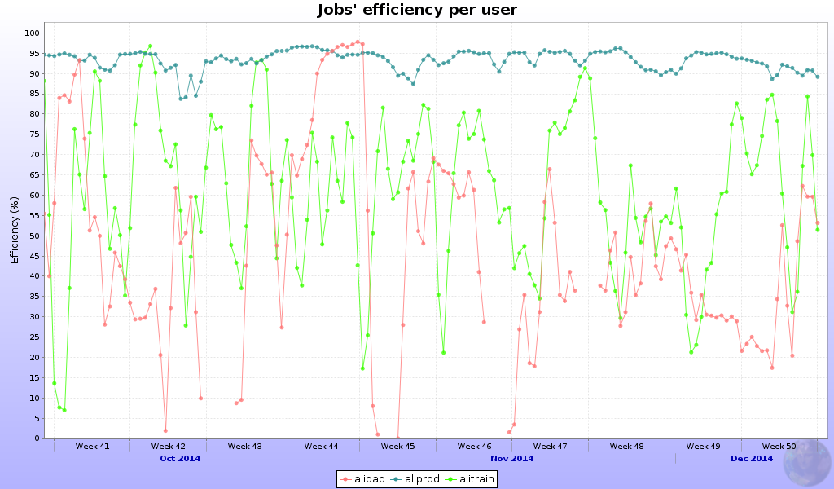

Efficiency per workflow
Average over all sites

Slide 17
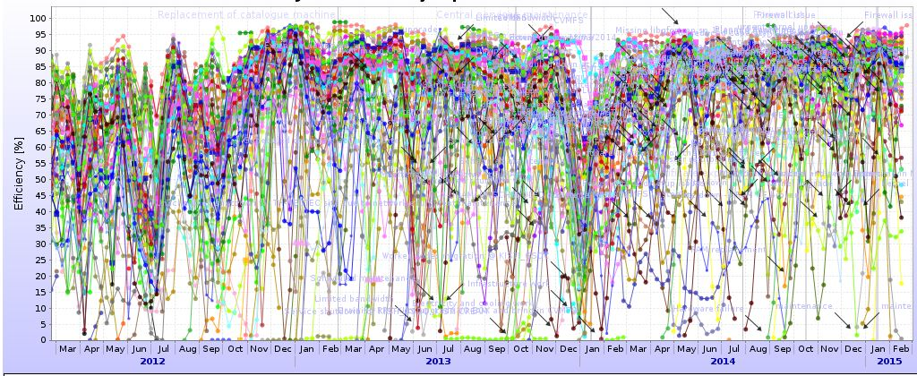
Grid efficiency
76%
84%
86%
Year on year change
+8%
+2%

Slide 18
Grid efficiency evolution
Since the re-introduction of TTree Cache, the efficiency has stabilized at ~85%
  The dramatic decrease of individual analysis also helped the efficiency increase
In the past year, there is a slight upward trend, could be attributed to the better availability of storage (see next)
We could expect a slight (2-5%) increase
  If the individual analysis is decreased by factor 2
  If the current efficiency level of the other activities remains the same

Slide 19
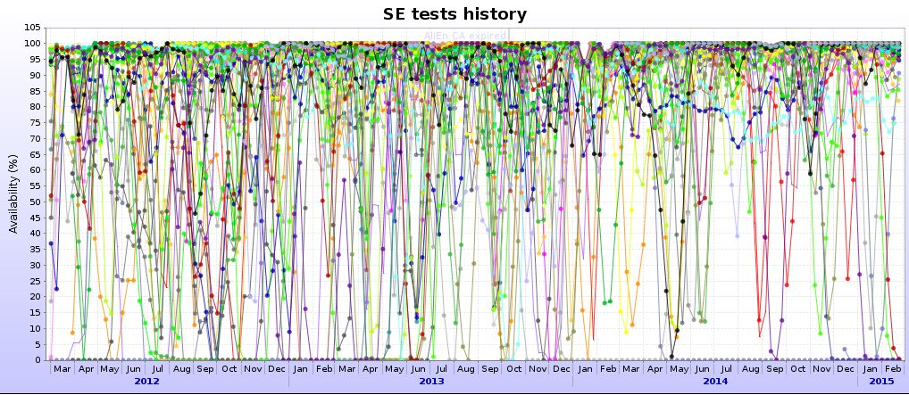
Storage availability
83%
87%
91%
Year on year change
+4%
+4%

Slide 20
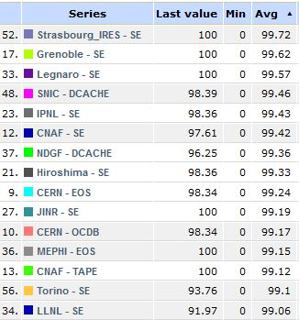
Storage availability evolution
Constant improvement in availability
  SEs are independent, no correlation in downtime
Directly affecting the workload efficiency
Room for further increase!
  Allowed downtime for availability >99% = 88 hours
Top 15 SEs, one year average
Current replica model (2 copies) => probability for both replicas to be inaccessible @91% SE availability = 0.8%
@95% availability = 0.25%

Slide 21
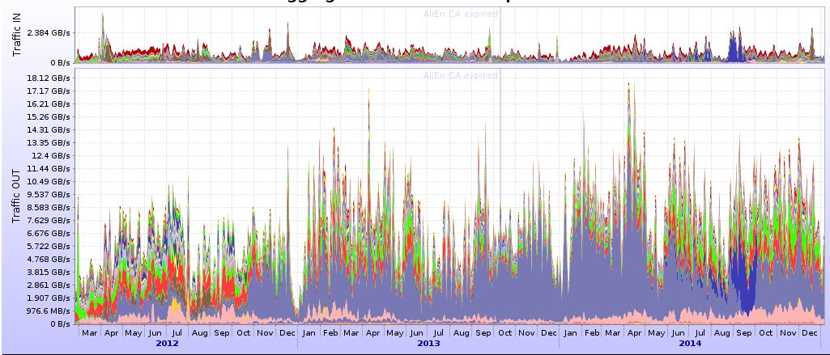
Storage use
30PB
28PB
29PB
180PB
237PB
284PB
Write
-7%
+4%
Year on year change
Read
+32%
+20%
Ratio r/w
8.5
9.8

Slide 22
Storage use evolution
Increase in read volume – directly correlated with the increase in analysis activity
  Improved ratio read/write
In 1 year ALICE overwrites the entire disk storage completely
  Timely cleanup is critical to keep the SEs in good health
  … and to have free space for the new data
  The disk cleanup is a continuous activity
  Minimal amount of ‘dark data’ and files with low popularity

Slide 23
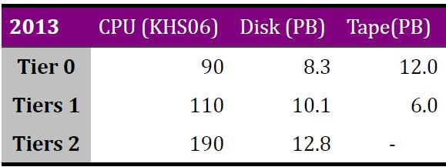
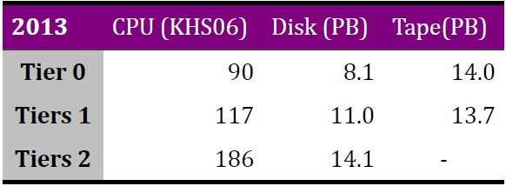
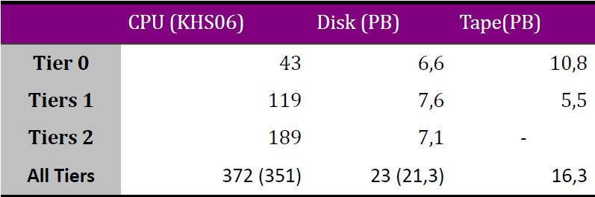
Resources usage 2014
Requirements
Pledges
Usage

Slide 24
Summary
2014 was (another) successful year for Grid operations
Despite the absence of data taking, the Grid resources use was uninterrupted
  In fact it has increased, as was the available capacity
New centers have entered production – the Grid is expanding above the ‘flat budget’ scenario
Substantial increase of analysis, most of it organized
Efficiency remains high, and can be increased further
The computing centres operation continues to be smooth
  Software and hardware updates have negligible effect on general Grid availability

