Slide 1



Cryogenic Current Comparator (CCC)
Beam intensity monitor for the Antiproton Decelerator
Miguel Fernandes
07/10/2015
International Conference on Accelerator Optimization

Slide 2
Presentation outline
Motivation and specifications for new intensity monitor
CCC functioning overview and design considerations
First beam measurements
Current limitations (monitor + cryogenics)
Summary
Miguel Fernandes
International Conference on Accelerator Optimization

Slide 3
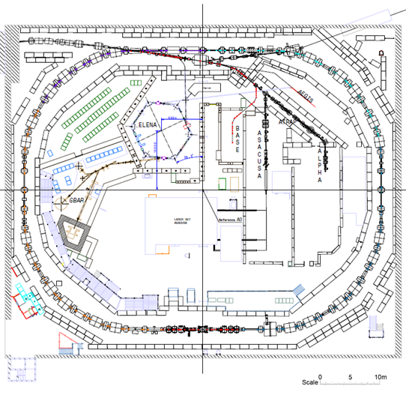
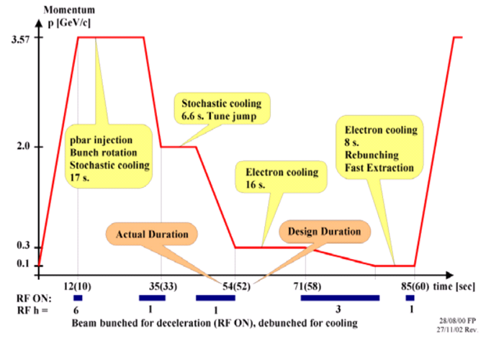
Antiproton Decelerator at CERN
ELENA
AD beam parameters
Beta | 0.97 … 0.11
Cycle | ~85 s
N particles | (5 … 1) x 10⁷
Current | (12 … 0.1) μA
Miguel Fernandes
International Conference on Accelerator Optimization

Slide 4
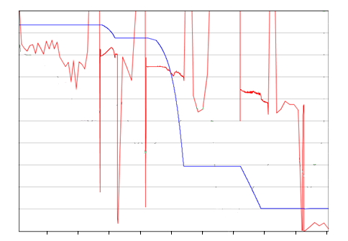
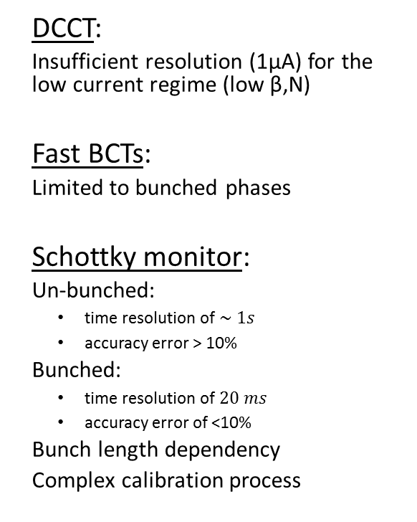
Motivation for new monitor in AD
Schottky Intensity Measurement
  DCCT:
  Insufficient resolution (1µA) for the low current regime (low β,N)
  Fast BCTs:
  Limited to bunched phases
  Schottky monitor:
  Un-bunched:
    time resolution of $\sim 1s$
    accuracy error > 10%
  Bunched:
    time resolution of $20 ms$
    accuracy error of <10%
  Bunch length dependency
  Complex calibration process
Coasting beam
Bunched beam
1.0
4
0.8
3
0.6
N [x 10⁷ pbar]
β [c]
2
0.4
1
0.2
0
10
20
30
40
50
60
70
80
90
0.0
time [s]
Miguel Fernandes
International Conference on Accelerator Optimization

Slide 5



Specifications for new intensity monitor
Requirements for a new current/intensity monitor:
Current resolution: 10 nA
Intensity resolution: 5 x 10⁵ charges
Bandwidth: DC - 1 kHz
Requirements for the cryostat
“Zero-boil off” using a pulse tube cryocooler as He reliquefier unit
Long term operation
Collaboration partners:
Miguel Fernandes
International Conference on Accelerator Optimization

Slide 6
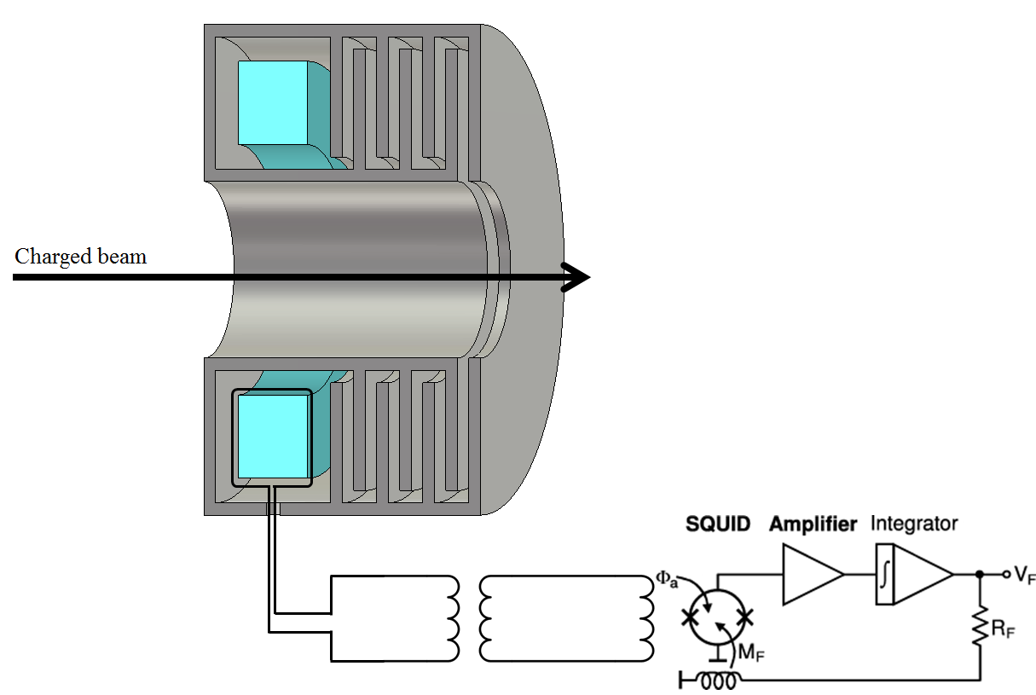
CCC functioning overview
Magnetic shield:
  Suppresses all field components except azimuthal beam component
Pickup coil:
  Soft ferromagnetic material with high-permeability concentrates flux
Flux transformer:
  Couples magnetic flux (down to DC) to SQUID
SQUID + Electronic readout:
  Superconducting QUantum Interference Devices
  Measures the magnetic field induced in the SQUID’s input coil
Miguel Fernandes
International Conference on Accelerator Optimization

Slide 7
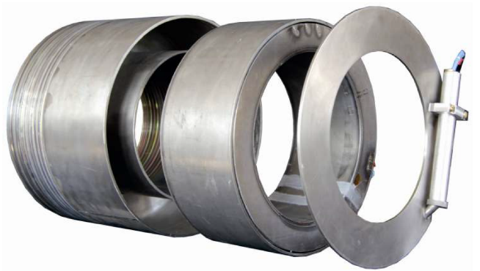
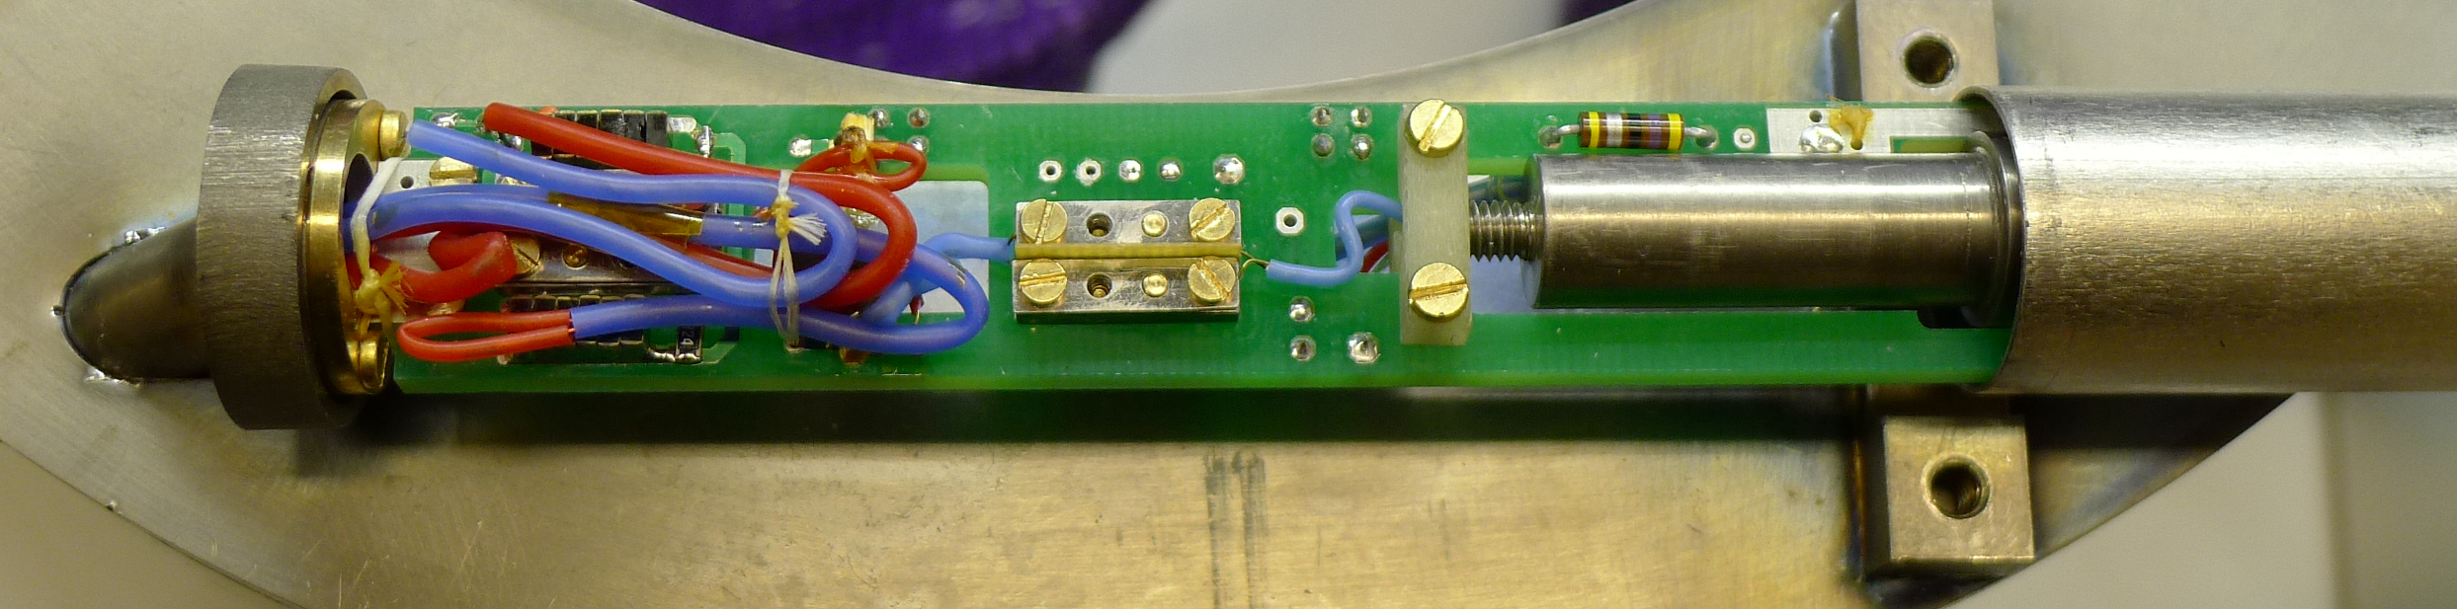
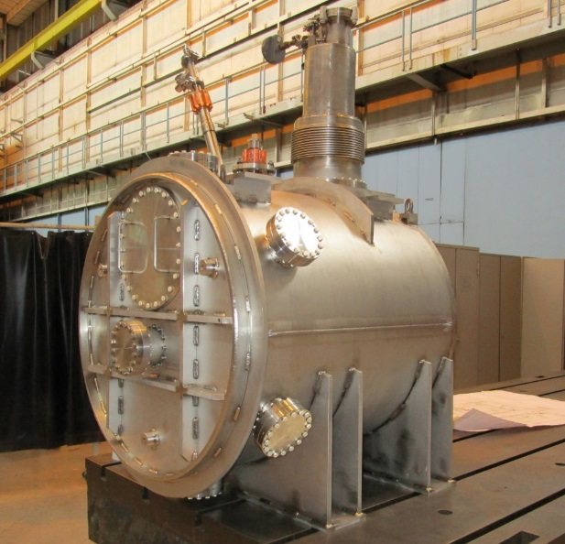
Monitor and cryogenic system
CCC magnetic shield and ferromagnetic core fabricated by collaboration partners
New coupling circuit was designed using commercially available SQUID system
New cryostat was designed and fabricated
  Low-level of mechanical vibration
  Low heat in leak
  Capacity for 50 liters liquid Helium
  Diameter of ~ 0.8m
Miguel Fernandes
International Conference on Accelerator Optimization

Slide 8
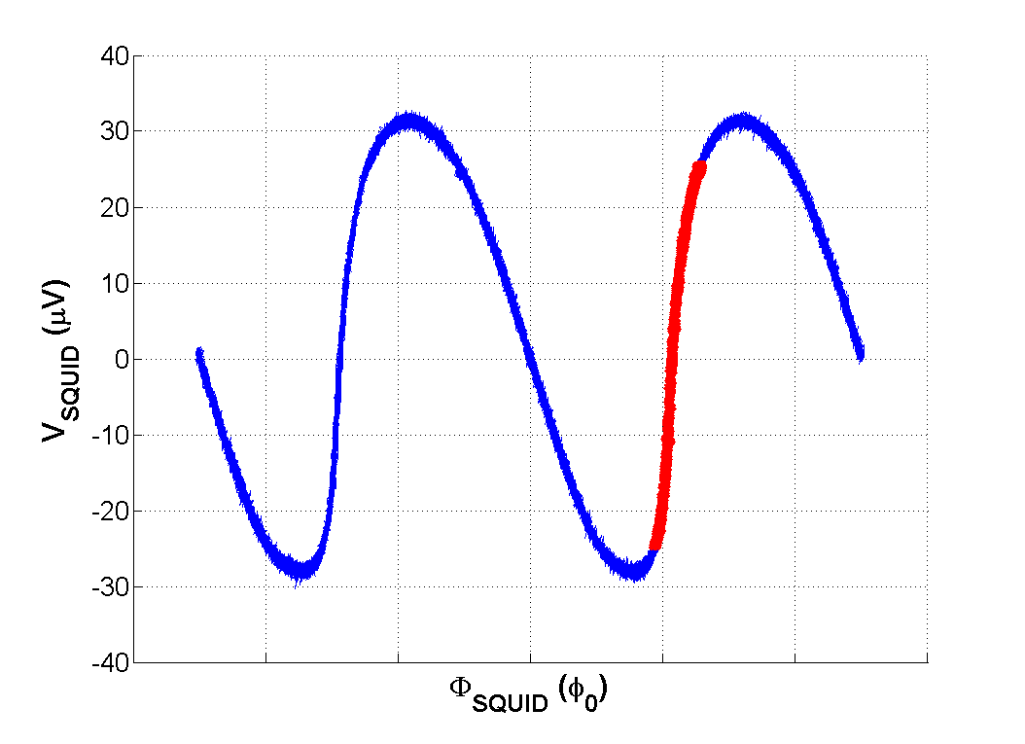
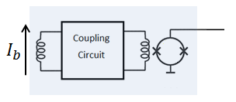



SQUID devices
$$φ_{0}=2.07×{10}^{−15} \text{Wb}$$
SQUID’s are very sensitive magnetometers
But periodic transfer function limits its dynamic range
Superconducting/cold parts
$$φ_{SQUID}$$
$$V_{SQUID}$$
Miguel Fernandes
International Conference on Accelerator Optimization

Slide 9
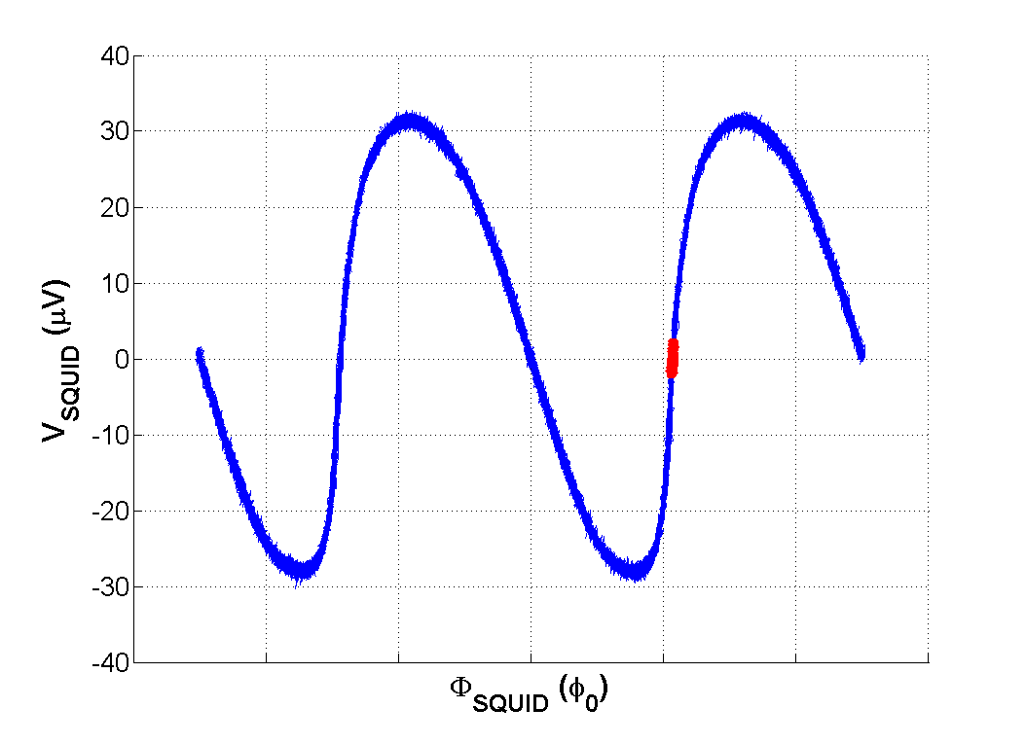
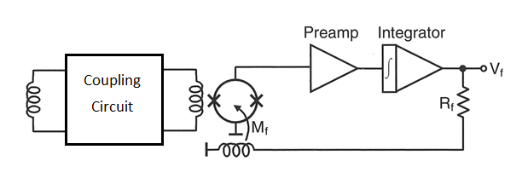



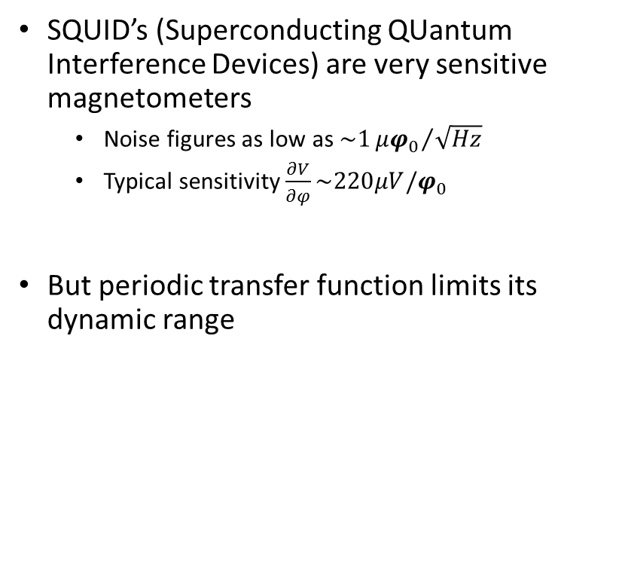
SQUID devices
$$φ_{0}=2.07×{10}^{−15} \text{Wb}$$
SQUID’s are very sensitive magnetometers
But periodic transfer function limits its dynamic range
Constant Working Point
$$V_{SQUID}$$
$$I_{b}$$
$$φ$$
Miguel Fernandes
International Conference on Accelerator Optimization

Slide 10
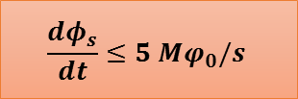
SQUID devices
$$φ_{0}=2.07×{10}^{−15} \text{Wb}$$
SQUID’s are very sensitive magnetometers
But periodic transfer function limits its dynamic range
Necessary to limit slew-rate of coupled signal to avoid flux-jumps
    $$\frac{dφ_{s}}{dt}≤5 Mφ_{0}/s$$
$$V_{SQUID}$$
$$I_{b}$$
$$φ$$
Miguel Fernandes
International Conference on Accelerator Optimization

Slide 11
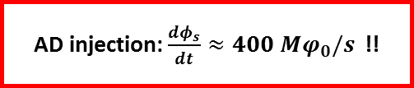
SQUID devices
$$φ_{0}=2.07×{10}^{−15} \text{Wb}$$
SQUID’s are very sensitive magnetometers
But periodic transfer function limits its dynamic range
Necessary to limit slew-rate of coupled signal to avoid flux-jumps
    $$\frac{dφ_{s}}{dt}≤5 Mφ_{0}/s$$
$$V_{SQUID}$$
    AD injection: $\frac{dφ_{s}}{dt}≈400 Mφ_{0}/s$ !!
$$I_{b}$$
$$φ$$
Miguel Fernandes
International Conference on Accelerator Optimization

Slide 12
Limiting slew-rate of input signal
Cryostat vaccum vessel
Cryostat thermal shield
Implement signal filtering to decrease slew-rate
RC filter in coupling circuit
RF-bypass in ceramic at beam pipe
I_{mirror}
I_{beam}
Miguel Fernandes
International Conference on Accelerator Optimization

Slide 13
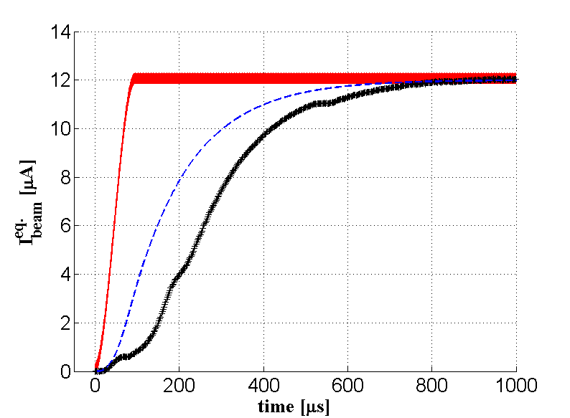
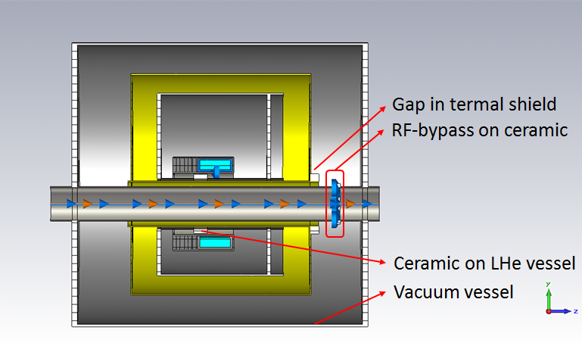

Laboratory measurement
Time response to a current signal identical to AD beam injection
Simulated signal using CST Wakefield simulation and linear system treatment
Laboratory measurement of wire carrying current through beam pipe
    $$\frac{dφ_{s}}{dt}≤2 Mφ_{0}/s$$
RF-bypass (C_{RF} = 100 µF)
RF-bypass + Coupling Circuit (C_{RF} = 100 µF)
Laboratory measurement (C_{RF} = 125 µF)
Miguel Fernandes
International Conference on Accelerator Optimization

Slide 14
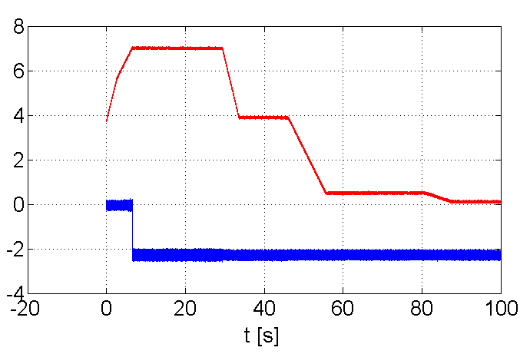
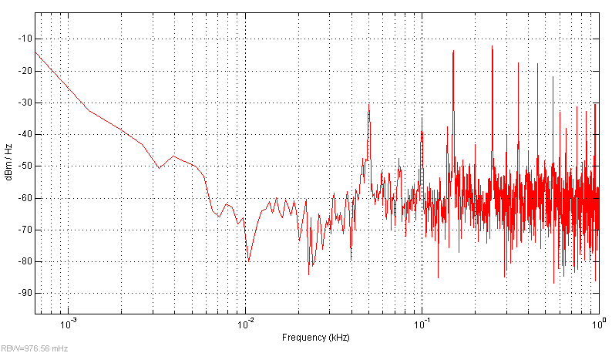
Measurements with no beam
Time-domain signals
Frequency-domain
150Hz
250Hz
Magnetic cycle [a.u.]
50Hz
SQUID measurement [V]
σ(I_{beam}) = 219 nA
Current resolution is mainly limited by noise/perturbations at 50Hz + harmonics
Offset jump around moment of injection due to discharge of bunch rotation cavities
Miguel Fernandes
International Conference on Accelerator Optimization

Slide 15
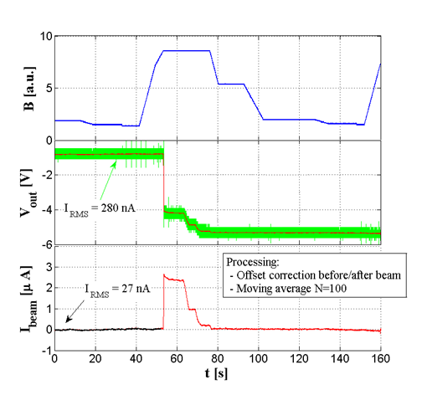
Beam current measurements
First measurement during beam setup
After signal filtering it’s possible to obtain resolution ~30 nA
Good example of how this measurement can speed up setup of AD beam (currently takes ~3 weeks)
Raw signal (T_{s} = 0.4ms)
Filtered signal (N_{avg} = 100)
σ(I_{beam}) = 280 nA
σ(I_{beam}) = 27 nA
Miguel Fernandes
International Conference on Accelerator Optimization

Slide 16
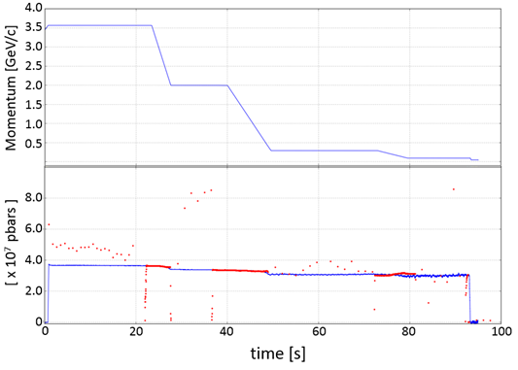
Beam intensity measurements
Coasting beam
Bunched beam
Momentum
Intensity obtained by normalizing beam current with velocity
Noise of current measurement is amplified for low-β.
CCC
SCHOTTKY
Nominal injection:
N_{inj} = 3.7 x 10⁷
σ(N) = 4.8 x 10⁴
σ(N) = 4.3 x 10⁵
Miguel Fernandes
International Conference on Accelerator Optimization

Slide 17
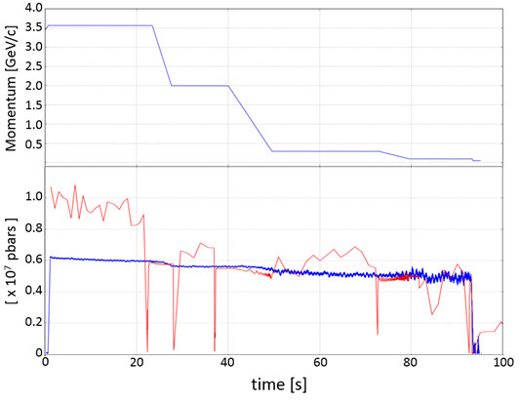
Beam intensity measurements
Coasting beam
Bunched beam
Momentum
Intensity obtained by normalizing beam current with velocity
Noise of current measurement is amplified for low-β.
CCC
SCHOTTKY
Low intensity injection:
N_{inj} = 0.61 x 10⁷
I_{beam} = 139 nA
Miguel Fernandes
International Conference on Accelerator Optimization

Slide 18
Performance limitations
Cryostat vaccum vessel
Cryostat thermal shield
RF-bypass
Needed for reducing signal slew-rate
opens path for perturbation currents flowing in beam pipe
I_{pert.}
I_{mirror}
I_{beam}
Could be responsible for:
Noise at 50Hz+harmonics
Offset jump due to discharge of rotation cavities
Miguel Fernandes
International Conference on Accelerator Optimization

Slide 19
Intensity measurement limitations
Cryostat vaccum vessel
Cryostat thermal shield
RF-bypass
Needed for reducing signal slew-rate
opens path for perturbation currents flowing in beam pipe
Proposed solution:
Move RF-bypass from ceramic gap to gap in thermal shield
Could be responsible for:
Noise at 50Hz+harmonics
Offset jump due to discharge of rotation cavities
Miguel Fernandes
International Conference on Accelerator Optimization

Slide 20
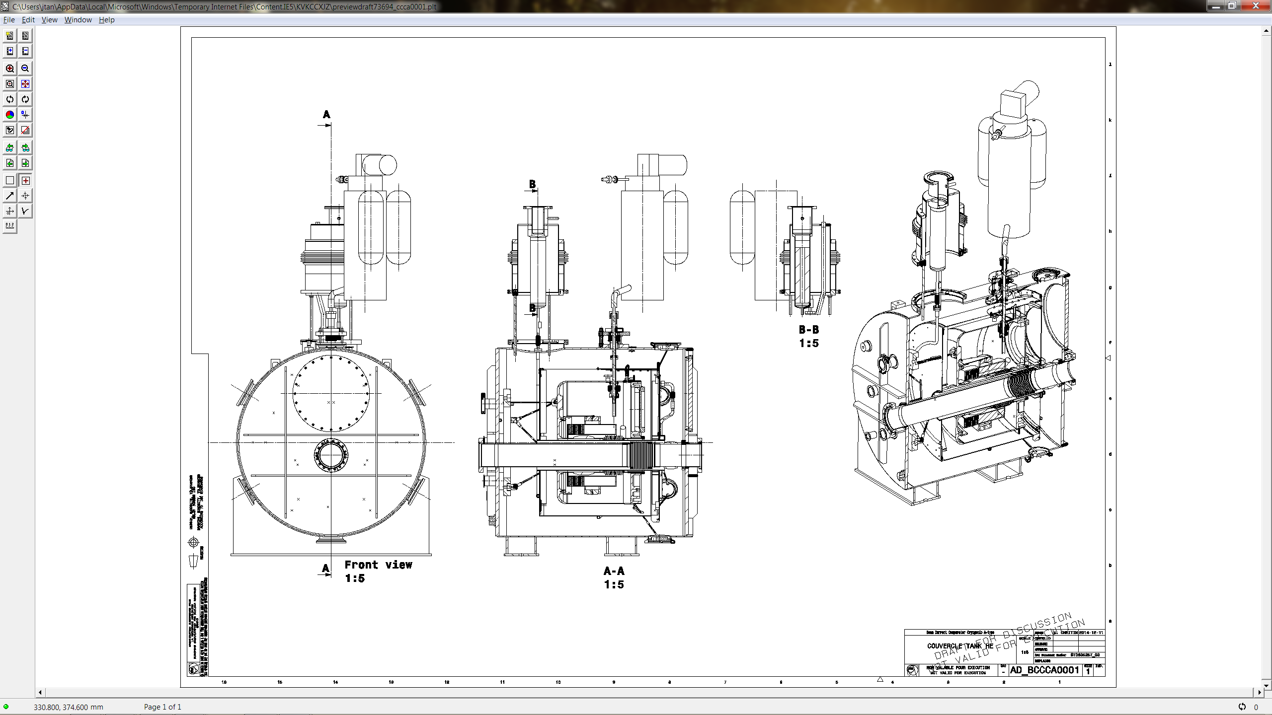
Cryogenic performance limitations
  Cryogenic system is not able to keep a constant level of liquid Helium
  Current investigations indicate this is due to excessive heat-load in thermal shield of: 12.1 W ( while design value is 7 W)
Miguel Fernandes
International Conference on Accelerator Optimization

Slide 21
Summary
CCC monitor adapted to AD-ring was implemented and installed, and first beam measurements were taken
Miguel Fernandes
International Conference on Accelerator Optimization

Slide 22
Summary
CCC monitor adapted to AD-ring was implemented and installed, and first beam measurements were taken
Measurement of beam current with 30nA resolution (after filtering) was demonstrated
Miguel Fernandes
International Conference on Accelerator Optimization

Slide 23
Summary
CCC monitor adapted to AD-ring was implemented and installed, and first beam measurements were taken
Measurement of beam current with 30nA resolution (after filtering) was demonstrated
First time ever CCC monitor is used on a synchrotron with a “fast” bunched beam
Miguel Fernandes
International Conference on Accelerator Optimization

Slide 24
Summary
CCC monitor adapted to AD-ring was implemented and installed, and first beam measurements were taken
Measurement of beam current with 30nA resolution (after filtering) was demonstrated
First time ever CCC monitor is used on a synchrotron with a “fast” bunched beam
Observed resolution limitations should be due to perturbation currents flowing in the beam pipe
Miguel Fernandes
International Conference on Accelerator Optimization

Slide 25
Summary
CCC monitor adapted to AD-ring was implemented and installed, and first beam measurements were taken
Measurement of beam current with 30nA resolution (after filtering) was demonstrated
First time ever CCC monitor is used on a synchrotron with a “fast” bunched beam
Observed resolution limitations should be due to perturbation currents flowing in the beam pipe
Cryostat needs to be periodically refilled due to excessive heat-load in thermal radiation shield
Miguel Fernandes
International Conference on Accelerator Optimization

Slide 26
Summary
CCC monitor adapted to AD-ring was implemented and installed, and first beam measurements were taken
Measurement of beam current with 30nA resolution (after filtering) was demonstrated
First time ever CCC monitor is used on a synchrotron with a “fast” bunched beam
Observed resolution limitations should be due to perturbation currents flowing in the beam pipe
Cryostat needs to be periodically refilled due to excessive heat-load in thermal radiation shield
Corrective measures for these limitations are to be implemented during next year end technical shutdown
Miguel Fernandes
International Conference on Accelerator Optimization

Slide 27

Acknowledgements
J. Tan; T. Koettig; A. Lees; J. Brachet; D. Lombard; P. Odier;
J. Belleman; E. Oponowicz; M. Ludwig
C. Welsch
F. Kurian; T. Schiwckert; T. Sieber; H. Reeg
R. Geithner; R. Neubert
Thank you !

Slide 28
EXTRA SLIDES

Slide 29
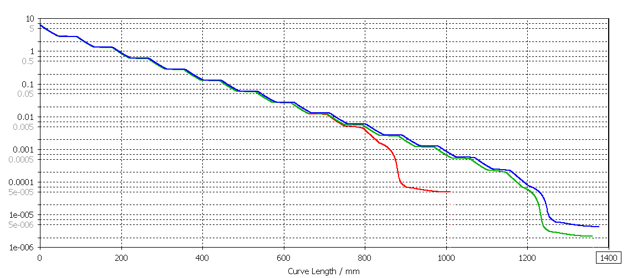
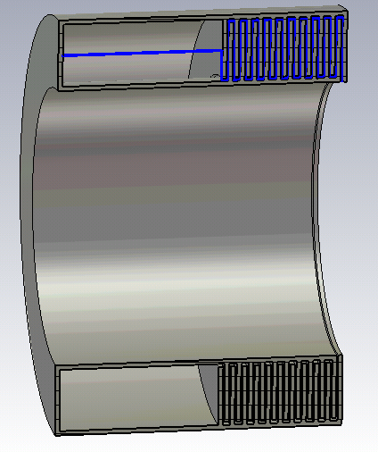
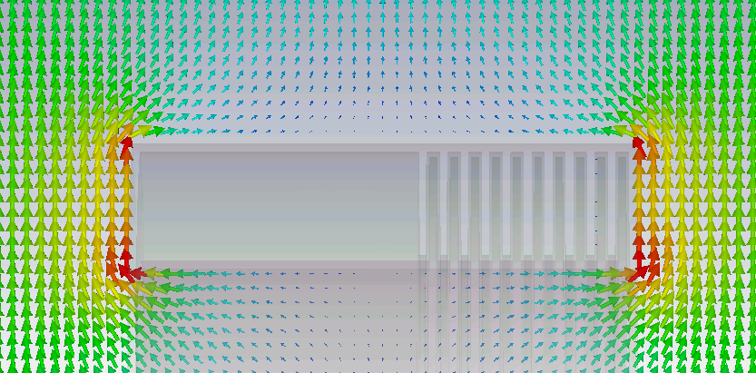
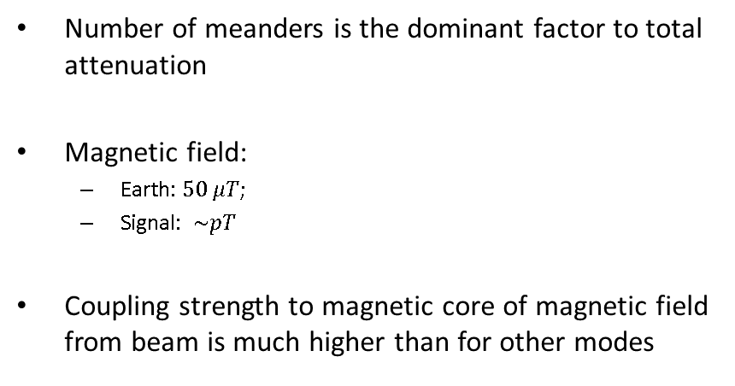

Magnetic shielding
14 meander
1mm gap
-127 dB
14 meander
0.5mm gap
-133 dB
10 meander
0.5mm gap
-106 dB
Number of meanders is the dominant factor to total attenuation
Magnetic field:
  Earth: $50 μT$;
  Signal: $\sim pT$
Coupling strength to magnetic core of magnetic field from beam is much higher than for other modes
$$A_{tt}≥\sim 120 dB$$

Slide 30
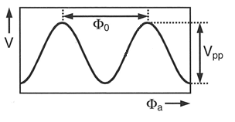
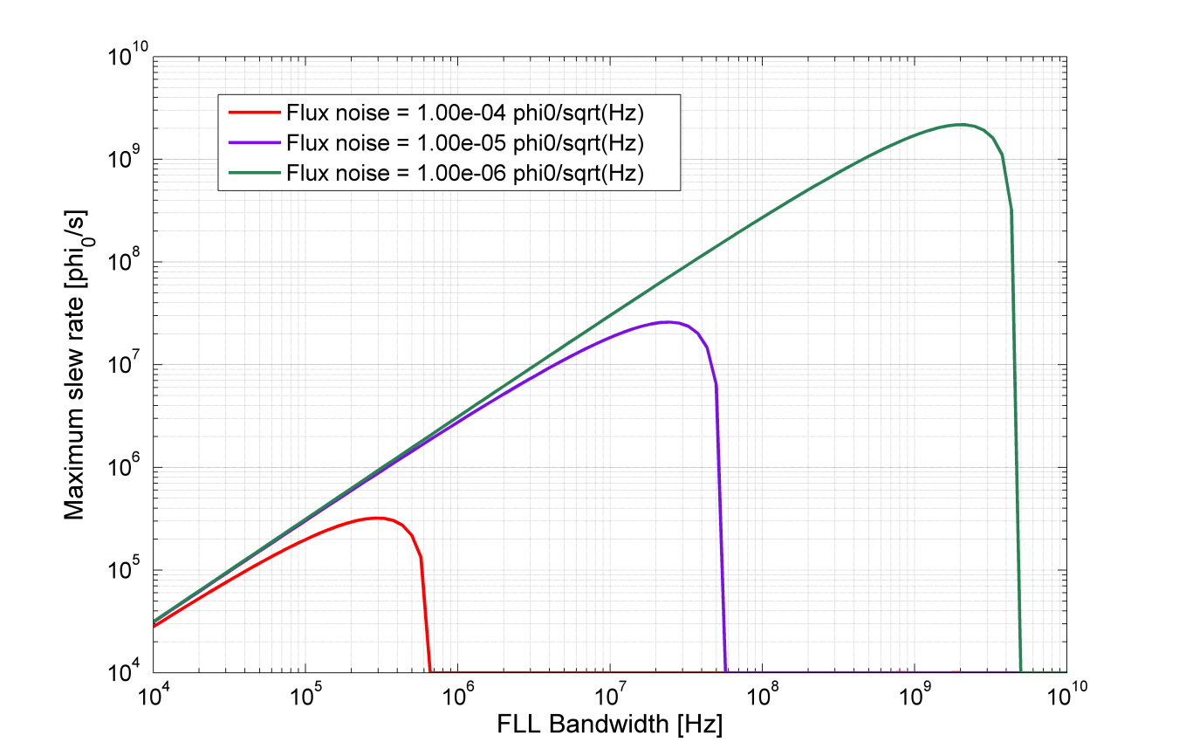
Stability limits
w
I_{beam}
Working region for our system
Allowed flux jump rate: <1/hour
FLL – Flux-Locked Loop

Slide 31
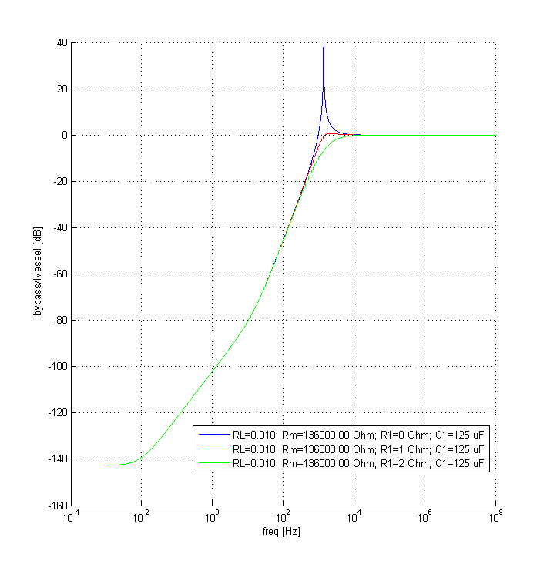
BCCCA functioning overview
Cryostat vaccum vessel
Cryostat thermal shield
I_{pert.}

Slide 32
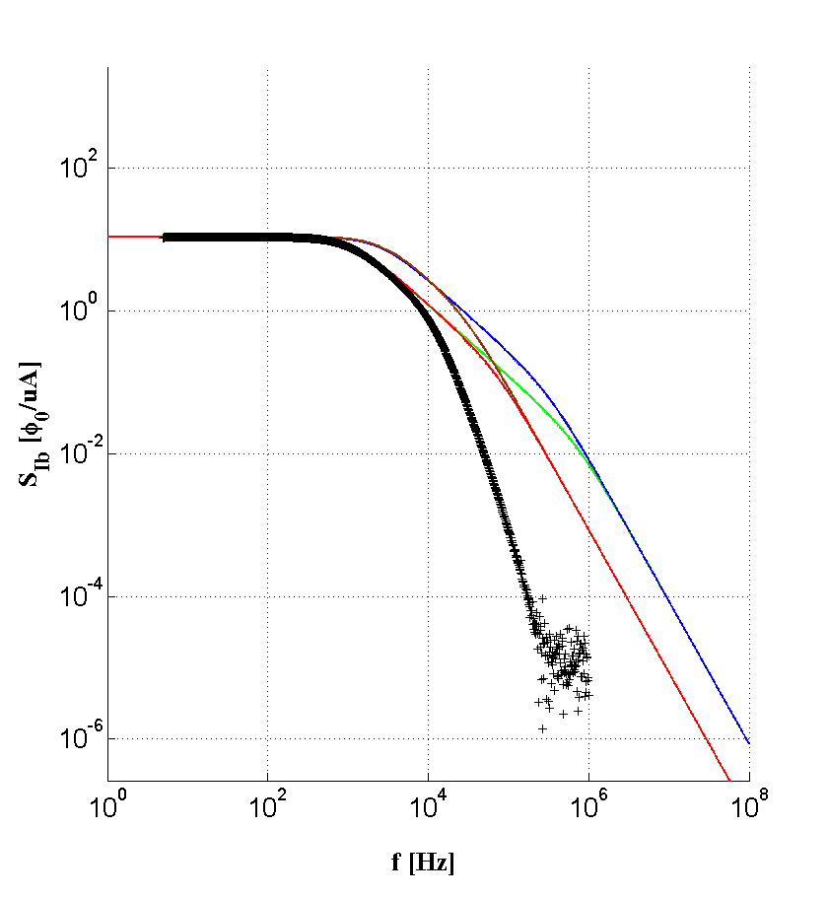
Frequency response
─ R = 0.50Ω; C = 1µF
─ R = 0.50Ω; C = 10µF
─ R = 0.23Ω; C = 1µF
─ R = 0.23Ω; C = 10µF
+ measurement with
(R = 0.23Ω; C = 10µF)
Coupling circuit theoretical response
Coupling circuit + cryostat measurement

Slide 33
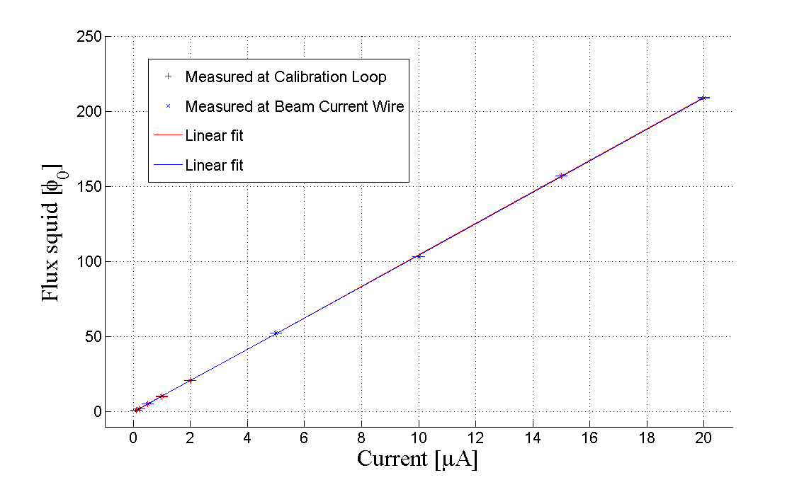
Calibration

