Slide 1
The Future of Human Space Exploration
William H. Gerstenmaier
Associate Administrator
Human Exploration & Operations Mission Directorate
April 2015

Slide 2
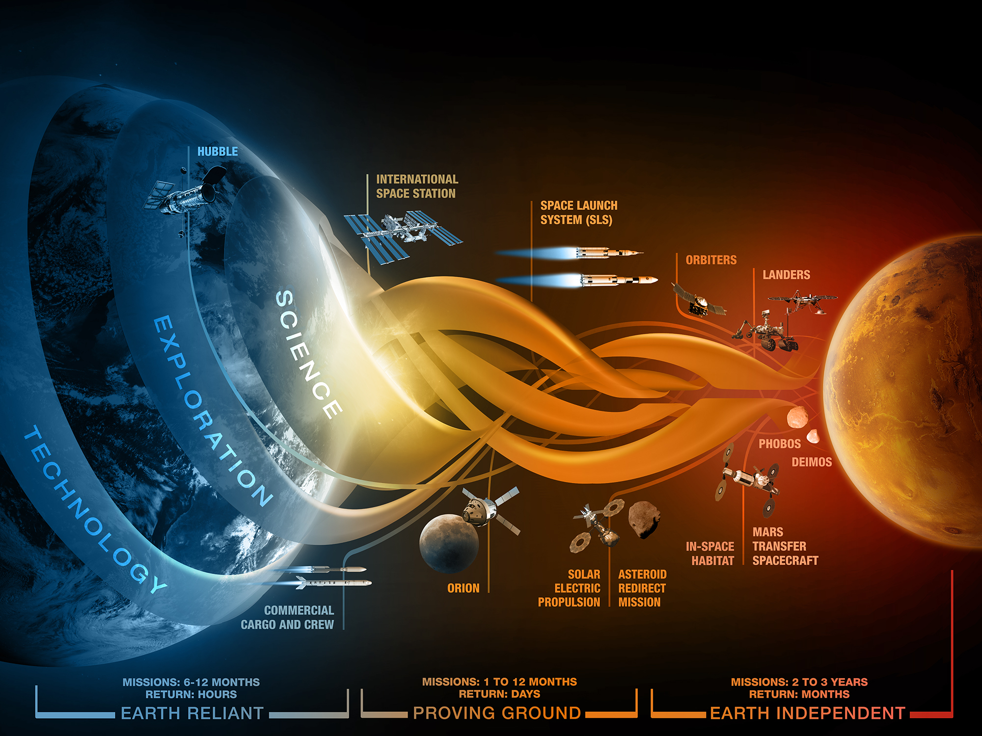



Slide 3
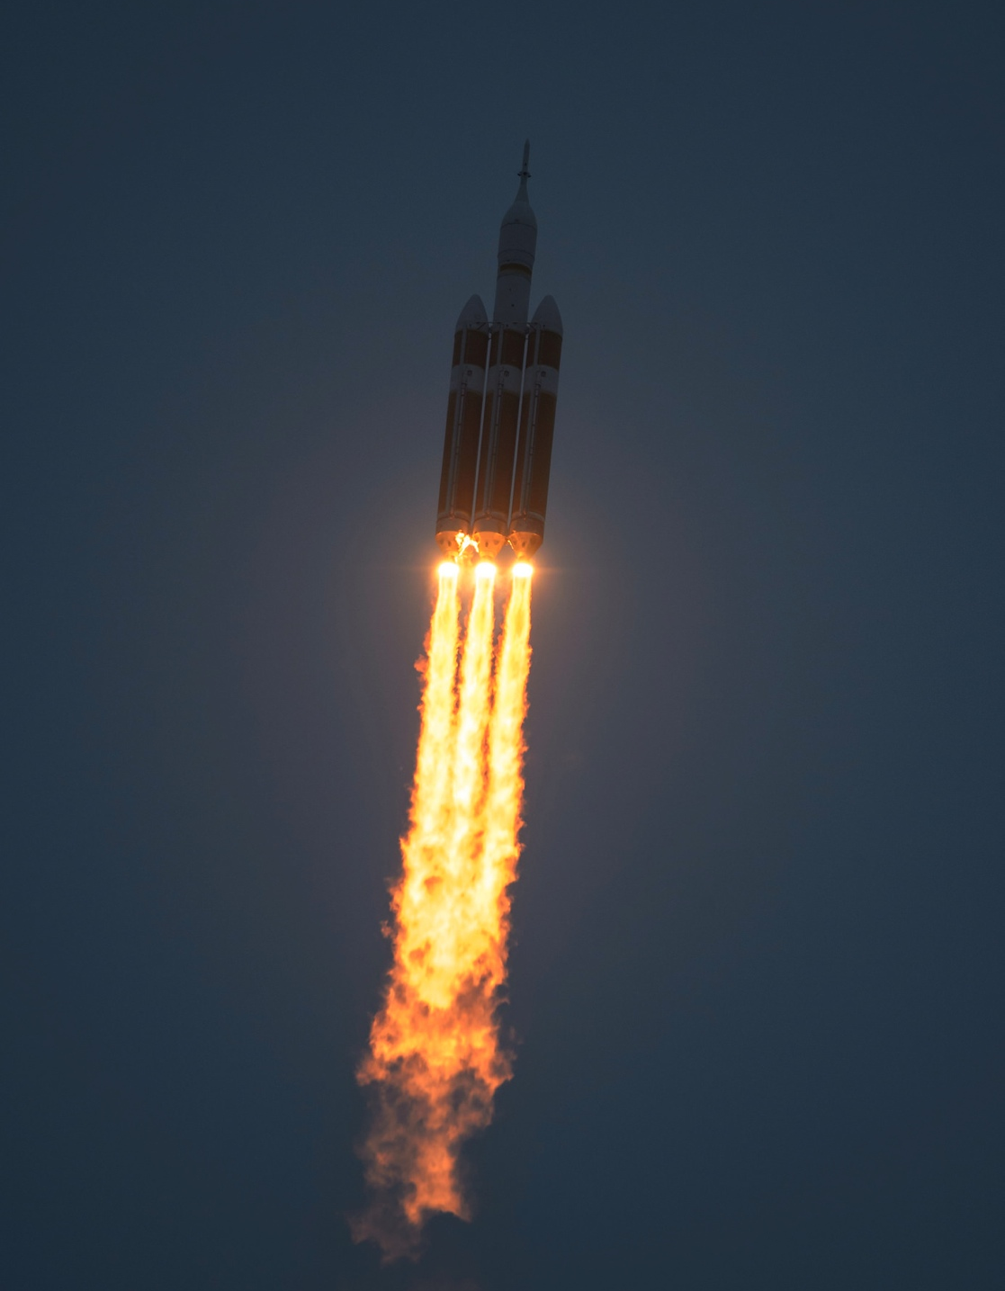
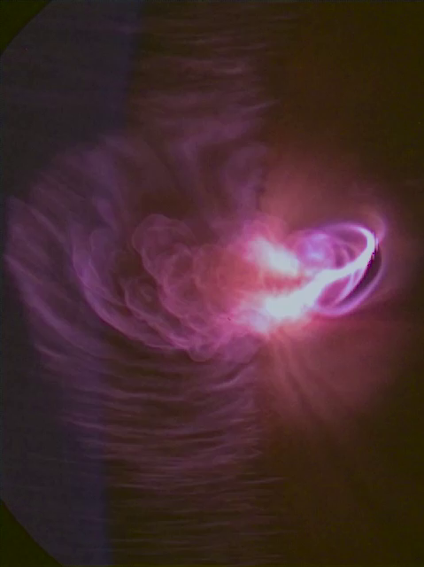
Exploration Flight Test-1
EFT image
View of plasma surrounding Orion during re-entry.
Notes:
The United Launch Alliance Delta IV Heavy rocket with NASA’s Orion spacecraft mounted atop, lifts off from Cape Canaveral Air Force Station's Space Launch Complex 37 at at 7:05 a.m. EST, Friday, Dec. 5, 2014, in Florida. The Orion spacecraft will orbit Earth twice, reaching an altitude of approximately 3,600 miles above Earth before landing in the Pacific Ocean.

Slide 4
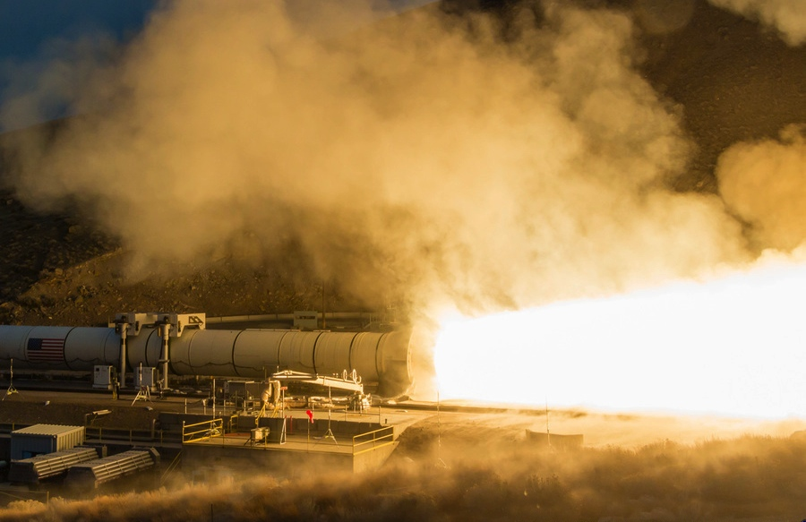
Qualification Motor-1

Slide 5
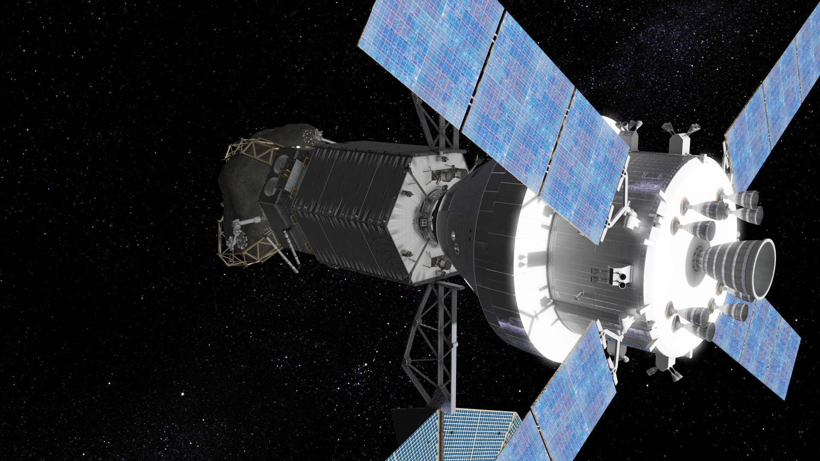
Asteroid Redirect Mission
Already, ARM has pointed us to the utility of both SEP and Distant Retrograde Orbits around the Moon for efficiently transporting large masses in space, e.g., from lunar orbit to Mars orbit.

Slide 6
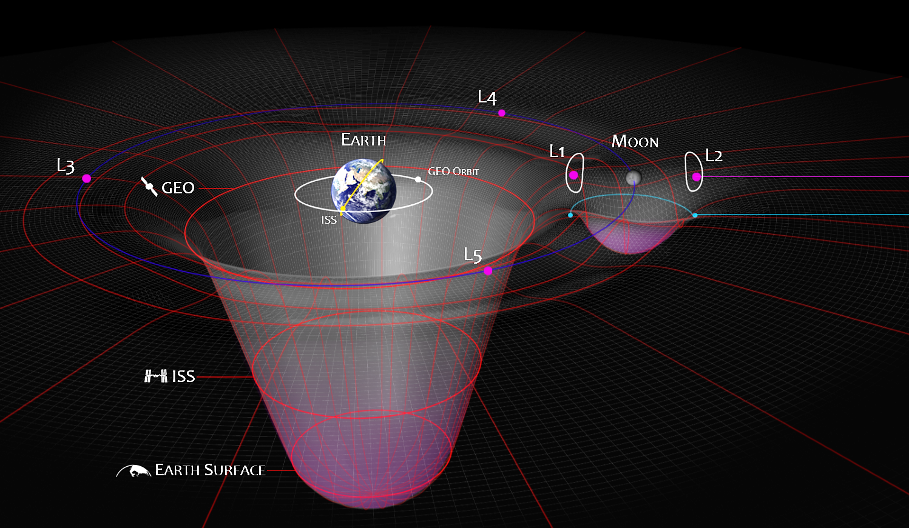
Cis-Lunar Space:
How the Earth and the Moon Interact
The contours on the plot depict energy states in the Earth-Moon System and the relative difficulty of moving from one place to another.
A spacecraft at L2 is actually orbiting Earth at a distance just past the Moon, however if you look at it from the Moon, the orbit will look like an ellipse around a point in space giving them the name “halo orbits”.
Family of DROs in Earth-Moon Plane
The interaction of the Earth and Moon creates bends in the energy contours that can be used to lower the energy needed to move around the Earth-Moon system and beyond, such as this example of a low energy transfer between L1 and L2 .
The Lunar Distant Retrograde Orbit leverages these equilibrium and low energy contours to enable a stable orbit with respect to the Earth and Moon, that is accessible with about the same energy as L1 or L2.

Slide 7
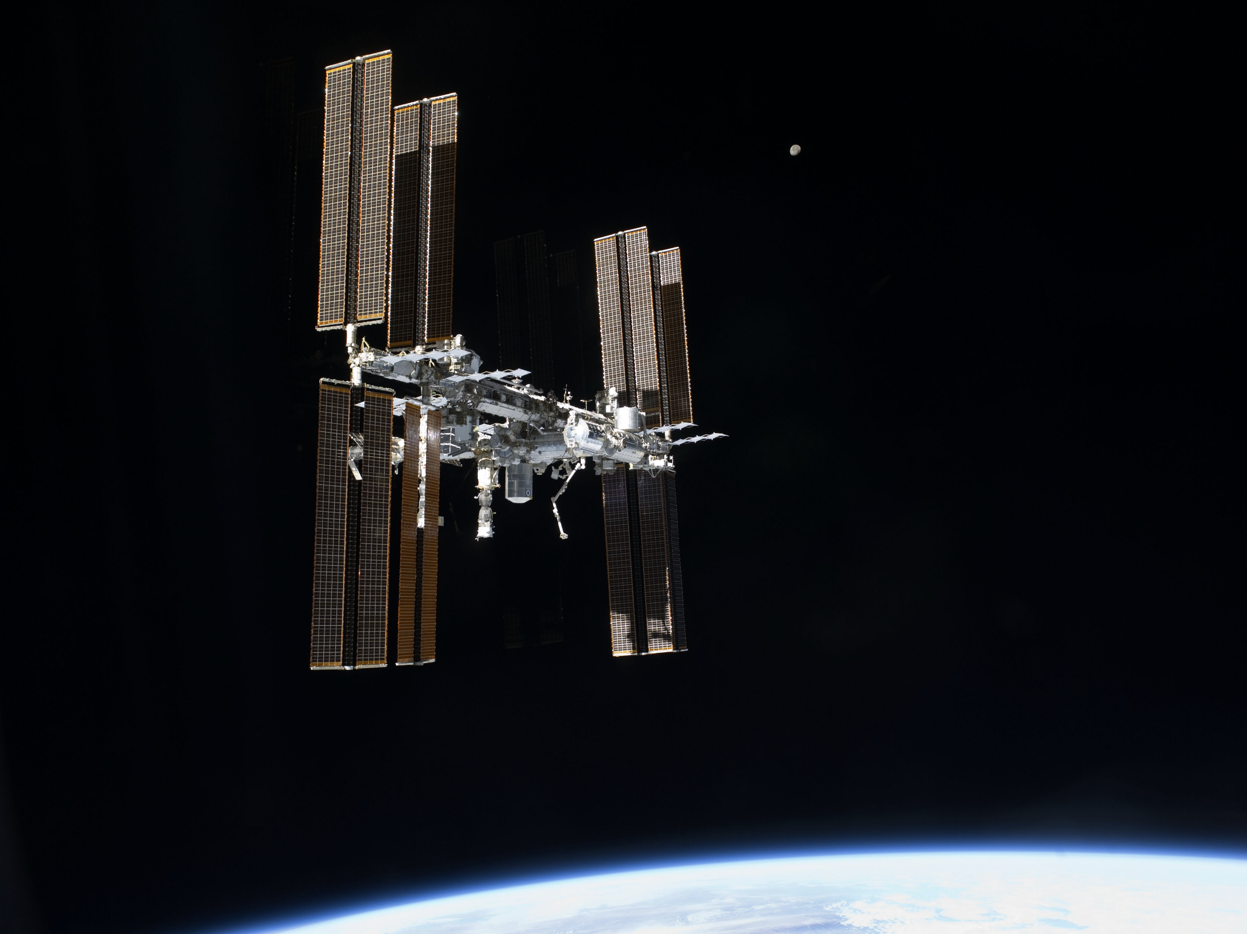

Slide 8
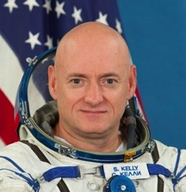
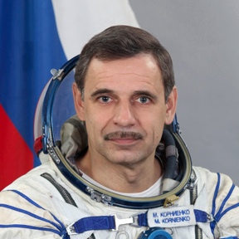
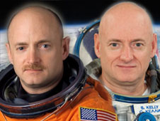
ISS One-Year Mission
2015 marks the launch of astronaut Scott Kelly and cosmonaut Mikhail Kornienko to the ISS for 12 months – the longest mission ever assigned to a US astronaut
  Joint US/Russian ISS research includes studies on: ocular health, immune and cardiovascular systems, cognitive performance testing, and effectiveness of countermeasure against bone and muscle loss
HRP study of identical twins astronaut Scott Kelly, and retired astronaut, Mark Kelly
  Provides unprecedented opportunity to research effects of spaceflight on twin genetic makeup, and better understand the impacts of spaceflight on the human body
Scott Kelly
STS-103, STS-118,
ISS 25/26
Mikhail Kornienko ISS 23/24
Retired astronaut Mark Kelly (left) and his twin brother, astronaut Scott Kelly, who will spend a year on ISS
http://www.nasa.gov/exploration/humanresearch/index.html

Slide 9

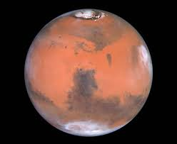

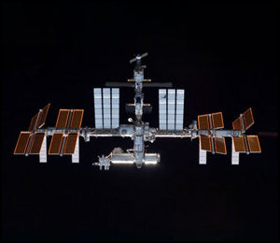
Compare Going to Mars to Where
We Are Today with ISS
228,000,000 kilometers
~1 - 3 years transit time
Communications (up to 42 minutes)
~ 2 days transit time
“ recreate living on Earth capability”
228,000,000 kilometers
Communications (near real-time)
390 kilometers
Crew exchanges
Crew supplies and logistics
Crew and atmosphere samples
Modified hardware
“extreme car camping in space”
Emergency Crew Return
Trash

Slide 10
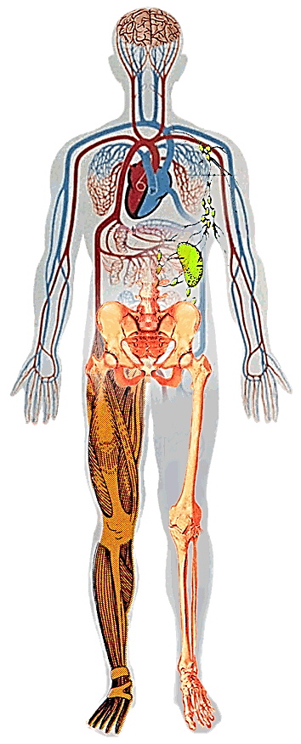
Human Spaceflight Risks are Driven by
Spaceflight Hazards
Altered Gravity - Physiological Changes
Distance from Earth
Drives the need for additional “autonomous” medical care capacity – cannot come home for treatment
  Balance Disorders
  Fluid Shifts
  Visual Alterations
  Cardiovascular Deconditioning
  Decreased Immune Function
  Muscle Atrophy
  Bone Loss
Hostile/
Closed Environment
Space Radiation
Vehicle Design
Environmental – CO₂ Levels, Toxic Exposures, Water, Food
Acute In-flight effects
Long-term cancer risk
CNS and Cardiovascular
Isolation & Confinement
Behavioral aspect of isolation
Sleep disorders

Slide 11
Mars Mission Human Health Risks
Based On The On-going Human System Risk Board (HSRB) Assessment,
The Following Risks Are The Most Significant For A Mars Mission:
Adverse affect on health
  space radiation exposure (long-term cancer risk)
  spaceflight-induced vision alterations
  renal stone formation
  compromised health due to inadequate nutrition
  bone fracture due to spaceflight induced bone changes
  acute and chronic elevated carbon dioxide exposure
Inability to provide in mission treatment/care
  lack of medical capabilities
  ineffective medications due to long term storage
Adverse impact on performance
  decrements in performance due to adverse behavioral
  conditions and training deficiencies
  impaired performance due to reduced muscle and aerobic capacity, and sensorimotor adaptation
Post Mission
Risks
In- Mission
Risks
11

Slide 12


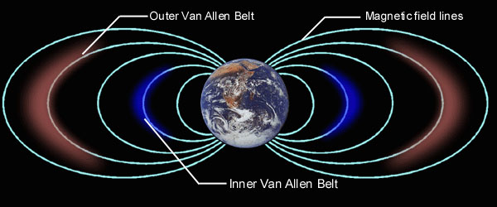
Environmental Considerations
Protection from SPE except high energy
Some protection from GCR low energy
Orbital debris and micro-meteoroid environment
Sun and reflected energy from the earth
6 months to 1 year crew exposure to microgravity
No protection from SPE
No protection from GCR
Micro-meteoroid environment
Energy from sun reduced
1 to 3 years crew exposure to microgravity
Isolation and distance

Slide 13
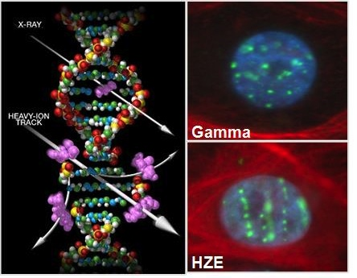
Space Radiation Challenge
Crews are exposed to the space radiation environment
  High-energy protons and heavy ions (HZE’s) as well as secondary particles produced in shielding and tissue
Space radiation produces potential increased health risks of cancer and acute exposure
  Damage to cells is uniquely different from terrestrial sources of radiation
Measurements to accurately characterize the GCR space radiation at high energies is needed to validate mitigation strategies
  AMS-02 can provide this information
DNA Damage in Cells: Space radiation (HZE) dense ionizing particle track

Slide 14
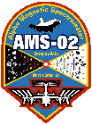

AMS-02 GCR and SEP Studies
Collaboration between NASA space radiation group and AMS-02 research group at the University of Hawaii, Veronica Bindi
Space Station is a unique platform for precision physics research
  AMS-02 is measuring the cosmic ray fluxes with unprecedented uncertainty and accuracy
  University of Hawaii research group is focused on the AMS-02 energy range that supports NASA human space exploration missions and is unavailable from other satellites
Improvement in accuracy will provide new insights in areas such as the study of the cosmic rays and solar activity, and has application to NASA space radiation health assessments and shielding design
Main Research Focus:
Cosmic Rays Fluxes and their changes with the solar activity
Heliophysics - Study of the Solar Energetic Particles

Slide 15
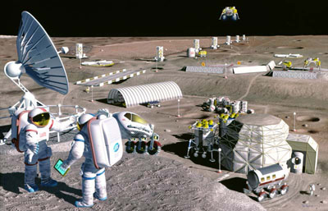
GCR Study Goals
Main goal of this collaboration is to provide to NASA during the next 5 years, the monthly Proton-Helium-Carbon fluxes measured
by AMS-02 from 2011 till 2019, in the energy
range from 1 to 10 GV - where the radiation
is expected to be the most harmful.
The radiation group will use the AMS-02 monthly fluxes to improve the GCR models employed to predict the radiation dose absorbed by astronauts for both ISS operations and long duration missions.

Slide 16
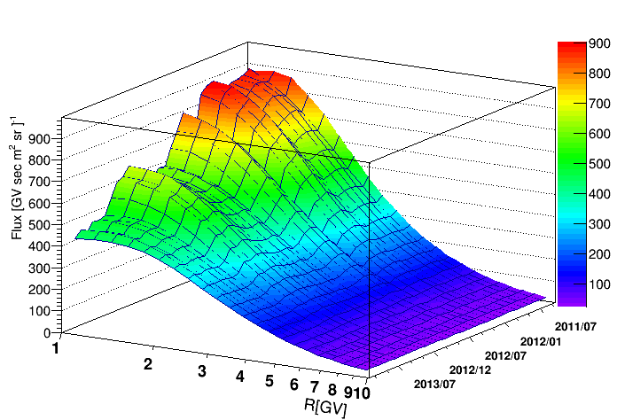
AMS-02 Proton Flux
First set of AMS-02 GCR fluxes to be delivered to NASA: Information over this energy range and of this quality is unavailable from any other source
May2011
Time
Nov2013
Graph shows the overall reduction of the proton flux at low energies due to increasing solar activity at unprecedented uncertainty and accuracy
Monthly fluctuations are the result of short timescale solar activity

Slide 17
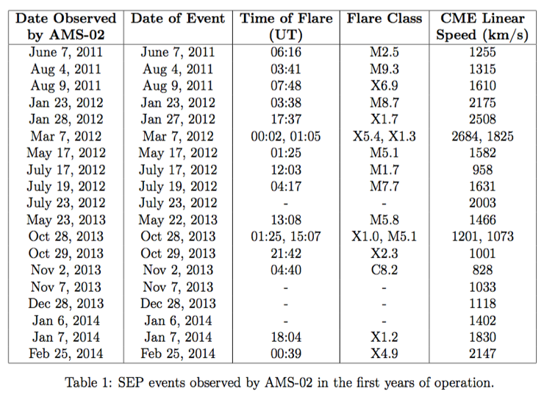
Heliophysics with AMS-02
AMS-02 is the largest SEP detector ever flown in Space that can measure Proton and Helium from solar events with unprecedented statistics at energies not always accessible from current satellites
  ~20 High Energy SEP events observed by AMS-02

Slide 18
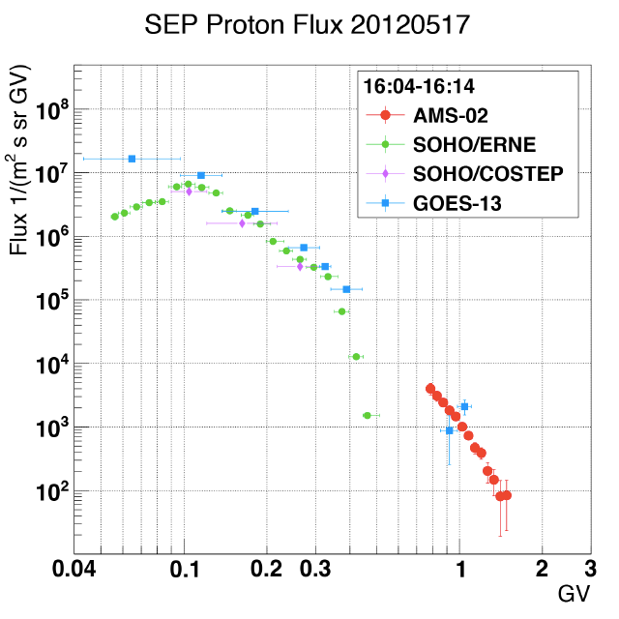
SEP Spectra
SEP spectra measured by AMS-02 cover the highest energy range
of SEPs (shown in red on graph)
AMS data combined with other instruments at lower energy, will provide a baseline for the modeling of SEP energy spectra
Energy range is unavailable from other satellites
This energy range is critical to understanding potential health effects from SEPs
Supports design of effective space radiation shielding and storm shelters for space exploration missions
May 17 2012 event
Preliminary results

Slide 19
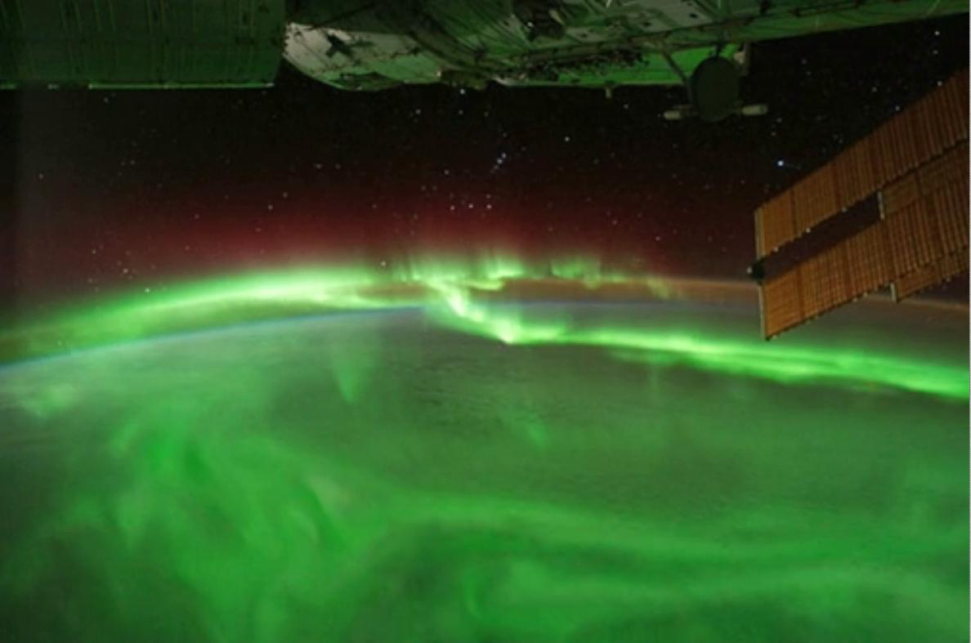
Earth’s visualization of particles and atmospheric interaction

Slide 20
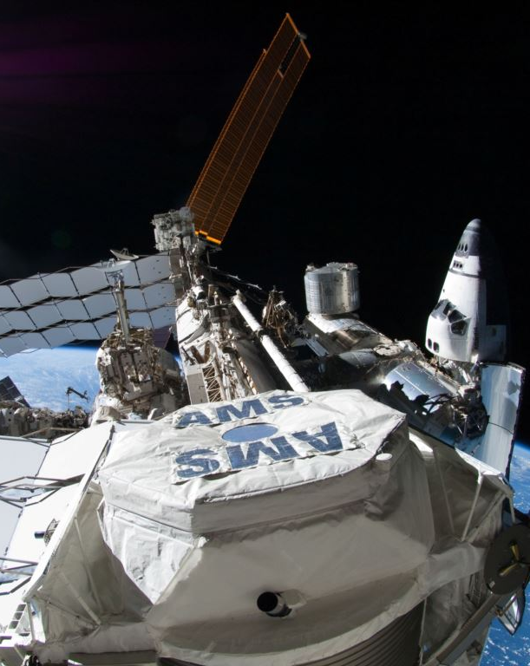
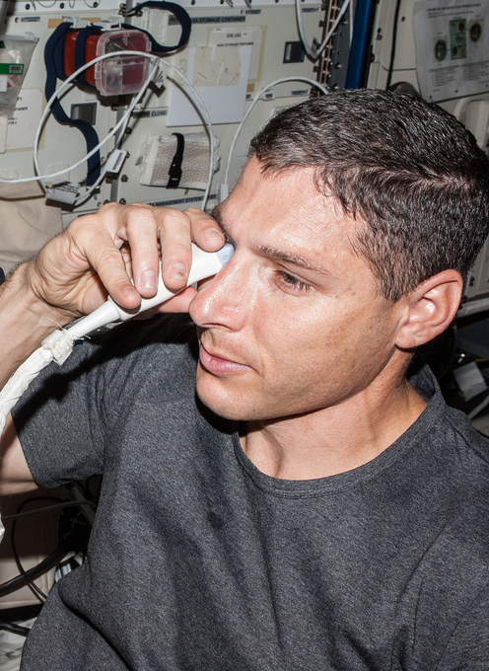
Continued ISS operation is essential for science and human exploration

