Slide 1
AMS DAYS at CERN: 15 – 17 April 2015
Latest Results from the Pierre Auger Observatory and Future Prospects for Particle Physics and Cosmic Ray Studies
Alan Watson
University of Leeds
on behalf of the Pierre Auger Collaboration
a.a.watson@leeds.ac.uk

Slide 2
Outline
The Auger Observatory – close to the end of phase 1
Events and analysis methods
Vertical and inclined showers
Spectrum measurements
Arrival directions – some recent results
Mass: Recent results on Nuclei
Photon limit
Neutrino limit
Insights into hadronic interactions
The future for the Auger Observatory
Very little discussion of implications of data: stress measurements

Slide 3
Flux of Cosmic Rays
1 particle m⁻² s⁻¹
Air-showers
Direct
Measurements
AMS
ATIC
PAMELA
CREAM
32 decades
in intensity
‘Knee’
1 particle m⁻² per year
Auger
Telescope Array
Ankle
1 particle km⁻² per year
S Swordy
(Univ. Chicago)
LHC
12 decades
in energy

Slide 4
Does the Cosmic Ray Energy Spectrum terminate?
Greisen-Zatsepin-Kuz’min – GZK effect (1966)
γ_{2.7 K} + p → Δ⁺ → n + π⁺ or p + πº
and
γ_{IR/2.7 K} + A → (A – 1) + n
Sources must lie within ~ 100 Mpc at 100 EeV
Note that neutrinos - of different energies –
come from the decay of π⁺ and n
Photons from decay of πº

Slide 5
The Pierre Auger Collaboration
Croatia* Czech Republic France Germany Italy Netherlands Poland Portugal Rumania Slovenia Spain (United Kingdom) | Argentina Australia Brasil Bolivia* Colombia* Mexico USA Vietnam* *Associate Countries ~ 400 PhD scientists from ~ 100 Institutions in 17 countries
Aim: To measure properties of UHECR with unprecedented
precision to discovery properties and origin of UHECR

Slide 6
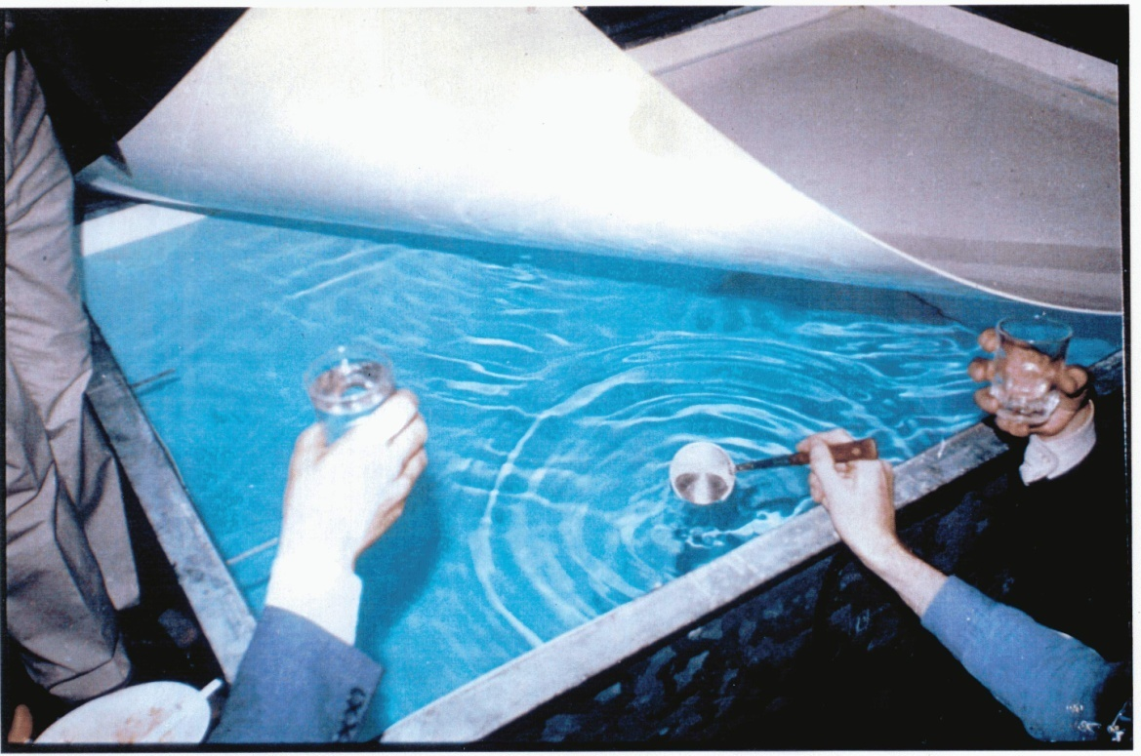
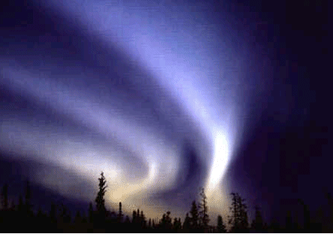
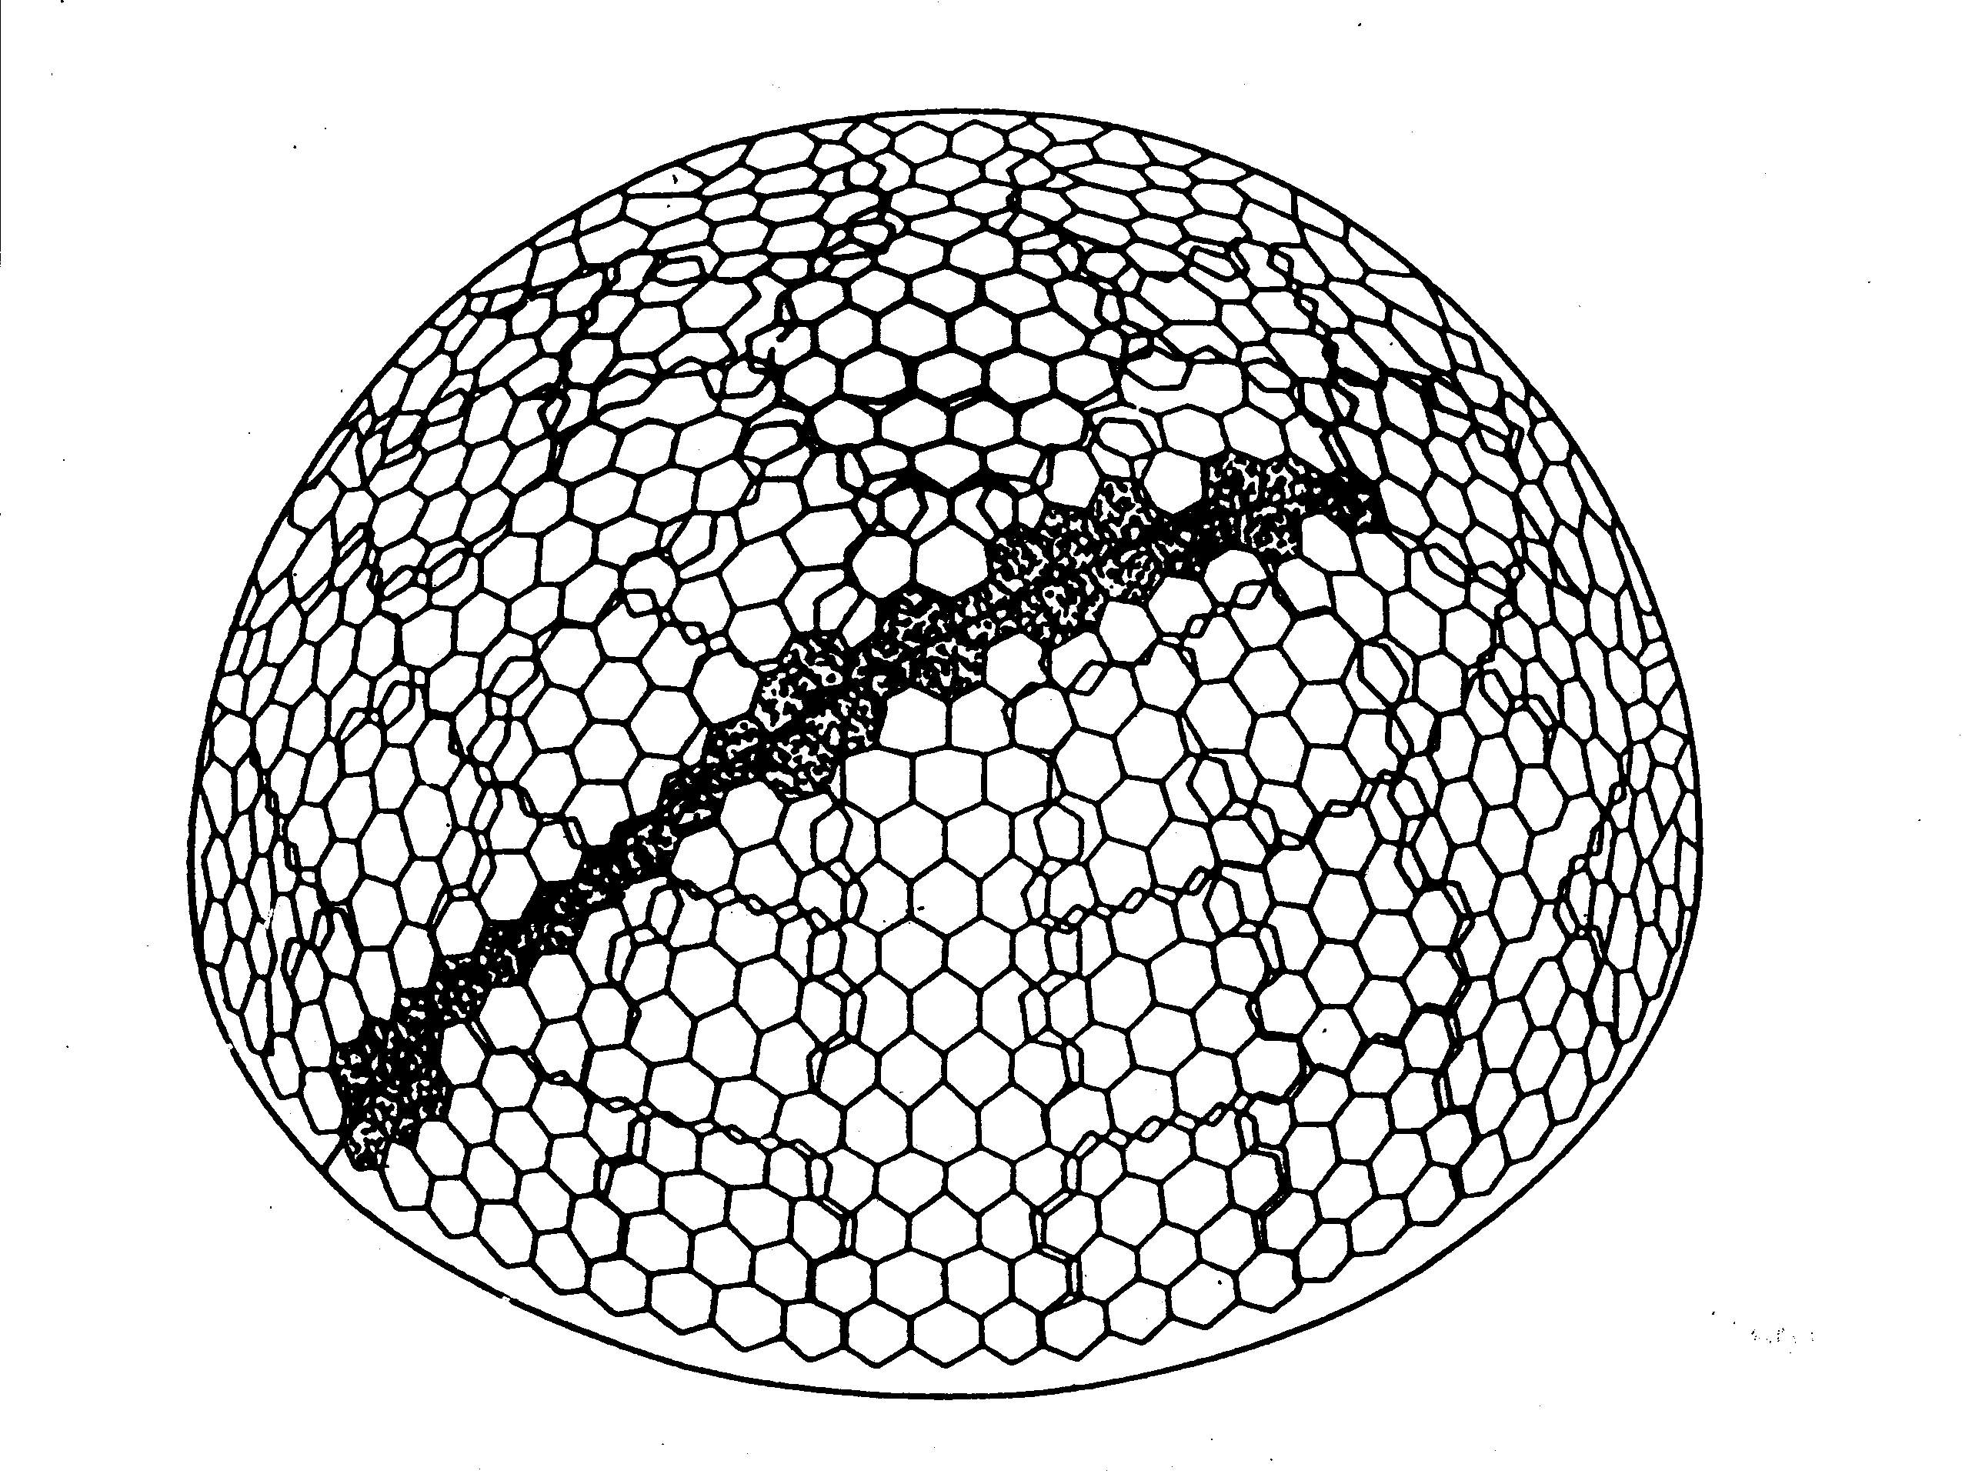
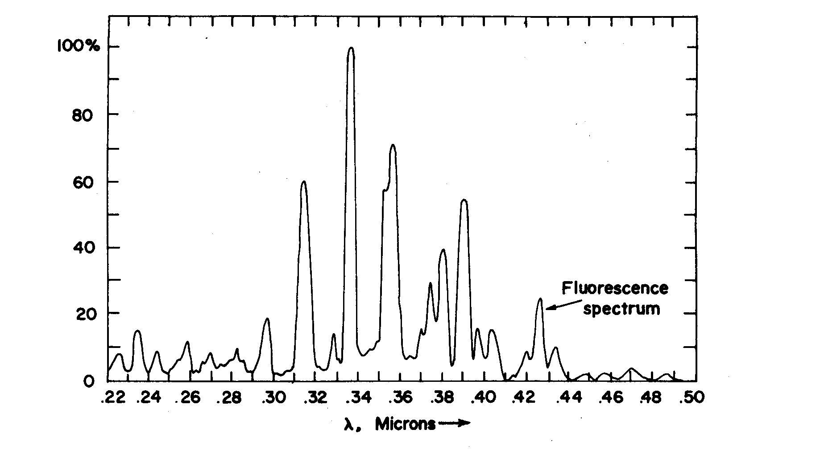
Water-Cherenkov, Haverah Park (UK):
A tank was opened at the ‘end of project’ party on 31 July 1987. The water shown had been in the tank for 25 years - but was quite drinkable
Jim Cronin: “An existence proof”
Schematic of the Fly’s Eye
Fluorescence Detector
of University of Utah
Notes:
Haverah Park tank open at end of experiment

Slide 7
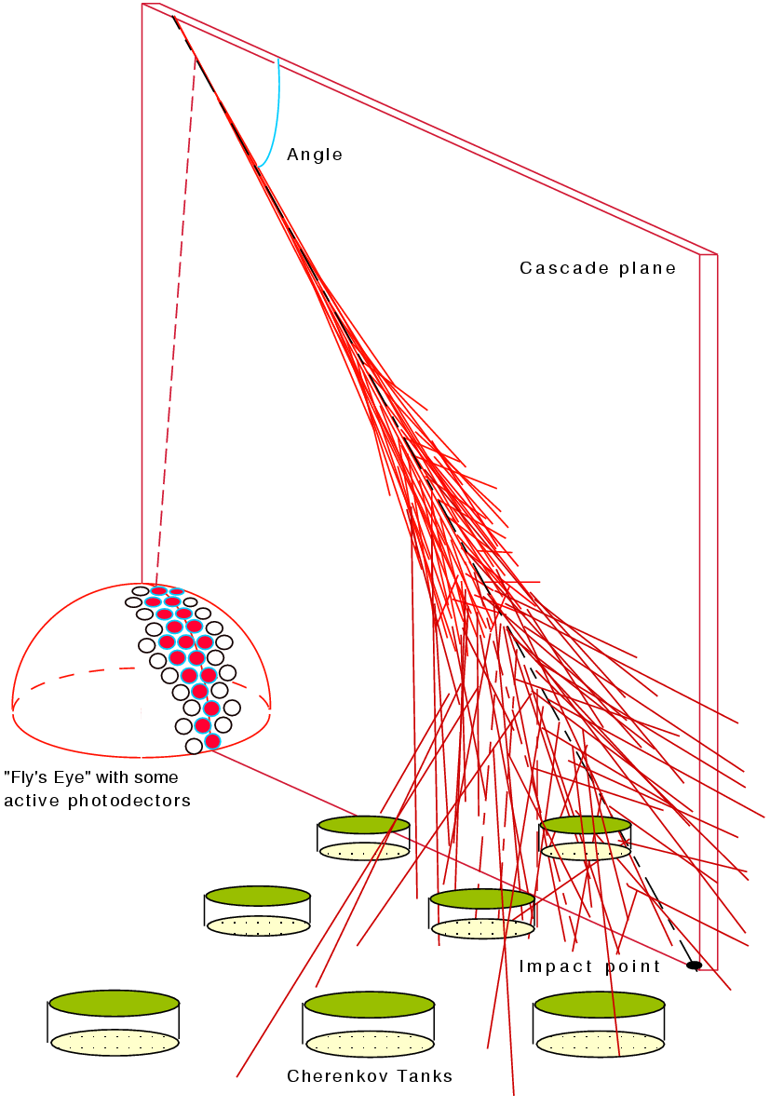
The Design of the Pierre Auger Observatory marries these two
techniques in
the ‘HYBRID’ technique
Fluorescence →
AND
Array of water- Cherenkov detectors →
11
Enrique Zas, Santiago de Compostela

Slide 8
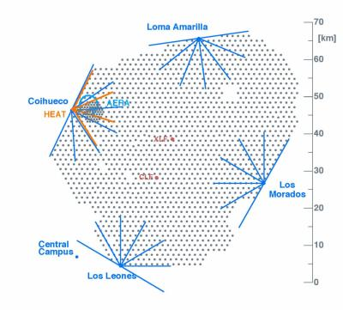
The Pierre Auger Observatory
1600 water-Cherenkov
detectors: 10 m² x 1.2 m
3000 km²
Fluorescence detectors
at 4 locations
Two laser facilities for
monitoring atmosphere and
checking reconstruction
Lidars at each FD site
Radio detection at AERA
Muon detectors – buried
.
LHC
LHC
.
XLF
CLF

Slide 9
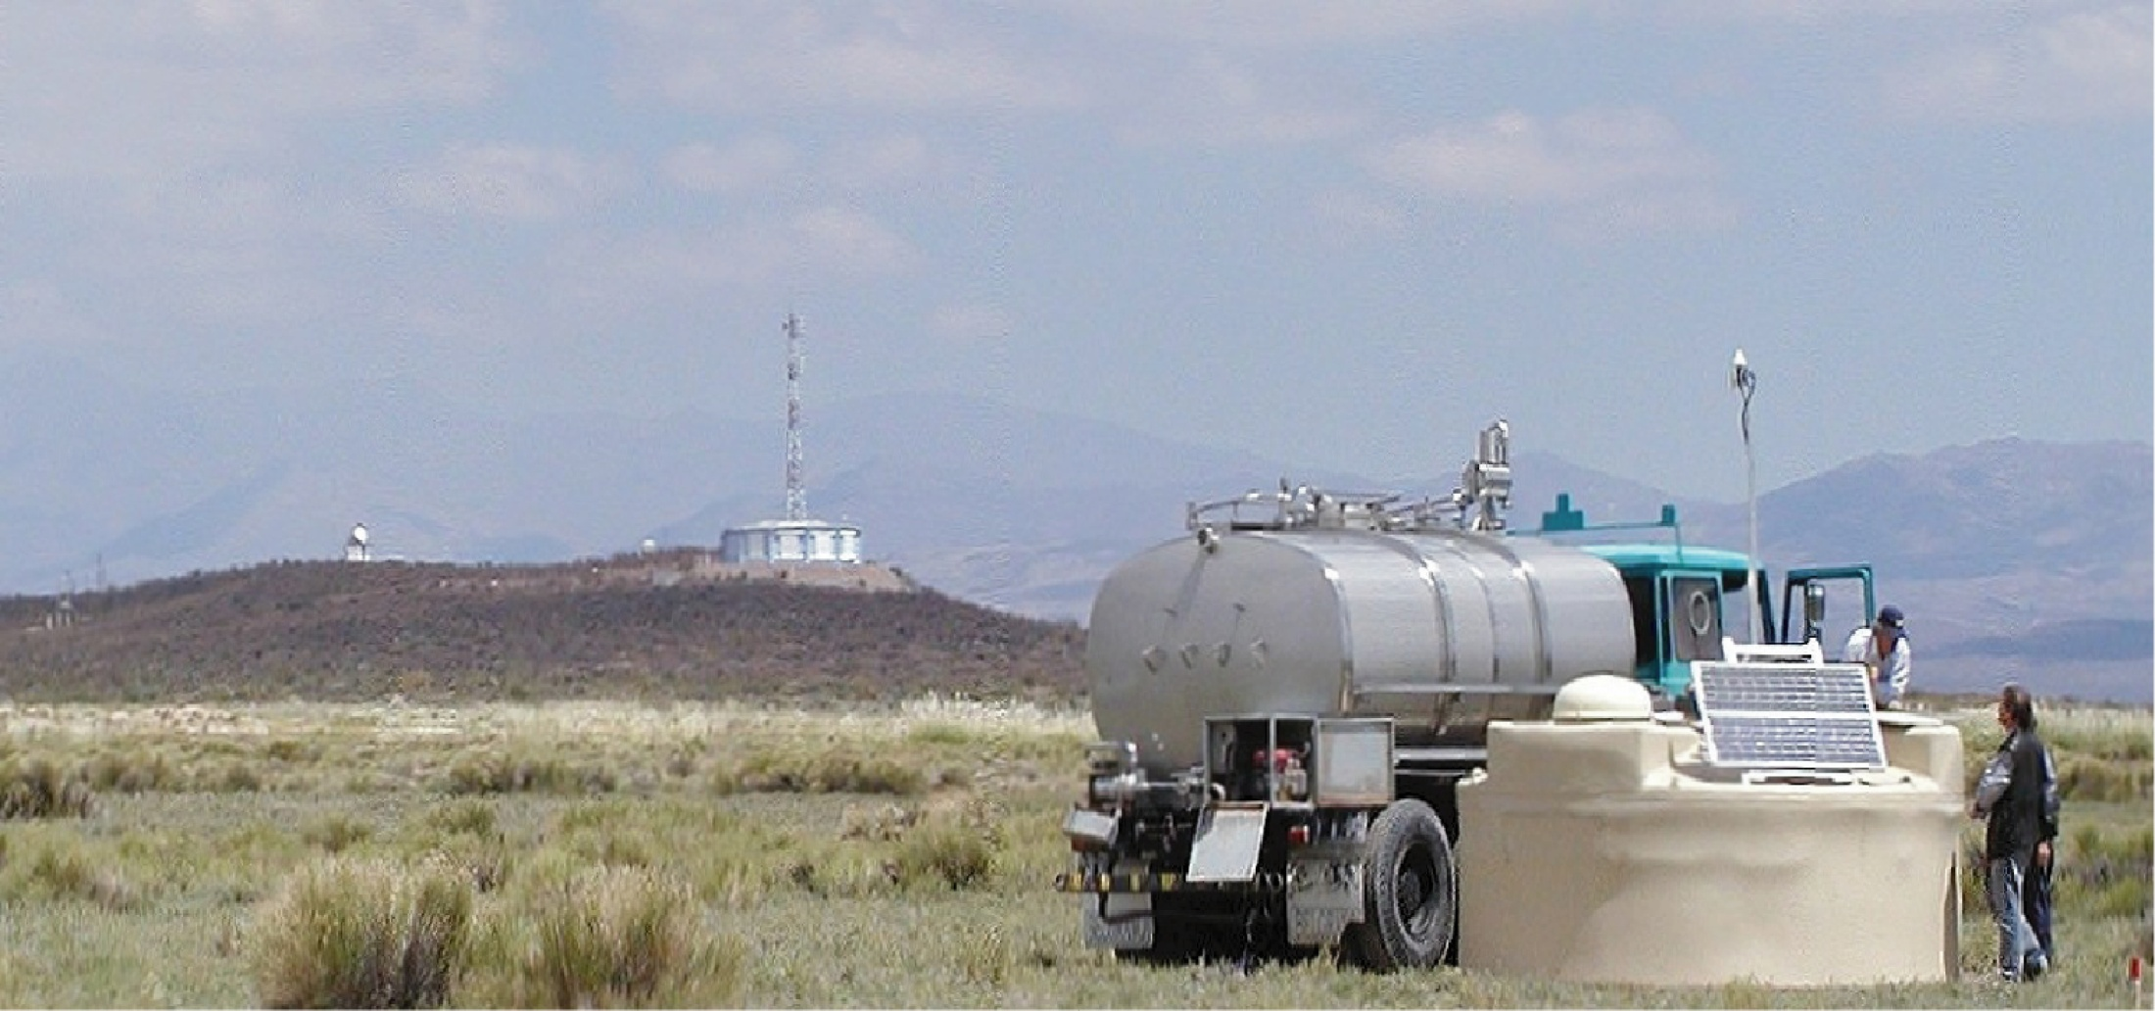
GPS Receiver
and radio transmission

Slide 10
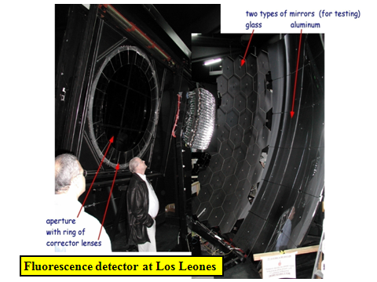

Slide 11
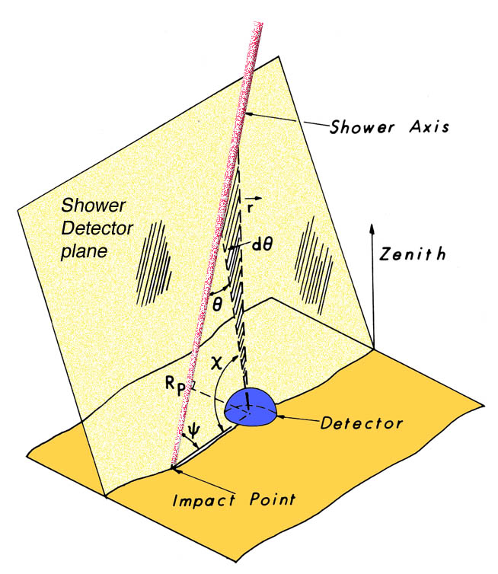
Important feature of the hybrid approach
Precise shower
geometry from
degeneracy given
by SD timing
Essential step towards high quality energy and X_{max} resolution
Times at angles, χ , are key to finding R_{p}

Slide 12
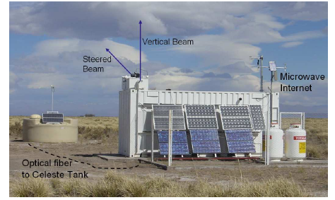
Angular and core location resolution from Central Laser Facility
355 nm, frequency tripled, YAG laser,
giving < 7 mJ per pulse: GZK energy

Slide 13
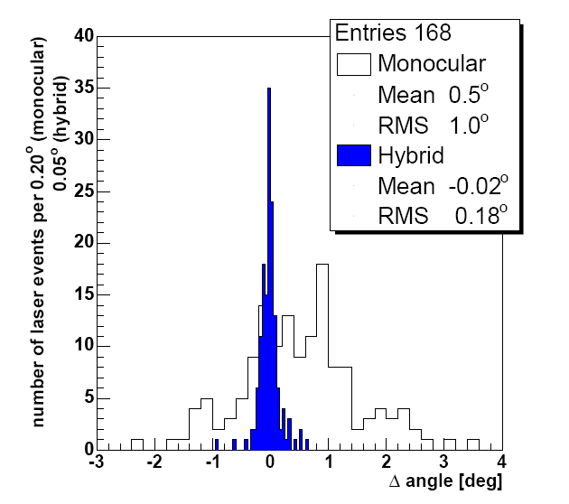
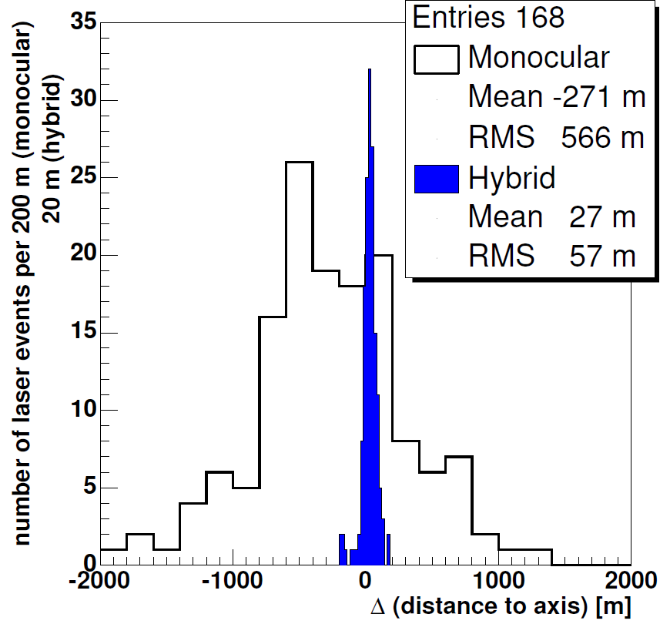
Angular Resolution
Core Location accuracy

Slide 14
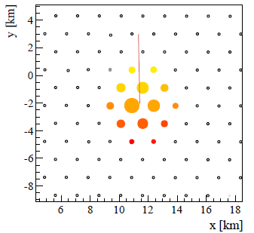
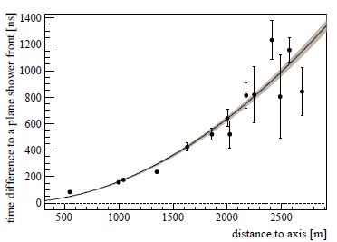
Reconstruction of an Auger Event using water-Cherenkov detectors
(i) Reconstruction of arrival direction
Angular Accuracy: better than 0.9° for more than 6 stations (arXiv 1502.01323)

Slide 15
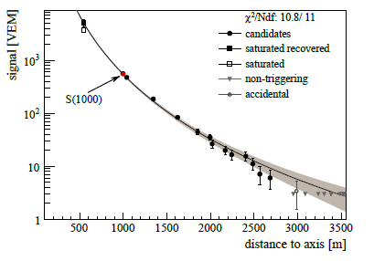
(ii) Reconstruction of shower size, S(1000)
Signal in event, E = (104 ± 11) eV and θ = 25.1°
14 stations
Choice of S(1000) as the ‘shower size’ is dictated by the spacing of the detectors
It is distance at which signal has minimum spread for a range of lateral distributions
Accuracy of S(1000) ~ 10%. Details at arXiv 0709.2125 and 1502.01323
(compare TA: 1.2 km spacing and parameter is S(800))

Slide 16
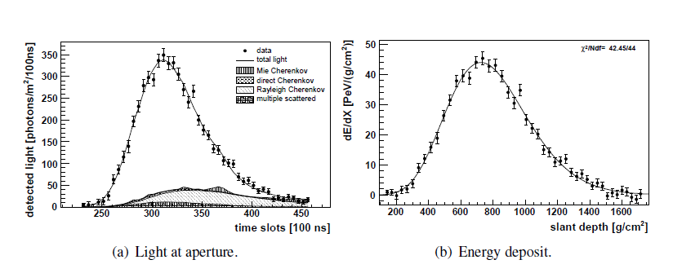
Reconstruction of fluorescence event

Slide 17

A Hybrid Event
Energy Estimate
from area under
curve
(2.1 ± 0.5) x 10¹⁹ eV
must also account for
‘invisible energy’

Slide 18
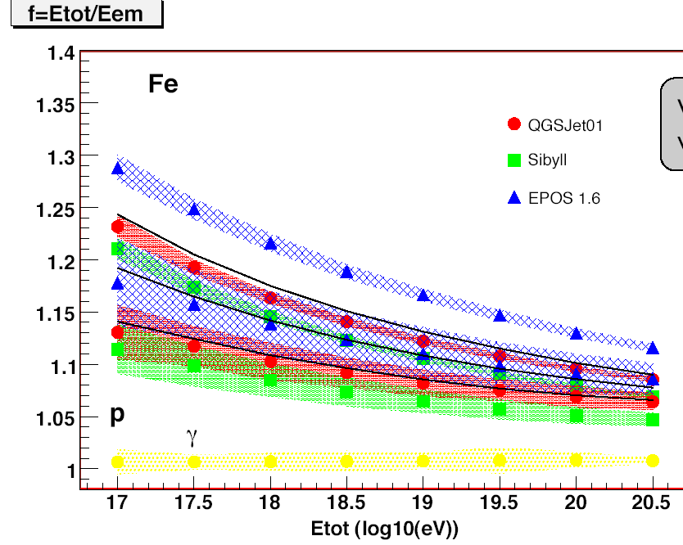
f = E_{tot}/E_{em}
Invisible Energy
For more detailed discussion, see arXiv 1307.5059
1.17
f
1.07
E_{tot} (log₁₀(eV))

Slide 19
Spectrum determination: Minimal use of hadronic models
Vertical events (< 60°):
Uses fact that showers at different zenith angles but
of the same energy come at same rate
Constant Intensity Cut: S(1000)_{θ} is normalised to 38°, S_{38°}, and then compared with the calorimetric energy measured with the fluorescence detectors, E_{FD}
Inclined events: increased declination spread and event number (by ~ 30%) but requires a different analysis approach

Slide 20
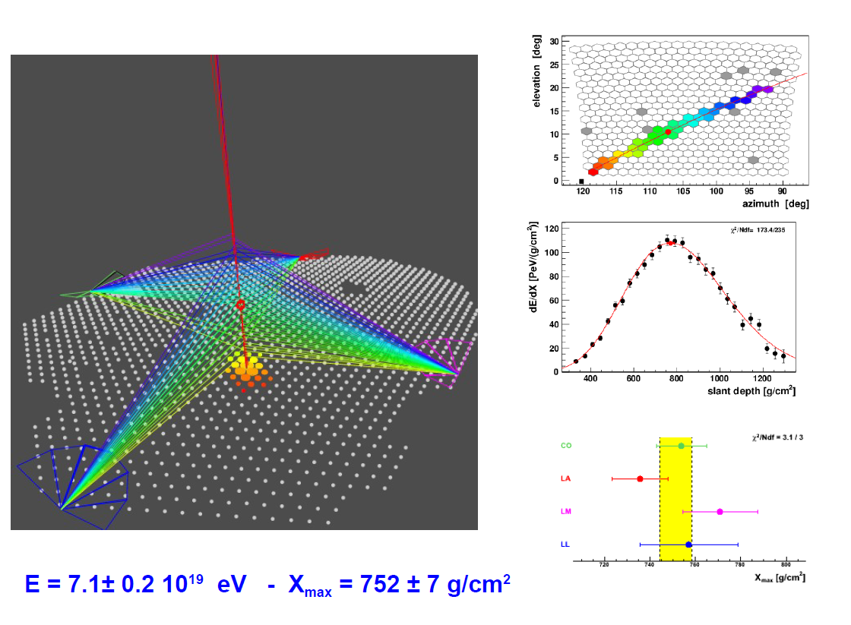
Checking the energy and X_{max} resolution

Slide 21
839 events
7.5 x 10¹⁹ eV
Auger Energy Calibration for Vertical Showers

Slide 22
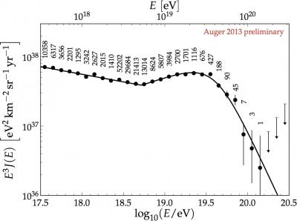
Auger Energy Spectrum from Vertical Events:2013
~175000 events
from 32,000 km² sr y

Slide 23
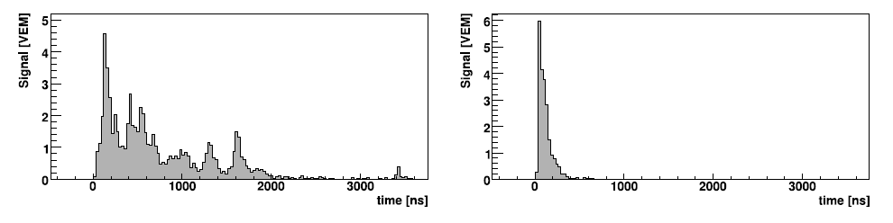
Analysis of inclined showers (> 60°)
Particles must penetrate more atmosphere and at observation
level the signals are almost entirely muons – with contemporaneous
component of electromagnetic radiation from µ-decay
and knock-on electrons
Muons are energetic but strongly deflected in geomagnetic field
Shower loses circular symmetry
FADC traces are short in
inclined events
1 km, 22°
1 km 80°: ~ 5000 g cm⁻²

Slide 24
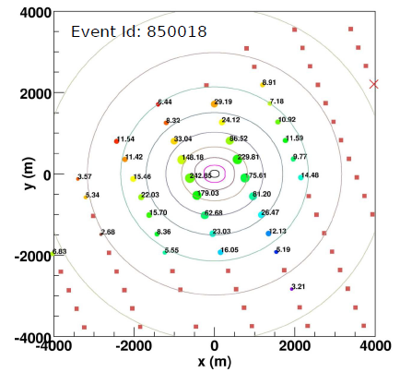
37 stations
71°
54 EeV
Fit made to density
distribution
Energy measured
with ~20 % accuracy

Slide 25
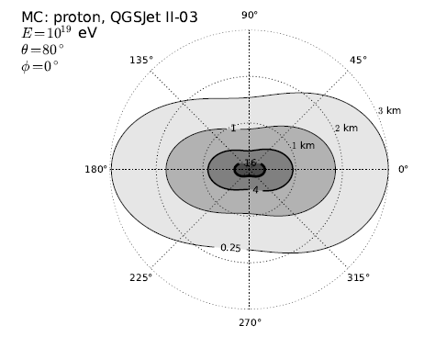

Average muon density profile
of simulated-proton of 10¹⁹eV
Maps such as these are compared and fitted to the observations so that the number of muons, N_{µ}, can be obtained

Slide 26
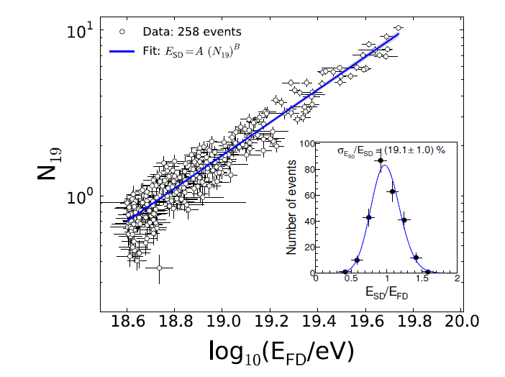

Slide 27
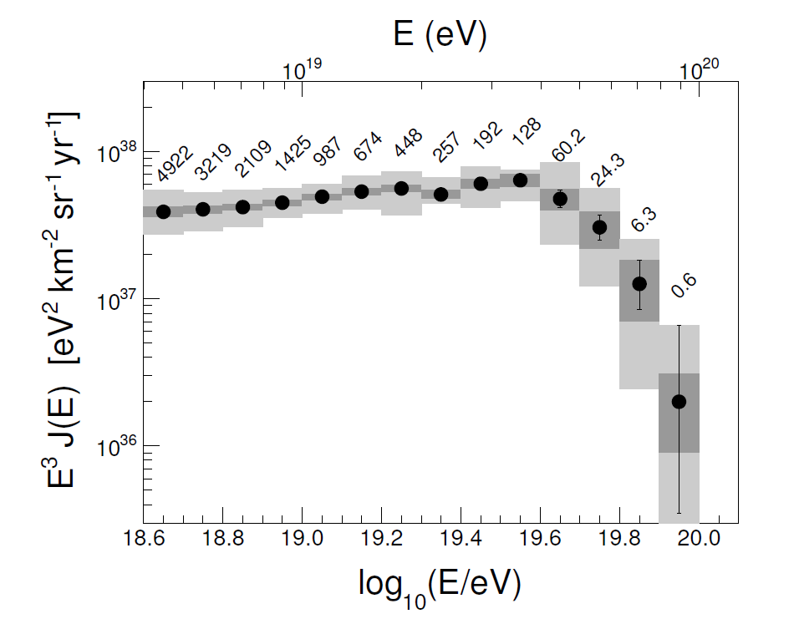
Spectrum from events 60 < θ < 80°: arXiv: 1503.00786
Deconvolved spectrum based on 15614 events

Slide 28
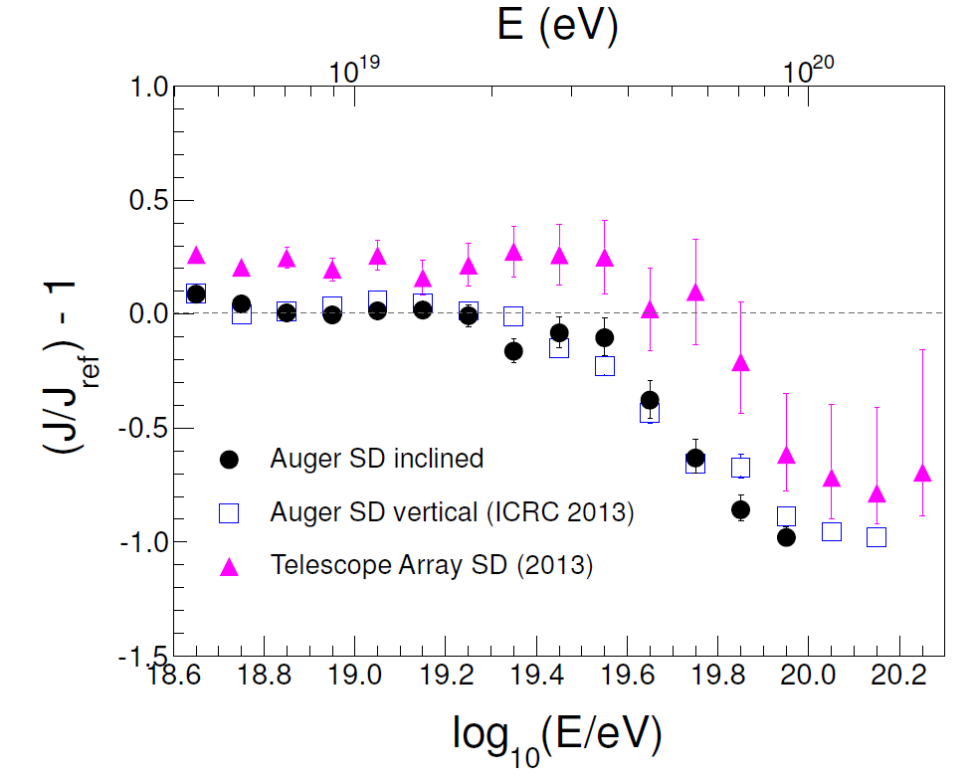
Comparison of two Auger Spectra with Telescope Array

Slide 29
Comparison with Telescope Array
Auger spectrum is now measured up to a declination of 25.3°N,
well into Telescope Array range
Up to suppression region, TA and Auger spectra agree well
Average TA residual is 23%.
In suppression region the differences are large and may be due to
Anisotropy effects
Atmospheric (Vertical aerosol depth as function of height)
Detector effects: energy dependence of systematic uncertainties
Different assumptions about composition
invisible energy
fluorescence yield

Slide 30
The well-established steepening of the spectrum itself is INSUFFICIENT for us to claim that we have seen the Greisen-Zatsepin-Kuz’min effect
It might simply be that the sources cannot raise particles
to energies as high as 10²⁰eV
It would be enormously helpful if the arrival directions were
Anisotropic and sources could be identified
Deflections in magnetic fields:
at ~ 10¹⁹ eV: still ~ 10° in Galactic magnetic field
- depending on the direction
Also knowing the mass composition would be useful

Slide 31
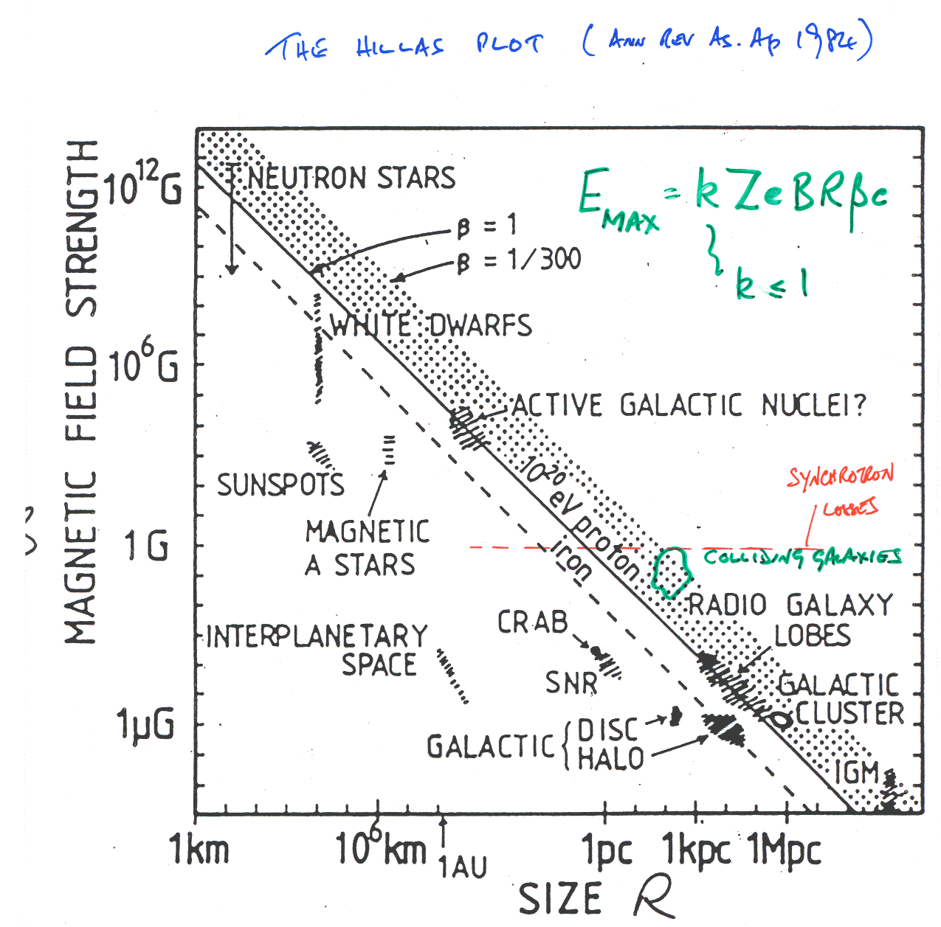
Magnetars
E_{max} = kZeBRβc
k < 1
Hillas 1984
ARA&A
B vs R
Active Galactic Nuclei?
Synchrotron Losses
B
Colliding Galaxies
R

Slide 32
Correlation has fallen from ~ 68% to ~ 28% (2007 –> 2014)
compared with 21% for isotropy: about 1.4% probablity
Cen A may be a source: in 13º circle around: 12 seen/1.7
A clear message from the Pierre Auger Observatory:-
We made it too small (2 per month at energy of interest)

Slide 33
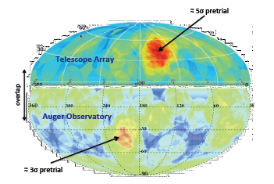
Auger and Telescope Array Hot-Spots

Slide 34
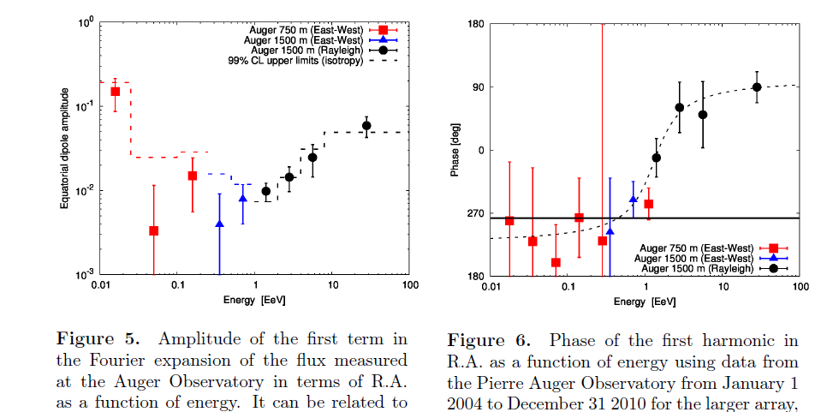
Broad anisotropy search in right ascension
Galactic Anti-Centre: 85.5°
Galactic Centre: 266°

Slide 35
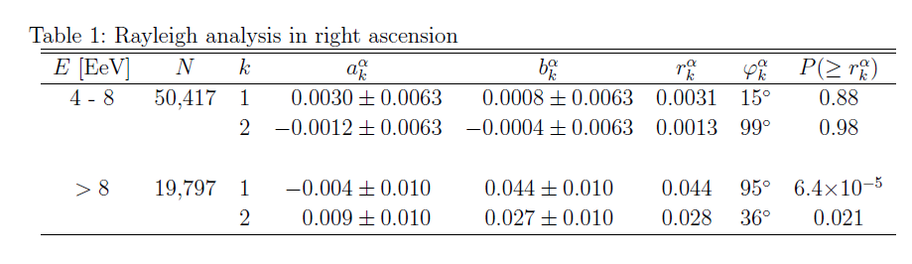
Latest News (ApJ in press: arXiv 1411.6111)
Recently we have completed analysis of inclined events above
4 EeV and the addition of 30% more data from inclined events.
This has:-
  given a broader sky coverage – up to declination 25.3°
  and
  (ii) improved the significance of anisotropy the largest energy bin
Note that the phase is in good agreement with previous work

Slide 36
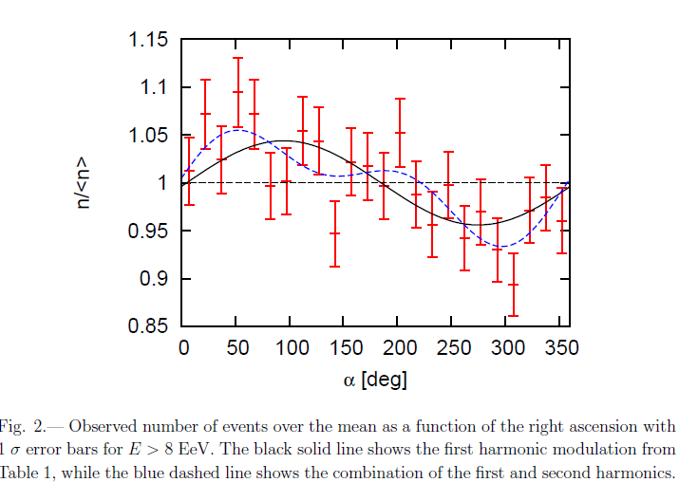
Galactic Anti-centre

Slide 37
To interpret the arrival direction data a crucial question is
“What is the mass of the cosmic ray primaries
at the highest energies?”
Answer is dependent on unknown hadronic interaction
physics at energies up to ~ 30 times CM energy at LHC
In particular, cross-section, inelasticity and multiplicity
and, in addition , pion-nucleus and nucleus- nucleus
interactions
Here is an important link between particle physics and
astroparticle physics

Slide 38
How we try to infer the variation of mass with energy
X_{max}
photons
protons
Data
Fe
dX_{max}/log E = elongation rate
Energy per nucleon is crucial
Need to assume a model
log (Energy)

Slide 39
Some Longitudinal Profiles measured with Auger
1000 g cm⁻² = 1 Atmosphere ~ 1000 mb
rms uncertainty in X_{max} < 20 g cm⁻² - from stereo-measurements

Slide 40
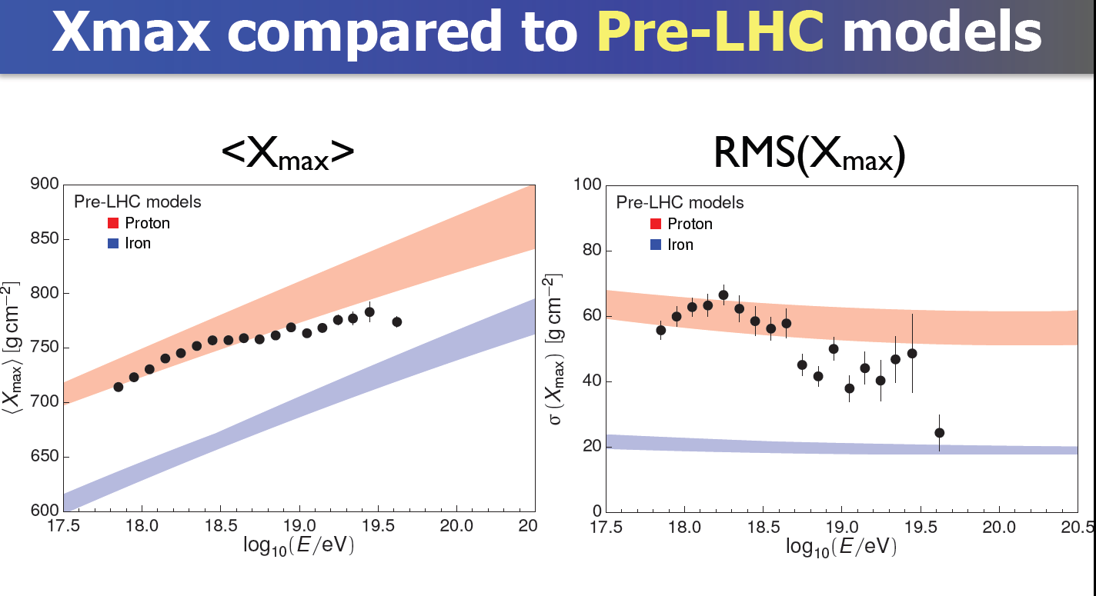
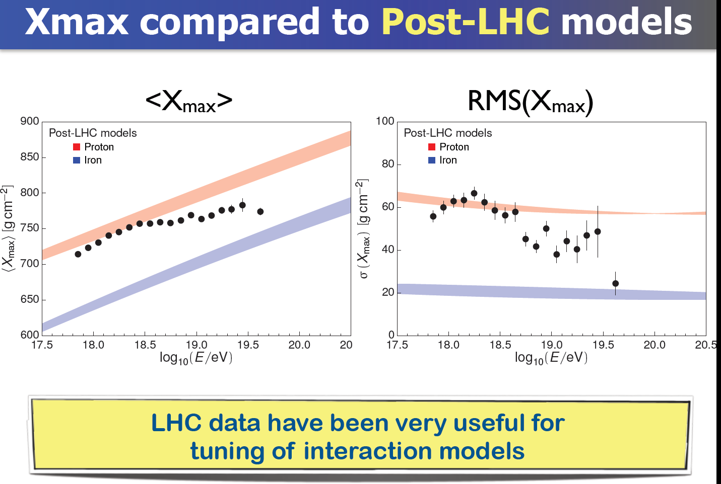
X_{max} and RMS(X_{max}) compared to Pre-LHC models
X_{max} and RMS (Xmax)compared to Post-LHC models

Slide 41
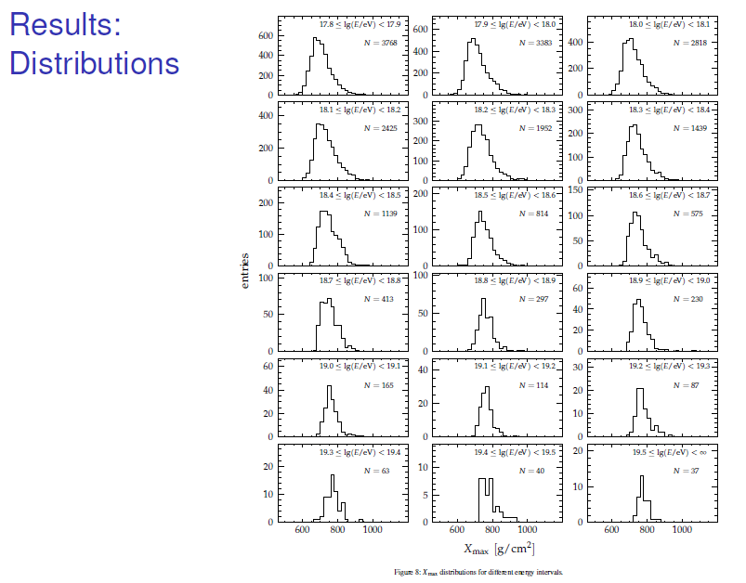
7 x 10¹⁷ eV
Distribution of X_{max}
as function of energy
PRD 90 1220005 2014
3768
814
19759 events
above 6 x 10¹⁷ eV
37
> 3 x 10¹⁹eV

Slide 42
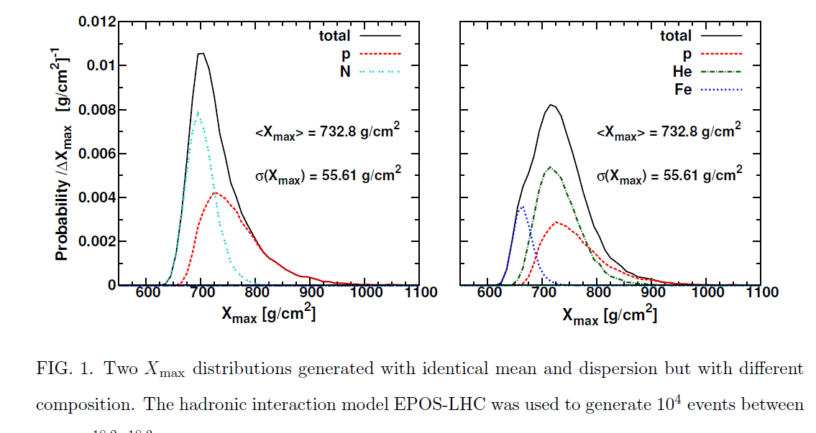
Detailed study of X_{max} distributions are required

Slide 43
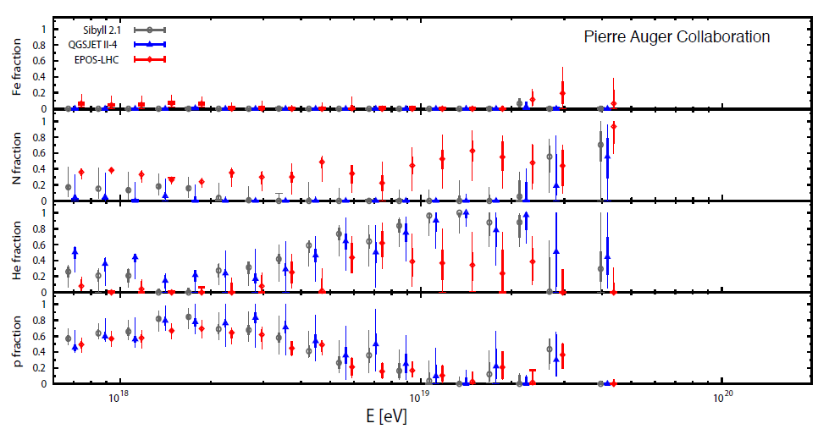

Slide 44
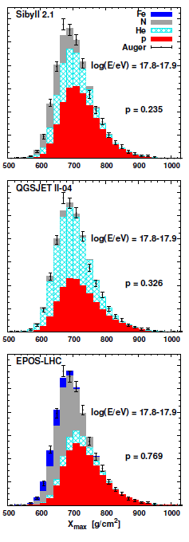
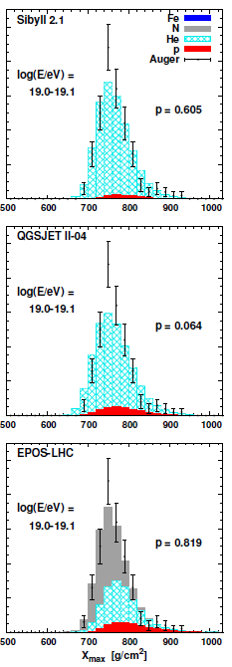
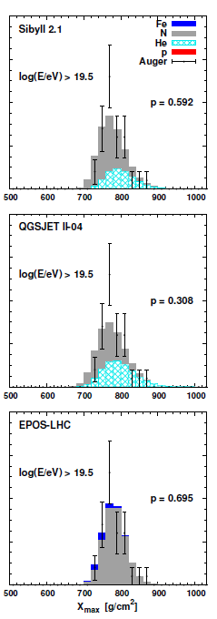
Auger Interpretation: Phys Rev D 90 1222006 2014 (arXiv 1409.5083)
7 x 10¹⁷ eV
1.1 x 10¹⁹ eV
> 3 x 10¹⁹ eV
3768
165
37

Slide 45
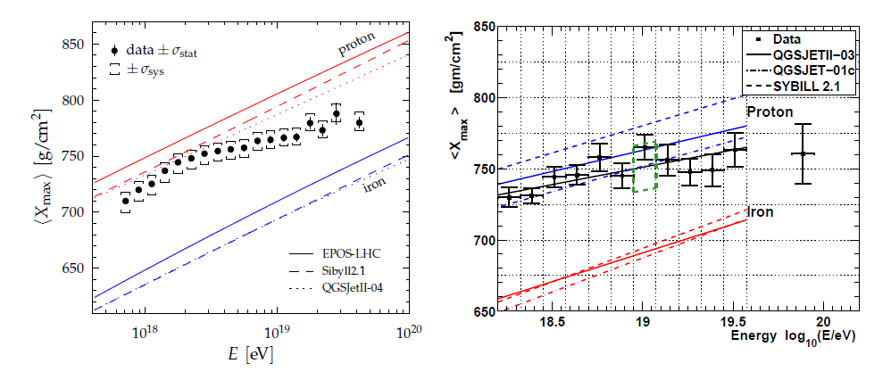
Discussion of Auger/Telescope array data: arXiv 1503.07540
Report of Joint Analysis Working Group
Auger: 19759 events
Telescope Array: 822 events
Direct comparison is not possible because of different approaches to analysis

Slide 46
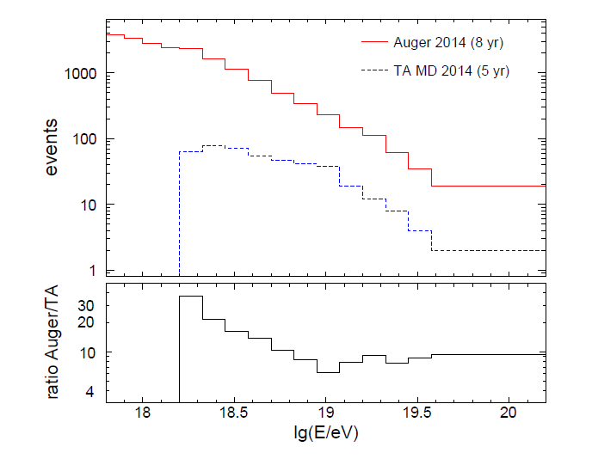
The TA approach has been to fold the detector resolution and the efficiency
into the raw data and into Monte Carlo comparisons.
The large Auger sample has allowed a more data-driven approach with only
certain geometries being selected that give an almost-unbiased X_{max} distribution:
Fiducial Selection

Slide 47
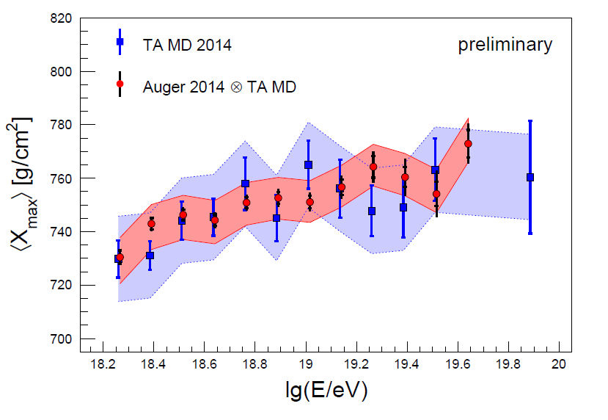
A joint TA/Auger working group has studied this problem
The mass composition inferred from the Auger measurements,
in terms of p, He, N and Fe has been simulated with the TA fluorescence
analysis methods.
X_{max} measured by TA is consistent with that found with Auger mass distribution
ΔX_{max} = 2.9 ± 2.7 (statistical) ± 18 (syst) g cm⁻²

Slide 48
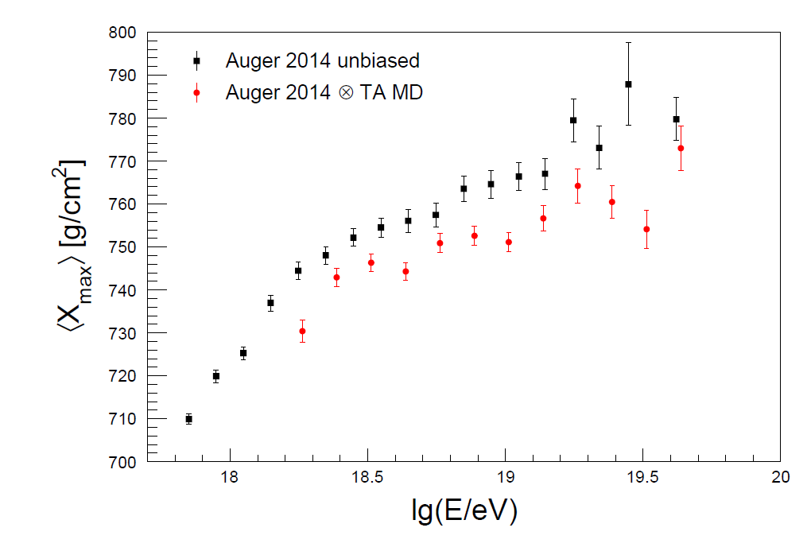
756 ± 3

Slide 49
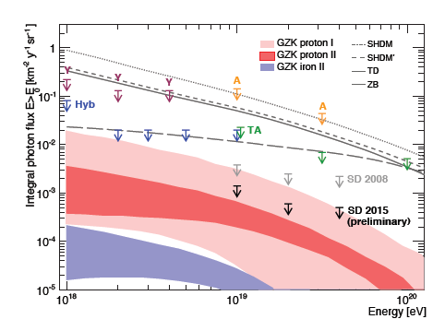
Photon Limit:
new results – to be reported at ICRC 2015
Searches for photons make use of anticipated differences
in showers arising from:-
the steeper fall-off of signal
with distance
the slower risetime of the signals
in the water-Cherenkov detectors
the larger curvature of the
shower front
the deeper development in the
atmosphere resulting in greater X_{max}
The limits rule out exotic, super-heavy relic models

Slide 50
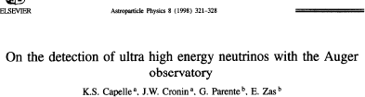
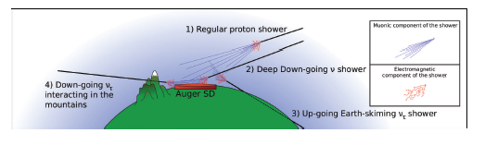
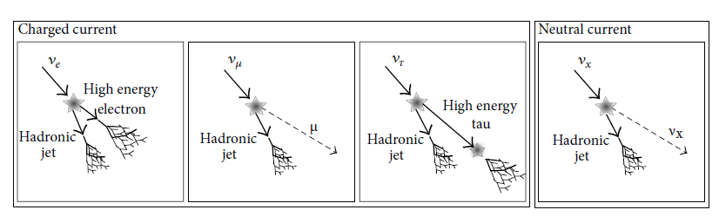
Search for High-energy Neutrinos
ApP 3 321 1988
Details in Advances in High Energy Physics 708680 2013

Slide 51
The neutrino search strategy
1 km, 22°
1 km 80°: ~ 5000 g cm⁻²
Are showers seen at very large zenith angles with the characteristics
of vertical showers?
The right-hand type of event is the hadronic background: the left-hand
type of event is what is expected from the signal
No candidates yet found

Slide 52
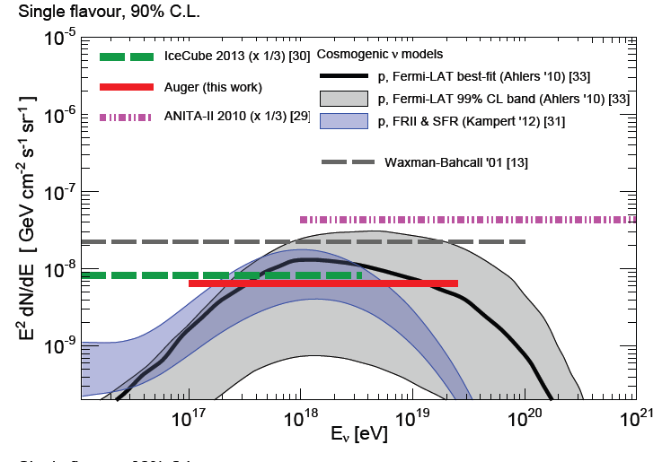
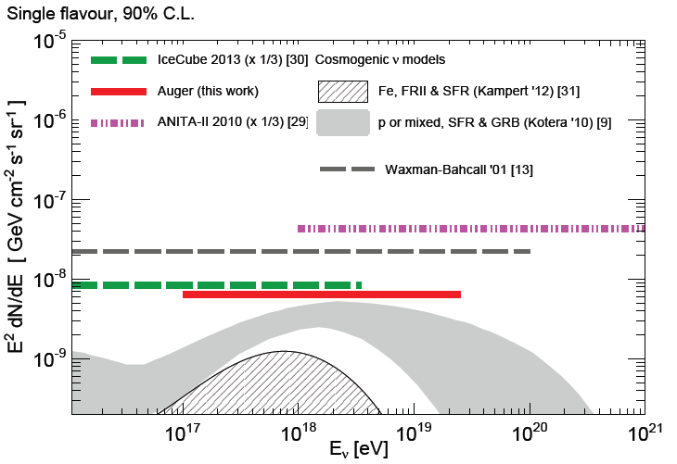
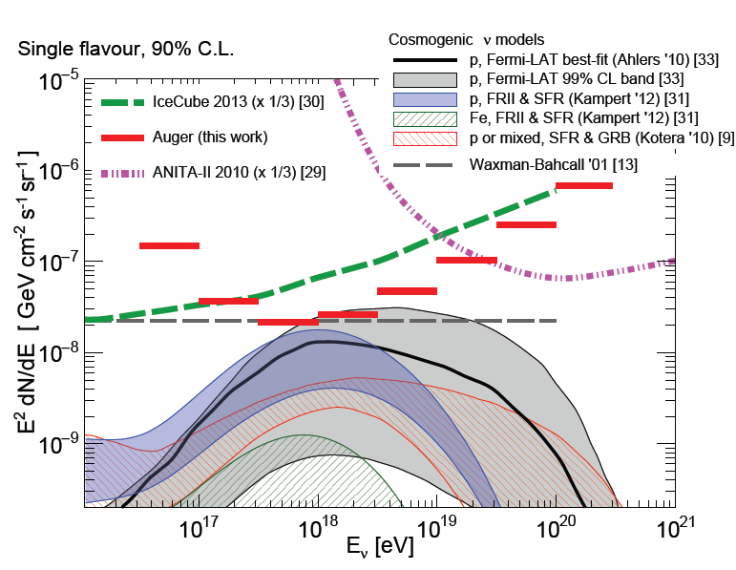
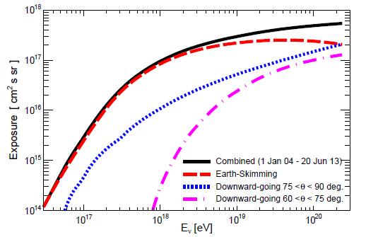
Latest result on search for neutrinos: submitted to Phys Rev D

Slide 53
Hadronic Interactions
Demonstrations of some successes
- and of some problems

Slide 54

Models developed by the Cosmic Ray community fitted early LHC data quite well
Accelerator Models
900 GeV 2.36 TeV 7 TeV
Cosmic ray models
d’Enterria, Engel, Pierog, Ostapchenko and Werner (2011)

Slide 55

Cross-section measurements from Auger Observatory: PRL 109 062002 2012
10¹⁸ < E (eV) < 10^{18.5}

Slide 56


Slide 57
Updated results on cross-section will be reported at ICRC 2015
Significant increase in number of events
Two energy ranges: 10^{17.8}< E(eV) < 10^{18.0} and 10¹⁸ < E(eV) < 10^{18.5}
Systematic Uncertainties from mass better understood
Only 20% of most proton-like events are being used
Taking advantage of model updates from LHC

Slide 58
Inclined showers are proving very useful to test models
We find that there are problems with models at high energies and large angles
where muon number in showers can be studied cleanly
Summary of following papers:-
Inclined Reconstruction: JCAP 08 019 2014
Inclined Muon Number: PRD 91 032003 2015
Muon Production Depth: Phys Rev D 90 (2014) 012012

Slide 59


Muon numbers predicted by models are under-estimated
by 30 to 80% (20% systematic)

Slide 60


d(ln R_{µ})/dln E

Slide 61


Second method of testing models:
Muon Production Depth (MPD)
PRD 90 012012 2014
log (E/eV) = 19.5

Slide 62


91 EeV
33 EeV

Slide 63




Slide 64
Summary of main results from Auger Observatory
Spectrum suppression above ~ 40 EeV
Large scale dipole in arrival distribution above 8 EeV
Large scale anisotropy indicated by phase shift in RA below the knee
Indications of anisotropy above 40 EeV – but hugely more events needed
X_{max} shows (i) distinct change of slope with energy
(ii) rms becomes smaller with energy
These changes suggest mass becomes heavier as energy increases
Important limits to fluxes of neutrinos and photons
Inconsistencies of muon data (number and depth of maximum) with models
Major question: Is suppression GZK or photodisintegration?

Slide 65

Maximum energy scenario
Propagation and photodisintegration
N
p
Fe
He

Slide 66
To answer this question we need mass information in more detail
and at higher energies
This is the main aim of the plans being evaluated now for the next
phase of the Observatory
What we plan to do:-
FD on-time will be extended to 19% to access higher energies
Radio technique will be developed to get many more data
on X_{max} at lower energies
Scintillators will be added above water-Cherenkov detectors to
deduce muons with method calibrated with buried muon detectors
Aim is to identify mass of primary on event-by-event basis

Slide 67




(i) Detection of Showers using Radio antennas
40 – 80 MHz
Energy resolution better than 22%
15.7 MeV in 1 EeV shower

Slide 68


Slide 69

Prospect of X_{max} resolution of ~20 g cm⁻²

Slide 70


(ii) 4 m² Scintillators above
Water-Cherenkov detectors
Scintillators respond to muons
and electromagnetic component
Water-Cherenkov detectors absorb
all of the em component and are
fully sensitive to muons
It has been demonstrated with
simulations that techniques exist
to separate out the muon
component

Slide 71


(iii) Buried Muon Detectors (1.3 m below surface)
60 x 20 m²

Slide 72
Long-term Future
Auger Observatory is at least one-order of magnitude to small
Planned space projects as very important: is there something interesting to measure beyond the present questions?
Compare SPS and LEP
Young people working together and getting to know each other is necessary for any future World Observatory
Joint Working Groups – great success
How can a giant Observatory be created?
How can we take this concept forward?
Timescale is surely at least 10 years to begin

Slide 73
Back Up Slides

Slide 74


Slide 75

AGN Correlation Update

Slide 76

UHECR Correlation with AGNs
Science: 9 November 2007
First scan gave ψ < 3.1°, z < 0.018 (75 Mpc) and E > 56 EeV

Slide 77


Slide 78


Taylor, arXiv:1107.2055

Slide 79


Slide 80


Slide 81

The phase-first argument of Linsley

Slide 82

Dependence of Exposure on Declination

Slide 83

Telecommunication system

Slide 84

Comparison of characteristics of the Pierre Auger Observatory and the Telescope Array
Enrique Zas: European Symposium, Kiel 2015

Slide 87


Slide 88


Slide 91


