Slide 1
Beampipe Considerations
FCC-hh MDI meeting
March. 13th 2015

Slide 2
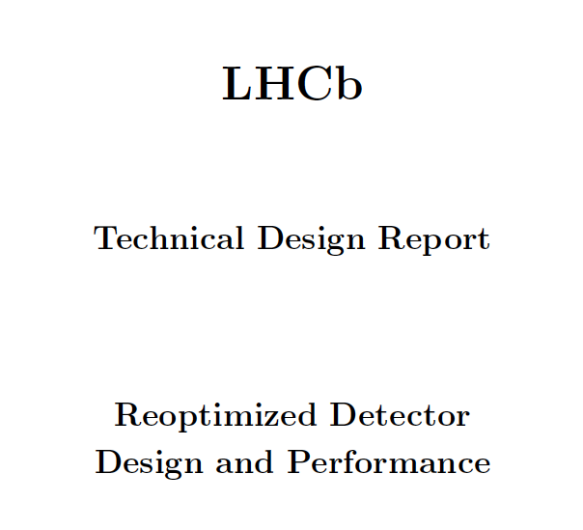

Slide 3
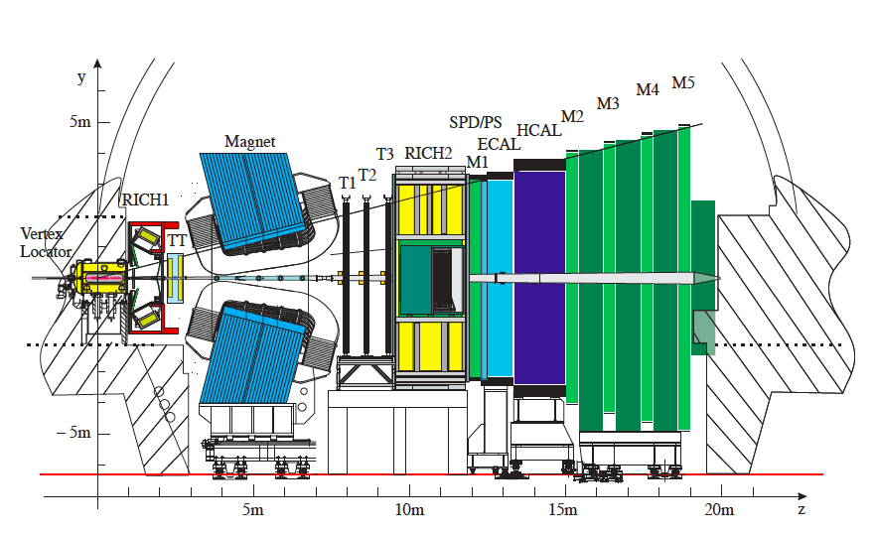
LHCb acceptance η = 2-5
Beampipe = 10mRad cone projecting to the IP: η = 5.3

Slide 4
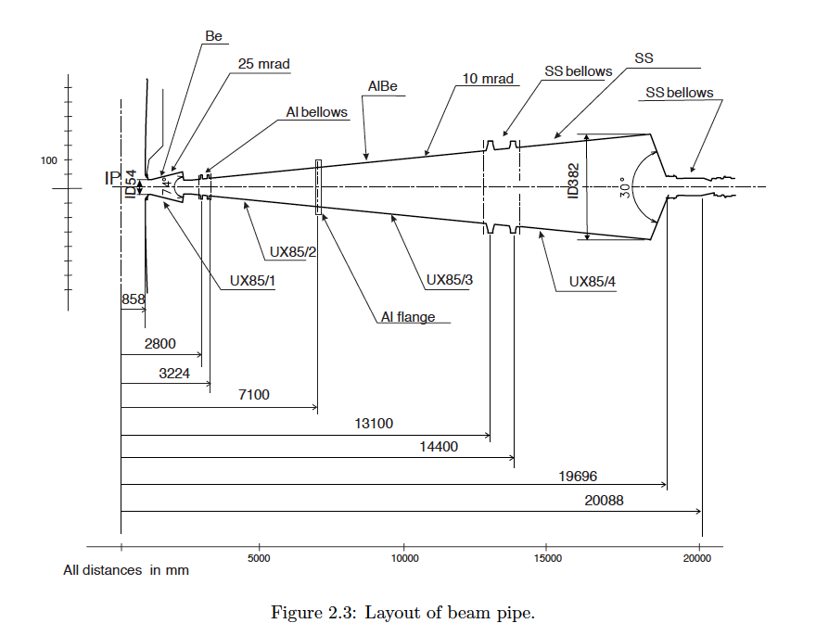
Wall Thickness 1mm
At z=13m, wall thickness = 2.8mm, radius = 122mm

Slide 5
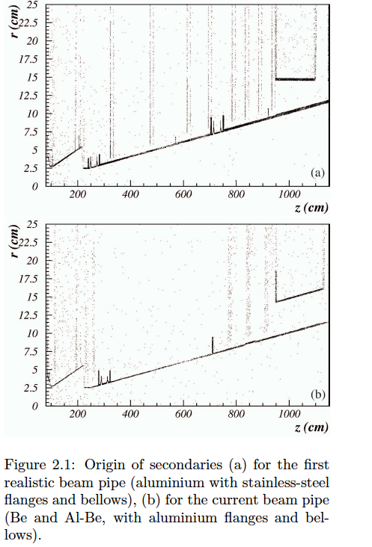
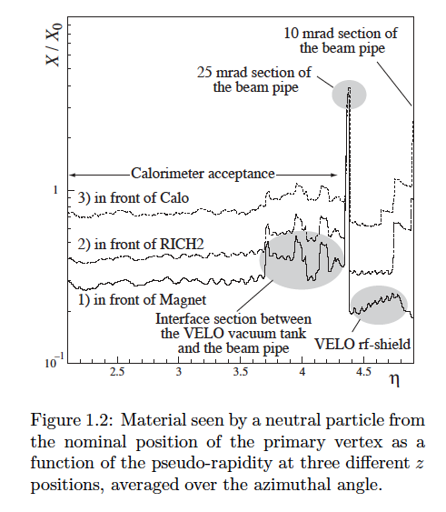

Slide 6
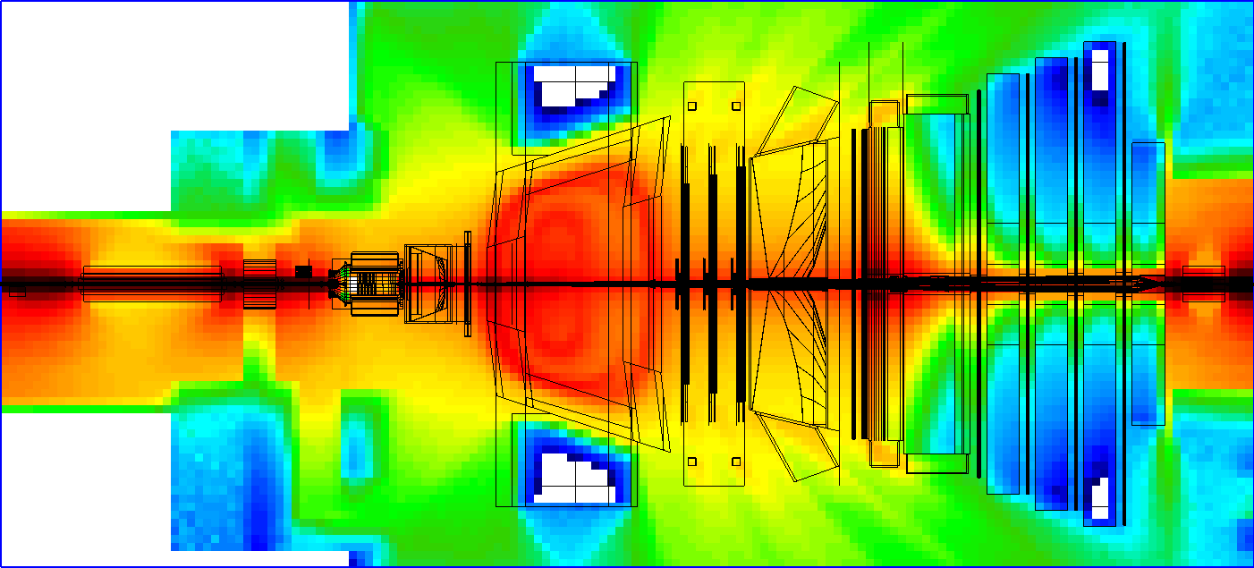
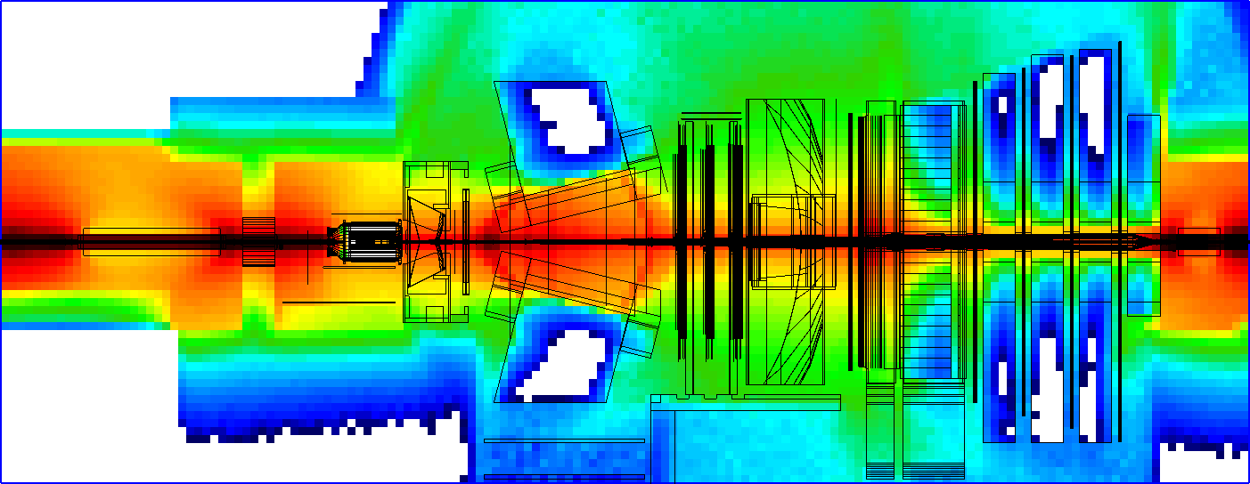

Slide 7
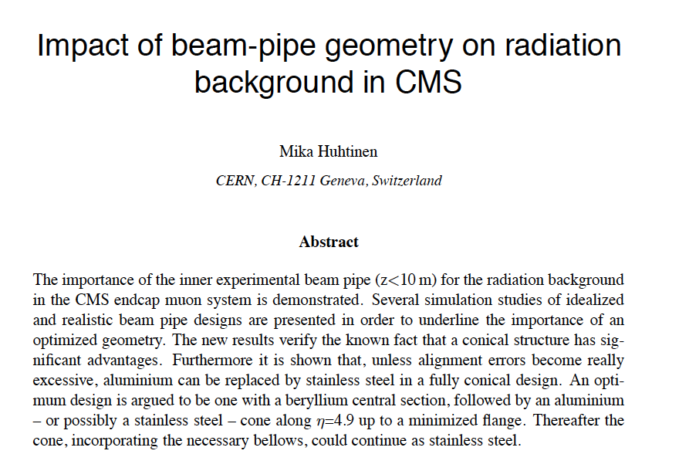

Slide 8
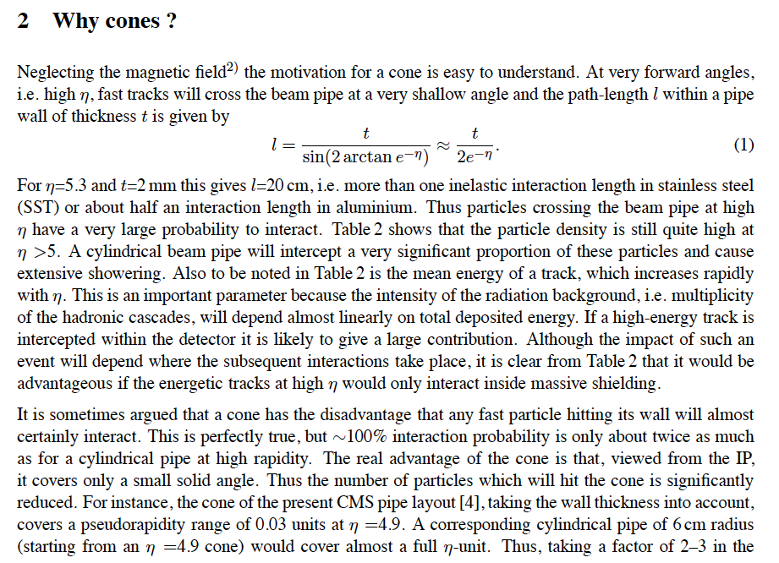

Slide 9
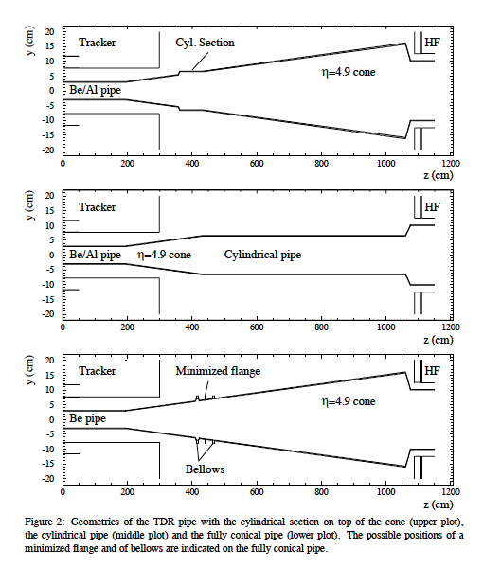
HF eta 3-5

Slide 10
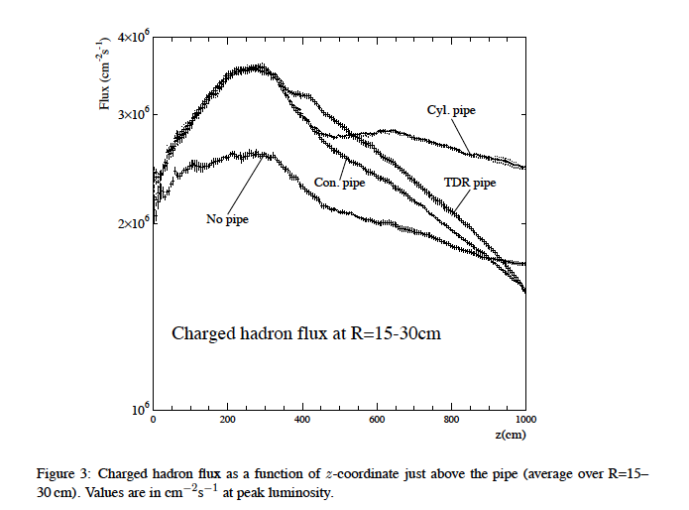
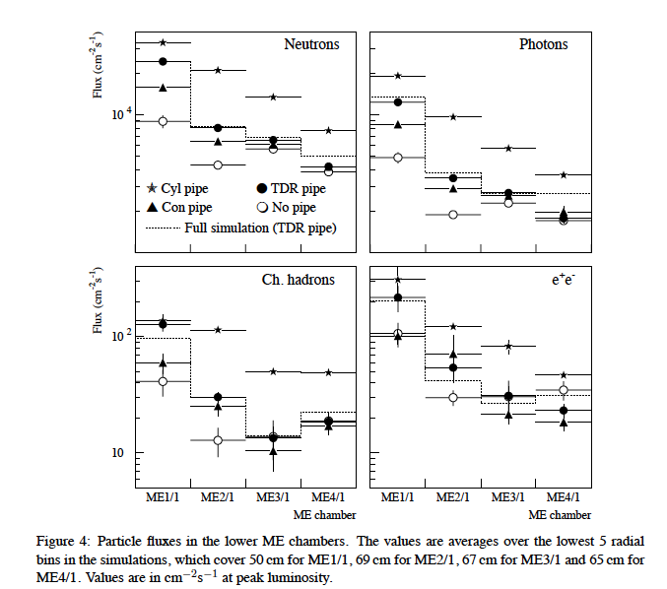

Slide 11
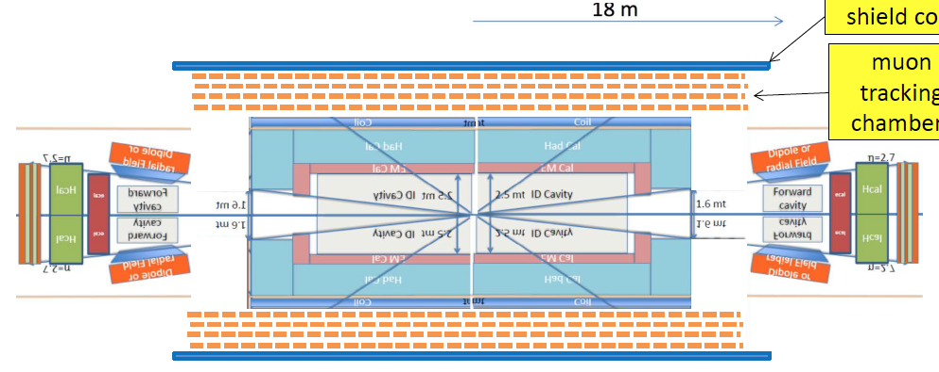
If we want calorimetry up to eta=6, the beampipe should be a projective cone along eta=6 → 5mRad or eta = 6.5 → 3mRad
The central pipe could be assumed with r=20mm in the central section and
A cone from z=4m (eta=6) or 6.7m(eta=6.5)
At z=25m the cone would have a radius of 125mm (eta=6) and 75mm(eta=6.5)
The wall thickness can gradually increase from 1mm to 3mm.
Misalignment ?
18m
Q1 TAS
TAS Q1
10m
10m
80m

