Slide 2
CERN Mobile network migration
Rodrigo Sierra
Communication Systems group, IT Department, CERN

Slide 3
Agenda
CERN mobile services
Mobile network migration
Mobile services changes
SIM card distribution
Migration
Conclusion

Slide 4
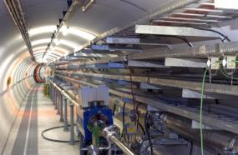
CERN mobile services
Mobile services:
  Single contract with a Swiss operator
  Closed VPN comprising > 5800 mobiles
  Voice and data services (GPRS/EDGE/UMTS/LTE)
  GSM calls from Switzerland routed via the CERN telephone exchange
  Dedicated access to CERN’s Intranet
  Roaming worldwide
Infrastructure
  > 50 km of leaky feeder cable covering underground facilities
  CERN’s own infrastructure to cover LHC tunnel
  68 radio/transmission sites at CERN
Technologies
  GSM, UMTS (3G) and LTE (4G)

Slide 5
Mobile network migration
What?
  Swisscom will replace Sunrise the 1st of July 2015
Why?
  Swisscom has won the call for tender for mobile services
When?
  Installation started in January
  All services should be ready in June
  The operator will be swapped the 1st of July
How?
  Swisscom’s network is being installed while Sunrise’s one is still in operation
  Sunrise will be decommission once Swisscom is operational

Slide 6
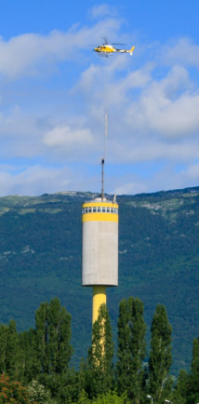
Mobile network migration
Challenges
The network must be installed while operating the current one:
  New space, fibers & power supplies required in all sites
  New mast/antennae for outdoor coverage
The complexity of the network :
  2G, 3G and 4G in all sites
  14 outdoor & 37 indoor sites
  17 CERN indoor sites in the LHC (REs & TI8)
Advanced services must be integrated:
  CERN APN, roaming control, PBX interconnection…
Regulation and legal permits in two countries
The new network must be ready in 6 months

Slide 7
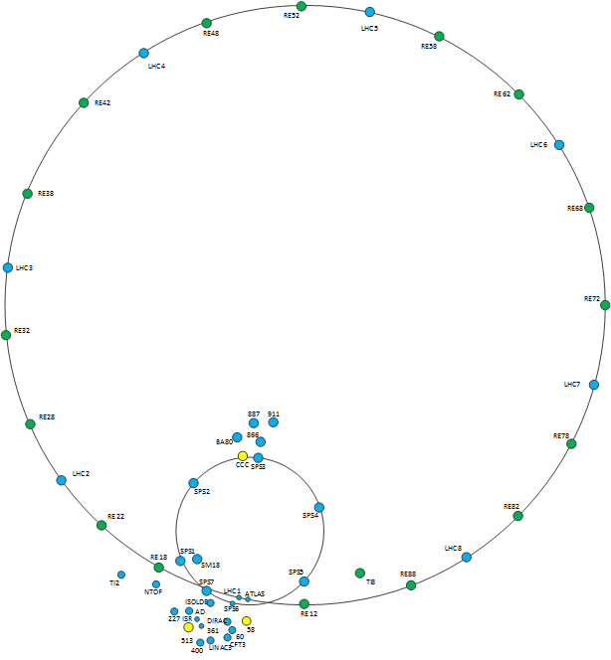
Architecture

Slide 8
Planning
Date | Work
Dec 14 – Feb 15 | Network design
Feb 15 – Jun 15 | Network deployment
15th June 2015 | Fully operational services
June 2015 | SIM cards distribution
1st July 2015 | Operator swap

Slide 9
Mobile services changes
Mobile services will be improved:
  LTE (4G) available in the Swiss part
  UMTS (3G) and LTE (4G) available in the French part (to be authorized)
  UMTS (3G) and LTE (4G) in the underground facilities
  LTE throughput target: 150Mbps DL in LHC experiments
New tariffs:
  Very interesting tariffs negotiated (~ 50% reduction in average)
New operator:
  New SIM card and new numbers

Slide 10
SIM card distribution
ALL SIM cards must be changed
  Sunrise SIM cards will stop working in July
Distribution of Swisscom SIM cards in June
Special procedure for users not at CERN in June
  No roaming: recover SIM first time they come at CERN
  Roaming: procedure to be announce in April
Planning, FAQ, procedures…
  To be published in https://cern.ch/gsm-migration

Slide 11
Migration
New number (last 4 digits will remain the same – 16xxxx won’t change)
All Swisscom subscriptions will be activated simultaneously
  You must change your SIM card at that moment
Sunrise SIM card will stop working in July
  You are responsible to communicate your new number, update your software, web sites, etc.
  Sunrise numbers redirected to a voicemail to announce the change during July
Underground facilities:
  Only one operator available at the same time
Migration planning to be announced
  https://cern.ch/gsm-migration/content/planning

Slide 12
Conclusion
Challenging project involving several departments
Mobile services will be improved
Your monthly bill will be reduced
SIM card and number must be changed
More information: https://cern.ch/gsm-migration

Slide 14
Why I can’t keep my current number?
We can transfer only active numbers (6,000 of the 10,000 range).
As soon as a number becomes inactive (i.e. someone leaves) the number reverts to Sunrise
CERN should pay 10,000 subscriptions per month to keep all numbers active for the duration of the contract with Swisscom so none will be reverted to Sunrise
In Switzerland, the capacity for moving numbers between operators is 500/day (12 days to move our current active numbers)

Slide 15
Transition period
What happens in case of delay ?
  Sunrise contract ends on the 31st of June.
  One month of delay will cost ~100 KCHF
    Provided that Sunrise is willing to maintain the service
Why such a short transition period ?
  7 months and half is long period to keep the “motivation” of the current operator
  During this period any changes are frozen
  The new operator needs to start as soon as possible to start generating revenues

Slide 16
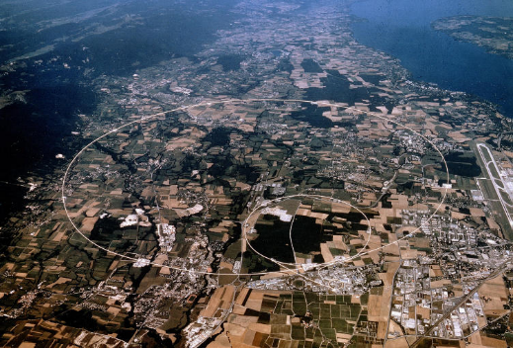
Sites
Outdoor (14 sites):
Meyrin (3 sites):
  Building 60
  Water tower
  Building 361 (PS)
Prevessin (2 sites):
  Building 866
  Building 887
SPS (1 site):
  BB4
LHC (8 sites)
  SD2, 4, 5, 6, 7, 8
  SZ33
  SDX1

Slide 17
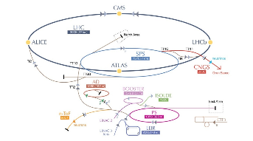
Sites
Indoor (37 Swisscom sites + 17 CERN sites)
LHC:
  9 sites on the surface covering the lifts and caverns
  16 CERN sites in the REs covering the tunnel
  SCX5
Transfer lines :
  1 sites covering TI2 and 1 CERN site covering TI8
SPS (8 sites)
Meyrin:
  PS, AD, LINAC3, LINAC 4, N_TOF, CFT3, ISR, DIRAC, ISOLDE
  Buildings 358, 2013, 839
Prevessin:
  North area, building 911
SM18 (1 site)
Transmission:
  Buildings 58, 513, 874

Slide 18
Advanced services
CERN intranet connection – IT/CS
CERN voice VPN – IT/CS
CERN PBX interconnection – IT/CS
Email2SMS gateways – IT/OIS
Roaming cost control – IT/CS
Automatic billing – GS/AIS
User provisioning – Labo Telecom
SIM cards migration – Labo & secretariats

