Slide 1
Charge Resolution Simulations for Camera Electronics
the Compact High Energy Camera for the Cherenkov Telescope Array
Jason Watson
PHD Supervisor: DR. Garret Cotter
Vth INFIERI WORKSHOP: INFIERI AT CERN
29 April 2015

Slide 2
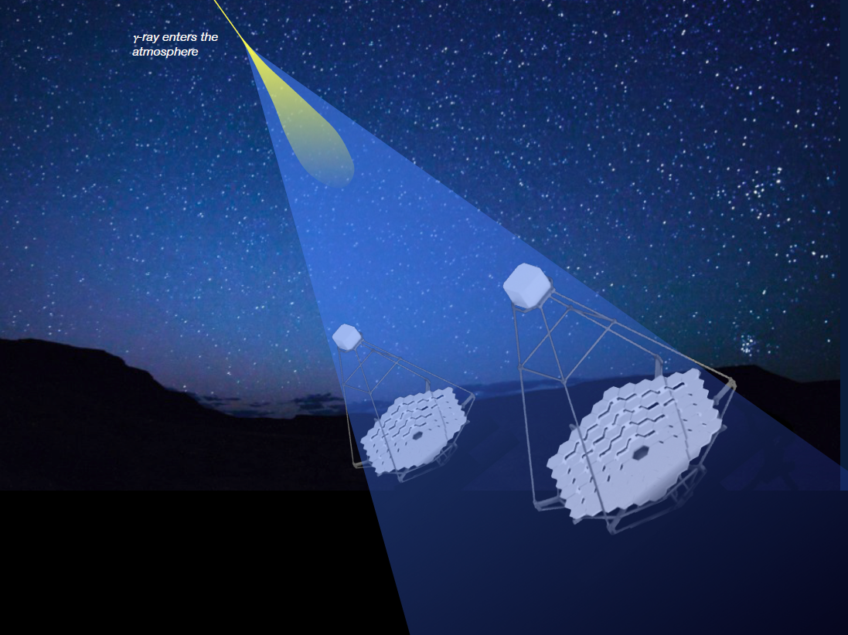
The Cherenkov Telescope Array

Slide 3
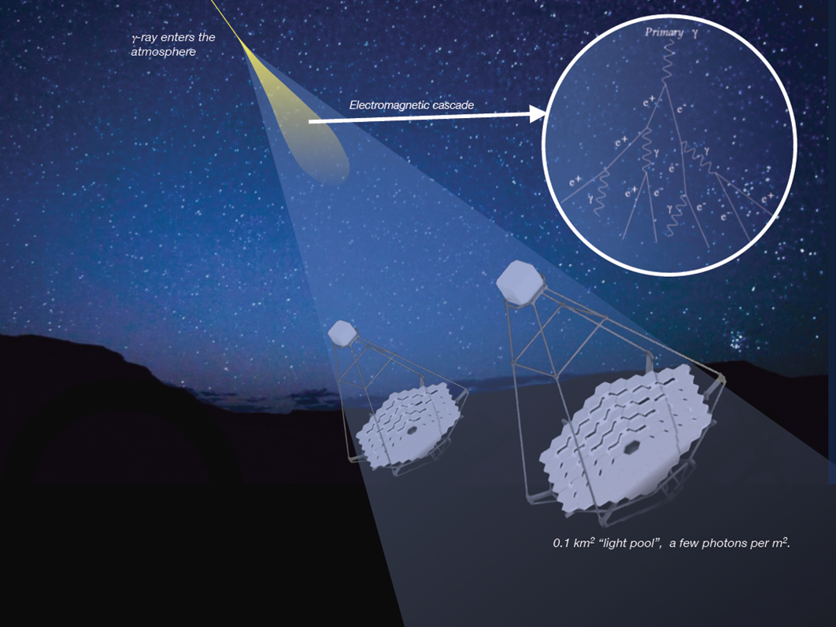
The Cherenkov Telescope Array

Slide 4
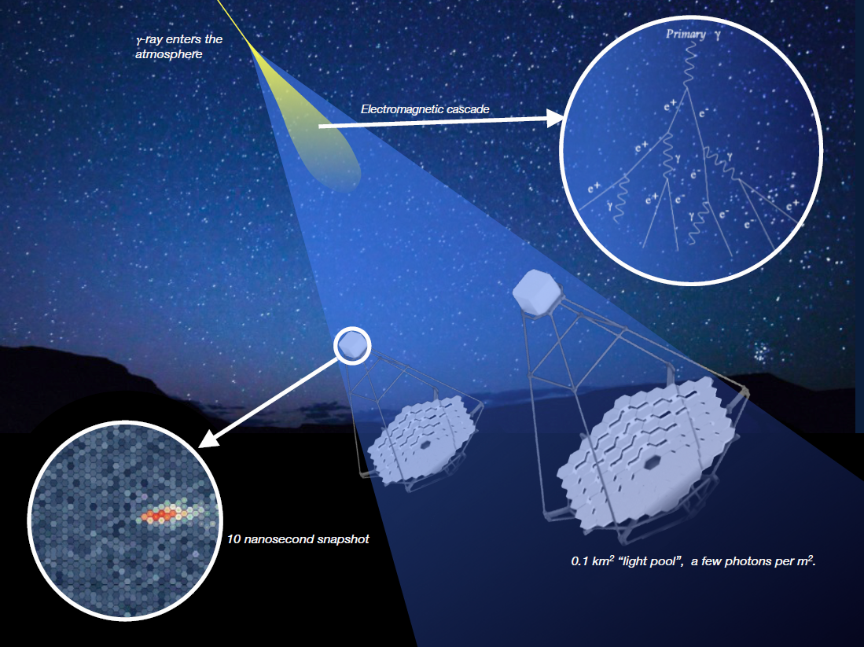
The Cherenkov Telescope Array

Slide 5
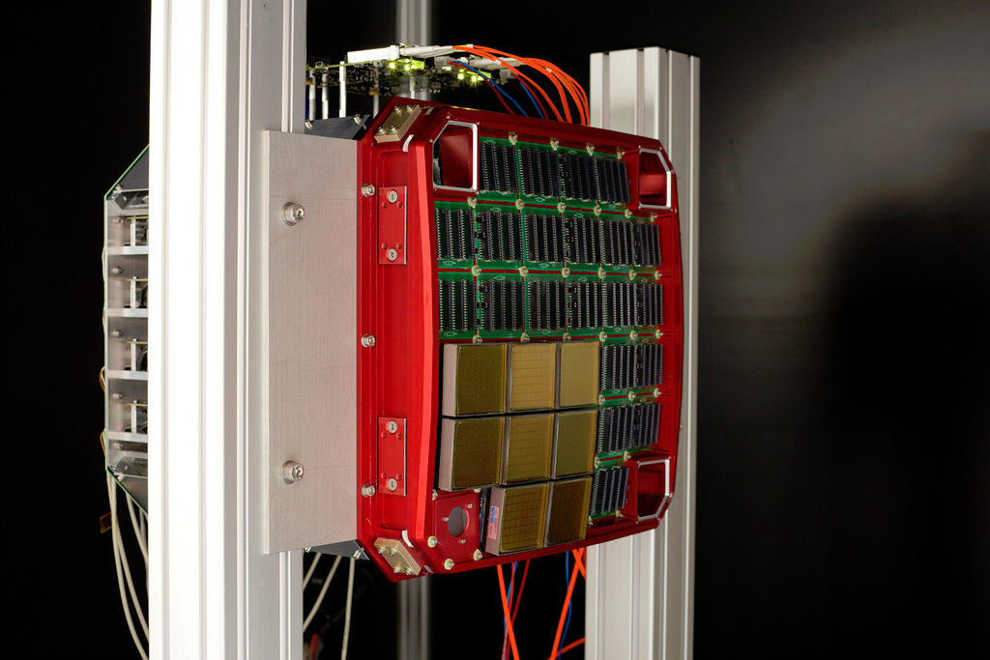
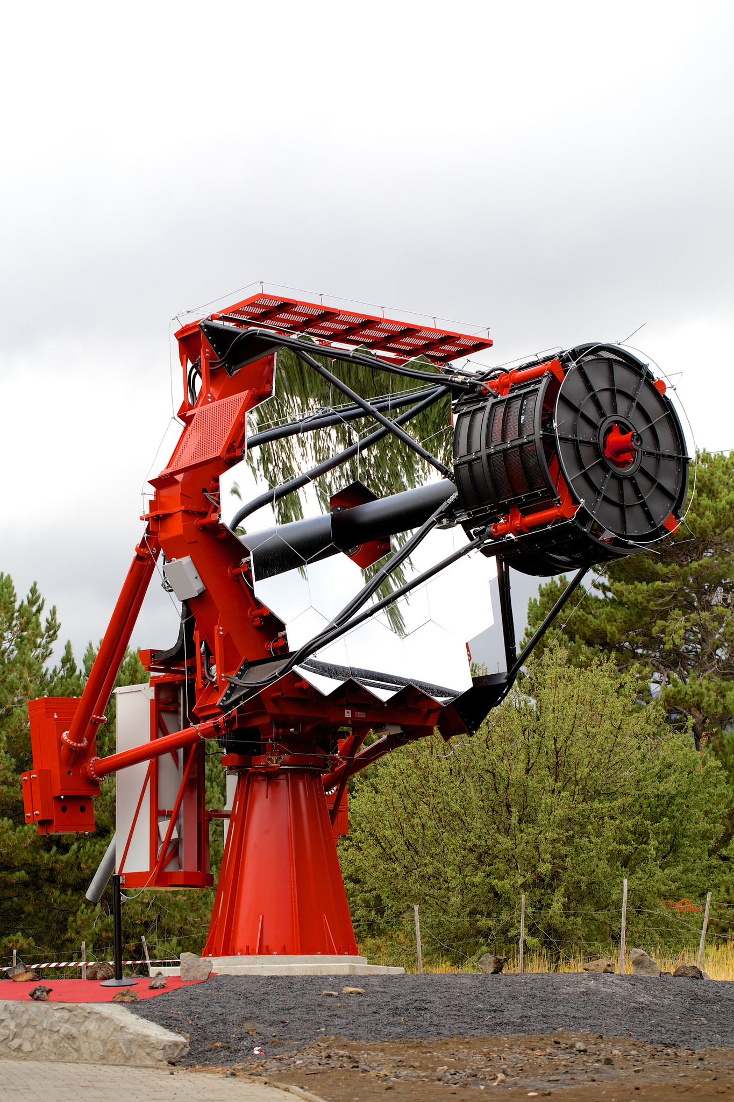
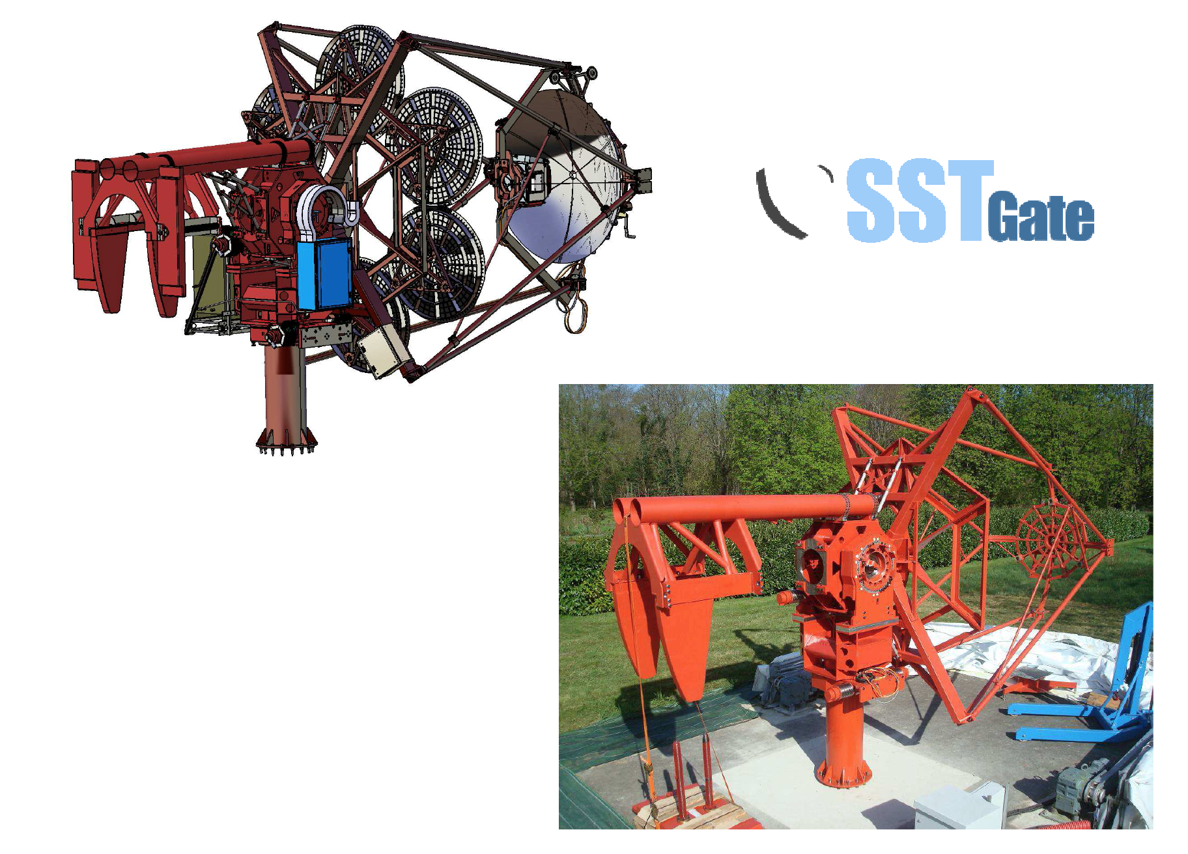
The Compact High Energy Camera (CHEC)
Camera for the dual-mirror Small-Sized Telescopes (SST-2m)
International involvement
  within INFIERI both Oxford and Amsterdam
Designed to work with both the ASTRI and GATE SST-2m telescope structures
Contains 2048 pixels (32 x 64 pixel modules)
CHEC-M (MAPM camera) prototype is almost finished
CHEC-S (SiPM camera) testing has started
CHEC-M
ASTRI

Slide 6
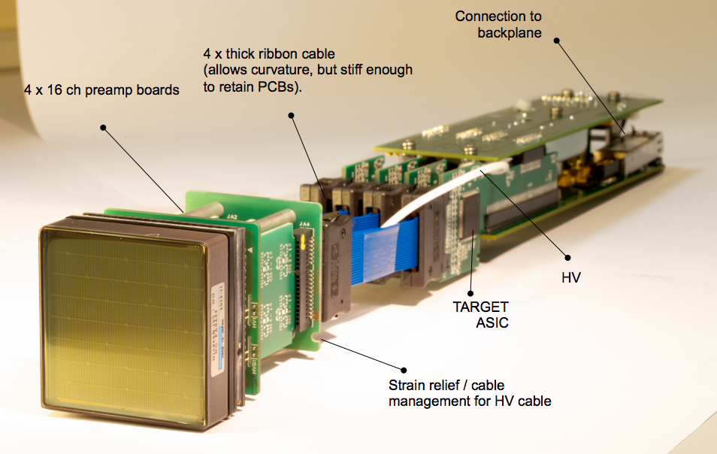
CHEC Electronics
CHEC-M MAPM: Hamamatsu H10966B
Notes:
Each of the photosensor modules has three components. The Multi-Anode Photomultiplier Tube, the pre-amplification boards, designed to amplify and shape the signal. And the TARGET module; a sample per nanosecond digitization device.

Slide 7
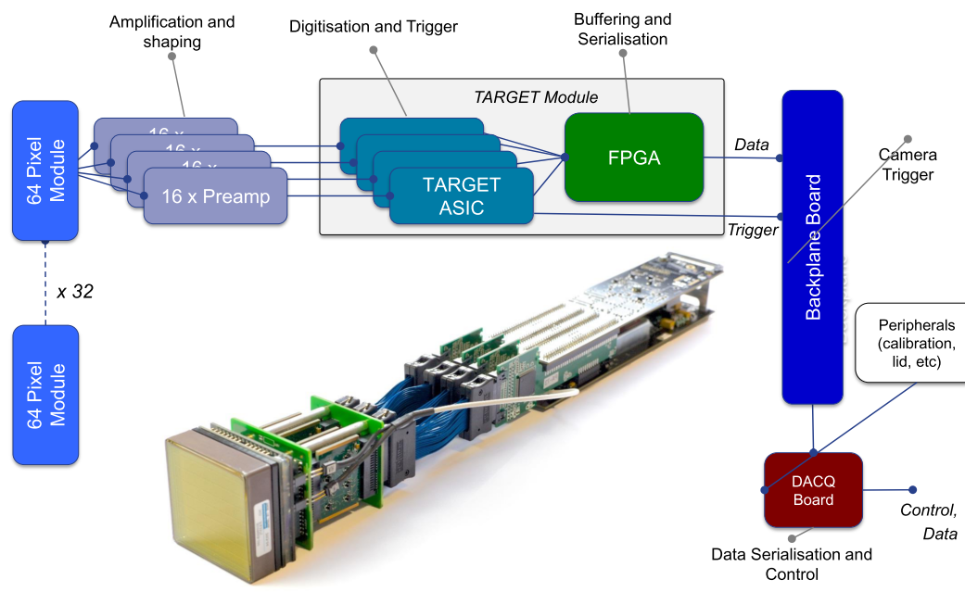
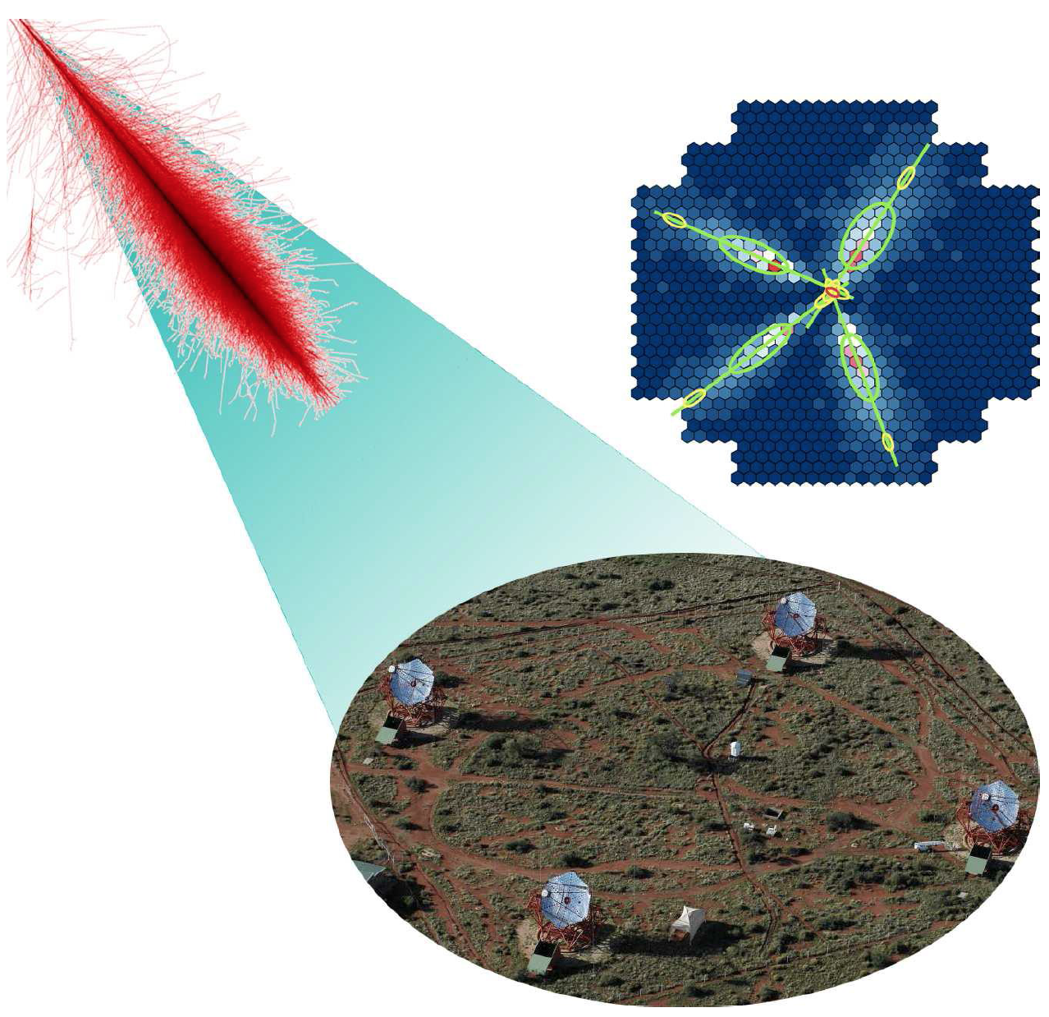
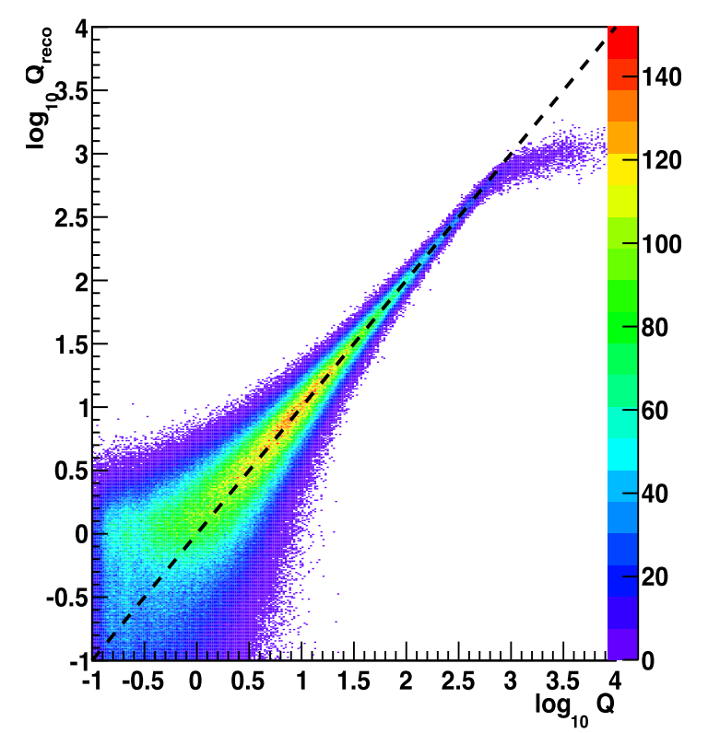
CHEC Electronics Simulations
CORSIKA
LTools
Investigations of camera capabilities
Notes:
In order to assess the effectiveness of the camera module, an electronics and readout simulation was created, called LTools. Combined with CORSIKA, an extensive air shower simulation, a variety of assessments of the camera can be performed.

Slide 8
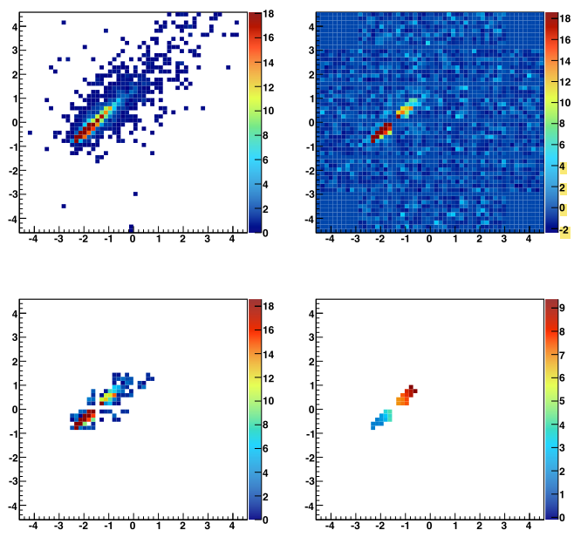
Camera Image from Simulations
Simulated Shower Image
Added NSB and electronic noise
Cleaned image using tailcuts of 6pe/12pe
Notes:
This is an example of the simulated shower image from CORSIKA. Once the process of adding NSB and electronic noise, and then performing a clean-up of that image, the charge generated in each pixel is reconstructed through three different methods.

Slide 9

Charge Reconstruction
Integration of the pulse.
  Method 1 (Blue):
    Integration is performed on entire readout window (by default 90ns)
  Method 2 (Green):
    Integration is performed in a window of fixed length around the intensity-weighted average peak time in all pixels with more than 4 pe charge.
  Method 3 (Black):
    integrated in a window of fixed length around the gradient of peak times along the major image axis
    Pixels with arrival time that don’t match the time for that position along the major axis are removed. (Pixel D)
Timeseries of the pulse in each pixel
Pixel A
Voltage
Pixel B
Pixel C
Pixel D
Time

Slide 10
Camera Image from Simulations
Simulated Shower Image
Added NSB and electronic noise
Further cleaned through application of arrival times as described in method 3
Cleaned image using tailcuts of 6pe/12pe

Slide 11
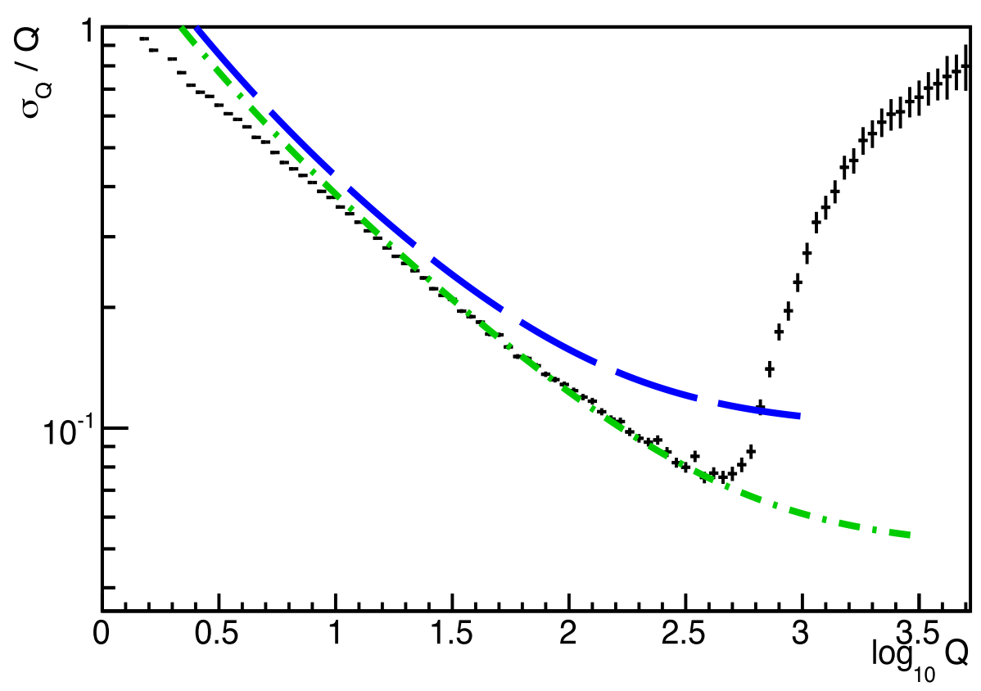
Charge Resolution
Model 1 (whole window integration)
Sampling speed: 666 MHz
Adc2pe: 8
Blue line: SST requirement
Green line: SST Goal
Notes:
One such assessment simulation that has been performed is the Charge Resolution of the MAPMT. Exploring how well the charge measured matches the true charge that is proportional the the photons detected.
This particular graph is the result of the simple whole window integration method.
The comparison of reconstructed charge against simulated “true” charge is then re-displayed as relative deviation of reconstructed charge against the simulated charge. This can then be compared to the requirements and goals for the small-sized telescope.
Pixel saturation.

Slide 12
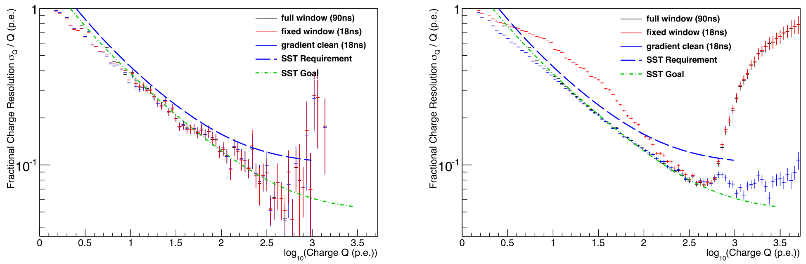
Charge Resolution Simulation Results
Comparison of the three integration window methods
Low energy (300 GeV – 60 TeV)
High energy (60 TeV – 300 TeV)
Notes:
All three can meet the requirements in the low energy (excluding the pixel saturation)
The 2nd method of integration violates the requirements at high energies, high-energy showers can have large impact distance and hence a larger spread in arrival time of photons in the camera. The fact that only the average t0 is used for all pixels implies that charge falls out of the integration window

Slide 13
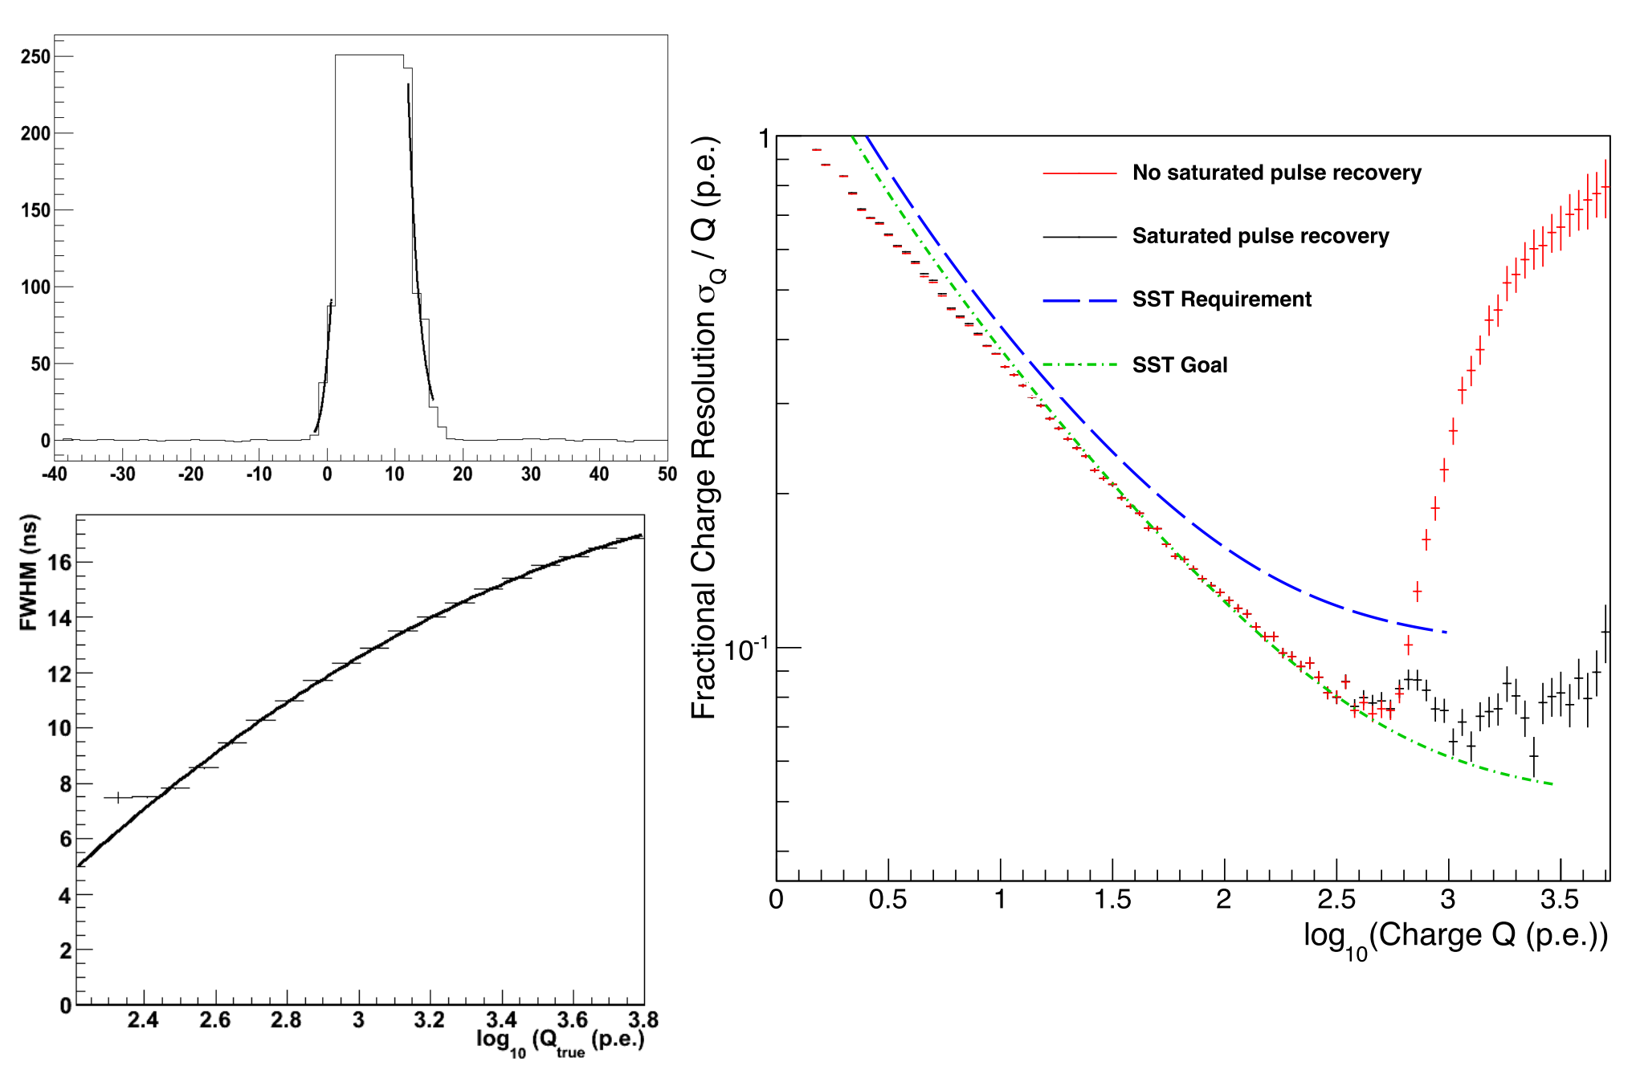
Charge Resolution Simulation Results
Saturated Pixel Restoration
The TARGET ASIC provides 12-bit digitisation
Corresponds to a maximum of 4095 digital counts
A setting of adc2pe of 4 results in the saturation of pixels with intensities of ~1000 photoelectrons
Notes:
Using the FWHM of the saturated pulse, we can generate a lookup table from knowledge of the true charge of the pulse, allowing the table to be used to obtain the reconstructed charge.

Slide 14
Charge Resolution Simulation Results
Recommendations:
  Sampling speed: 400 MHz - 1 GHz
  (Peak) ADC counts per photoelectron: 1 - 16
  Integration window length: 10 ns - 30 ns
  Readout window length: > 60 ns

Slide 15
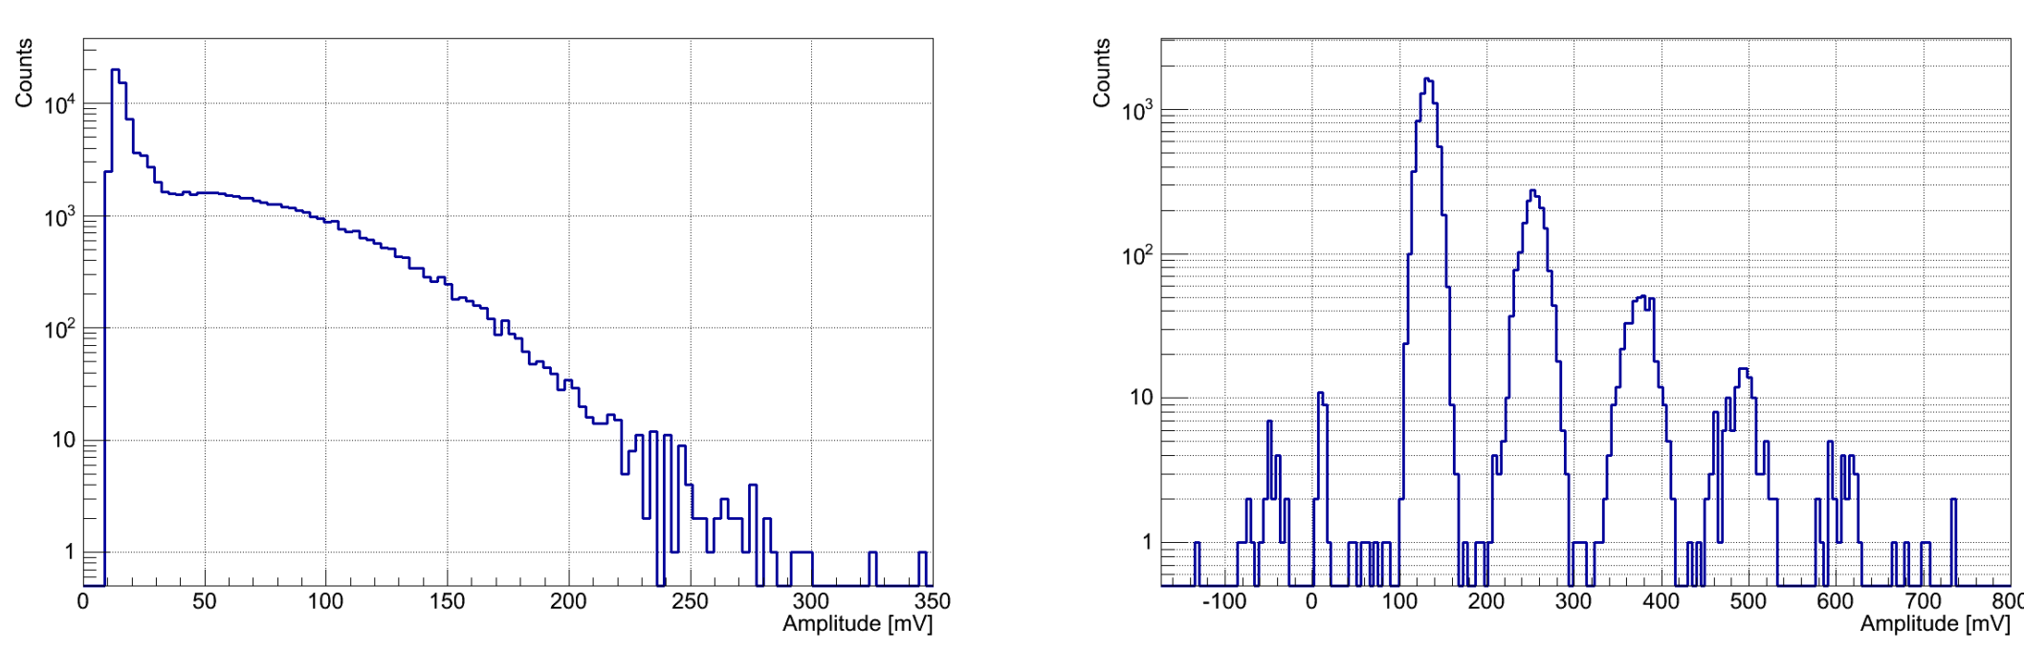
Charge Resolution of SiPMs for CHEC-S
SiPMs have many advantages over MAPMs including:
  Resistance to high light levels allowing observations under moonlight
  Excellent Pulse Height resolution
  Low voltage operation (20 – 100 Volts)
SiPMs require different considerations within the simulation:
  Much wider pulse shape – pre-amp must shorten SiPM pulses
  Cross-talk - Important to consider for cherenkov telescopes, can give NSB high amplitudes

Slide 16
Conclusions and intentions
The charge resolution of the MAPM camera meets the requirements of the two-mirror small sized telescopes
The same investigations now need to be performed for the SiPM
Further investigations are required for the SiPM including cross-talk impact on charge resolution.
Currently presumes perfect optics – Implementation of Ray-Tracing simulation ROBAST is also intended for the future.

