Slide 1




Tracking at the
Fermilab Test Beam Facility
Matthew Jones, Lorenzo Uplegger
April 29th 2015

Slide 2
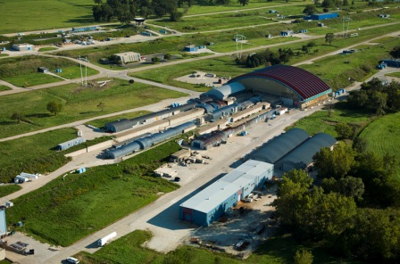
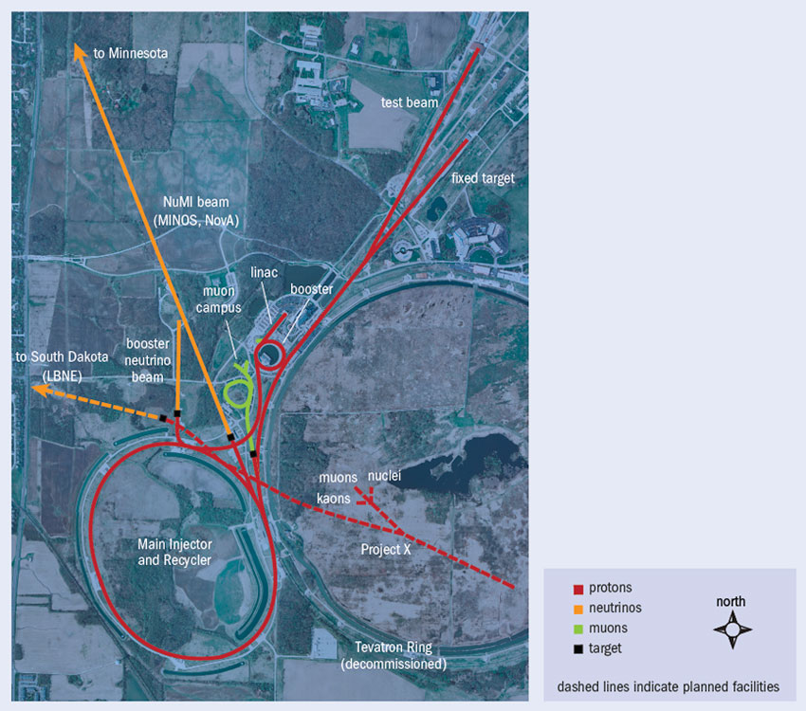
Fermilab Test Beam Facility (FTBF)
Beam

Slide 3
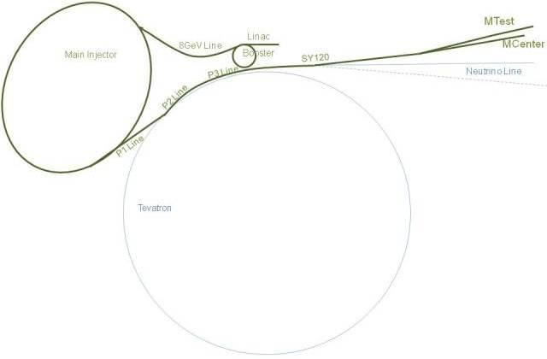
Fermilab Test Beam Facility overview
Main Injector accelerates protons to 120 GeV
  Accelerating RF frequency: 53 MHz
  Ring circumference: 11.13 μs
Resonant extraction into electrostatic and magnetic septa
1.6 μs of one beam revolution is shaved off and split between MTest facility and SeaQuest experiment
Up to 800k protons per spill to test area over 4.2 seconds
Repeated every 60 seconds
Secondary beams including kaons, pions, electrons and muons
  Energies of 1-60 GeV possible (3% resolution)

Slide 4
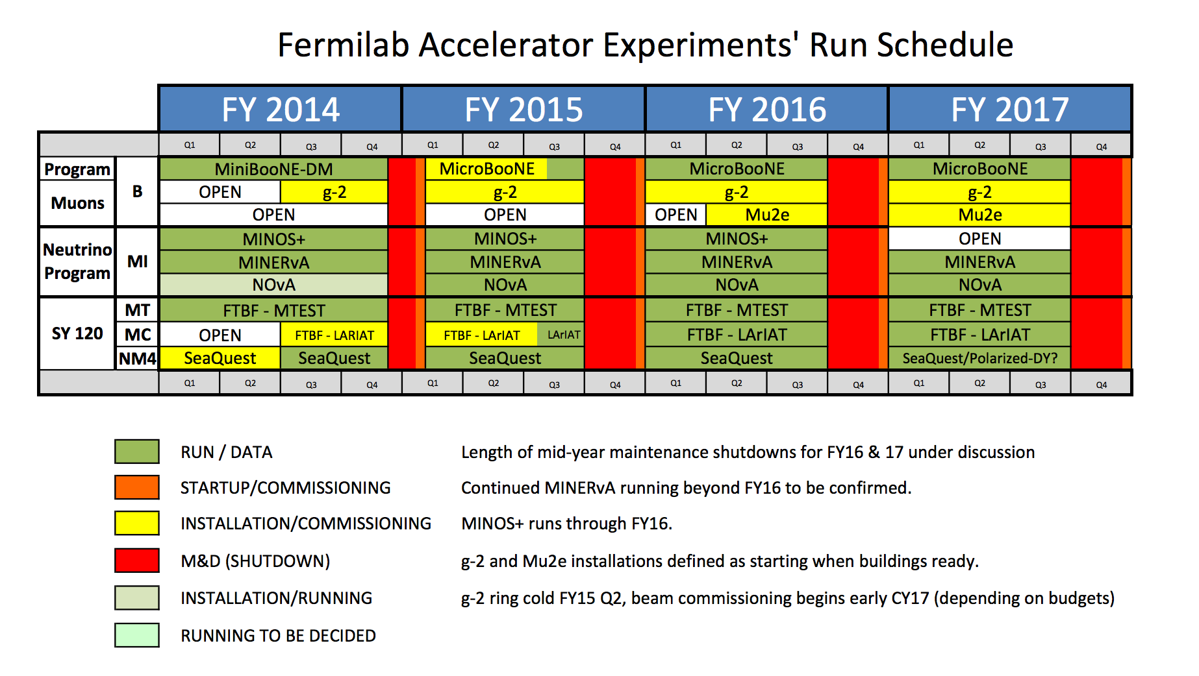
Availability

Slide 5
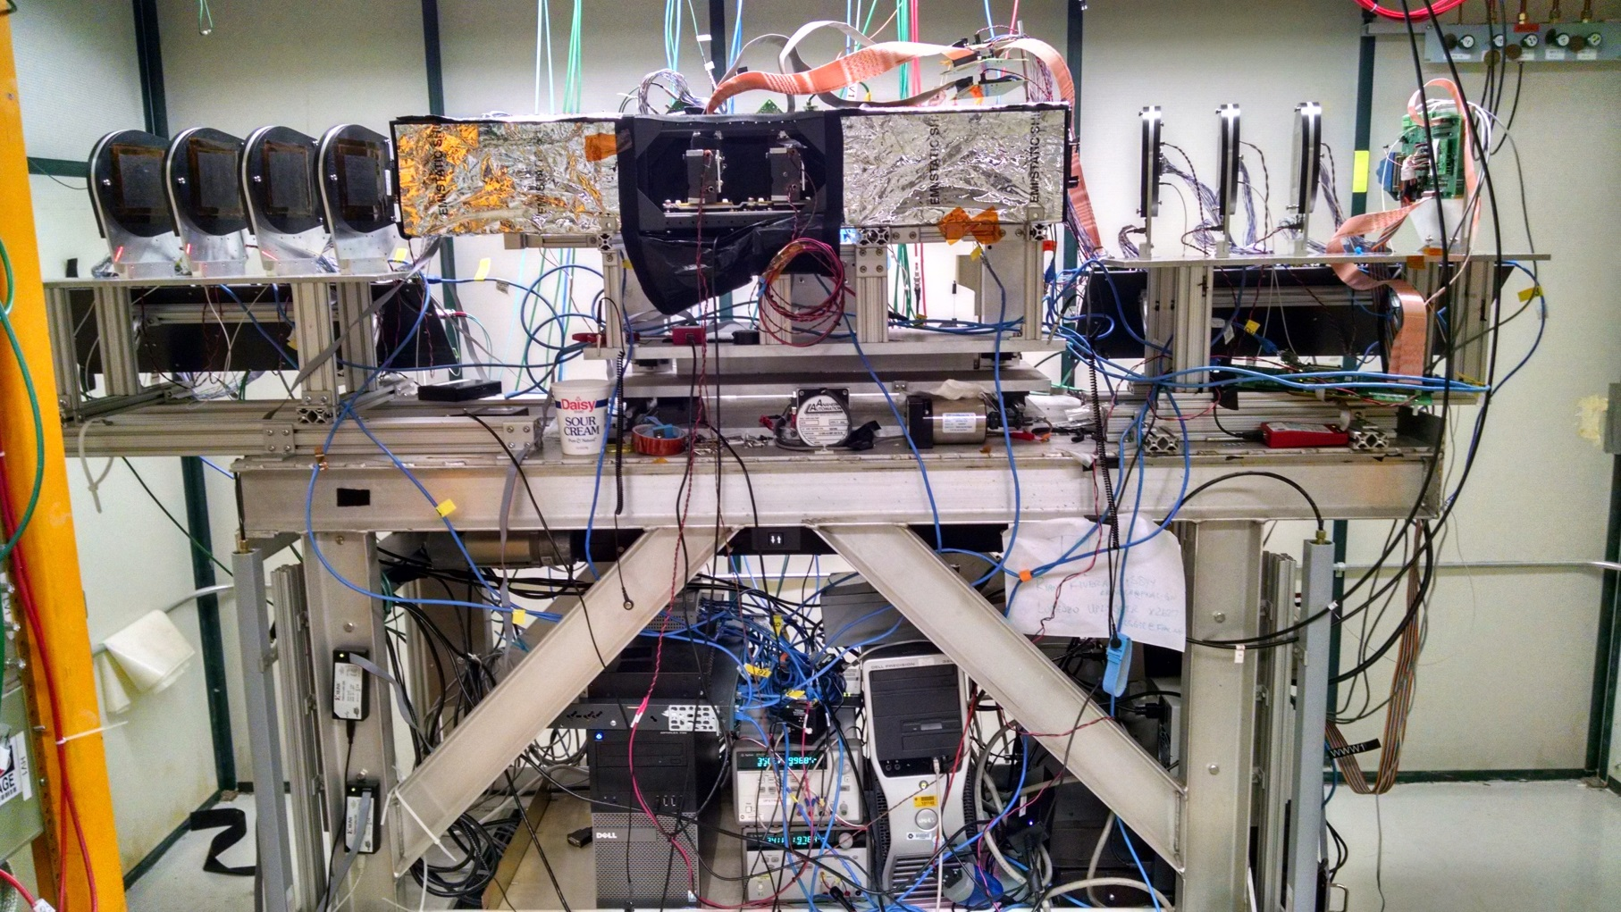
Tracking systems at MTEST
At present 2 tracking telescopes are installed:
  The legacy pixel telescope built using leftover CMS modules
  The new strip based telescope
Pixel Telescope
Strip telescope

Slide 6
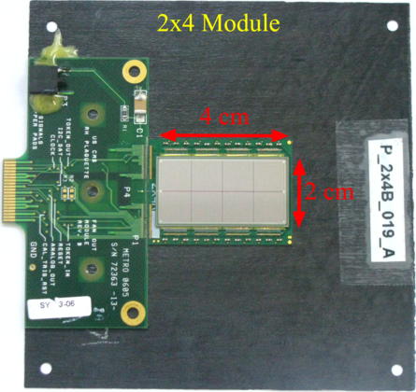
Leftover modules from the FPIX production
PSI46 analog readout chip (ROC)
100x150 μm² pixel pitch
Modules with 8 (2x4) or 6(2x3) ROCs

Slide 7
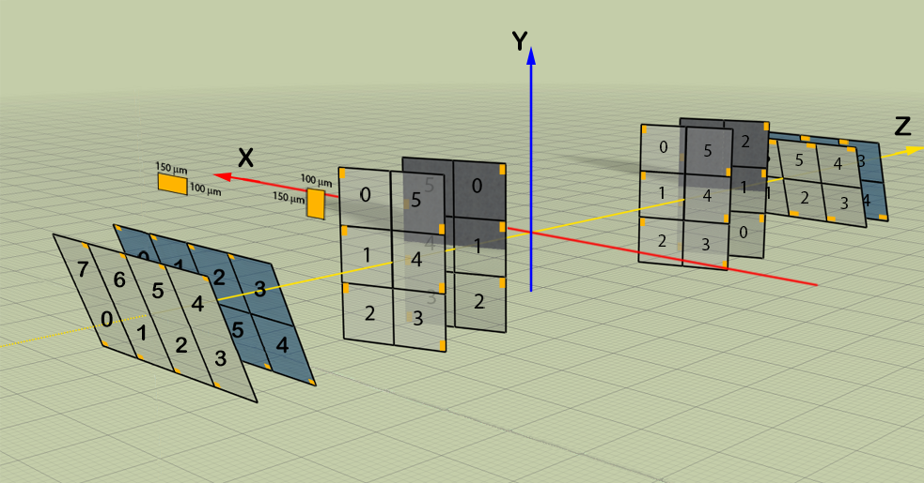
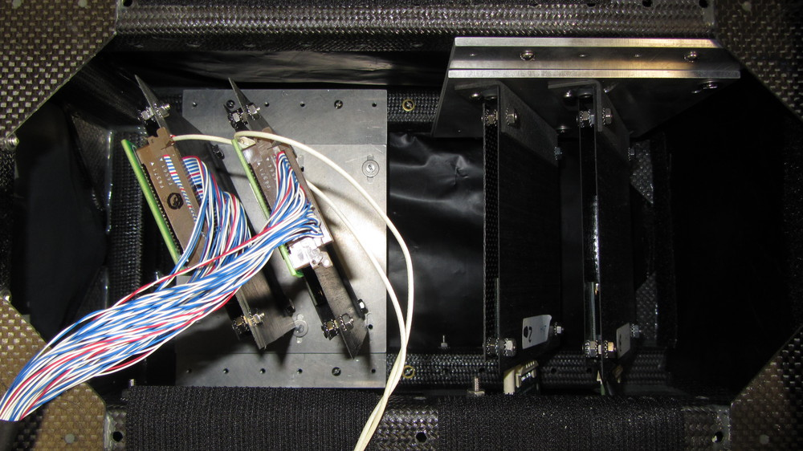
Schematic view of the pixel telescope planes
8 modules tilted at 25º to
maximize charge sharing
Coverage area only 1.6x1.6 cm²
Resolution on the DUT of ~7um

Slide 8
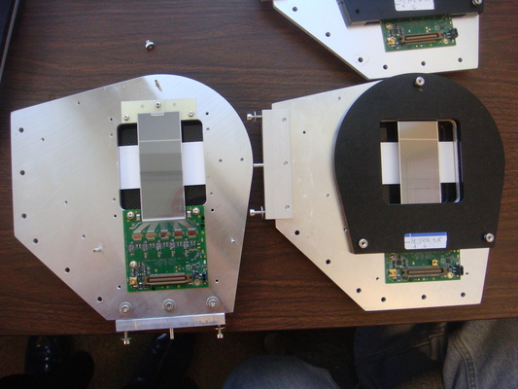
Silicon strip telescope station
Extra holes to allow a different mounting configuration for a total coverage of 7x7 cm²
The 3.8x3.8 cm²
overlap area
The Silicon strip telescope has a coverage of ~3.8 x 3.8 cm² which is almost 6 times than the current pixel telescope coverage.
Improved resolution with a 30 μm strip pitch
Minimal material in the path of the beam, using covers made of carbon fiber sheets
The software, firmware, hardware and DAQ have been developed in a very productive collaboration between Purdue University and Fermilab
20 stations have already been built but only 14 are currently installed

Slide 9
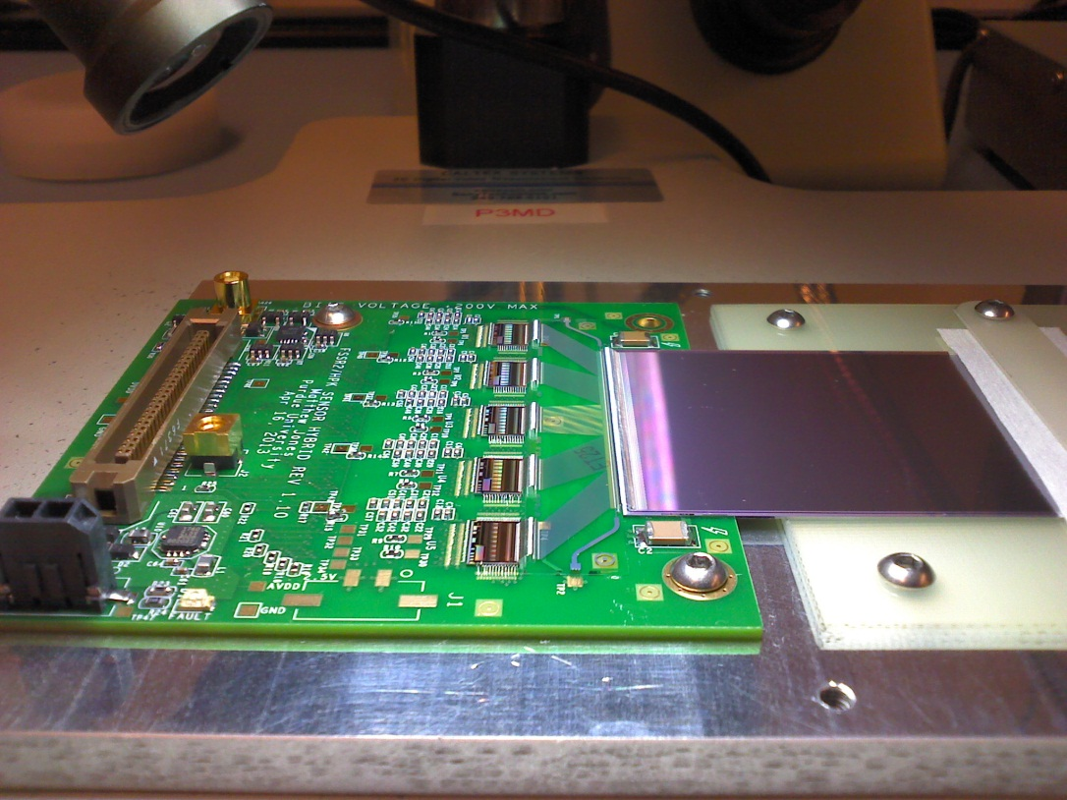
Sensor assembly

Slide 10
FSSR2 Readout Chip
0.25 μm CMOS process
128 analog inputs
8 programmable 8-bit thresholds
Independent BCO and readout clocks
Readout clock runs at up to 100 MHz
DDR serial output on 1,2,4,6 LVDS pairs
Data driven– no external trigger required
Data tagged with 8-bit bunch counter
“Fast-OR” trigger output
Originally developed for BTeV and gently given to us by Valerio Re of University of Bergamo

Slide 11
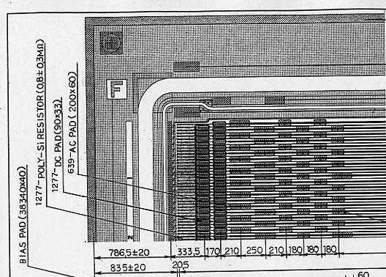
DØ Run IIb strip sensor
320 μm thick
639 strips
30 μm strip pitch
60 μm readout pitch
Sensitive area: 3.8 x 9.8 cm²
Fully depleted at ~100 V
Coverage area is then 3.8 x 3.8 cm²
Expected resolution on DUT ~3μm
Originally produced for DØ Run IIb upgrade

Slide 12
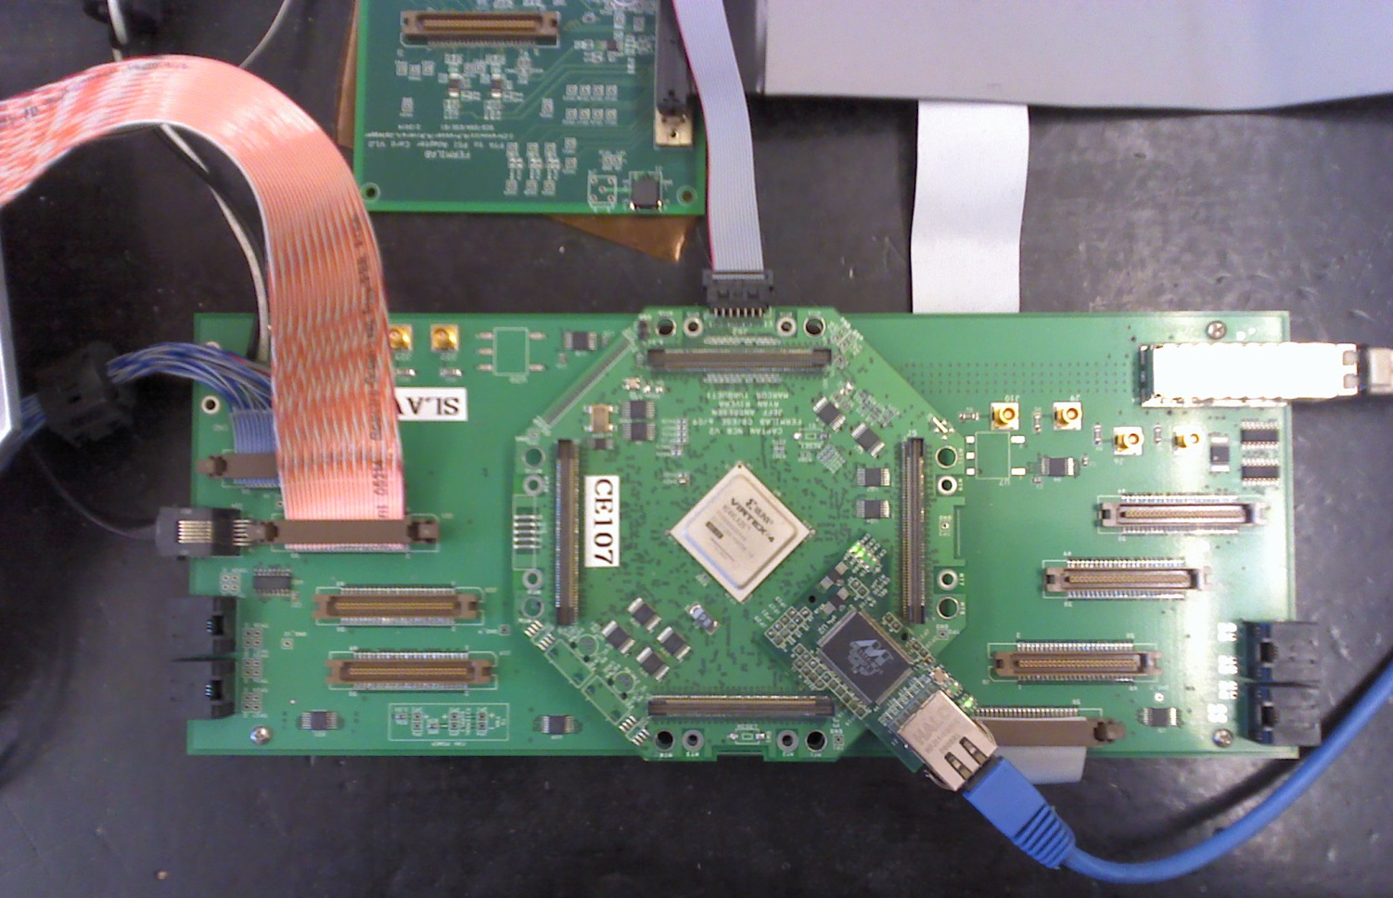
The CAPTAN Data Acquisition board
DAQ based on the CAPTAN (Compact and Programmable daTa Acquisition Node) designed few years ago at Fermilab
Simple FPGA board with an Ethernet link

Slide 13
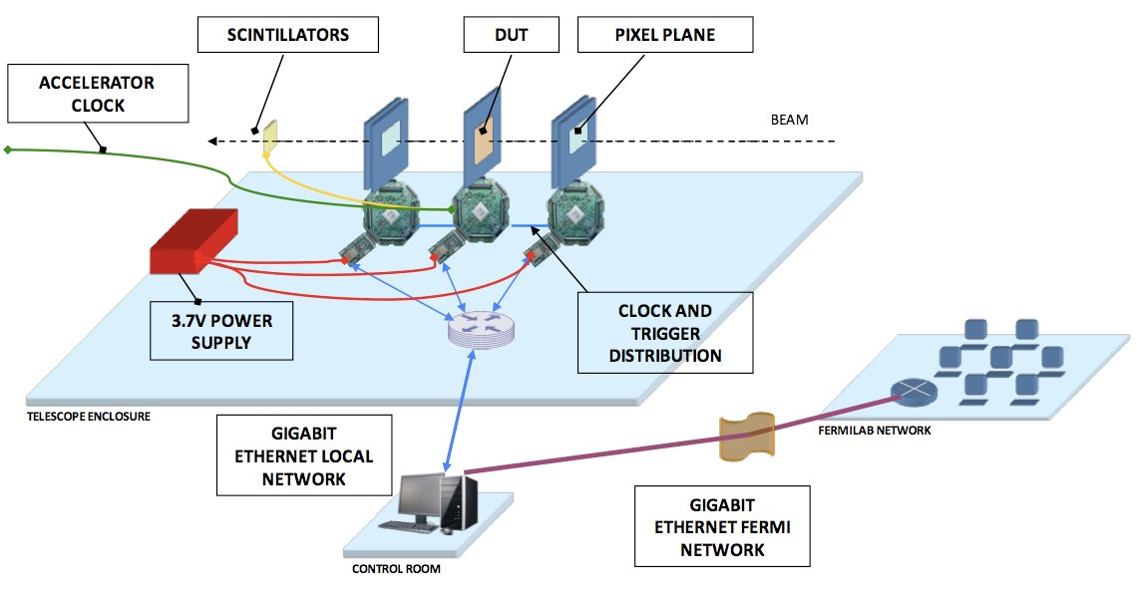
The readout system

Slide 14
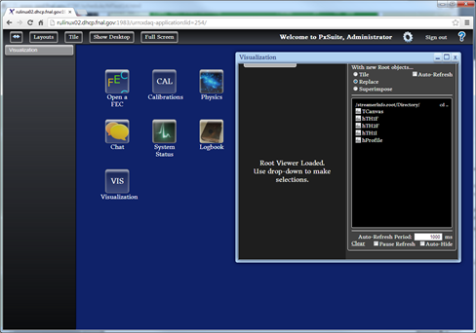
The Data Acquisition software
The software is based on XDAQ which is the framework used by CMS and is basically a web server that allow to build a web based Graphical User Interface.
The Data Quality Monitor is also a XDAQ application based on WebGL and ROOTJS

Slide 15
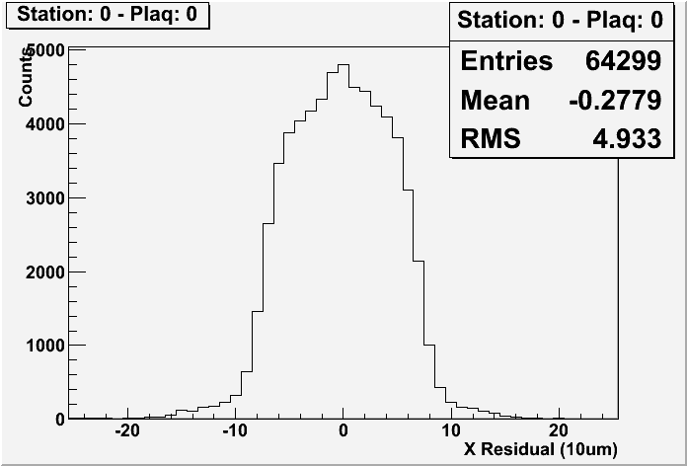
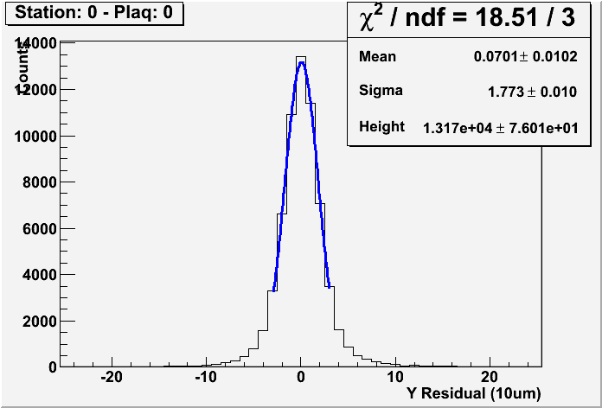
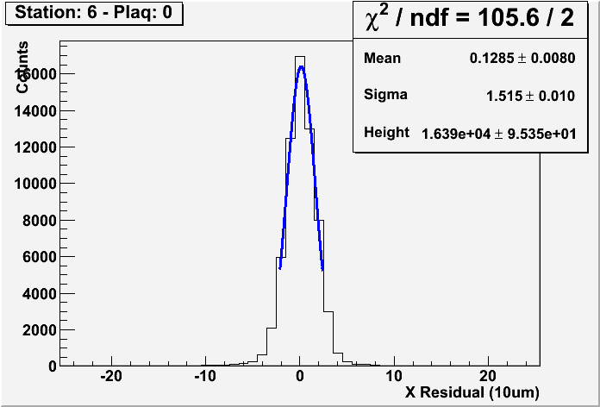
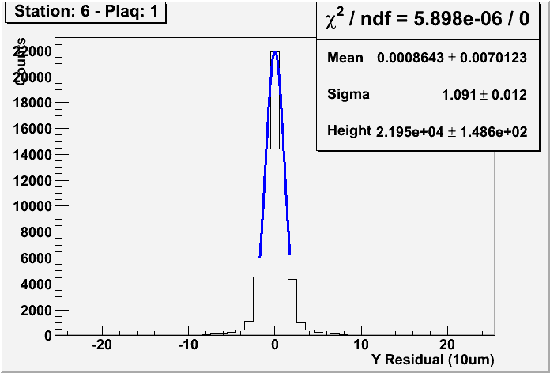
Silicon strip preliminary results
Pixel telescope
Strip telescope
We had to modify the alignment software (designed with pixels in mind) to accommodate the strip detectors
Already with this not optimal alignment we have a resolution at the center of the telescope of ~4 μm (to compare with 7 μm of the pixel telescope)

Slide 16
Synchronizing a data driven ROC with a trigger
The FSSR2 transmits all data that are above threshold
Data are internally time-stamped in the chip with a running 8 bit counter called BCO
In order to correlate these data with a trigger, another counter, synchronous with the BCO counter of the FSSR, has been implemented in the CAPTAN FPGA. This counter is used to extend to 48 bits the native FSSR 8 bits counter but also to time-stamp the trigger coming from the scintillators.
Since the trigger is always registered in the FPGA with a fixed delay, then we can correlate the particle arrival and FSSR BCO with the constant delayed trigger counter latched in the FPGA.

Slide 17
Synchronizing a data driven ROC with a trigger
FSSR Data driven
PSI46 Triggered
Scintillator
FSSR DATA
BCO 1
PSI46 DATA
TRIGGER 1
FPGA
COUNTER 1
FPGA
COUNTER 1
FPGA
COUNTER 0
FPGA
COUNTER 0
TIME 0
TIME 1
TRIGGER – FSSR BCO
ALWAYS 4
BUILDER

Slide 18
Synchronizing a data driven ROC with a trigger
FSSR Data driven
PSI46 Triggered
Scintillator
PSI46 DATA
FSSR DATA
BCO 1
TRIGGER 1
FPGA
COUNTER 2
FPGA
COUNTER 2
TIME 2
BUILDER

Slide 19
Synchronizing a data driven ROC with a trigger
FSSR Data driven
PSI46 Triggered
Scintillator
PSI46 DATA
FPGA
COUNTER 3
FPGA
COUNTER 3
TIME 3
FSSR DATA
BCO 1
TRIGGER 1
BUILDER

Slide 20
Synchronizing a data driven ROC with a trigger
FSSR Data driven
PSI46 Triggered
Scintillator
PSI46 DATA
FPGA
COUNTER 4
FPGA
COUNTER 4
TIME 4
FSSR DATA
BCO 1
TRIGGER 1
BUILDER

Slide 21
Synchronizing a data driven ROC with a trigger
FSSR Data driven
PSI46 Triggered
Scintillator
PSI46 DATA
FPGA
COUNTER 5
FPGA
COUNTER 5
TIME 5
TRIGGER 1
FSSR DATA
BCO 1
BUILDER

Slide 22
Synchronizing a data driven ROC with a trigger
FSSR Data driven
PSI46 Triggered
Scintillator
PSI46 DATA
FPGA
COUNTER 5
FPGA
COUNTER 5
TIME 5
TRIGGER 1 DATA
BCO 5
FSSR DATA
BCO 1
BUILDER

Slide 23
Synchronizing a data driven ROC with a trigger
FSSR Data driven
PSI46 Triggered
Scintillator
PSI46 DATA
TRIGGER 1
FPGA
COUNTER 6
FPGA
COUNTER 6
TIME 6
FSSR DATA
BCO 1
TRIGGER 1 DATA
BCO 5
TRIGGER – FSSR BCO
ALWAYS 4
BUILDER

Slide 24
Synchronizing a data driven ROC with a trigger
FSSR Data driven
PSI46 Triggered
Scintillator
PSI46 DATA
TRIGGER 1
FPGA
COUNTER 7
FPGA
COUNTER 7
TIME 7
FSSR DATA
BCO 1
TRIGGER 1 DATA
BCO 5
TRIGGER – FSSR BCO
ALWAYS 4
BUILDER

Slide 25
Synchronizing a data driven ROC with a trigger
FSSR Data driven
PSI46 Triggered
Scintillator
FPGA
COUNTER 8
FPGA
COUNTER 8
TIME 8
FSSR DATA
BCO 1
PSI46 DATA
TRIGGER 1
TRIGGER 1 DATA
BCO 5
TRIGGER – FSSR BCO
ALWAYS 4
BUILDER

Slide 26
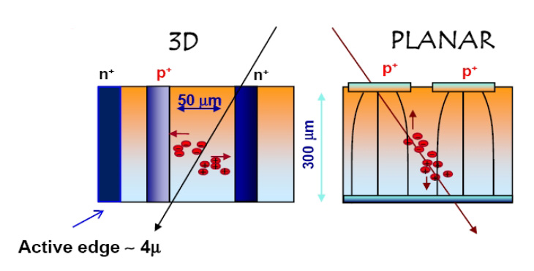
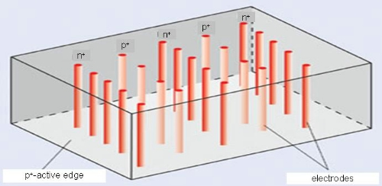
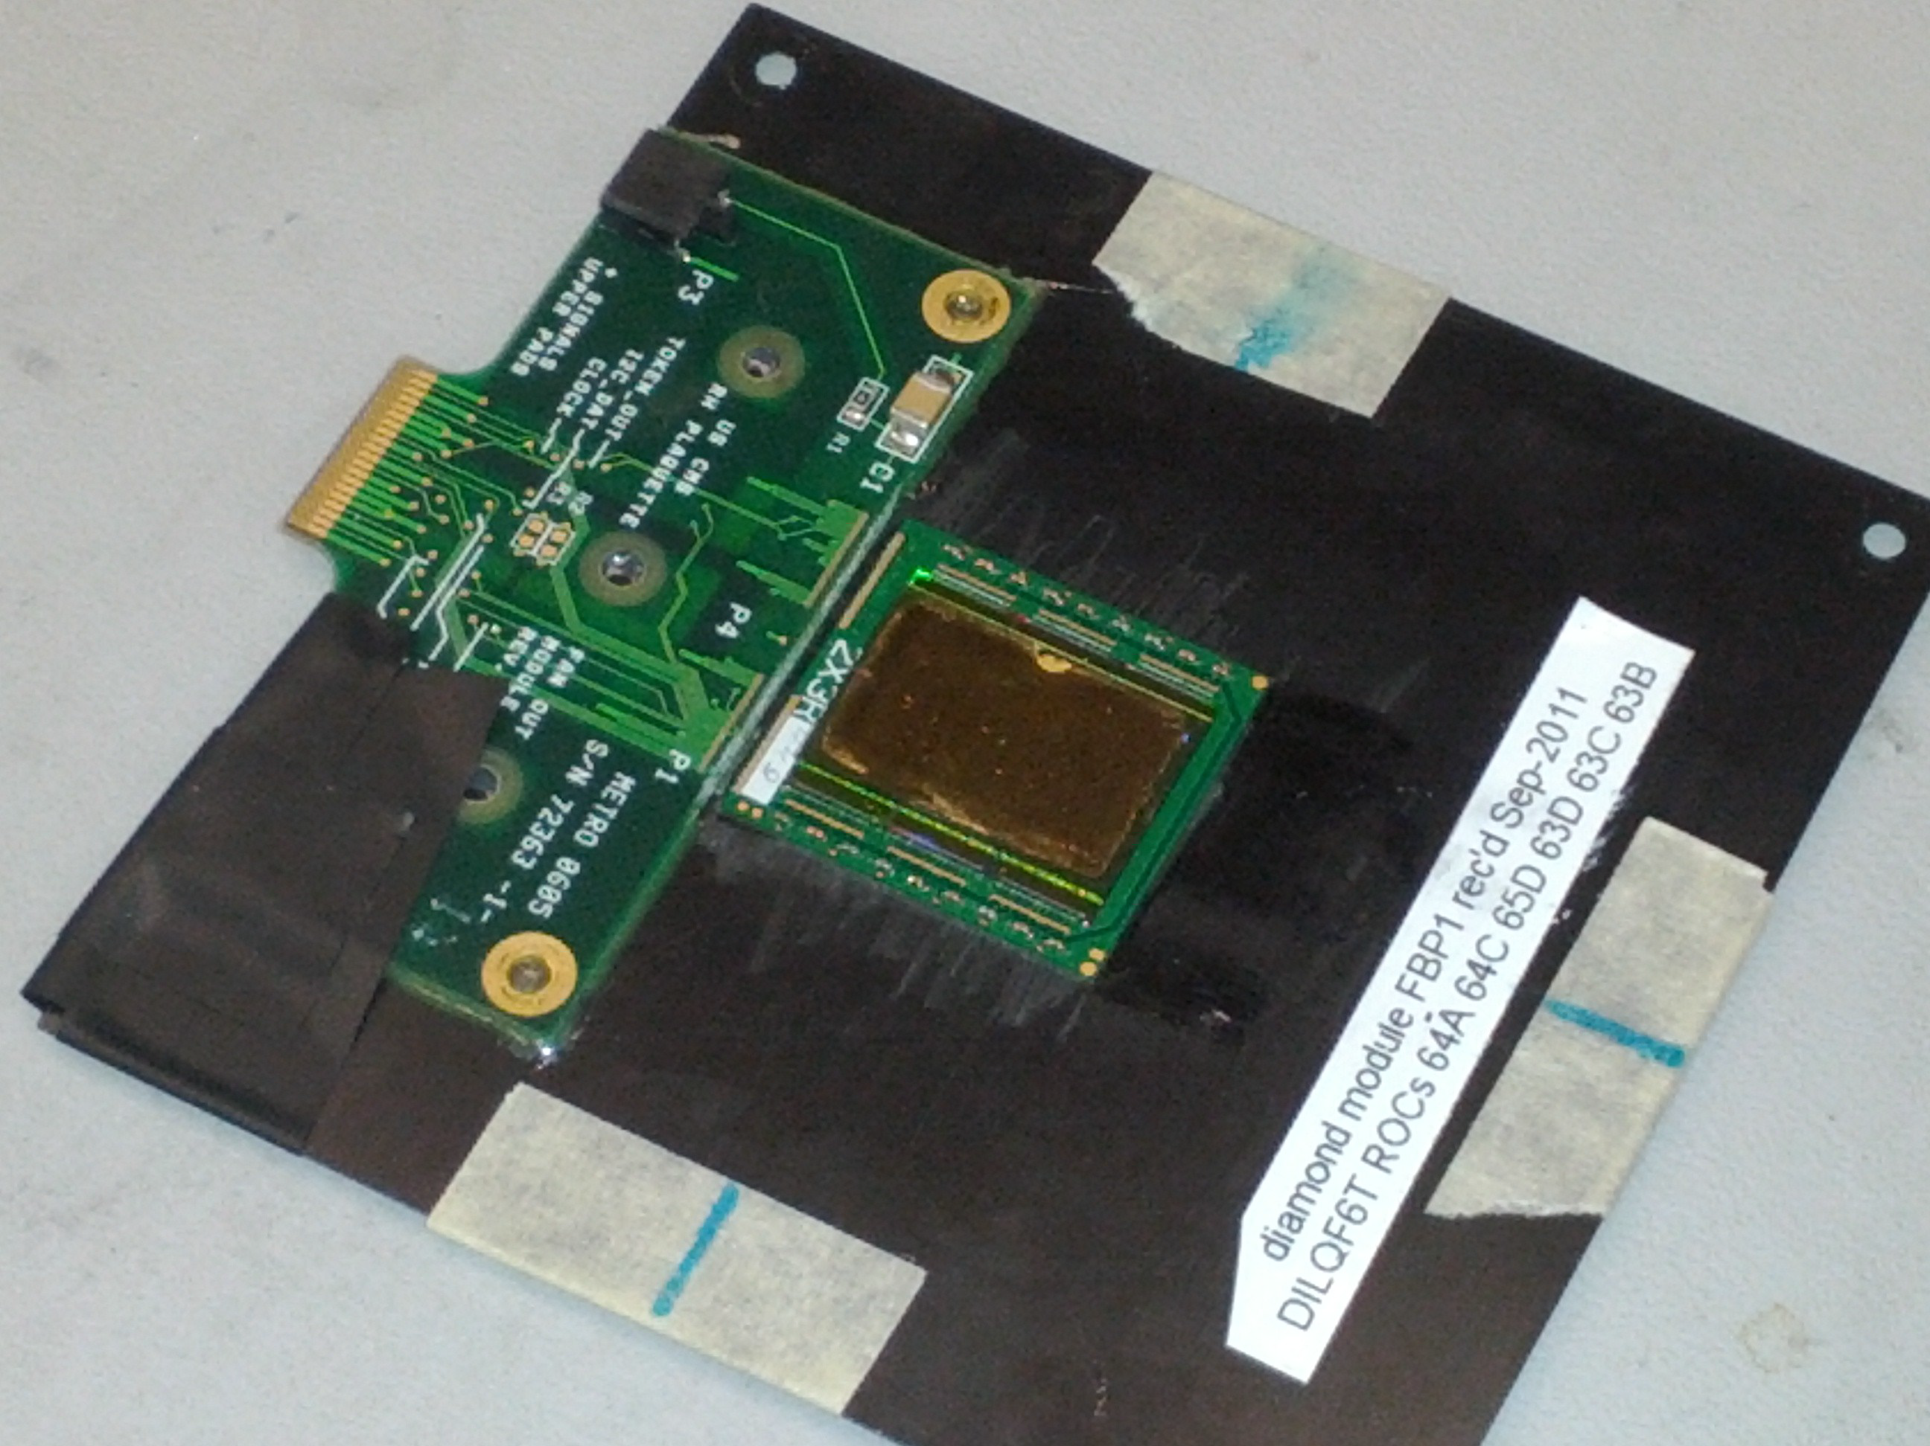
Why a tracking telescope
In the next 10 years the LHC will increase the beam intensity by a factor of at least 10
A new generation of sensors will be necessary to sustain the much higher level of radiation
The most promising technologies are: thin silicon, 3D silicon and diamond

Slide 27
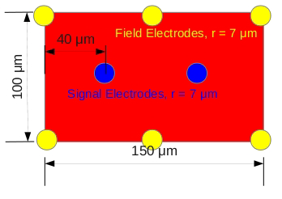
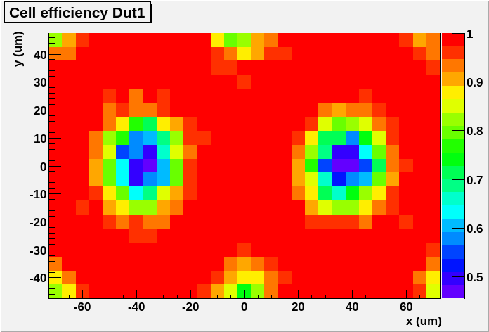
Test results on 3D sensors
You can see the 7 μm electrodes with the telescope when the sensors are hit by the beam

Slide 28
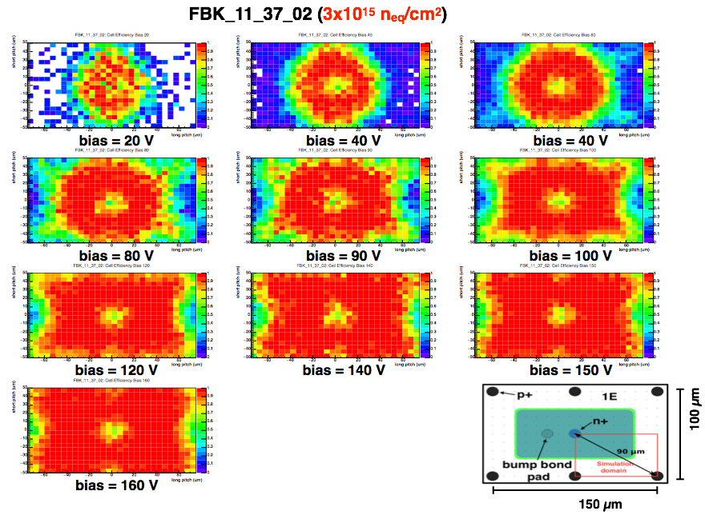
Efficiency for irradiated 3D sensors

Slide 29
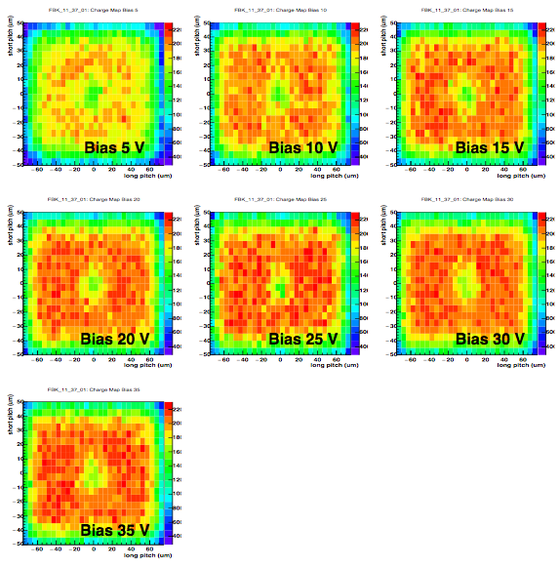
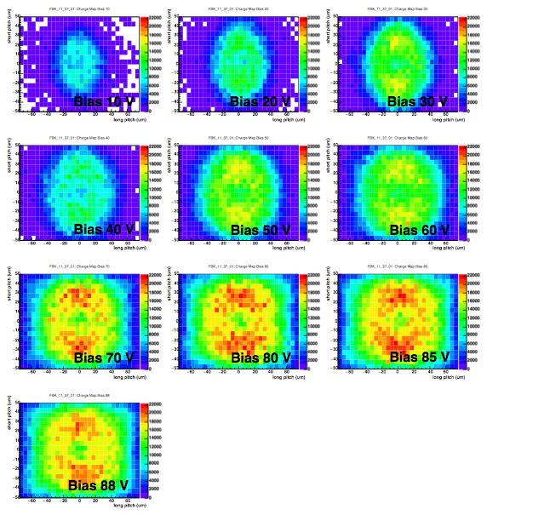
Cell charge for 3D sensors
Irradiated 3D sensor
FBK_11_37_01 (1x10¹⁵ n_{eq}/cm²)
Non irradiated 3D sensor

Slide 30
Test results on 3D sensors
The Fermilab Test Beam Facility provides different beams available for detector studies
http://ppd.fnal.gov/ftbf/
Two tracking systems are currently available but we are hoping to resolve the remaining issues and remove the pixel tracker
The telescopes are available for experimenters’ that need tracking information extrapolated on their devices

