Slide 1
The High-Luminosity Upgrade
of the CMS Tracker
Focusing on the Outer Tracker
Duccio ABBANEO
CERN

Slide 2
Requirements for the High-Luminosity Upgrade
The Outer Tracker
Silicon sensors
p_{T} modules
Electronics system
  Front-End hybrids
  Powering
Optimization of the detector layout
Mechanical structures and cooling
Performance
The Pixel detector
Main challenges

Slide 3
Requirements for the High-Luminosity Upgrade
(1) From the LHC
Radiation tolerance up to 3000 fb⁻¹
Keep the possibility to repair the pixel detector: the inner parts could be replaced if needed
Operate up to 200 <PU>
Maintain occupancy at the ~1% level → much higher granularity

Slide 4
Requirements for the High-Luminosity Upgrade
(2) From CMS
DAQ compatible with higher L1 rate and longer latency
100 kHz → 750 kHz
3.2 μs → 12.8 μs
Contribution to the Level1 trigger decision
p_{T} modules in the Outer Tracker

Slide 5
Requirements for the High-Luminosity Upgrade
(3) Extra commodities
Extended tracking acceptance
Up to η~4 (concerns mostly the pixel detector)
Main purpose: assign jets to primary vertices in the forward region
Reduce material in the tracking volume
If we can, as much as we can
The tracker material is a major limitation to the overall performance of CMS today

Slide 6
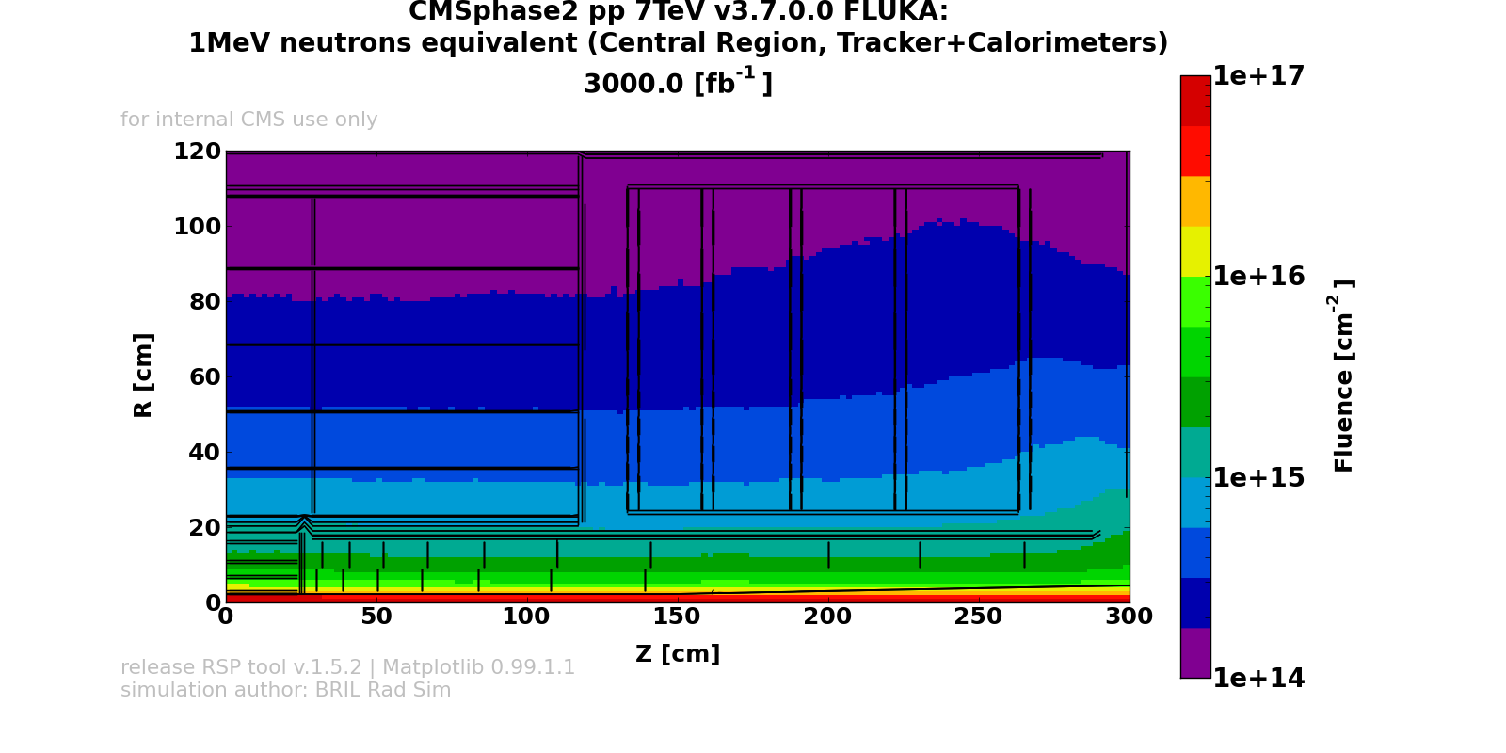
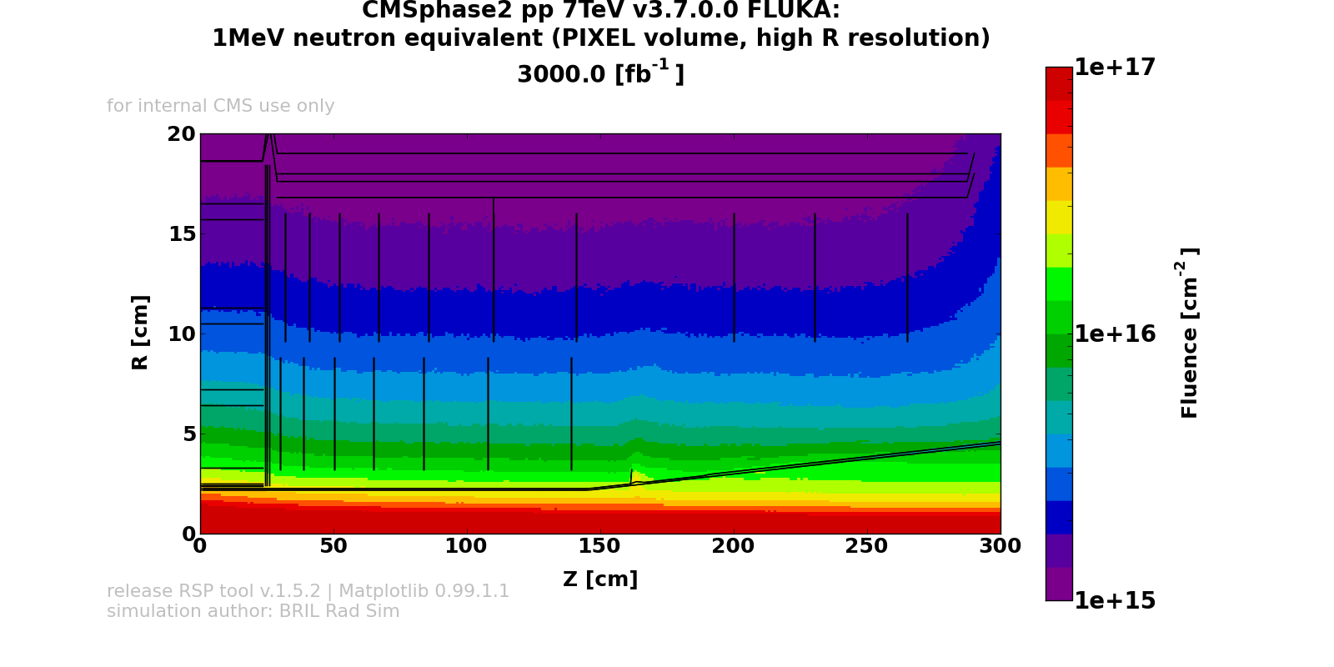
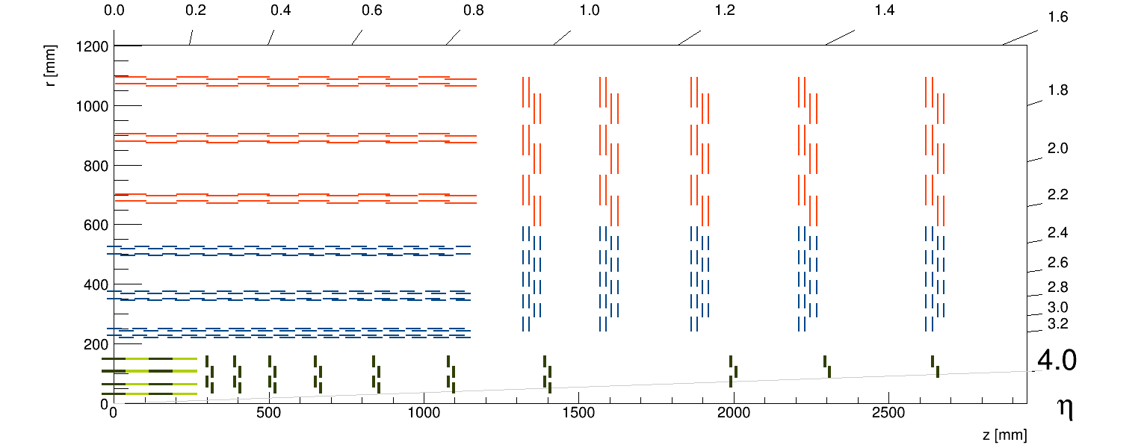
Radiation tolerance
Radiation levels depend essentially on R, not on z
  The target is 10× present tracker
  Challenging for silicon sensors and electronics (notably in the pixel region)
Pixel 4th layer
1.6E+15
2S modules
3.5E+14
Pixel 2nd layer
5.8E+15
PS modules
9.3E+14
Pixel 1st layer
2.0E+16
Pixel service cylinder
1.0E+15

Slide 7
Sensors for Outer Tracker
After heavy irradiation (~10¹⁵) charge from 320 μm thick sensors drops down to the same level as 200 μm
  More trapping
  In 200 μm the leakage current is smaller, and can be operated at smaller V_{bias}: mitigate requirement on cooling!
In p-in-n sensors observed spurious signals (random non-gaussian noise, a.k.a. Random Ghost Hits)
`

Slide 8
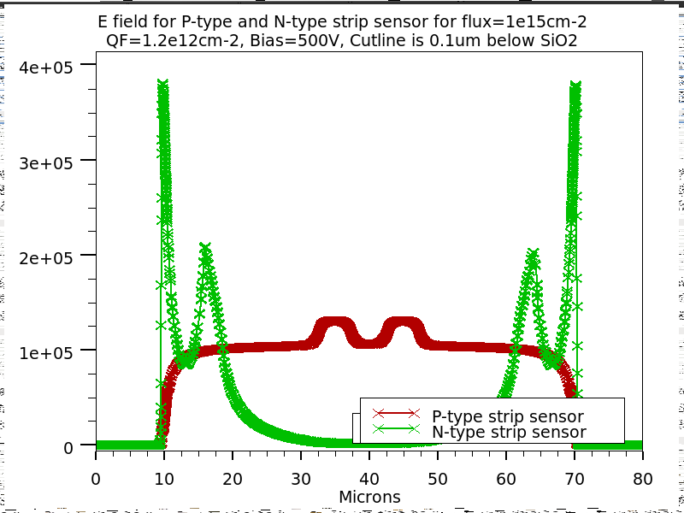
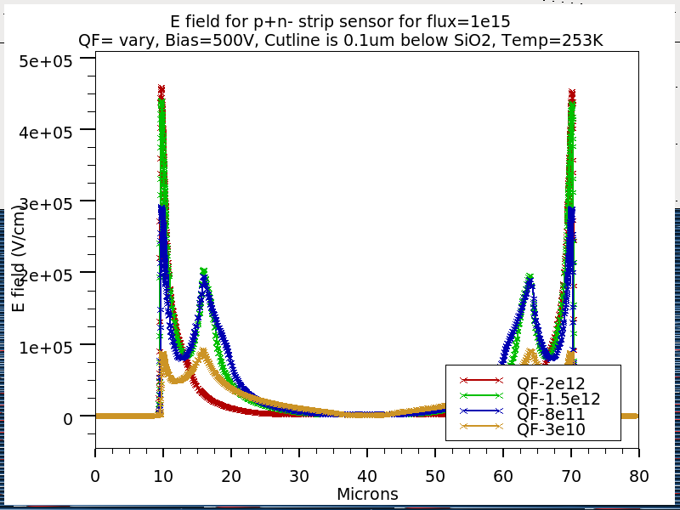
Understanding RGH
T-CAD simulations show higher electric fields at the strip edges for irradiated p-in-n sensors than for p-type sensors with same geometry
  Suggests the occurrence of “micro-discharges” in p-in-n
Increasing oxide charge…
  increases max. electric fields in p-in-n, reduces max. electric fields in n-in-p
  Observation: rate of RGHs are smaller for neutron than for proton irradiation
    less ionization, less surface damage
n-in-p
p-in-n
p-in-n
F=1x10¹⁵cm⁻² ; Q_{F} = 1.2x10¹²cm⁻²;
U = 500 V; 5-trap model (Silvaco)
strip doping
aluminum

Slide 9
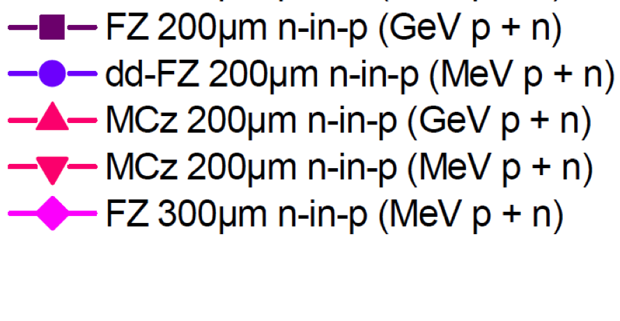
Annealing
All thin p-type samples work well and show seed signals >8ke- at 600V until about 20w@RT
Can be used to reduce the leakage current by keeping the detector at RT for 2 weeks each year, e.g. during YETS
MCz material shows significantly better behaviour after long annealing time

Slide 10
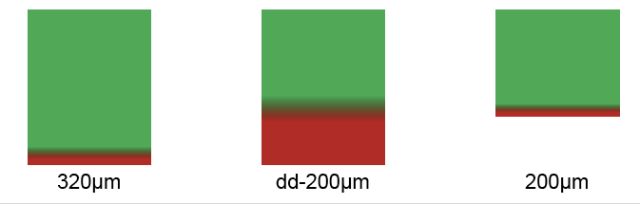
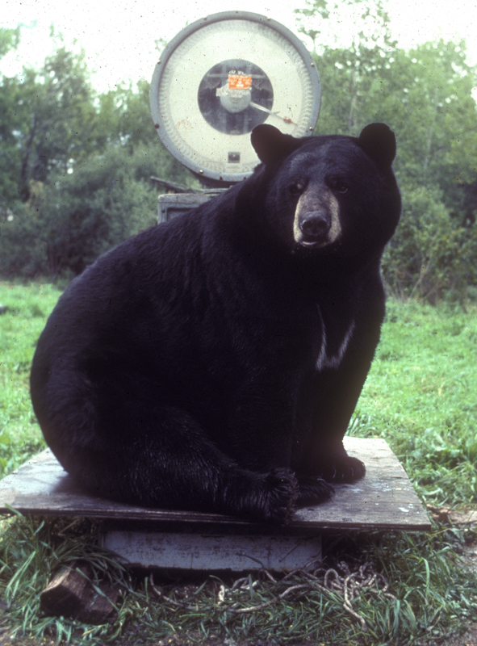
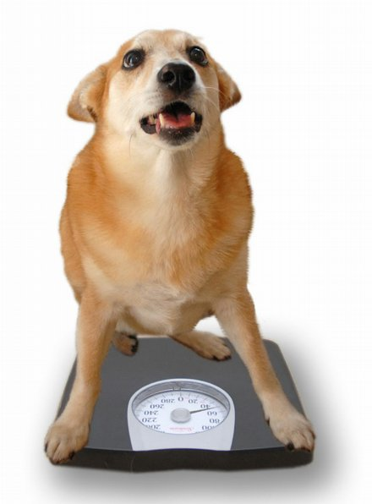
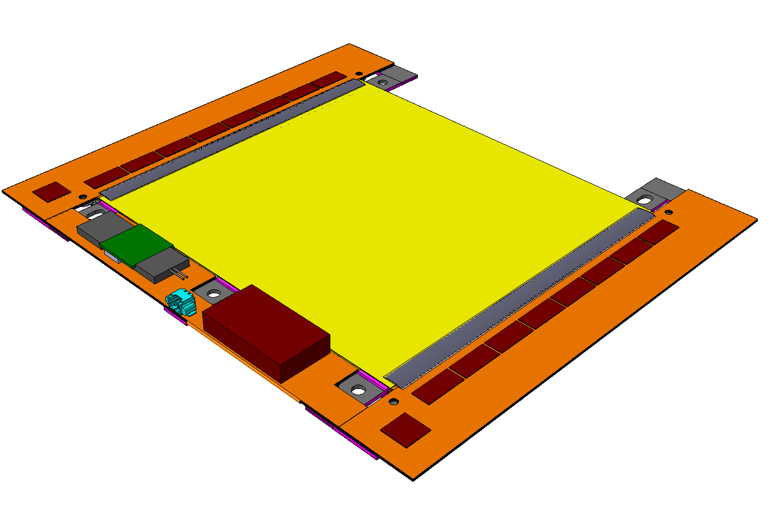
Sensor thickness
200 μm active thickness provides sufficient charge
  With smaller charge loss after irradiation
Adding (inactive) silicon thickness increases the mass
With larger active thickness the leakage current is larger
  … and most likely V_{bias} would be larger, eventually
→ additional material for thermal management
Example for 2S modules
≈ 30 g
≈ 34 g
≈ 40 g

Slide 11
Outer Tracker sensors summary
Polarity
  n-in-p is the selected option, as it offers robust performance (i.e. graceful degradation) after heavy irradiation
Material
  MCz is the preferred option
    Allows for long annealing times with no adverse effects
    Could be (eventually) operated at lower V_{bias}, mitigating the requirements on the cooling
Thickness
  200 μm active and physical thickness is the preferred option
    Sufficient charge, good annealing behaviour, lower I_{dark} and V_{bias}
  200 μm active 320 μm physical is a good backup
  We can build a Tracker with sensors of 300 μm active thickness, but that would have a visible impact on the mass

Slide 12
Tracker input to Level-1 trigger
  μ, e and jet rates would substantially increase at high luminosity
    Even considering other trigger upgrades
  Increasing thresholds would affect physics performance
    Performance of algorithms degrades with increasing pile-up
      Muons: increased background rates from accidental coincidences
      Electrons/photons: reduced QCD rejection at fixed efficiency from isolation
  Even HLT without tracking seems marginal
  Add tracking information at Level-1
    Move part of HLT reconstruction into Level-1
Goal for “track trigger”:
  Reconstruct tracks above 2 GeV
  Identify the origin along the beam axis with 1÷2 mm precision
    Enables vertex discrimination

Slide 13
General concept
Silicon modules provide at the same time “Level-1 data” (@ 40 MHZ), and “DAQ data” (upon Level-1 trigger)
  The whole tracker sends out data at each BX
Level-1 data require local rejection of low-p_{T} tracks
  To reduce the data volume, and simplify track finding @ Level-1
  Threshold of ~ 2 GeV ⇒ data reduction of ~ one order of magnitude
Design modules with p_{T} discrimination (“p_{T} modules”)
  Correlate signals in two closely-spaced sensors
  Exploit the strong magnetic field of CMS
Level-1 “stubs” are processed in the back-end
  Form Level-1 tracks, p_{T} above ~2 GeV
  To be used to improve different trigger channels

Slide 14
Working principle of p_{T} modules
“stub”
pass
fail
.
→
y
1 ÷ 4 mm
B
→
z
.
B
x
≤ 100 μm
ΔR
R
φ
R
ϑ
Δz = ΔR / tg ϑ
z
Sensitivity to p_{T} from measurement of Δ(Rφ) over a given ΔR
  For a given p_{T}, Δ(Rφ) increases with R
  In the barrel, ΔR is given directly by the sensors spacing
  In the end-cap, it depends on the location of the detector (tgϑ)
    End-cap configuration typically requires wider spacing, and yields worse discrimination
Optimize selection window and/or sensors spacing
  To obtain, ideally, consistent p_{T} selection through the tracking volume
The concept works down to a certain radius
  20÷25 cm with the CMS magnetic field and a realistic 100 μm pitch

Slide 15
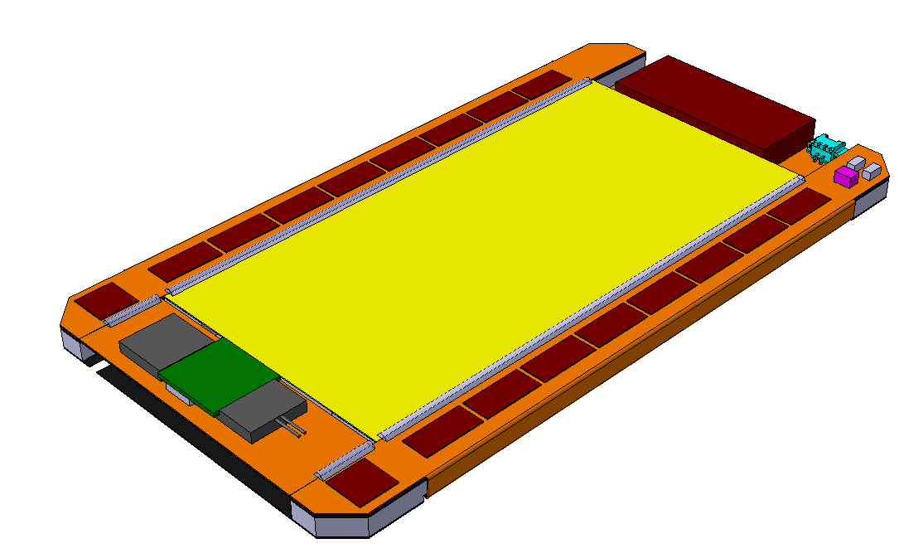
p_{T} modules
2S
PS
2 Strip sensors
2×1016 Strips: 5 cm × 90 μm
2×1016 Strips: 5 cm × 90 μm
P ~ 5 W
~ 90 cm² active area
For R > 60 cm
coarse z coordinate
2S
Pixel + Strip sensors
2×960 Strips: 2.5 cm × 100 μm
32×960 Pixels: 1.5 mm × 100 μm
P ~ 7 W
~ 45 cm² active area
For r > 20 cm
accurate z coordinate
PS

Slide 16
Module design
Two types of modules combined with different sensors spacing
  2S modules with 1.8 mm and 4.0 mm
  PS modules with (provisionally) 1.6 mm, 2.6 mm and 4.0 mm
Cooling requirement
  Silicon sensors at −20°C or lower, with full power and radiation damage, for cooling set point of −30°C
    Ensures that modules can be operated (no thermal runaway)
    Design cooling system capable of −40°C (the margin is on the cooling plant)
    Low operating temperature mitigates requirement on thermal management
      Notably on 2S modules
Additional requirements
  Low mass, good mechanical precision and stability, little deformations in cold, simple and reproducible assembly, affordable
Module design driven by Finite Element Analysis of thermal performance
  Minimize differences between different types and versions

Slide 17
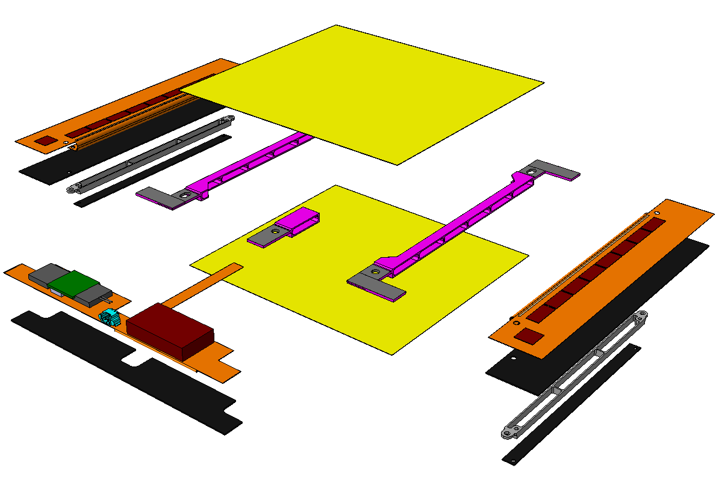
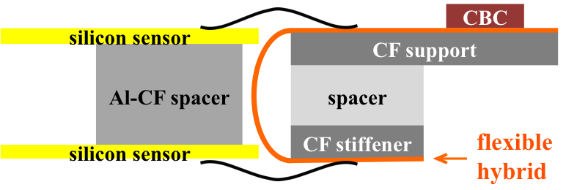
2S module
Five mounting/cooling points – peripheral cooling
  Concept similar to modules of the present tracker
Al-CF spacers provide good thermal conduction, and enable simple, high-precision assembly with ~ no CTE mismatch
Hybrids are laminated on the CF supports by the company
2S silicon sensors
Al-CF spacer
Al-CF tab
CF support
Al-CF spacer
CF stiffener
Al-CF short spacer
Service Hybrid
FE Hybrid
CBC
CIC
Mounting points / cooling contacts
1
4
5
2
6
9
7
1
10
3
11
8
4

Slide 18
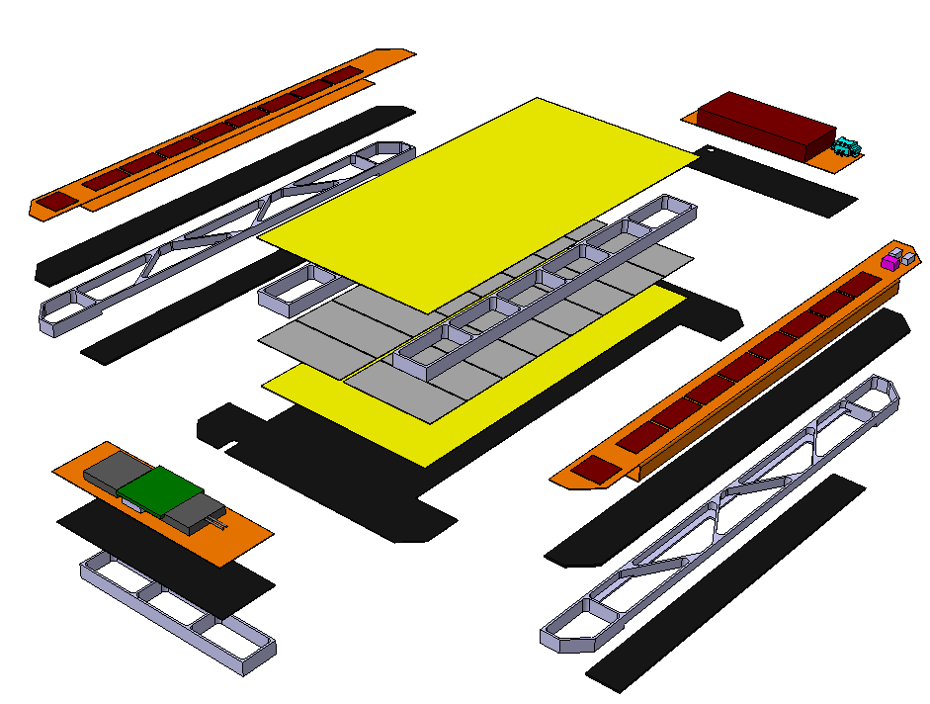
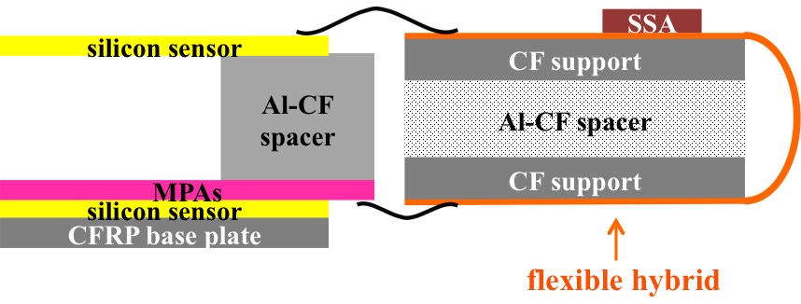
PS module
Heat dissipation in the MPA requires large area cooling contact
Cooling through CF base plate, glued on a cold surface on the supporting mechanics
Module assembly starts from the base plate
  Additional spacer under the Opto-Link Hybrid, wire-bonded to the FE Hybrids
PS-s silicon sensor
PS-p silicon sensor
MPAs
Al-CF sensor spacer
CFRP base plate
FE Hybrid
Opto-Link Hybrid
Power Hybrid
SSA
CIC
Hybrid CF support
Al-CF Hybrid spacer
1
8
11
4
3
9
2
12
10
6
7
5
11
11
12
11

Slide 19
Al-CF composite
Aluminium with embedded carbon fibers, randomly oriented in a plane
Excellent combination of mechanical and thermal properties
Easy to machine
Breakthrough in the design of p_{T} modules!
Property |  | Al-CF V2-4 | Al
Density [g cm⁻³] |  | 2.4 | 2.7
Thermal conductivity [W m⁻¹ K⁻¹] | In plane | 230 | 237
 | Through plane | 120
CTE [ppm K⁻¹] | In plane | 4 | 23
 | Through plane | 24

Slide 20
Electronics architecture
shown for 2S modules
2S Module
HV
LV/HV PS
FE-Hybrid
L
FE-Hybrid
R
LV
L1 Tk-Finding
FPGA
AM
Process &
Route
CBC
CBC
TRIG
CIC
CIC
FE BE
stubs
DTC
CTRL
Service-Hybrid
DC/DC
m-Tx
LP-GBT
VTRx⁺
GBT
FPGA
Process &
Route
TTC
m-Rx
DAQ
  8 CBCs / side, 130 CMOS, bump-bonded on the flex hybrids together with the passive components
    800 bumps @ 250 μm pitch
    127×2 channels, performs top-bottom correlations
  Sensors wire-bonded to high-density FE hybrid
  Wire bonds from FE Hybrid to Service Hybrid
  FE hybrid implements all line routing (data, control, power)
    Sensors → CBCs, CBCs → CIC, CIC → GBT on Service hybrids
    Power from Service Hybrid to all chips

Slide 21
Data flow (2S modules)
  The Concentrator IC combines data from 8 CBCs and for 8 consecutive BX
    “Block synchronous” system. Efficient use of bandwidth with fixed latency
CBC
CBC
@ 320 Mb/s
each CBC
@ 320 Mb/s
each CBC
1b
DAQ
5b
TRIG
5b
TRIG
1b
DAQ
CIC L
CIC R
FE-Hybrid L
FE-Hybrid R
@ 320 Mb/s
1b
DAQ
4b
TRIG
4b
TRIG
1b
DAQ
@ 320 Mb/s
Service-Hybrid
5b + 5b
@ 320 Mb/s
LP-GBT
Based on a conservative assumption of 3.2 Gb/s available bandwidth in the LP-GBT
Most likely the real value will be higher
E.g. 3.84 Gb/s or 4.48 Gb/s, depending on error correction scheme chosen (specs under discussion now)
Option to use the high-speed version (2 × bandwidth) at the cost of some extra power
→ Can be useful in the first layer of PS modules

Slide 22
N.B. L1 tracking acceptance is limited at η~2.4
DAQ data @ 750 kHZ
L1 data @ 40 MHz
DAQ data @ 750 kHz
The L1 data output is disabled for modules located at low angle in the End Caps
(p_{T} discrimination insufficient to achieve reasonable bandwidth and stub purity)

Slide 23
FE electronics for PS modules
Two different chips: Macro-Pixel ASIC (MPA) and Short Strip ASIC (SSA). TSMC 65 nm.
  Correlation in the MPA
  2×8 MPA per module, ~2000 bumps / MPA, ~30,000 macro-pixels
  Connectivity and data formats as for 2S modules
Service Hybrid split in two boards (readout and power) since the module is ½ length
  Sensors → CBCs, CBCs → CIC, CIC → GBT on Service hybrids
  Power from Service Hybrid to all chips
System fully efficient in layers 2-3
Limited by bandwidth in layer 1 for the stub data
  If <PU> = 200 is confirmed as design goal, the 10 Gb/s version of the LP-GBT will be needed!

Slide 24
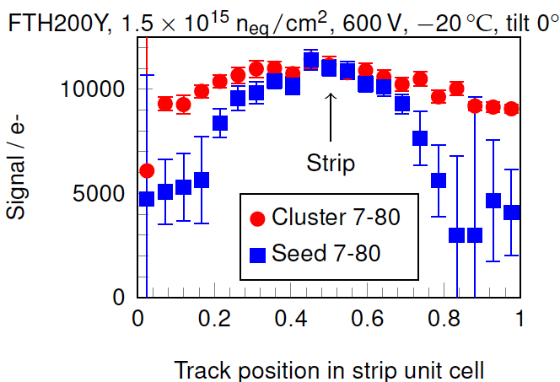
The requirements for the FE ASICs are calculated taking into account the effect of sensor irradiation and the specific functionality of p_{T} modules
Measured
in the beam
The case of charge sharing sets the requirement on S/N to achieve full efficiency
Efficiency
  We aim at delivering a detector with ~99% initial efficiency, all effects combined
    Module dead area, faulty channels/chips/modules, faulty electrical connections, broken fibers…
  → Each individual source of inefficiency should be at the 1 ÷ few ‰ level
Noise
  p_{T} < 2 GeV particles are 98% at R=60 cm
  Stub rate for combinations of low-p_{T} hits with noise hits 10% of rate of good particles
  → Stub misid probability of 0.2% (0.2% × 50 = 10%)
Full Geant4 simulation of an irradiated module @ 60 cm,
200 μm active thickness, Lorentz angle, V_{bias} = 600 V, reduced CCE

Slide 25
Operability ≡ max(inefficiency,misid)
  Operability < 0.2% means
  Both inefficiency and misid < 0.2%
  → good!
Before irradiation

Slide 26
After irradiation
Good working point:
Threshold 3700e-
With noise < 1060 e-
Requirement for the CBC set to:
noise < 1000 e-

Slide 27
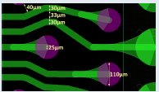
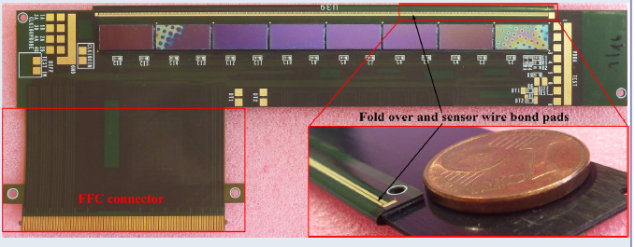
High density flex hybrids
25 μm double-sided polyimide core layer, plus two single-sided 12.5 μm polyimide layers on either side. 25 μm coverlay on the bottom, solder mask on the top. Total thickness ~130 μm.
2S hybrid. Wirebonding pitch to sensor 90 μm × 2 sensors. Bump bonding pitch of CBC 250 μm,
800 bumps × 8 chips. High-density routing: thinnest line 30 μm with spacing 33 μm.
Prototype with Flat Flexible Connector (CIC not yet available).
Eventually will be wire bonded to the Service Hybrid.

Slide 28
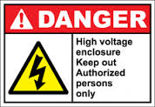
Front-End powering with on-board DC-DC converters
12 V
upFEAST
2.5 V
2nd stage
1.2 V
ASICs
2S module
opto
upFEAST improved version of existing FEAST
2nd stage to be designed - technology chosen TSMC 130 nm
12 V
upFEAST
2.5 V
2nd stage
1.2 V
ASICs
DC-DC inside
2nd stage
0.8 V
ASICs
PS module
opto
The module is a self-contained functional unit
Individually connected to the back end with power lines and optical fibers for readout and control

Slide 29
Optimization of the detector

Slide 30
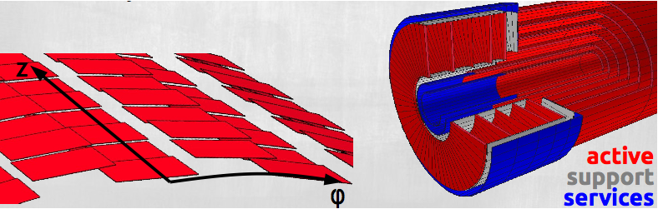
Optimization of the detector
Detector standalone modelling: tkLayout
Flexible tool to create 3D models of the tracker from simple configuration files and user-defined rules
Includes both active surfaces and inactive materials

Slide 31
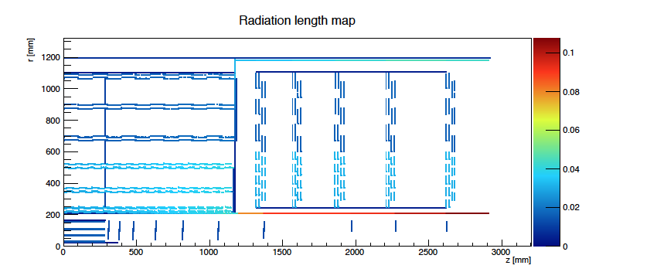
Detector standalone modelling: tkLayout
Simple (semi-automatic) modelling of services
Material of sensitive elements
Dedicated volumes for supports and services

Slide 32
Detector standalone modelling: tkLayout
Simple (semi-automatic) modelling of services
Material of sensitive elements
Automatic routing of outgoing services
Dedicated volumes for supports and services

Slide 33
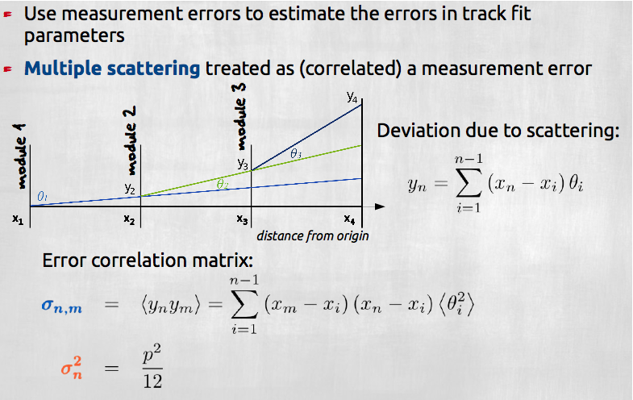
Detector standalone modelling: tkLayout
Implements estimates of tracking performance

Slide 34
Detector standalone modelling: tkLayout
Provides:
  Estimates of the tracking precision including multiple scattering
    For both offline tracking and L1 tracking
  All useful summaries/statistics
    # of modules, active surface, # of channels, total power, total weight, etc etc….
  Radiation length and interaction length vs rapidity
  Map of leakage current in all modules after irradiation
    Input from FLUKA – used to optimize module cooling
  Stub p_{T} resolution for each module location
    Used to optimize distribution of sensor spacing in the Tracker volume
  … and more…
Outputs:
  Mini web-site with full information
  Geometry files for CMSSW
  Module coordinate files for the 3D modelling of the detector structures
  Geometry files for FLUKA

Slide 35
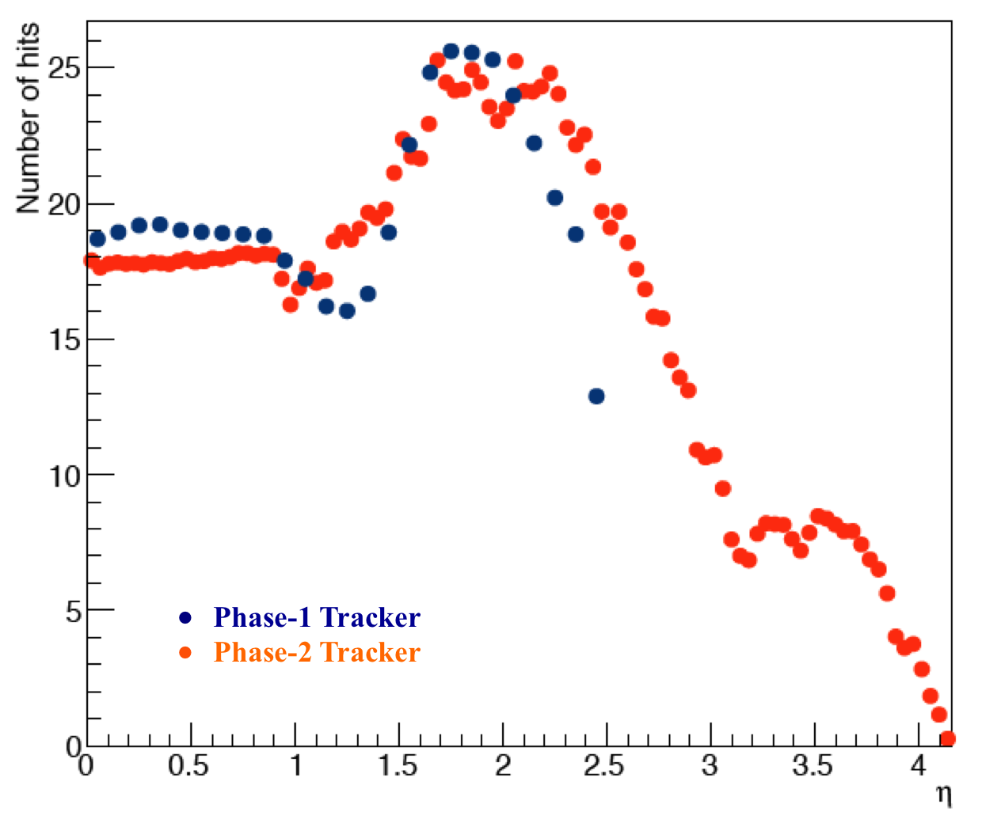
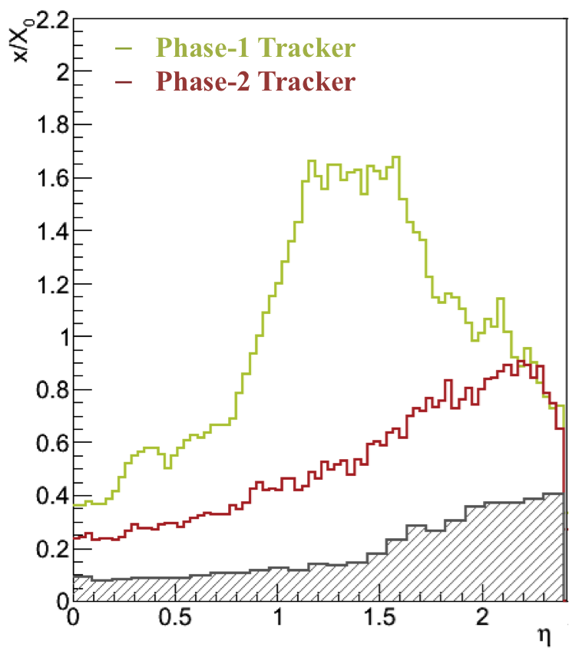
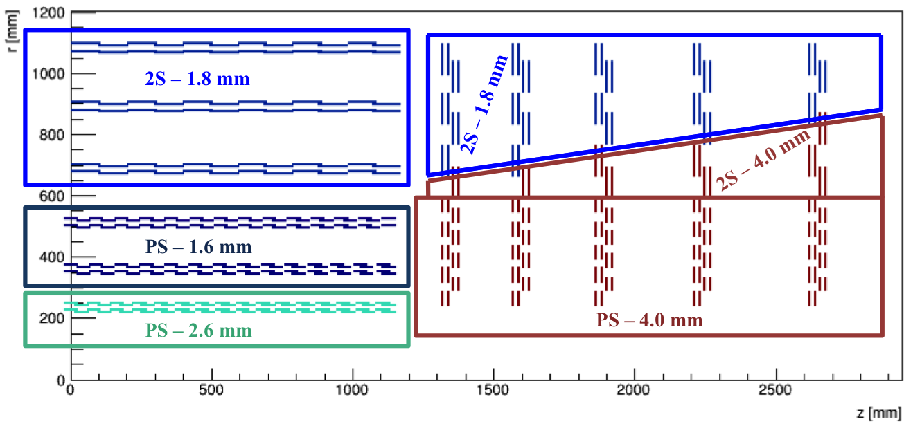
Some infos from tkLayout

Slide 36
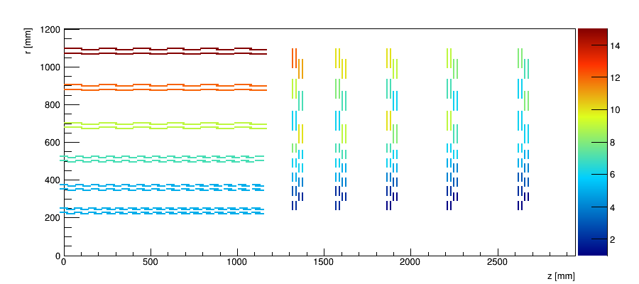
Acceptance window
Width 5÷15 channels in the barrel, 2÷12 in the endcap.

Slide 37
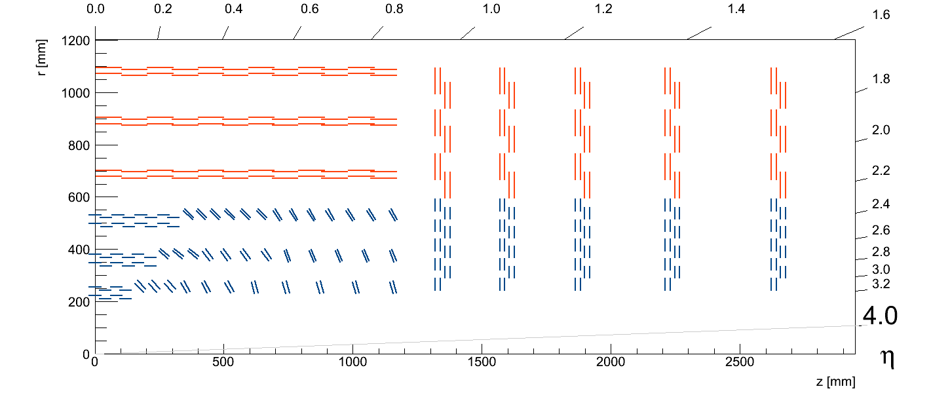
Beyond baseline?
Variant of TBPS with progressively tilted modules
Short central section followed by groups of rings with same tilt
Same coverage and ~same tracking performance with a smaller number of modules

Slide 38
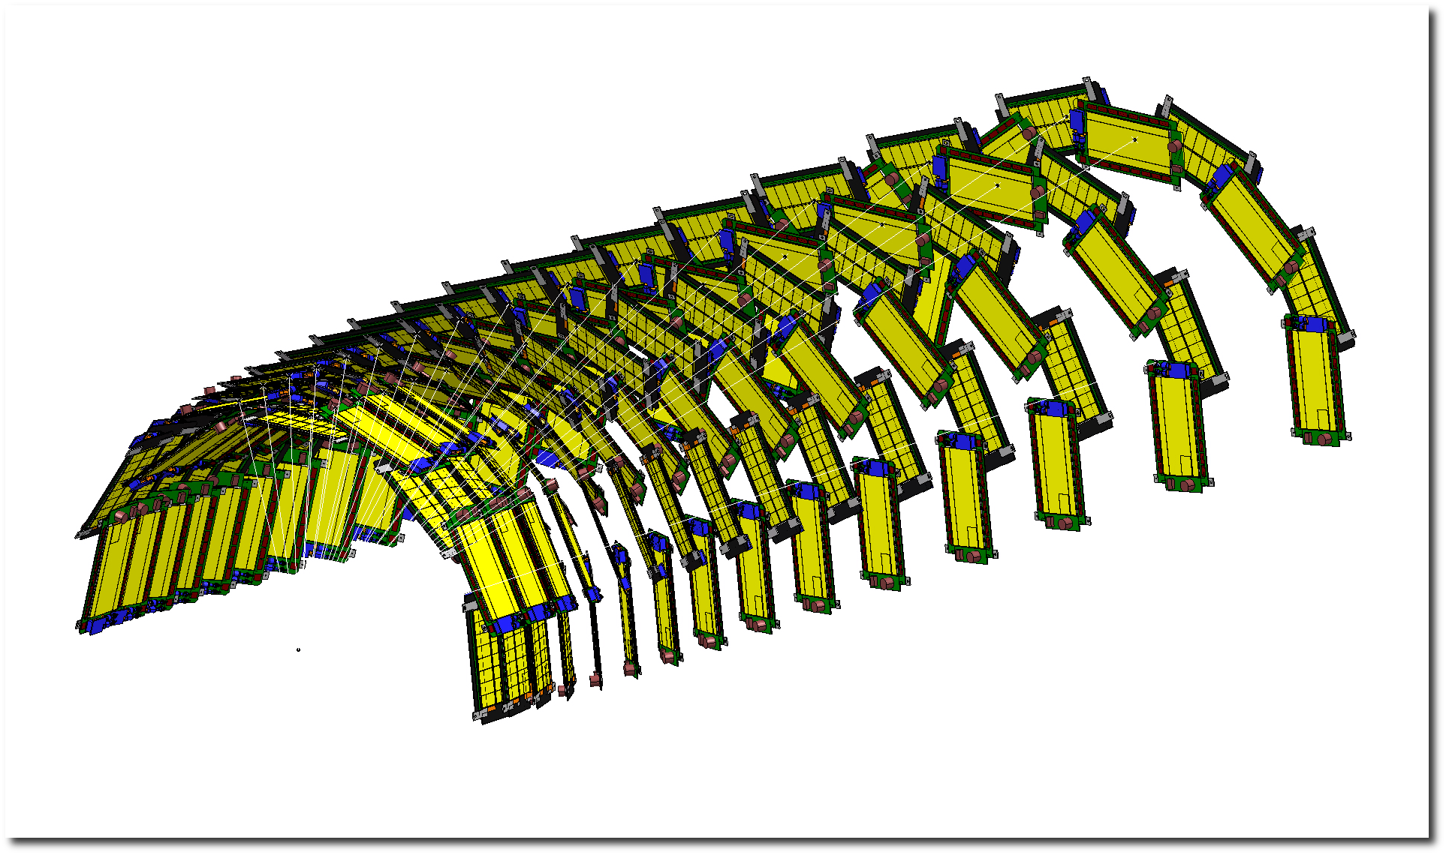
Beyond baseline?
Variant of BPS with progressively tilted modules
Short central section followed by groups of rings with same tilt
Same coverage and ~same tracking performance with a smaller number of modules

Slide 39
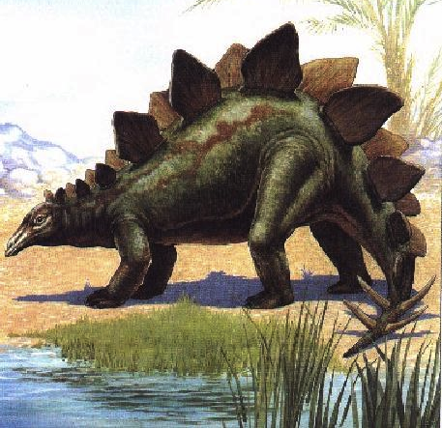
Also Known As:
“The Dinosaur”
Variant of BPS with progressively tilted modules
Short central section followed by groups of rings with same tilt
Same coverage and ~same tracking performance with a smaller number of modules

Slide 40
Is it really a good idea???
Many tracking detectors have been designed and built by smart people…
… and they don’t look like that!

Slide 41
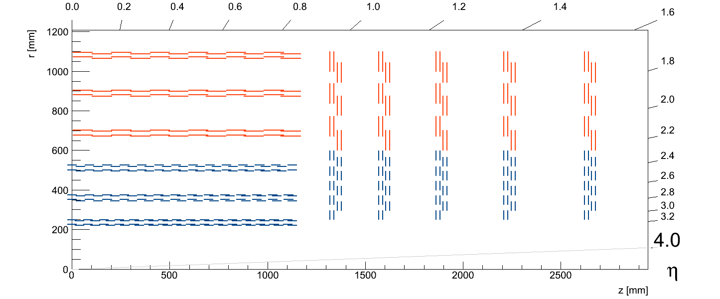
Stub Finding logic efficiency results
Recovered
V
Module B
Without an interconnect technology (ex: TSV) between the two sides of the module, tracks crossing the middle will not be identified as stubs
X
Module A
Vertex
Z
Clashes of hybrids

Slide 42
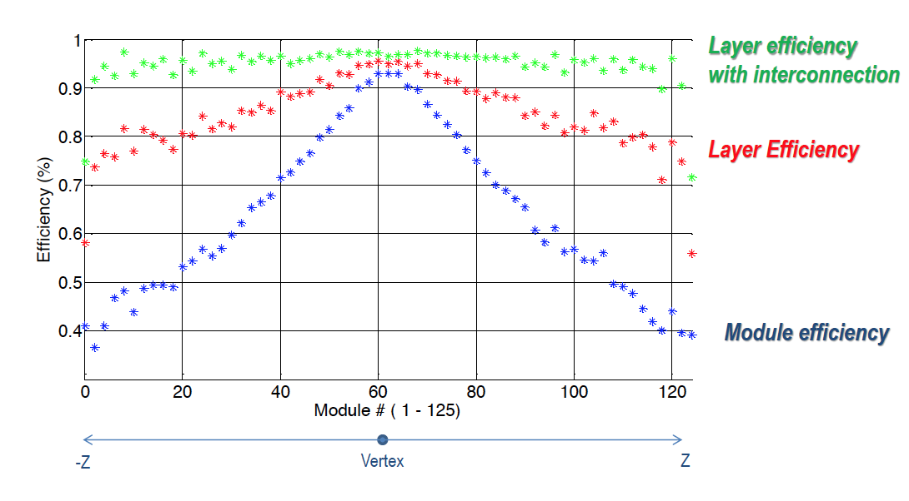
Stub Finding logic efficiency results
In reality even this is not achievable!
-Z
Vertex
Z

Slide 43
Through-Silicon Vias would be required to achieve acceptable efficiency in the “flat” layout
SSA
SSA
CF support
PS-strip sensor
CF support
Al-CF spacer
Al-CF spacer
Al-CF spacer
Al-CF spacer
CF support
MPAs
MPAs
CF support
PS-pixel sensor
flexible hybrid
CFRP base plate
flexible hybrid
SSA
SSA
CF support
PS-strip sensor
CF support
Al-CF spacer
Al-CF spacer
Al-CF spacer
Al-CF spacer
CF support
MPAs
MPAs
CF support
PS-pixel sensor
flexible hybrid
CFRP base plate
flexible hybrid

Slide 44

Stub Finding logic efficiency results
The tilted layout solves the problem (with a smaller the number of modules!)
V
V
V
Module A
Vertex
Z

Slide 45
Three specific facts favour the tilted layout
Stub finding efficiency
Avoids needs of TSVs to interconnect the two halves of a PS modules
Avoids huge overlaps between consecutive modules in z
  Impossible to implement at the edge of the barrel anyway
Module length
(3) Modules only 5 cm long in the z direction because of technology limitations
Aggravates effects (1) and (2), but makes tilt possible!

Slide 46
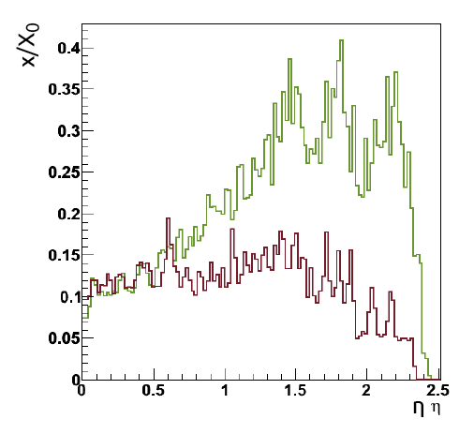
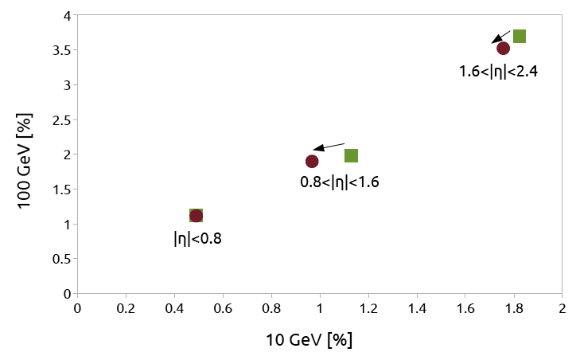
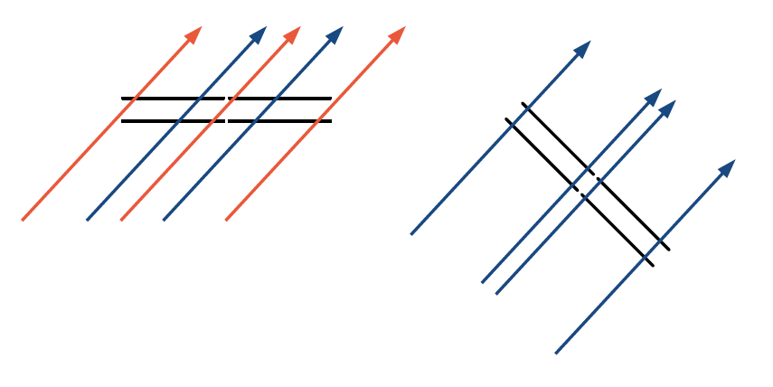
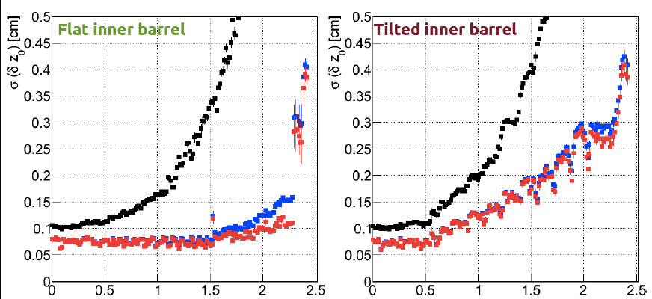
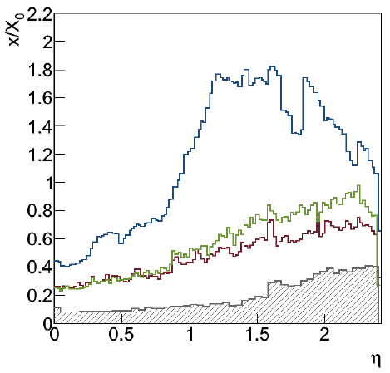
Tilted TBPS - performance
Less material, equal or better tracking performance, better stub coverage, no need of TSVs
Less modules, cost saving
  1200 modules, 10 m² of silicon
Slightly degraded z₀ resolution for L1 tracks
TBPS material
p_{T} resolution
Flat
Tilted
TK material
• 1 GeV
• 10 GeV
• 100 GeV
Flat
Tilted

Slide 47
Mechanics
TB2S
TEDD
TBPS

Slide 48
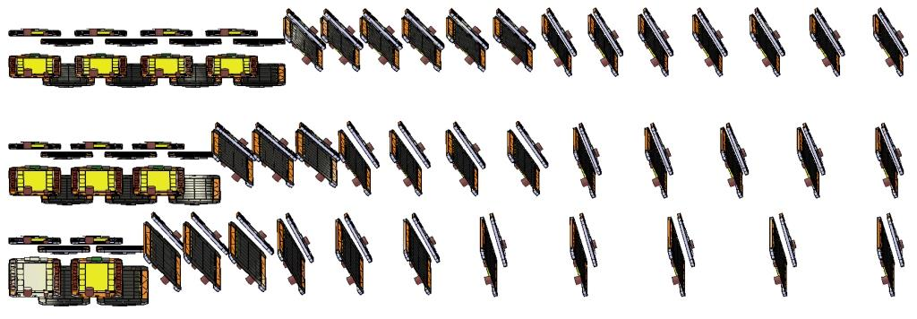
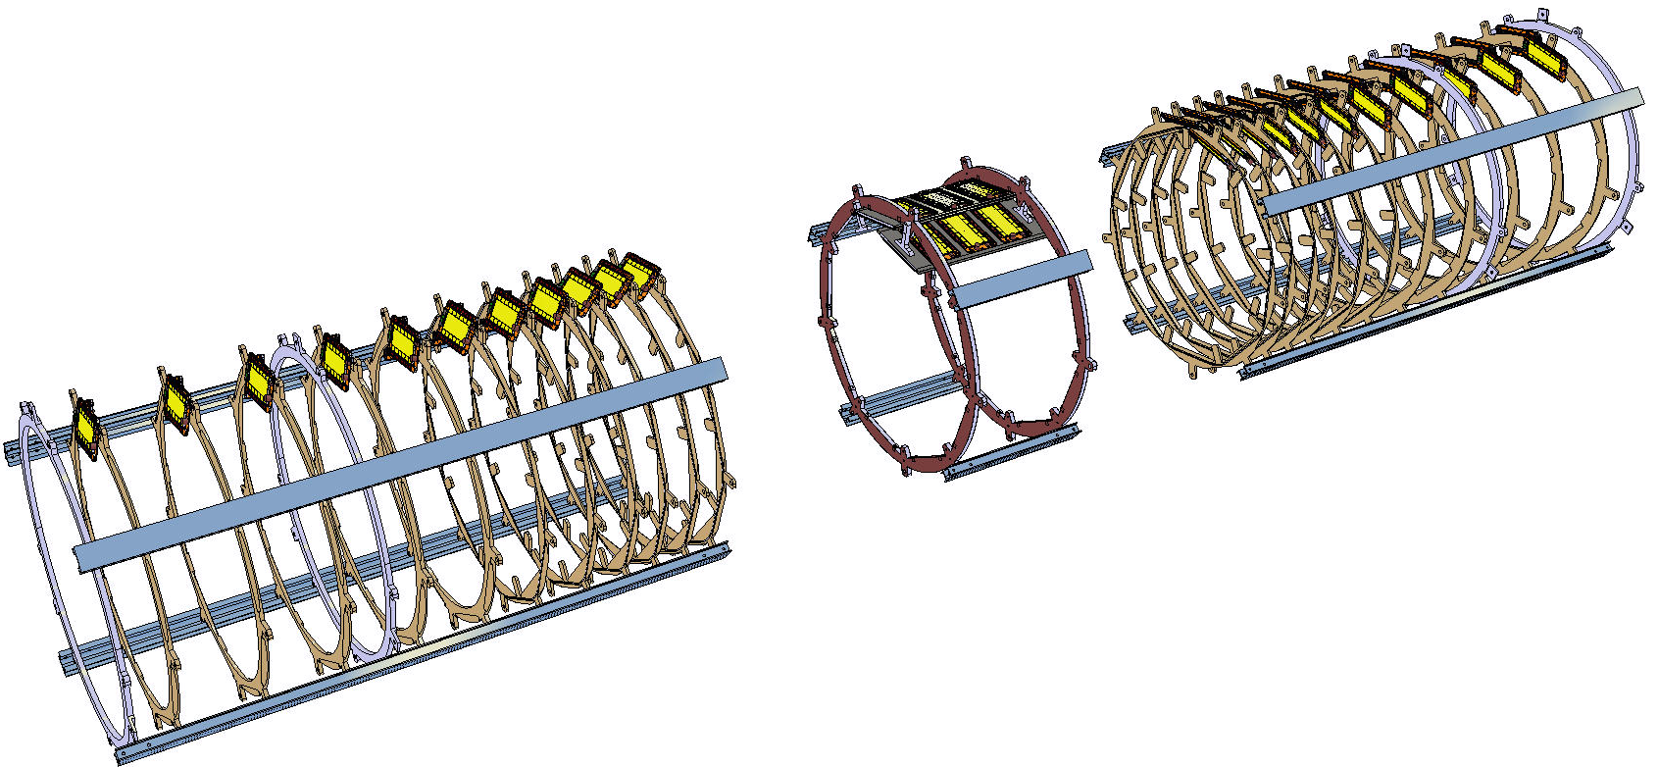
TBPS: How to construct the tilted geometry?
The current idea is to divide the assembly into following sub-structures:
Three layers as individual units
Each layer: Central flat section + 2 tilted sections
Central section: 2 end rings and module support plates
Tilted sections: module support rings
Longitudinal profiles join
the sections and provide
for services routing paths.
0.8 - 1 m
0.4 – 0.8 m
0.4 – 1.1 m
0.8 - 1 m

Slide 49
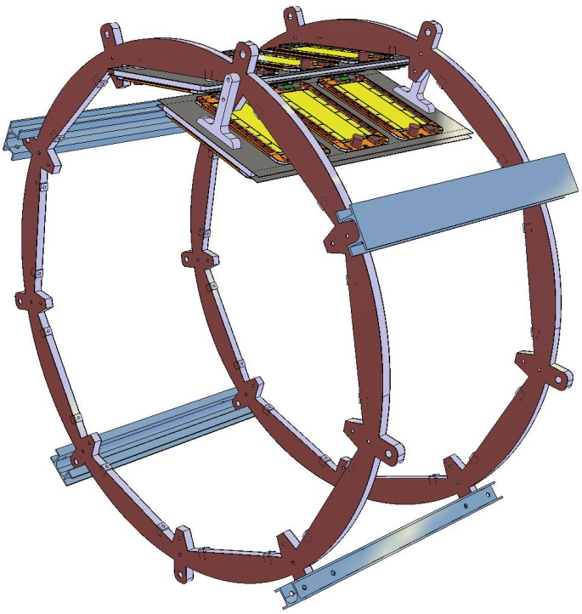
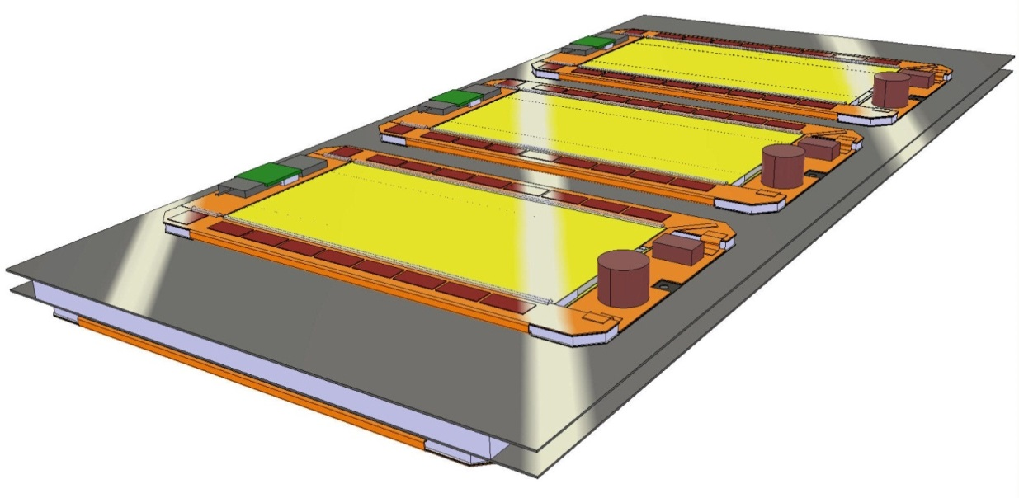
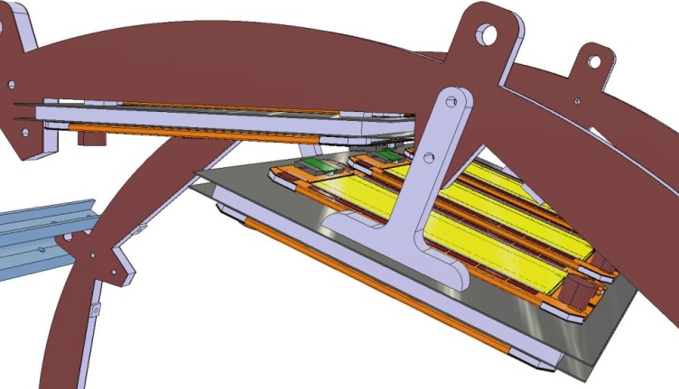
Central flat section
Space frame made of end rings
and longitudinal profiles
4-6 mm thick module support & cooling plate
Modules attached with phase-change adhesive
Diam ~2 mm cooling pipe, U-loop
Carbon foam or aluminium/carbon-fibre block next to cooling pipe
~0.5 mm high-conductivity carbon-fibre composite skins
Foam core
Geometrically simple building blocks
Main challenges:
Precise and light plates with integrated cooling
Thermal and mechanical connections

Slide 50
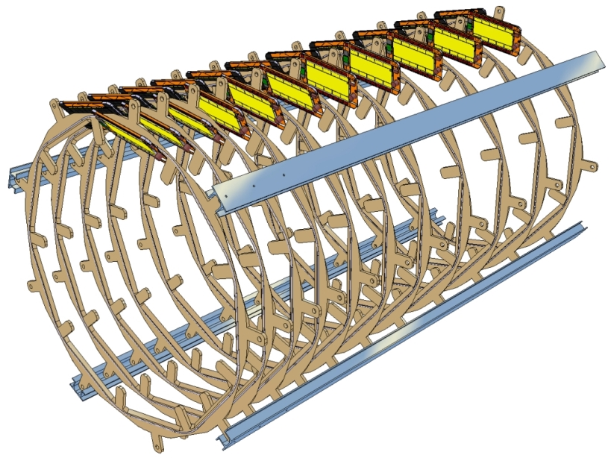
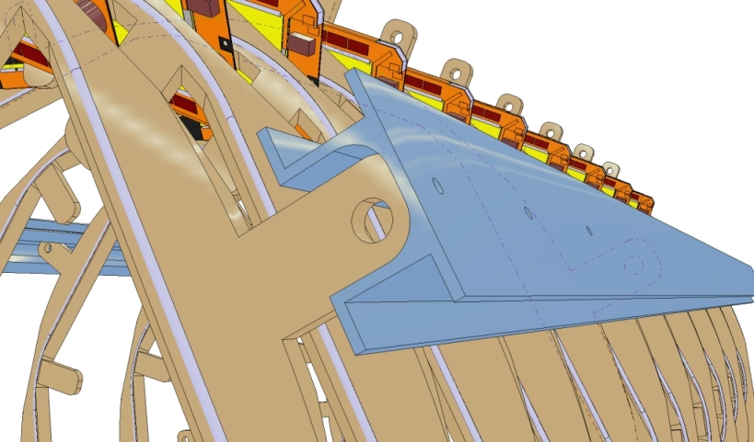
Modules supported by Rings
Rings joined by longitudinal bars.
Cooling supply pipes, wires and fibres routed along the bars.

Slide 51
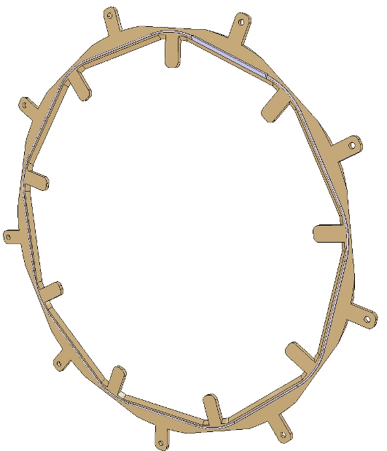
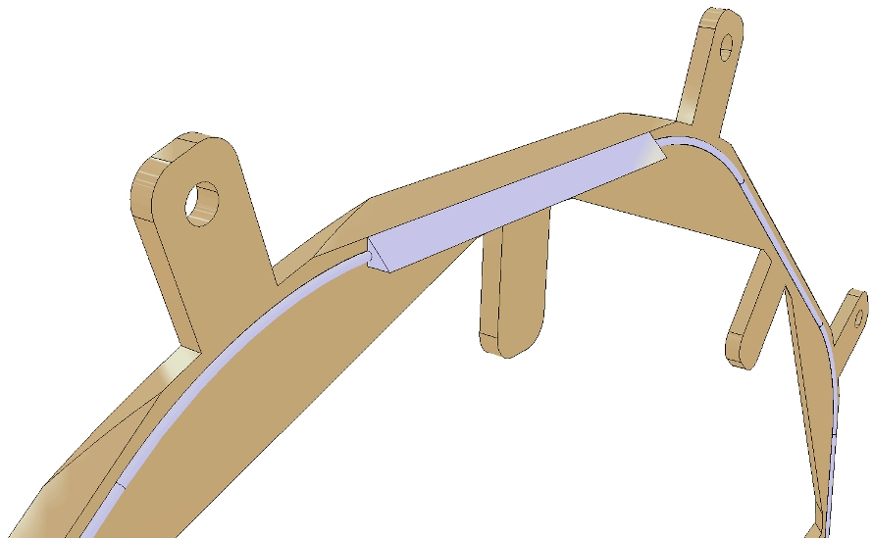
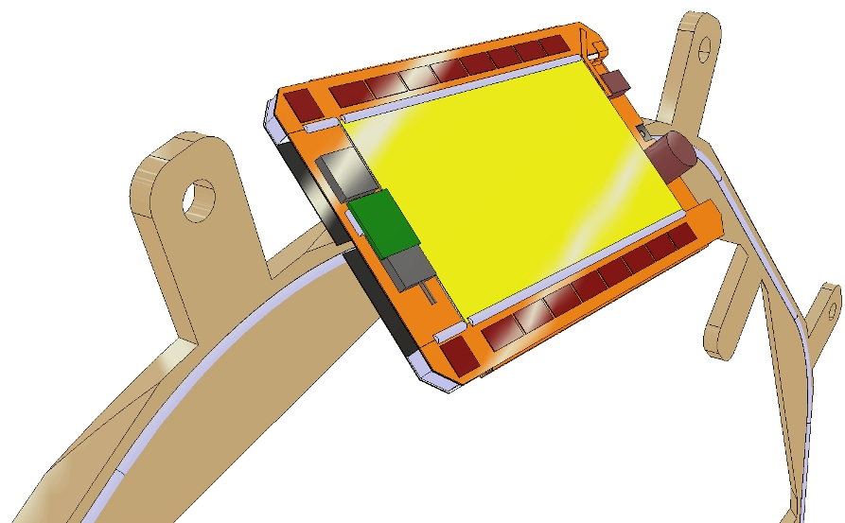
The Ring concept
Flat disk with cooling pipes and module supports on each side.

Slide 52
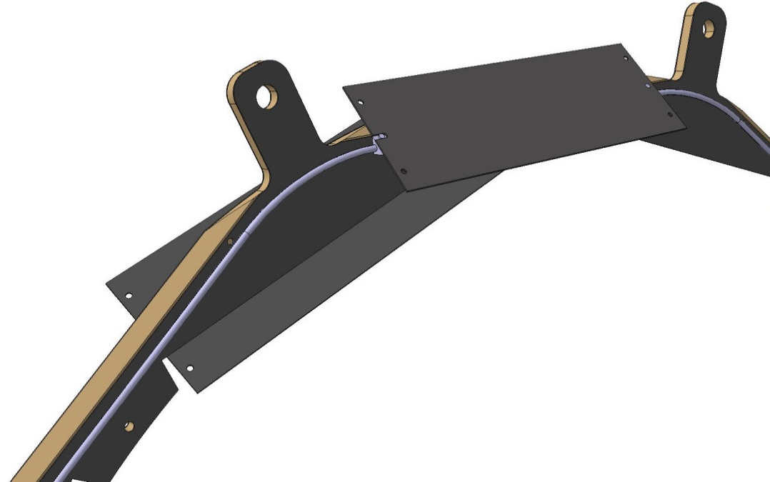
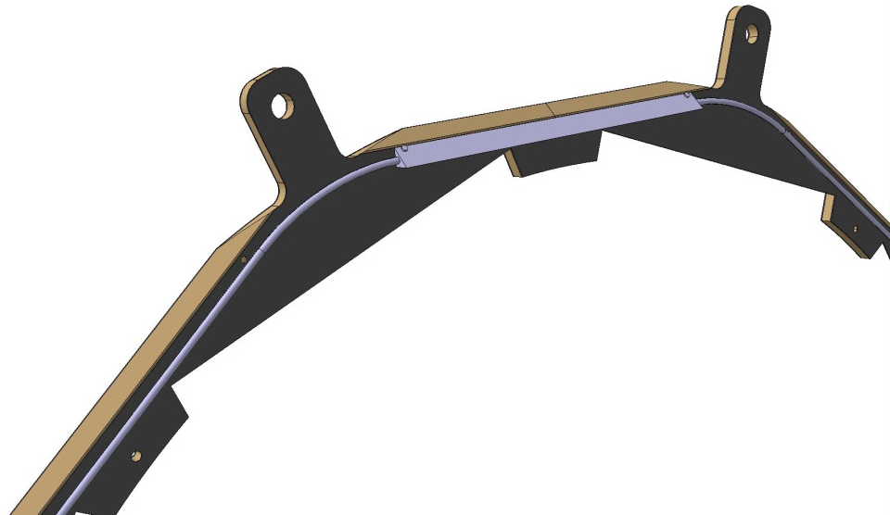
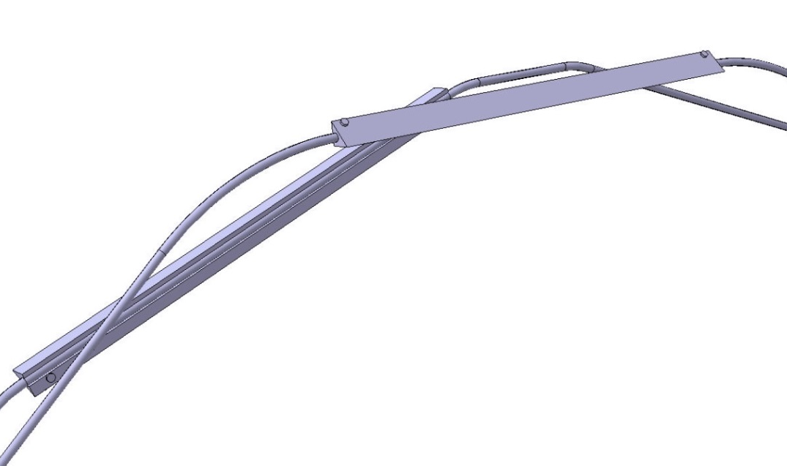
The Ring
Ears for joining the Ring to the other Rings of the Layer
~5 mm thick sandwich structure with carbon-fibre composite skins and foam core
Inserts for module positioning
Module support / thermal contact plates in high thermal conductivity carbon-fibre composite
Cooling pipes on front and back side, with thermal contact pads in Al-CF composite

Slide 53
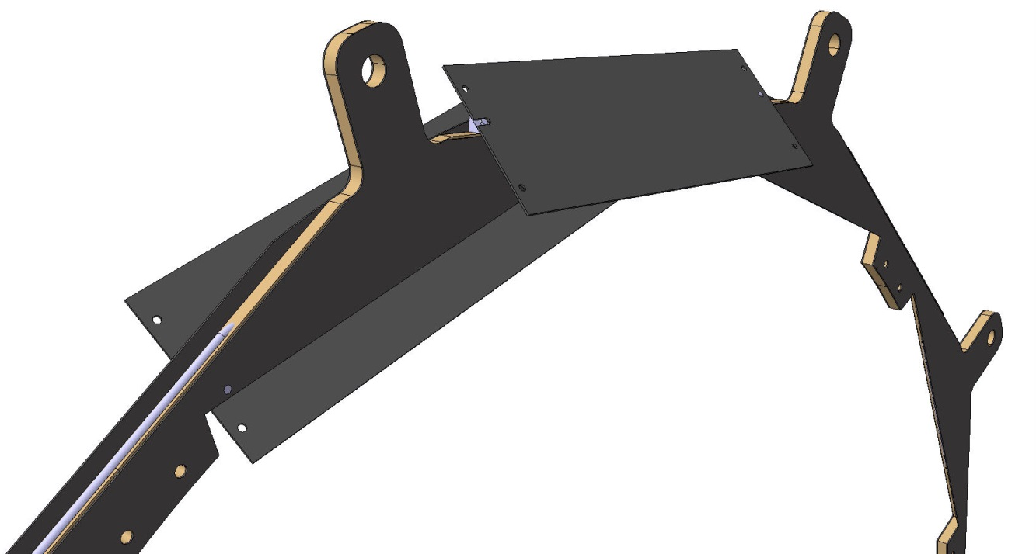


Cooling
(… looks OK, but does the cooling actually work? … in progress….)

Slide 54



Ring with modules

Slide 55

Joining layers
3rd layer
2nd layer

Slide 56



Additional rings for joining layers together

Slide 57


Slide 58



TB2S
TB2S
TEDD
TBPS
Z overlap within one “ladder”
φ overlap between consecutive ladders

Slide 59


Ladder
L ~ 1.15 m
Two overlapping ladders
Full barrel length of L ~ 2.3 m

Slide 60




Slide 61



Slide 62

Tracker End-Cap Double Disks (TEDD)
Modules mounted on four surfaces on two disks, each made of two dees
  φ overlap within disk, R overlap with next disk
Same rectangular modules as in the barrels
9 rings of PS modules + 6 rings of 2S modules
Cooling pipes embedded in the disk structure, wires and fibers running above and between the modules

Slide 63


Slide 64


Slide 65


Slide 66

TEDD: sector-wise cooling loops
2S modules:
5 Al* inserts
_{*or Al-CF}
PS modules: C-foam pads

Slide 67


Slide 68


Slide 69



Detector cooling
Overview of the system parts
Main pipework
Detector transfer lines
Detector distribution
manifold
Detector
& on board
cooling loops
Cooling plant
Manifold
Connected to a commercial chiller

Slide 70
Chosen cooling technology: two-phase CO₂
Advantages of evaporative cooling
Heat Transfer Coefficient higher than for liquid cooling
Limited temperature excursion on the detector
(isothermal evaporation – cooling exploits latent heat)
Advantages of CO₂
Large latent heat of evaporation
Low liquid viscosity
Particularly high heat transfer coefficient
Very convenient fluid to work with (environmental friendly, not activated)
Convenient range of operating temperature −45°C to +25°C
Easier at low temperature

Slide 71


The 2PACL process
Ideal lines with no pressure drop
Capillaries

Slide 72
In practice a quite complex system…
Detector loops must be properly sized (avoid dry out)
Flow distribution must be stable wrt to load changes
In reality there is pressure drop along the detector loops
Requires some pre-heating to ensure that the CO₂ boils!
Higher operating temperature → higher pressure rating
Realistic case: Pixel “phase-1”
Just started reflection on system parameters
Evaporation temperature −30° C, with operational margin to −40° C
Total power ~80 kW, about 50 cooling lines splitting to ~600 detector loops
On-detector pipes typically 2.0/2.2 mm (maybe larger in TEDD)
Detector Outlet
Detector Inlet
Electronics
Detector

Slide 73
Some performance plots

Slide 74




Stub finding performance
Muon stub finding efficiency in all layers (barrel, endcap)
Barrel layer 1 for muons, pion electrons
  Effect of interactions
Efficiency measured on DESY beam with 2-CBC2 module prototype
p_{T} simulated with module tilt
Selected threshold equivalent to a nominal p_{T} cut of 2.14 GeV @ 75 cm
Fit to data gives effective threshold of 2.2 ± 0.1 GeV

Slide 75




Level-1 track finding
Track finding performance taken from “tracklet” method
  Estimates with AM track finding qualitatively similar
  N.B. Track finding not demonstrated in hardware
    Indication of the performance that could be achievable

Slide 76
Offline tracking
Compare Phase-1 @ 50 PU with Phase-2 @ 140 PU

Slide 77
The phase-2 pixel upgrade
Radiation tolerance is a major worry, not only for sensors but also electronics!
Huge ongoing effort in RD53 to qualify TSMC 65 nm technology
R&D on thin n-in-p planar sensors, 3D sensors
Rapidity extension
Main requirement is to match jets to vertices in the forward region
(Anything else is a bonus)
Recall: operate at 200 PU x 750 kHz
Maintain/improve single hit resolution and two-track separation
Rad tolerance requirements implies thinner sensors, less charge (100 ÷ 150 μm active thickness).
Achieve hit resolution with less charge sharing and smaller pixels.
Rectangular pixels give lower occupancy and mitigate requirement on pixel chip threshold
(around 1000 e-, under study)

Slide 78
The service cylinders are completely inside the tracking volume
200 PU x 750 kHz → x 30 increased bandwidth wrt to phase-1
Huge increase of the cross section of electrical links
Optical converters can be integrated on the service cylinders
No option for module-level optical conversion…?
Service cylinders

Slide 79
The service cylinders are completely inside the tracking volume
Even worse: higher power, with lower operating voltage
On-chip DC-DC conversion seems hard
And a factor of 2 would not be good enough
Inductor-based converters are bulky
Not suitable to be integrated on modules, away from modules don’t help much
Started to reconsider serial powering…!
Service cylinders

Slide 80
DC-DC conversion vs serial powering: the basics
Parallel powering
No conversion
Parallel powering
DC-DC converter
with ratio R
Serial powering
Same current flows through all the loads in the chain
ΔV
I×N
ΔV×R
(I×N)/R
ΔV×N
I
DC-DC converter
Voltage regulator
Each load works at a different potential!

Slide 81
In summary: a lot of interesting problems to solve!
Service cylinders

Slide 82
Questions?

