Slide 1



RF cavity induced sensitivity limitations on Beam Loss Monitors
CLIC / CTF3 experimental verification meeting
09 March 2015
M. Kastriotou

Slide 2
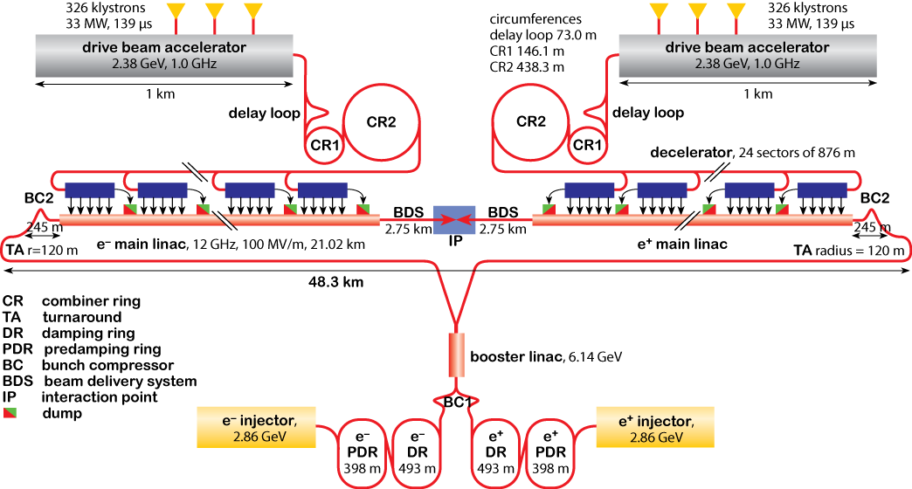
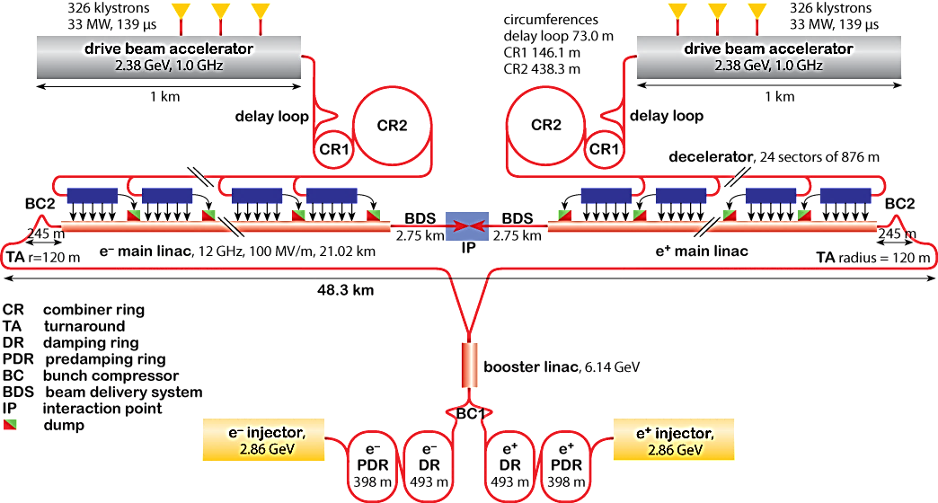
Compact Linear Collider (CLIC)
2 linacs (~24 km each)
~70000 accelerating structures per linac!

Slide 3
Beam Loss Monitor technology
Radiation detectors positioned around the machine, detecting secondary showers generated when particles hit the vacuum chamber (Beam losses)
A system based on Ionization Chambers satisfies the requirements of Machine Protection –(CLIC Conceptual Design Report)
  But requires a large number of BLMs ( > 40000)
Optical fibre based BLMs (OBLMs)
  Pure Silica core multimode fibres as Cherenkov radiators. Both ends of fibre coupled to photon-sensors
  Potential of covering full beam line in a cost-effective way.
Fast BLMs (diagnostics oriented):
  Diamonds (1 ns): LHC for bunch by bunch beam loss monitoring
c
2c/3
2c/3
Photon sensor
Photon sensor

Slide 4
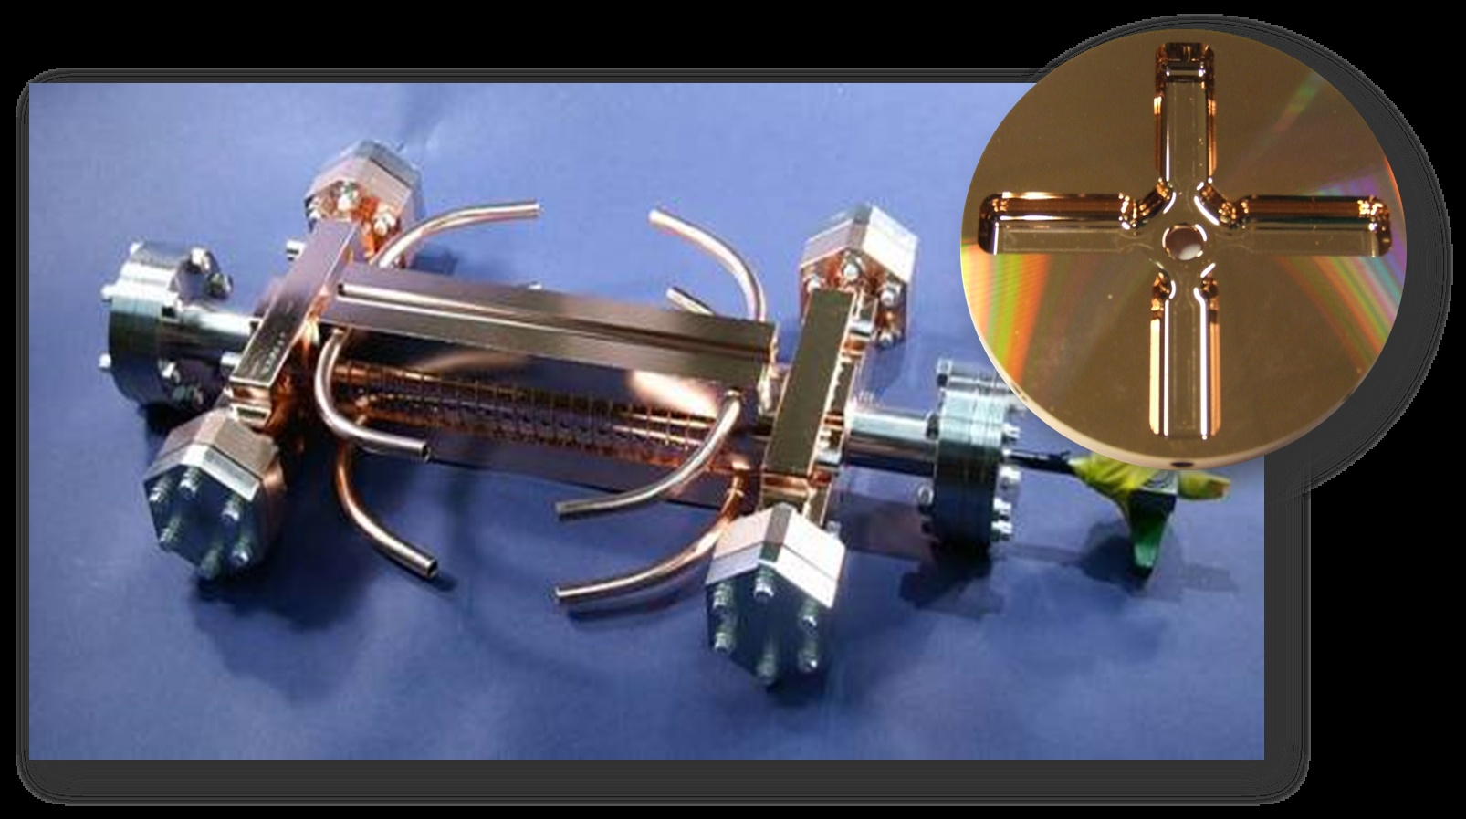
CLIC accelerating structure
Normal conducting
24 or 26 discs
Copper
100 MV/m
Max RF Breakdown rate 3∙10⁻⁷ BD/(pulse∙m)
Image: Helsinki Institute of Physics

Slide 5
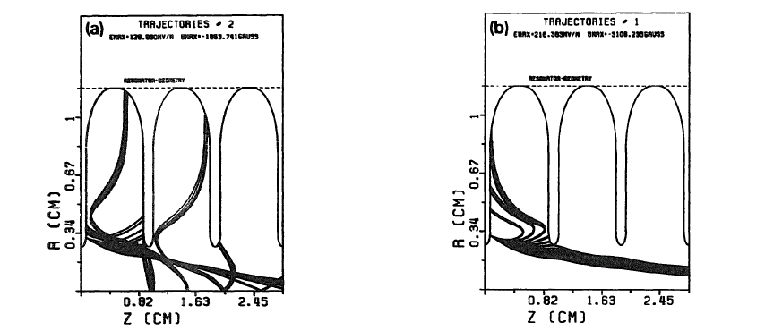
Dark current
Electron field emission ^{[1]}:
  The emission of electrons induced by an electrostatic field
  Emission current determined by E
  Captured by the electric field → accelerated!
63 MV/m
105 MV/m
Capture field for LEP Injector Linac (LIL) type structure (10.5 GHz)^{[2]}
[1] Dark current simulation for the CLIC T18 high gradient structure - Z.Li et al., WE5PFP046
[2] An investigation on the field emitted electrons in travelling wave accelerating structures – G. Bienvenu et al., NIM. A320 (1992) 1-8

Slide 6
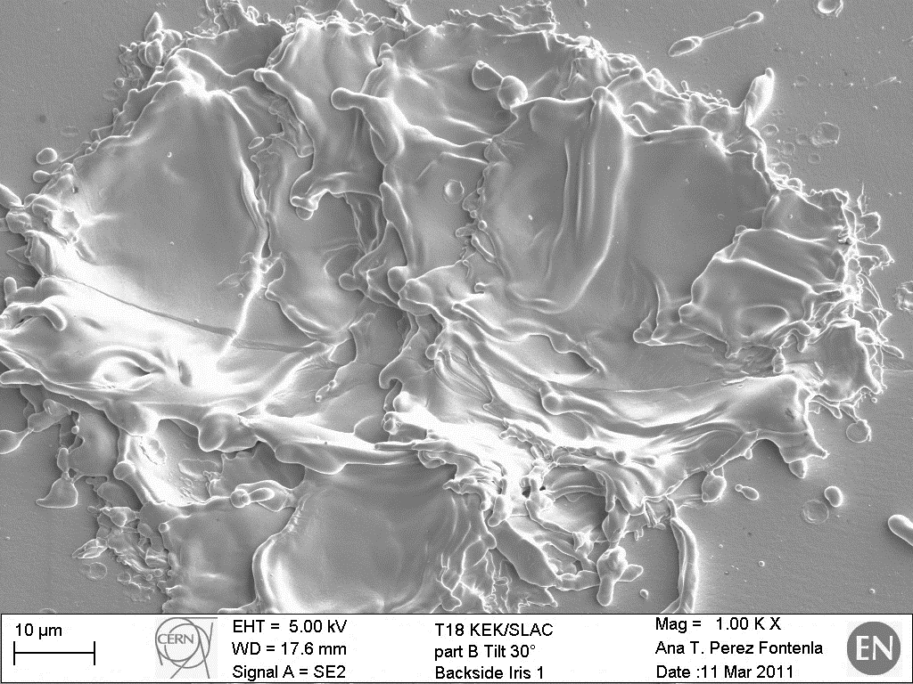
RF Breakdown (CLIC CDR)
Complex phenomenon, beginning to be relatively understood
Sites of the structure with enhanced electron field emission
  Contaminants
  Geometric field enhancement features
  Crystal defects
Ionisation cascade → Electric arc → plasma formation
Plasma expands transversely
Electrical current of hundreds of amperes → magnetic fields which deflect the beam!
Courtesy of : Anité Pérez Fontenla

Slide 7
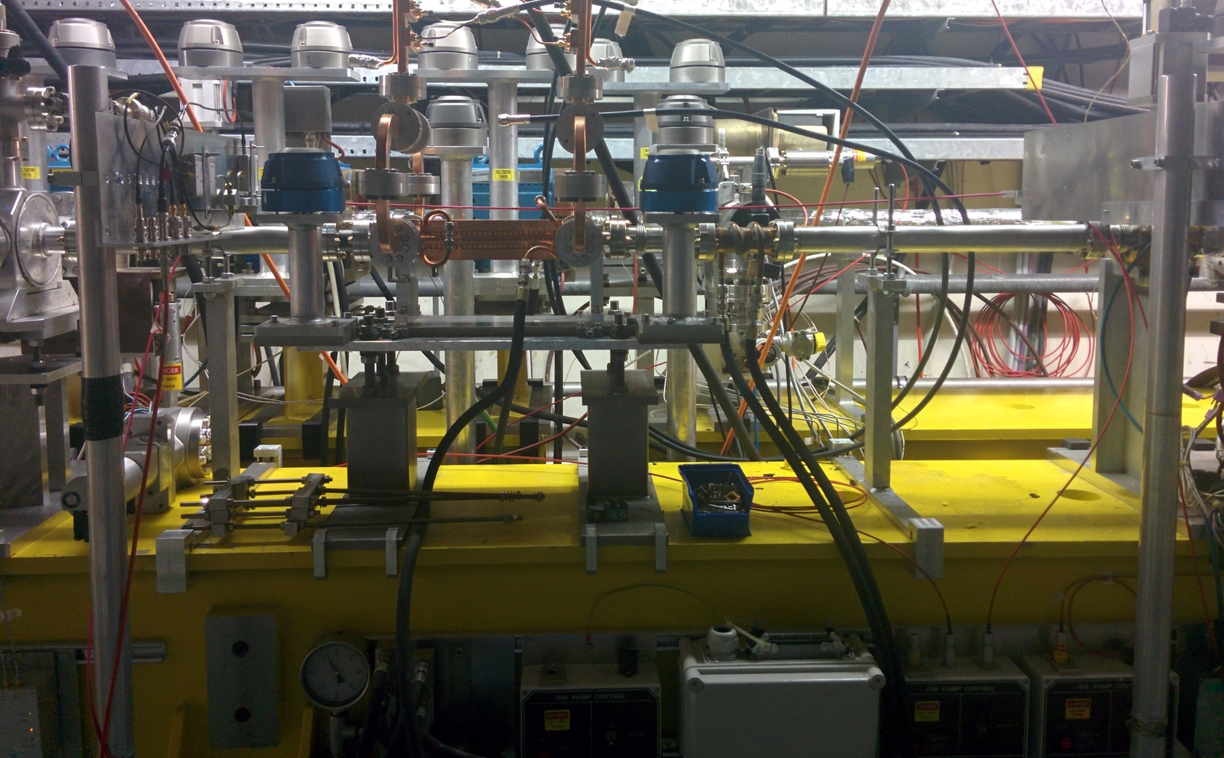
Installation at the dogleg experiment
Localised
  pCVD diamond
  40 dB Broadband Current Amplifier
OBLM – optimised for dark current measurements
    Ø 900 μm fibre + SiPM
  Custom-made low-pass voltage filter and crate modules
2.5 cm
Diamond
OBLM
125 cm

Slide 8
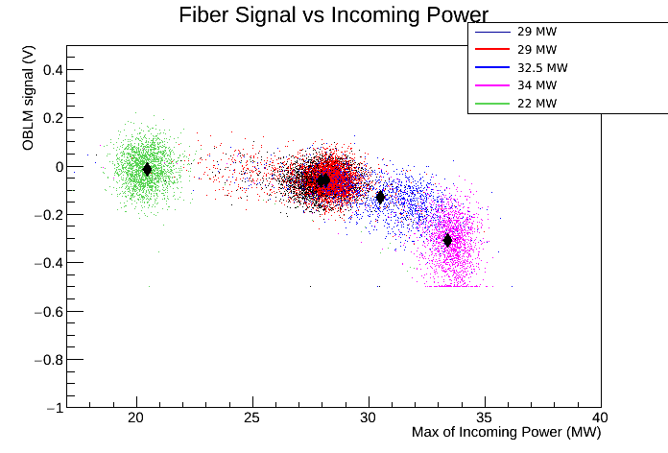
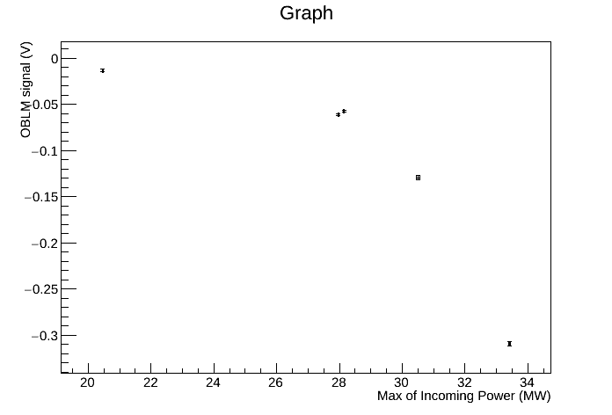
Experimental data : Dark current
Students' meeting 09 March 2015
8

Slide 9
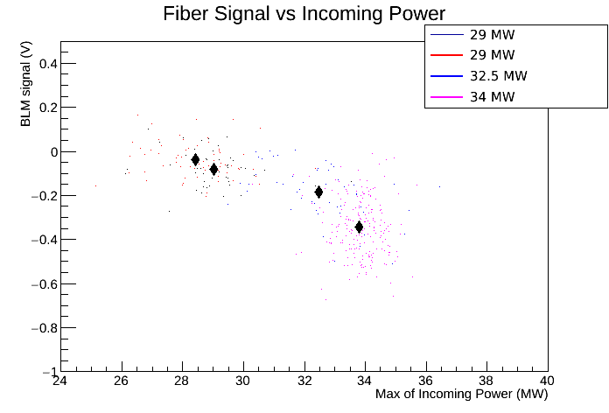
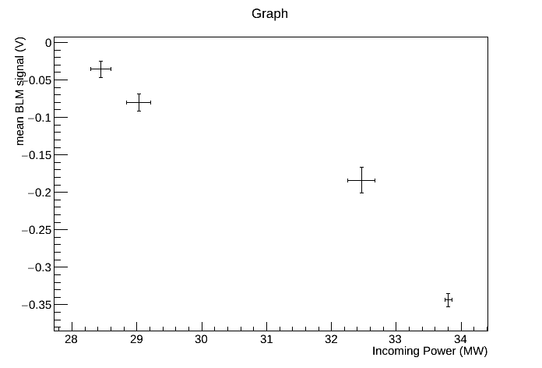
Experimental data : RF Breakdown
Less statistics

Slide 10
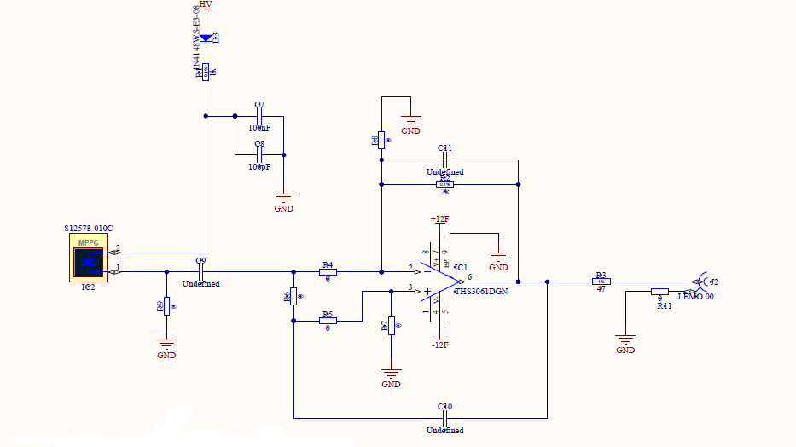
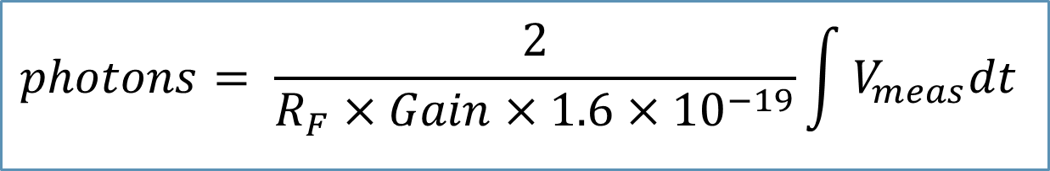
Calculations (I)
Estimation of photons giving signal (downstream of the fiber only) taking into account:
Readout circuit design
SiPM Gain for the given HV
R_{F}
of SiPM
10

Slide 11
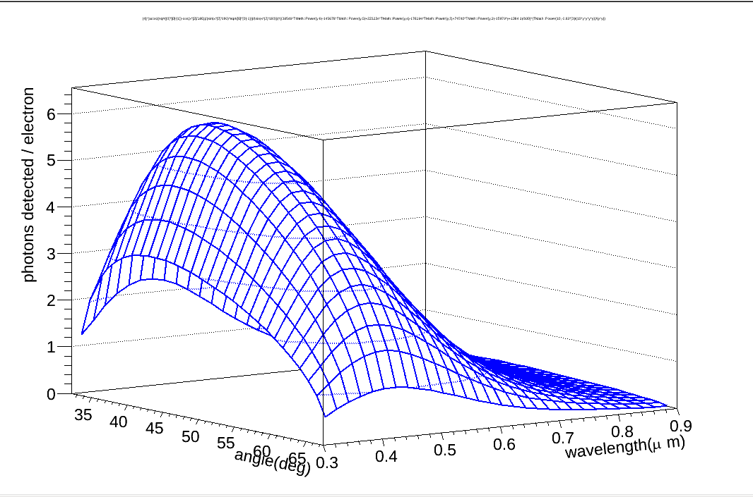
Calculations (II)
Estimation of photons detected by the SiPM per electron crossing the fiber taking into account:
Light attenuation in the optical fiber
Angular dependency of photon yield
Wavelength distribution of photon yield (~1/λ²)
MPPC efficiency dependence on wavelength
θ
e⁻
Distribution of photons detected per relativistic electron crossing the fiber
11

Slide 12
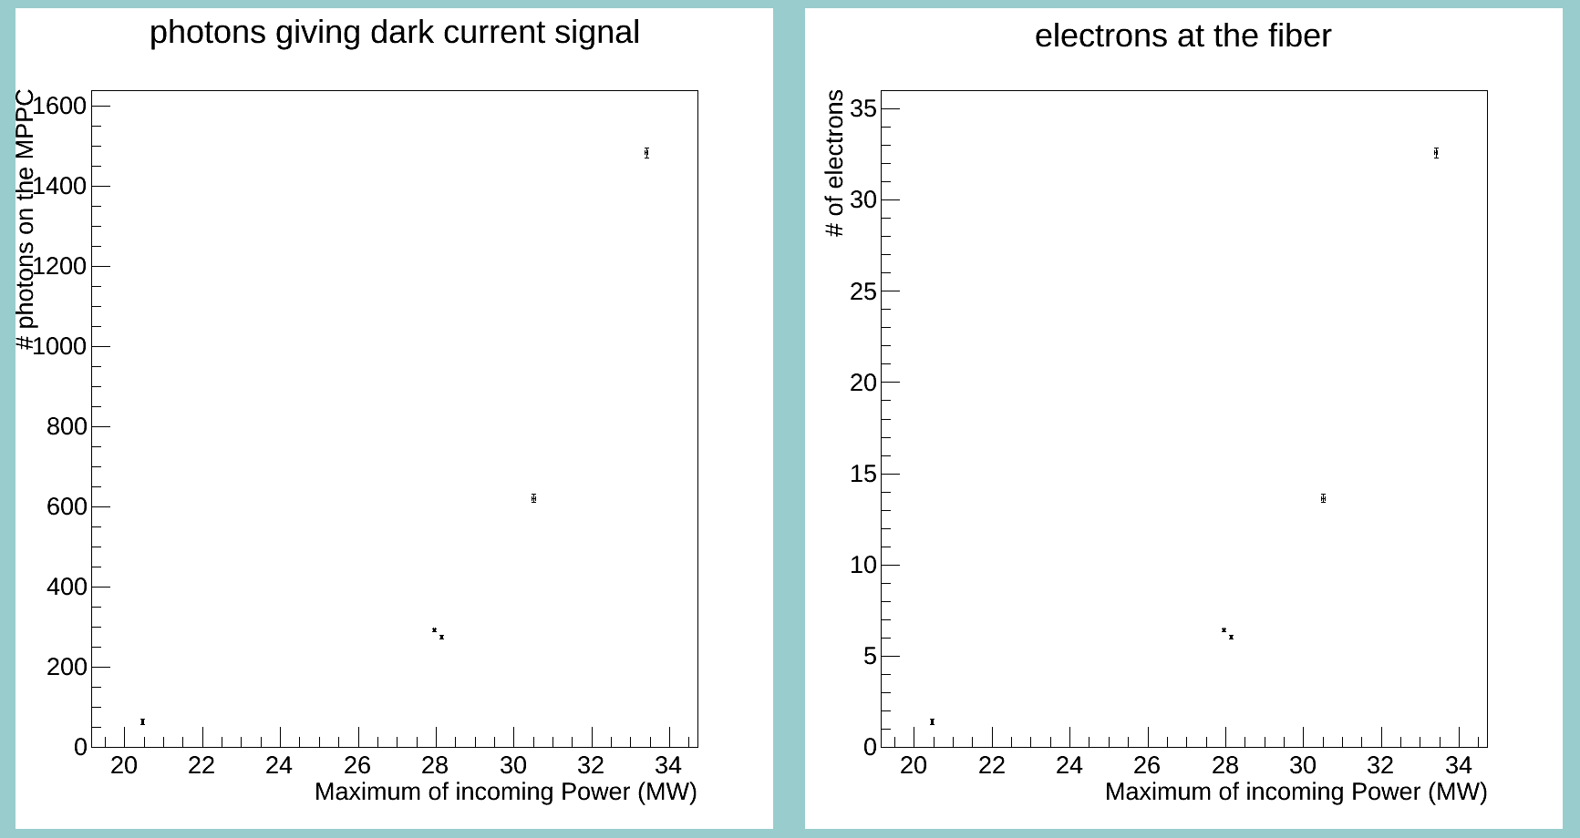
Electrons detected (dark current)
Photon equivalent of the signal
Electrons crossing the fiber
BLM signal higher with higher input power → detection of dark current losses

Slide 13
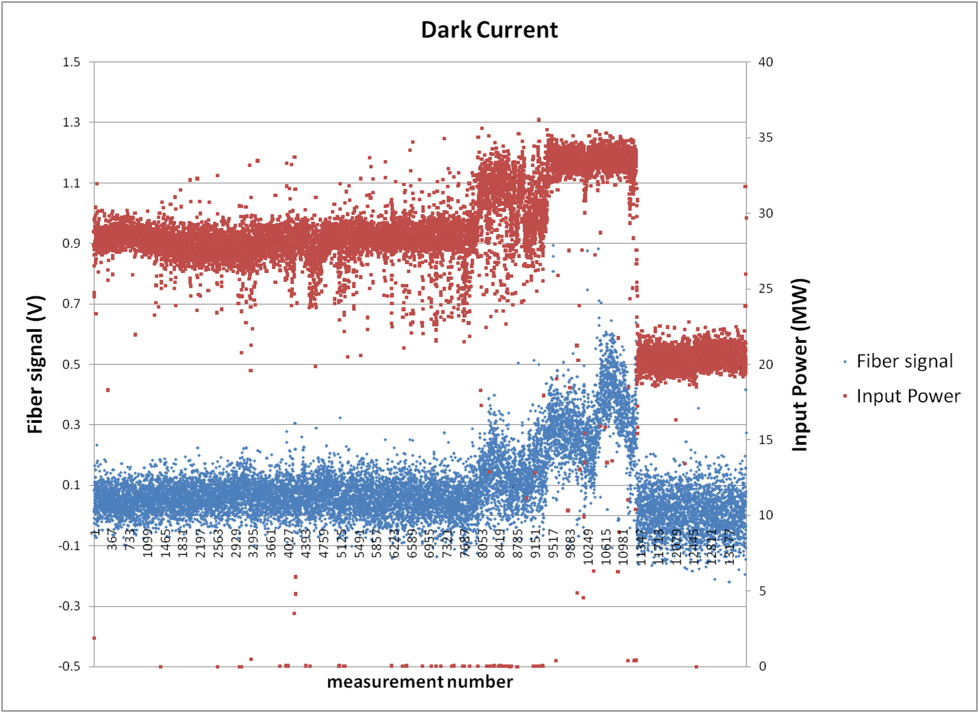
Input Power and BLM signal history (dark current)

Slide 14
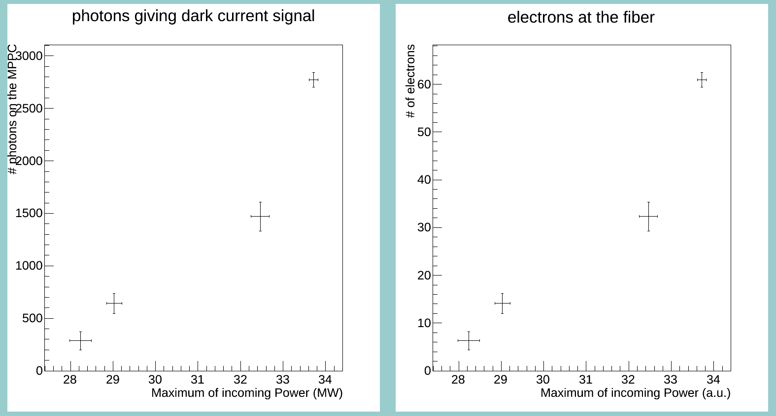
Electrons detected (RF Breakdowns)
Photon equivalent of the signal
Electrons crossing the fiber
BLM signal higher with higher input power → detection of dark current losses

Slide 15
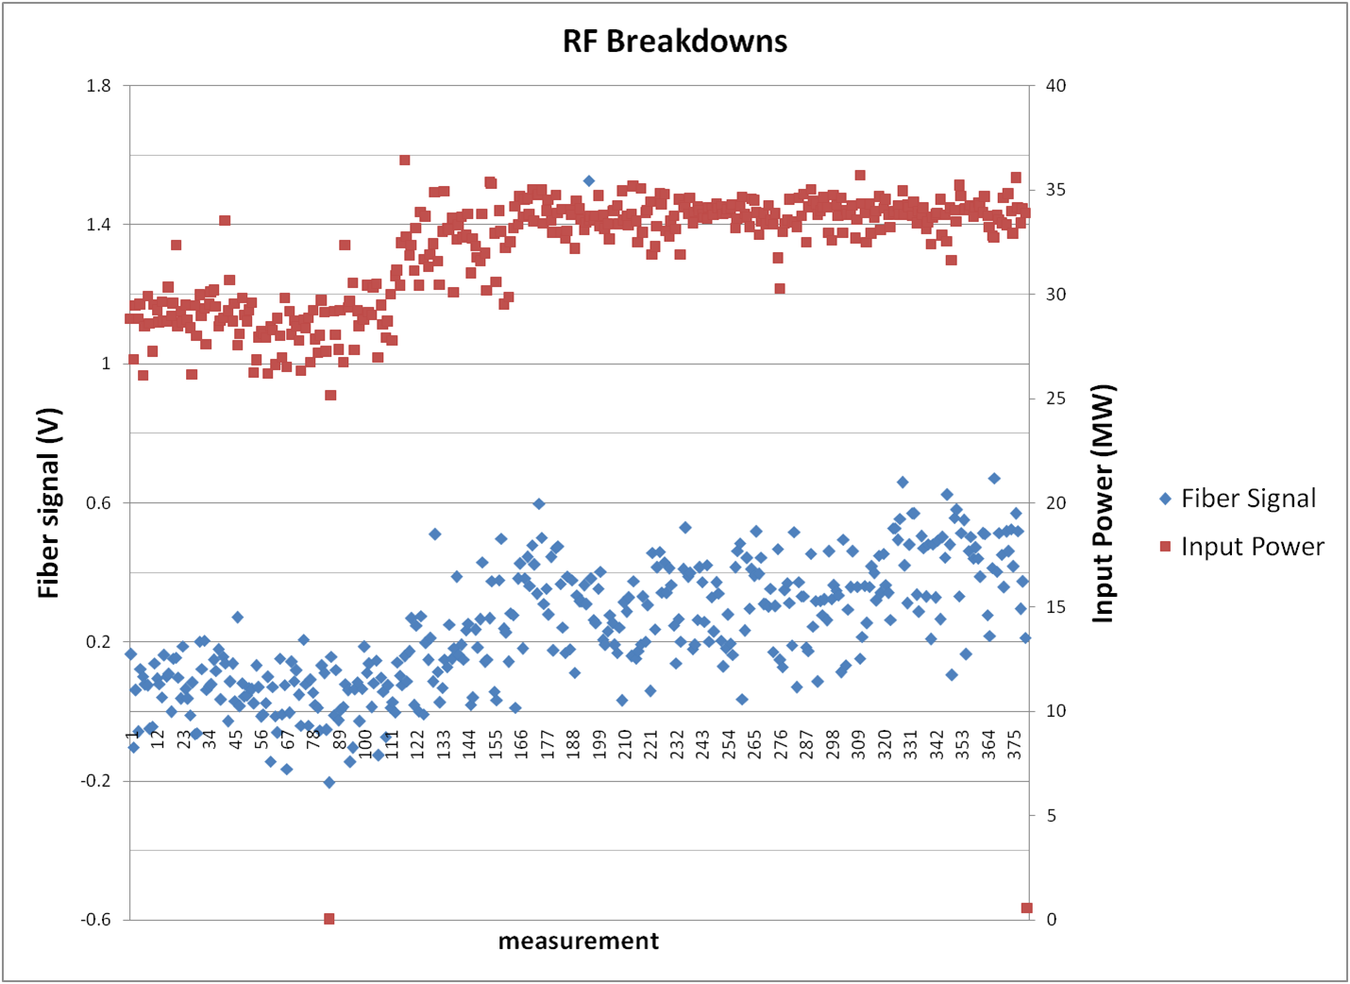
Input Power and BLM signal history (RF Breakdown)

Slide 16
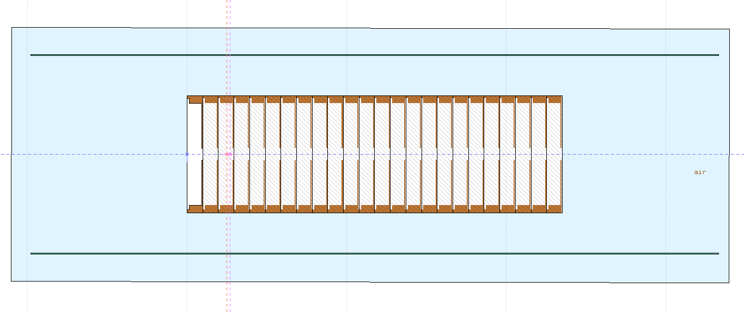
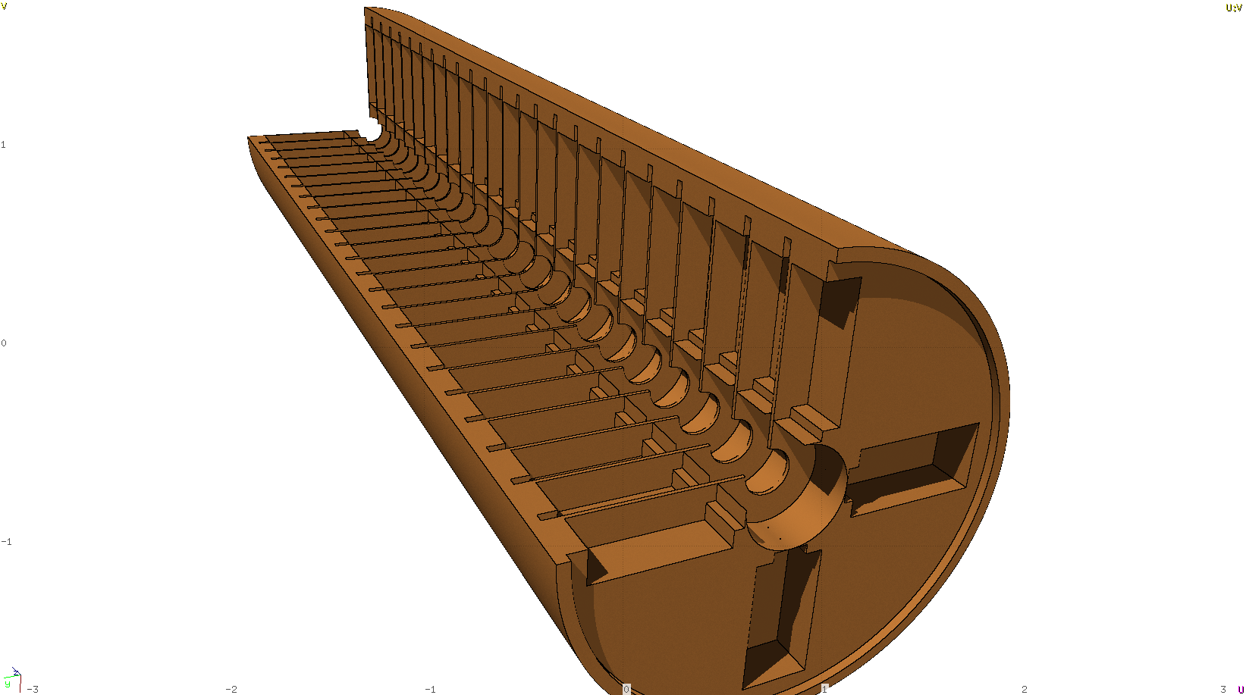
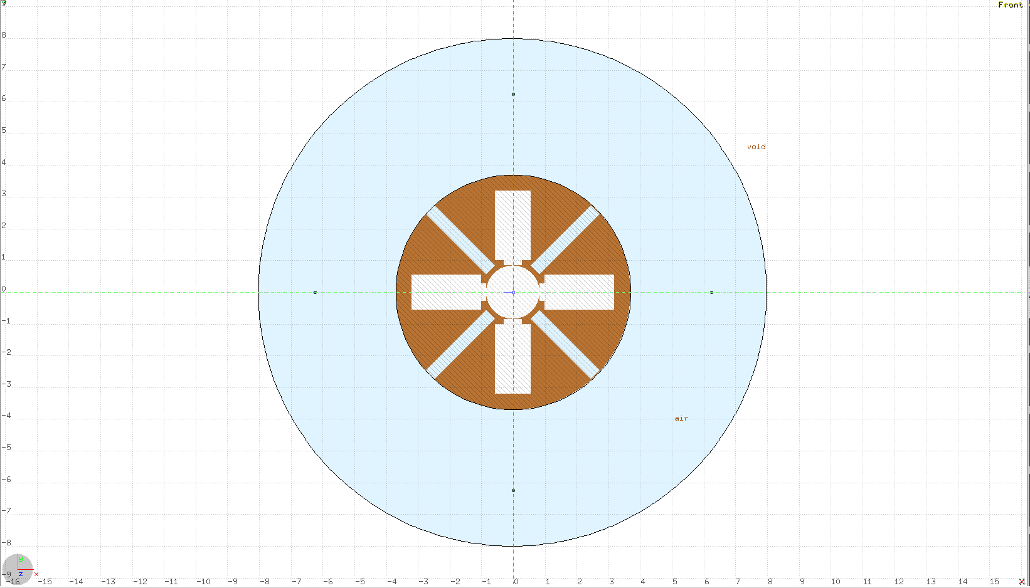
FLUKA simulations: Geometry

Slide 17
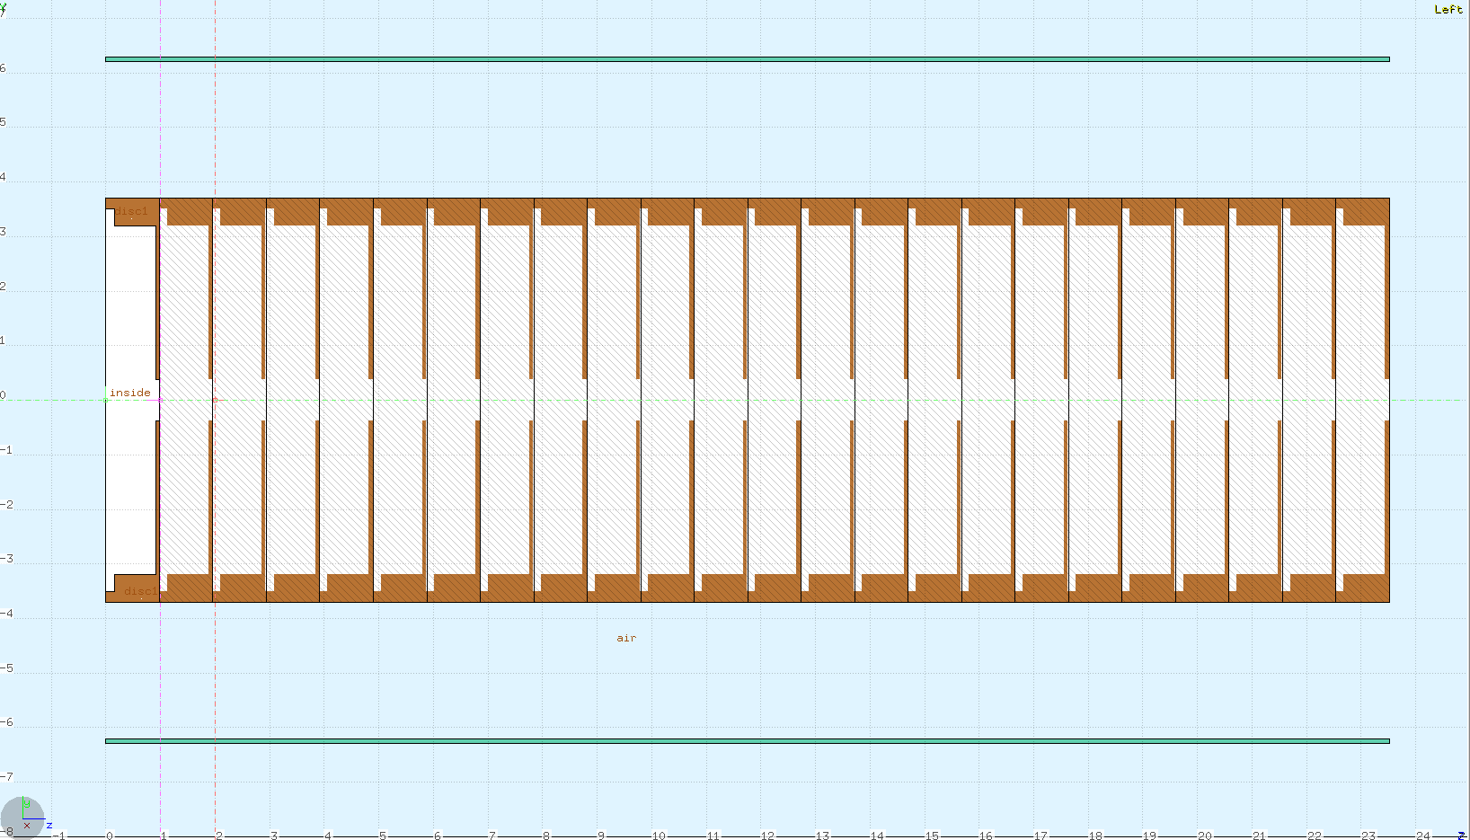
Simulations performance
Disc 20
Case 1
Case 2
20 MeV
15 MeV
θ
100 MeV/m →1 MeV/cm

Slide 18
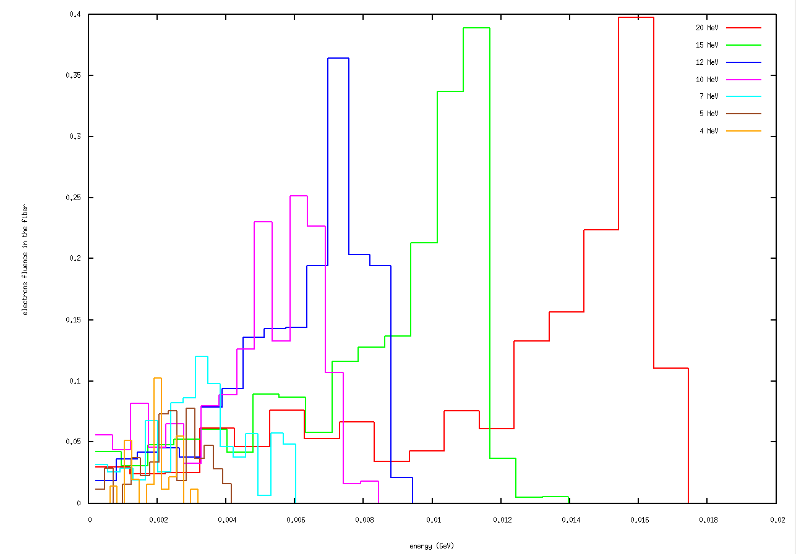
Electron fluence on the fiber per electron lost (top fiber)
Electrons fluence per lost particle
Top fiber
Energy (GeV)

Slide 19
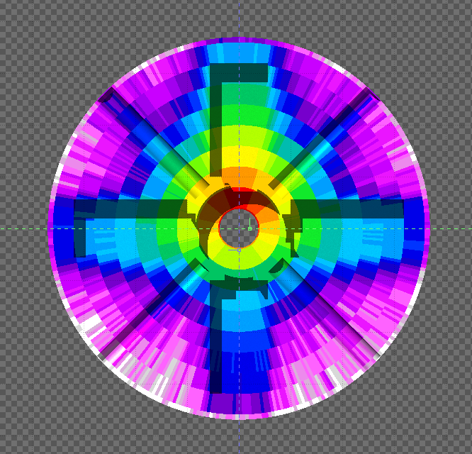
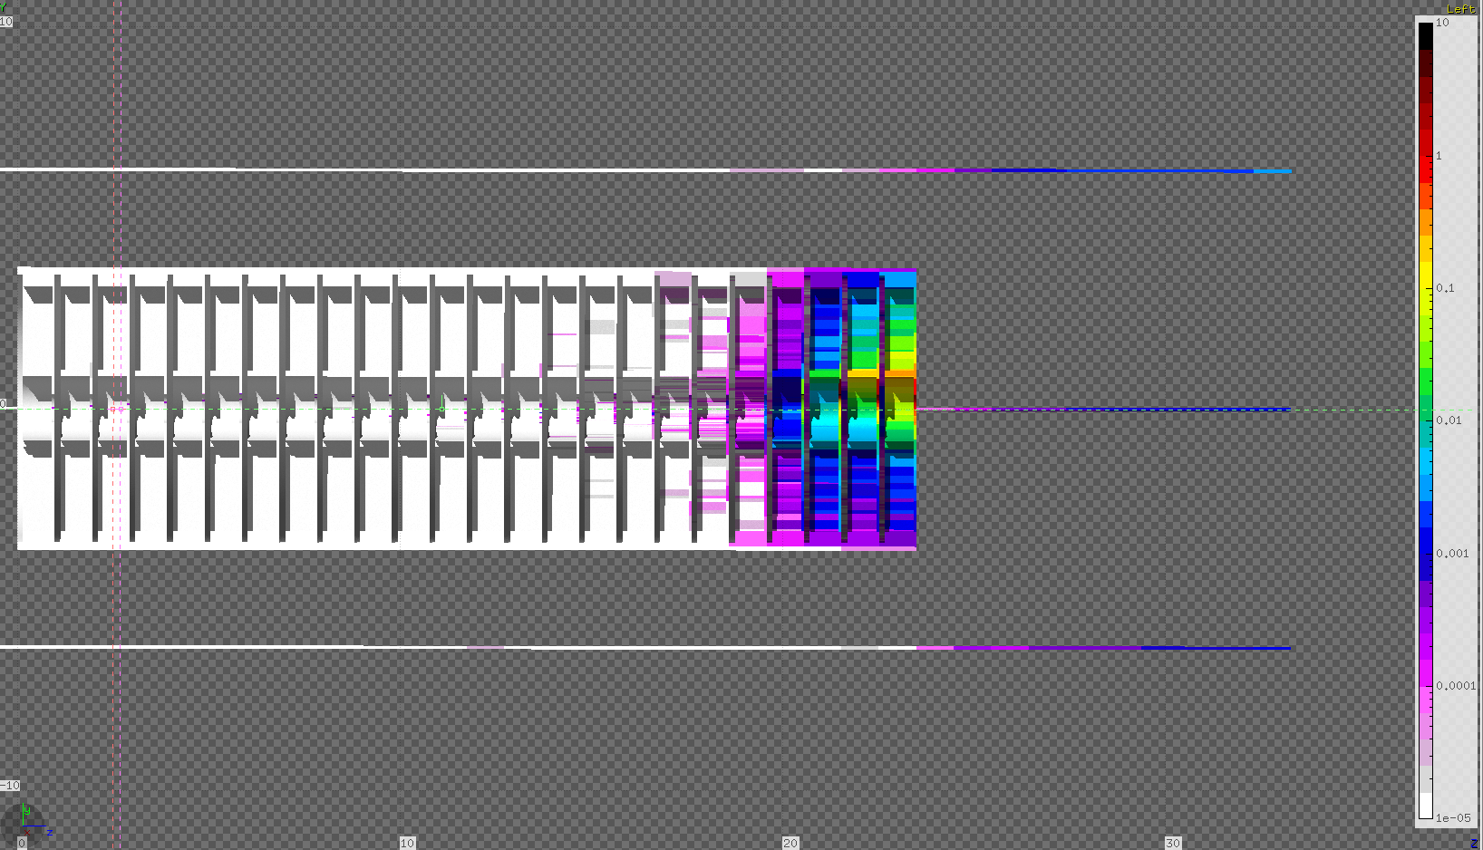
Electron fluence for 20 MeV loss
Disk 24

Slide 20
Conclusions
OBLM system sensitive to dark current losses, without beam presence
  Higher Power → Higher energy gradient → Higher energy dark current → Higher Signals
  Sensitivity limitations
OBLM system sensitive to RF Breakdown losses, without beam presence
  Sensitivity limitations
RF cavity induced background losses results in sensitivity limitations in Beam Loss Monitors
BUT ALSO
Beam Loss Monitors could also be utilised as a Beam diagnostics tool

Slide 21
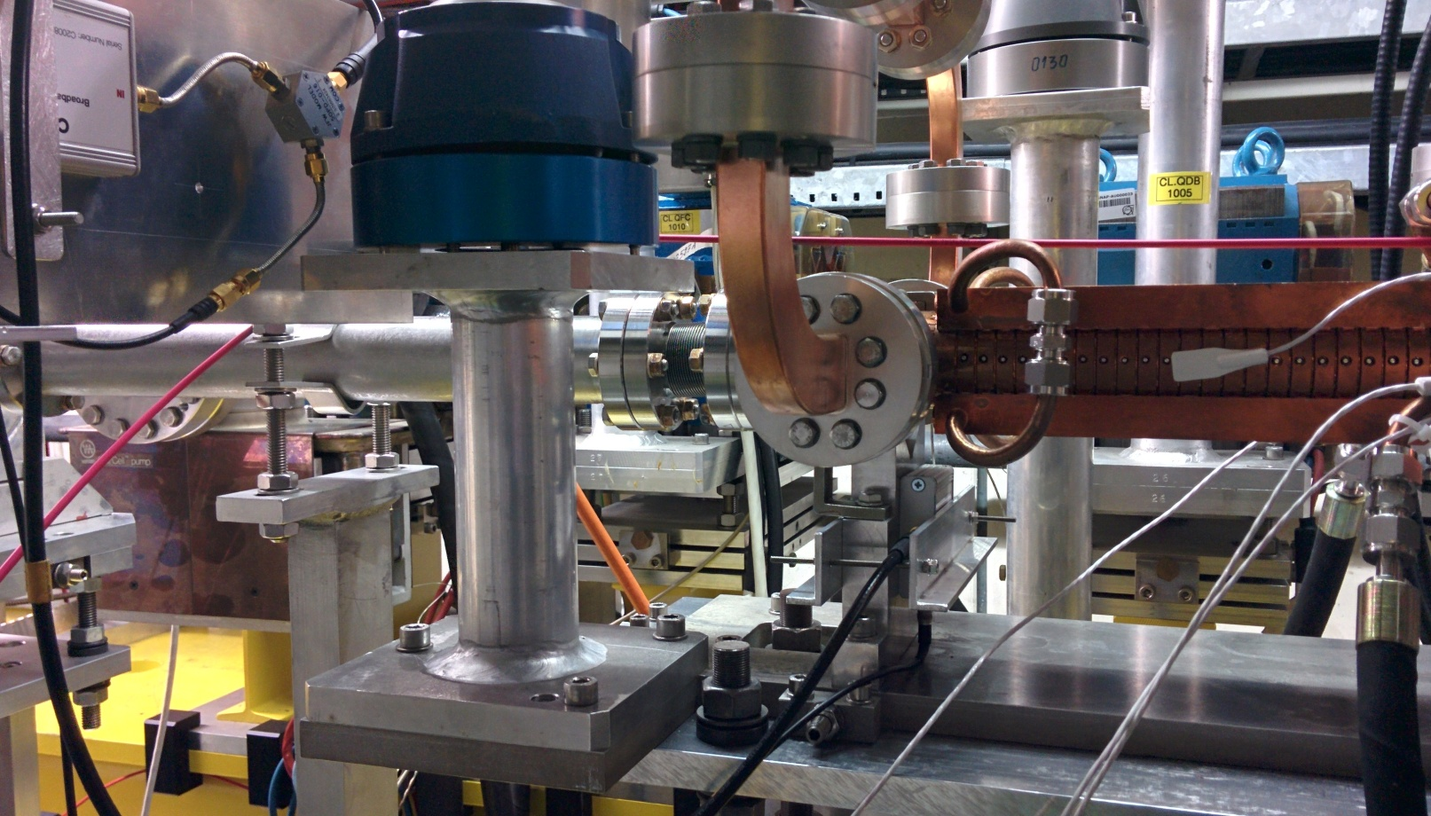
Next Steps
Same calculation for data with Beam
Diamond detector results (new position!)
New data with the OBLM (no feedback resistor → ability to monitor higher signals without saturation)
More refined simulations
Thank you!

Slide 22
Backup slides

Slide 23
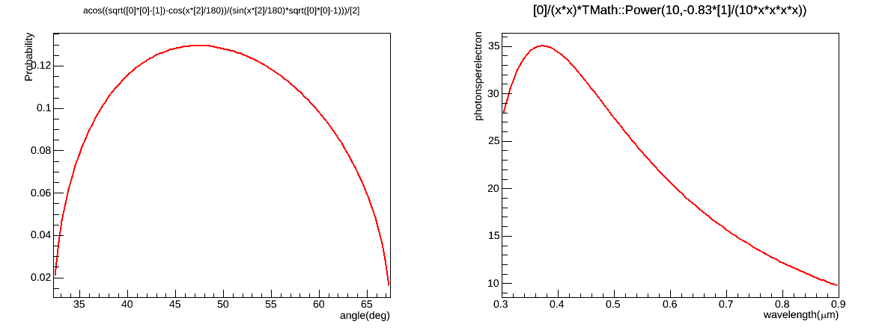
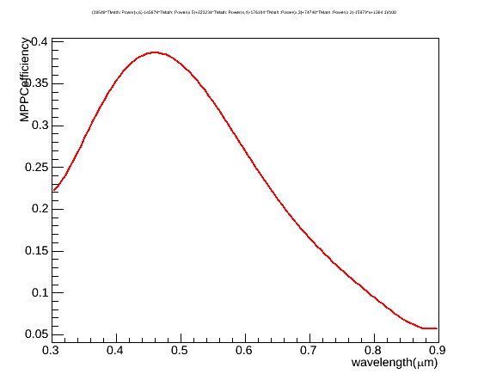
Calculations
Students' meeting, 09 March 2015
23

Slide 24
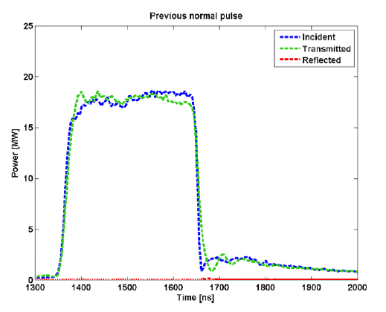
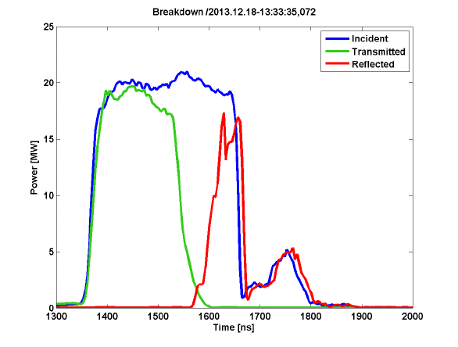
incoming
transmitted
reflected
incoming
reflected
transmitted
[1] Advances in the understanding of the physical processes of vaccuum breakdown – W.Wuensch, CLIC-Note-1025

