Slide 1
TE-VSC activities during LS1
Jose A. Ferreira on behalf of TE-VSC

Slide 2


Safety first
No significant impact of LS1
VIC useful but not always all the stakeholders involved
Presence of DGS in the tunnel when coactivity (arbitration). i.e. LSS1 cabling campaign, P7 LHC, etc.
Numbers for 40/30 to be added

Slide 3
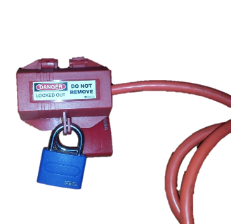
Safety first
Objective: Continuous improvement
i.e. Improvement consignation of ion pumps
  Big number of ion pumps consigned during LS1, difficult to follow up.
  Procedure approved and available in EDMS
  First implementation during 2015 (test and validation)
  Fully implemented during LS2
No significant impact of LS1

Slide 4
Radioprotection
Saved dose in almost 100% of activities
6 VSC members allowed to exceed 3 mSv/year objective (memo EDMS 1389670)
Only 3 have exceed 3 mSv (<10%)
Flexibility allowed to finish the work in time

Slide 5
Radiological issues (i.e. SPS LSS1works)
Objectives achieved for collective dose
Difficulties to get experienced resources to share dose
Detailed planning during LS1 → No time to reallocate resources and lack of global view (work in several machines at the same time)

Slide 6
Radiological issues (i.e. SPS LSS1works)
Interventions in hot environments should be planned well before the shutdown
Time for Training and Tooling (TE-VSC)
Coordination of different activities and resources
Follow accumulated dose of team involved by VSC responsible
Objectives achieved for collective dose
Difficulties to get trained resources to share dose
Detailed planning during LS1 → No time to reallocate resources and lack of global view (work in several machines at the same time)

Slide 7
Radiological issues
MSWG, 24/10/2014
  Example after 4 months of cool down (survey 18/04/2013) Dose rates at 40 cm
  PSB:
    Average: 34 μSv/h (88 h to 3mSv)
    Median: 11 μSv/h (34 working days to 3mSv)
  PS:
    Average: 89 μSv/h (34 h to 3mSv)
    Median: 23 μSv/h (16 working days to 3mSv)
TE-VSC technicians spend long periods in the machine. LIU works during LS2: Or increase limit or personnel

Slide 8
Vacuum Surface & Coatings
VSC inputs
Cabling
Mechanical work
Survey
Transport
VSC outputs
Cryogenics
Surface Treatments
Coatings (NEG, carbon, etc.)
Mechanical installation
Vacuum acceptance tests
RP
Coordination

Slide 9
Characteristics of VSC work during LS1
Consolidation and maintenance of vacuum systems in the accelerator complex
Implement new installations (modification vacuum chambers, pumping, etc.) ECRs
Preparation (surface treatment, coatings, vacuum acceptance test)
Mechanical installation
Pumpdown, leak detection, bake out
Last step before machine available (except LHC arcs)
Coordination: to optimize resources all activities in same vacuum sector at the same time when possible

Slide 10
Planning (PLAN tool)
Plan tool (plan.cern.ch)
List of activities (vacuum support required)
Tentative period (planning)
No work oriented (missing info: functional position, etc.)
Not updated during LS1
Iterations? (i.e. works to be regrouped)

Slide 11
Support Given
Too many last minute requests and unforeseen works (surface treatment, installation, etc.)
Dedicated meetings to solve specific issues
Same VSC resources used in different machines (different methodologies and too many planning meetings) → difficult VSC coordination
Implementation of vacuum acceptance tests in all the accelerator complex (validation that technical specifications are fulfilled)
Some works requiring development not announced

Slide 12
Support requested by VSC (PLAN tool)
Only number of requests but some require a lot of resources

Slide 13
Support received
All the teams shown flexibility
EN/EL: Discussions after LS1
  Improve procedures
  Check cabling schema during renovation campaign (improvements)
  Reports should be available after cable test
Layout DB should be updated ASAP (TE-VSC control system not updated). Problems during commissioning.
ECRs not always approved in time
Better coordination between machines and experiments (i.e. access, coactivity, resource smoothing and priority setting)

Slide 14

Support received
All teams were ready to implement practical solutions to tackle different issues found
EN-MME, DGS-RP, EN-EL, BE-BI, etc…

Slide 15
Access
IMPACT: Useful tool
  Availability at access point of approved IMPACTs very useful in cPS new access system
  Extension to other machines?
MAD access very often problematic

Slide 16
Summary
what | I – keep | II - improve | III - change
Safety | Good awareness about the working environment (personnel well trained) | Presence of DGS in the tunnel when high level of coactivity
Radio protection | Excellent assistance from DGS/RP | Planning activities in hot areas well before the activity starts (before LS2) Follow-up accumulated dose during LS2 (reorganization of resources) | Add resources to deal with contingencies Overall view across machines (same guidelines)
Support Given | Tool to declare requested work (PLAN) | Improve work description (positions, etc.) → Better resource estimations | Iterations to regroup activities and optimize resources when possible
Support Obtained | Ensure flexibility (contingency resources or low priority activities) | Improve flow of information between TE-VSC and other groups
Access conditions | IMPACT proved useful to declare work | Access through MAD Availability of IMPACT numbers (as in PS complex)
Coordination | Specific meetings to address big activities proved very useful | Better coordination between different machines (same resources) | Use same formats and tools in different machines (easier coordination inside TE-VSC)

Slide 17

Thank you for your attention
Special thanks to all people involved during LS1!

Slide 18
Insulation Vacuum
LS1 Debriefing Day

Slide 19
Insulation Vacuum
Safety:
  Accidents: 1 (industrial support). Fall from PEFRA; 2 days off.
  Smoke in LHC tunnel due to roughing mobile pumping groups: 3 incidents (2 including personnel evacuation); 0 incidents after action plan
    LS1 action plan: revision of all pumps and change on maintenance plan; and, new operation procedure, including no start-up in evening, presence at early pumping and ‘palier’ to avoid pumping on big leaks
    LS2 action plan: dry pumping groups to replace oil pumps
Access conditions:
  Material SAS slow: time loss with impact in planning during first months
  Access flexibility enabled to avoid coactivity and to better adapt the own activities planning to the general one (see last slide)
Support given:
  Only one unplanned activity with high impact: QRL compensator issue (6-8% of LS1 workload)
  QRL unplanned activity + SMACC delay between 07/13 and 12/13 were absorbed by tasks independent from train (~24% of total) with no further cost ⇒ highlights the importance of a percentage of activities to be used as a contingency (see last slide)

Slide 20
Insulation Vacuum
Support obtained:
  SMACC: excellent collaboration and structure of project team including coordination, planning and NC follow-up
  TE-CRG: excellent support, flexibility and availability for evacuation and backfilling of He during leak test activities of different lines ⇒ leak testing faster and more efficient; asset to be maintained
  EN-MEF: very useful and efficient weekly meetings for main activities progress
  Other acknowledgements: EN-MME, BE-OP, TE-MSC

Slide 21
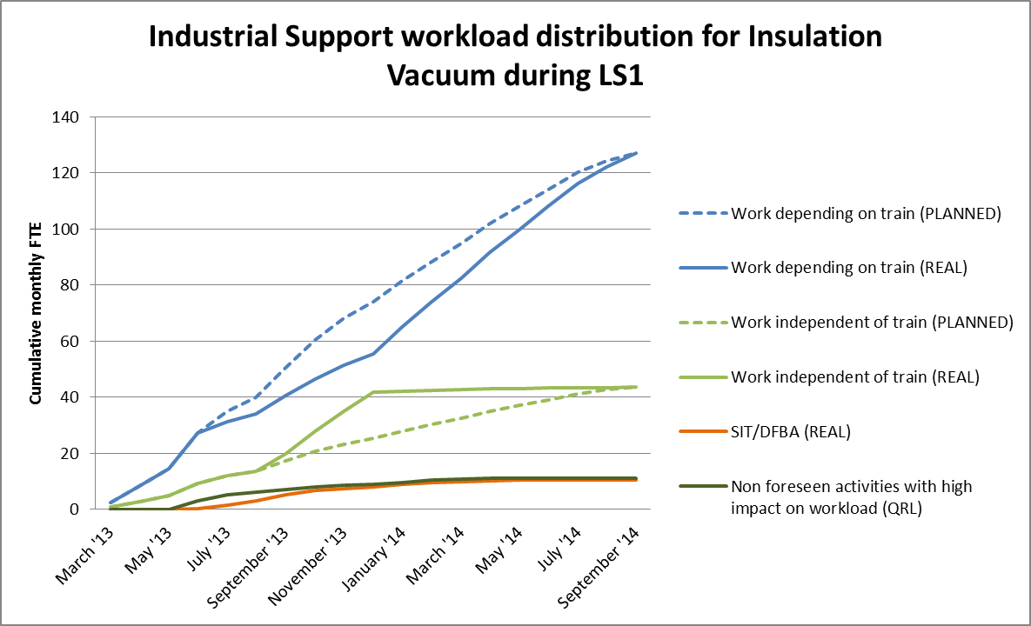
Insulation Vacuum
No more contingency margin!!!

Slide 22
TE-VSC-SCC (surface coatings and chemistry) summary
  Problems which could have been prevented:
    Several jobs requesting developments were not announced in time (no preliminary discussion of design, insufficient evaluation of the type of treatment, modified piece compared to prototype, too tight schedule…). This is not compatible with working with high workload
    EFF: some coatings/treatments failed
    EFF: delays and sometimes no technical solution found
    SOL: anticipate problems by discussing design
  Underestimated issues (accepted non-relevant prototype, underestimated resources, did not ask information..):
    EFF: delays
    SOL: …take the time to think, technical solution is available
  Problems difficult to foresee (even seeing the design we would not have spotted):
  “Surprises” (typical: unexpected peel-off ….)
    EFF: Pointed to a “weak” point in a process
    EFF: delays
    SOL: have more time margin, the technical solution is in general available
    NB: Time is difficult to be compensated by resources if one need highly trained personnel

