Slide 1
Feedback on Warm Magnet Activities during LS1
J.Bauche, on behalf of the TE/MSC/MNC section
With contributions from:
P. Catherine, M. Dumas, P. Fessia, A. Newborough, P. Thonet, and D. Tommasini

Slide 2
Outline
Magnet maintenance program in LS
Review of TE/MSC/MNC activities in LS1
Foreseen
Unforeseen
Feedback
Support from/to other groups
Coordination
Electrical and radiation safety
Infrastructure (incl. access)
Resources
Summary

Slide 3
Main Conclusions
LS meets well magnet maintenance program; magnet inspection dedicated period at start of LS period shall be kept
Overall feedback:
LS1 work well prepared, well in advance (commitment of resources already at this stage). Initiatives like IEFC workshop 03/2012 helped a lot.
Excellent collaboration with other groups, good communication in technical coordination meetings
Additional workload from inspection results or from external requests
SMACC priority committed a lot of MNC resources. Support with external collaborations (BINP & NCBJ) helped to recover some
Margin to be considered in schedules in particular for restart phase (late activities / issues found during restart tests)
Prioritization of projects is of utmost importance for resource allocation
Radiation aspects well addressed (e.g. TDC2 / LSS1+); few electrical safety issues: reminder of basic safety rules
Safety rules and procedures demanding more and more resources

Slide 4
Spare slides from IEFC workshop 03/2012

Slide 5

Magnet baseline strategy for LS1
Memorandum addressed in October 2011:
TE/MSC/MNC activities in IEF during LS1 (EDMS 1169429)
We intend to complete:
Full inspection of the magnets
Corrective maintenance
Preventive maintenance and necessary consolidations
Necessary actions in highly radioactive areas
LIU activities to be done during LS1
To reserve resources for LHC splice consolidation, we will put on hold:
Less urgent consolidations (SMIT quadrupoles in L2, L3 and PSB; SPS pole shims, PS busbars and PFW’s, NEA interlock cabling, etc.)
Many desirable but less urgent maintenance activities
Most of it could not be done during short shutdowns of the last 3 years

Slide 6
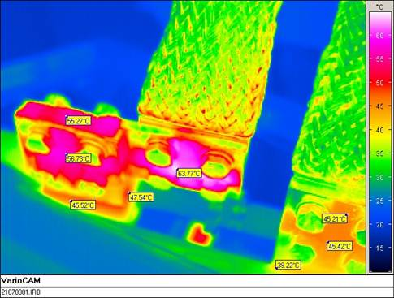
Maintenance and consolidation in IEF
In all machines
Detailed inspection of magnets
Removal of the magnet covers
Electrical tests
Audio-visual inspection in pulsed mode
Thermal inspections
Machine conditions
Machine closed to non-MNC personnel during power tests
Power, cooling, interlocks, access operational
Support from other groups
BE/OP to power the magnets and lock the accesses
TE/EPC support for power converters operation
To be done in the beginning of LS1
(except zones!)
Loose electrical connection

Slide 7
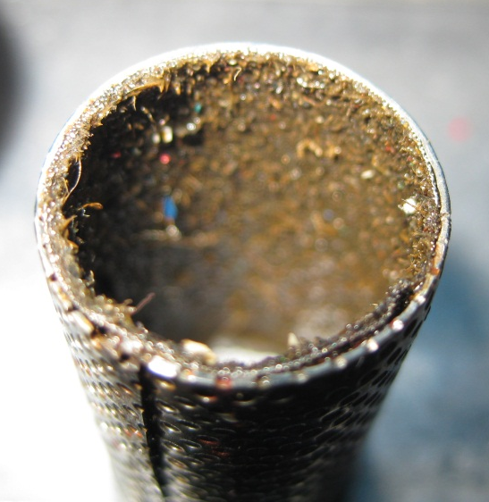
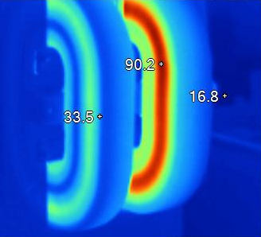
Maintenance and consolidation in IEF
In all machines
Corrective / preventive maintenance
Repair / replacement of faulty magnets
Shimming in-situ or replacement of magnets with critical coil movement
Refurbishment of defective magnets in workshops
Cleaning of all magnet filters
Machine conditions
Free access for handling and transport in the tunnel (coactivity)
Support from other groups
EN/HE, TE/VSC, BE/ABP for magnet replacements
Activity spread over the whole LS1 duration, ending with the most radioactive zones
Clogged filter
Clogged coil

Slide 8
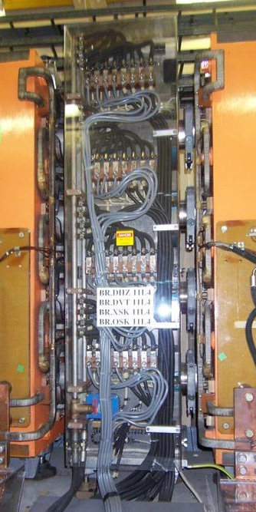
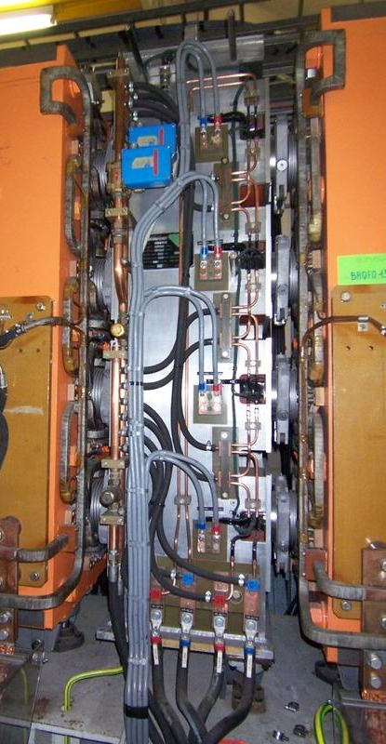
Maintenance and consolidation in IEF
PS Booster
Revise most critical auxiliary magnet cooling circuits
Missed preventive maintenance
Replacement of internal flexible hoses
Check hoses crimping system
Activity spread over the whole LS1 duration
ONO/XNO/QSK-Type IA
OSK/XSK/DVT/DHZ (Type B)

Slide 9
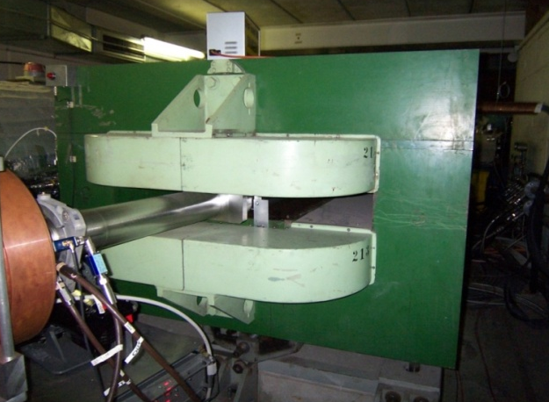
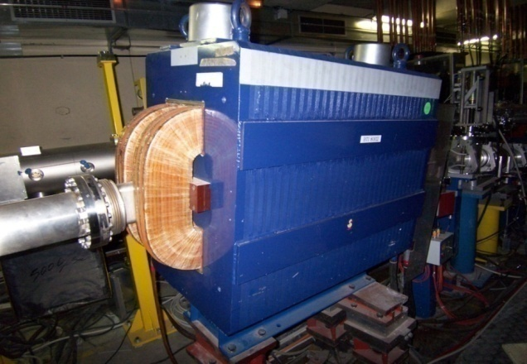
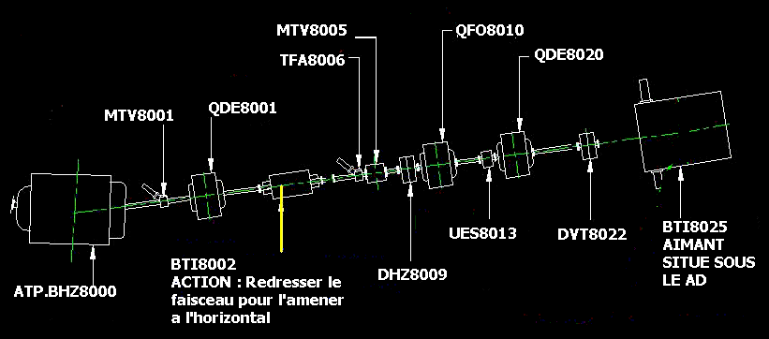
Maintenance and consolidation in IEF
AD transfer lines
Removal of unused magnet in beam lines 7000 and 8000
Required for the ELENA project
Machine conditions
Opening the concrete roof of AD
Support from other groups
EN/HE, TE/VSC
BHZ 8000 – 30 T
Layout of transfer line 8000
BTI 8002 – 7.5 T

Slide 10
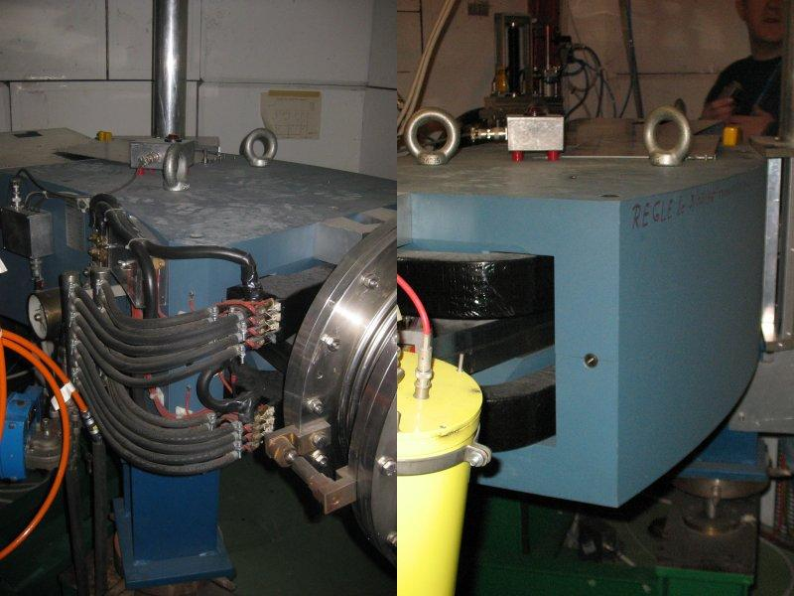
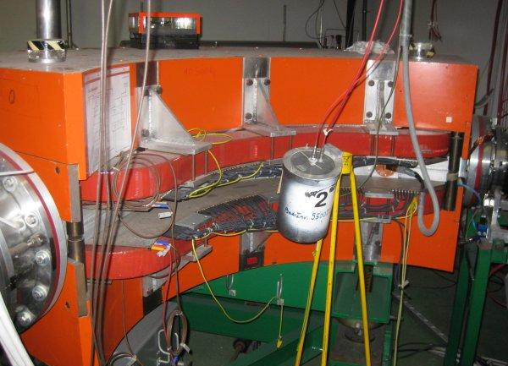
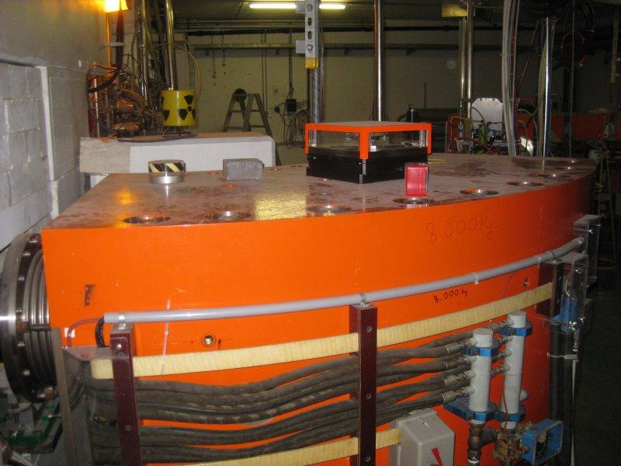
Maintenance and consolidation in IEF
ISOLDE
Refurbishment in-situ of separator magnets GPS and HRS
Missed preventive maintenance
Support from other groups
None if work in-situ
EN/HE, TE/VSC, BE/ABP, if major refurbishment in workshop is needed
After radiation cool-down period
GPS 70 deg. magnet
HRS 90 deg. magnet
HRS 60 deg. magnet

Slide 11
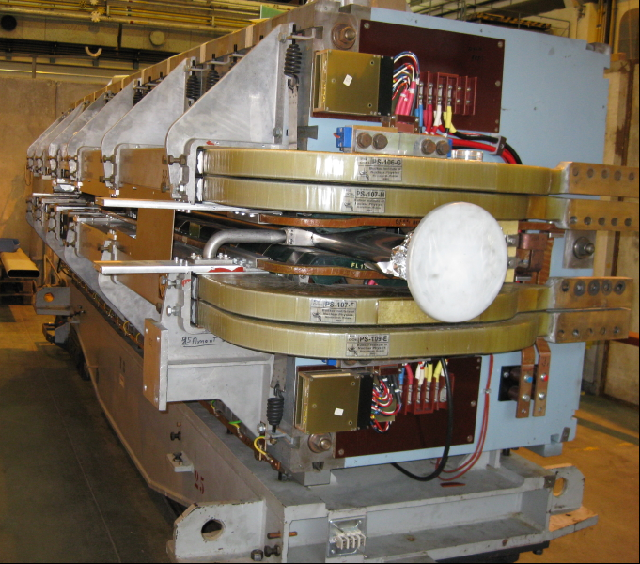
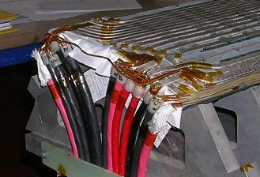
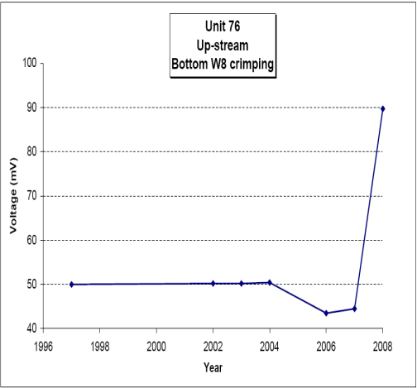
Maintenance and consolidation in IEF
PS ring
Replacement of PFW sets on main units #55 and #75
Corrective maintenance
Crimped contact resistance increase monitored recently
Support from other groups
EN/HE, TE/VSC, BE/ABP
After radiation cool-down period
PS main unit
PFW internal assembly
Typical increase of contact resistance

Slide 12
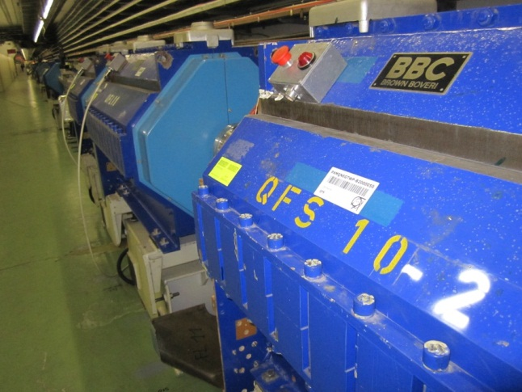
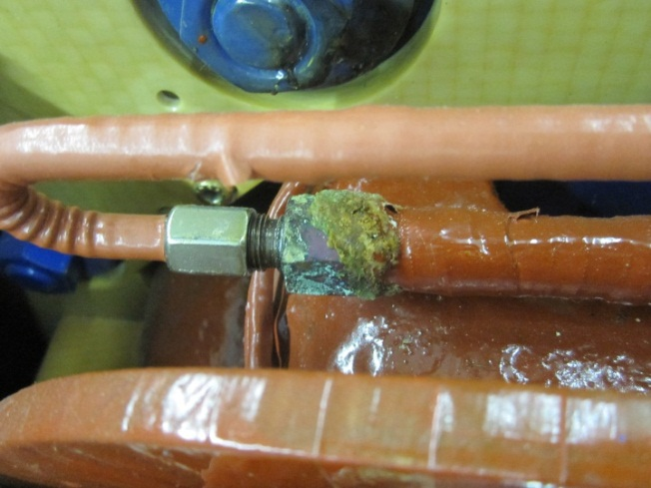
Maintenance and consolidation in IEF
TT2 transfer line
Refurbishment of most critical quadrupole cooling circuits
Corroded brazed hydraulic connections on several magnets
Degraded internal soft hoses to be replaced
Support from other groups
EN/HE, TE/VSC, BE/ABP for replacement of some of the magnets
TT2 quadrupoles
Degraded hydraulic connection brazed joints

Slide 13
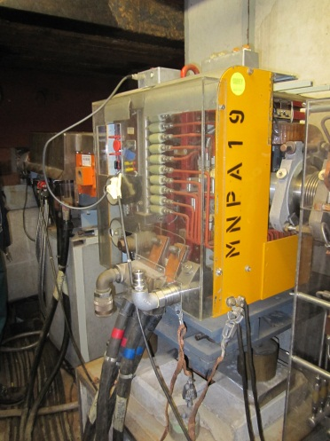
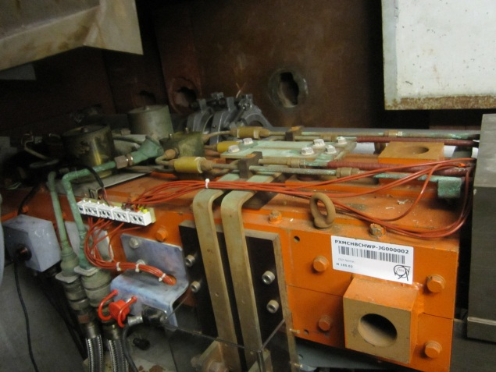
Maintenance and consolidation in IEF
East Area
Refurbishment of defective magnets
F61N.DVT01 out of service due to water leak, replacement requires to dismount part of the concrete block shielding around
F61N.DHZ01 in degraded state, no spare
Magnets to be refurbished in workshop
Support from other groups
EN/HE, TE/VSC, BE/ABP
F61N.DVT01
F61N.DHZ01

Slide 14
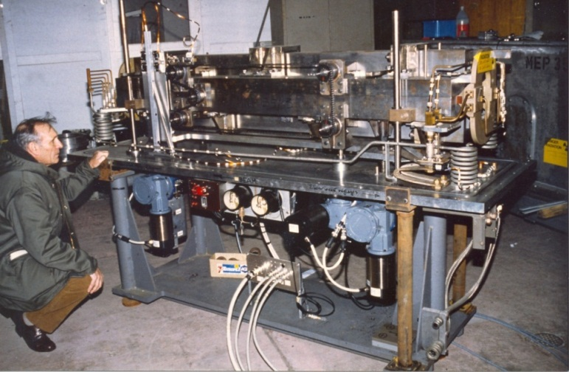
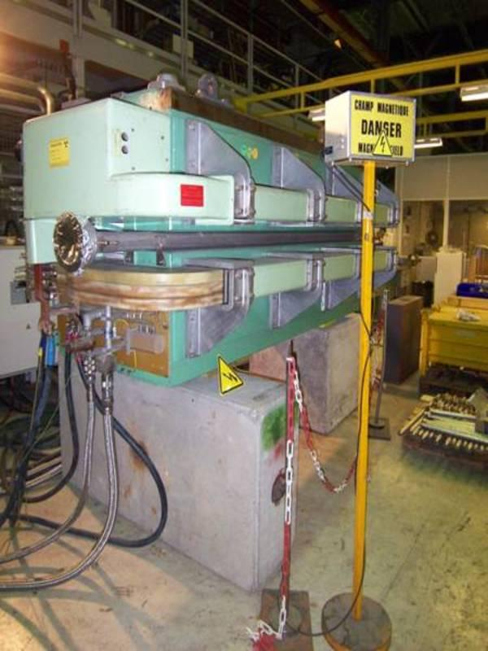
Maintenance and consolidation in IEF
East Area
Replacement of the SMH.01 splitter by a “standard” dipole
Control system of mechanical movement is “orphan” equipment
Split functionality not needed anymore with modification of beam distribution mode (replacement of MNP23 septum by MCB)
Support from other groups
EN/HE, TE/VSC, BE/ABP
Start after radiation cool-down period
MEP35 splitter
MCB dipole

Slide 15
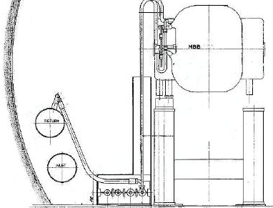
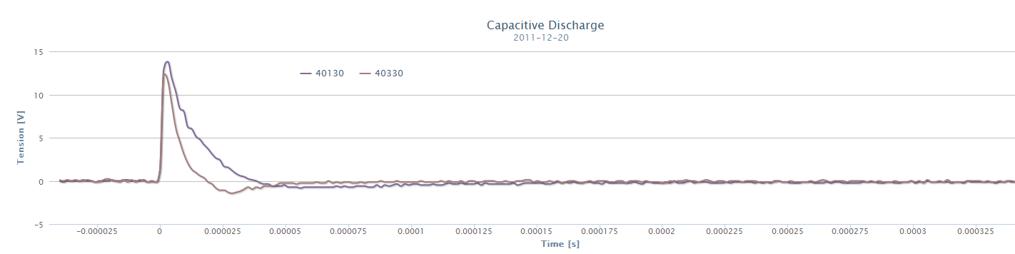
Maintenance and consolidation in IEF
SPS
Special inspections and tests of main magnet circuits
Inspection of the busbars → removing of all BB covers
Completion of capacitive discharge tests campaign (3/3): 250 dipole coils
Machine conditions
Sectors 1-2 and 2-3 not accessible during a few days (capacitive discharge)
Support from other groups
TE/EPC to separate the SMD’s from the load in sector 6-1 and 1-2
After cool-down time for works in half-sextants 1+ and 2-
SPS cross-section at MBB
Inter-turn short-circuit on MBB 40330 during capacitive discharge campaign 2/3 in 2011

Slide 16
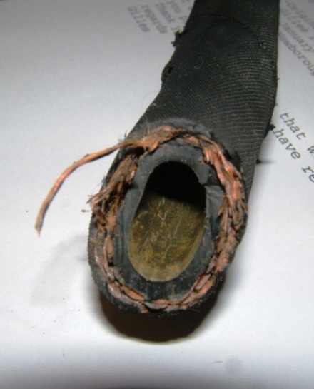
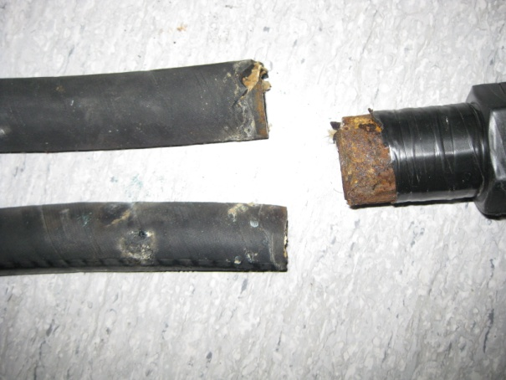
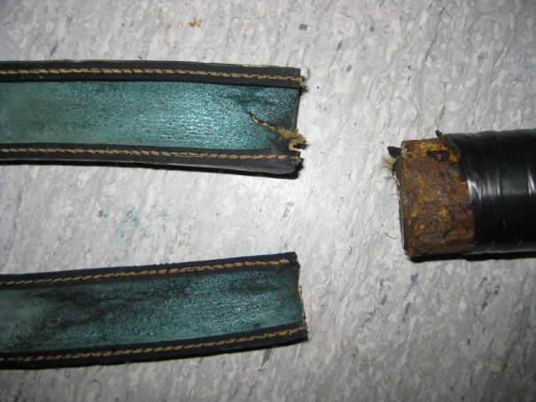
Maintenance and consolidation in IEF
SPS and transfer lines
Replacement of all cooling supply flexible hoses
Consolidation approved, all 2000 hoses already purchased in 2010
Equipment stored since then, could not be installed during previous short shutdowns
Support from other groups
EN/CV to empty demineralized water circuits in all sextants
When all inspections requiring cooling water will be completed
Delaminated cooling hose
Burst cooling hose

Slide 17
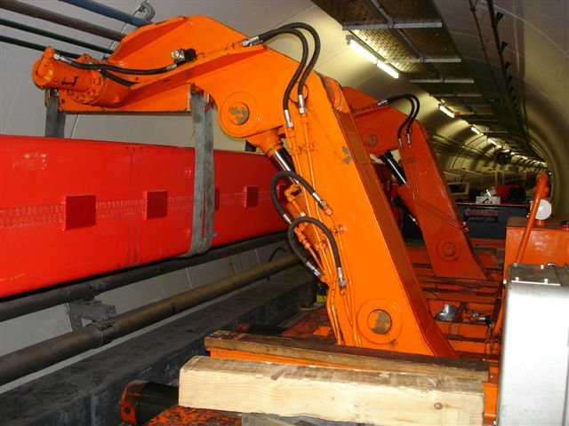
Maintenance and consolidation in IEF
SPS
Expected exchange of 10 to 15 main magnets, following audio-visual inspection results
Standard preventive and corrective maintenance (few spares)
Machine conditions
Need access to material lift
Support from other groups
EN/HE, TE/VSC, BE/ABP
Main dipole exchange in the SPS

Slide 18
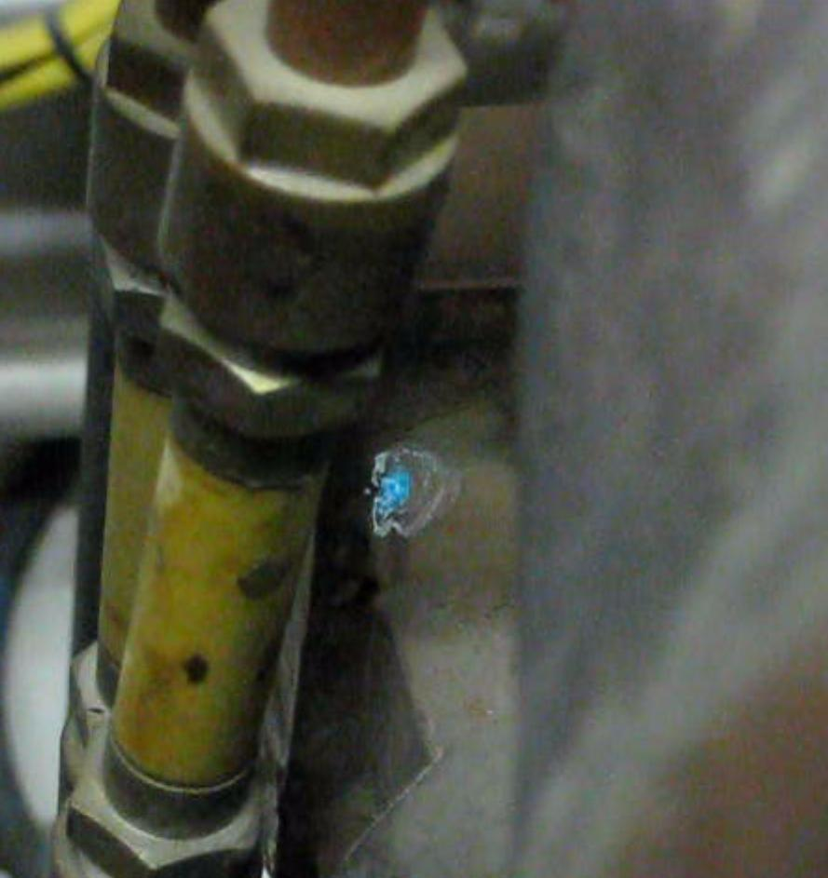
Maintenance and consolidation in IEF
SPS
Refurbishment of the 10 most critical MBA magnets with corroded manifold brazed joints
Brazed joints corrosion → sign of future water leaks
Problem identified on 70 dipoles, mostly MBA
Machine conditions
Possibility to do it in ECX5 to avoid logistics
in surface? TBC
Otherwise, need access to material lift
Support from other groups
EN/HE, TE/VSC, BE/ABP
Corroded brazed joint

Slide 19
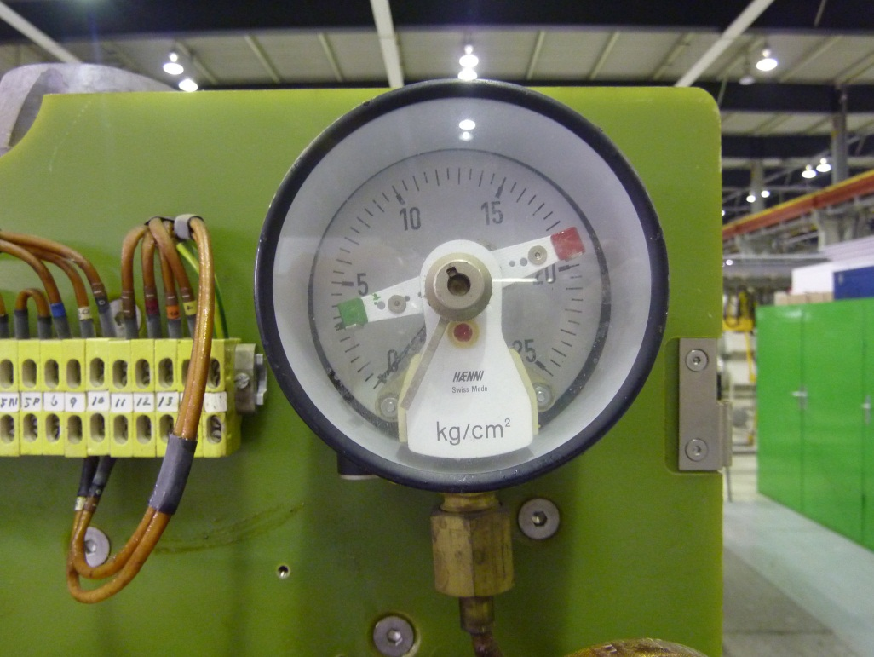


Maintenance and consolidation in IEF
North Experimental Area – TCC2
Suppression of weak electrical contacts of water pressure and water temperature interlocks
False triggering of interlock system → important part of piquet interventions
Decision to be taken about technical solution
Support from other groups
Possibly TE/MPE, depending on technical solution
After cool-down period
Manometer with gold tip contacts corroding due to water pressure oscillations
Interlock
circuit
kg/cm²

Slide 20
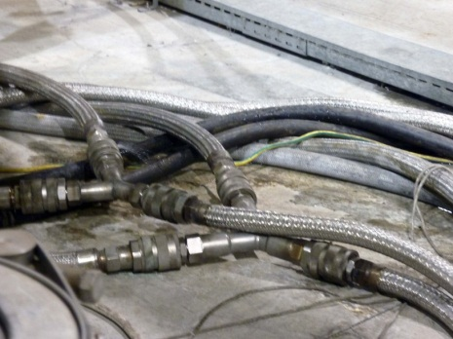
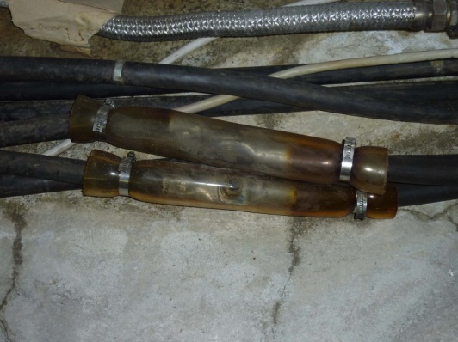
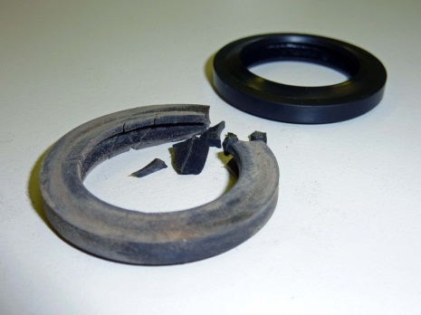
Maintenance and consolidation in IEF
North Experimental Area – TCC2
Improvements to magnet supply circuits
Reduction of hoses interconnections in radiation exposed areas
Replacement of obsolete electro-valves by manual valves
Proper sleeving of power cables connections on the ground
After radiation cool-down period
Improper electrical connections to be sealed with appropriate sleeves
Quick connector gaskets degraded by irradiation

Slide 21
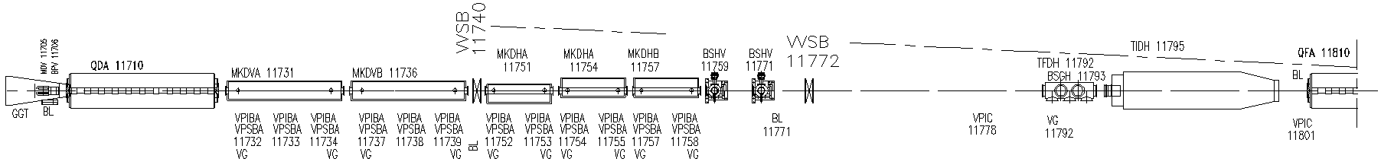
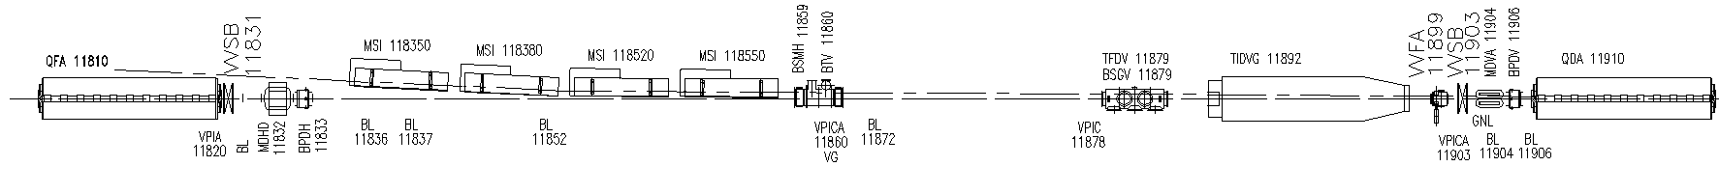
Maintenance and consolidation in IEF
Requests from other groups
EN/EL - Removal of magnets in SPS – LSS1+
To allow access to cable trays for irradiated cable replacement campaign
To be confirmed
Layout of dumping region
Requests to other groups
DGS/RP – Support needed in all interventions described above
TE/EPC – Consignation of power converters
EN/CV – Maintain flow in demineralized water circuits

Slide 22
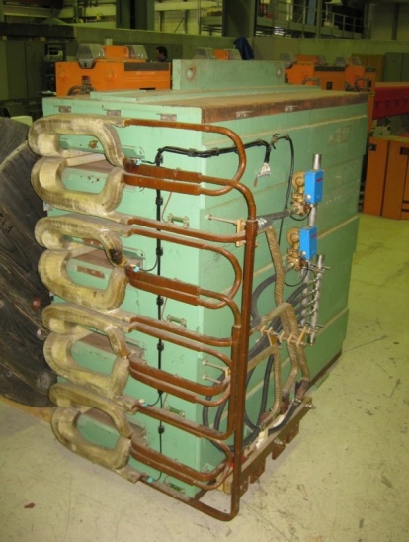
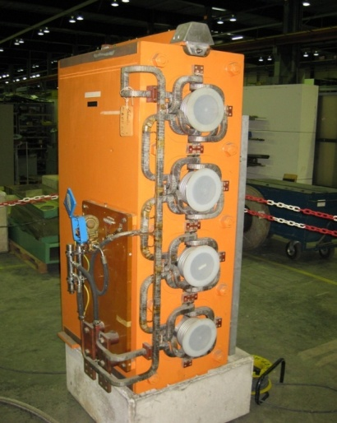
LHC Injector Upgrade activities
LIU-PSB
Upgrade of cooling circuits of the main bending and quadrupole magnets
Necessary to allow 2 GeV operation of main magnets
Cannot fit with other modifications in LS2 planning
Removal of flow-switches and installation of additional temperature interlocks
Upgrade of hydraulic connections
Activity spread over the whole LS1 duration, ending with the most radioactive zones
PSB main bending magnet
PSB main Quadrupole magnet

Slide 23
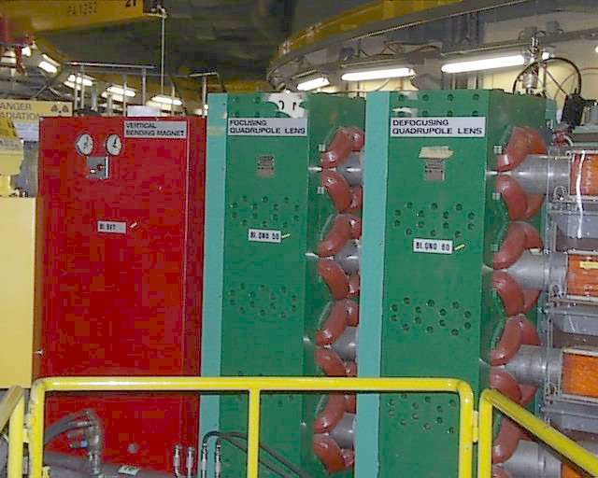
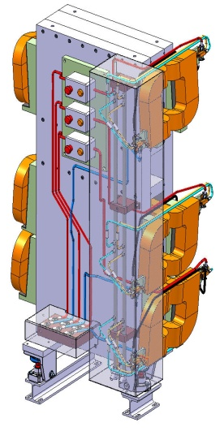
LHC Injector Upgrade activities
LIU-PSB
Installation of the PSB injections magnets
To reduce congestion during the connection of LINAC 4
BI.BVT10 – required for LINAC 4 (160 MeV) operation
BI.QNO 50 & 60 – Consolidation action (profit of vacuum opening)
Support from other groups
EN/HE, TE/VSC, BE/ABP
To be confirmed based on magnet availability and planning agreement
Magnets BI.BVT10 (red) and BI.QNO 50 & 60 (green)
Design of new BI.BVT 10

Slide 24
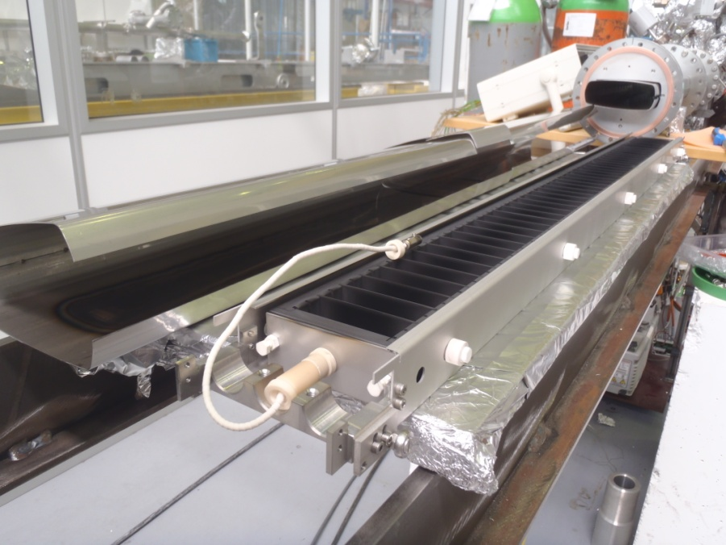
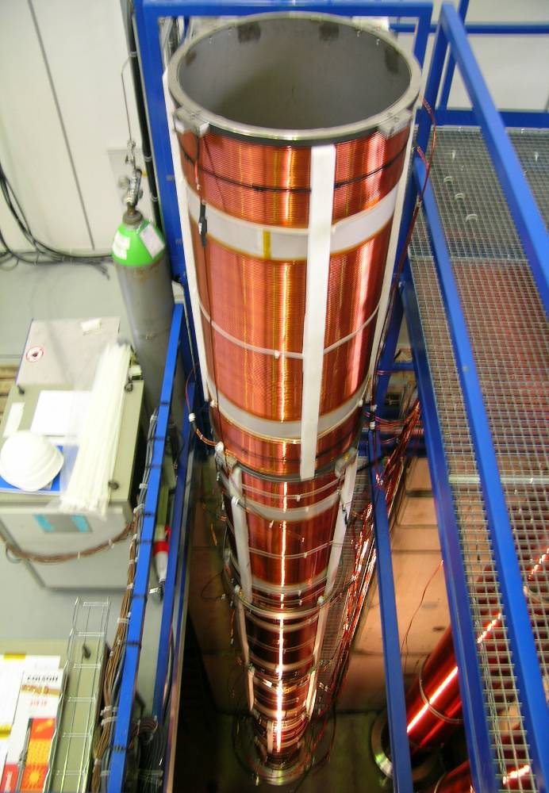
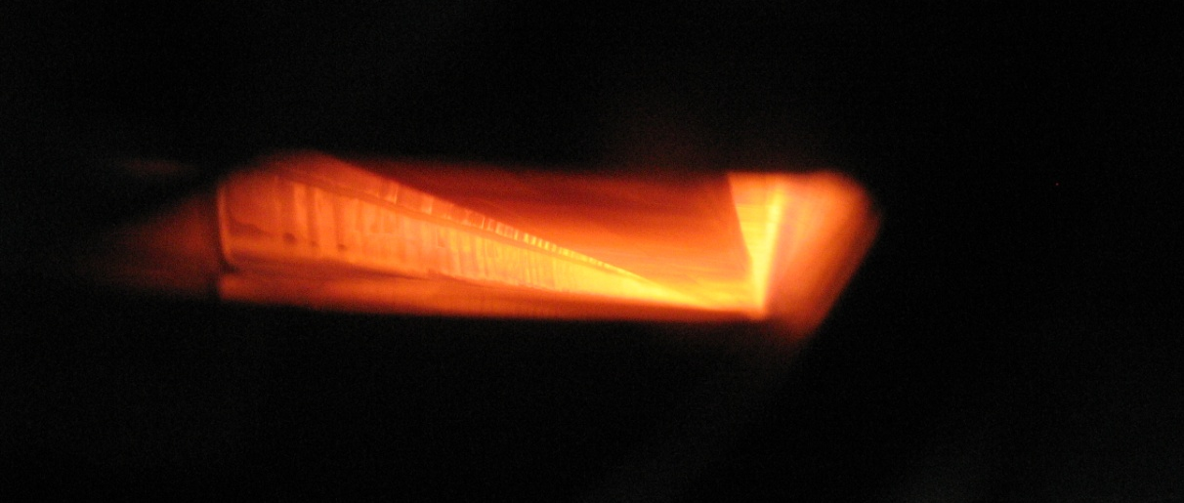
LHC Injector Upgrade activities
LIU-SPS (e-cloud mitigation)
Coating of 16 dipoles and 4 quadrupoles in 2 adjacent cells of sextant 5
Validation of both magnetron sputtering and hollow cathode coating of VC with a-C during 2014 MD’s
Dipoles removed from machine to be coated in workshop (50% to be rebuilt)
Installation of pre-coated VC in quadrupoles
Machine conditions
Access needed to material lift
Support from other groups
EN/HE, TE/VSC, BE/ABP
All magnet should be removed from SPS at the beginning of LS1, and put back in place at the end in a single batch
Hollow cathode coating *
* Pictures: courtesy of P.Costa Pinto – TE/VSC
Magnetron sputtering *

Slide 25
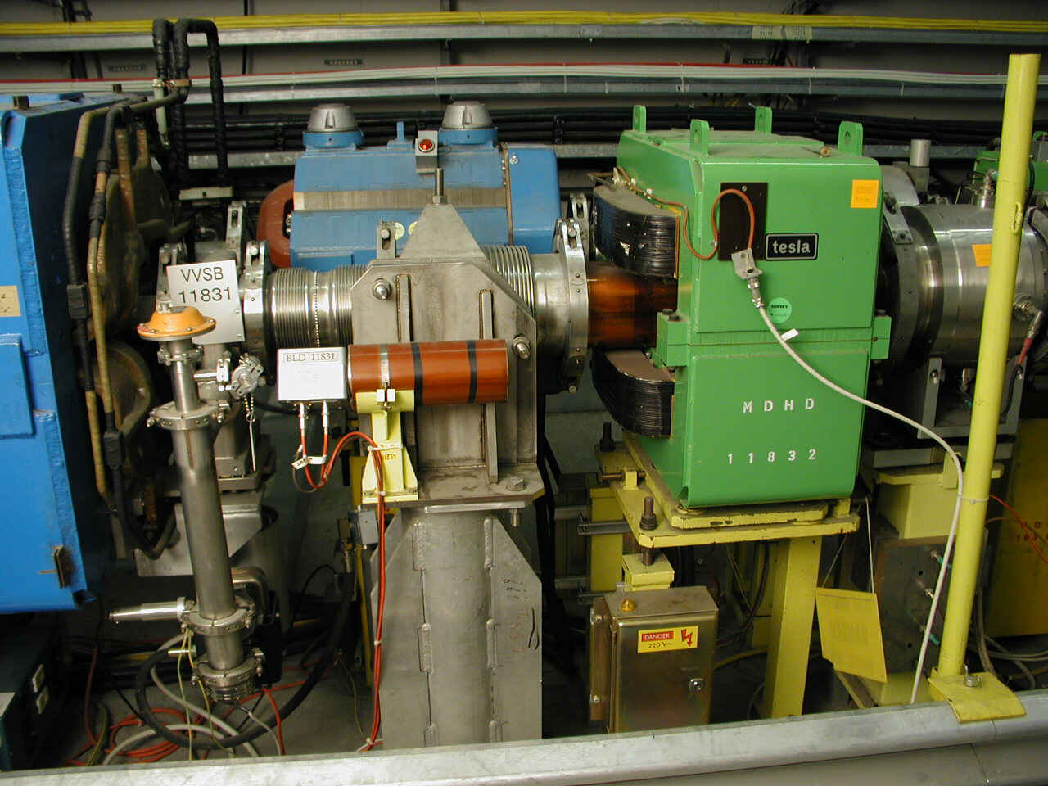
LHC Injector Upgrade activities
LIU-SPS (Q20)
Modification of the MDHD 11832 for injection dogleg compensation
Modification of the coils powering scheme from series to parallel to increase strength
Required to be done in workshop
Machine conditions
Access needed to material lift
Support from other groups
EN/HE, TE/VSC, BE/ABP
MDHD11832 (green)
Layout of half-cell 118

Slide 26
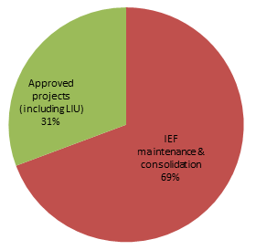
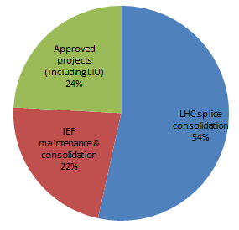
Resources
MNC staff and FSU resources
MNC resources distribution per activity in 2011
MNC resources distribution per activity during LS1

Slide 27
Summary
Baseline strategy described in EDMS 1169429
More than half of the staff and FSU personnel of MNC will be involved in the LHC splice consolidation
We will perform all the necessary actions to ensure a reliable operation of the magnets in the CERN accelerator complex, including the ones only possible during a long shutdown
We will perform all the necessary actions required by the LIU and the other approved projects
We must postpone less urgent consolidation and maintenance
We acknowledge in advance our colleagues for:
Their support to our activity
Ensuring the availability of the technical services during the inspections
To avoid interrupting the water flow in magnets for long periods

