Slide 1

Transport System for
Large objects at
Ljubljana JSI TRIGA Reactor
(part of WP15.5)
Marko Mikuž, Luka Snoj
J.Stefan Inst. & Univ. Ljubljana, Slovenia
AIDA2 Kick-Off Meeting, CERN, June 4, 2015

Slide 2
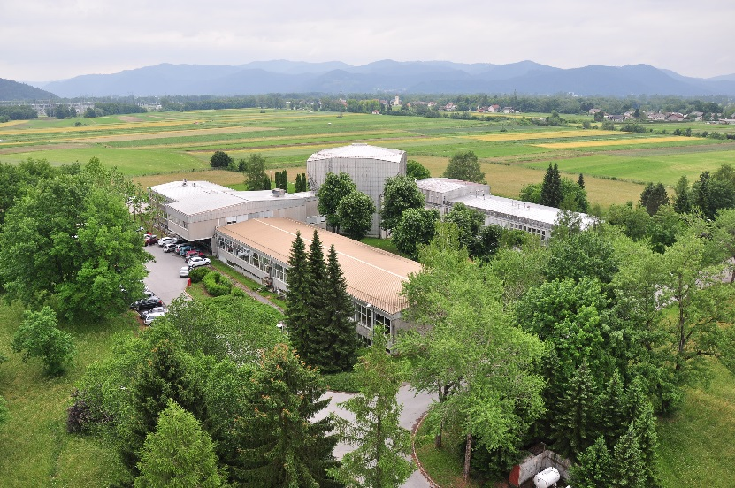
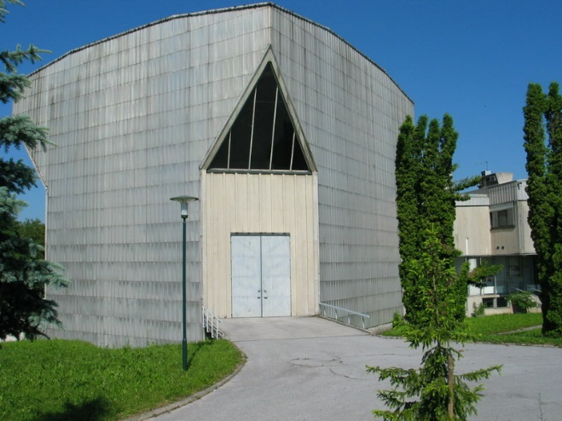
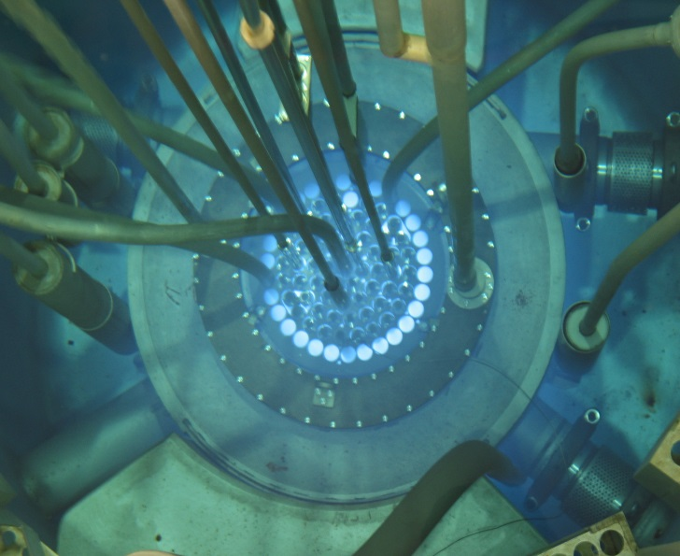
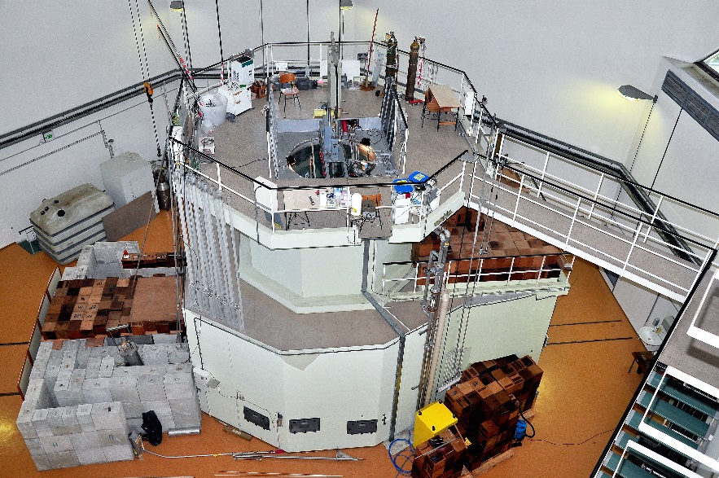
TRIGA Mark II Reactor Ljubljana
1st criticality:
  31st May, 1966
P_{max}
  250 kW (steady state)
  1 GW (pulse)
Fuel
  UZrH (12 wt. % U)
  E= 20 %
Notes:
2
2

Slide 3
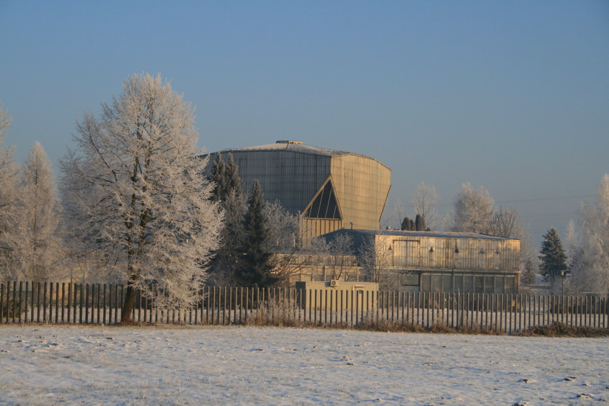
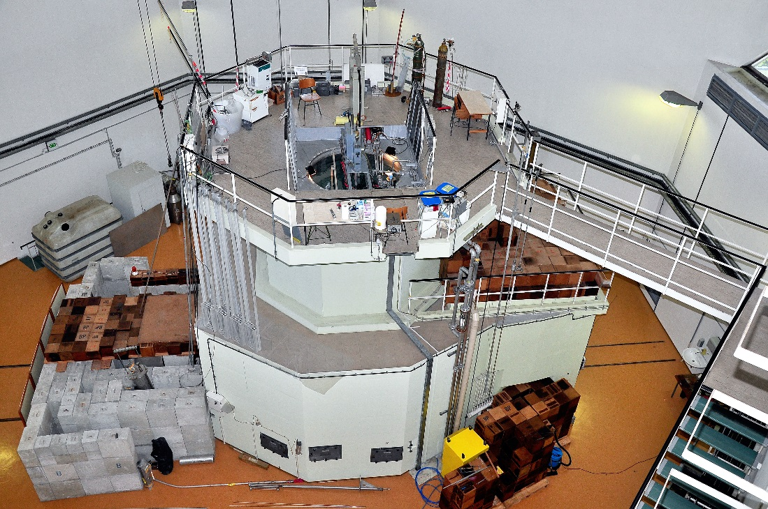
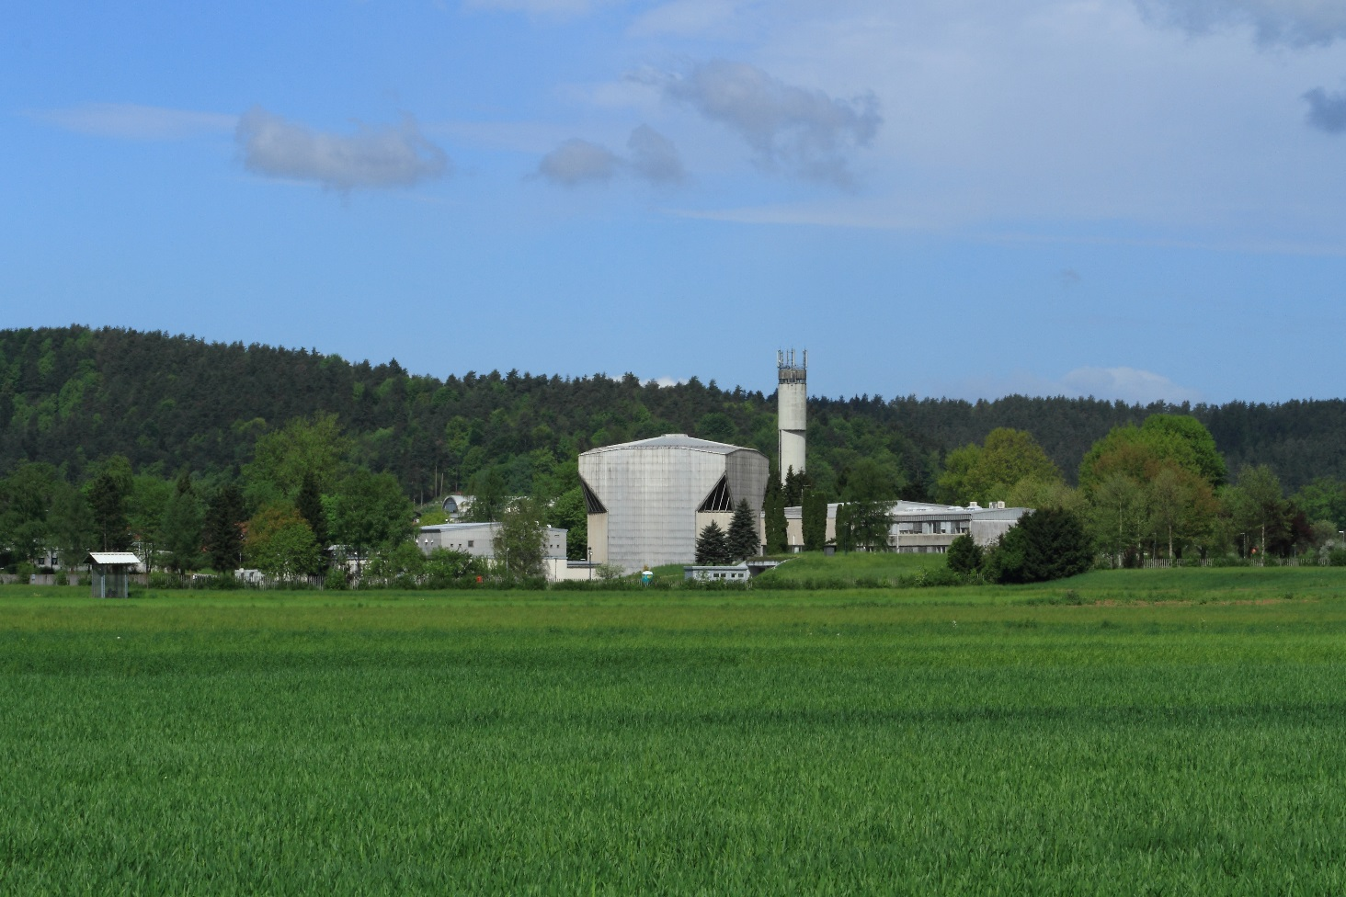


Slide 4
Naris

Slide 5
TLORIS
Proposed irradiation facility

Slide 6
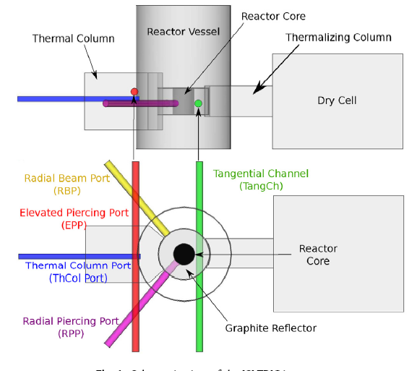
TRIGA Irradiation Channels

Slide 7
Goal
Develop and install a large sample irradiation (2R < 15 cm) facility in the tangential channel of the JSI TRIGA reactor

Slide 8
Tangential Channel Characteristics
Inner diameter: 15 cm
Neutron flux characterisation:
  L. Snoj et al., Appl. Rad. Isot. 70 (2012) 483–488
Neutron flux: 1.3e12 n/cm²s
  Thermal (E<0.625 eV): 58 %
  Epithermal (0.625 eV < E < 100 keV): 25 %
  Fast ( E > 100 keV): 17 % -> 2.2 E11 n/cm²s
    1e15 n_{eq}/cm² in 1 ½ hours

Slide 9
Neutron Spectra
Thermal
Epi-thermal
Fast
Tangential channel

Slide 10
Activities
Calculations to support development of the irradiation facility
Experimental and computational characterisation of the facility
Design and installation of the facility
  need for strong neutron + gamma shields

Slide 11
Milestone, Deliverable, Budget
MS15.9: Design of a transport system for neutron irradiations of large samples:
  The design of a transport system for large objects of a diameter of up to 12cm into the Ljubljana reactor irradiation position including the possibility for electrical and cooling connections to the samples has been documented.
  Milestone for M12 (Report to StCom)
D15.9: JSI TRIGA Reactor Transport system:
  The transport system for large objects of a diameter of up to 12cm into the reactor irradiation position including the possibility for electrical and cooling connections to the samples has been installed and commissioned. (Task 15.5)
  Deliverable for M18
Budgeted with 25 k€ EC contribution, additional cost covered by internal funds

