Slide 1

ESI in a few words . . .
ESI today
    >20 years of thematic schools on scientific tools and methods and their industrial, medical and societal applications: particle accelerators, instrumentation for particle detection, their applications to medicine, bio-health computing, scientific computing.
    For whom?
Master and PhD students studying sciences, mostly in European universities, and young professionals
With whom ?
CERN and CERN’s network of many hundreds of university institutes, other scientific institutions, university hospitals or medical centres, industrial firms, . . .
    What’s different to other places of formation
      CERN’s scientific approach (collaborative, open, innovative, international) applied to teaching and knowledge transfer
      specific, modular, intensive, state of the art courses presented by specialists
      students and teachers work together in a “campus” environment
AIDA-2020 Kick-off meeting
03-06-2015

Slide 2
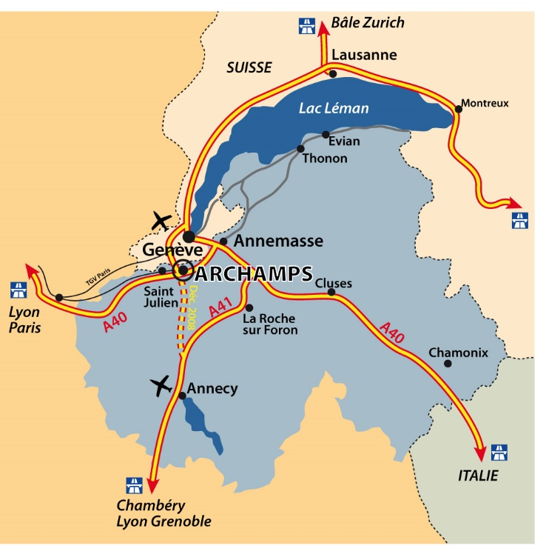
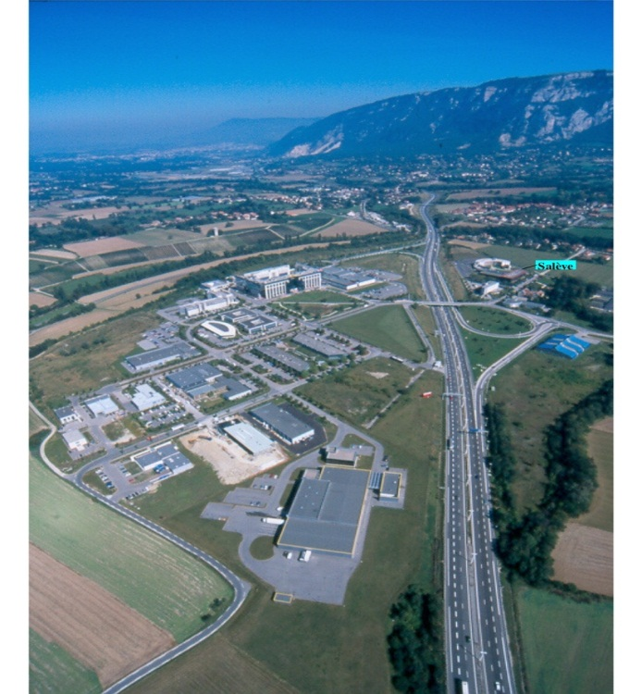
Geneva area
2
Notes:
2

Slide 3
ESI is 17 km south of CERN
CERN
ESI

Slide 4
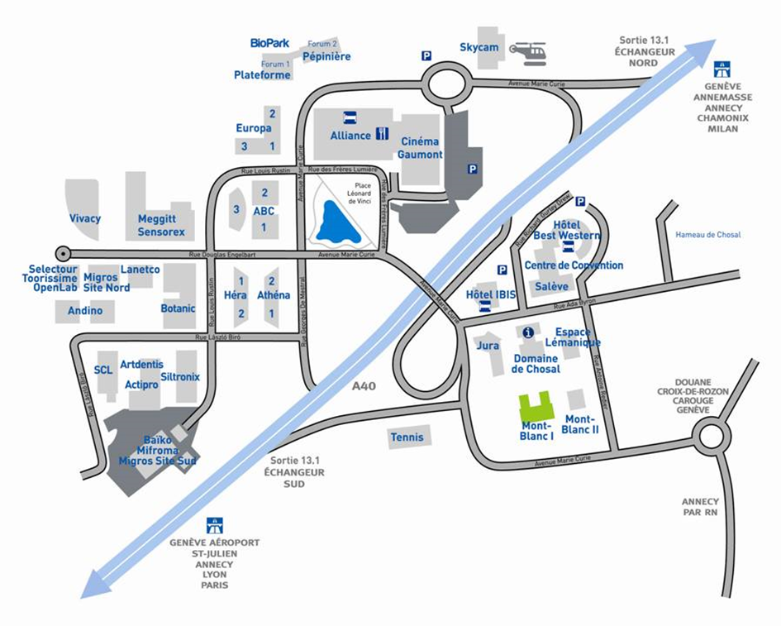
Site of Archamps Technopole

Slide 5
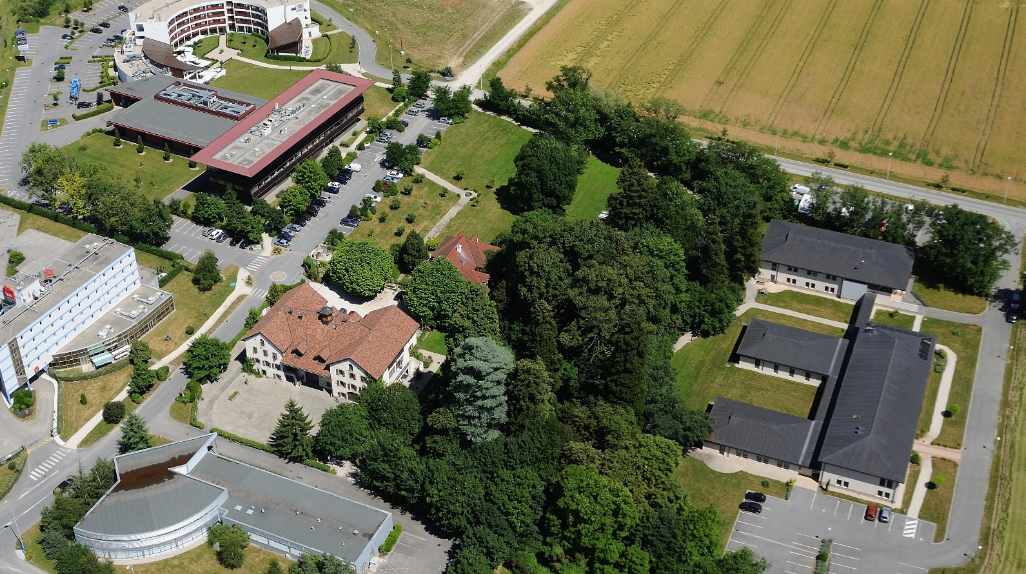
Mont Blanc 1 building
t
TPG - bus stops
ESI schools

Slide 6

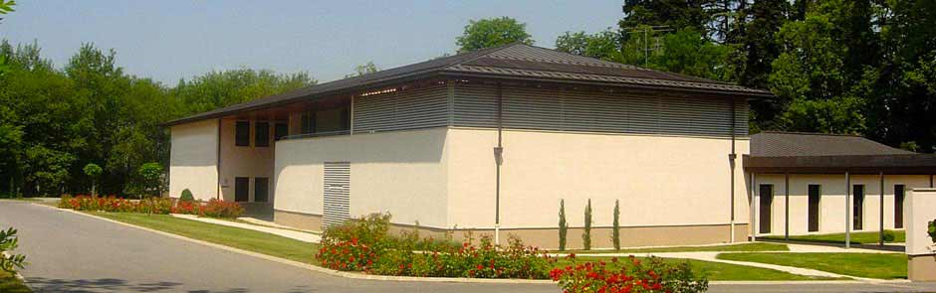
Bâtiment Mont Blanc 1
61 rue Antoine Redier
Archamps Technopole
F-74166 Saint-Julien-en-Genevois Cedex
Tél: +33 4 56 44 81 40

Slide 7


Main sponsors of the
European Scientific Institute (ESI)
The “Conseil Général de Haute Savoie” provides financial support to ESI
“Archamps Technopole” provides ESI with facilities for organization of the school including amphitheaters and computing room
AIDA-2020 Kick-off meeting
03-06-2015

Slide 8

  Director : Dr. Louis RINOLFI (ret. CERN)
  22nd edition : January - March 2015
  56 students - 17 nationalities
  16 Master
  15 PhD
  25 professionals
  45 lecturers, inc. 20 from CERN
  15 European partner universities
  (France, Germany, Italy, Spain, UK)
  19 Sponsors (research facilities, companies (€50K in sponsorship)
  International Advisory Board (hosted in 2015 by University of Liverpool)
  visits to CERN, PSI, Geneva University Hospital, ESRF & practical sessions at CERN, PSI and Bergoz Instrumentation.
AIDA-2020 Kick-off meeting
03-06-2015

Slide 9
15 European Universities partners of JUAS in 2015
Universities | Members of Advisory Board | Since
Université Joseph Fourier Grenoble | Jean-Marie De Conto | 1994
Technische Universität Darmstädt | Joachim Enders | 1994
Karlsruher Institut fur Technologie | Anke-Susanne Müller | 1994
Universitat Politècnica de Catalunya | Antoni Mendez | 1994
Universitat Autonoma de Barcelona | Youri Koubychine | 1994
Institut Polytechnique de Grenoble | Elsa Merle-Lucotte | 1994
Università degli studi di Napoli “Federico II” | Vittorio Vaccaro | 1994
Università degli studi di Roma “La Sapienza” | Mauro Migliorati | 1994
Università degli studi di Genova | Marco Bozzo | 2002
Technische Universität Berlin | Heino Henke | 2002
Universitat de Valencia | Angeles Faus-Golfe | 2002
University of Liverpool | Carsten Welsch | 2011
Université Paris-Sud Orsay | Sophie Kazamias | 2012
University of Rostock | Ursula van Rienen | 2013
University of Oxford | Andrei Seryi | 2014

Slide 10

















Logos of JUAS sponsors

Slide 11

  Director : Prof. Johann COLLOT
  (University of Grenoble)
  2nd edition: January - March 2015
  12 students - 8 nationalities
  7 Master
  4 PhD
  1 Professional
  42 lecturers
  University partnership (Grenoble, Strasbourg … Uppsala-Sweden, Helsinki-Finland, Casablanca/Rabat-Morrocco …)
  Guest lecturers for special sessions open to a wider audience
  Visits and practical sessions at CERN
AIDA-2020 Kick-off meeting
03-06-2015

Slide 12

  Director : Prof. Philippe SABATIER
  University of Grenoble
  2nd edition of BioHC summer school, August 2015
  Integrated Medicine for Chronic Diseases
    15 students enrolled in the Erasmus Mundus Master programme
      (France, Spain, Italy, Romania, China, Korea and India)
      Interdisciplinary (biology, mathematics, informatics, medicine)
    12 lecturers from partner universities
    9 intensive days including lectures and group work on complex problem solving around a case study of Chronic Obstructive Pulmonary Disease
    New schools under development : Big Data for Healthy Living; Predictive toxicology for Nanoparticles
AIDA-2020 Kick-off meeting
03-06-2015

Slide 13

  2013-2014 : process of change, no school in 2014
  1. Medical Computing P. Arce, CIEMAT
  2. Diagnostic & Interventional Radiology K. Geleijns, Leiden University Hospital
  3. Non-Ionising Radiation Imaging J. Alger, UCLA
  4. Nuclear Medicine & Molecular Imaging L. Bidaut, University of Dundee
  5. External Radiotherapy U. Oelfke, ICR/Royal Marsden NHS ; B. McClean, Trinity College Dublin
  6. Brachtherapy A. Rijnders, Europe Hospitals Brussels ; A. Carlsson-Tedgren, Karolinska
  Progressively introduce preparation via « distance learning » here: radio-protection manuals from IAEA
AIDA-2020 Kick-off meeting
03-06-2015

Slide 14


European School of Instrumentation
in
Particle and Astroparticle Physics

Slide 15
ESIPAP : objectives
To create a reference school in HEP instrumentation in the vincinity of CERN, the focal point of our community (like JUAS for accelerators)
to prepare the next generation of young physicists who will carry out HL-LHC upgrades and many other experimental projects
Very intensive school with test of knowledge acquired by students
5-year target : recruit 32 students per year at international level
To mix Master & Ph.D. students

Slide 16
ESIPAP : present model
Organization and management managed by ESI, that already organizes JUAS & ESMP
1 director (Johann Collot) + Steering + Organizing committees
2 independent modules : 25 January to 21 March : 8 weeks
32 students per year at European level
Master students, Ph.D. students and continuing education trainees
~100 h / module
Students are evaluated - 16 ECTS ( 2 x 8)
Accommodation of students organized by ESI
lab sessions organized at CERN (with the support of CERN)
progressive involment of European universities
collaboration & synergy with other European schools (CCS - ISOTDAQ)

Slide 17

Programme summary
Module 1 : Physics of particle & astroparticle detectors :
  Introduction to experimental particle physics
  Introduction to experimental astroparticle physics and cosmology
  Interaction of particles with matter
  Probability, statistics and MV analysis
  Detector Simulation
  Calorimetry
  Tracking
  Muon detection
  Particle Identification
  Imaging & Cherenkov detectors
  Radioprotection
  Lab sessions at CERN
  Computing sessions at ESI
Module 2 : Technologies and applications :
  Detector Technologies
  Advanced Electronics and signal processing
  Composite materials with practical training
  3D printing and innovation.
  Magnets for particle detectors
  Triggering and Data acquisition
  Advanced computing : C++, python, GRID, data technologies
  Ultra cold neutron production and detection
  Medical applications
  Project management
  Specific aspects of space projects
  Lab sessions/exercices at CERN
  Computing sessions at ESI

Slide 18
Module 1 : 108.5 hours of lectures !
Experimental particle physics (15 h) : Marco Delmastro LAPP (ATLAS)
Experimental cosmology (9 h) : Juan Macias-Perez LPSC (Planck)
Experimental astoparticle physics (6 h) : François Montanet LPSC (Auger)
Interaction of particles with matter (6 h) : Johann Collot LPSC (ATLAS)
C++ programming (6 h) : Éric Chabert IPHC (CMS)
Reminder on probablity and statistics (3 h) : Benoît Clément & Mathieu Guigue LPSC (GRANIT)
MVA Analysis & boosted decision trees (6 h) : Yann Coadou CPPM (ATLAS)
Tracking (6 h) : Jérôme Baudot IPHC (CMOS & ILC)
Calorimetry (6 h) : Isabelle Wingerter LAPP (ATLAS)
Muon detection (6 h) : Laurent Chevalier IRFU (ATLAS)
Radioprotection (3 h) : Helmut Vincke CERN (radioprotection group)
Imaging & Cerencov detectors (4.5 h) : François Montanet LPSC (Auger)
Detector simulation (6 h) : Alberto Ribon & Witold Pokorski CERN (G4 collab)
Particle identification (3 h) : Guillaume Unal CERN (ATLAS)
Computing sessions (12 h) : Éric Chabert & Éric Conte IPHC (CMS)
Lab sessions (14 h) : 12 people from CERN ! I can't list them all, my apologies !
Exams (10 h) !
More than 30 lecturers and lab tutors !
https://indico.cern.ch/event/366272

Slide 19
Module 2 : 101 h of lectures
Detector technologies (7.5 h): Jean-Marie Brom IPHC (CMS)
-Working principles, gazeous detectors, semiconductor detectors, scintillation
, cerenkov and transition radiation detctors
Noble liquid detectors (3 h): Johann Collot LPSC (ATLAS)
Low temperature detectors (1.5 h) : Alain Benoît Néel Institute (PLANCK)
Electronics and signal processing (9 h) : Daniel Dzahini LPSC (ATLAS)
Project management (6 h) : Pierre Bonnal CERN (CERN project office)
Advanced C++ programming (9 h) : Sébastien Ponce CERN
TDAQ ( 9 h):
-VME bus : Markus Joos CERN
-Modular Electronics : Markus Joos CERN
-TDAQ software : Enrico Pascalucci (INFN Roma)
-FPGAs : Hannes Sakulin CERN
-Triggering : Francesca Pastore (Royal Holloway London)
Data handling technologies (6 h) : Roberto Pace CERN
Composite materials (9 h) : Jérôme Senmartin (Compositec)
Magnets for particle detectors (4.5 h) : Herman Ten Kate CERN (ATLAS)
3D/additive printing (1.5 h) : Marc Krauth IPHC
Python programming (3 h) : Jérôme Odier LPSC
Grid computing (3 h) : Catherine Biscarat LPSC
Ultra cold neutron production and detection (6 h) : Guillaume Pignol LPSC (Granit)
Medical applications (6 h) : Ziad El Bitar IPHC
Space projects (4.5 h) : Jan Droz CNES (Ariane project manager for CNES)
Lab sessions (12 h) : people from CERN (can't list them all, apologies)
Exams (8 h)
More than 20 lecturers and lab tutors !
https://indico.cern.ch/event/366442

Slide 20
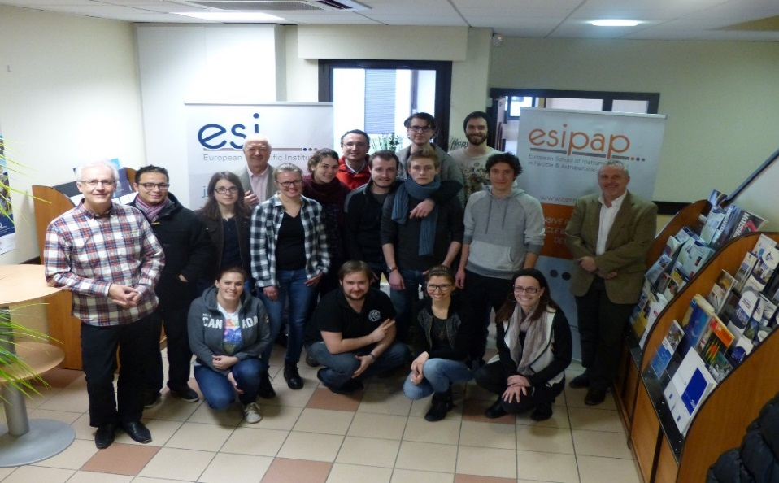
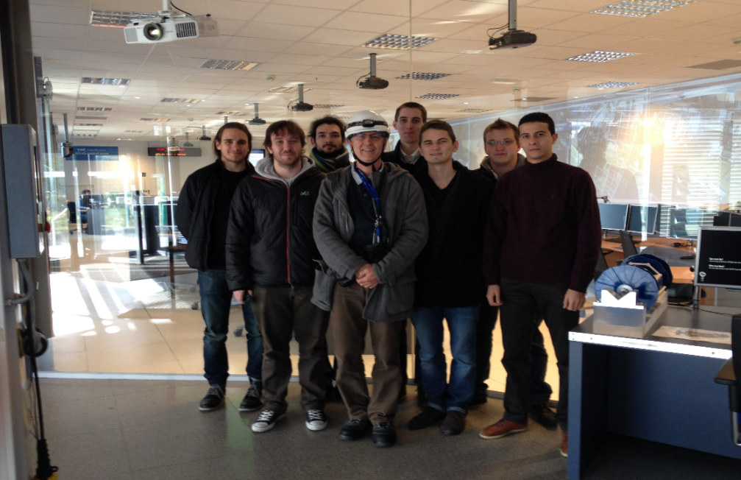
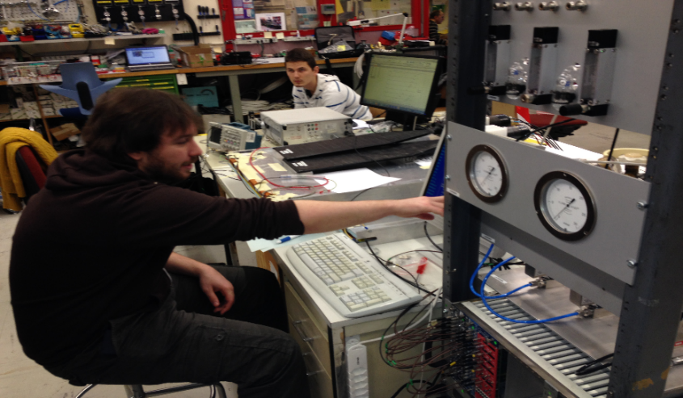
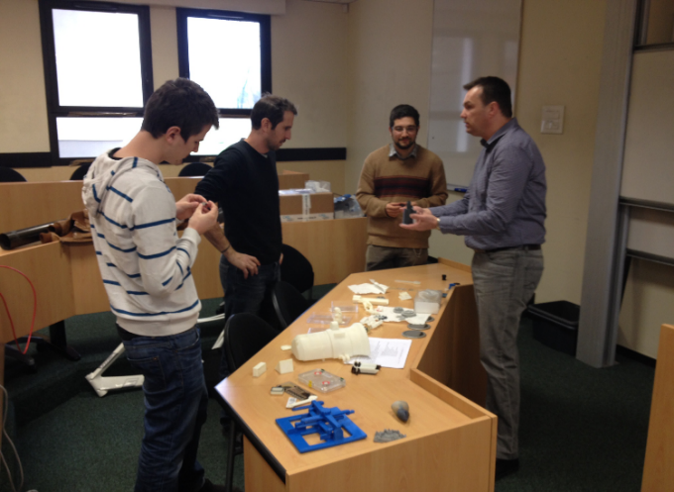
2014 and 2015 Alumni
19 students recruited in 2014 and 2015
from 9 countries... (France, Sweden, Algeria,
Morocco, Germany, Finland, Austria, Poland, Romania)
60% Master students, 40% PhD.students, 1 post-doc
this year. 2 theory Ph.D. students !
2015 session
2014 session
interactive lectures
lab session at CERN

Slide 21
Summary
School program and organization are now mature enough to welcome more students ;
At the moment, partners are : universities Grenoble-Alpes (JF, USMB) and Strasbourg, LPSC, LAPP, IPHC, IRFU, CPPM and CERN;
Very positive feedback from students (19) and professors (>50) ;
Increase student recruitment by proper/massive/alumni advertisement ;
Seek partnership with more European universities, labs and other topical instrumentation schools (already the case with ISOTDAQ, CSC...) ;
Hope ESIPAP will become a reference in instrumentation training ;
http://www.esi-archamps.eu/Thematic-Schools/ESIPAP

Slide 22
ESI investing in the future
    New ESI Website: www.esi-archamps.eu
    New computer room ready for ESMP 2015
    35 PCs – 3 year leasing contract
    Technical support
    Link to virtual machines at CERN for certain software applications
    (External-) Server for other software
Polycom Visio conferencing in meeting room
Available from May 2015
Increase frequency of coordinator meetings at no extra cost
ESI “promotes” a student hostel at Archamps
AIDA-2020 Kick-off meeting
03-06-2015

