Slide 1
AIDA-2020 kick-off meeting
L. Serin (CNRS/LAL)

Slide 2
Outline
Project history
Overview of scientific content
- Networking Activities
- Transnational Access
- Joint Research Activities
Collaboration members -Management structure – Budget
Main AIDA 2020 steps :
- Resources utilisation justification
- Milestones / deliverables
- Periodic reporting
- Publication
Conclusion

Slide 3
Project History (1)
Nov 2012 : EC consultation on possible topics :contribution from AIDA community, similar to contribution sent to European Particle Physics Strategy
Feb 2013 : “AIDA” topic included in the list of high priority projects. List was about 2 times more than what could be really funded.
October 2013 : looked like that our topic would be in the first call in ” Advanced Physics community”. Call was opened in December 2013 with submission dead line September 2nd 2014
→ Decided to go through a large consultation
→ Call for Expression of Interest (sent to HEP communities through project/experiments). Received about 50 documents with a total about 70-80 expression of interest
→ Open meeting summarizing these EoI by topics on Feb 2014. Promising topics identified with working groups to build concrete proposal, grouping EoI. Set up a coordination team with members of each scientific community (LHC, ILC, CLIC, neutrinos).

Slide 4
Project History (2)
Converged on work package definition & budget sharing/allocation per work package in June 2014, and beneficiary list in July2014. First Draft was circulated in July/August 2014 → submitted on September 2nd
Project selected on January 18th 2014, ranking 14.5/15
Excellence : 5/5
Impact : 5/5
Quality and efficiency of the implementation : 4.5/5

Slide 5
Project History (3)
Strict delay to prepare & sign Grant Agreement (< 3 months from invitation letter received on January 18th)
Only minor modifications with respect to proposal :
- more detailed description of deliverables/milestones
- TA resources corrected following EC requests
- Reduced the total eligible cost from 110 to 100 % except for two partners
(AGH, CNRS) willing to declare their total costs.
- Added two new collaborating Institutes : IHEP (China) and Gangneung- Wonju National University (Korea)
→ Was tough to get all administrative inputs from beneficiaries but succeed to submit GA on March 27th and get all signatures by April 28th
Project officially started on May 1st !

Slide 6
AIDA-2020 overview
Covers mostly all steps in detector R&D life-cycle

Slide 7
Scientific contents

Slide 8
Trans-national Access
Financial support to facilitate access and use of test facilities :
WP10 : Beam Test at CERN & DESY (beam is “free”, support mainly subsistence fee for
user on site, try to facilitate PhD & postdoc)
WP11 : Irradiation test facilities : try to cover (LHC) community needs in terms of particle
type, flux and energy : Birmingham cyclotron, CERN (IRRAD + GIF++), JSI, KIT, UCL
Budget mainly to pay beam “hours” and subsistence fees/shipments of components
depending of the way the facility is used
WP12 : Detector characterisation facilities : new with respect to AIDA
ITANOVA : EMC measurements on components & detector elements
RBI : micro ion beam to study characterise solid state detectors
Reminder :
- Do not need to be AIDA-2020 member to benefit from TA
European people are eligible if not from same country as facility used
Non European also if member of a European group
Need to fill application form (available from AIDA-2020 web) with formal acceptation by
facility leader and AIDA-2020 user selection panel

Slide 9
Networking activities
Organised around :
- Two specific “community” oriented WP :
- WP5 : Data acquisition system/framework for beam test of LC detectors
→ achieve combined sub-detector test beams
- WP8 : Large scale cryogenic liquid detector (neutrinos)
→ R&D and assessment of keys elements for large scale cryogenic liquid detectors
(purification charge and light readout, very high voltage…)
- Two networking WP transversal to all communities and AIDA-2020 WP :
- WP3 : Advanced software
→ Continuation/improvement of AIDA developments + implementation of parallel
mechanisms/software
- WP4 : Micro-Electronics & interconnections
→ Provide access to (and develop) micro-electronics for detectors in AIDA (trackers, calorimeters, gas detector, neutrinos…)
Provide interconnection process for pixel detector (WP6 and WP7)

Slide 10
Networking activities
- Three specific NA covering in a coherent way “pixel detectors” aspects :
- WP6 : Novel resistive and High Voltage CMOS sensors
→ investigate / assess performance of CMOS sensors for HL-LHC environment
- WP7 : Advanced hybrid pixels detectors
→ Technological guidelines for production of advanced hybrid pixels (HL-LHC/CLIC)
Investigate LGAD technology performances
- WP9 : New support structure and micro channel-cooling
→ sharing expertise on support structure characterisation and cooling
Standardisation of production techniques
+ interconnection aspects in WP4
Expect regular common discussion between these three NA.

Slide 11
Innovation and outreach
- Innovation / TT was specifically recommended in ECcall. Long discussion during proposal
submission how to implement it * .
Decided to have a specific networking WP including
- TT networking + academic-industry workshop + link with other fields
- Proof of Concept task (mechanism will be explained in WP2 plenary talk by Marcello )
- European industry survey/ assessment for large production Si detectors
- Communication/outreach (more visibility &weight / AIDA). Any new idea welcome
→ Today’s talk by Agnes
* Non selected project (ENSAR3 and Hadron physics project) paid less attention to this recommendation, not including specific WP and new ideas

Slide 12
Joint Research Activities
- Two JRA centred on two detector topics :
- WP13: Innovative gas detectors
→ R&D on RPCs and MGPDs (gas, high rate performance…) , common tools and infrastructure to prepare low cost large series production
- WP14 : Advanced calorimeter infrastructure
→ R&D on highly granular calorimeters and associated infrastructures
- One JRA centred on test facility upgrade :
- WP15 : Upgrade of beam and irradiation test infrastructure
→ Beam test : permanent pixel telescope on CERN PS + user support for beam telescope, Si strip telescope for DESY PCMAG facility , additional beam line at LNF
Irradiations facilities : upgrade at IRRAD/GIF++@CERN, JSI and Birmingham

Slide 13
AIDA-2020 collaboration
19 countries involved and three different status for institute involved :
1) Beneficiaries : received contribution from EC (except CH)
Duties with respect to EC and AIDA consortium : scientific (milestones/deliverables) and
administrative reporting/resource utilisation declaration (Form C)
2) Partner organisations : Received indirectly EC grant through a beneficiary, or commit
funds in project receiving specific funds from their agency (Gangneung-Wonju).
Duties with respect to AIDA-2020 consortium (agreed commitments) and to
linked beneficiaries
3) Collaborating institutes :
Scientific collaboration
No duty
Is defined by Grant agreement
Is defined by Consortium Agreement
+ 2) are members of governing board
body
Consortium agreement to be validated
at Friday GB and signed by the 38 beneficiaries + 14 partner organisations

Slide 14
Beneficiaries (38 )
CNRS, INFN & CSIC are national
consortia of Institutes

Slide 15
Partner organisations and collaborating institutes

Slide 16
Management structure
Administrative Manager should be from project Host lab (CERN)
Scientific coordinator should be validated by CERN DG
Management team + steering group to be endorsed by GB on Friday for project duration

Slide 17
Management team
L. Serin (CNRS/LAL) Scientific Coordinator
S. Stavrev (CERN) Administrative manager
P. Giacomelli (INFN/Bologna) Scientific Deputy coordinator
F. Sefkow (DESY) Scientific Deputy Coordinator
Were members of AIDA-2020 coordination team during proposal preparation
To be endorsed on Friday
As announced at proposal submission time, I will step down as scientific coordinator at the
latest in May 2016. (discussion at GB meeting)

Slide 18
Steering group
Try to select expert persons while respecting community/geographic balance….
No | Type | WP | WP Coordinators | Institute
WP1 | MGT | Project management and coordination | Laurent Serin | CERN, CNRS
WP2 | NA1 | Innovation and outreach | Marcello Lossasso Agnes Szeberenyi | CERN CERN
WP3 | NA2 | Advanced software | Witold Pokorski Frank Gaede | CERN DESY
WP4 | NA3 | Micro-electronics and interconnections | Christophe De La Taille Valerio Re | CNRS INFN
WP5 | NA4 | Data acquisition system for beam tests | Matthew Wing David Cussans | UCL UNIBRIS
WP6 | NA5 | Novel high voltage and resistive CMOS sensors | Ivan Peric Gianluigi Casse | KIT UNILIV
WP7 | NA6 | Advanced hybrid pixel detectors | Anna Macchiolo Ivan Vila | MPG-MPP CSIC
WP8 | NA7 | Large scale cryogenic liquid detectors | Dario Autiero Sebastien Murphy | CNRS ETHZ
WP9 | NA8 | New support structures and micro-channel cooling | Paolo Petagna Georg Viehhauser | CERN UOXF
WP10 | TA1 | Beam test facilities | Henric Wilkens Natalia Potylitsina | CERN DESY
WP11 | TA2 | Irradiation facilities | Marko Mikuz | JSI
WP12 | TA3 | Detector characterisation facilities | Stjepko Fazinic Fernando Arteche | RBI ITAINNOVA
WP13 | JRA1 | Innovative gas detectors | Silvia Dalla Torre Imad Laktineh | INFN CNRS
WP14 | JRA2 | Infrastructure for advanced calorimeters | Roman Poeschl Frank Simon | CNRS MPG-MPP
WP15 | JRA3 | Upgrade of beam and irradiation test infrastructure | Federico Ravotti Marcel Stanitzki | CERN DESY

Slide 19
Scientific Advisory Panel
External committee with internationally known experts (not involved in the project)
- 4-5 members covering the various AIDA-2020 activity fields & community
Attend Annual Meeting and make suggestions/recommendations to GB. Short written
document.
Demonstrated to be useful in AIDA for discussion with CERN management with respect
to PS-IRRAD upgrade and for the Mid Term review with project officer.
Composition to be discussed at GB meeting
Would like to have it ready by September/October

Slide 20
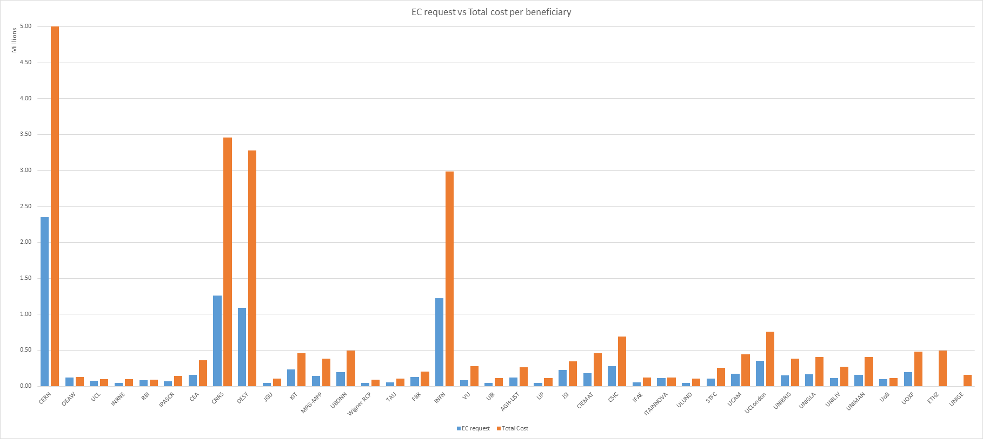
Budget sharing (I)
Budget sharing is fully defined by Grant Agreement signed by all beneficiaries
Most of the matching funds are man-power.
Total budget : 29.0 M€ (beneficiaries) + 1.2 M€ (Partner organisation)
Total eligible budget for EC : 13 M€
EC grant : 10 M€
Matching funds ratio from 1 (TA) to 3 .5

Slide 21
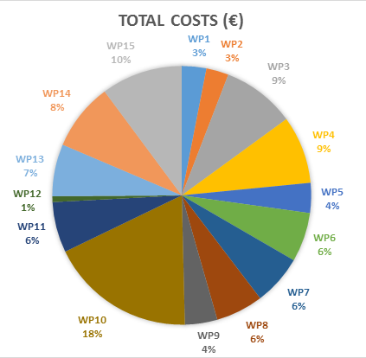
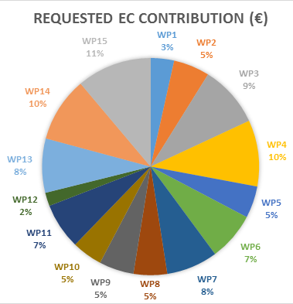
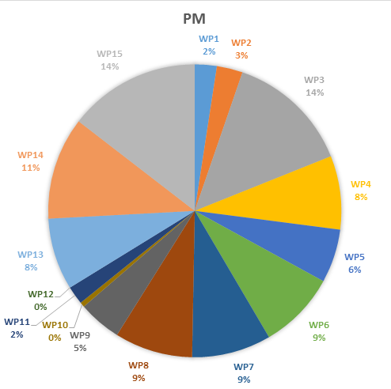
Budget sharing (II)
Large fraction of WP10 (CERN&DESY TA) only due to the access costs are included, while free
14 % of budget in TA, 5 % Innovation & communication and other WP from 5-10 %
Large fraction of matching funds are manpower : up to 2500 PM

Slide 22
EC payments to AIDA-2020
  Max. EC Grant = 10 M€
  Pre-financing = 37.5 %, including 5% withheld for H2020 Guarantee Fund, to be reimbursed at the end
  Effective pre-financing received = 32.5% of the 10 M€ of which 70% will be paid to each participant (pro-rata to project share) a.s.a.p. and the other 30% will be distributed after the end of the first year.
  → Received at CERN. 70 % to be delivered after CA signature : 15-19/06, 22-26/06 or later
  (100 % for beneficiary with less than 100 k€ EC contribution)
  Second EC payment – at (M18+2-3) = reimbursement of costs for the first Reporting Period ~ 37.5% assuming uniform spending profile (18 / 48)
  Third EC payment (limited by 85% of the 10 M€) – at (M36+2-3) ~ 15%
  Final EC payment (10% + 5%) – after the Final Report is approved
5%
32.5%
37.5%
15%
10%
5%
M0
M1
M18
M24
M36
M42
M48
1st Reporting Period
2nd Reporting Period
3rd Reporting Period
03 June 2015
There will a detailed presentation by Svet at the GB meeting

Slide 23
AIDA-2020 steps – reports
Success of AIDA-2020 will rely on few important steps (some being contractual by GA or CA ) :
Interim Resource utilisation at M12, M18, M36 and M48
Periodic reporting : scientific (all) and resource utilisation for beneficiaries at P1 (M18),
P2 (M36) and P3 (M48). Reimbursement of cost by EC only under validation of periodic
report. To be delivered at Px + 2 months
→ Any delay or mistake in resource declaration of one beneficiary impact ALL beneficiaries
Final Report : Last 15 % of EC grant delivered under validation of final report
In AIDA, even it was quite tough, always succeed to deliver Periodic/Final report in time or
with minor delays (a few days) negotiated with EC officer. Project ended 31/01/15, final
payment received in May.
→ SHOULD BE SIMILAR IN AIDA-2020

Slide 24
AIDA 2020 steps-deliverables
Success of AIDA-2020 will rely on few important steps (some being contractual by GA external
or CA internal ) :
Deliverables : produced “objects” if any + written report
Responsibility of the Lead beneficiary of the deliverable as defined in GA
Has to be approved last day of contractual month by Steering Group
Small delays (< 3 months) can be managed internally by Coordination,
longer delays will need justification with respect to EC.
Producing the deliverable reports in time is essential for the success of the project.
Would like to improve the process / AIDA.
80 deliverables
No deliverable in Y1
First peak before
Mid-term review

Slide 25
AIDA 2020 steps - milestones
Success of AIDA-2020 will rely on few important steps (some being contractual by GA external
or CA internal ) :
Milestones : There are defined in the GA but not contractual as the deliverables yes/no
but not achieving the milestones would be the sign of a bad project…
Responsibility of the lead beneficiary
Short (1-2 page) document requested by management and delay justification
if exceeds 3 months
100 milestones

Slide 26
AIDA 2020 steps :
Please :
- use the AIDA-2020 acknowledgement
sentence in publication and conference
proceedings, and AIDA logo on conference
slides
Send us or upload them on AIDA-2020
repository system (in discussion with CERN
If CDS used or new system for EC project)
Expect 2-3 academic-industry and 2-3
detector workshop intra-communities
during Annual Meeting
WP2
Let’s us know when students are working in
AIDA-2020 even if only part time.
Upload PhD thesis document if contains
fair fraction of work in AIDA-2020

Slide 27
AIDA 2020 mailing list / web
AIDA-2020 web page http://aida2020.web.cern.ch/ or
http://cern.ch/aida2020
It contains link to Indico, repository document system
Member registration : Please do subscribe of the email lists

Slide 28
Conclusion
AIDA-2020 is started since May 1st !
The success of AIDA paves the way to AIDA-2020 project which should continue on the same
way
Success will be based on the deliverable reports (quality of scientific activity) and periodic
reports (scientific and resource utilization ) submitted to the EC
Can be achieved by the commitments and cooperation of ALL the AIDA-2020 participants
Reminder : Cocktail-Diner at R1 Thursday from 19h00
Friday plenary starts at 8h30 !

