Slide 1
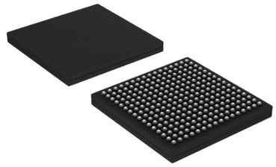

GBT-SCA
The Slow Control Adapter for the GBT system
Alessandro Caratelli, Kostas Kloukinas, Cristian Paillard, Sandro Bonacini,
Alessandro Marchioro, Rui De Oliveira, Paulo Moreira
CERN PH-ESE/ME
alessandro.caratelli@cern.ch
GBT - SCA

Slide 2
Outline:
What the GBT-SCA is
Interfaces and communication
Prototypes testing status and results
Practical information

Slide 3
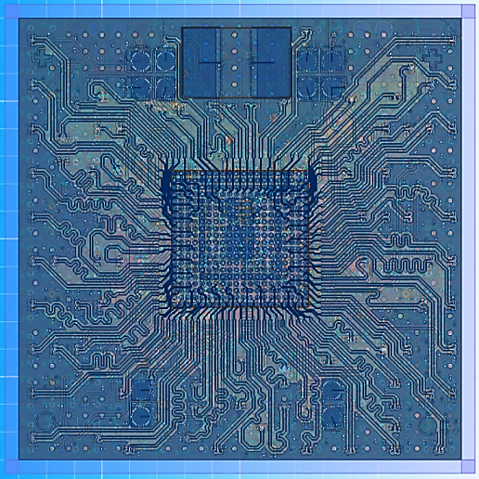
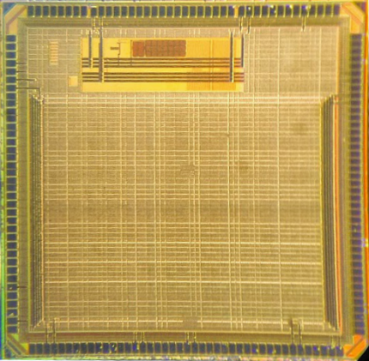
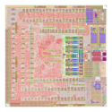
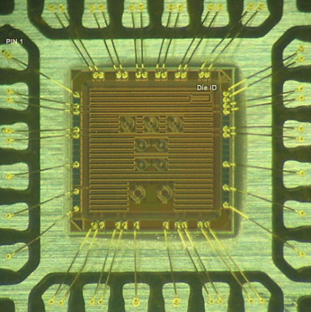
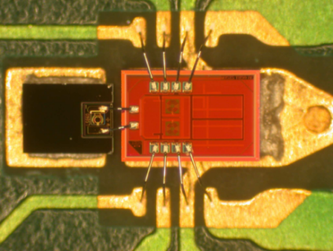
The GBT Chipset
  GBTX:
    4.8 Gb/s Transceiver
    Manages the communications between the counting room and the frontend modules
  GBT–SCA
    Slow Control Adapter
    Experiment control and environment monitoring
  GBTIA:
    4.8 Gb/s Transimpedance Amplifier
    Amplifies the weak photo-current detected by the PIN diode
  GBLD:
    4.8 Gb/s Laser Driver
    Modulates laser current to achieve electro-optical conversion
GBTX
GBT-SCA
GBTIA
GBLD

Slide 4
The SCA in the GBT system
FE ASICs
Data
Timing
GBT on
FPGA
E-port
GBTX
Slow Control
E-port
GBTTIA
E-port
E-port
DAQ
GBTLD
E-port
Timing and Trigger
E-port
E-port
E-port
User busses and I/O for Control and monitoring
E-port
GBT-SCA
Embedded electronics in the detector
Control room

Slide 5
Communication
Successfully tested
SCA ASIC can connect via an e-link to any e-port of the GBTX
40MHz double date rate (80 Mbps)
Point-to-point network topology with fixed bandwidth allocated by the GBTX
Double redundancy scheme allowing connection from two GBTX links.
  Switching between masters requires a “CONNECT” command defined in the high-level communication protocol
SCA
GBTX
SCA
SCA
GBTX

Slide 6
Communication protocol scheme
8
bits
8
bits
8
bits
16
x
N bits
16
bits
8
bits
SOF
Address
Control
Data
FCS
EOF
HDLC
frame
Dow
ID
CH
LEN
CMD
DATA
n
-
link SCA frame
:
Up
ID
CH
LEN
ERR
DATA
-
link SCA frame
:
8
bits
8
bits
8
bits
8
bits
0 bits / 16 bits / 32 bits
The e-link ports implement a packet oriented full duplex transmission
based on the HDLC standard (ISO/IEC 13239:2002)
  Not deterministic!
Bits within the frame are transmitted from the least significant to the most significant
The frame delimiter is composed of six ‘1s’.
The protocol assures that this combination is not found anywhere by stuffing a ‘0’ in any sequence of five consecutive ‘1’

Slide 7
Communication protocol scheme
8
bits
8
bits
8
bits
16
x
N bits
16
bits
8
bits
SOF
Address
Control
Data
FCS
EOF
HDLC
frame
Dow
ID
CH
LEN
CMD
DATA
n
-
link SCA frame
:
Up
ID
CH
LEN
ERR
DATA
-
link SCA frame
:
8
bits
8
bits
8
bits
8
bits
0 bits / 16 bits / 32 bits
The CONTROL field contains the frame sequence number of the currently transmitted frame and of the last correctly received frame to implement an acknowledgement handshake between the SCA and the control room electronics.
The CONTROL field is also used to convey three supervisory level commands.
  CONNECT To select the active interface between primary and auxiliary e-port
  RESET To remotely reset the SCA chip
  TEST Loopback mode for communication verification

Slide 8
Communication protocol scheme
8
bits
8
bits
8
bits
16
x
N bits
16
bits
8
bits
SOF
Address
Control
Data
FCS
EOF
HDLC
frame
Dow
ID
CH
LEN
CMD
DATA
n
-
link SCA frame
:
Up
ID
CH
LEN
ERR
DATA
-
link SCA frame
:
8
bits
8
bits
8
bits
8
bits
0 bits / 16 bits / 32 bits
The Frame Check Sequence (FCS field) is calculated over the address, control and information fields using a CCITT standard 16-bit CRC.

Slide 9
Communication protocol scheme
8
bits
8
bits
8
bits
16
x
N bits
16
bits
8
bits
SOF
Address
Control
Data
FCS
EOF
HDLC
frame
Dow
ID
CH
LEN
CMD
DATA
n
-
link SCA frame
:
Up
ID
CH
LEN
ERR
DATA
-
link SCA frame
:
8
bits
8
bits
8
bits
8
bits
0 bits / 16 bits / 32 bits
Command oriented protocol to address the on-chip interface channels
Bits within the field are transmitted from the least to the most significant bit
  ID: Transaction identifier to associate ‘request’ packets to the corresponding ‘replies’
  ID 0x00 and 0xff are reserved for spontaneously generated interrupt packets
  CH: Define the destination channel interface in the SCA
  CMD: indicates the operation to be performed
  ERR: Indicate eventual error conditions encountered in the execution
  DATA: Is a command dependent field whose length is defined by the LEN qualifier field

Slide 10
The GBT-SCA architecture
I2C master
X 16
E-PORT
I2C master
X 16
CLK
CLK
SDA x16
I2C master
X 16
RX FIFO
RX
SCL x16
I2C master x16
RX
TX
SERDES
SLVS
Cm: +0.2V
Dif: ±0.2V
TX FIFO
TX
SCLK
SPI master
Config
MISO
MOSI
SS x8
AUX_E-PORT
TCK
JTAG master
TDI
CLK
Network controller
TDO
CLK
RX
TMS
RX FIFO
TX
RES
RX
SERDES
SLVS
Cm: +0.2V
Dif: ±0.2V
General purpose I/O
Interrupt inputs
TX FIFO
GPIO
x32
TX
Config
Analog IN
x31
ADC
Aux serial port
Interface
Serial interface
SDA
SCL
sync
Calibration
Clock ctrl
Temperature sens.
E-FUSEs bank
Arbiter
DAC
SEU counter
Analog OUT
x4
DAC
Interface
DAC
DAC x4

Slide 11

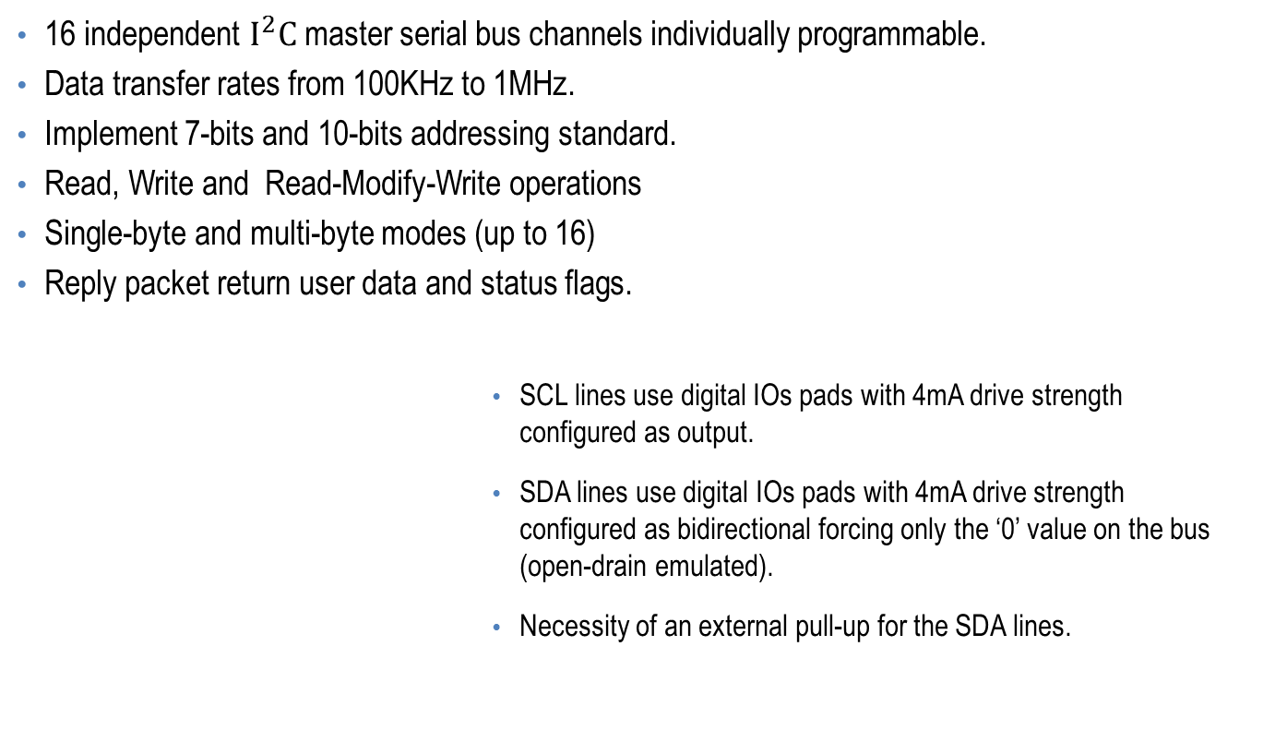
$I^{2}C$ master
Successfully tested
16 independent $I^{2}C$ master serial bus channels individually programmable.
Data transfer rates from 100KHz to 1MHz.
Implement 7-bits and 10-bits addressing standard.
Read, Write and Read-Modify-Write operations
Single-byte and multi-byte modes (up to 16)
Reply packet return user data and status flags.
SCL lines use digital IOs pads with 4mA drive strength
configured as output.
SDA lines use digital IOs pads with 4mA drive strength
configured as bidirectional forcing only the ‘0’ value on the bus (open-drain emulated).
Necessity of an external pull-up for the SDA lines.

Slide 12

Example of $I^{2}C$ operation
Supposing that you want to execute
I2C single byte write operation , using the I2C master number 4, in 7bit addressing mode,
The sent packet will be:
And you will receive at the end of the operation:
01111110
Address
Control
Data
FCS
011111110
HDLC
frame
Tr. ID | CH | LEN | CMD | DATA<1> | DATA<0>
N | 7 | 2 | I2C_WRITE | I2C address | DATA BYTE
Tr. ID | CH | LEN | ERR | DATA<1> | DATA<0>
N | 7 | 2 | 0 | Status (ACK) | -

Slide 13
JTAG master Interface
Successfully tested
Configurable bus transactions length up to 128-bit.
Longer transactions are possible by segmenting on consecutive channel commands.
Asynchronous reset line of configurable pulse width
Bus frequency spans from 156KHz up to 20MHz in 128 user programmable steps.
JTAG Tap controller state machine need to be implemented in the FPGA circuitry in the control room electronics.
Use standard IBM 130 digital IOs library pads with 12mA drive strength.

Slide 14
SPI serial bus master Interface
Successfully tested
Full duplex synchronous serial bus with configurable bus transactions up to 128-bit long.
Longer transactions are possible by segmenting on consecutive channel commands.
Supports all the standard SPI bus operating modes: 00, 01, 10 and 11.
8 individual slave select lines.
Bus frequency spans from 156KHz up to 20MHz in 128 user programmable steps.
Use standard IBM 130 digital IOs library pads with 12mA drive strength.

Slide 15
Parallel Interface Adapter
Successfully tested
32 General Purpose digital IO lines.
Each line can be individually programmed as input or outpu.
Input signals are sampled and registered at the raising or falling edges of the system clock or of an external strobe signal from the user’s application connected on a dedicated input line.
Any line configured as input can generate an interrupt request to the control room electronics.
Use standard IBM 130 digital IOs library pads with 4mA drive strength.

Slide 16
ADC
PRELIMINARY Test results
31 input analog multiplexer connected to a 12-bit analog to digital converter.
One analog input internally connected to the embedded temperature sensor.
All inputs feature a switchable 100uA current source to facilitate the use of externally connected resistance temperature sensors (RTD).
Time of conversion: 760uS (compatible with the conversion requirements of slow varying parameters like detector leakage current and temperature, power supply voltages etc.)
Analog input range: 0.0 V to 1.0 V
Implements internal Gain correction and Offset cancellation.
The gain calibration coefficient is evaluated during the testing phase for every chip and stored on the on-chip e-fuse bank.
The stored coefficient can be overridden to compensate for any possible drifts caused by the radiation environment.

Slide 17
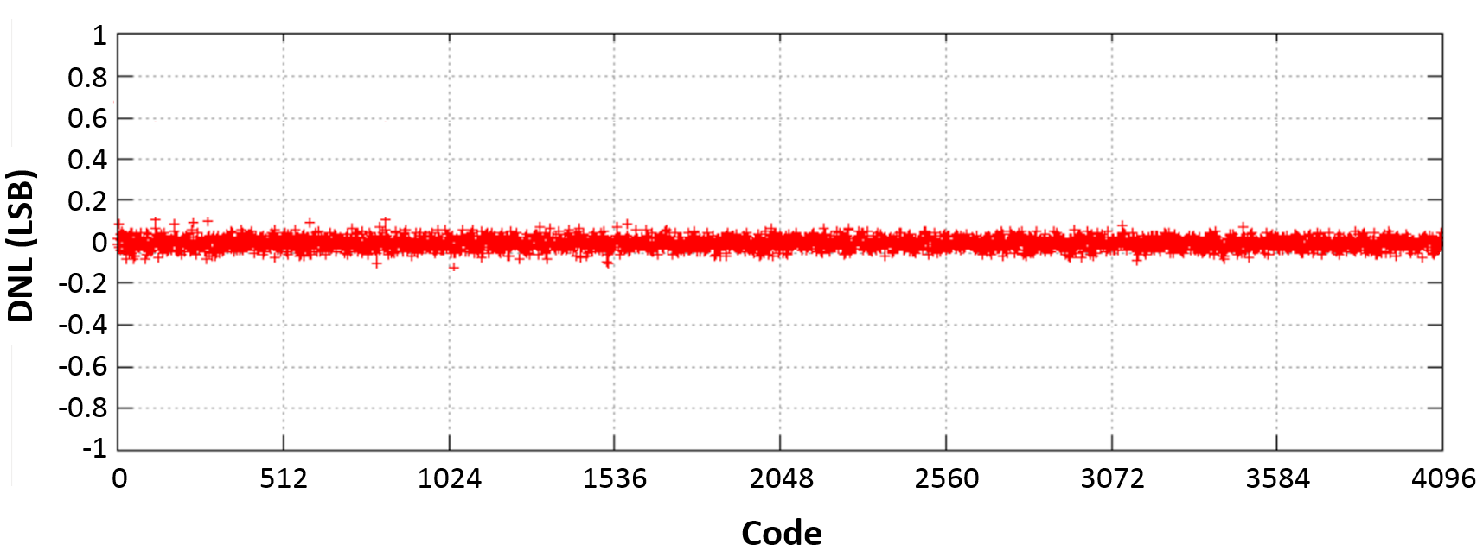
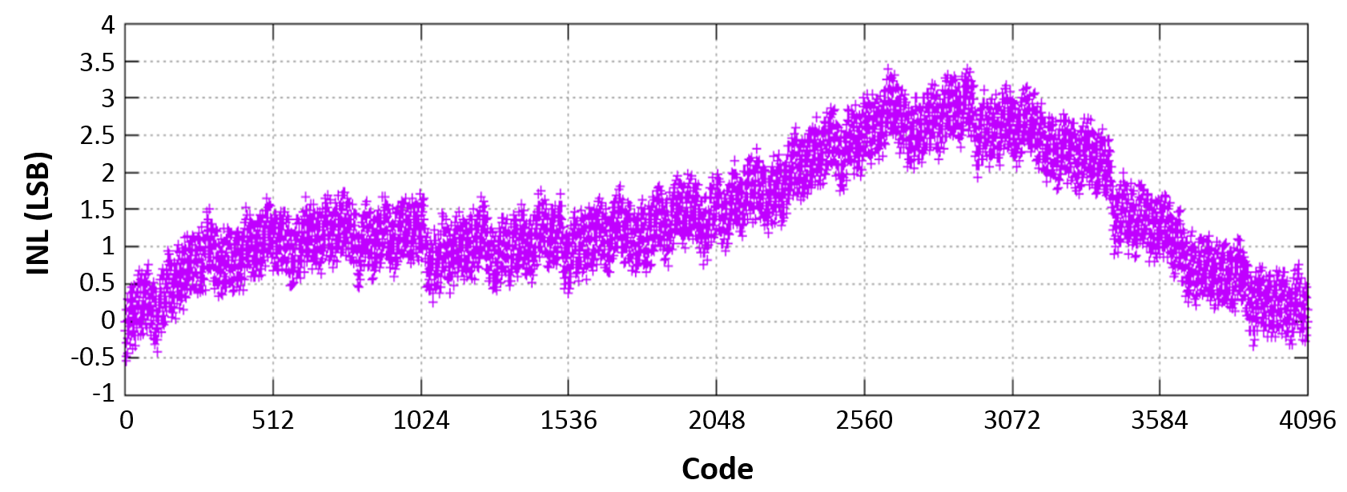
ADC
PRELIMINARY Test results

Slide 18
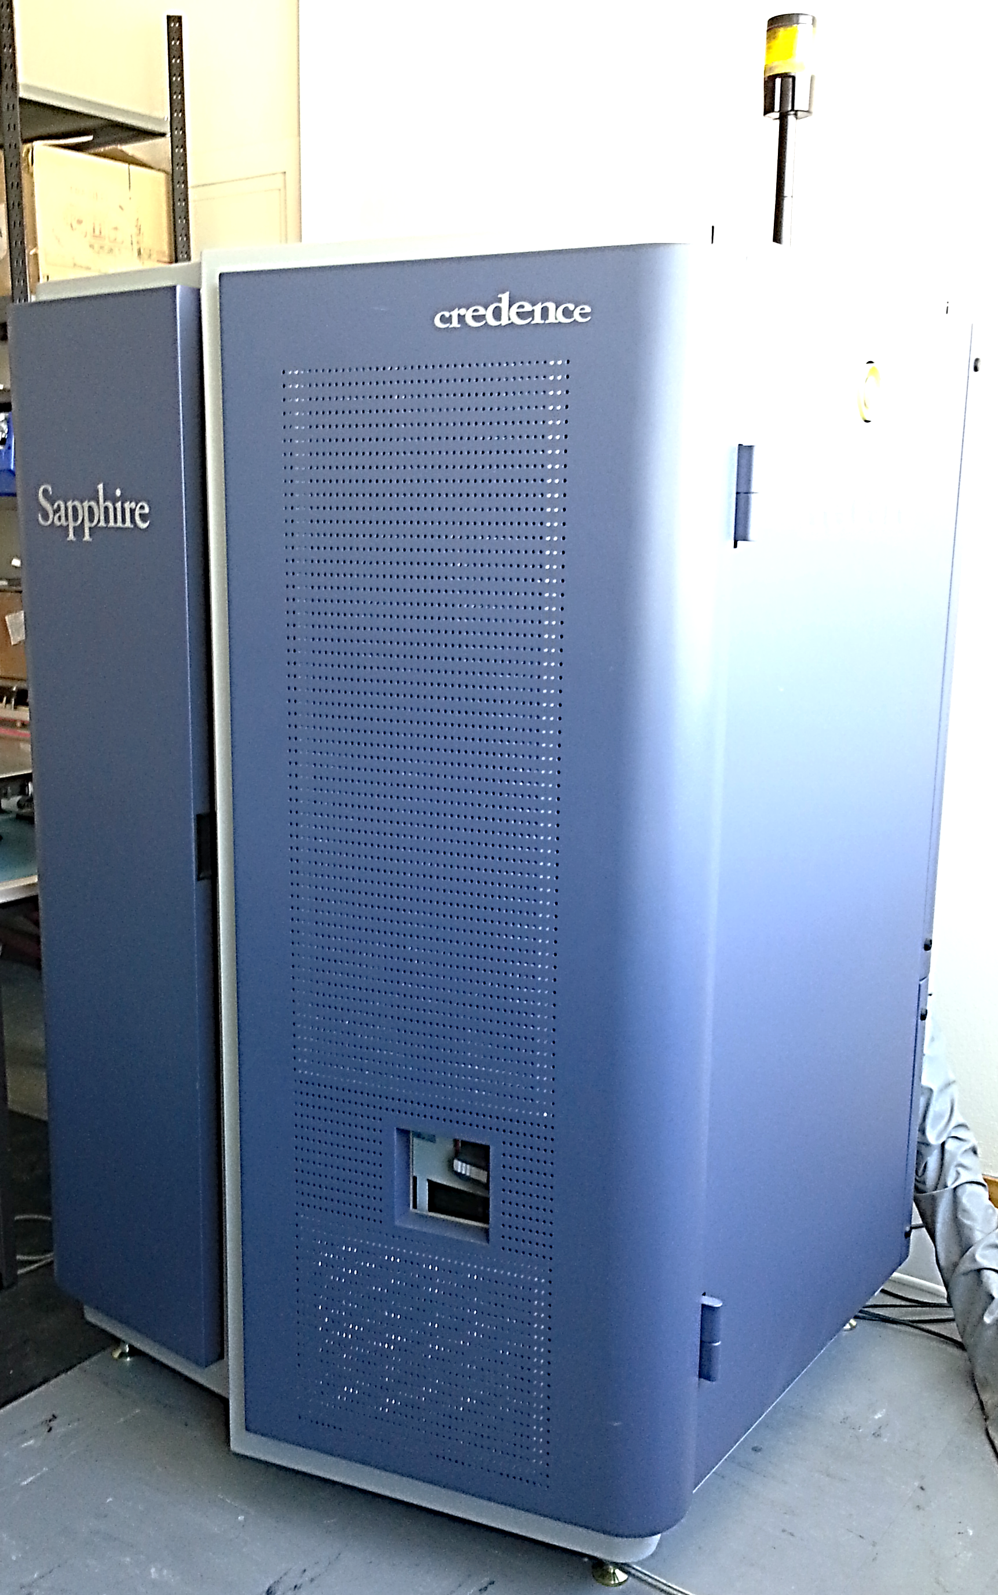
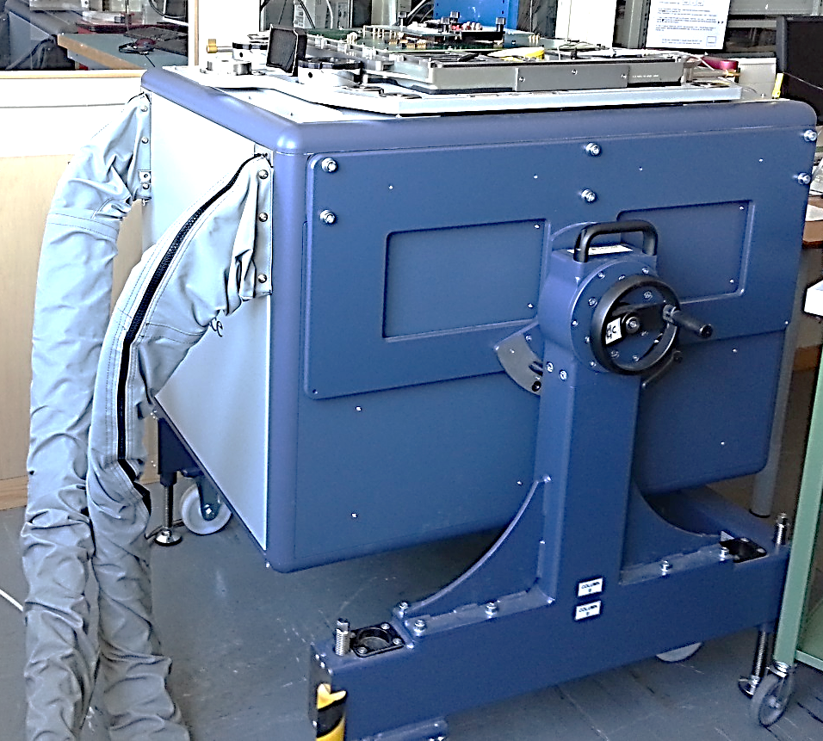
Prototype test bench
For precise ADC and DAC characterization.
For the final production testing

Slide 19
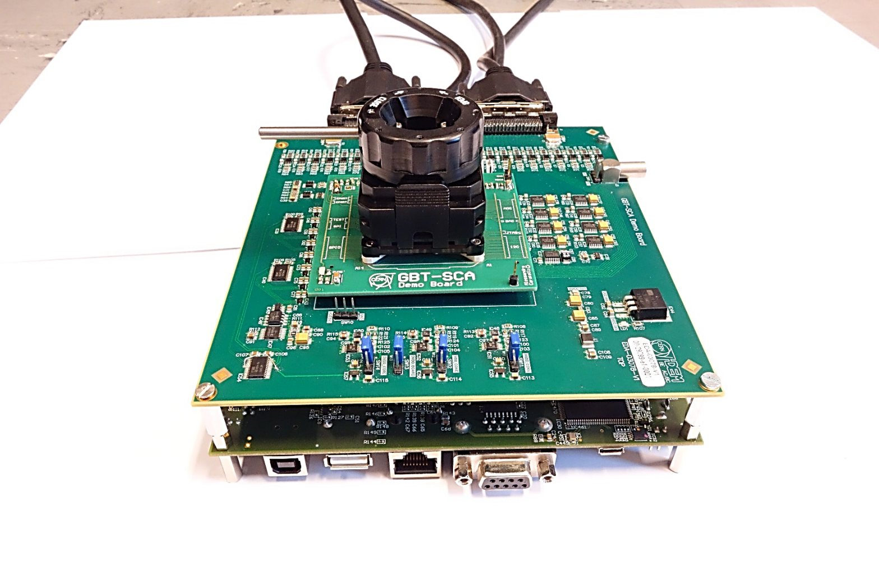
Stand-alone test-bench
For functional verification (on bare-die)
Irradiation performance testing (on bare-die and packaged parts)

Slide 20
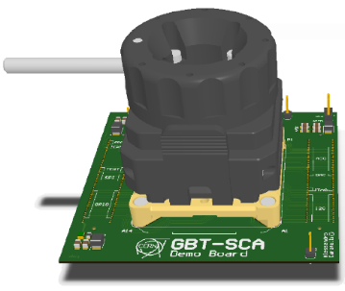
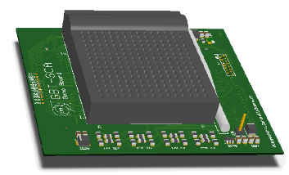
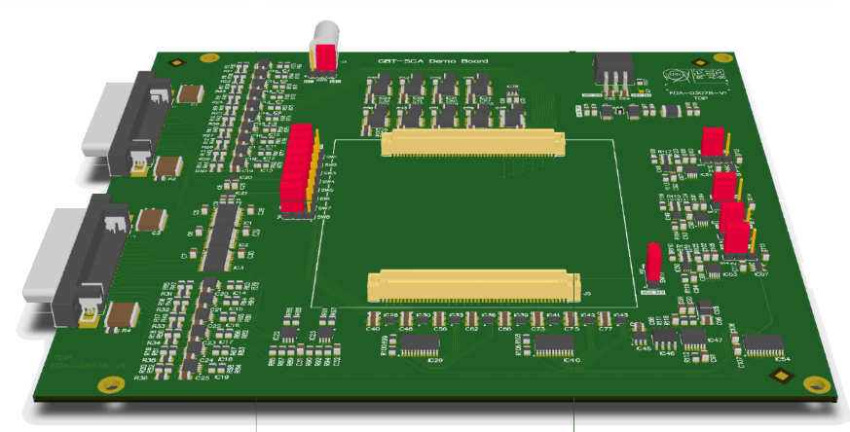

Stand-alone test-bench
Software
Test routines (python)
Interface (python and C++)
  SCA access classes
  PCB control classes
  Slave interfaces classes
Firmware
GBT-SCA communication handle
  Tx and Rx FIFOs
  HDLC encoding
Slave interfaces
PCB components control
Test Boards
Interface board
  Level translators
  Voltage regulators
  etc..
Load boards
  ADCs/DACs
  Current monitors
BGA Socket
CPGA ZIF socket
XILINX
Developement
card
FPGA

Slide 21
Radiation Performances
Radiation tests will take place on the 20 April
To address the TID requirements:
  The SCA is implemented in a commercial 130 nm CMOS technology largely characterized for radiation tolerance
To address the SEUs requirements :
  The SCA adopt the Triple Modular Redundancy technique at the state machine level in the entire digital circuitry
  The clock tree was also triplicated to mitigate the effects of SET.
  The SCA SEUs robustness has been strongly verified at simulation level
SEUs tests will take place on the April, 20th in Louvain-la-Neuve

Slide 22
Electrical characteristics
Standard Supplies by design:
The GBT-SCA digital functions
have been successfully tested at 1.2V supply
ADC instead needs 1.5 V supply to correctly work
Digital supply voltage: 1.5 V
Analog supply voltage: 1.5 V
Periphery supply voltage: 1.5 V

Slide 23
Packaging
Successfully tested
Package: Low Profile Fine Pitch BGA
(Chip Scale Package)
Ball Pitch: 0.8 mm
Size: 12 x 12 mm
Height: 1.7 mm
Pin count: 196

Slide 24
Others information
1st Prototype submitted for fabrication in July 2014
  Part of the “GBT-chipset” MPW run
  Received 2 wafers (~ 520 dies) in middle of November
    250 bare die chips
    208 BGA packaged chips (possibility to package 260 additional dies)
    Distribute sample parts to system developers

Slide 25
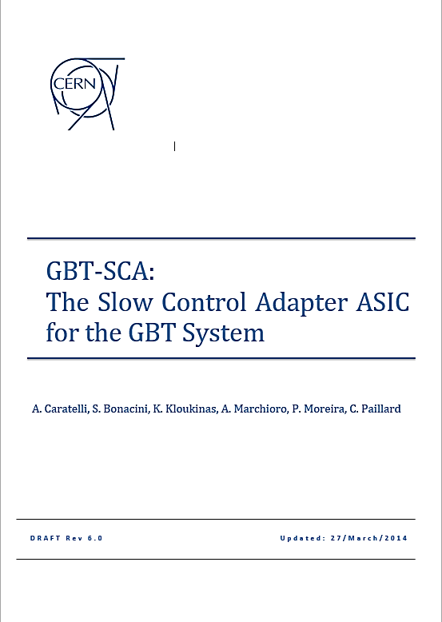
User manual
  Available on GBT sharepoint site:
  https://espace.cern.ch/GBT-Project/GBT-SCA/Manuals/Forms/AllItems.aspx
  Latest version: GBT-SCA_Manual_Rev7.0
Rev 7.0

Slide 26
GBT-SCA
The Slow Control Adapter for the GBT system
For additional information do not hesitate to contact me at: alessandro.caratelli@cern.ch

