Slide 1
Detector Cabling and Patching
Rainer Schwemmer 9.4.2015

Slide 2
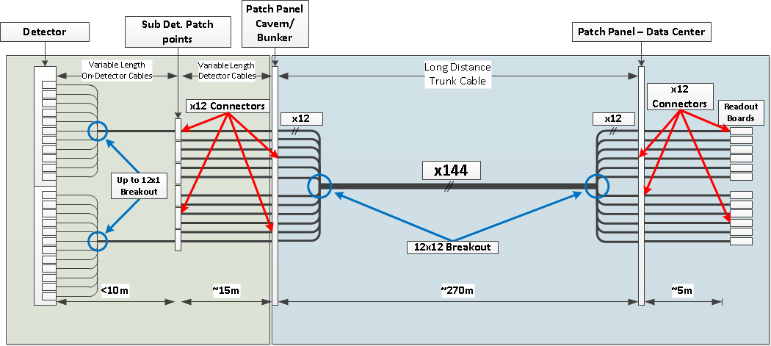
Break Points
Originally assumed 1 break point in optical budget calculation between detector and Patch Panel in Cavern
No additional breaks foreseen on read-out board side
Is this assumption still correct?
If not, what is the proper number?
2

Slide 3
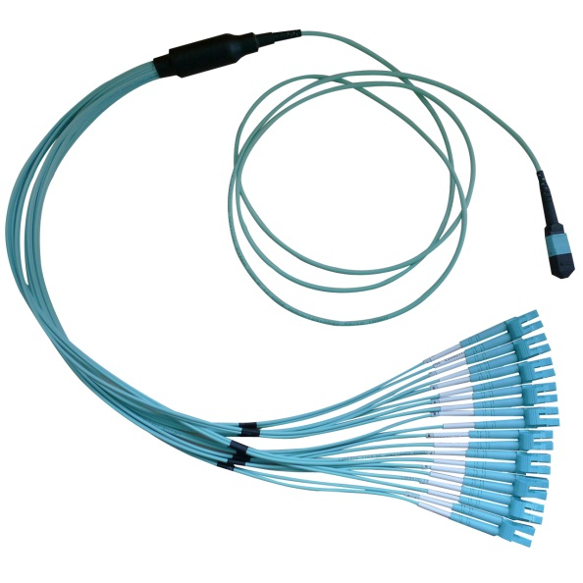
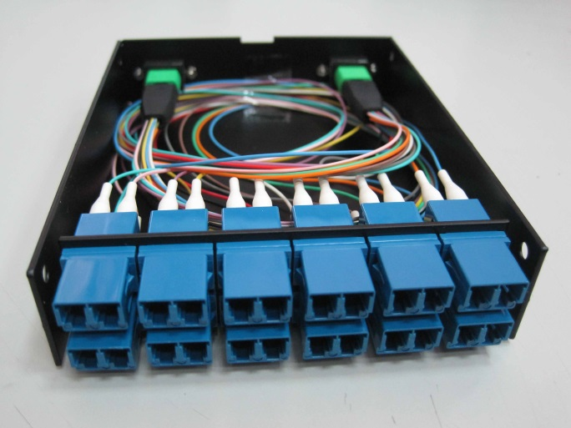
On Detector Cabling
Two options for LC → MPO conversion
Break-out cable
  +1 break point
  Direct connection to Cavern patch panel or additional MPO patch
  Special requests like staggered lengths for the individual strands are usually not a problem
LC → MPO cassette
  +2 break points !
  Use LC patch cords to go from FE to cassette
  MPO patch from cassette to Cavern patch panel
  The additional break point increases the risk of Bit Errors on the link → suggest to use if only absolutely necessary
Spares
  What kind of contingencies do you plan on your sub detector?
  How are they going to be connected?
3

Slide 4
Purchasing
CERN is currently negotiating a new frame contract for buying optical cables
We have currently the possibility of suggesting specs for fibers that can be bought within this contract
  Can use this to include your on-detector cable specs
The CERN frame contract can be used as a baseline for now
  Allows to see what is technically possible
  Allows to get an estimate for prices
4

