Slide 1


Optical links for
VELO upgrade.
LHCb electronics upgrade meeting.
J. Buytaert.
9 April 2015

Slide 2
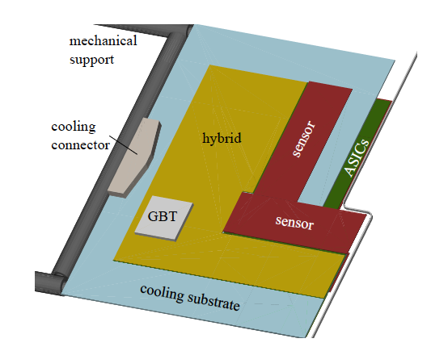
Data 20 optical links
TFC/ECS: 6 optical links
52 modules
Total number of optical links for data :1040
  Use of GWT instead of GBT protocol:
    Link speed = 5.12 Gbps
    Word length = 128 bit
    Fixed header (8 bit) , fixed length (120bit) data format
Total number of links for TFC/ECS : 312

Slide 3
Data Optical cabling.
    Needed : 1040 links.
    Installed : 9 ‘trunk cables’, i.e. 9x144 = 1296.
      Straight forward partitioning:
        2 x MPO (=24 fibres) per module.
        2 x MPO (=24 fibres) per Tell40.
        4 fibres spares .
    Spares: 17%.

Slide 4
UX85 caverne
PM85 pit
Surface
1
2
3
4
5
6
7
8
9
10
11
12
13
14
15
16
17
18
19
20
LC
5-10m
MPO-MPO Adaptors Path Panel
MPO-MPO Adaptors Path Panel
MPO-MPO Adaptors Path Panel
1-3m
MPO 1
MPO
5-10m
12f
MPO
10 used
12f
MPO
MPO 1
330-350m
PCIe
2 MPO Input
Module 1
2 Spares
MPO 2
12f
MPO
10 used
12f
MPO
MPO 2
Ex:48f?
for Module 1
144f
2 Spares
Trunk 1
MPO-MPO Adaptors Path Panel
1
2
3
4
5
6
7
8
9
10
11
12
13
14
15
16
17
18
19
20
LC
MPO 3
MPO
12f
MPO
11 used
5-10m
PCIe
2 MPO Input
12f
MPO 3
Module21
MPO 4
11 used
12f
MPO
2 Spares
for Module 2
12f
MPO 4
“Option 2” for DATA.
From Laurent Roy.
…
…
for Module 3
2 Spares
…
…
MPO 12

Slide 5
TFC/ECS Optical cabling.
ECS & TFC.
  Standard GBT serial format @ 4.8Gbps. Bidirectional.
  3 bidirectional GBT links per module:
    1 for each of 2 hybrids
    1 for local OPB control & monitoring
  Full VELO:
    Needed: 3 x 2 x 52 = 312 links
    Installed: 3 trunk cables. (432 links):
      2 cables for VELO only: 2x144=288 links.
      1 cable : VELO uses only 24 links out of 144:
        Remaining 120 links can be used by nearby sub-detector (RICH or UT?).

Slide 6
for TFC
LC Duplex
UX85 caverne
PM85 pit
Surface
1
2
3
1f
MPO-MPO Adaptors Path Panel
5-10m
MPO-MPO Adaptors Path Panel
1-3m
MPO
5-10m
12f
12f
MPO
MPO 1
330-350m
MPO 1
MPO
MPO
SOL40
Module 1
1f
1
2
3
MPO 2
12f
MPO
Module 2
MPO
MPO 2
Ex:48f?
…
144f
1
2
3
Trunk TFC/ECS 1
MPO 3
MPO
MPO
Module 3
MPO
MPO 3
MPO 4
1
2
3
1f
…
Module 4
MPO
MPO 4
…
…
Total 26 Modules / side
MPO 12

