Slide 1
HL-LHC operational scenario: Beam-beam considerations on table parameters
T. Pieloni
J. Barranco, D. Banfi, C. Tambasco
Task 2.4 and 2.7 meeting 25th March 2015

Slide 2
Injection parameters
Separation at Interaction Point
 | IP1 (6m β*) | IP5(6m β*) | IP2(10m β*) | IP8(10m β*)
Total Separation | 23 σ (4 mm) | 23 σ (4 mm) | 18 σ (4 mm) | 18 σ (4 mm)
Flat-top parameters
 | IP1(6m β*) | IP5(6m β*) | IP2(10m β*) | IP8(10m β*)
Total Separation | 33 σ (1.5 mm) | 33 σ (1.5 mm) | 35 σ (4 mm) | 35 σ (4 mm)
Collision parameters full squeeze
 | IP1(0.15m β*) | IP5(0.15m β*) | IP2(10m β*) | IP8(3m β*)
Total Separation | 200 σ (1.5 mm) | 200 σ (1.5 mm) | 120 σ (4 mm) | 70 σ (4 mm)
The head-on interaction is safe in all these configurations!

Slide 3
Injection parameters
Separation at Interaction Point
 | IP1 (6m β*) | IP5(6m β*) | IP2(10m β*) | IP8(10m β*)
Total Separation | 23 σ (4 mm) | 23 σ (4 mm) | 18 σ (4 mm) | 18 σ (4 mm)
Flat-top parameters
 | IP1(6m β*) | IP5(6m β*) | IP2(10m β*) | IP8(10m β*)
Total Separation | 33 σ (1.5 mm) | 33 σ (1.5 mm) | 35 σ (4 mm) | 35 σ (4 mm)
Collision parameters full squeeze
 | IP1(0.70m β*) | IP5(0.70m β*) | IP2(10m β*) | IP8(3m β*)
Total Separation | 97 σ (1.5 mm) | 97 σ (1.5 mm) | 120 σ (4 mm) | 70 σ (4 mm)
The head-on interaction is safe in all these configurations!

Slide 4
Long range 1st encounter
0.45 TeV
7 TeV
 | 6 m β* | 6 m β* | 70cm β* | 40cm β*
Radial Sep@LR | 22 σ (4 mm) | 42 σ (1.5 mm) | 32 σ (1.5 mm) | 25 σ (1.5 mm)
15cm β* | 15cm β*
15 σ (1.5 mm) | 12.5 σ (0 mm)
Beam-Beam only: parallel separation in IP1 and 5 could be reduced for baseline scenario and ultimate to 1 mm total at top energy to have a faster collapse for collision
For Landau damping gives a reduced long range effect so less reduction of stability diagrams 2 mm total can avoid reduction of SD for ultimate scenario. Could this be a solution? We increase from 25→ 28 σ the separation for few encounters…Need to check with SD calculations.

Slide 5
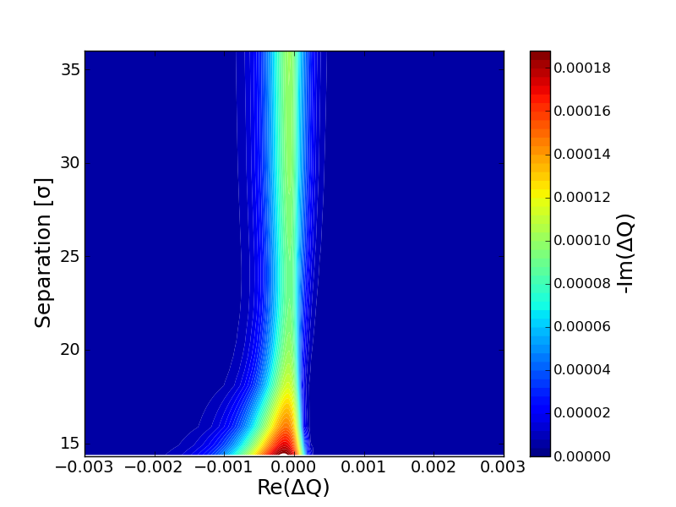
Betatron Squeeze
Evolution of the betatron squeeze with LR beam beam
LR beam-beam in IP1 and IP5
I=2.2e11 ppb ε=2.5 μm
Negative LOF
β*=1.8m
Long range slightly reduce the SD
2mm sep
At 22σ the β in the arcs increases and compensates LR effects
β*=40cm
β*=32cm
The SD keep increasing below β*=32cm
β*=15cm
This could be a solution for the ultimate instead of larger betas in arcs which will reduce DA!
Will then make longer the collapse for collision.
TO be checked!

