Slide 1


Open Actions EN-MEF-SU

Slide 2
Open Actions EN-MEF-SU
Outline:
Investigate issue of radial alignment of main PSB bending magnets (jacks and oil injection) and provide a solution for the future.
Study the fabrication of a new precision tilt measurement tool for the PSB main bending magnets.
Work out a tool to move magnets in the PSB whose screws are currently not accessible.
Report about the possibility to align the BRx.BHZ162 with a precision below 1 mm.

Slide 3
Open Actions EN-MEF-SU
Outline:
Investigate issue of radial alignment of main PSB bending magnets (jacks and oil injection) and provide a solution for the future
Study the fabrication of a new precision tilt measurement tool for the PSB main bending magnets.
Work out a tool to move magnets in the PSB whose screws are currently not accessible
Report about the possibility to align the BRx.BHZ162 with a precision below 1 mm

Slide 4
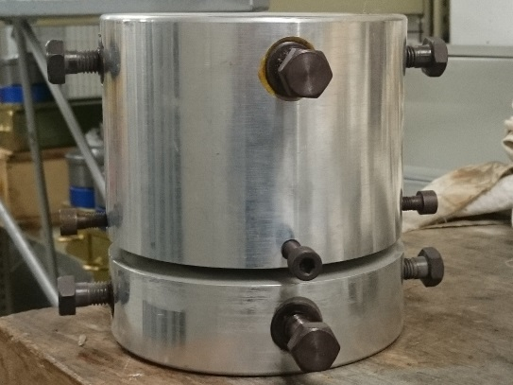
Open Actions EN-MEF-SU
Situation today: vertical movement OK, radial / longitudinal not used since more than 20 years. Furthermore: pumps for oil film injection not anymore available.
Solution could be to adapt existing pumps to the oil injection system (connectors), BUT: uncertainty about leak tightness of the jacks.
Other (better) solution: change jacks.
Found a good jack which could replace the existing ones with minor modification:

Slide 5
Open Actions EN-MEF-SU
Fits with the weight of the magnet (~13T): 2 types of these jacks available (for 6 and 10T)
Fits with the dimensions in width (existing plate underneath the magnets) and height (needs a steel block to «shim» of around 17 X 17 X 17 cm)
Easy to align with small effort
Can be tested in the next YETS, as some are available immediately.
Exchange scenario to be discussed with transport and RP.

Slide 6
Open Actions EN-MEF-SU
Outline:
Investigate issue of radial alignment of main PSB bending magnets (jacks and oil injection) and provide a solution for the future
Study the fabrication of a new precision tilt measurement tool for the PSB main bending magnets.
Work out a tool to move magnets in the PSB whose screws are currently not accessible
Report about the possibility to align the BRx.BHZ162 with a precision below 1 mm

Slide 7
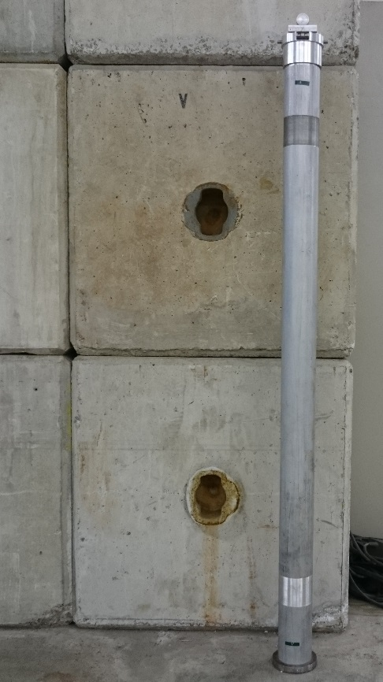
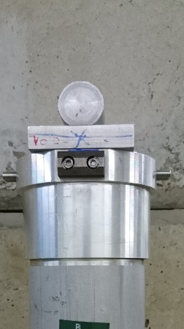
Open Actions EN-MEF-SU
Starting with the existing tool for the main quads,
Needs modification of the length and the parts which have contact with the magnet,
Needs calibration on a precision table
Can probably be manufactured in our workshop.
Drawings need to be made and fabrication launched.
First test possible in YEST 2015/16

Slide 8
Open Actions EN-MEF-SU
Outline:
Investigate issue of radial alignment of main PSB bending magnets (jacks and oil injection) and provide a solution for the future
Study the fabrication of a new precision tilt measurement tool for the PSB main bending magnets.
Work out a tool to move magnets in the PSB whose screws are currently not accessible
Report about the possibility to align the BRx.BHZ162 with a precision below 1 mm

Slide 9
Open Actions EN-MEF-SU
For the time being , no good and simple solution found, as nothing available on the market for this size of nuts (36mm), for example «cliquet-type-demultiplication-keys».
Therefore, the idea is, to have a frame which can be fixed to the magnet which contains a motorized mecanism to turn a very short key (10cm range) with the needed force of ~10-15kg.

Slide 10
Open Actions EN-MEF-SU
Even with such a device: not sure to reach all feet, as we can see:
  Pumps
  Cables
  «passerelle»
  …..

Slide 11
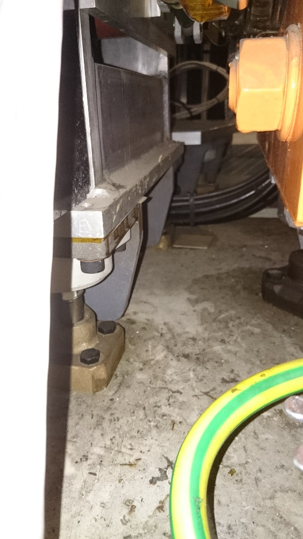
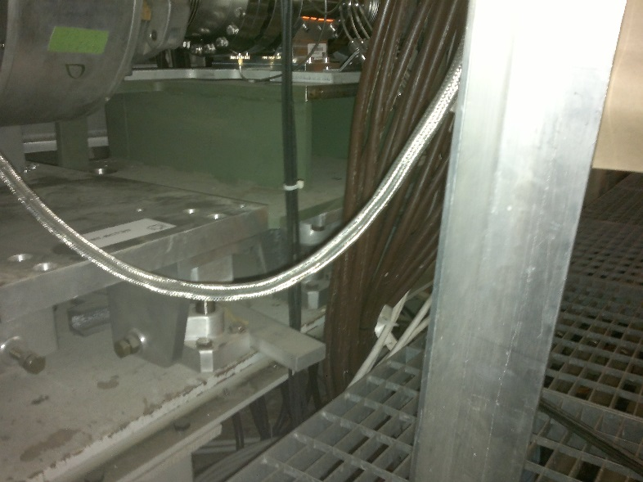
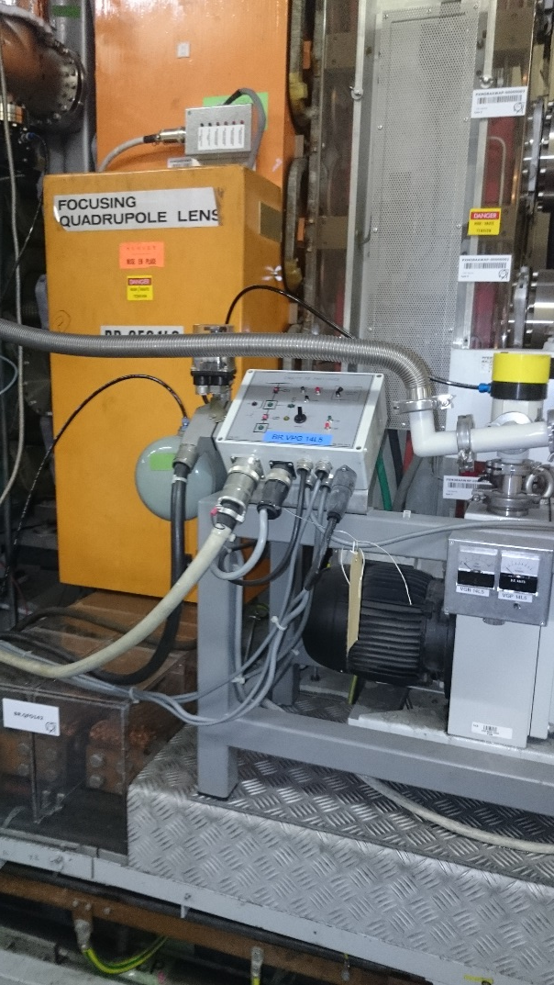
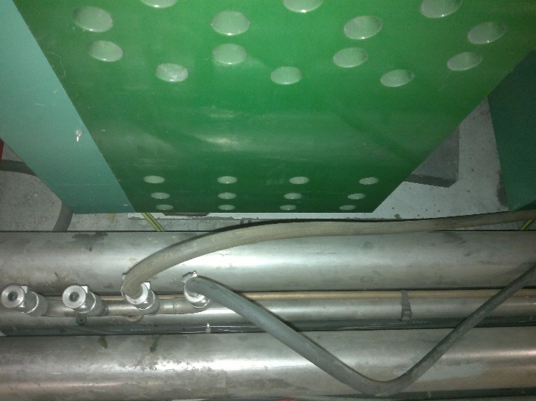
Open Actions EN-MEF-SU

Slide 12
Open Actions EN-MEF-SU
Outline:
Investigate issue of radial alignment of main PSB bending magnets (jacks and oil injection) and provide a solution for the future
Study the fabrication of a new precision tilt measurement tool for the PSB main bending magnets.
Work out a tool to move magnets in the PSB whose screws are currently not accessible
Report about the possibility to align the BRx.BHZ162 with a precision below 1 mm

Slide 13
Open Actions EN-MEF-SU
More precisely: a procedure needs to be found for the alignment of the vacuum chamber (injection).
Meeting held in December with magnet and vacuum people.
Solution:
  to fabricate a plate which can easily be referenced to the magnet references / target points
  To place a plumb line at the edge of these plate (edge is in the direction of the chamber), and thus position / align the chamber accordingly.

Slide 14
