Slide 1
Compact Linear Collider
AKA CLIC

Slide 2

What’s a CLIC?
CLIC is a positron-electron collider that is proposed to be built underneath Geneva in the future.
It will be ~50km long and run at up to 3TeV

Slide 3


Well what good is that?
A positron-electron collider is nice in comparison to a regular proton-proton collider because it’s cleaner.
CLIC
LHC

Slide 4
What do you mean?
Basically when proton’s collide there is a huge nasty shower of all sorts of things.
But when electrons and positrons collide there is relatively few resultant particles.
So we can make more precise measurements.

Slide 5
Staged construction
One of the great things about building a straight collider is that we can use it before it’s done!
The machine is planned to be turned on when it is the length required for ~1 TeV
At this length we will start the measuring of the Higgs Strahlung cross section.

Slide 6
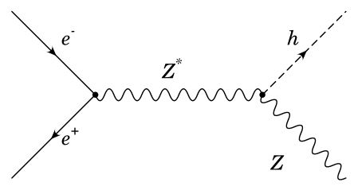
Higgs strahlung
Just means Higgs radiation

Slide 7
Our Project
Basically our goal is to prepare for the upcoming measurements of the Higgs Strahlung at CLIC
Specifically we need to find which beam energy will provide the most precise measurements
We do this by simulating the events at different energies (250 GeV, 350 GeV, 380 GeV, 500 GeV)

Slide 8
What we have done so far
We have determined how to filter out background events from the desired Higgs Strahlung events so now we can measure the precision.

Slide 9
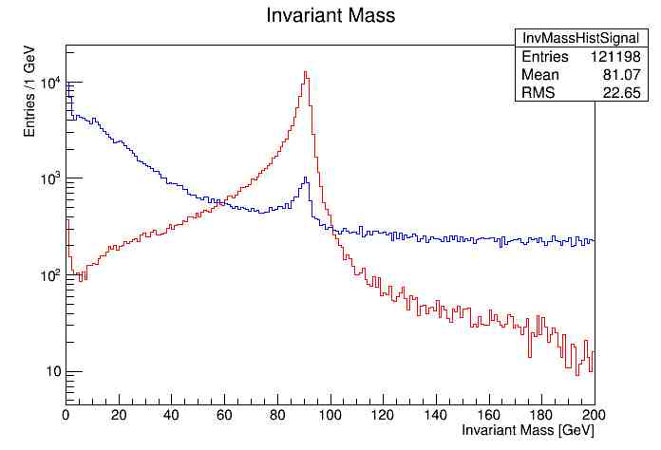
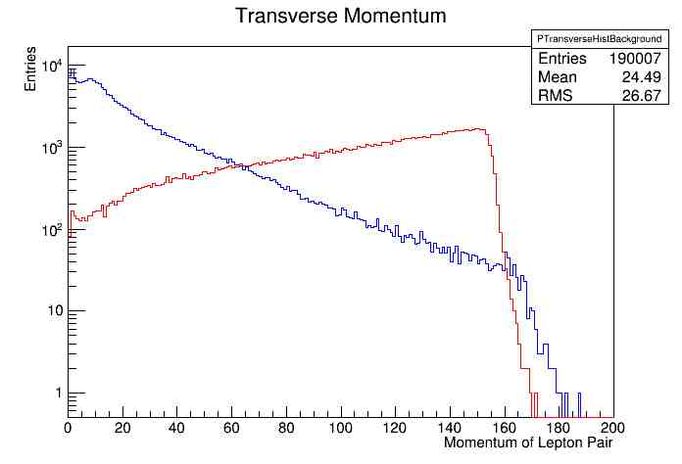
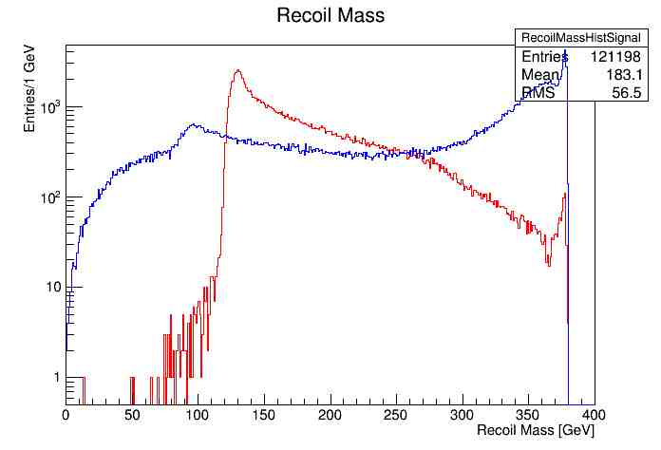
We started by making these plots of generated Higgs events (red) and generated background events (blue)

Slide 10
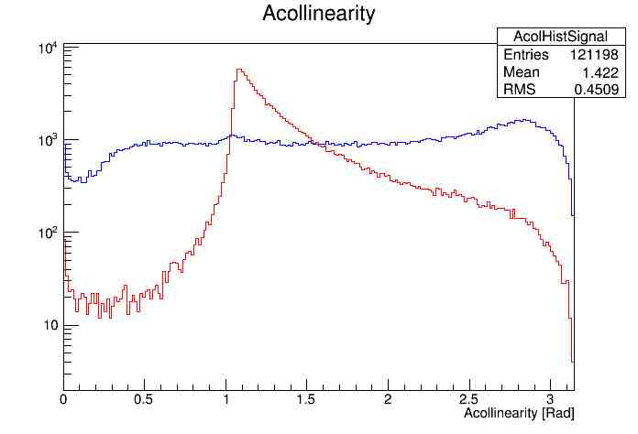
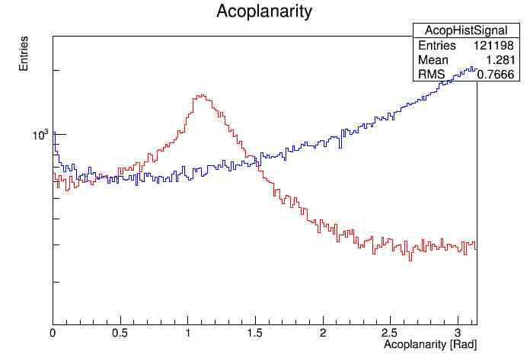
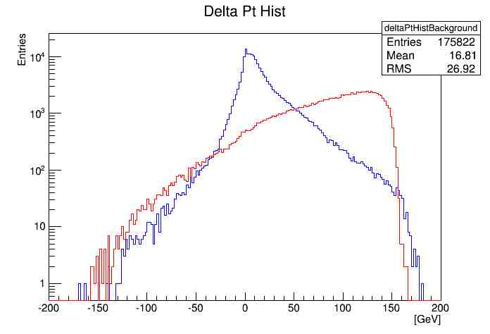
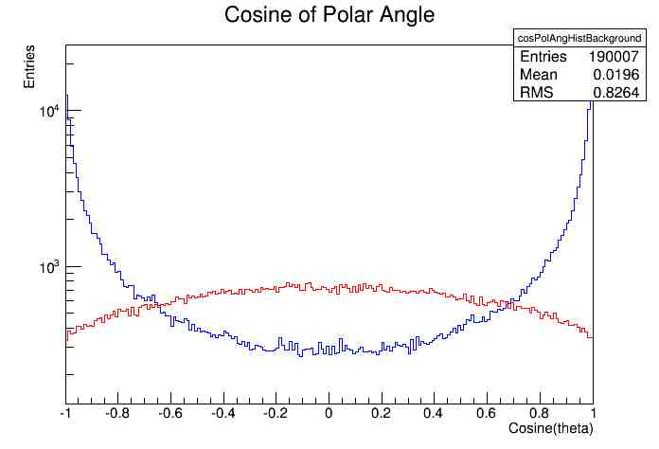
More plots

Slide 11
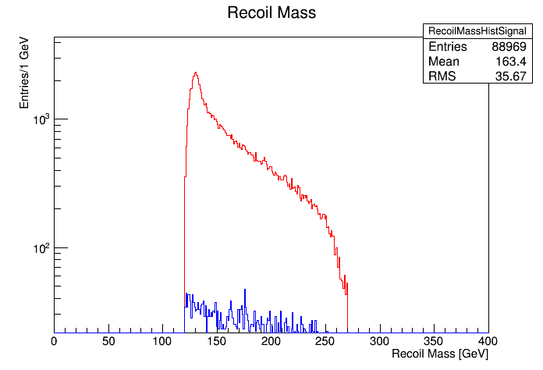
And we were able to use these plot to determine the best way to filter out non-Higgs Strahlung events.
Before cuts
After Cuts

Slide 12
What’s Next?
We will perform some statistical hocus pocus to determine the precision with which we can measure the cross section at this energy

