Slide 1
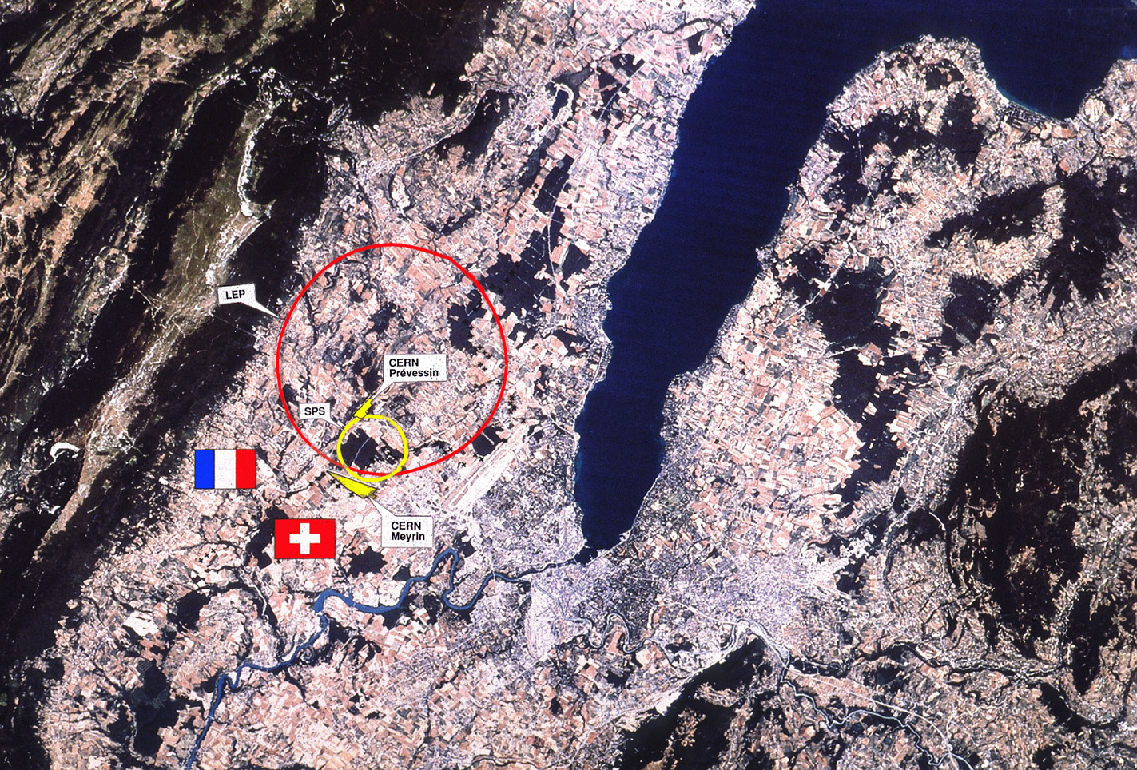
Introduction to accelerators
Django Manglunki
CERN/BE/OP

Slide 2
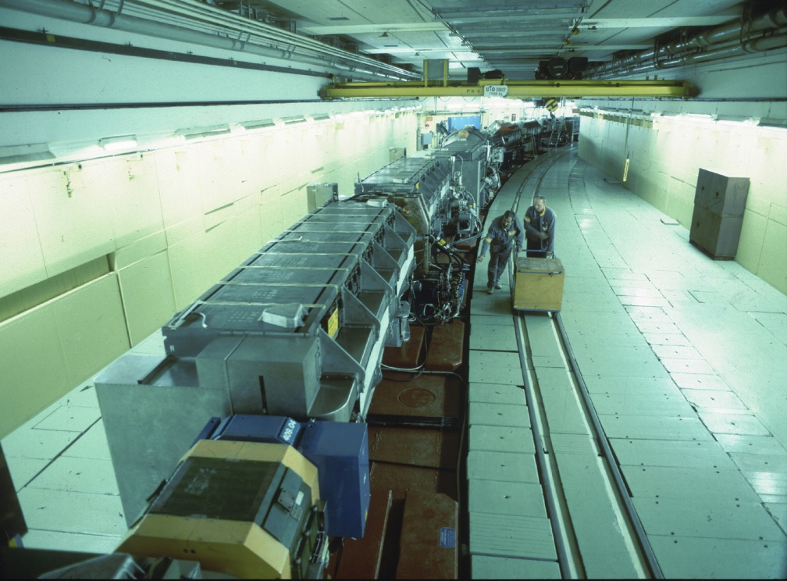
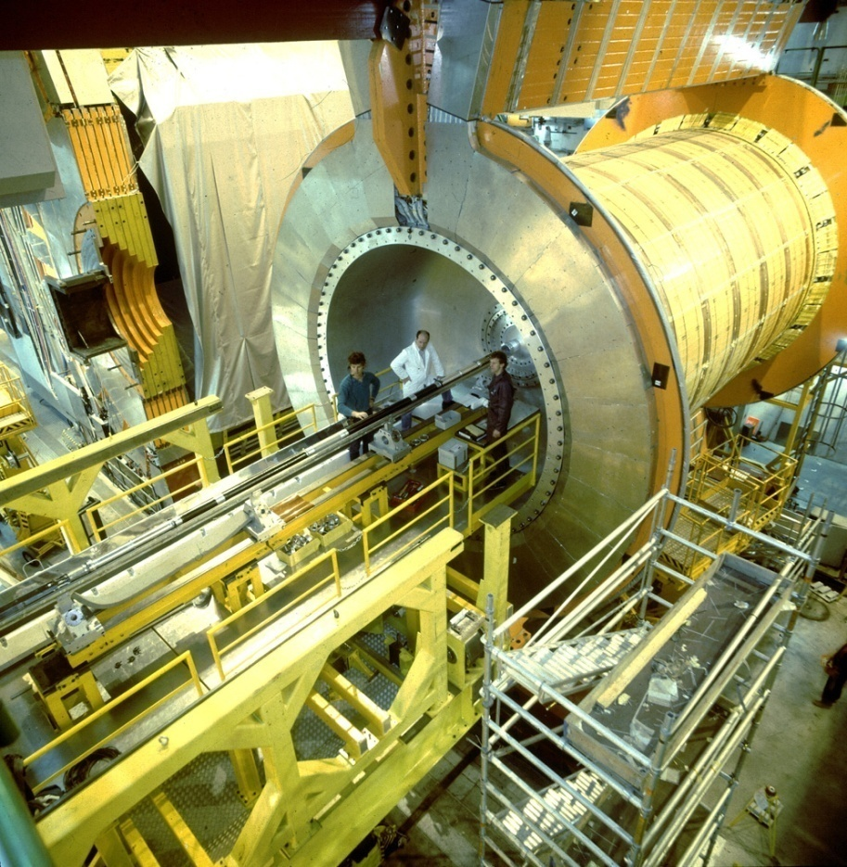
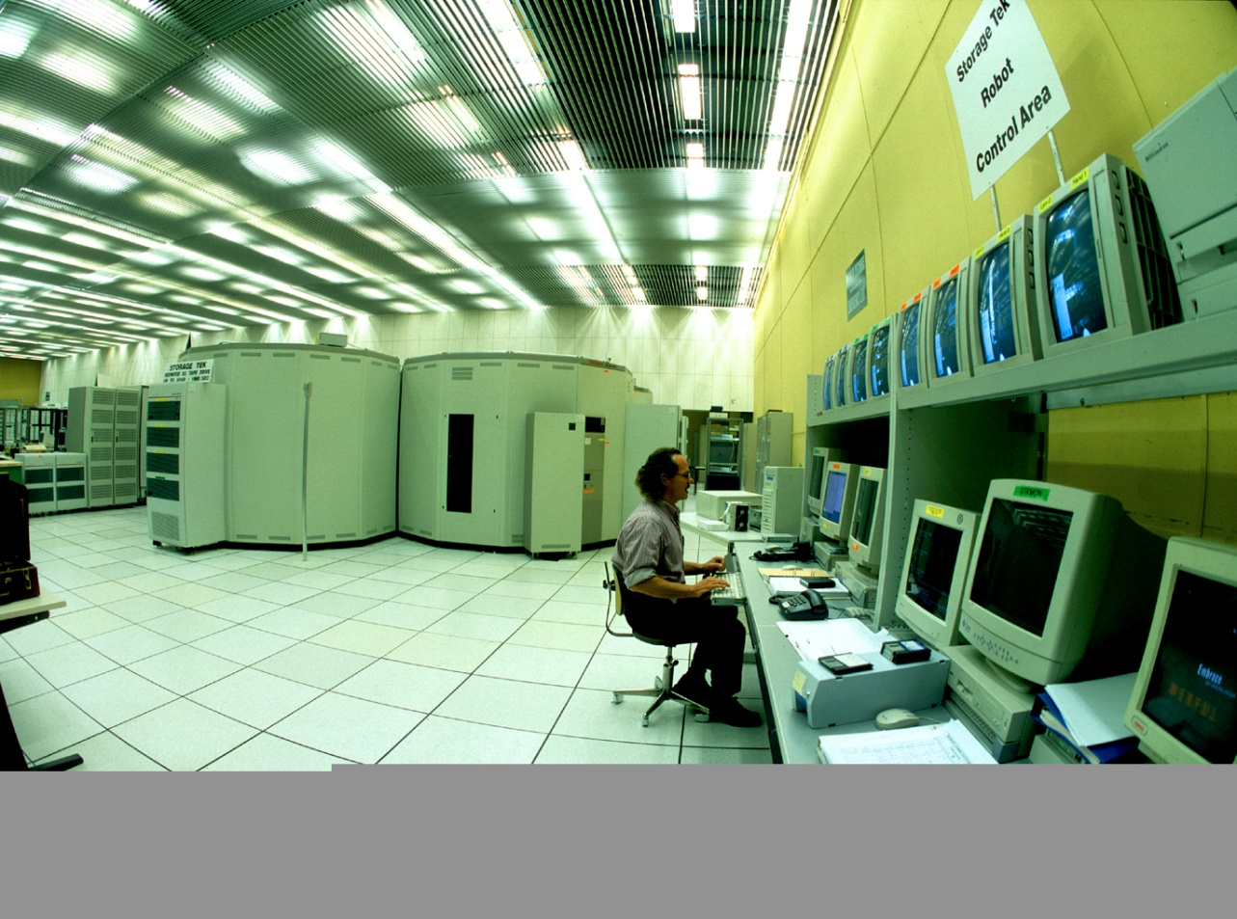
Tools for High Energy Physics
Accelerators
Detectors
Computers

Slide 3
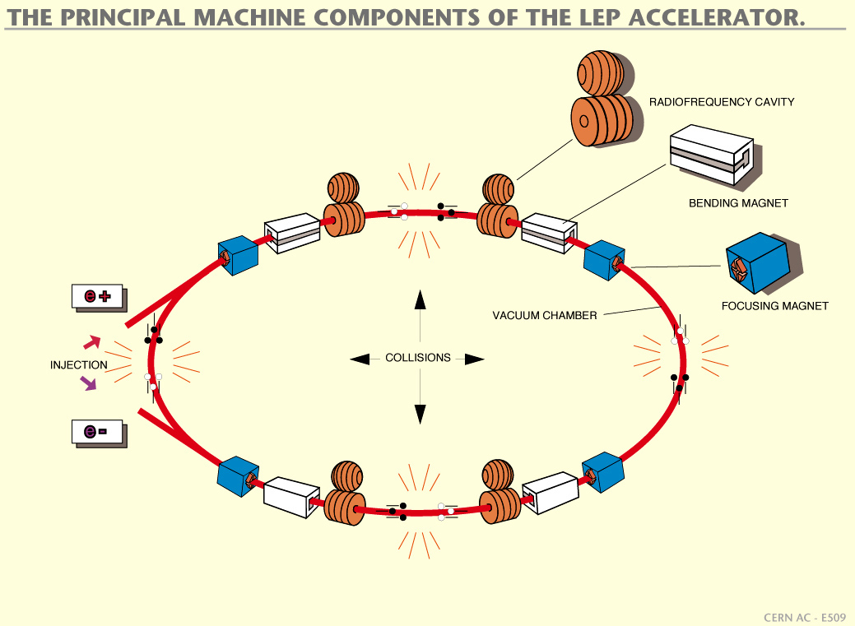

Slide 4
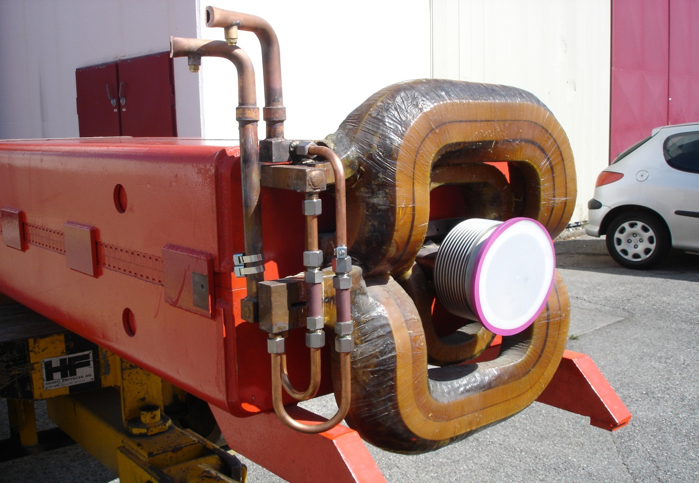
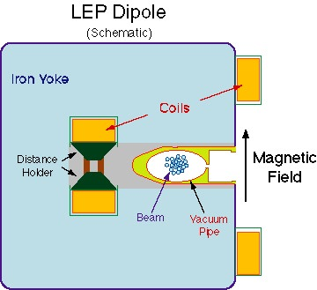
Bending magnets
Bending by dipolar magnetic fields
The field must follow
the energy (or, more
exactly, the momentum)

Slide 5

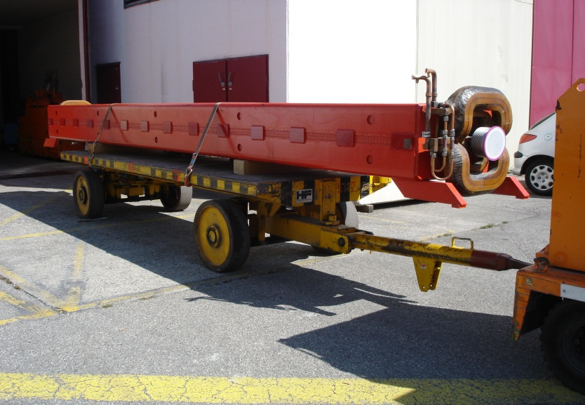

Slide 6
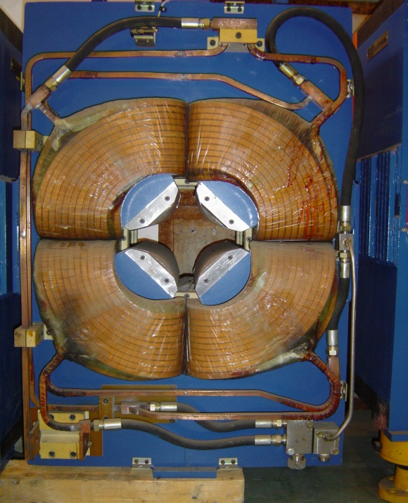
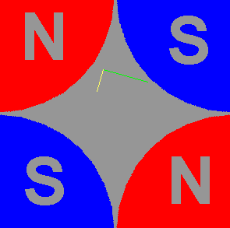
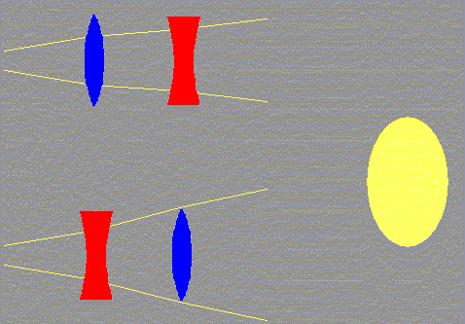
Focusing magnets
Focusing by quadrupolar magnetic fields
One can only focus in one plane (H or V) at a time so we need to alternate gradients

Slide 7

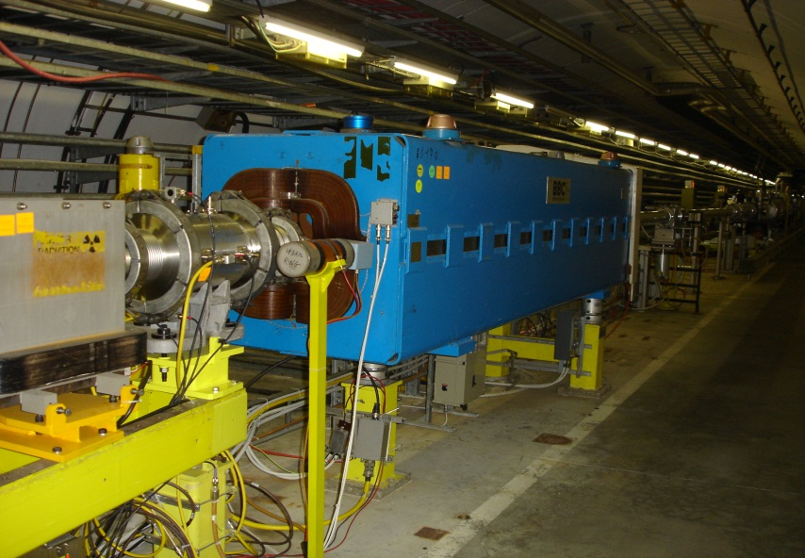

Slide 8
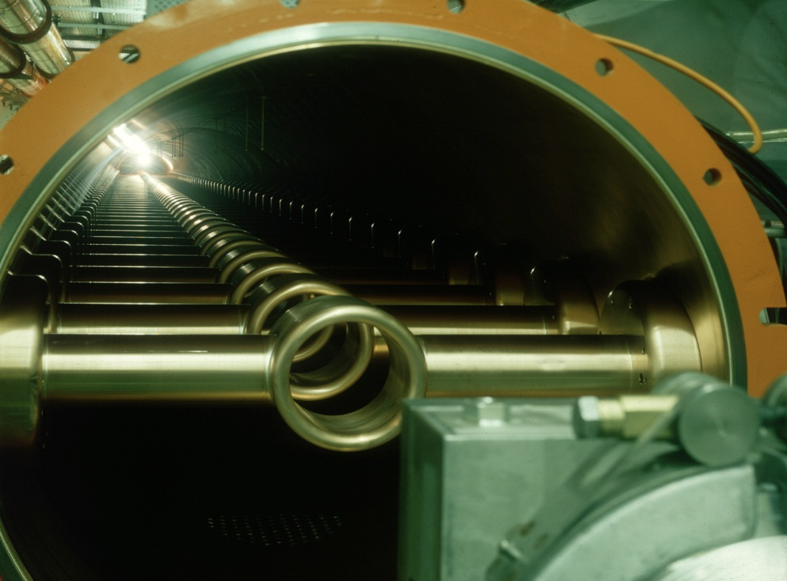

RF cavities
Acceleration by electric fields
  1 eV = 1 electron accelerated by 1 Volt

Slide 9
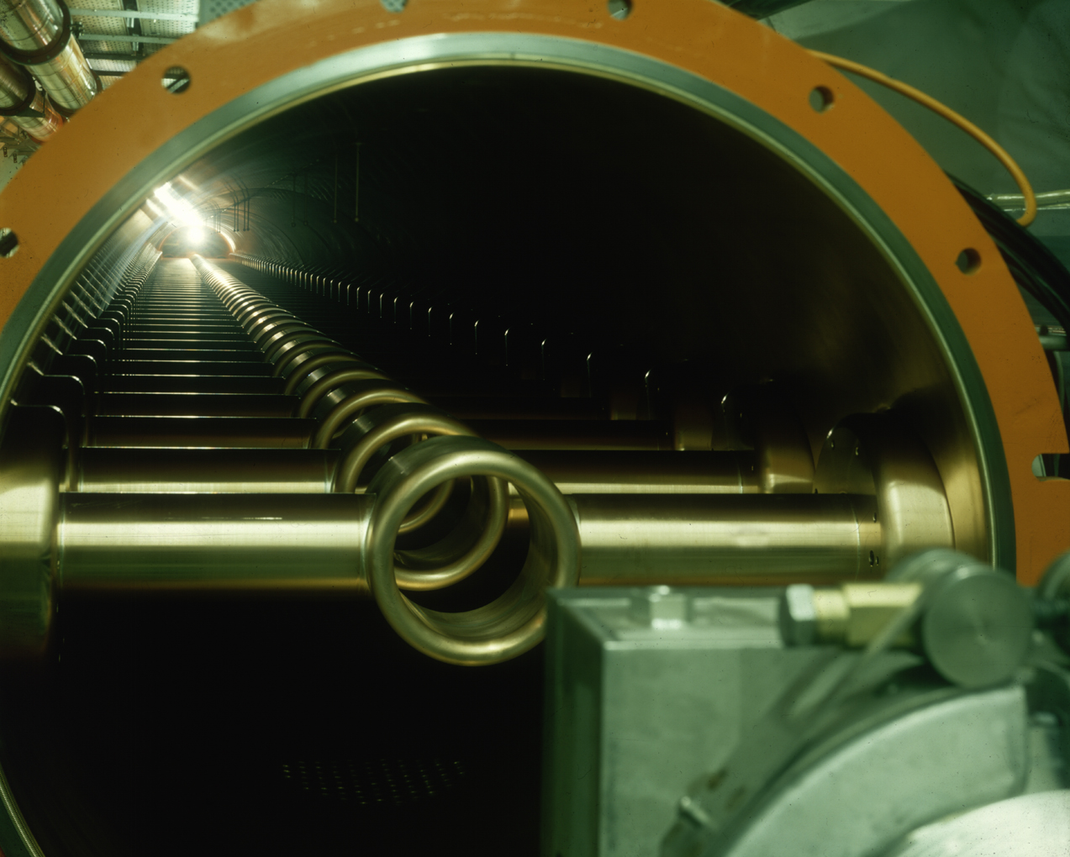

Slide 10
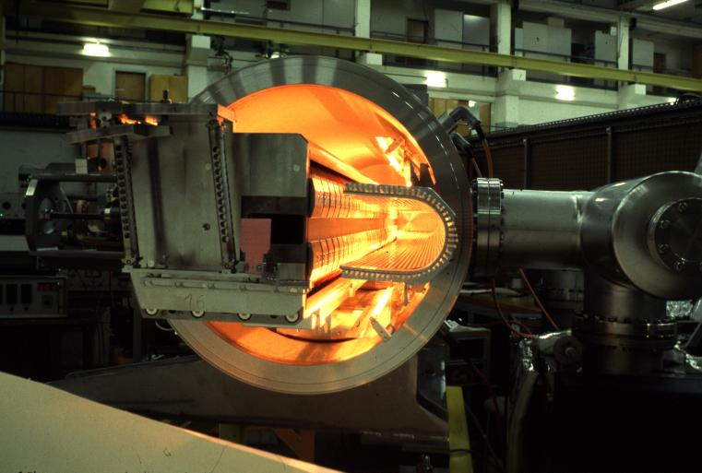
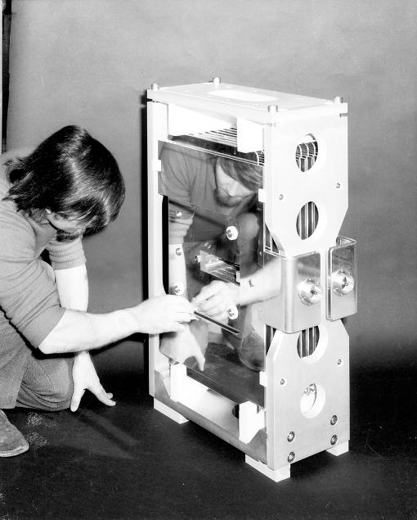
Injection/ejection systems
Septum magnet
Note: there are other systems
Kicker magnet

Slide 13
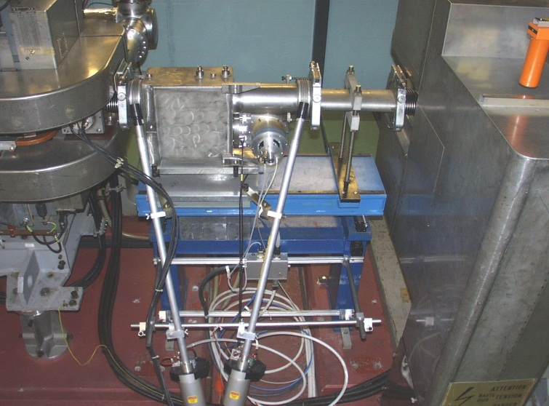
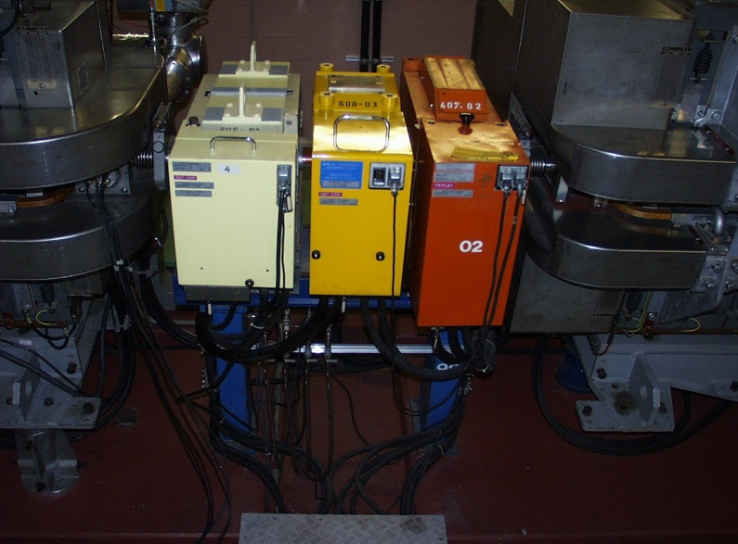
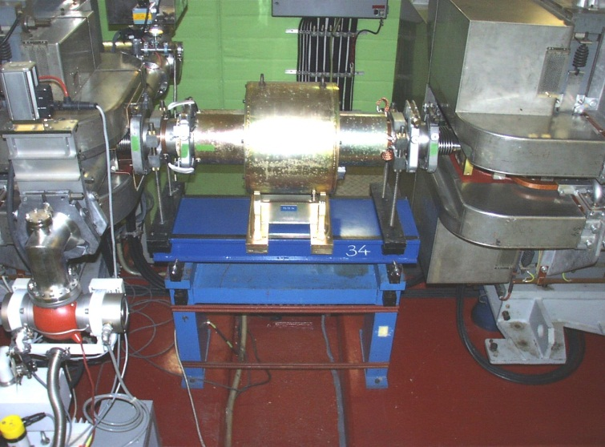
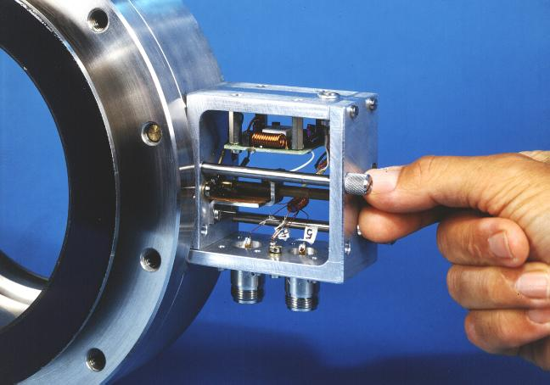
Other components
Vacuum pumps
Instrumentation
Corrector magnets
Safety elements
…

Slide 14


Slide 15
Cycles & Supercycles
Cycle:
  Injection plateau or flat bottom
  acceleration ramp
  ejection plateau or flat top
  field decrease ramp
B
I_{P}

Slide 16
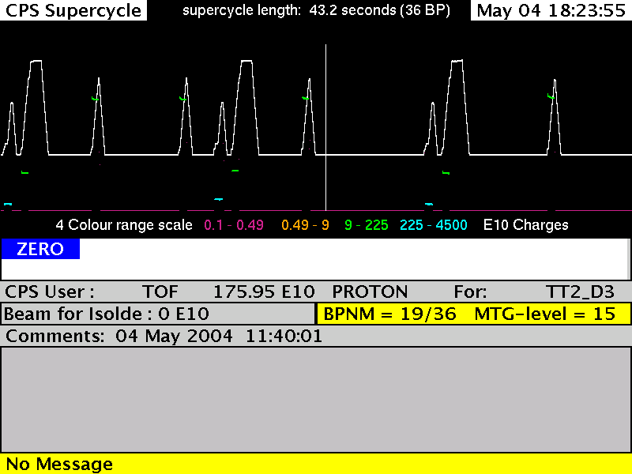
PS Supercycle
Energy, Intensity, Destination…

Slide 17
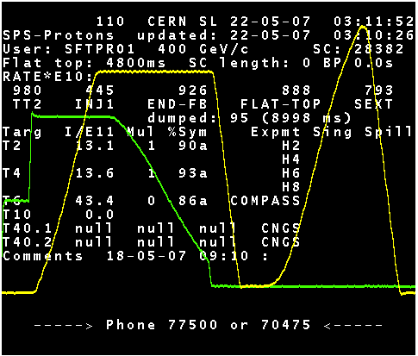
SPS supercycle
Extraction
Double
injection
Acceleration ramp
Fixed target cycle
LHC pilot cycle

Slide 18
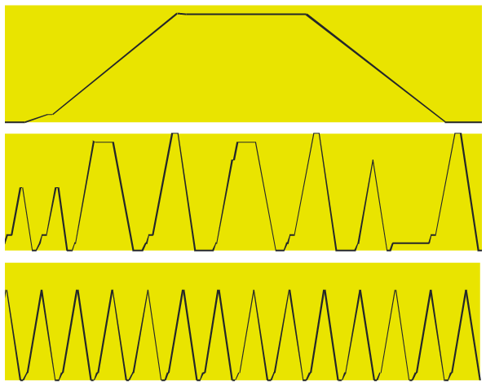
Cycles & Supercycles
SPS
CPS
PSB

Slide 19
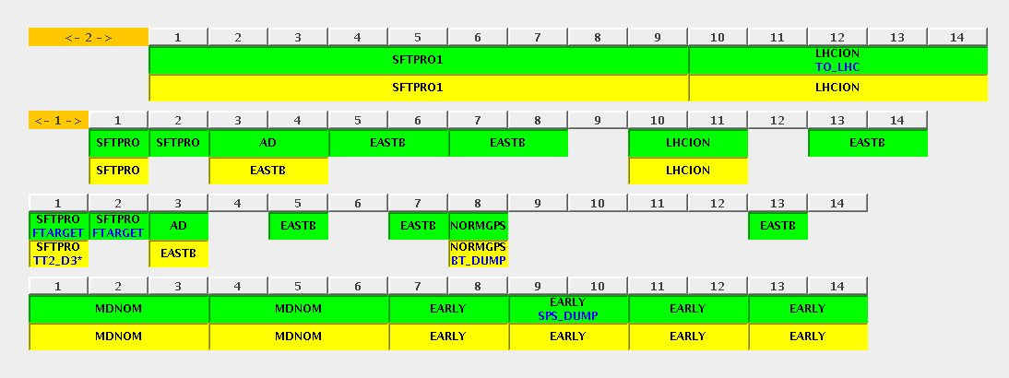
Cycles & Supercycles

Slide 21
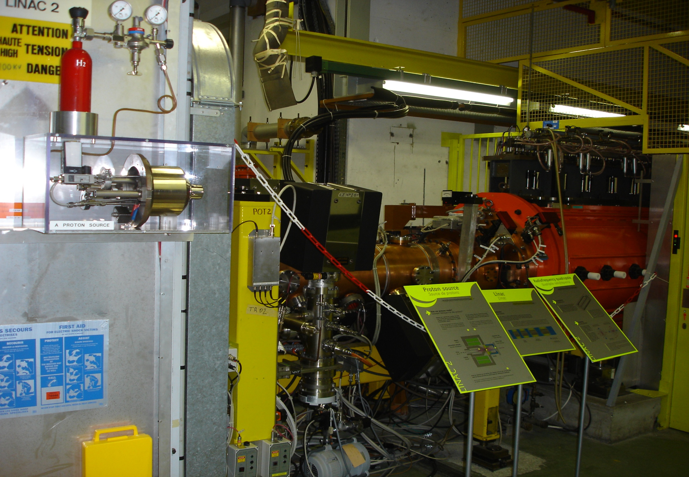
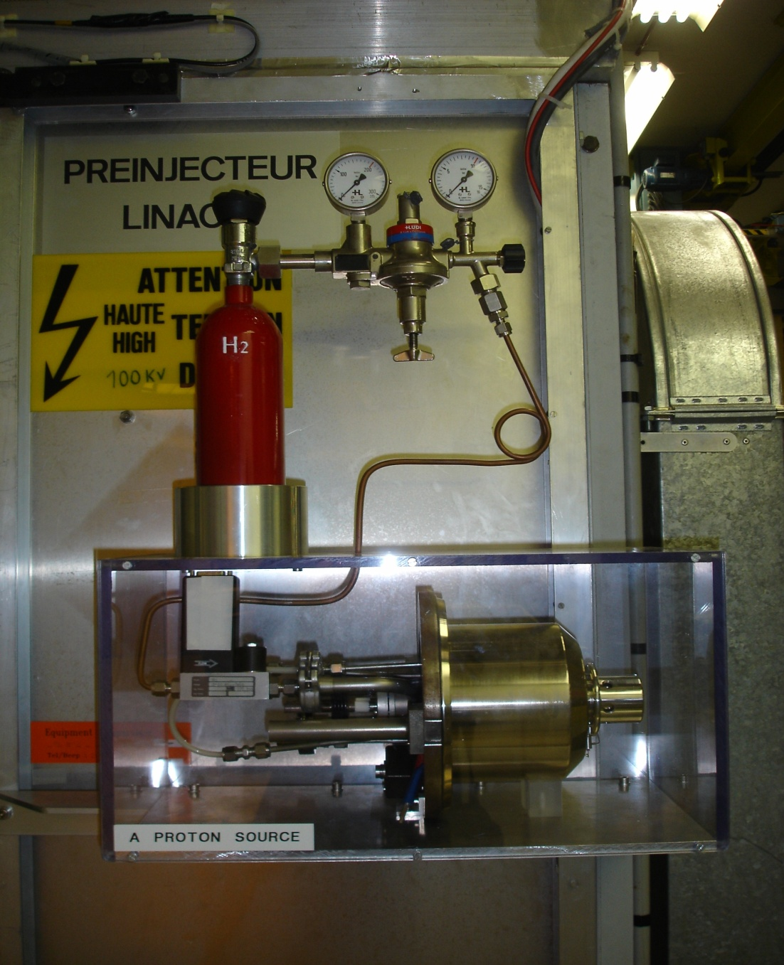
Duoplasmatron proton source
90keV ; 500mA
Radio Frequency Quadrupole (RFQ)
~1m ; 750keV

Slide 22
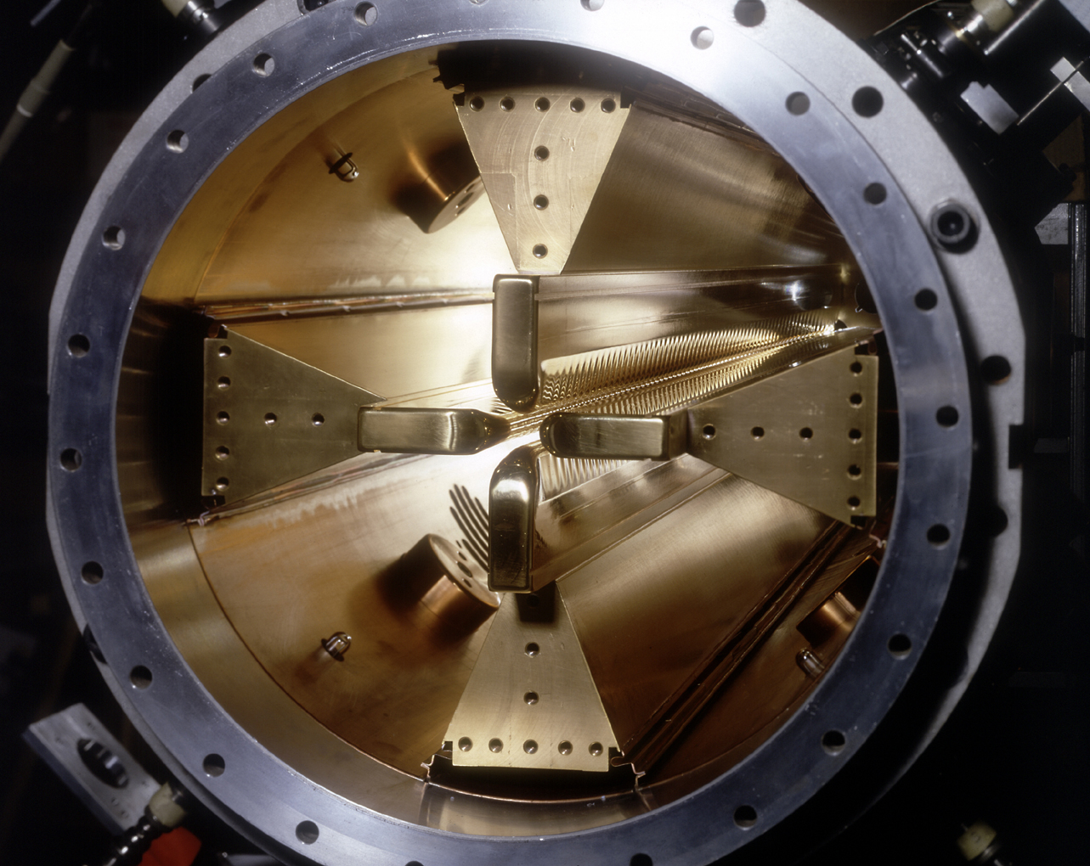
The accelerator complex at CERN
PSB, PS, SPS
Radio Frequency Quadrupole (RFQ)
~1m ; 750keV

Slide 23
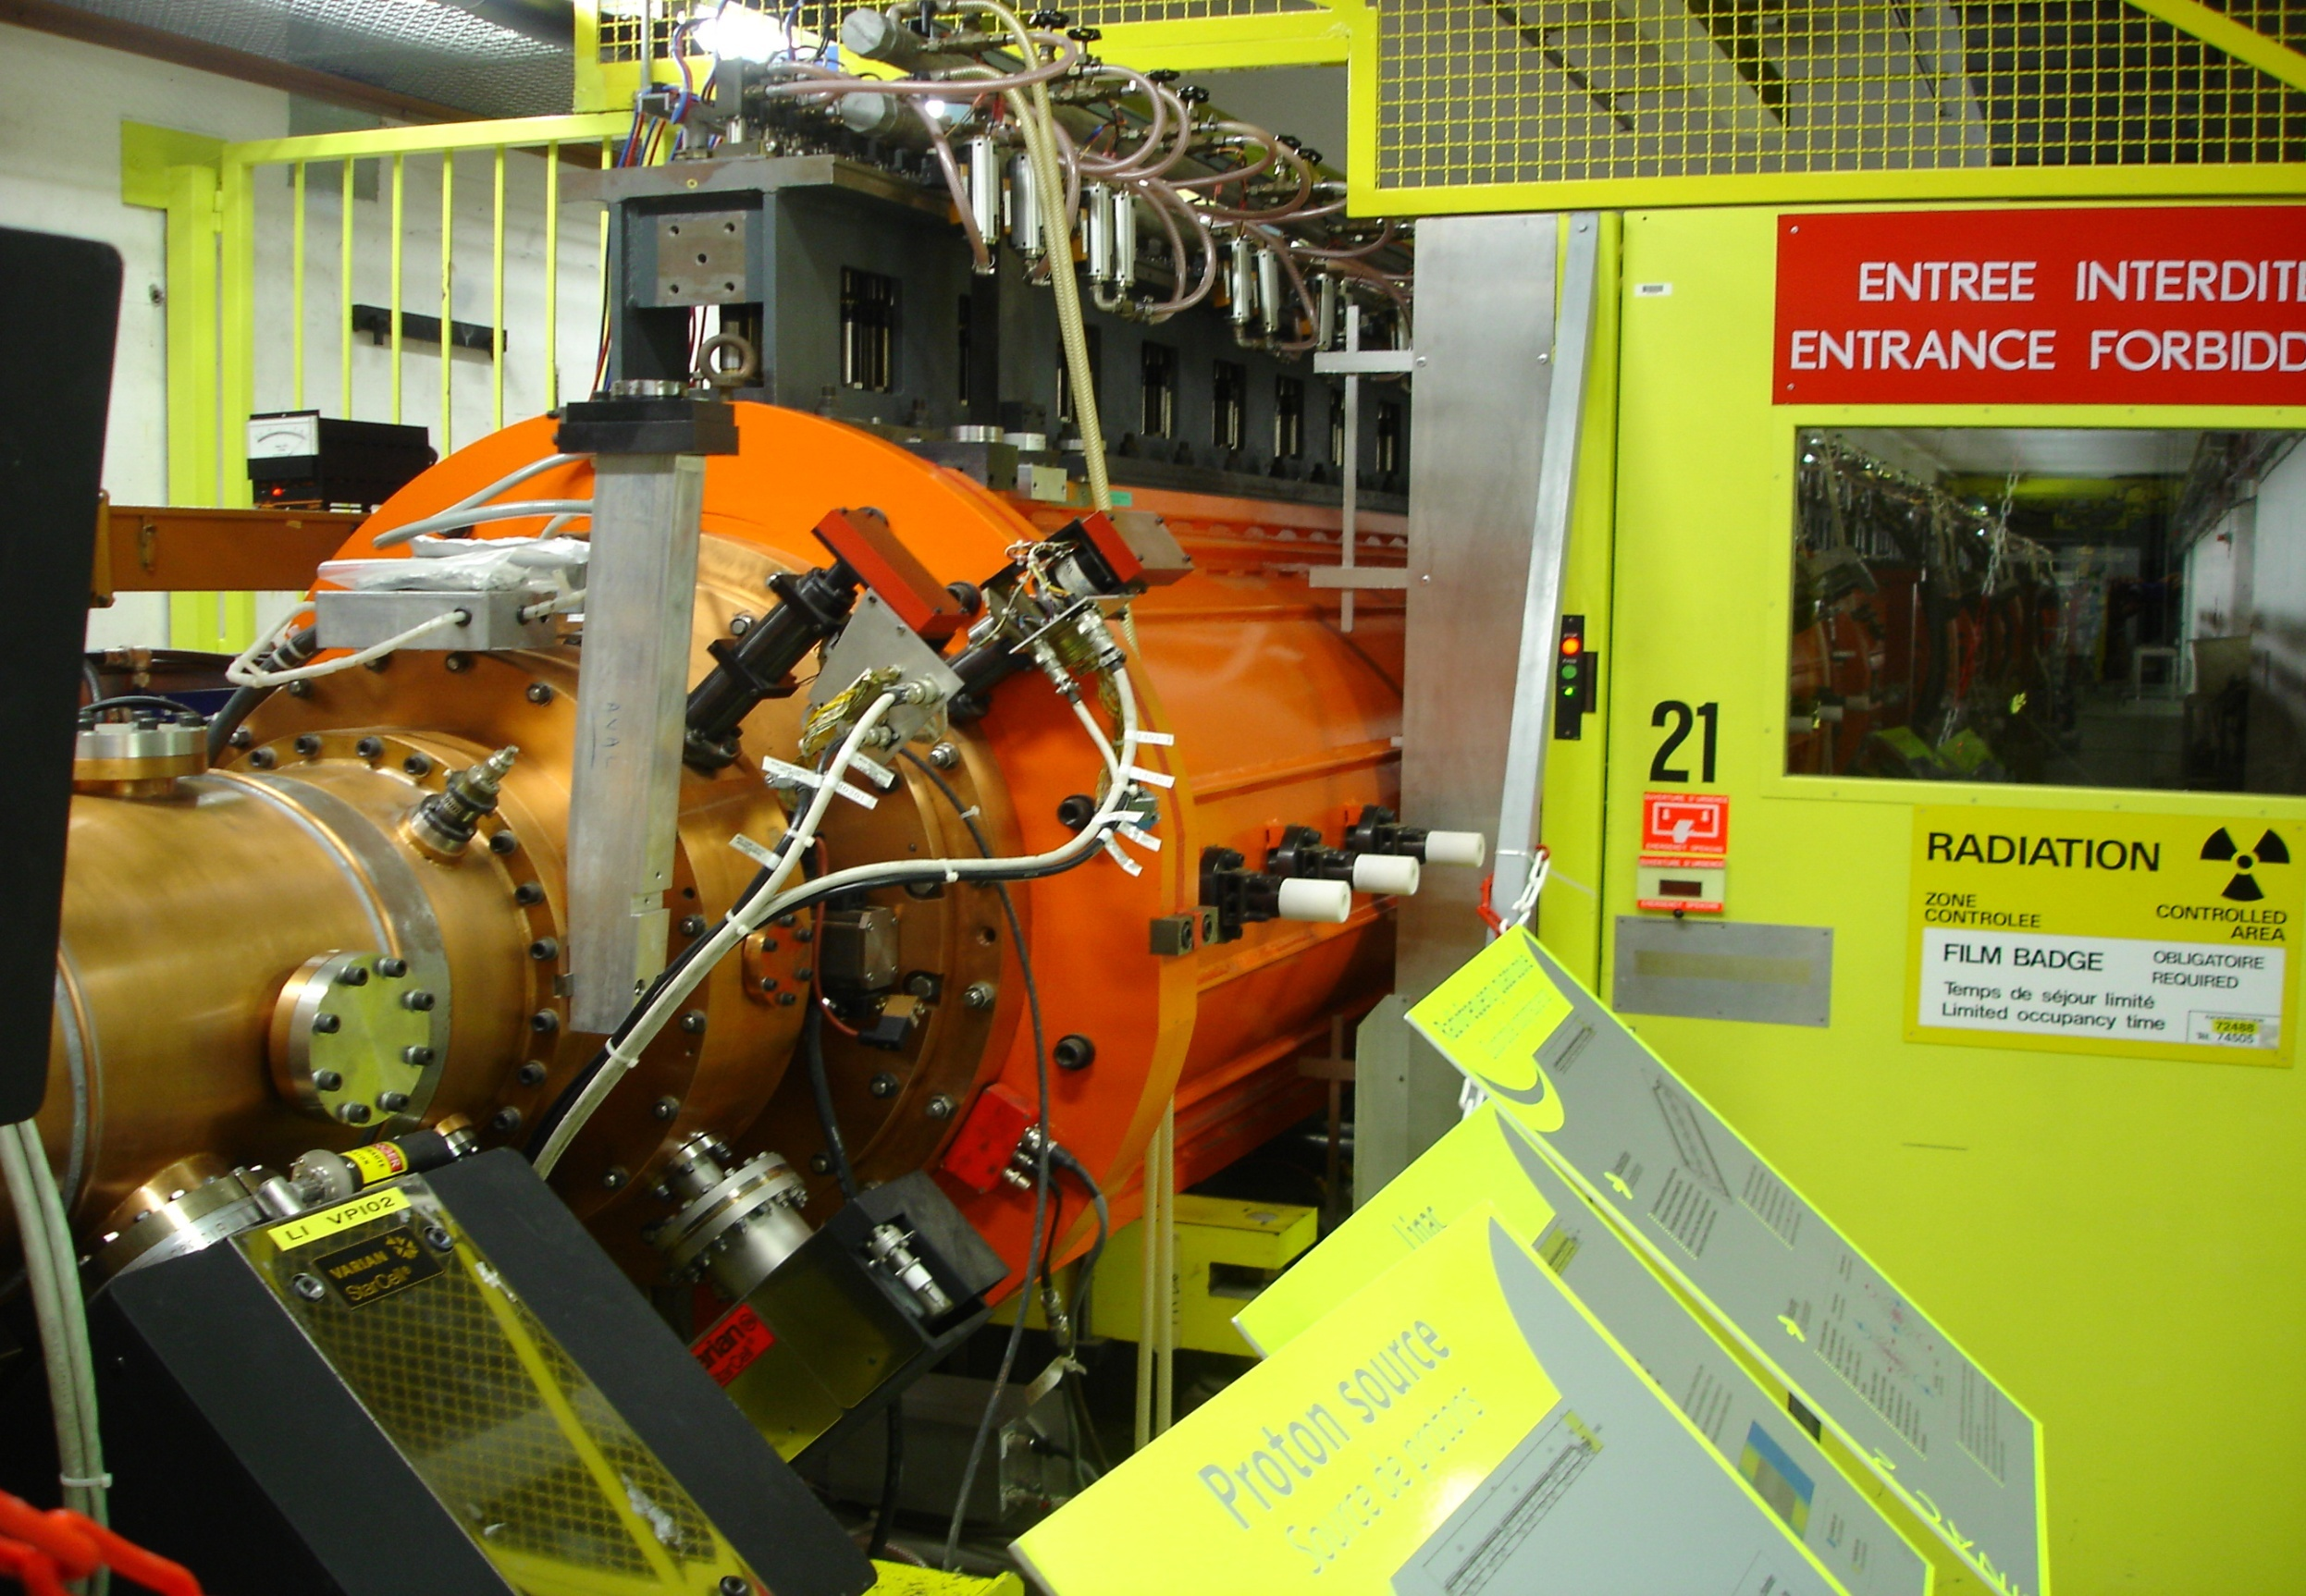
Linac 2
30m ; 50MeV ; 180mA

Slide 24
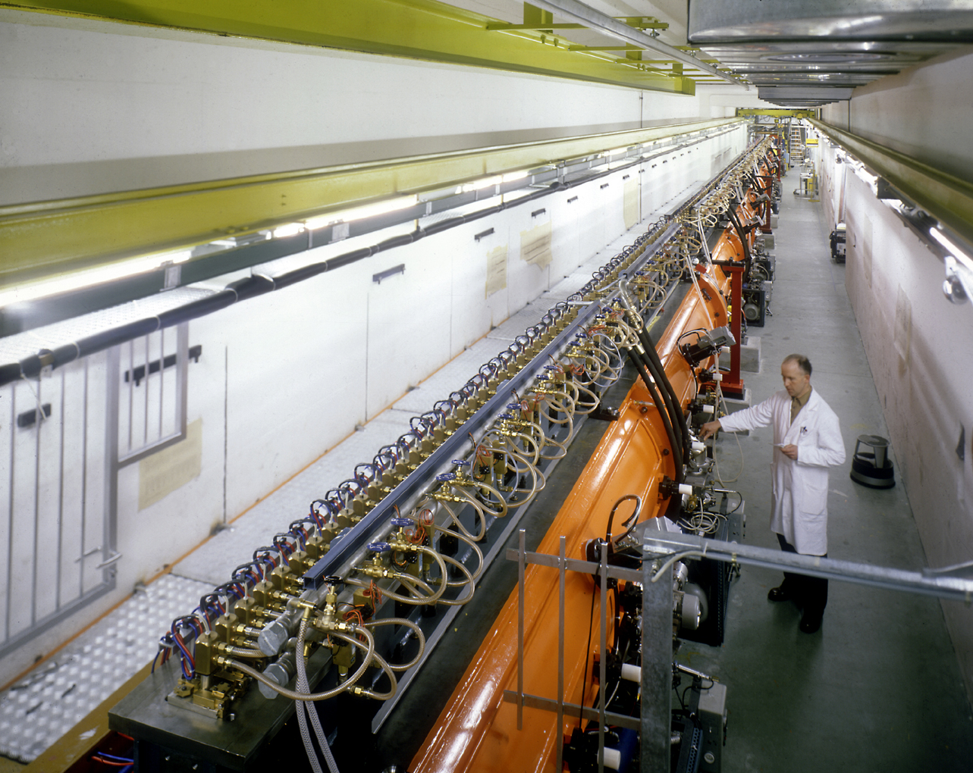
Linac 2
30m ; 50MeV ; 180mA

Slide 25
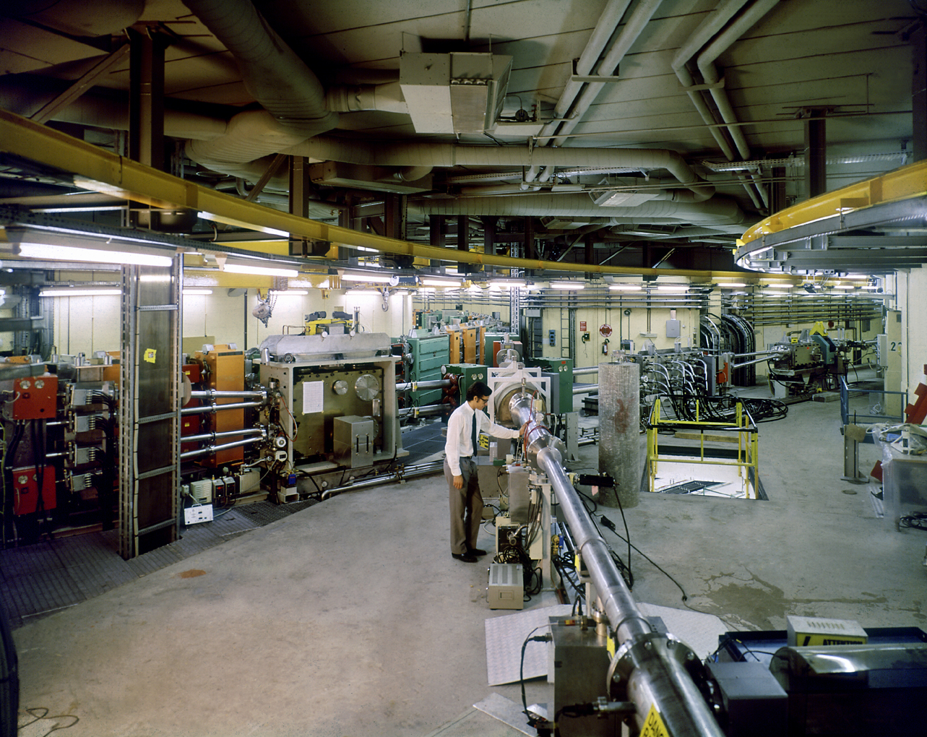
PSB distributor
Transfer line from Linac 2 to Proton Synchrotron Booster (PSB)

Slide 26
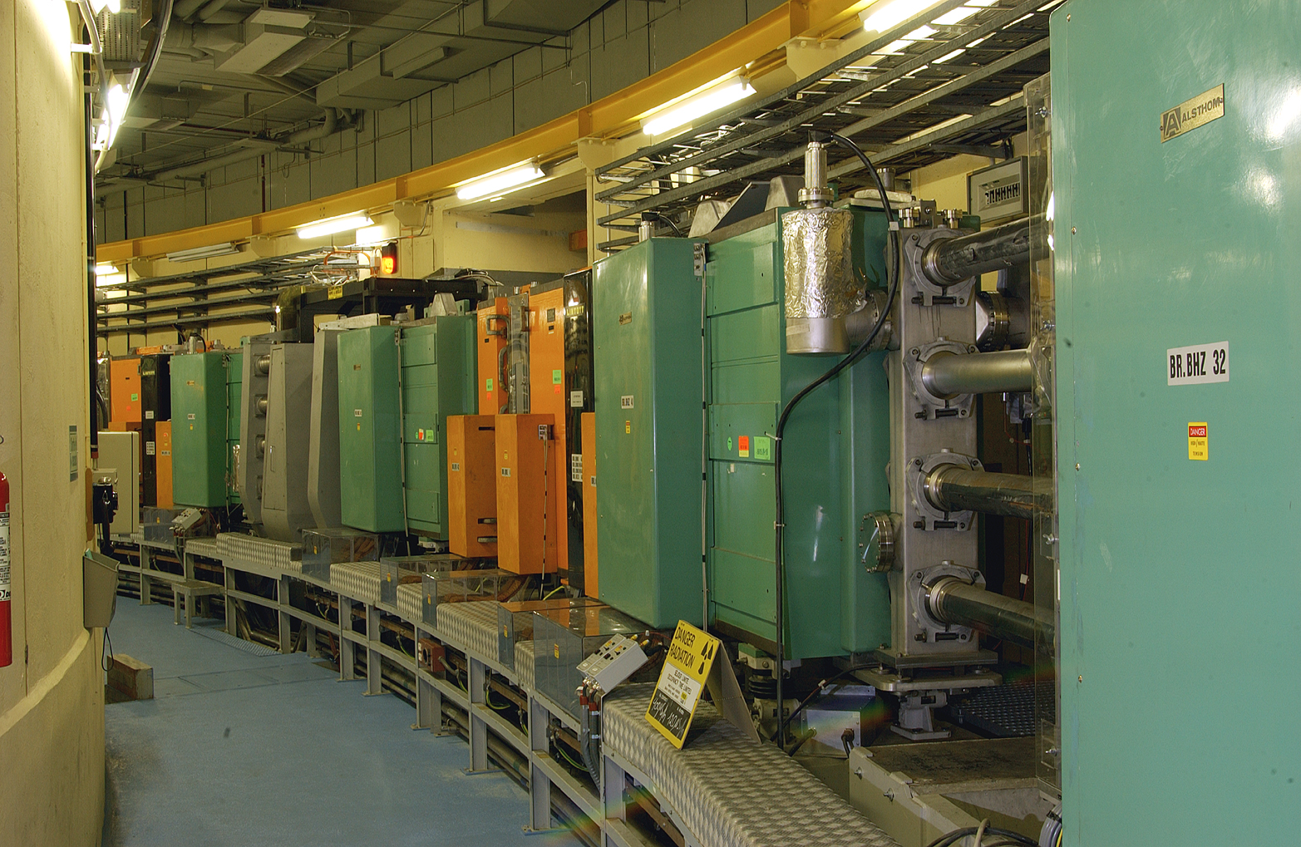
Proton Synchrotron Booster
4 rings ; 157m each
1.4GeV ; 10¹³ p⁺/ring

Slide 27
Extraction line from PSB to Proton Synchrotron (PS)
& Isolde
Individual extraction lines from each ring of the PSB
Recombinations
1+2 & 3+4
Recombinations
(1-2) + (3-4)

Slide 28
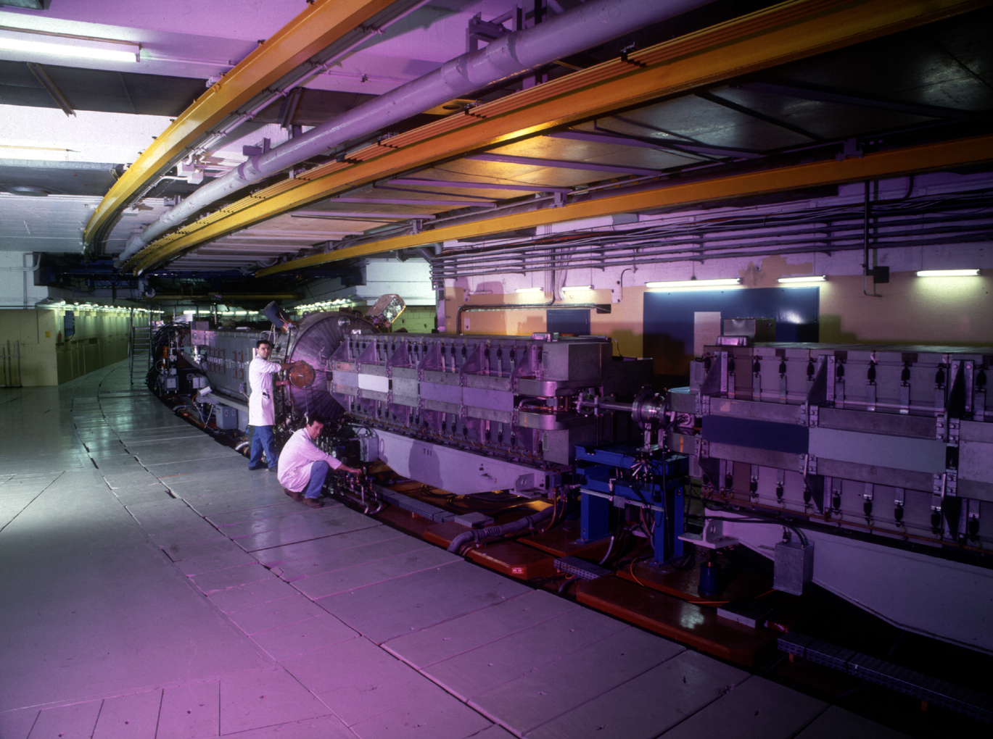
Proton Synchrotron (1959)
628 m
25 GeV ; 3x10¹³ p⁺
[5.9 GeV/u Pb⁵⁴⁺]

Slide 29
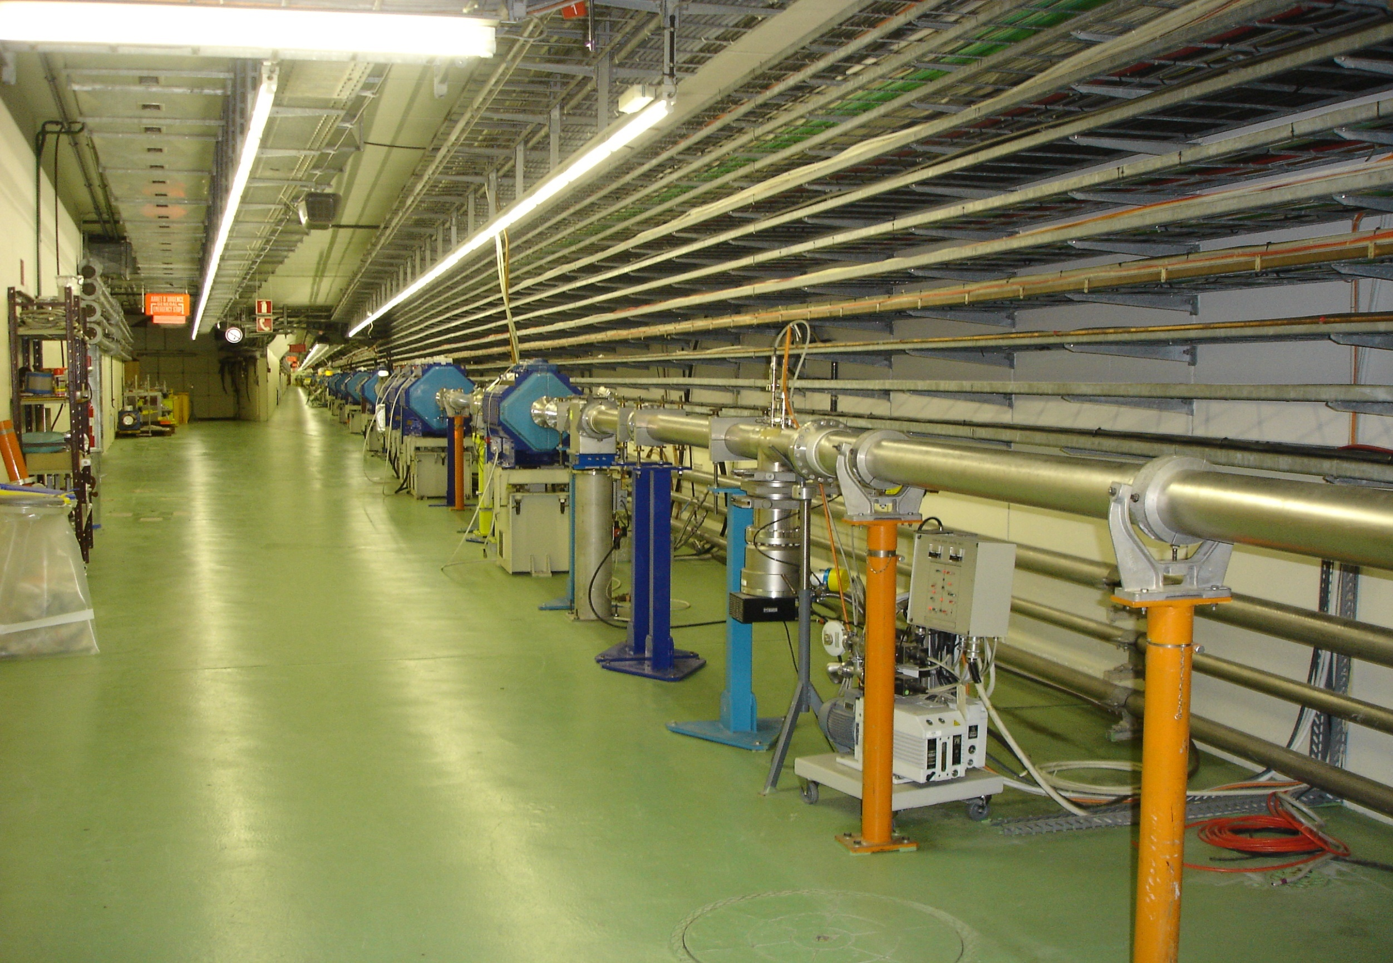
TT2 transfer line from PS to SPS, AD, nTOF, and D3 dump

Slide 30
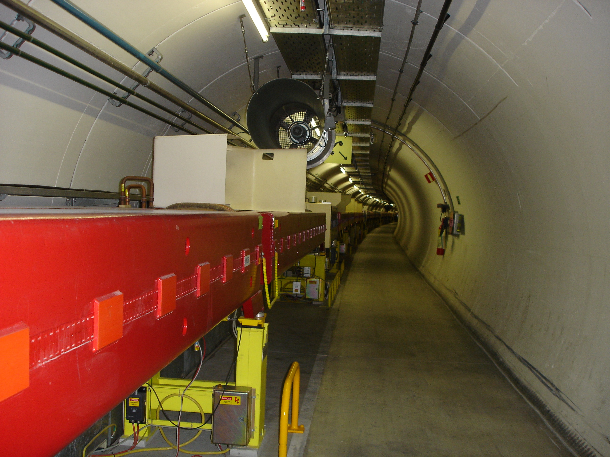
Super Proton Synchrotron (SPS)
6.9 km
450 GeV ; 5x10¹³ p⁺
[177 GeV/u Pb⁸²⁺]

Slide 31
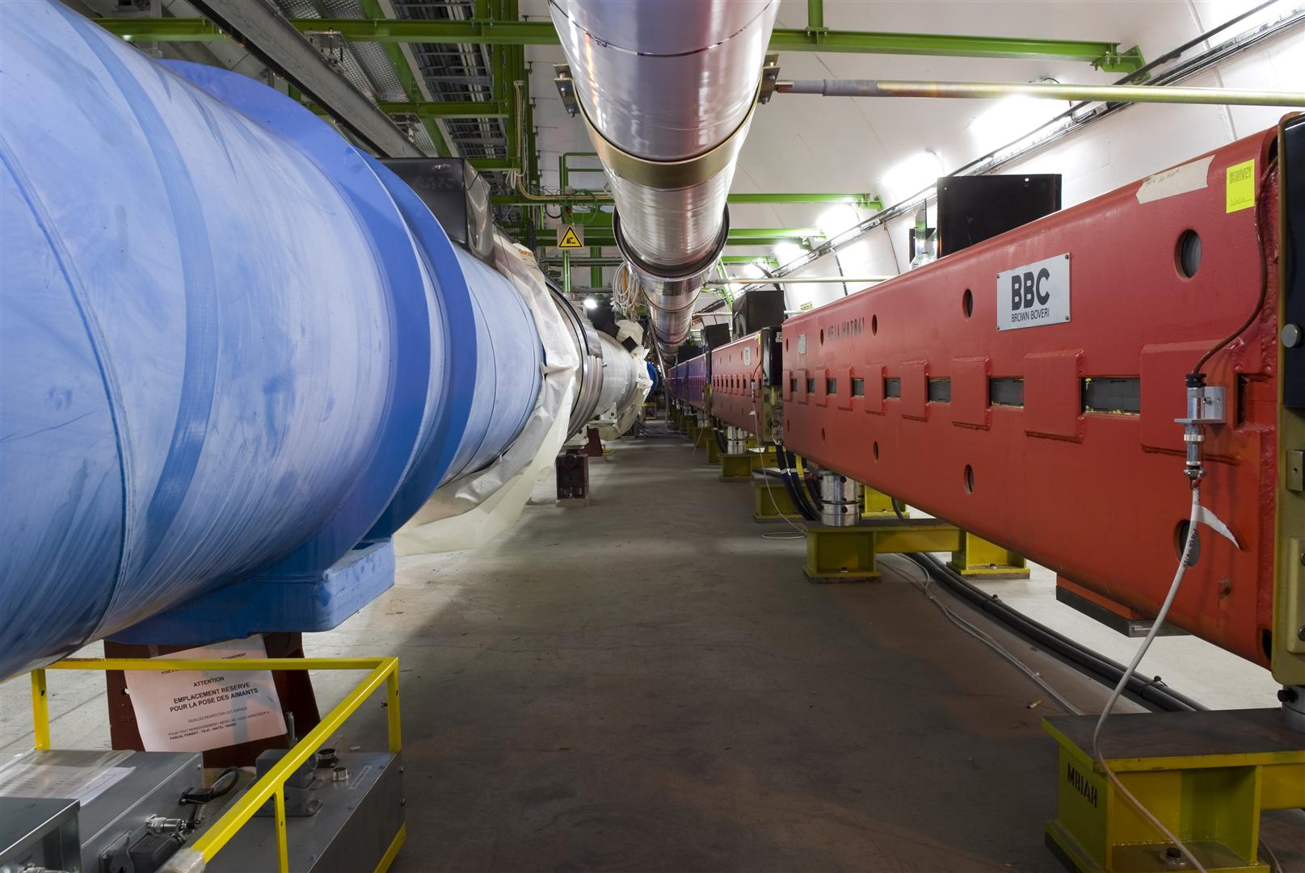
TI8 counter-clockwise transfer line from SPS to LHC

Slide 32
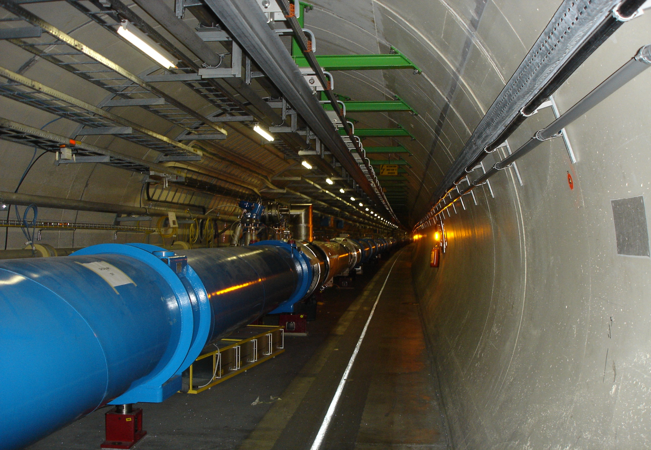
Large Hadron Collider (LHC)
2 interleaved rings; 26.7 km
7 TeV ; 3x10¹⁴ p⁺/ring
[2.8 TeV/u Pb⁸²⁺]

Slide 33
Proton beam production for LHC
  Linac2 (50MeV)
  PSB (1.4GeV) 4+2 bunches
  PS (25GeV) 72 bunches
  SPS (450 GeV) 4 x 72 bunches
  LHC (7 TeV) 2 x 2808 bunches

Slide 34
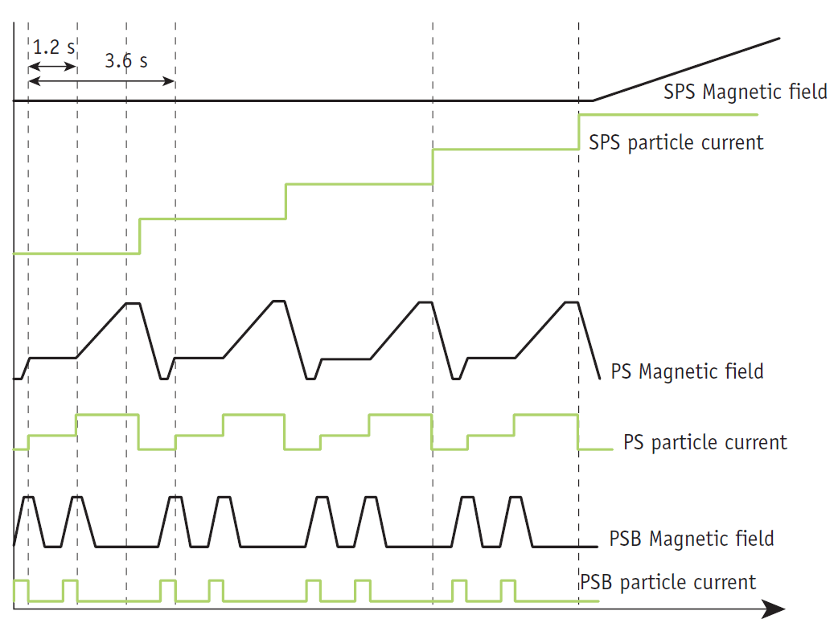

Slide 35
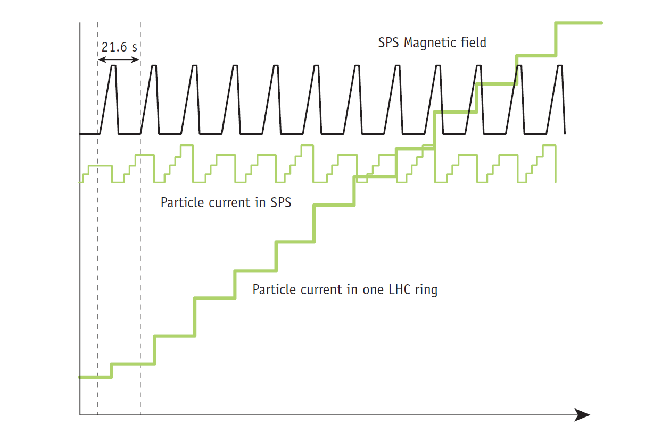

Slide 36
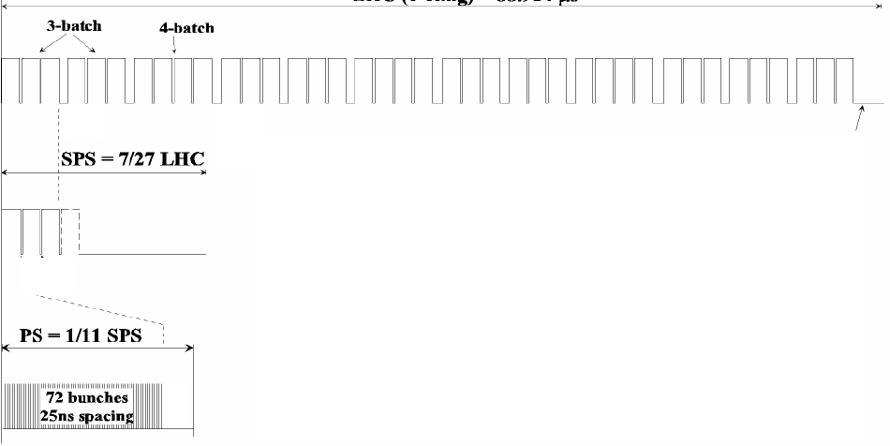
12 injections from SPS to LHC
The gaps between trains are necessary to make room for rise/fall times of injection/ejection/abort kicker magnets.

Slide 37
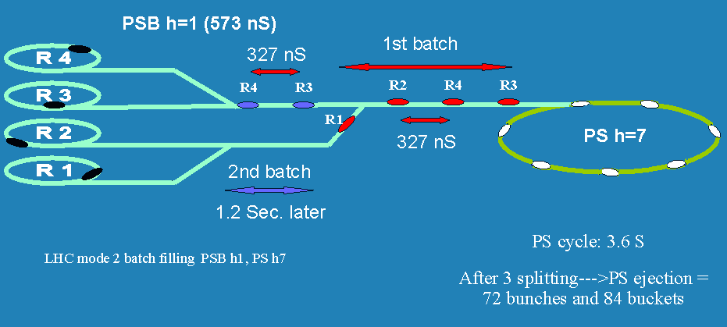
Double batch injection from PSB to PS
[M.Lindroos]

Slide 38
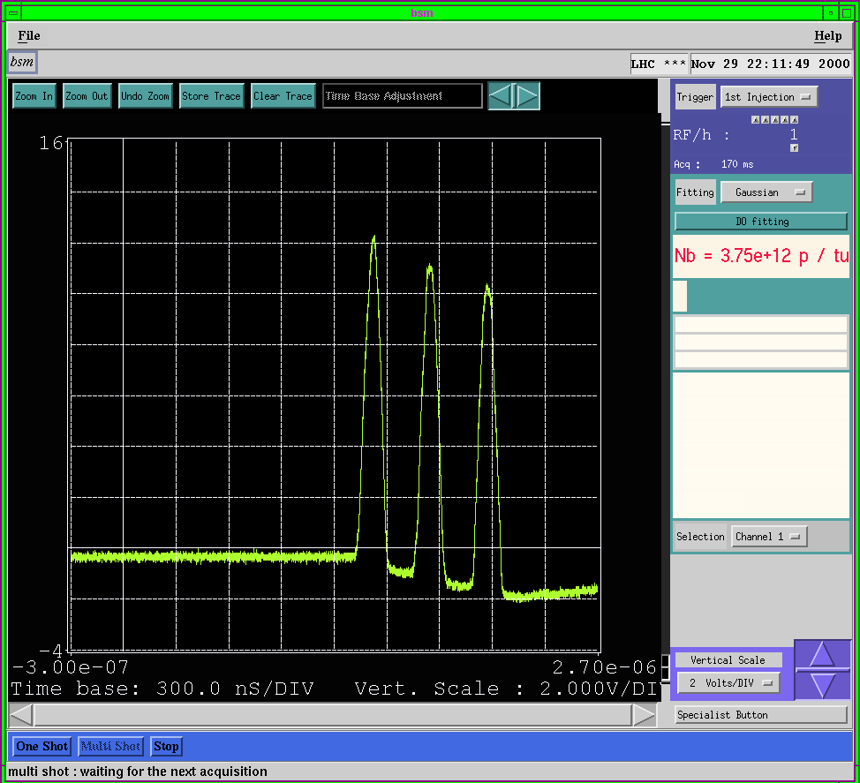

Slide 39
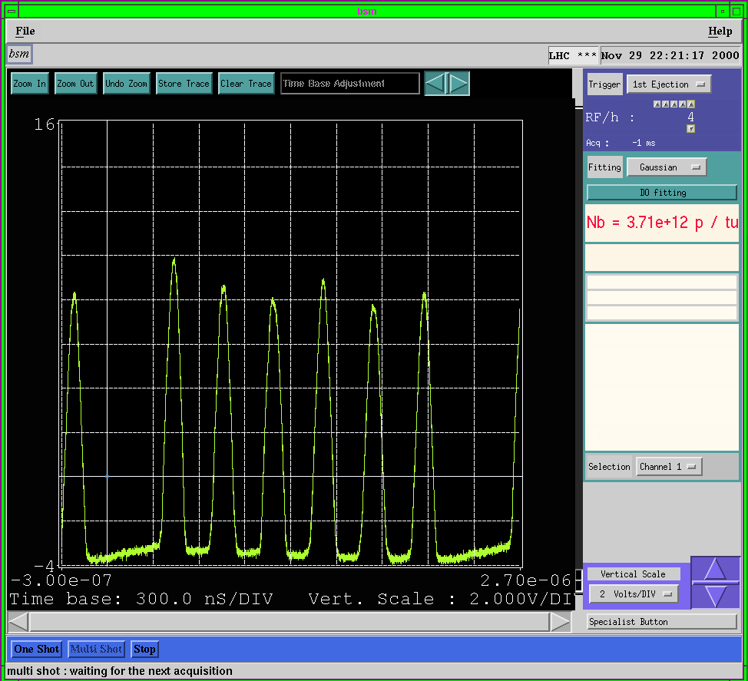

Slide 40
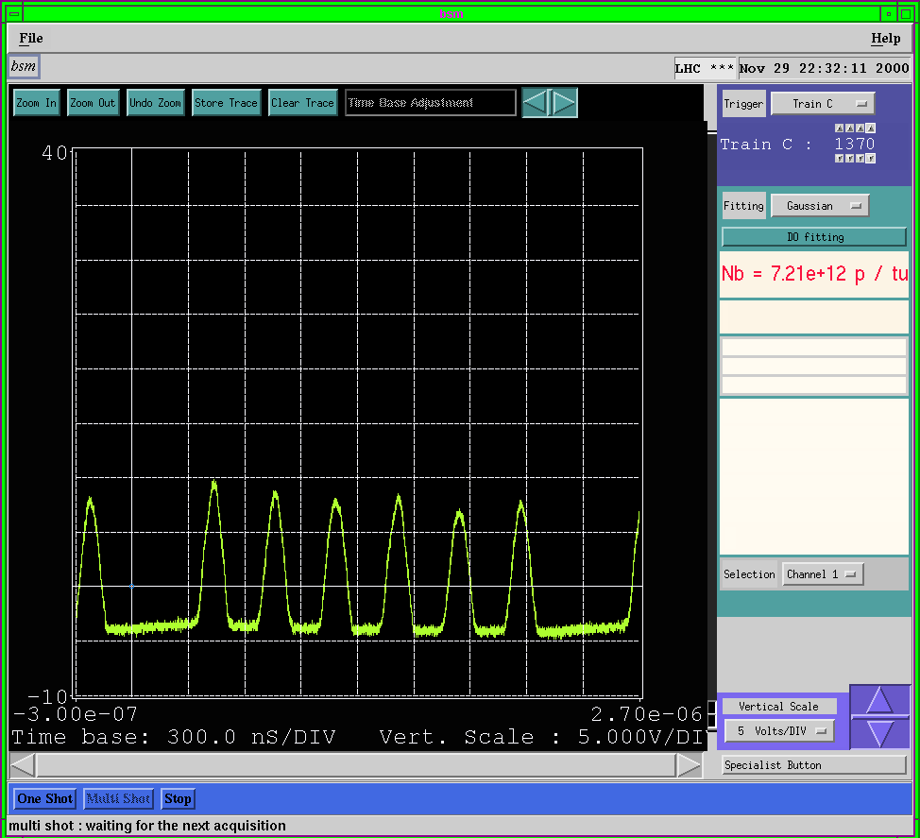

Slide 41
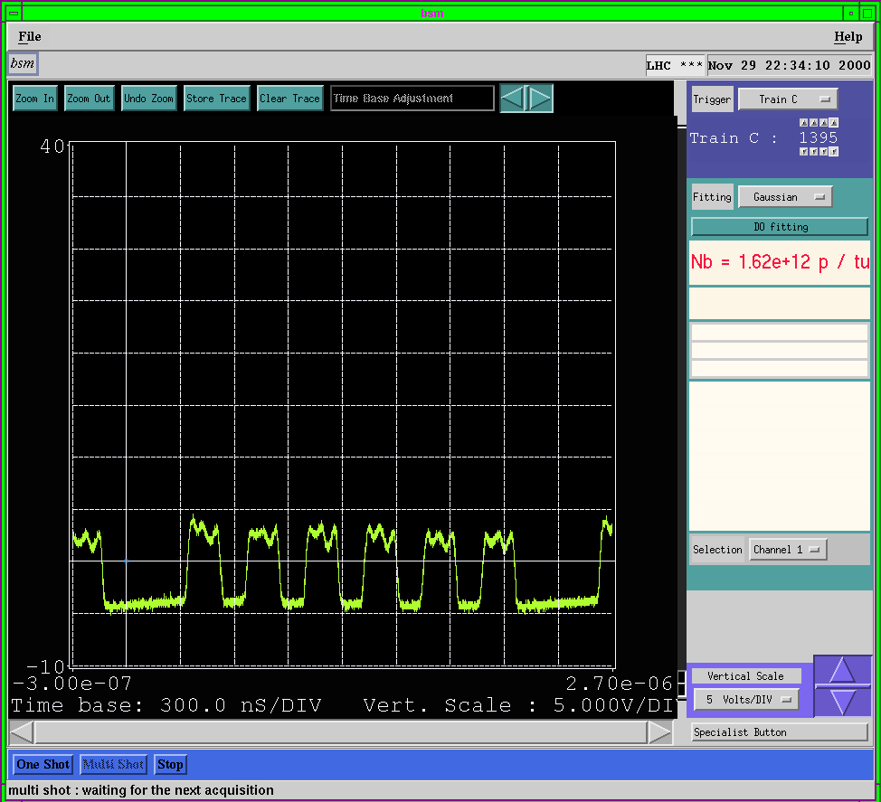
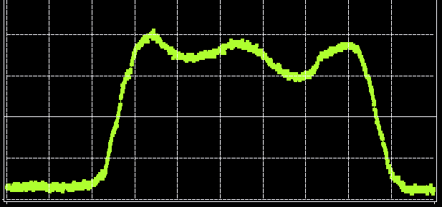

Slide 42


Slide 43


Slide 44

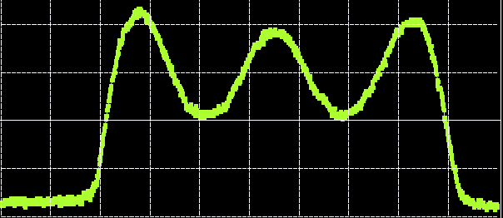

Slide 45

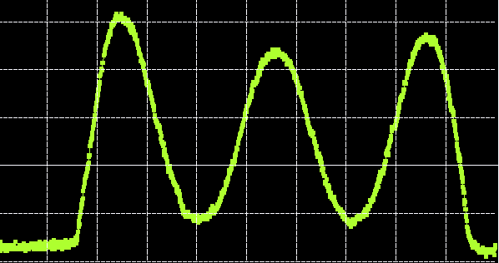

Slide 46

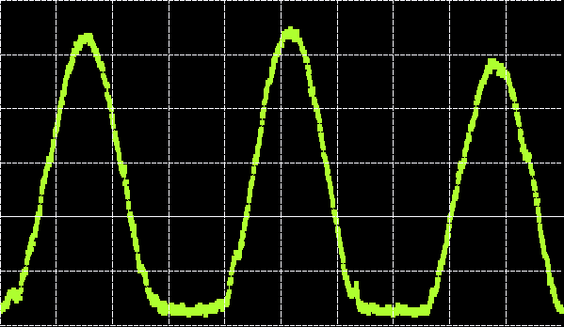

Slide 47
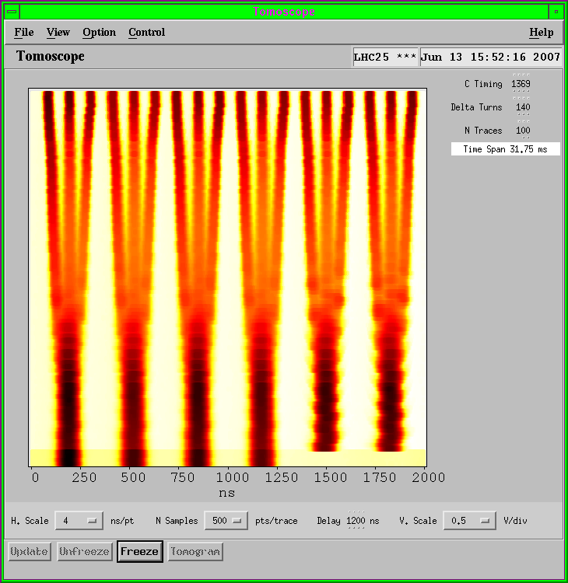
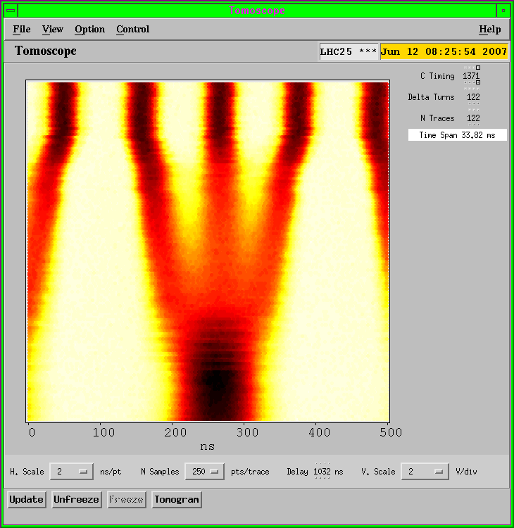
Triple bunch splitting in PS
“Waterfall” representation: V=time, H=position, colour=density
time
position

Slide 48

Two more bunch splittings in PS

Slide 49


Slide 50


Slide 51


Slide 52


Slide 53


Slide 54


Slide 55


Slide 56


Slide 57


Slide 58


Slide 59


Slide 60

72-bunch train ready to be sent to SPS

Slide 61

Thanks for your attention!

Slide 62





Questions ? …

