Slide 1



The Large Hadron Collider:
In Search of New Physics
Albert De Roeck
CERN, Geneva, Switzerland
Antwerp University Belgium
UC-Davis California USA
IPPP, Durham UK
BU, Cairo, Egypt
NTU, Singapore
CERN 23 April 2015

Slide 2
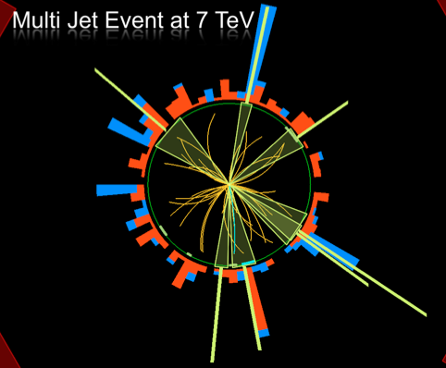
Outline
Introduction
Higgs discovery
New Physics Searches
@ the Large Hadron Collider
-Dark Matter?
-Supersymmetry?
-Extra space dimensions?
-Black Holes?
-Matter Substructure?
Summary

Slide 3

What is the world made of?
What holds the world together?
Where did we come from?

Slide 4
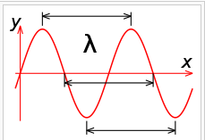
Accelerators are Powerful Microscopes
They make high energy particle beams
that allow us to see small things.
h
p
Planck constant
λ =
momentum
~ energy
wavelength
seen by low energy beam of particles
(poorer resolution)
seen by high energy beam of particles
(better resolution)

Slide 5


We can create particles
from energy
•Two beams of protons collide and generate,
in a very tiny space, temperatures over a
billion times higher than those prevailing at
the center of the Sun.
•Produce particles that may have existed at
the beginning of the Universe, right after the
Big Bang
Notes:
4

Slide 6
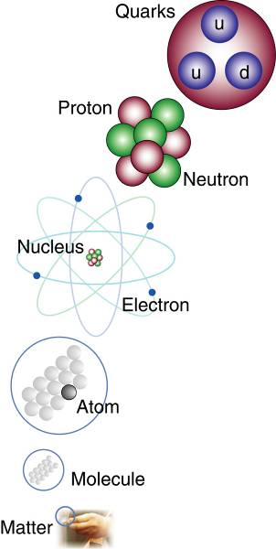
The Structure of Matter
Matter
Quarks and electrons are
the smallest building blocks
of matter that we know
of today.
Are there still smaller
particles?
The Large Hadron Collider
will address this question!

Slide 7
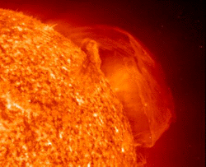
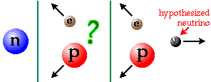
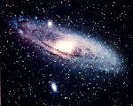
The Fundamental Forces of Nature
Electromagnetism:
gives light, radio, holds atoms together
Strong Nuclear Force:
holds nuclei together
Weak Nuclear Force:
gives radioactivity
together
they make
the Sun
shine
Gravity: holds planets and stars together

Slide 8

The “Standard Model”
Over the last 100 years: combination of
Quantum Mechanics and Special Theory of relativity
along with all new particles discovered has led to the
Standard Model of Particle Physics.
The new (final?) “Periodic Table” of fundamental elements:
Fermions
Bosons
The most basic mechanism of the SM, that of granting mass to particles remained a mystery for a long time
A major step forward was made in July 2012 with the discovery of what could be the long-sought Higgs boson!!
Matter particles
Force particles
Fermions: particles with spin ½
Bosons: particles with integer spin

Slide 9

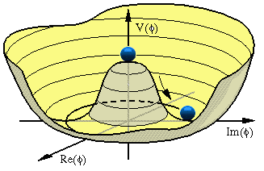


The Hunt for the Higgs
The key question (pre-2012):
Does the Higgs particle exist?
Where
do
the
masses of
elementary particles come from?
If so, where is the Higgs?
Massless particles move at the speed
We do not know the
mass of the Higgs Boson
of light -> no atom formation!!
Scalar field with at least
Note: NOT the mass of
protons and neutrons
It could be anywhere
from 114 to ~700 GeV
one scalar particle

Slide 10



The Higgs Field and the Cocktail Party
By David Miller
Imagine a
cocktail party
This is the Higgs
field
Enters a famous person…
He is slowed down on his way to the drinks!!

Slide 11
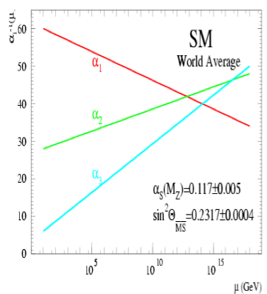
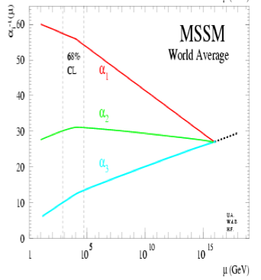
Physics case for new High Energy Machines
Understand the mechanism Electroweak Symmetry Breaking
Discover physics beyond the Standard Model
Reminder: The Standard Model
- tells us how but not why
3 flavour families? Mass spectra? Hierarchy? 19 parameters!
- needs fine tuning of parameters to level of 10⁻³⁰ !
- has no connection with gravity
- no unification of the forces at high energy
- Supersymmetry
- Extra space dimensions
Many other ideas: More symmetry and gauge bosons, composite
Higgs models, L-R symmetry, quark & lepton substructure,
Little Higgs models, Technicolor, Hidden Valleys, Vector-like quarks…
Most popular extensions around 2000
Higgsless models rather disfavoured these days

Slide 12
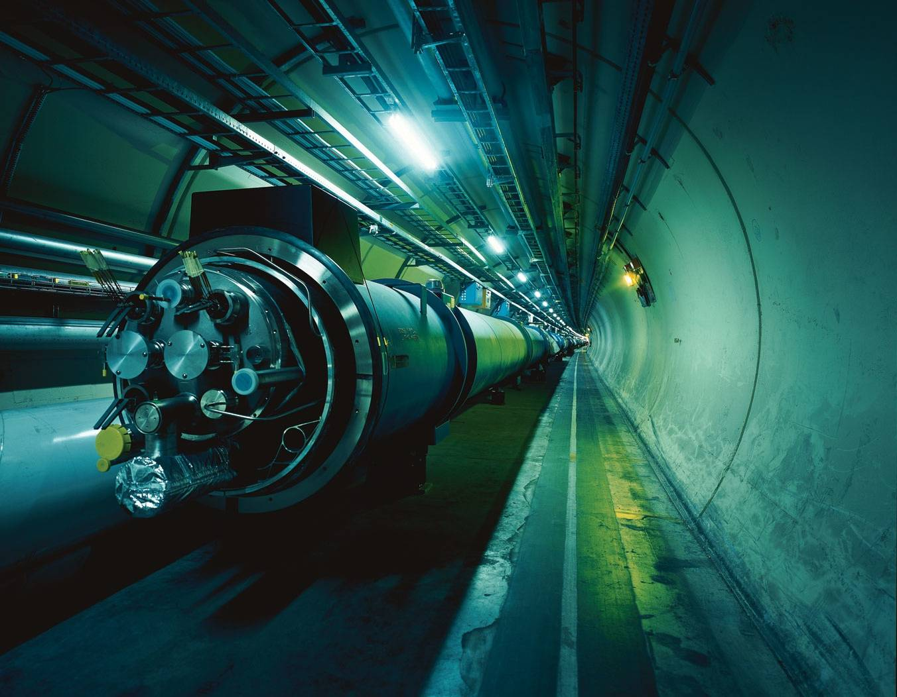

The Large Hadron Collider = a proton proton collider
7 TeV + 7 TeV
(4 TeV + 4 TeV)
1 TeV = 1 Tera electron volt
= 10¹² electron volt
Primary physics targets
• Origin of mass
• Nature of Dark Matter
• Understanding space time
• Matter versus antimatter
• Primordial plasma
The LHC is a Discovery Machine
The LHC will determine the Future course of High Energy Physics
Notes:
.999999991 % speed of light
At near light-speed, a proton in a beam will make 11 245 turns per second. A beam might circulate for 10 hours, traveling more than 10 billion kilometers – far enough to get to the planet Neptune and back again.

Slide 13

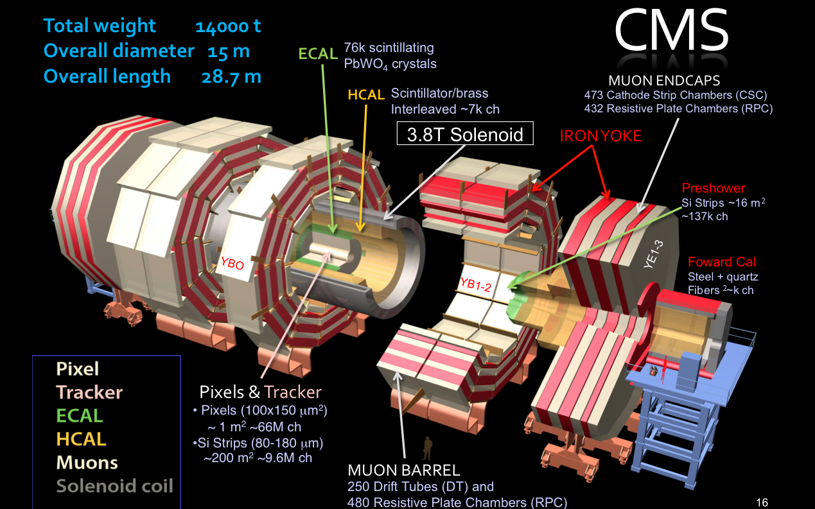
The Higgs Hunters @ the LHC
LHC: pp collisions
at 7/8 TeV
The ATLAS experiment
The CMS experiment
These experiments are likely to
become DARK MATTER HUNTERS
in 2015 and beyond…

Slide 14


Slide 15

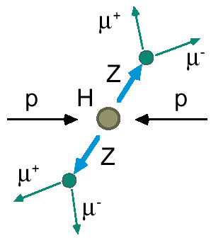
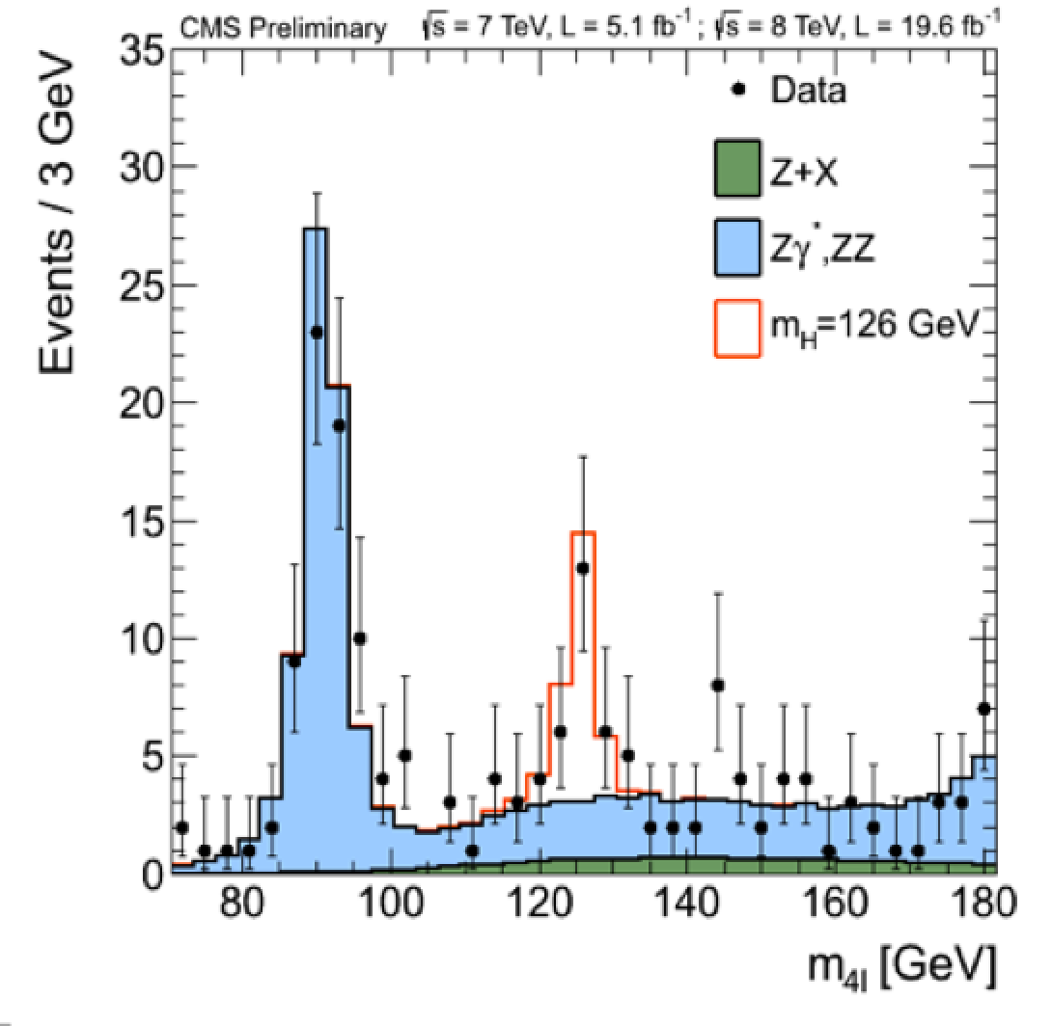

2012: A Milestone in Particle Physics
Observation of a Higgs Particle at the LHC, after about 40 years
of experimental searches to find it
proton
proton
2013
The Higgs particle was the last missing particle in the Standard Model
and possibly our portal to physics Beyond the Standard Model

Slide 16
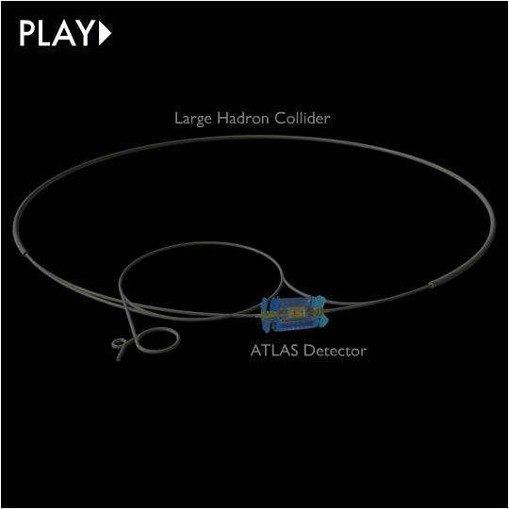

Slide 17
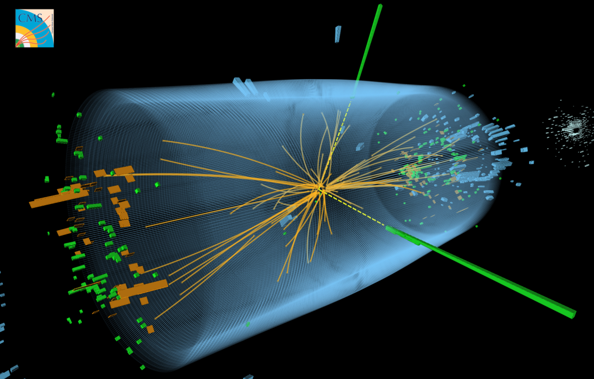
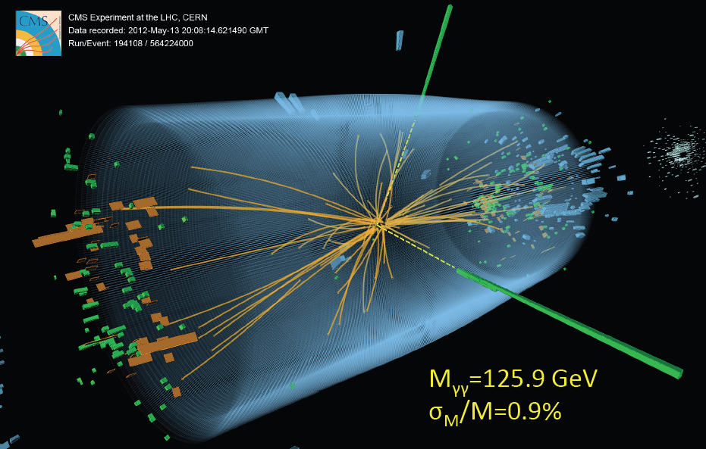
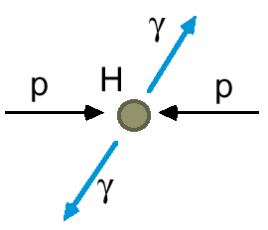
A Collision with two Photons
A Higgs or
a ‘background’
process without
a Higgs?
Note: the LHC is a Higgs Factory: 1 Million Higgses already produced
15 Higgses/minute with present luminosity

Slide 18
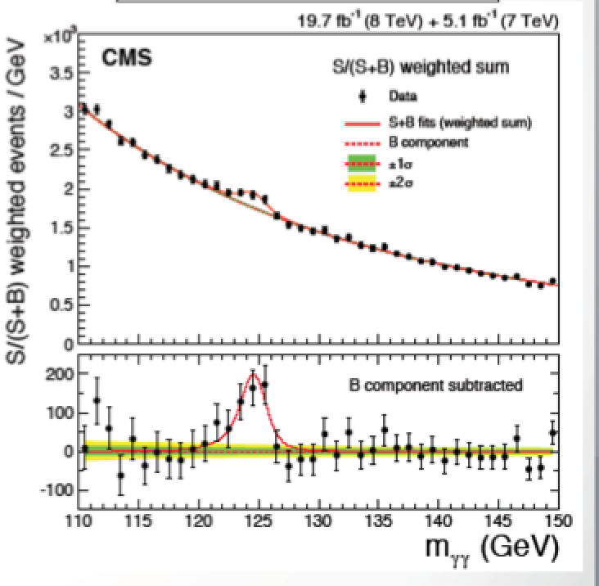
Discovery of the Higgs Boson...

Slide 19
Discovery of the Higgs Boson...

Slide 20
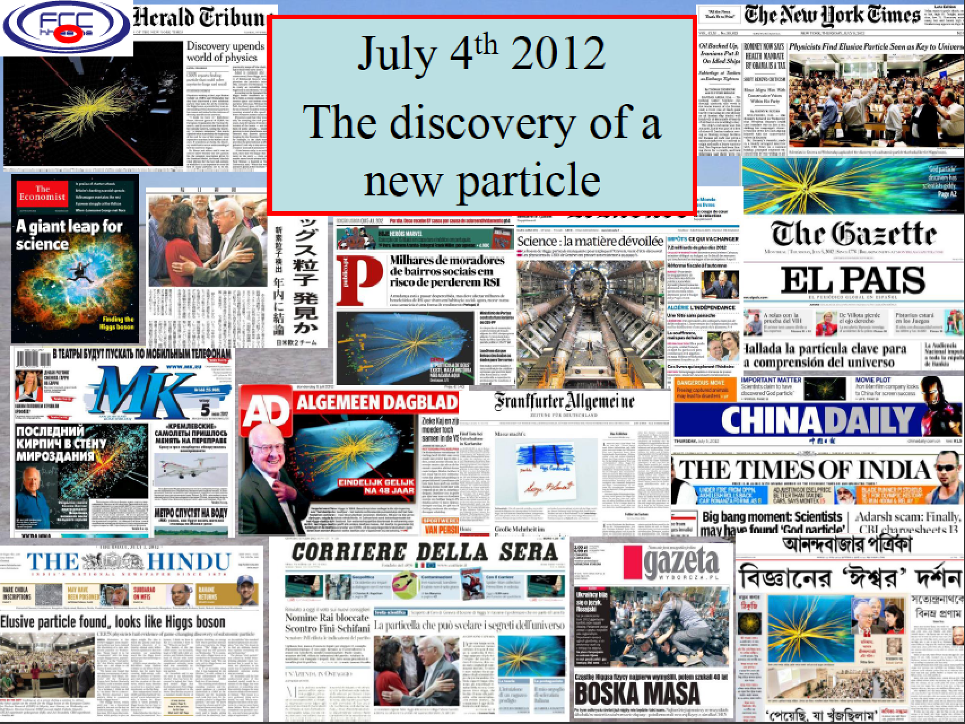

Slide 21
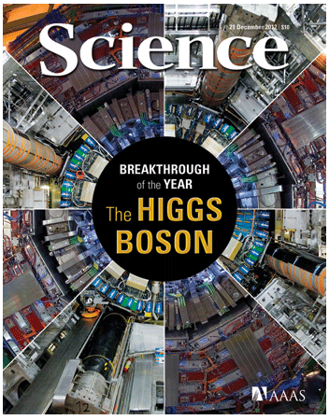

Most cited paper so far...
Special Physics Letters B edition with the ATLAS and CMS CMS papers on the Higgs Discovery
Also…
Cited about 4200 times so far…

Slide 22

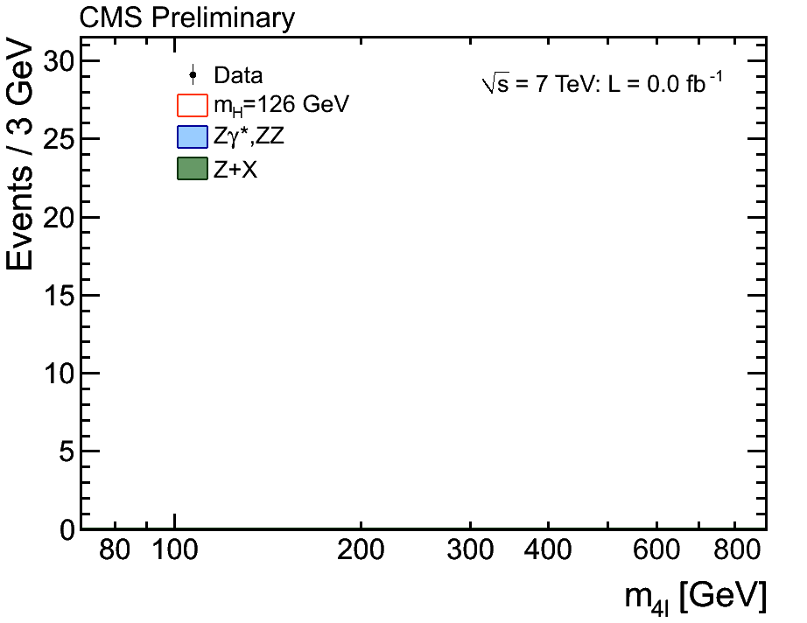
The Birth of a Particle
“History” of the data
accumulation during
the last two years
ATLAS
CMS

Slide 23


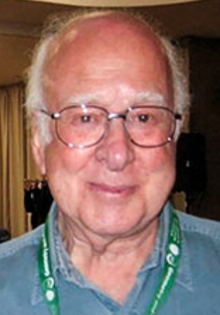
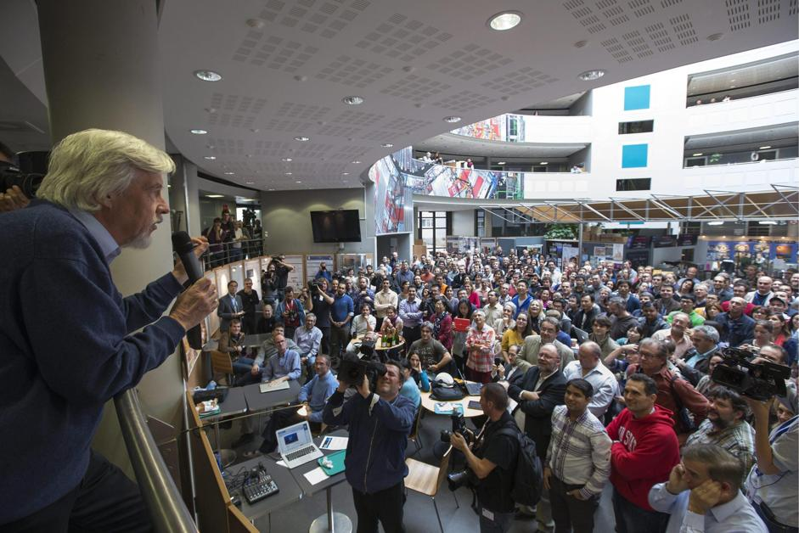


Tuesday 8 October 2013
Francois Englert
Peter Higgs
Congratulations!!!!

Slide 24

...and December 2013
The Nobel Prize in Physics 2013 was awarded jointly to François Englert and Peter W. Higgs "for the theoretical discovery of a mechanism that contributes to our understanding of the origin of mass of subatomic particles, and which recently was confirmed through the discovery of the predicted fundamental particle, by the ATLAS and CMS experiments at CERN's Large Hadron Collider”.

Slide 25
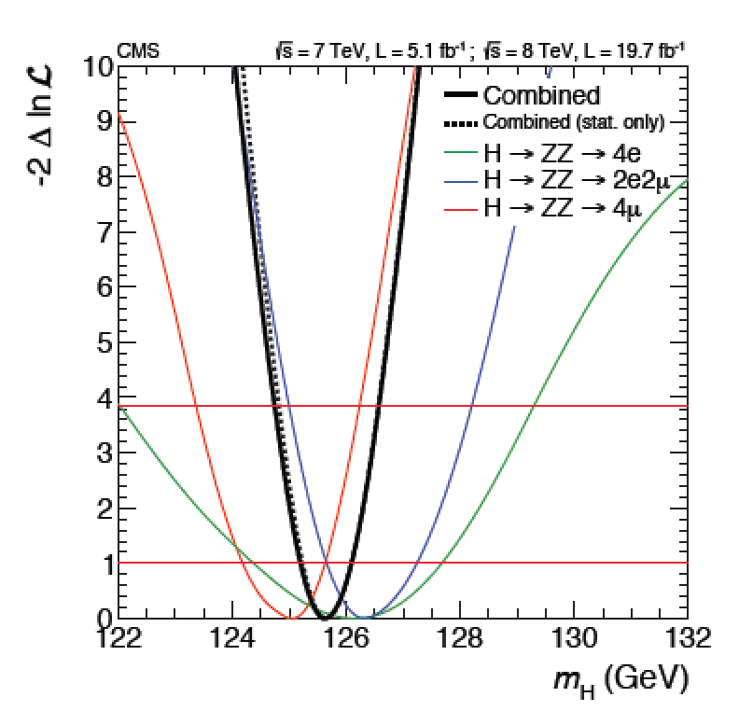
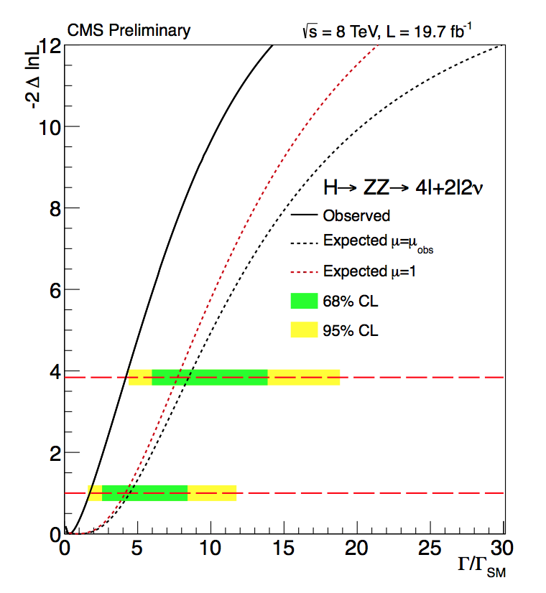
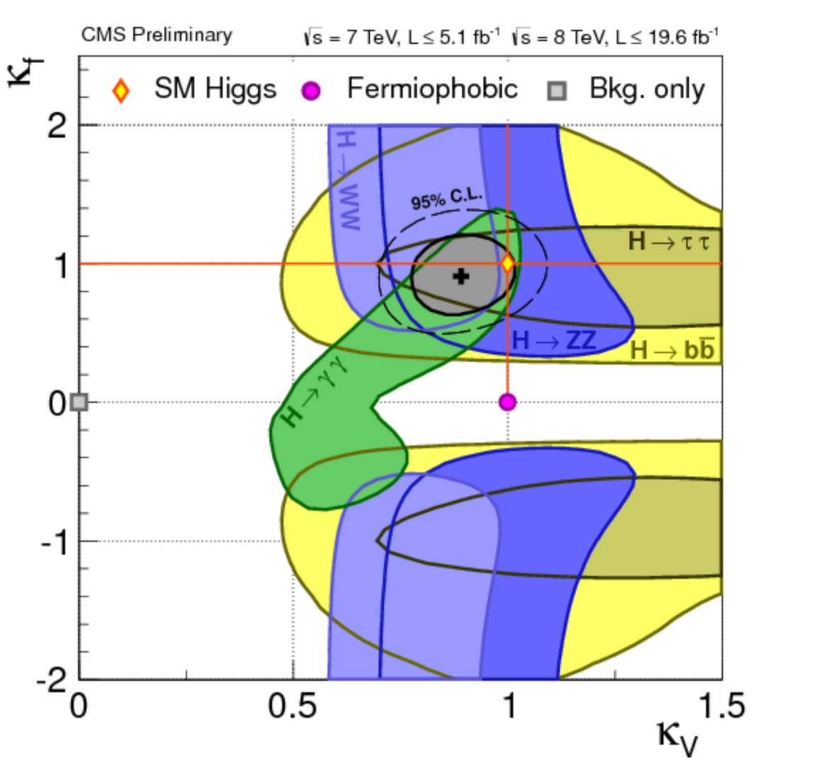
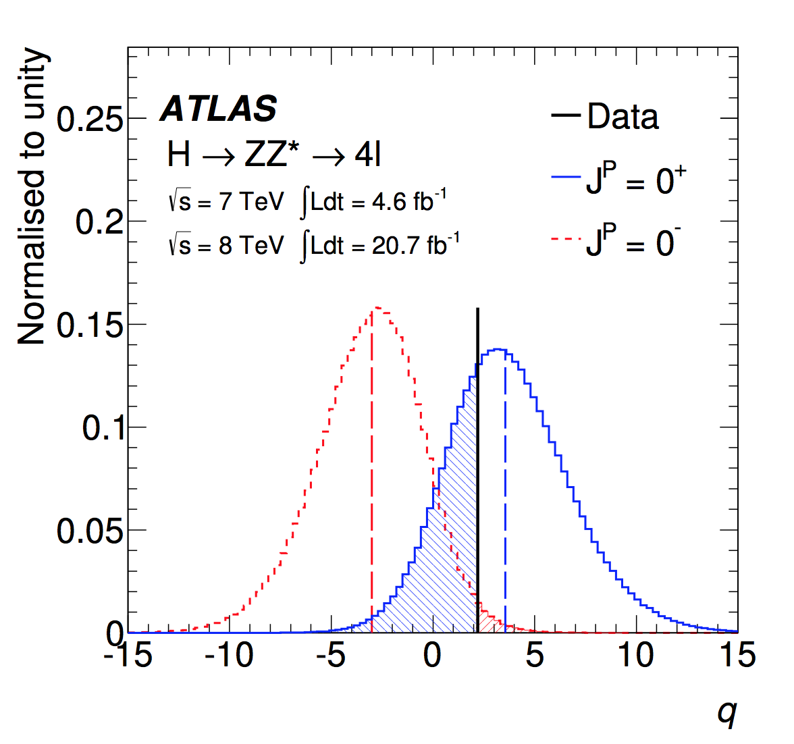

A Higgs…
We know already a lot on this Brand New Higgs Particle!!
Mass =
125.0 ±0.2 GeV
Width =
< 22 MeV
(95%CL)
Couplings are
within 20% of
the SM values
Spin =
0⁺ preferred
over 0⁻,1,2
Note: We study the properties of the Higgs carefully, and check if these in
Fact are as expected from the Standard Model. We also look for new “Higgses”

Slide 26
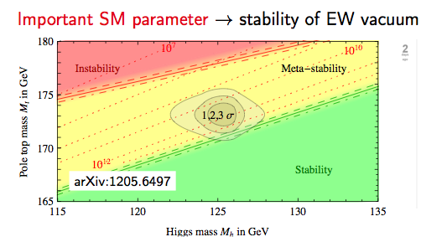
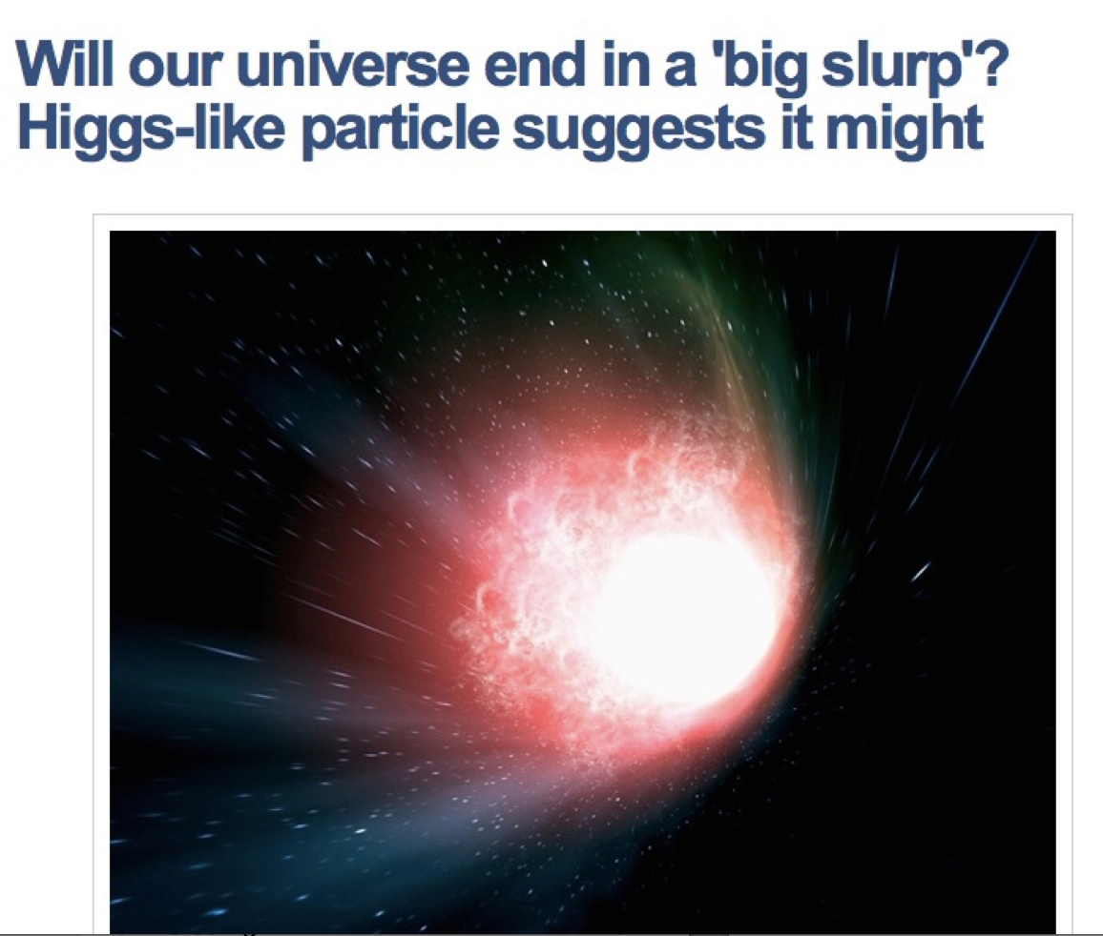


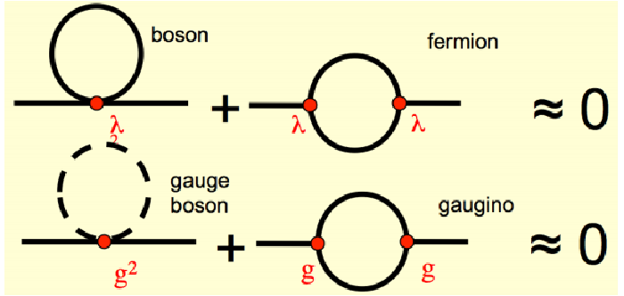

Consequences for our Universe?
Precise measurements
of the top quark and
first measurements of the
Higgs mass:
Our Universe meta-stable ?
Will the Universe disappear
in a Big Slurp? (NBCNEWS.com)
New Physics inevitable?
But at which scale/energy?
…The May 2014 Issue...
N. Arkani-Hamed

Slide 27
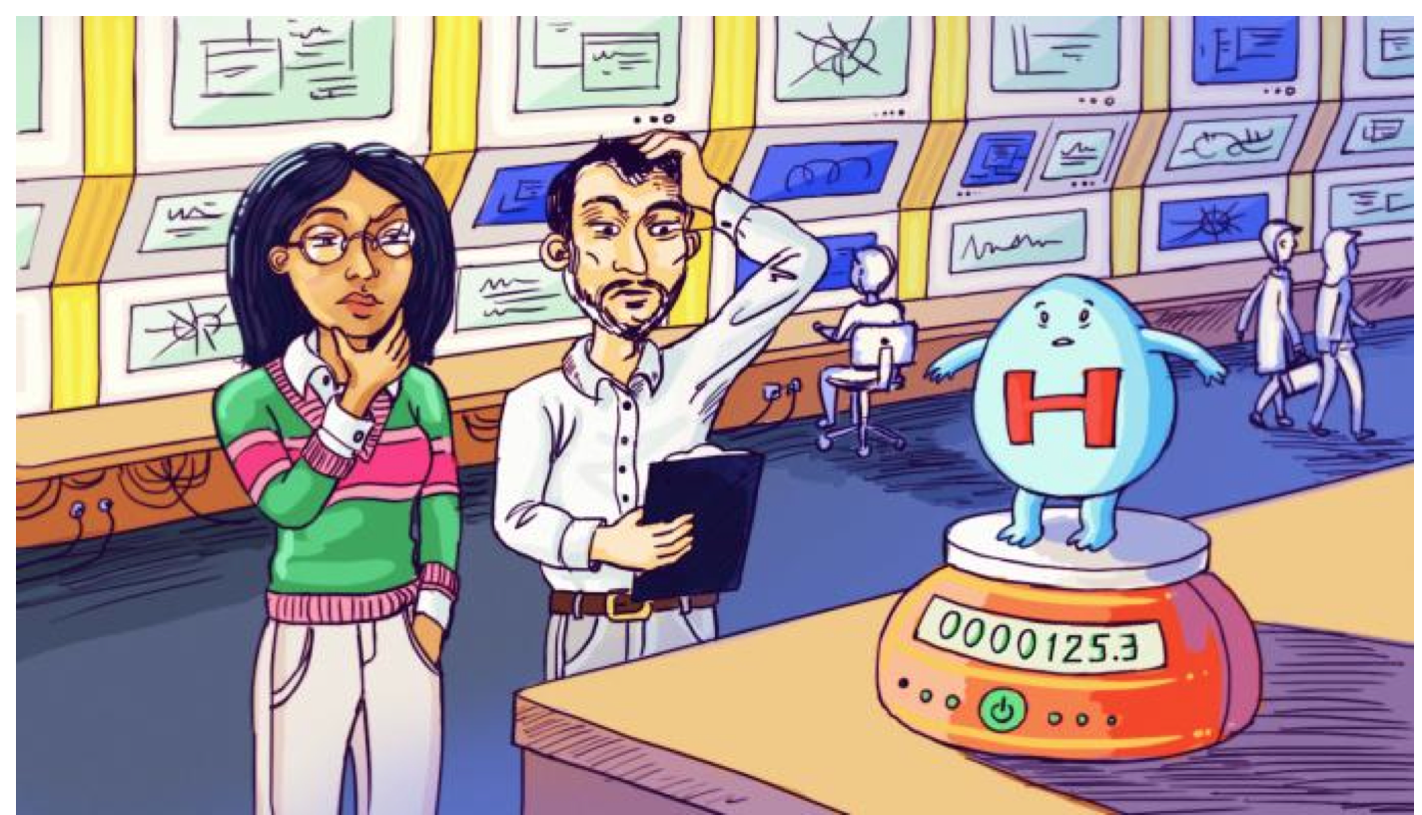
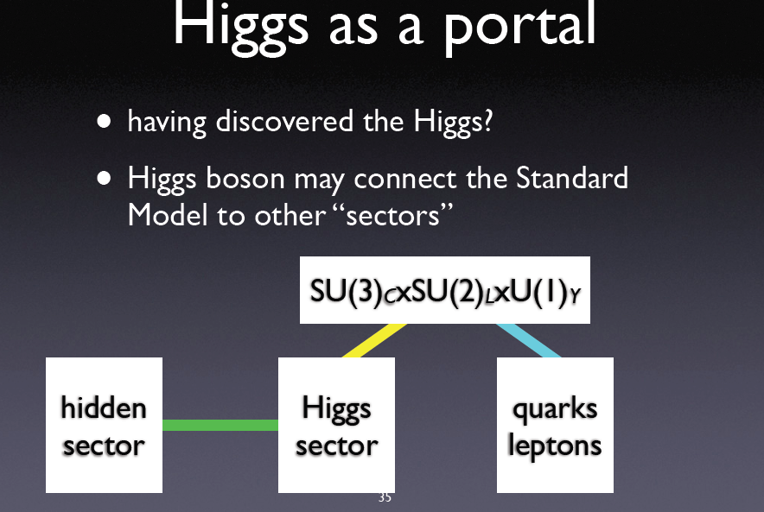
The Future: Studying the Higgs…
•More LHC Data 2015-2022
•LHC upgrade !
•Experiment upgrades!!
•(Other/new machines?)
Many questions are still unanswered:
•What explain a Higgs mass ~ 126 GeV?
•What explains the particle mass pattern?
•Connection with Dark Matter?
•Where is the antimatter in the Universe?
•…

Slide 28
Dark Matter at the LHC?
Are we Supersymmetric?
Next Questions…

Slide 29
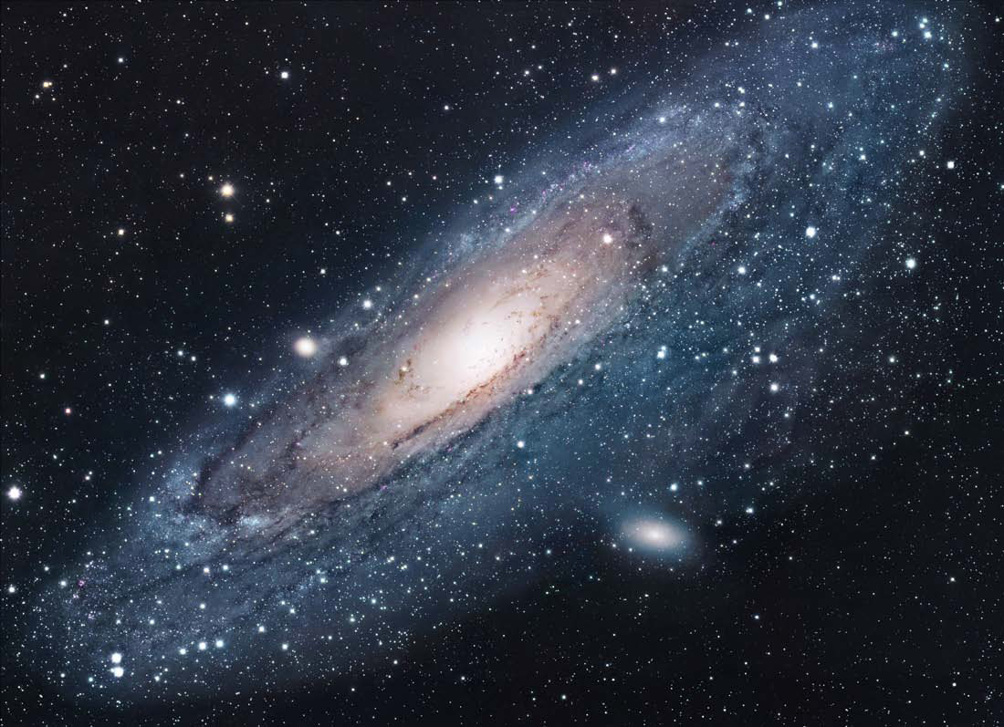
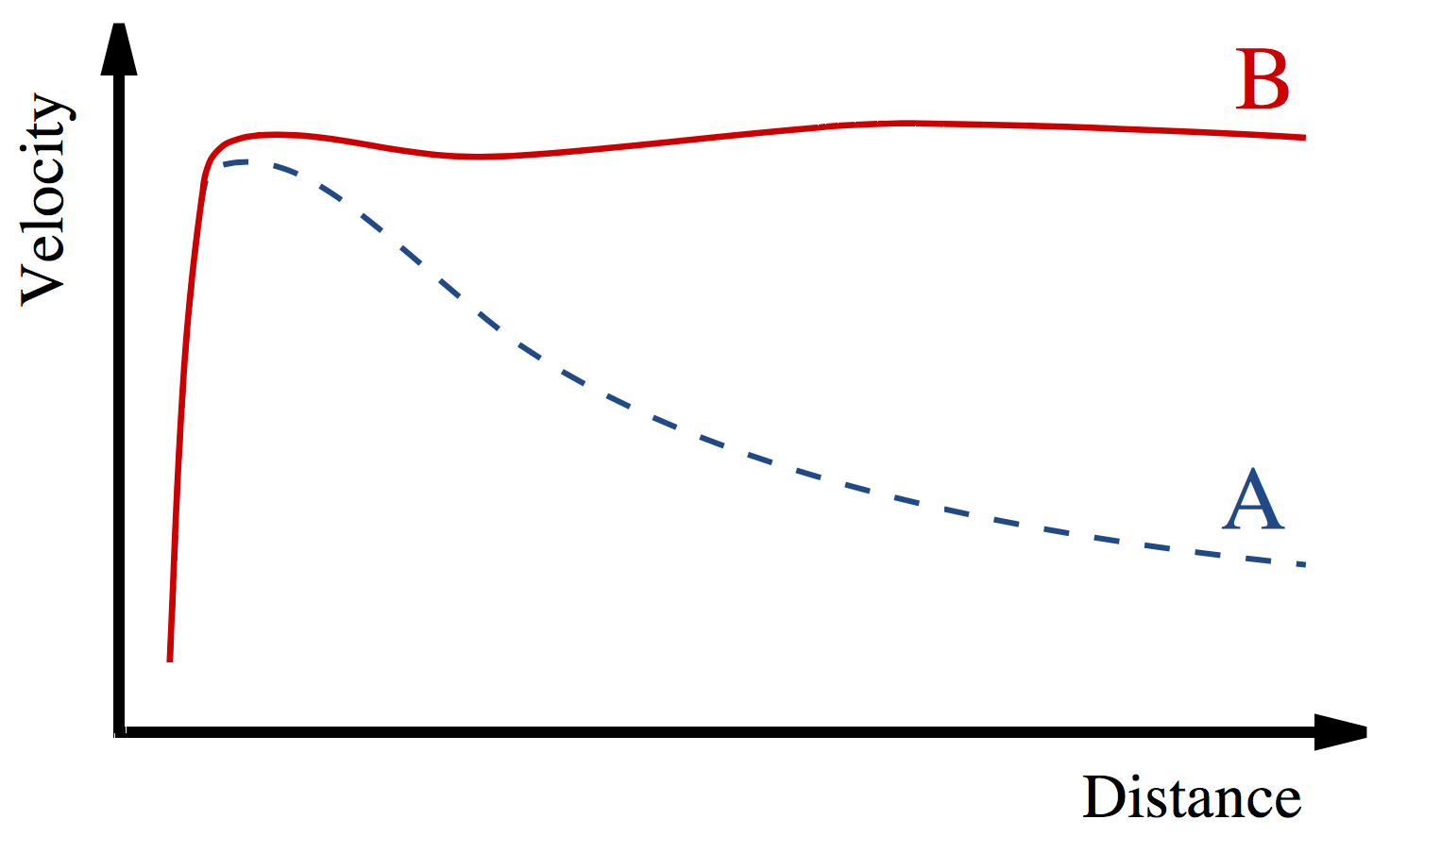
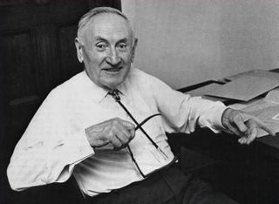
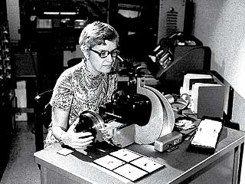
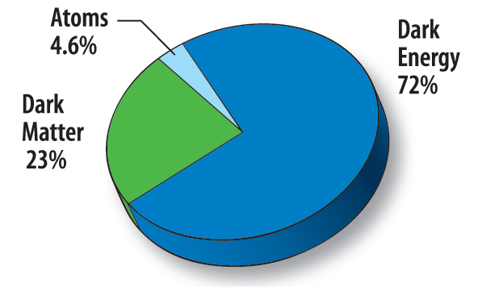
Dark Matter in the Universe
Astronomers found that most of the matter in the Universe must be invisible Dark Matter
‘Supersymmetric’ particles ?
Vera Rubin ~ 1970
F. Zwicky 1898-1974

Slide 30
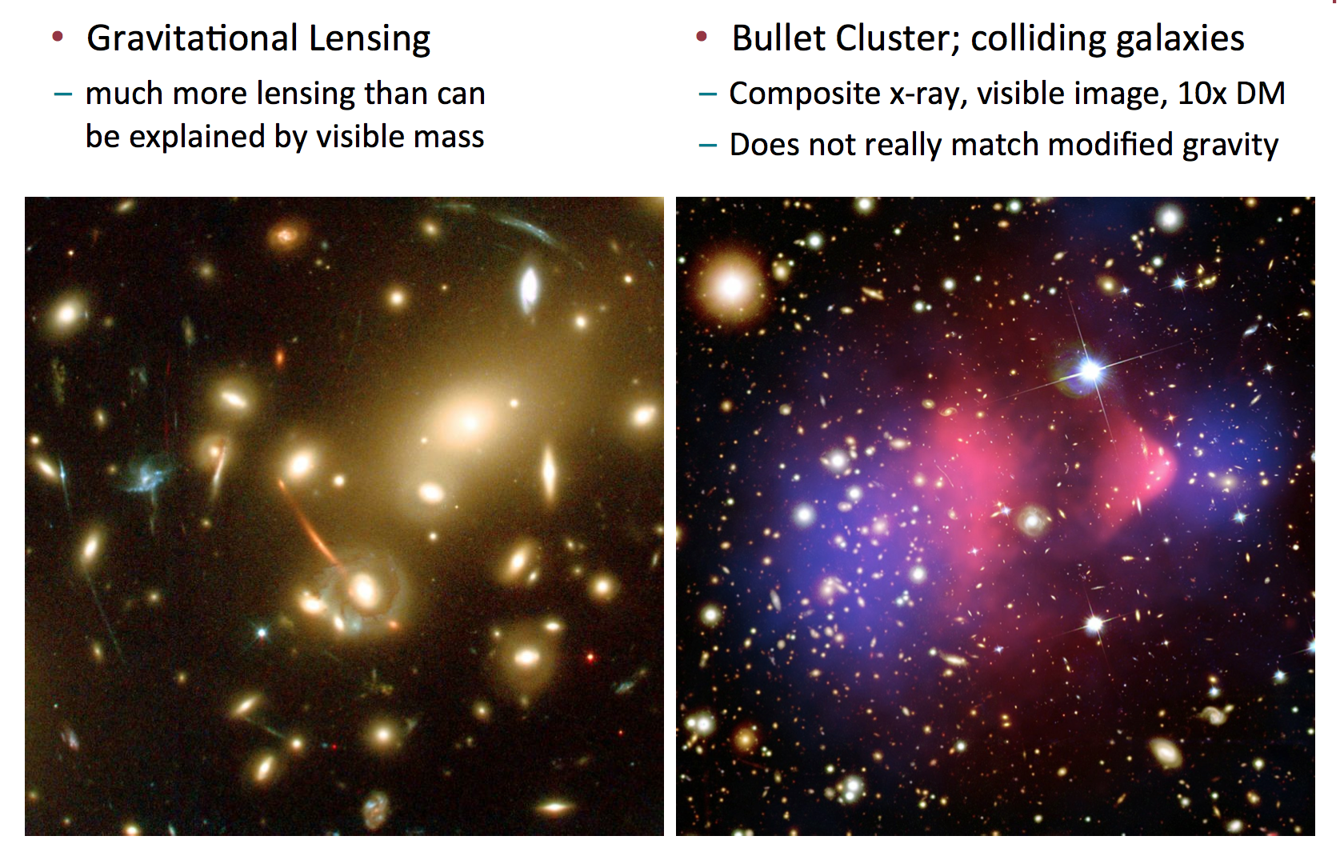
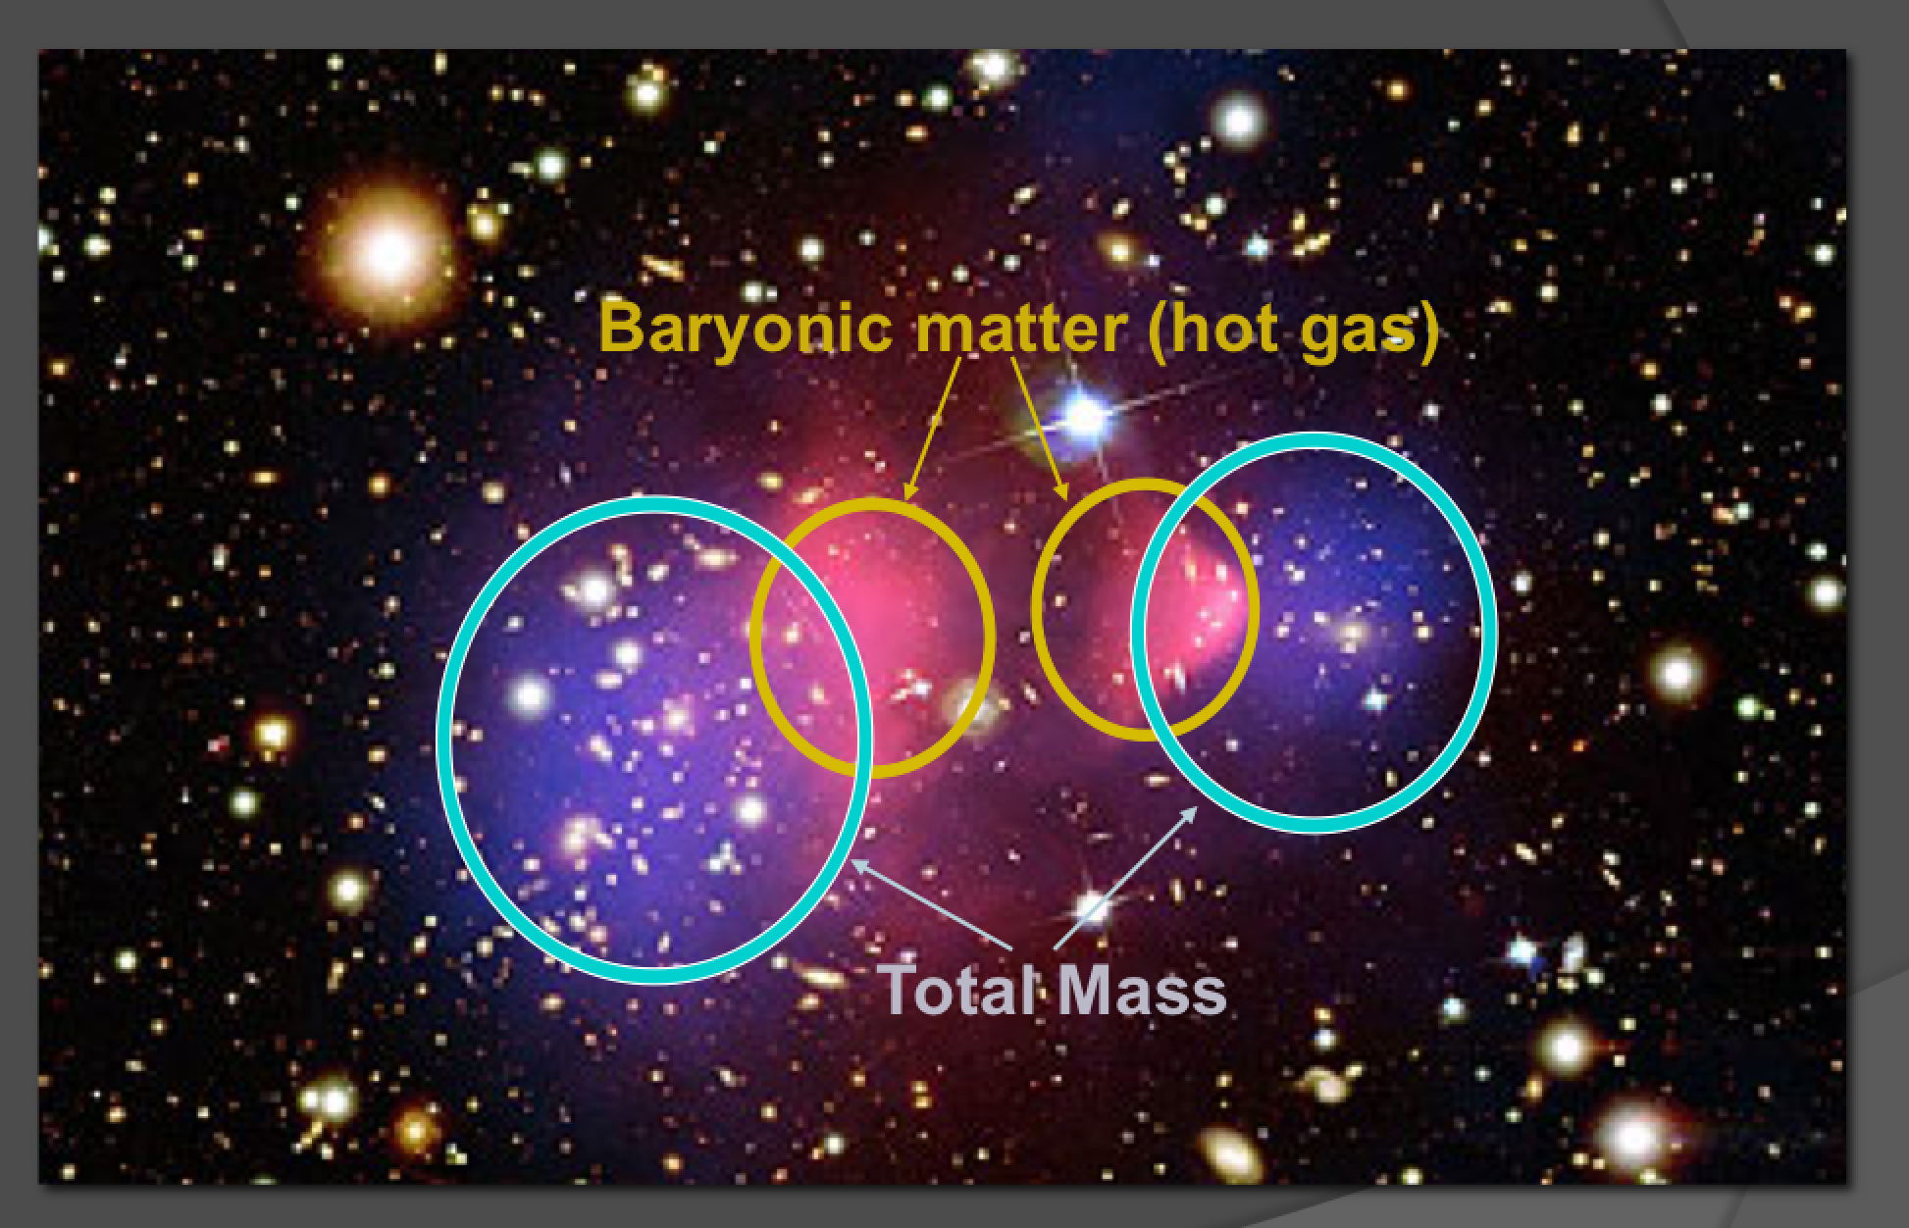
More Evidence for Dark Matter

Slide 31
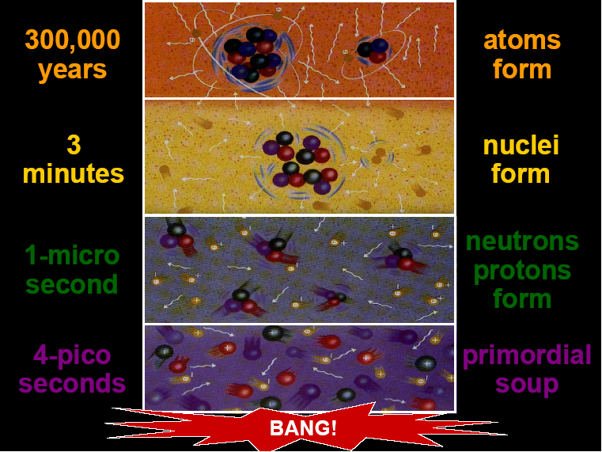
300,000
years
Formation
of atoms
3
minutes
Formation
of nuclei
Formation
of protons
& neutrons
1 micro-
second
Appearance
of dark matter?
1 pico-
second
Appearance
of mass?

Slide 32
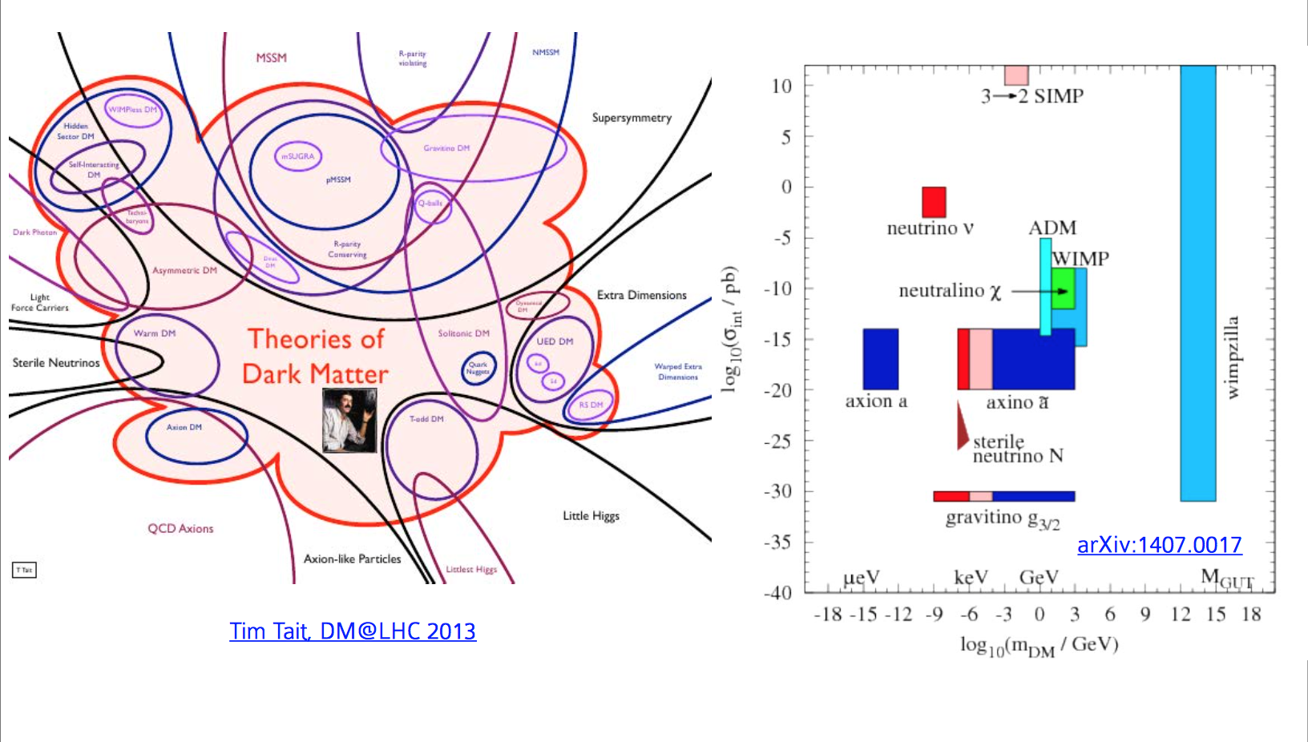
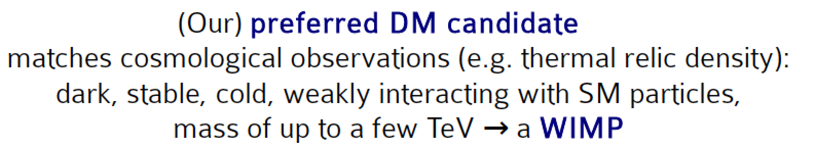
Theories on Dark Matter

Slide 33

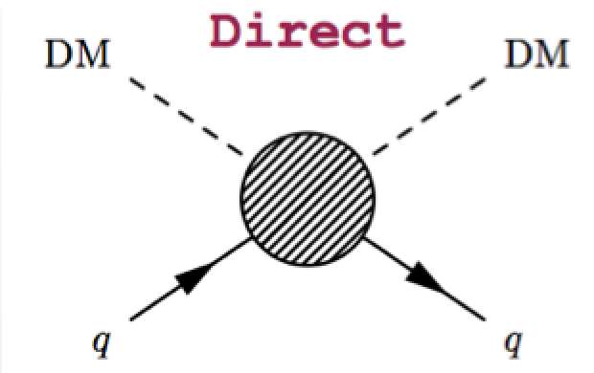

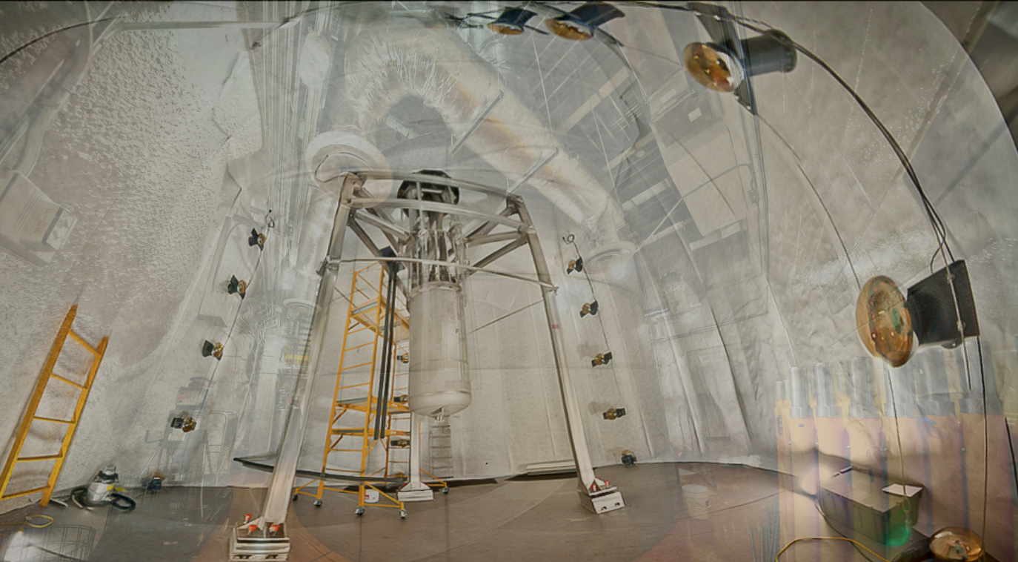
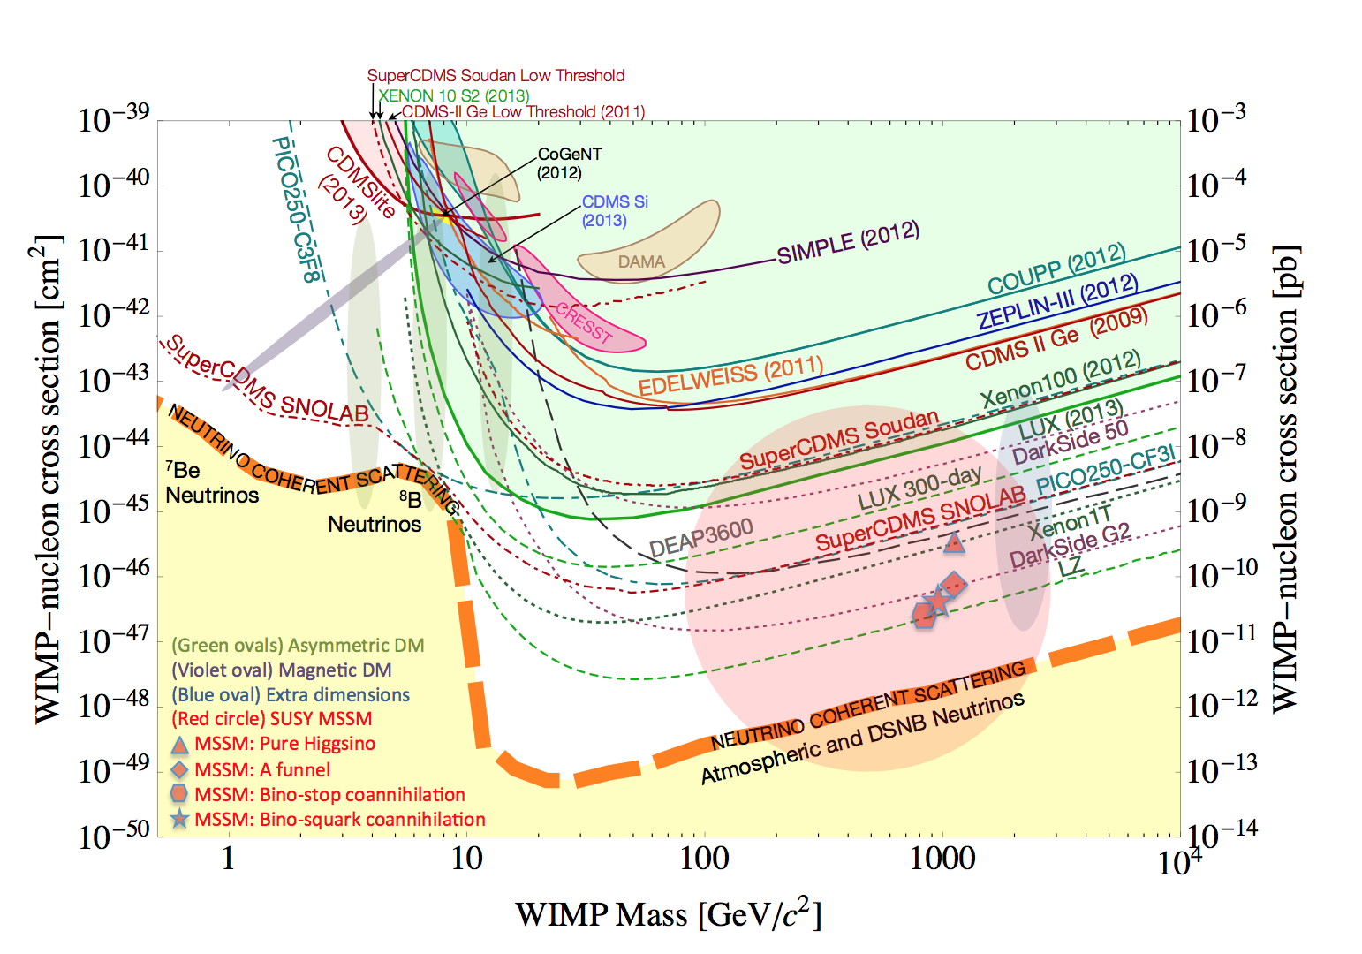
Direct Searches for Dark Matter
State of the art today:
Driven by the results of
the LUX experiment
Intensive campaign of
direct detection
experiments since more
than ~20 years
No (real) sign so far…

Slide 34
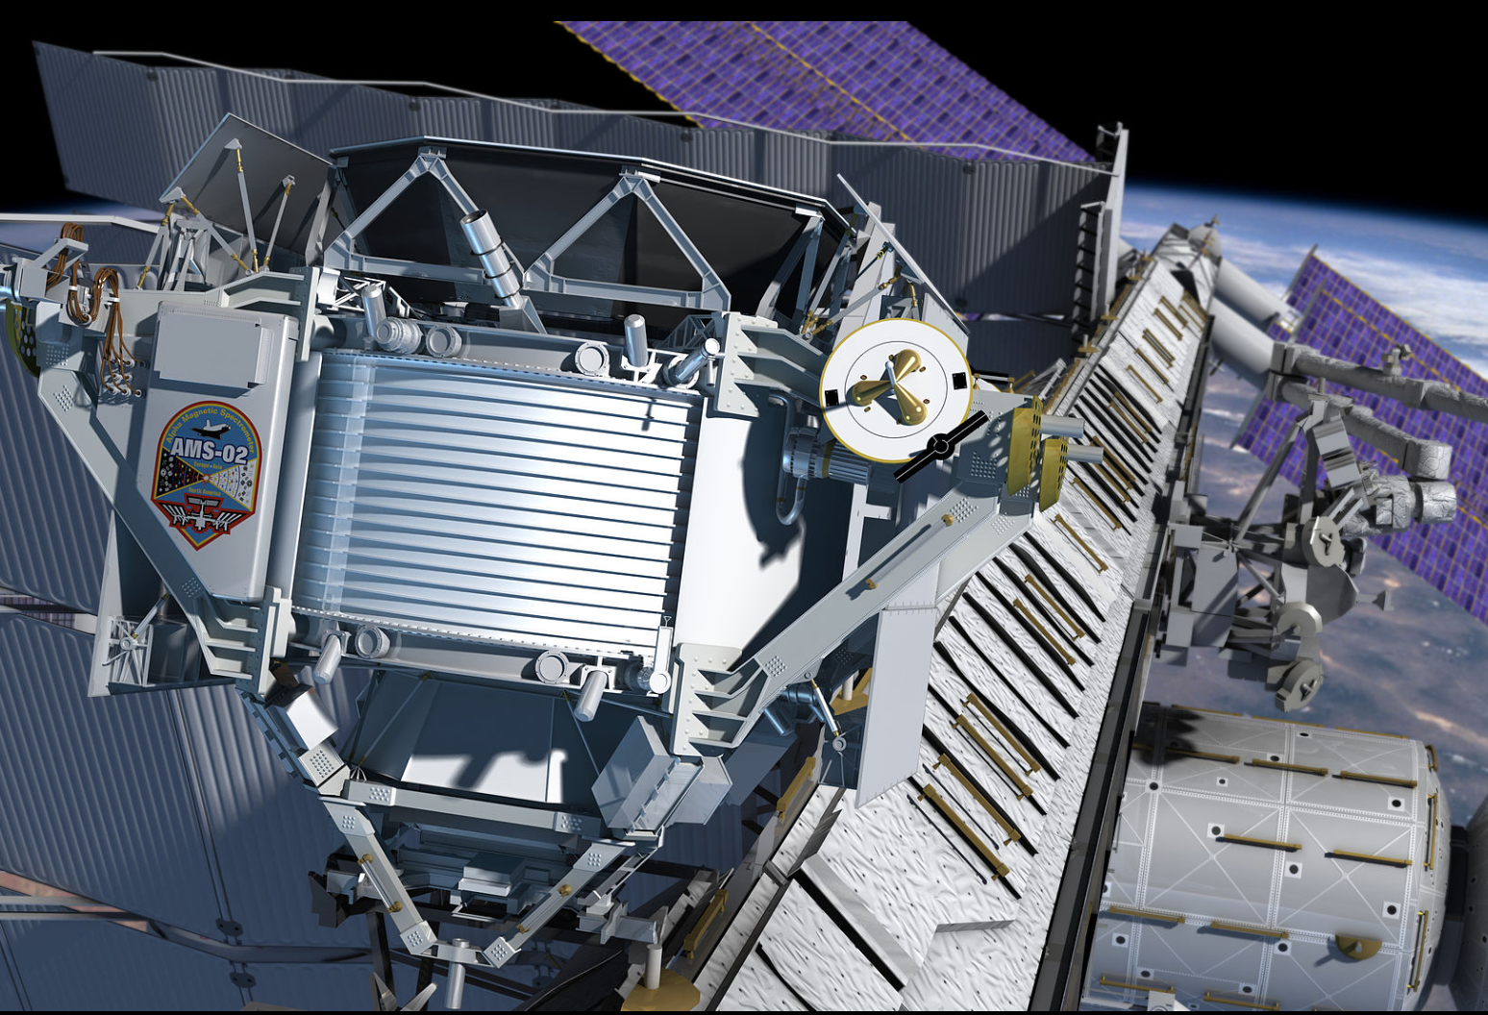

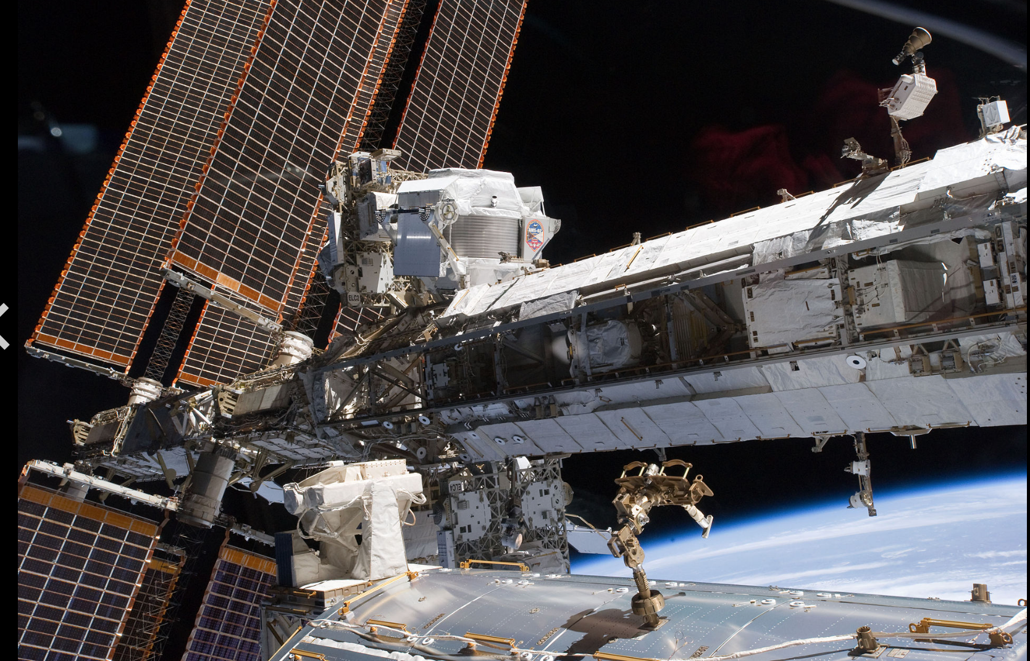
Dark Matter Searches in Space!
Visit the AMS control
room at CERN today…

Slide 35
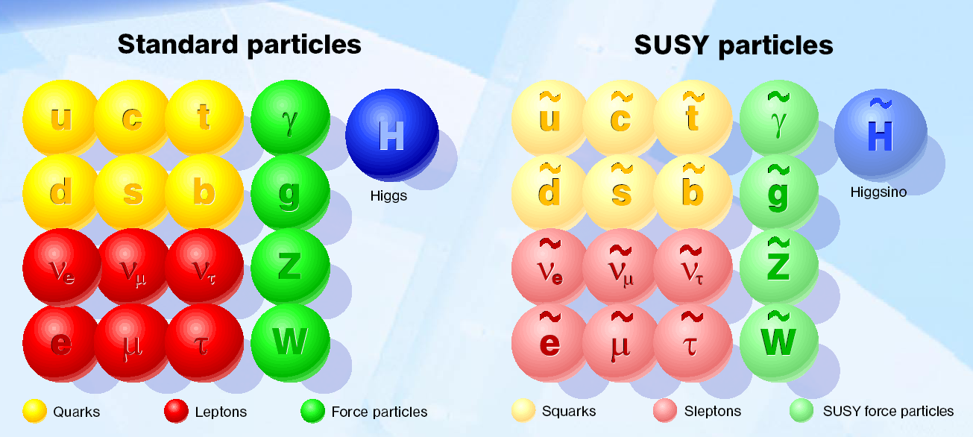
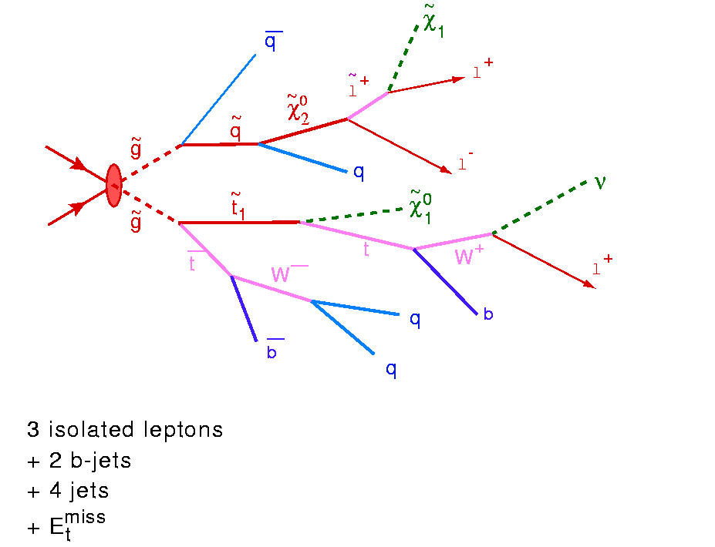
Beyond the Higgs Boson
Supersymmetry: a new symmetry in Nature?
Candidate particles for Dark Matter
⇒ Produce Dark Matter in the lab
SUSY particle production at the LHC
Picture from Marusa Bradac

Slide 36
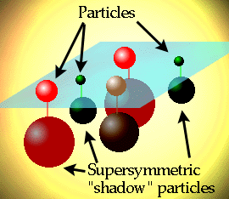
Supersymmetry
(Julius Wess and Bruno Zumino, 1974)
Establishes a symmetry between fermions (matter)
and bosons (forces):
- Each particle p with spin s has a SUSY partner p
with spin s -1/2
- Examples q (s=1/2) → q (s=0) squark
g (s=1) → g (s=1/2) gluino
~
~
~
Our known world
Maybe a new world?
Motivation:
- Unification
(fermions-bosons,
matter-forces)
- Solves some deep
problems of the
Standard Model

Slide 37
Supersymmetry
Supersymmetry (SUSY) → assumes a new hidden symmetry between the bosons (particles with integer spin) and fermions (particles with half integer spin). Stabelize the Higgs mass up to the Planck scale
Each particle with spin S has a SUSY
partner p with spin S -1/2
q (s=1/2) → q (s=0) squark
g (s=1) → g (s=1/2) gluino
f
H
-
f
Fermion and boson loops cancel, provided m ≤ TeV.

Slide 38


Supersymmetry
A VERY popular benchmark…
"One day, all of these will be supersymmetric phenomenology papers."
More than 10000 papers
since 1990
“One day all these trees will be SUSY phenomenology papers”
Considered as a benchmark for a large class of new physics models

Slide 39

Summary: Why SUSY is good for you!!

Slide 40


Detecting Supersymmetric Particles
simulation
Energy produced in the detector
θ
φ
Supersymmetric particles decay and produce a cascade of jets, leptons and missing transverse energy (MET) due to escaping ‘dark matter’ particle candidates
Very prominent signatures in CMS and ATLAS

Slide 41


…Some Interesting Collisions…
…already in 2010…
•Events with five jets of particles and large missing energy
which could come from a possible dark matter particle
•But a few events is not enough too prove we have something new
No visible excess has been building up with time…

Slide 42

SUSY Searches: No signal yet to date…
Status in 2013
•So far NO clear signal of
supersymmetric particles
has been found
•We can exclude regions
where the new particles
could exist.
•Searches will continue for
the higher energy in 2015
allowed
excluded
Plenty of searches ongoing: with jets, leptons, photons, W/Z,
top, Higgs, with and without large missing transverse energy
Also special searches for contrived model regions
CMS-SUS-11-015

Slide 43






The Generic Dark Matter Connection
Searches for mono-jets and mono-photons can be used to search for
Dark Matter (DM)
Use effective theory or simplified models to relate measurements to Dark Matter studies

Slide 44

Dark Matter at Colliders
Searching at the LHC for WIMPs
Weakly Interacting Massiver Particles

Slide 45



Mono-object Searches in CMS
Mono-jets: Generally the most powerful
Monophotons: First used for dark matter Searches
Mono-Ws: Distinguish dark matter couplings to u- and d-type of quarks
Mono-Zs: Clean signature
Mono-Tops: Couplings to tops
Mono-Higgs: Higgs portal of dark matter
Effective Field Theories for DM
interpretation are under scrutiny!
Alternatives such as SMS proposed…
Example Monojets
Dark Matter?

Slide 46

Mono-Jet Event

Slide 47

Mono-Jet Studies: Latest Results

Slide 48


Mono-object Searches in CMS
Mono-jets: Generally the most powerful
Mono-photons: First used for dark matter Searches
Mono-Ws: Distinguish dark matter
couplings to u- and d-type of quarks
Mono-Zs: Clean signature
Mono-Tops: Couplings to tops
Mono-Higgs: Higgs-portals
Higgs Decays?
Effective Field Theories for DM
interpretation are under scrutiny!
Alternatives such as SMS proposed…
arXiv:1407.8257
arXiv:1411.0535
Example Monojets
arXiv:1410.8812
arXiv:1408.3583
Dark Matter?

Slide 49
Are there Extra Space Dimensions?
Or Micro Black Holes?
New Questions…

Slide 50






Extra Space Dimensions
Problem:
No signal found yet
New Planck scale is
larger than 3 TeV
The Gravitational force becomes strong!

Slide 51

Large Extra Dimensions

Slide 52



Quantum Black Holes at the LHC?
Black Holes are a direct prediction of Einstein’s
general theory on relativity
If the Planck scale is in ~TeV region:
can expect Quantum Black Hole production
Quantum Black Holes are harmless for the environment: they will decay within less than 10⁻²⁷ seconds ⇒ SAFE!
real collision
R_{S}
Black holes with mass
below 6 TeV are excluded
Simulation of a Quantum Black Hole event

Slide 53


Search for Micro Black Holes
Nice events, eg a 10 jet event
Extra Dimensions!
Planck scale
a few TeV?
arXiv:1202.6396
Look for the decay producs
of an evaporating black hole
•Define S_{T} to be the scalar
sum of all high p_{T} objects
found in the event
•Look for deviations
at high S_{T}
Black hole masses excluded in range ~5 TeV depending on assumptions

Slide 54

Black Holes Hunters at the LHC…

Slide 55






New Physics?
New Gauge Bosons?
Supersymmetry
ZZ/WW resonances?
Technicolor?
Little Higgs?
Extra Dimensions?
Hidden Valleys?
Black Holes???
What stabelizes the Higgs Mass? Many ideas, not all viable any more
A large variety of possible signals. We have to be ready for that
Notes:
54

Slide 56



Are Quarks Elementary Particles?
Rutherford experiment:
Unexpected backscattering
of α-particles:
Evidence for the structure
of atoms !! (1911)

Slide 57





Are Quarks Elementary Particles?
Measurement of the production angle
of the jet with respect to the beam
-> High Energy Rutherford Experiment
Quarks remain elementary particles after these first results

Slide 58

Summary of Searches for Exotica

Slide 59
The Physics Program at LHC
Data taking started in 2010
Now we have more than 300 reviewed scientific papers per experiment!
Mostly measurements of the strong and electroweak force at 7/8 TeV and Searches
-Are quarks the elementary particles? So far yes
-Do we see supersymmetric particles? Not yet
-Do we see extra space dimensions? Not Yet
-Do we see micro-black holes? No
->The Discovery of a Higgs-like particle!!

Slide 60

Many Other New Physics Ideas…
Plenty!
  Compositeness/excited quarks & leptons
  Little Higgs Models
  leptoquarks
  String balls/T balls
  Bi-leptons
  RP-Violating SUSY
  SUSY+ Extra dimensions
  Unparticles
  Classicalons
  Dark/Hidden sectors
  Colored resonances
  And more….
Have to keep our eyes open for all possibilities:
Food for many PhD theses!! And Discoveries!!!

Slide 61





MoEDAL: Monopole and Exotics Detector at the LHC
Heavy particles which carry “magnetic charge”
Could eg explain why particles have “integer
electric charge”
Direct Monopole
production
Remove the sheets after some
running time and inspect for ‘holes’

Slide 62



LHC data and Theorists
NOW!

Slide 63

How does it feel to be a (BSM) Theorist?
H. Murayama
ICFA Seminar October 2011

Slide 64

Summary: The Searches at the LHC!
The LHC has entered a new territory. The ATLAS and CMS experiments are heavily engaged in searches for new physics. The most popular example is SUSY, but many other New Physics model searches are covered.
No sign of new physics yet in the first 20 fb⁻¹ at 8 TeV with the analyses reported in this lecture.. This starts to cut into the ‘preferred regions’ for a large number of models
More exotic channels are now being covered: monopoles, fractional or multiple charged particles, long lived particles… Still many unexplored channels left to explore
The LHC did its part so far with a great run in 2011 and 2012 Collected about 20 fb⁻¹@ 8 TeV by end of 2012
In 2015 the energy will be 13/14 TeV, excellent for searches
And maybe one day soon:

Slide 65

Electro-weak phase transition
(Higgs,…)
QCD phase transition
(quark gluon plasma)
LHC studies the first
10⁻¹⁰ -10⁻⁵ seconds…

Slide 66





Matter-Antimatter
The properties and subtle differences of matter and anti-matter using mesons containing the beauty quark, will be studied further in the LHCb experiment

