Slide 1
Large Piwinski angle and crab waist scheme in LHC
K. Ohmi, KEK
CARE-HHH, LHC beam-beam and beam-beam compensation
28 Aug.,2008
Thanks to F. Zimmermann, J.P. Koutchouk, O. Bruning, R. Calaga, R. Tomas, Y. Sun, A. Morita, M. Aiba

Slide 2
Two approach toward high luminosity in e⁺e⁻ colliders
High current, high beam-beam parameter.
Low emittance, low beta, low current, so-called super bunch collision
x
s

Slide 3
Tune shift
Short bunch Super-bunch(LPA)

Slide 4
Super B
 | SuperKEKB | Middle | SuperB (LNF/SLAC)
εx | 9.00E-09 | 6.00E-09 | 0.8E-09
εy | 4.50E-11 | 6.00E-11 | 2E-12
βx (mm) | 200 | 50 | 9
βy (mm) | 3 | 0.5 | 0.133
σz (mm) | 3 | 6 | 6
νs | 0.025 | 0.01 | 0.012/0.026
ne | 5.50E+10 | 5.50E+10 | 1.9E+10
np | 1.26E+11 | 1.27E+11 | 3.3E+10
θ/2 (mrad) | 0 | 15 | 25
ξx | 0.397 | 0.022
ξy | 0.794->0.24 | 0.179
Lum (W.S.) | 8E+35 | 1.00E+36 | 1.00E+36
Lum (S.S.) | 8.25E35 | 8-9E35

Slide 5
Crab crossing
Crab waist
Crab cavity
Sextupole magnet
Particles collide another beam at their waist point

Slide 6
Crab waist
Add sextupole magnets at both side of collision point for finite crossing collsion.
Effective potential is expressed as follows,
U(x,y,z)δ(s-s*)+Kxp_{y}²δ(s-s*-ε)-Kxp_{y}²δ(s-s*+ε)
Put sextupole magnets both side of the collision point at the vertical betatron phase difference, π(2n+1)/2 and horizontal mπ.

Slide 7
Crab waist scheme (P. Raimondi et al.)
Take linear part for y, since x is constant during collision.

Slide 8
Taking a=1/2θ_{h}
β waist is shifted to s=-ax
Beam particles with various x collides with other beam at their waist.
Waist position of red beam
Beam shape is not Gaussian, but is like triangle at IP.
Beam shape on red beam frame

Slide 9
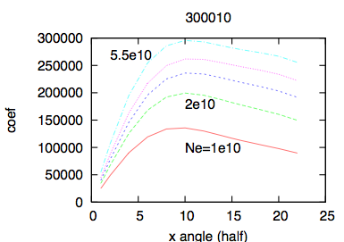
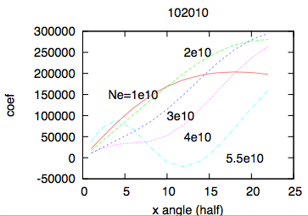
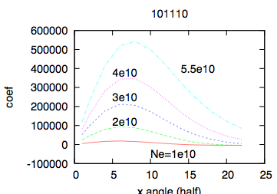
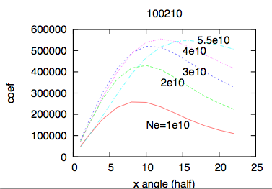
Taylor map analysis for KEKB
Resonance line ν_{x}-2ν_{y}=k is effective for the beam-beam limit in e⁺e⁻ colliders.

Slide 10
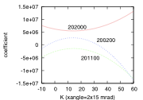
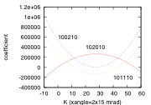
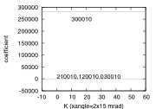
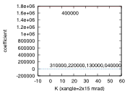
4-th order Coefficients as a function of crab sextupole strength, KEKB
H=K x p_{y}²/2, theoretical optimum, K=1/xangle.
Clear structure- 220,121
Flat for sextupole strength- 400, 301, 040

Slide 11
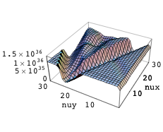
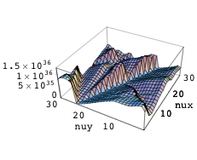
Tune scan of luminosity for super B
Crab waist ON OFF
(0.8,0.5)
(0.5,0.8)
(0.5,0.8)
(ν_{x}, ν_{y})=(0.5,0.5)
(ν_{x}, ν_{y})=(0.5,0.5)

Slide 12
A simple picture of the crab waist
The distribution is Gaussian for x₀ and p_{y0}.
Non-Gaussian distribution for x(s),y(s).
y(s)=y₀ for
s independent because of x=sθ_{h}

Slide 13
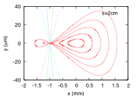
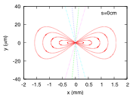
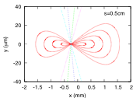
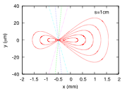
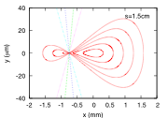
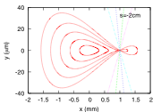
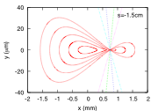
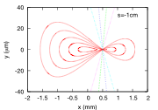
Beam distribution at s

Slide 14
Strength of Crab waist sextupole
Sextuples are located a position where the betatron phase difference is nπ and (n+1/2)π for horizontal and vertical, respectively. The strength is
For LHC, β_{x}=β_{y}=2000m, β_{x}*=β_{y}*=0.25m and θ_{h}=140μrad, K₂=0.08.
This value is not very large, since the strength of the normal sextupoles

Slide 15
Crab waist scheme at LHC
The waist position can be shifted along the axis of the colliding beam. However the gain is week for β_{xy}>σ_{z}.
Betatron phase of x and y varies simultaneously in the round beam.
Possible condition for crab waist in LHC
An example
φ=3.5 in LPA option. β_{y} can be squeezed to σ_{x}/φ=2.1cm. L increases (14/2.1)^{1/2}=2.6 times. ξ_{y} decreases and ξ_{x} is small for LPA.
Crab waist has an opportunity to work.

Slide 16
Another possibility
Waist control for parasitic collision
Betatron phase of beam particles rotate ~π/2 at parasitic collision points.
The distribution is Gaussian for p_{x} and p_{y}.
Non-Gaussian distribution for x(s) and y(s).
Choosing a and b, beam distribution can be distorted at parasitic collision points.

Slide 17
x(s)=x₀
y(s)=y₀
p_{x}=1/2θ for parasitic encounter.
The condition is s dependent and coupled for x and y.
For s=>-s, the condition break.
But this is Garbage idea.

Slide 18
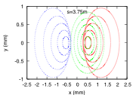
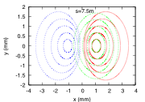
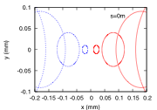
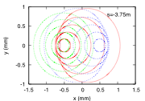
β=0.25m, 140μrad
a=30000, b=10000. Sorry for showing garbage.

Slide 19
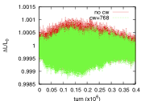
Crab waist in the nominal and upgrade LHC
Crab waist sextupoles may have some effects on halo in nominal or upgrade LHC.
In the beam intensity, the effects are not seen.
The effects in higher intensity (Np=10¹²) is investigated.

Slide 20
Large Piwinski Angle scheme
For a target Luminosity, there are choices for keeping ξ, β and Ι.
For example, increasing Piwinski (crossing) angle and bunch population can keep ξ. To keep Ι, bunch repetition is decreased.
This is gain for avoiding parasitic interaction depending on arrangement of separation magnet and wires.

Slide 21
LPA or crab cavity scheme
For σ_{z}<β_{xy}, both scheme seems to be compatible.
Crab waist scheme works well for σ_{z}>β_{y}.
Crab cavity installed in LPA scheme can deliver the same or more luminosity. If the beam-beam parameter becomes too high due to the crab cavity, the bunch population is decreased.
Luminosity leveling.

Slide 22
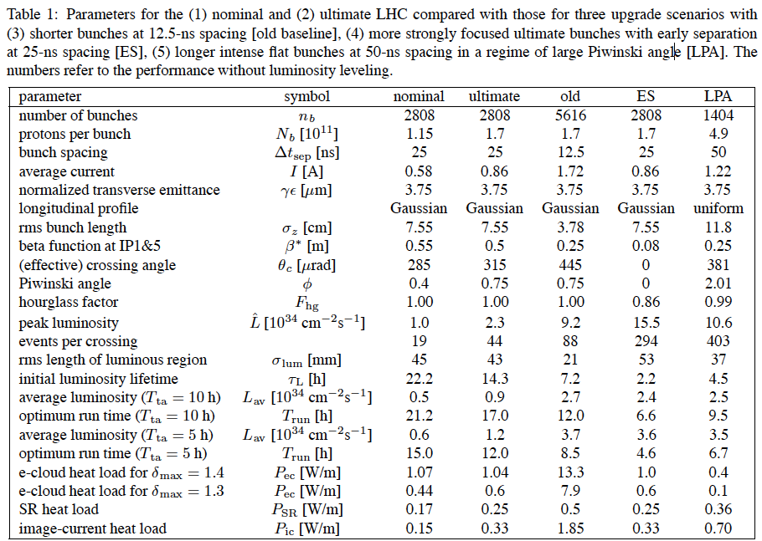
F. Zimmermann, PAC07, J.P. Koutchek, EPAC08
LPA-II
2808
2.5
25
1.22
3.75
Gaussian
7.55
0.14
786

Slide 23
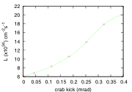
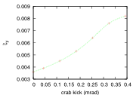
Luminosity with crab cavity in LPA-II
Luminosity and beam-beam parameter for LPA-II (393x2 μrad) with crab cavity

Slide 24
Summary
We could not find good solution for the crab waist scheme in LHC yet.

