Slide 1
Initial thoughts on “PicoTDC”:
Data framing
Readout
Architecture
Data buffers and SEU
Time offsets/parameters
Configuration
Monitoring
Test
Jorgen Christiansen, PH-ESE

Slide 2
Time measurement
Full time measurement:
  Course count (40MHz): 12 (cover LHC machine cycle)
  Fine count (2.56GHz): 6
  DLL interpolation: 5
  Resistive interpolation: 2
  Total TDC: 25
Edge lead/trail: 1
Channel ID: 4, 4 readout ports with 16 channels
6, 1 Readout port with 64 channels
5, 1 readout port with 32 channels
Data type field (minimum): 1
Total: 31bits - 33bits
Data packet: 32bits !
Type (1)
Channel (4-6)
Edge (1)
Coarse cnt (12)
Fine cnt (6)
DLL int (5)
Res int (2)
31 - 33 bits

Slide 3
4 readout ports, 16 channels
1 readout port, 32 channels
16/32 channel mode: DEFAULT FORMAT
Type (1)
Channel (4+1)
Edge (1)
Coarse cnt (12)
Fine cnt (6)
DLL int (5)
Res int (2)

Slide 4
1 readout port, 64 channels
DEFAULT: One course count bit less:
Type (1)
Channel (6)
Edge (1)
Coarse cnt (11)
Fine cnt (6)
DLL int (5)
Res int (2)
POSSIBLE OPTIONS: To be define which ones to implement
No edge bit: If only measuring leading or trailing
Type (1)
Channel (6)
Coarse cnt (12)
Fine cnt (6)
DLL int (5)
Res int (2)
No resistive interpolation:
Type (1)
Channel (6)
Edge (1)
Coarse cnt (12)
Fine cnt (6)
DLL int (5)
0
(No type identifier: Exception , separate signal required to mark valid data ! )
Channel (6)
Edge (1)
Coarse cnt (12)
Fine cnt (6)
DLL int (5)
Res int (2)

Slide 5
Leading + TOT
Packet Type: 1bit
Channel ID: 4 - 6 bits
Leading: >16 bits
  Large dynamic range
    16bit 3ps resolution: 200ns
    19bit 3ps resolution: 1600ns
  Programmable part of full 25bits leading TDC
  (Relative to trigger to be useable)
TOT (Relative to leading): >8 bits
  Short dynamic range:
    8bit 3ps resolution: 780ps
    11bit 3ps resolution: 6.1ns
  Programmable part of full 25bits TOT difference
    TOT assumed to be used for offline time-walk correction of leading.
Alternative: Readout of Individual Leading and Trailing edges with full range/resolution
  2x readout bandwidth
4 readout ports, 16 channels
Type (1)
Channel (4)
Leading (16)
TOT(11)
Type (1)
Channel (4)
Leading (19)
TOT(8)
1 readout port, 64/32 channels
Type (1)
Channel (6)
Leading (16)
TOT(9)

Slide 6
Relative to trigger
Single edge with full/reduced coarse count
Leading + TOT with prog. Resolution
A: Triggered with relative time and reduced coarse count: Same as absolute
4 readout ports, 16 channels or 1 readout port, 32 channels
Type (1)
Channel (5)
Edge (1)
Coarse cnt (12)
Fine cnt (6)
DLL int (5)
Res int (2)
1 readout port, 64 channels
Type (1)
Channel (6)
Edge (1)
Coarse cnt (11)
Fine cnt (6)
DLL int (5)
Res int (2)
B: Triggered with relative leading and TOT: Same as absolute Lead. + TOT
4 readout ports, 16 channels
Type (1)
Channel (4)
Leading (16)
TOT(11)
Type (1)
Channel (4)
Leading (19)
TOT(8)
1 readout port, 64/32 channels
Type (1)
Channel (6)
Leading (16)
TOT(9)

Slide 7
Framing
Triggered
  Event header per trigger
  TDC measurements (relative to trigger)
    Single edge
    Leading + TOT
  (Errors, per event)
  (Debugging, per event)
  Event trailer
  Idle/no data
Non triggered
  TDC measurements (absolute)
    Single edge
    Leading + TOT
  (Errors, when they occur)
  (Debugging, when ?)
  (Counter overflow)
  Idle/no data

Slide 8
Data frames
Header: Triggered
  Type: 1000
  Event ID: 12bit
  Bunch ID: 12 bit
Trailer: Triggered
  Type: 1001
  Event ID: 12 bit
  Status/error flags: 8bits
    Buffer overflows encountered.
    ?
  Number of hits or Check sum: 8bits
Errors: Triggered or non triggered (can be enabled/disabled)
  Type: 1010
  Status word with bit signalling what error
    Buffer overflows
    Hit error (time decoding)
    PLL loss of lock
    DLL loss of Lock
    SEU detect
    ?
  Error flags reset after having sent error status
  (error flags can also be read and reset via control/monitoring interface)
Monitoring/debugging: Triggered (can be enabled/disabled)
  Type: 1011
  Buffer occupancy: 64 L1 buffers * 8bit + 8 Readout FIFOs * 8 bit = 576bits !
  (can also be read via control/monitoring interface)
Counter overflow
  Type: 1100
TDC measurements:
  Type: 0xxx (xxx part of channel ID)

Slide 9
32bit frames
TDC measurement
Type (1)=0
TDC data (31)
Event header
Type (4)=1000
Event ID (12)
Bx ID (12)
Div(4)
Event trailer
Type (4)=1001
Event ID (12)
Flags(8)
#Hits/check (8)
Errors/status
Type (4)=1010
Error/status flags, TBC (28)
Monitoring data, possibly with sub-types to read out all buffer occupancies
Type (4)=1011
Sub-Type (8)
Monitoring data, TBC (20)
Coarse count overflow
Type (4)=1100
TBC (28)
Idle/null (When using 8B/10B this is part of coding)
Type (4)=1111
Undefined

Slide 10
Encoding
Byte lane using max 10 signals + clk.
Encoding not required.
Two options
  Data-valid strobe(s)
    Data valid
    First byte in 32bit frame
  8B/10B:
    Frames
    Idle
    Data lines NOT guaranteed to be DC balanced.
  Who drives Byte lane clock (40, 80, 160, 320M): TDC or GBT ?
    Normally GBT. Then we need to synchronize within the TDC
    TDC clock derived from ref clock normally coming from GBT
Serial: Encoding required
  DC balancing
  Embedded clock
  Byte, Frame alignment
  Idle
  8B/10B:
  25% overhead
  64B/66B encoding ?
  2 bit preamble
  64bit scrambled data
  3% overhead
  We have 32B frames and no 32B/34B coding exists

Slide 11
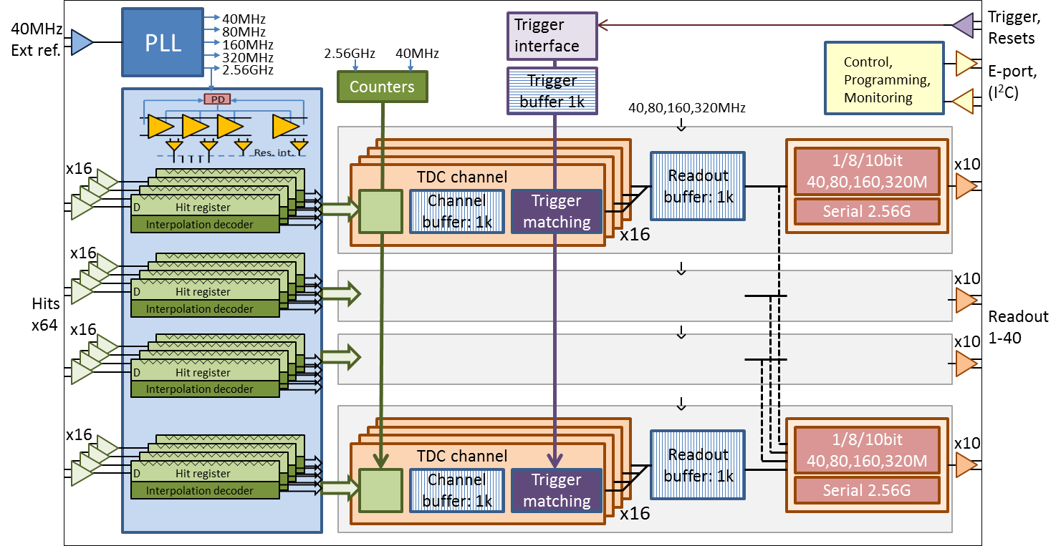
Block diagram

Slide 12
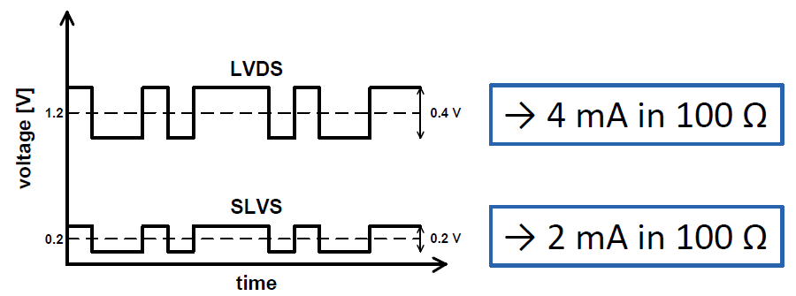
IO and Pins
Differential SLVS (LVDS on inputs)
Hits: 128
Clk: 2
Trigger, resets: 6
Readout: 80
Control: 6
  E-link: clk, Din, Dout
  (I²C ? )
  Single ended, Voltage
Div test: 8
Power, GND: 40
  PLL: 4
  TDC: 8
  I/O 16
  Core: 8
Total: ~270 (17 x 17 FPBGA)

Slide 13
Internal buffering
TDC time: 25bits
Edge: 1 bit
Channel ID:
  Latency buffer: 0bits, buffer per channel
  Readout FIFO: 4 Bits, buffer per 16 channels
Max TOT: 11bits
SEU detect: 1bit parity or Hamming
  Hamming for 32bit data: 6bit = 38bits
  Hamming for 26bits data: 5 bit = 31bits
  Extra parity bit to detect double errors (but not correct), (fits well for 26 bit data)
Latency buffer: Basic TDC measurements
  Full TDC time + edge
  Full Leading + TOT (or split across two words)
  SEU detect/(correct)
    SEU errors can seriously confuse trigger matching as hits may look like being out of time order
Readout FIFO: Data as it will be sent out on readout port
  Full TDC time + edge
  Required Leading + TOT
  Event separator: Header, (Trailer)
  Other: (error flags), (Monitoring)
  Final readout formatting can be done before or after readout FIFO, or as a combination
  SEU detect/(correct)
    SEU errors can corrupt/disturb readout data but not the TDC chip itself
Buffers: 32 bit wide or larger if required
  Latency buffer: 32 bit OK with 5+1 bit hamming if leading and trailing as separate words
  Readout FIFO: 32bit with 1 bit parity or 38/39 with hamming

Slide 14
Latency buffer
Required TDC data:
26bits
Edge (1)
Coarse cnt (12)
Fine cnt (6)
DLL int (5)
Res int (2)
11bits
Max_TOT(11)
Full TDC data in 32bit with 5+1bit hamming (single bit correct and double bit detect)
32bits
SEU (5+1)
Edge (1)
Coarse cnt (12)
Fine cnt (6)
DLL int (5)
Res int (2)
Leading + TOT requires two consecutive memory locations
Full Leading + max TOT: 36bits
36bits
Coarse cnt (12)
Fine cnt (6)
DLL int (5)
Res int (2)
Max_TOT(11)
Full Leading + max TOT + 6+1bit Hamming: 43bits
43bits
SEU (6+1)
Coarse cnt (12)
Fine cnt (6)
DLL int (5)
Res int (2)
Max_TOT(11)
Not interesting to protect only coarse count (requires 5+1bit hamming code)

Slide 15
Readout FIFO
Full TDC: 16/32 channel mode: DEFAULT READOUT FORMAT
Type (1)
Channel (5)
Edge (1)
Coarse cnt (12)
Fine cnt (6)
DLL int (5)
Res int (2)
Only 4 bit channel ID needed within channel group of 16
Room for 1 parity bit
Leading + TOT: 4 readout ports, 16 channels
Type (1)
Channel (4)
Leading (16)
TOT(11)
Type (1)
Channel (4)
Leading (19)
TOT(8)
No Spare bit for Parity
Full 6+1 bit Hamming on 32bit data: 39 bits
39bits
SEU (6+1)
32bit readout data (32)
Parity on 32bit data: 33 bits
33bits
Parity(1)
32bit readout data (32)

Slide 16
SEU protection
Configuration data:
  TMR (or on purpose NOT as not to be classified rad hard)
  Parity, simple SEU detect
State machines, counters:
  TMR (or on purpose NOT as not to be classified rad hard)
  One-hot with error detect and self reset, Simple SEU detect as in HPTDC
Data memories
  Latency buffer:
    Full Hamming
    Hamming on course count (used for Trigger matching)
    Parity
  Readout FIFO:
    Hamming
    Parity
    None
Hit registers:
  Fine time: No SEU protection but data verification as possible (bubbles)
  Course, Fine count: Parity to the extent possible
Data pipeline registers:
  Parity
PLL: To extent possible (e.g. phase detector)
DLL: Not needed
Must not be classified as 100% rad hard !

Slide 17
Time offsets/parameters
Coarse count offset: 12 bit
  Loaded with external BX-reset signal
  Not required every machine cycle as chip programmed to know LHC machine cycle.
Machine cycle period: 12 bit (Only support for LHC period)
  Must be taken into account:
    Coarse counter to zero
    Trigger counter to zero
    Channel offset
    TOT
    Comparison to trigger
    Relative to trigger
Per channel offset: 16 bit
Trigger latency: 12bit
Other ?

Slide 18
Configuration
Interface: E-port and/or I2C
  E-port: Get E-port IP block (Sandro/Kostas)
  (I²C: Get I²C block (Ken ?). Problem with IO and voltage levels)
Configuration bits
  PLL: 16
  DLL: 16
  Global clocking: 16
  Channel enable: 64
  Leading/trailing/both: 2
  Channel dead time: 8
  Coarse count offset: 12
  Machine cycle: 12
  Trigger latency: 12
  Reject latency: 12
  Trigger window: 12
  Channel offsets: 16 x 64 = 1024
  Data formatting: 32
  Readout: 32
  Test selects: 32
  Total: ~1300
Must be possible to reload and read config while running.
TMR or Parity

Slide 19
Monitoring
PLL status
DLL status
Div. status/error flags
SEU counts
Triggers
Buffer occupancies
Slow readout via control/monitoring path ?.
?

Slide 20
Test features
Access to raw data/inject specific hits ?
Scan path ?
Boundary scan path ?
BIST of memories ?
DLL ?
PLL ?
Other ?

Slide 21
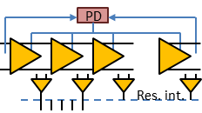
40MHz
Ext ref.
PLL
40MHz
Trigger
interface
Trigger,
Resets
80MHz
160MHz
2.56GHz
40MHz
320MHz
Control,
Programming,
Monitoring
2.56GHz
Trigger
buffer 1k
E-port,
(I²C)
Counters
40,80,160,320MHz
x16
TDC channel
Readout
buffer: 1k
1/8/10bit
40,80,160,320M
x10
D
Hit register
D
Hit register
D
Interpolation decoder
D
Hit register
Channel
buffer: 1k
Trigger matching
Interpolation decoder
Hit register
Serial 2.56G
Interpolation decoder
Interpolation decoder
x16
x16
D
Hit register
D
Hit register
x10
D
Interpolation decoder
D
Hit register
Interpolation decoder
Hits
x64
Hit register
Interpolation decoder
Interpolation decoder
Readout
1-40
x16
x10
D
Hit register
D
Hit register
D
Interpolation decoder
D
Hit register
Interpolation decoder
Hit register
Interpolation decoder
Interpolation decoder
x16
Readout
buffer: 1k
1/8/10bit
40,80,160,320M
x10
D
Hit register
TDC channel
D
Hit register
D
Interpolation decoder
D
Hit register
Interpolation decoder
Hit register
Interpolation decoder
Channel
buffer: 1k
Trigger matching
Interpolation decoder
Serial 2.56G
x16
PD
D
Hit register
Interpolation decoder
Res. int.
D
Hit register
D
Hit register
D
Interpolation decoder
D
Hit register
Interpolation decoder
Hit register
Interpolation decoder
Interpolation decoder

