Slide 2
The media plan in brief
. ESOF June 2014 – press briefing: LHC schedule 1st announcement
. December 2014 – Council press release: Restart confirmed for Spring 2015
.
. AAAS February 2015 – #RestartLHC press briefing
. March 2015 – #RestartLHC press briefing at CERN
. April 2015 – Beams back in the LHC – liveblog + press release + VNR + webcast Q&A
. May/June 2015 – Start of Run2 - liveblog + press release + VNR + (live) webcast Q&A
In addition to these steps, we have to adapt to the situation and send update to the media occasionally (short circuit, 13 TeV collisions?...)

Slide 3
LHC Restart
Global media coverage
Number of press cuttings – CERN & LHC
New DG PR + briefing
Short circuit
LHC Restart briefing
LHCb baryons PR
LHC Restart PR
AAAS briefing
CERN 60

Slide 4
LHC Restart
Media impact
Monthly unique visitors of media mentioning CERN (≈ potential reach)
Keywords CERN & LHC
Short circuit
LHC Restart briefing
AAAS briefing
CERN 60

Slide 5
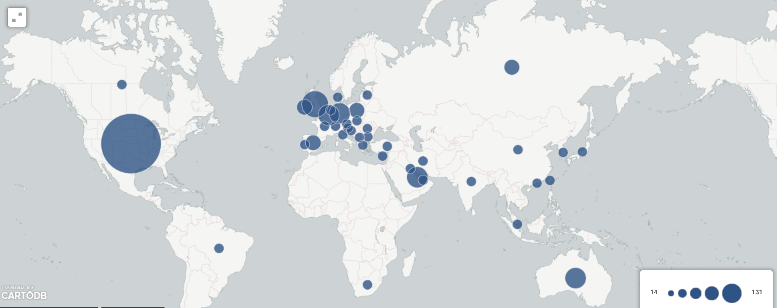
TV media coverage – Easter RestartLHC
Identified TV footage from CERN identified 555 times worldwide

Slide 6
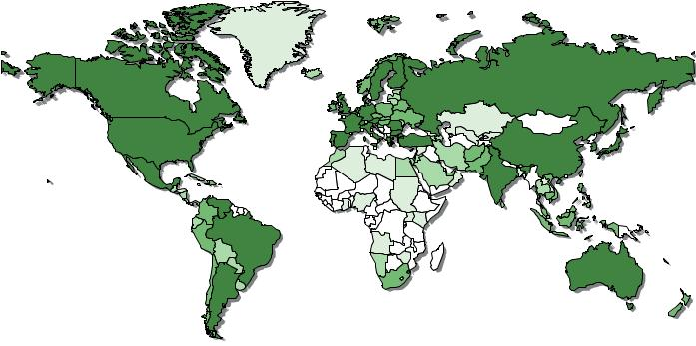
Media coverage by country
April 2015

Slide 7
Tone* of articles
April 2015
Negative
Positive
Neutral
*Tone as automatically defined by our media monitoring system - indicator to be taken cautiously

Slide 8
Potential upcoming updates (meaning web stories)
. 900 GeV collisions - tuning the experiments (done)
. Preparations in the experiments
. Beams at nominal intensity
. 13 TeV collisions tests – also sent to media (end of the week?)
. Increasing intensity and bunch spacing
. Scrubbing runs and electron clouds
. UFO/MUFO issues

Slide 9
Lessons from 450 GeV collisions
. Collisions before start of physics are challenging for us…
… But we try to prepare in advance and need to be reactive!
. What we did for 450 GeV collisions
. Nothing to the media in this case, but web story + social media
. Coordination with LHC experiments is key in such situations (messaging, event displays…)
. We monitor social media continuously in such a case in order to send out if needed as soon as needed
. Media reported quite correctly – they react very quickly to such news, but the coverage is not that high level for this – so it is fine
. The message for 13 TeV collisions happening before start of physics will be tricky

Slide 10
13 TeV collisions – this week?
. Messaging:
Test collisions at record energy is one of the last steps before the start of physics, to prepare the machine and the experiments
. An udpate in preparation:
Web story + social media + information to the media
Continuous social media monitoring
We may need some more proactive actions (depending the situation)

Slide 11
Start of Run2 event
. We should know about 1 week in advance and will inform stakeholders
. We will NOT announce timing
. We will have live blog on the day as for Easter week-end (including short videos when ready)
We will try to make videos available as fast as possible
. We will switch to live webcast when close to collisions + Q&A afterward
Live from experiment control rooms included
No news media onsite (but Discovery, Sixty Minutes for later documentaries)
. We will have press release + Footage to TVs (as for the Easter week-end)

Slide 12
Discussion
. Any plan(s) in the different countries?
. Anything you need from us?
Round table...

