Slide 2
CvmFS deployment status and trends
Alberto Rodríguez Peón, HEPiX Autumn 2015

Slide 3
Outline
What is CvmFS?
  Overview
  Stratum 0 and Stratum 1s
  Former Stratum 0 deployment
Redesigning our Stratum 0
  CEPH, ZFS, Zrep
Improvements in the way we do Ops

Slide 4

What is CvmFS?
A network file system that provide scalable and reliable software distribution
Data is aggressively cached and available on-demand
Every change on the file system is released using a publication model

Slide 5
Stratum 0 and Stratum 1s
Hierarchical distribution network
Client
Client
Client
read-only
Stratum 1x
Client
read-write
read-only
Stratum 1
Client
Stratum0
Stratum 1
Stratum 1
Client
Client
Client
Client
Single source of new data
Replication of Stratum0
In this talk we will focus
on CERN’s Stratum0 deployment!
Local-cache pulling for changes

Slide 6
CERN’s Stratum 0
At CERN we maintain 21 CvmFS repositories
  Most of them very active repositories, e.g.
    cms.cern.ch: 16630 releases, 1.31T of space used
    lhcb.cern.ch: 32029 releases, 897G of space used
  But some are not …
    aleph.cern.ch: 4 releases, 627M of space used
    opal.cern.ch: 3 releases, 6M of space used
  All together sum up to ~ 10Tb
    ~ 44 million files

Slide 7
“Old” Stratum0 deployment
All CvmFS repositories used to share a monolithic NetApp filer
NetApp Filer
Backup
SLC6
Stratum 0
atlas.cern.ch
Mirrored via
FS snapshots
NetApp Filer
SLC6
Stratum 0
aleph.cern.ch
Backed up regularly to tape
Each repository lived in
a dedicated server
Tape Server
Notes:
Filer split in independent qtrees

Slide 8
Moving to CEPH
Not viable to continue using NetApp
  NetApp filer reaching end of warranty, need to avoid technology blocking
The most sensible choice for storage is CEPH
  Works well with OpenStack and is centrally provided by CERN IT
This change gave us the opportunity to rethink our deployment model
  Identify and recover from different failure scenarios
  Ease the rollback to a previous state
  Avoid wasting resources

Slide 9
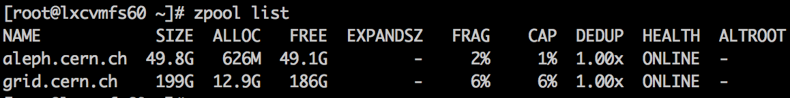
ZFS between CEPH and CvmFS
ZFS is both a file system and logical volume manager
  Inspired by the work of the NFS service team at CERN
A ZFS pool per CvmFS repository give us:
  Filesystem snapshots
  “Live” data integrity checks
  “Live” migration and resize of a volume
  Easy data replication
  Possibility to have several pools (several file systems) per server

Slide 10
“New” Stratum0 deployment
Every repository uses a single CEPH volume,
but can share a Stratum0 server
Backup
SLC6
Stratum 0
atlas.cern.ch
CEPH ZFS
atlas.cern.ch
CEPH ZFS
atlas.cern.ch
ZFS snapshots
replication
SLC6
Backup
Stratum 0
Backup
CEPH ZFS
grid.cern.ch
CEPH ZFS
grid.cern.ch
ZREP
SLC6
Stratum 0
grid.cern,ch
opal.cern.ch
Backup
CEPH ZFS
opal.cern.ch
CEPH ZFS
opal.cern.ch

Slide 11
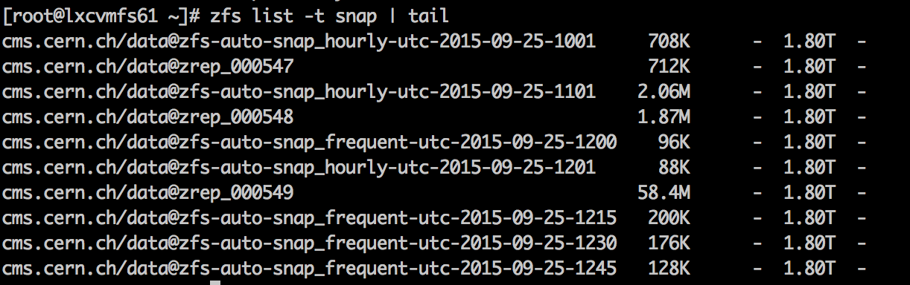
Rolling back the whole FS
ZFS snapshots at filesystem level
  Essential in case CvmFS history gets corrupted
  ZFS snapshots are cheap
  Periodically or on-demand (e.g. triggered by a CvmFS hook)
  Rewinding is as easy as “zpool rollback <snapshot_name>”

Slide 12
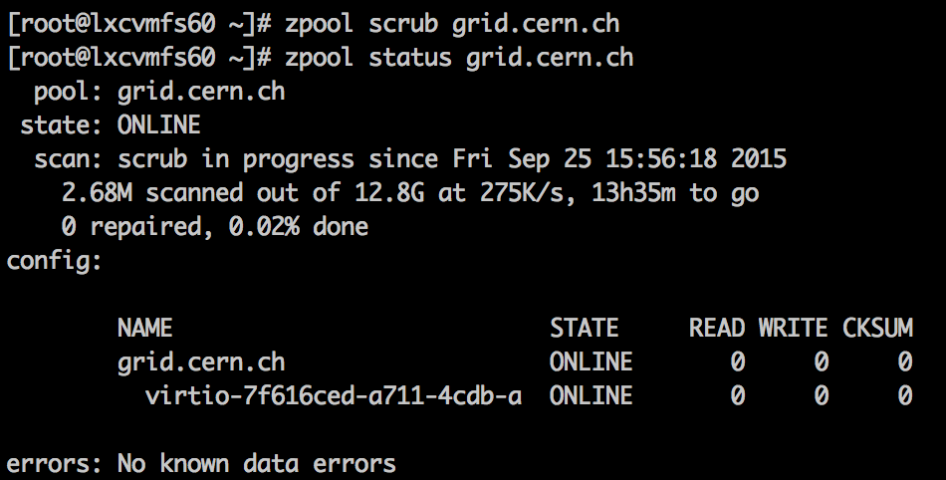
Checking for data integrity
ZFS includes its own repair tool called scrub
  Checks and repairs silent corruption on live disks
  Cronjob runs it once a month

Slide 13
ZREP
An open-source solution for ZFS replication
    http://www.bolthole.com/solaris/zrep/
    Not the usual rsync-based system
      Wrapper around ZFS send and receive
    Replicates both content and snapshots
    Provides locking and failover features
  One thing we don’t like happens when a replication fails
    Then manual intervention is needed
    Rolling back the backup to the most recent common snapshot is usually enough

Slide 14
Recovering from server failure
Easy to detach and re-attach the CEPH volume to a spare server
  Gracefully with “zpool export atlas.cern.ch virtio-1234-etc…”
  If we don’t have access to the server, detaching via OpenStack is also an option (but could lead to data corruption)
Stratum 0
atlas.cern.ch
CEPH ZFS
atlas.cern.ch
Stratum 0
Stratum 0
atlas.cern.ch

Slide 15
Recovering from disk failure
We can hot-replace a misbehaving volume directly with its backup
  Then, replicate its content to a new empty CEPH volume to get back to the original state
Stratum 0
atlas.cern.ch
Backup
CEPH ZFS
atlas.cern.ch
Backup
CEPH ZFS
atlas.cern.ch
Backup
Stratum 0
Backup
CEPH ZFS
atlas.cern.ch
CEPH ZFS
CEPH ZFS
atlas.cern.ch
ZREP
CvmFS deployment status and trends

Slide 16
Conclusions & Future work
We are reasonably happy with our situation
  Both CEPH and ZFS have simplified the way we do Ops!
But we are just starting…
  Spread disks and backup across datacenters (Meyrin and Wigner)
  Automate our procedures
    Replacing a damaged volume, Zrep going out of sync, etc.
  Reconsider whether dumping data to Tape can help
  Investigate ZFS on some kind of RAID

Slide 17
References
  CvmFS Puppet Module
  https://github.com/cvmfs/puppet-cvmfs/
  ZFS on linux
  http://zfsonlinux.org/
  https://docs.oracle.com/cd/E19253-01/819-5461/zfsover-2/
  http://open-zfs.org

