Slide 1

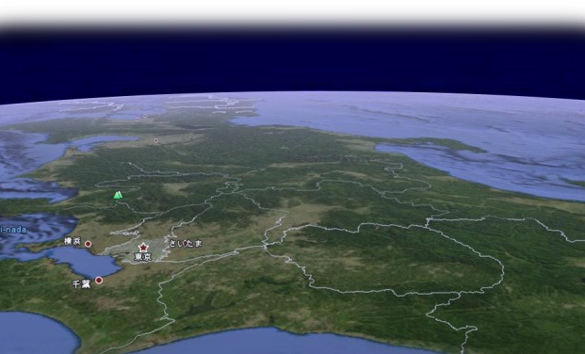
T2K, T2K upgrades and HyperK
神岡
Kami oka
東海
Tō kai

Slide 2
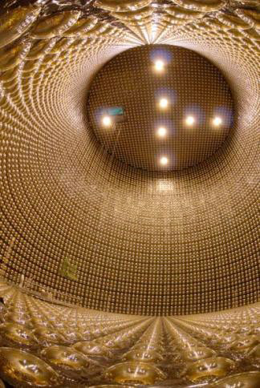
Idea of T2K was born 1999-2001 hep-ex/0106019 combining:
-- existing SuperKamiokande detector (50kton W.Č., 22.5 kton fiducial)
-- JAERI-KEK Japanese Proton Accelerator Research Complex (JPARC)
at TOKAI including a high power, 0.75MW/30GeV Proton Synchrotron
neutrino beam from pion decay π⁺ →μ⁺ ν_{μ}
-- baseline 295 km ➔ neutrino energy for first maximum is ~650 MeV
achievable by pion-decay beam at 2.5 degrees off-axis

Slide 3
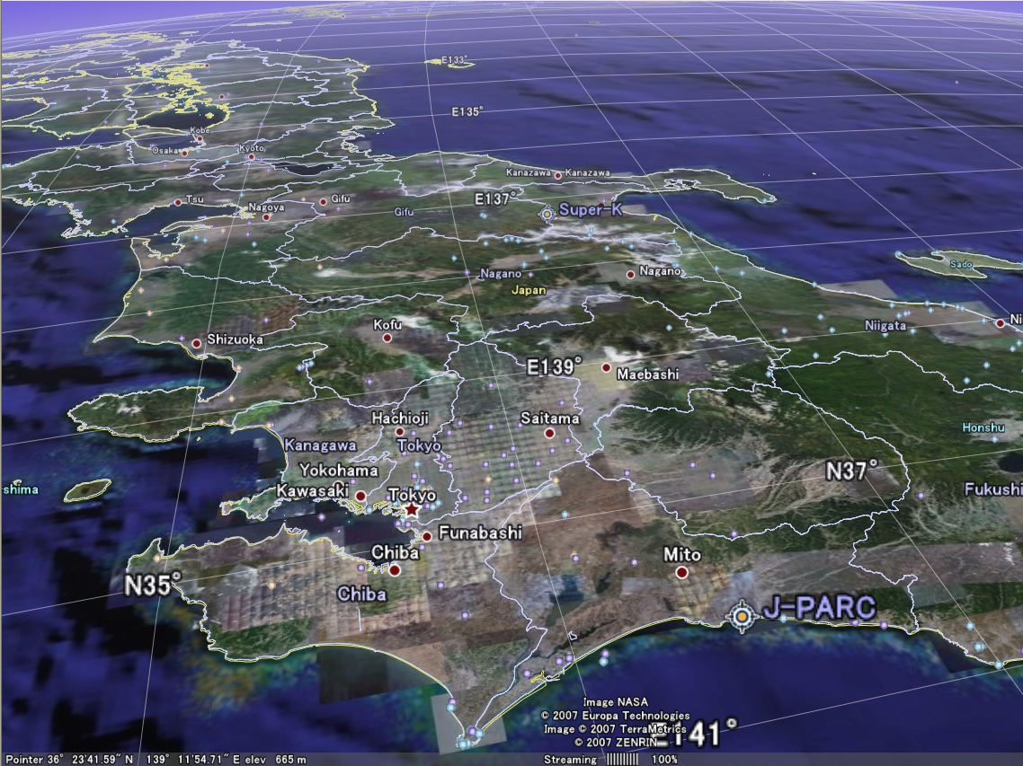
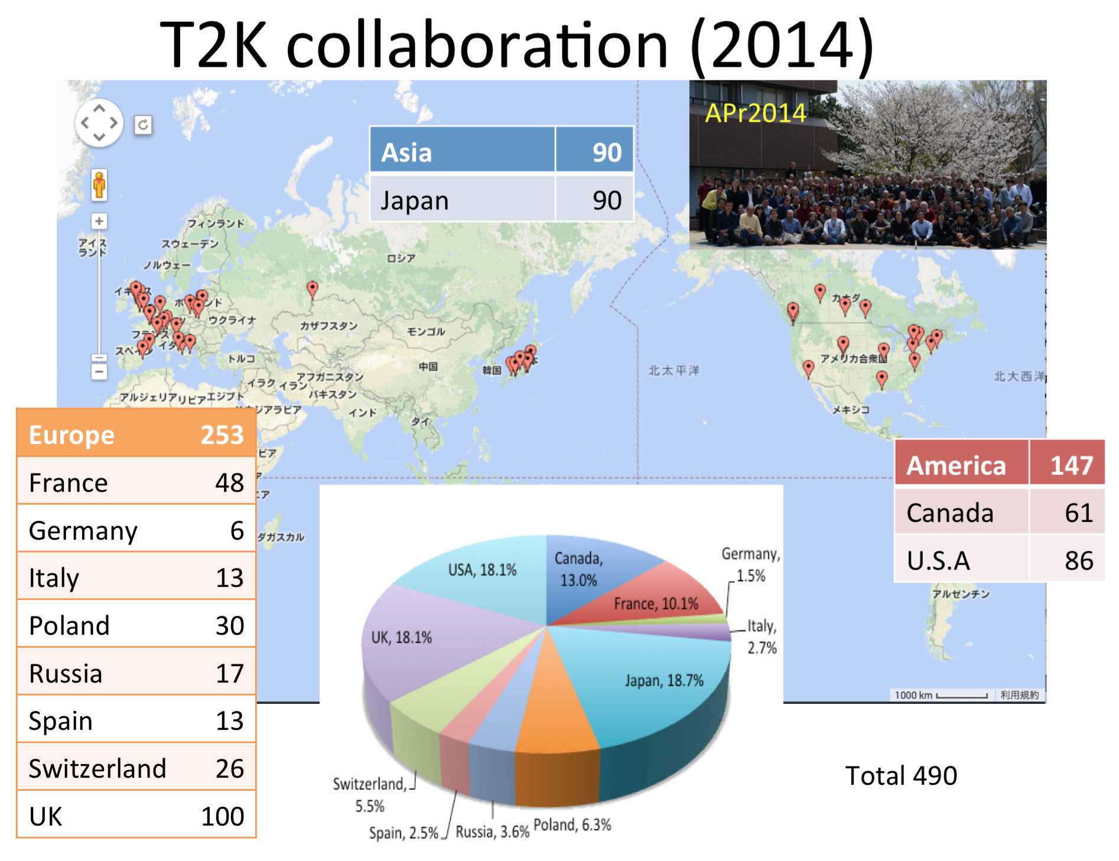
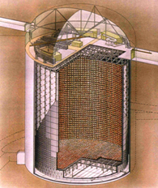
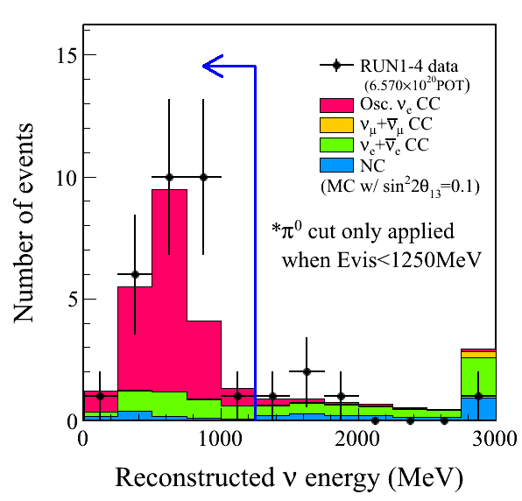
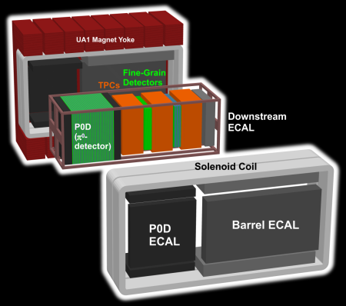
#
T2K Long Baseline Neutrino
Oscillation Experiment
Attack fundamental questions of nature, eg,
How matter (us) was created in the Universe
What is the ultimate law to govern extreme microscopic world
through exploring most elusive elementally particle called “neutrino”
40m^{φ}x40m^{H}
50kt Water Cherenkov det.
Super-Kamiokande
Discovery of appearance of electron neutrino
Near neutrino detector
295km
Muon neutrino beam
7.3σ
T2K collaboration ~500 collaborators from 59 institutions, 11 countries
Funded in FY2004, Started measurements in 2010
First discovery of ν_{e} appearance in ν_{μ} beam
Best measurement of ν_{μ} disappearance
Opens the door for CP violation measurements
  Could be the key to matter in the universe!

Slide 4

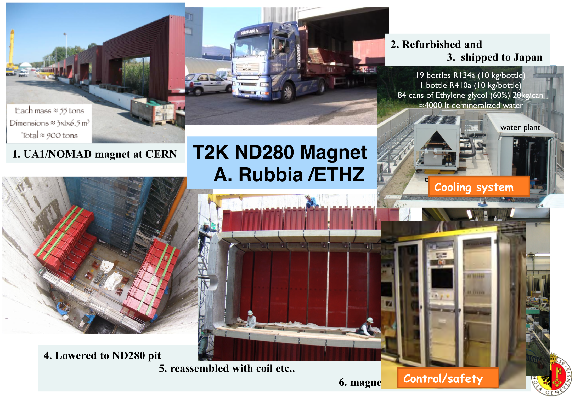
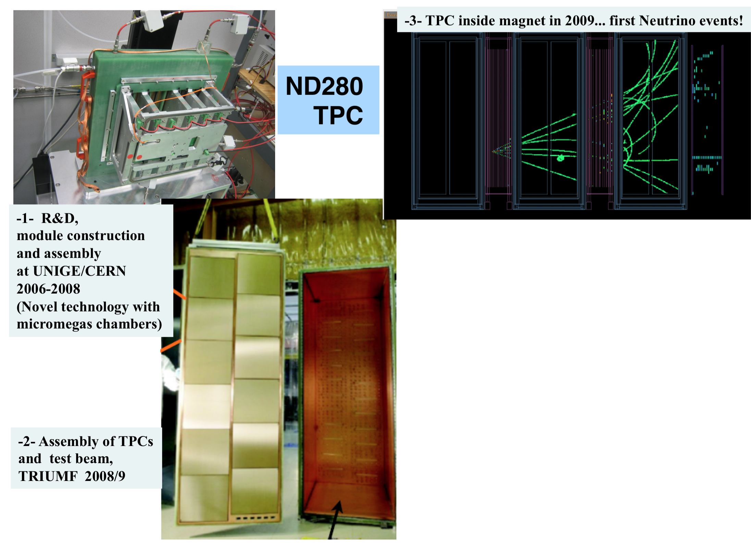
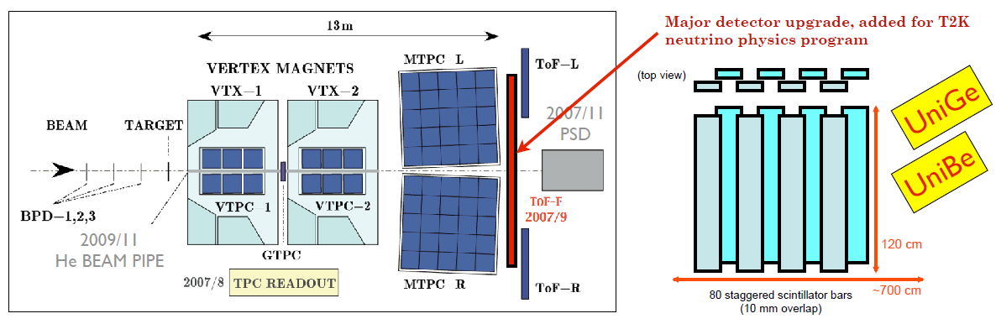
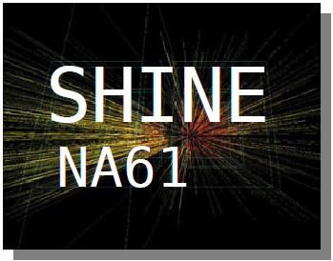
Swiss contributions to T2K
Collaboraton
  University of Bern (Prof. A.Ereditato)
  University of Geneva (Prof. A.Blondel)
  ETH Zurich (Prof. A. Rubbia)
  24 scientists + engineers & technicians (34 total) + 8 PhD students + 5 PhD thesis
Contributions
  Responsibility on UA1 magnet
  Tracking detector TPC
  Essential NA61 measurement for T2K at CERN
Total contributions since 2005:
  3.1 MCHF (FORCE/FLARE/SINERGIA) for hardware, common fund, maintenance
  Adding manpower and travel: over 10MCHF (SNF, ETHZ, University funds and foundations)
Refurbishment, transport, installation, commissioning, operation of UA1 magnet donated from CERN
Contributions to near detector TPC
Critical input data for T2K from experiment at CERN
Analysis: UniGE, ETHZ

Slide 5
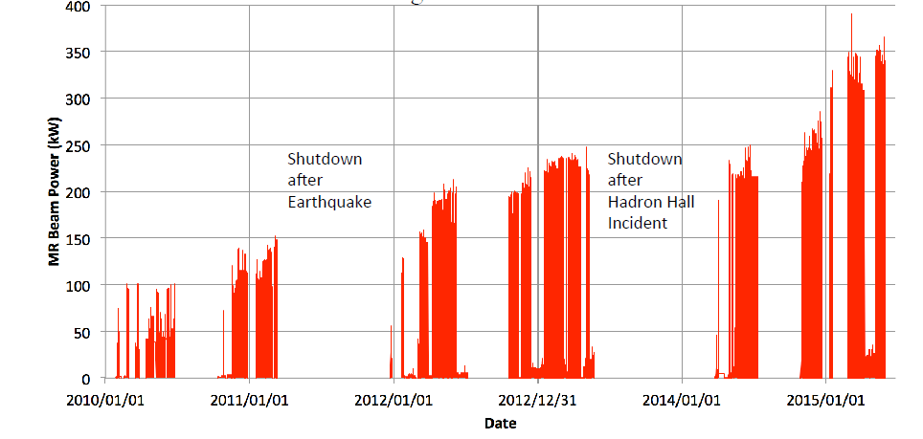
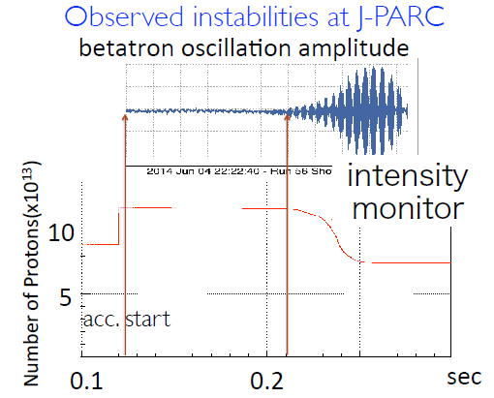
Neutrino source: off axis neutrino beam with peak at 650 MeV.
-- quasi-elastic dominates, well suited for Water Cherenkov detector
-- kinematics assures precise energy reconstruction
Beam power has raised regularly, operations suffered from big earthquake and shutdown
improvements: increased linac energy, intra-bunch feed-back system
achieved 365kW intensity limited by instabilities
next steps: double rep.rate with new power supplies, fast kickers and higher gradient RF
improve loss controls further with more feedbacks

Slide 6
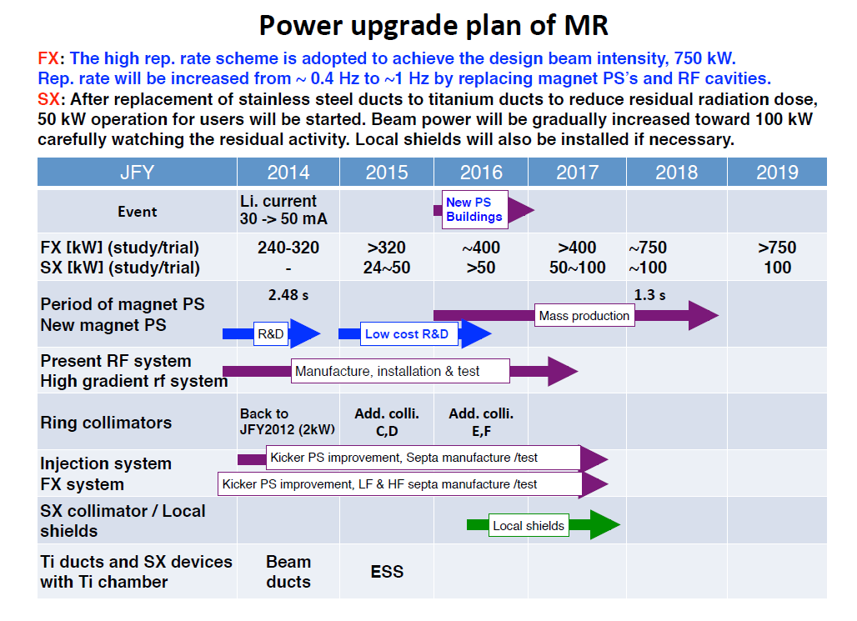
Expect O(1MW by 2019)
original beam request:
5 yrs @750kW

Slide 7
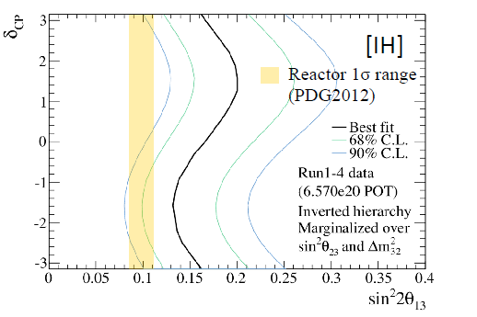
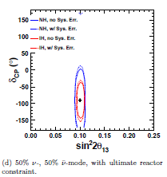
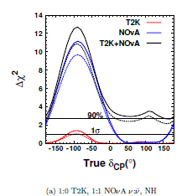
T2K will run at least until the original request is fulfilled... or more.
This will be discussed in an international workshop on neutrino strategy in Japan (4-6 Aug’15)
present observation of ν_{μ}→ν_{e} favours negative value of δ_{CP}
(thanks to a bit of luck)
If this is true this will be demonstrated with T2K
full exposure with 50% antineutrino
and many other precise measurements. ➔ The backbone of the neutrino program.
T2K + NOvA will determine the mass hierarchy at more than 90%
NB with improvements to the proton accelerator, contemplate 2-3x nominal T2K by 2025
(above curves should be redone).
NBB Together with ORCA, PINGU, JUNO in early 2020’s MH will be known by 2025.

Slide 8

Upgrade path and Swiss plans
2015-2018
Upgrades to T2K:
-- Accelerator double rep rate → O(1MW) on target
-- Gadolinium loading of SuperK
-- Wagasci and BabyMIND to measure H2O/Scintillator cross-section (2016)
-- NA61 improved long target results or measurements
-- ND280 upgrade
2018-2024
HyperK construction → far detector is increased to >500kton fiducial
-- one of the two pillars of the Japan particle physics community road map.
-- classified in 27 priority projects in Japan
-- not ready for approval in 2014
-- CDR review end 2015, proposal in 2016, approval 2017/8
-- AB member of International Steering Group ISG (4 non japanese)
-- CDR in preparation (near detectors, electronics/trigger, reviewing)
-- characterization of photodetectors, definition of electronics (Bravar, UNIGE)
-- «intelligent data filter/trigger» (Ariga, UNIBE)
➔ aim at major contribution in electronics and trigger

Slide 9
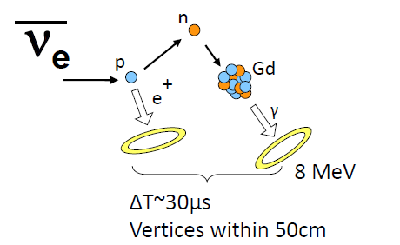
SK and T2K upgrades
1. Gadolinium-loaded SuperK
=> high efficiency for ‾νe
especially for the search for SN relic‾ν
also improvement on tagging/rejection
of interactions producing a neutron‾ν vs ν
Expected date 2017/8 (same time as accelerator upgrade)
2. ND280 detector upgrade
Now have sufficient experience to understand limitations of ND280 as built
mainly:
-- angular acceptance of momentum measurement has large hole at 90º
-- ND280 targets are mostly scintillator and far detector is water
-- time resolution of ECAL is not sufficient to associate photons to events
-- this will reduce Far/Near systematics to ~3-4% level or better
We have taken the lead on this.

Slide 10
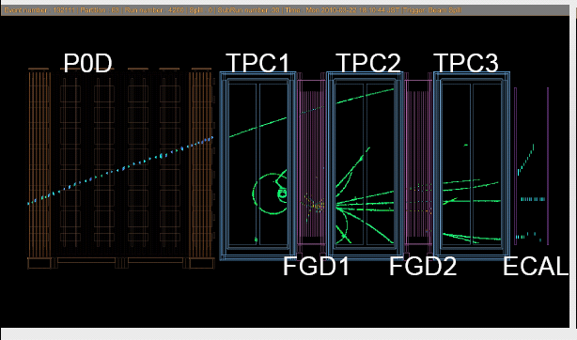
ND 280 upgrades
Acceptance
scintillator 40% water
aim of upgrade: full angular acceptance, 80% water in target
reduce systematics on predicted SK numberof events to ~3% (from 8%)

Slide 11
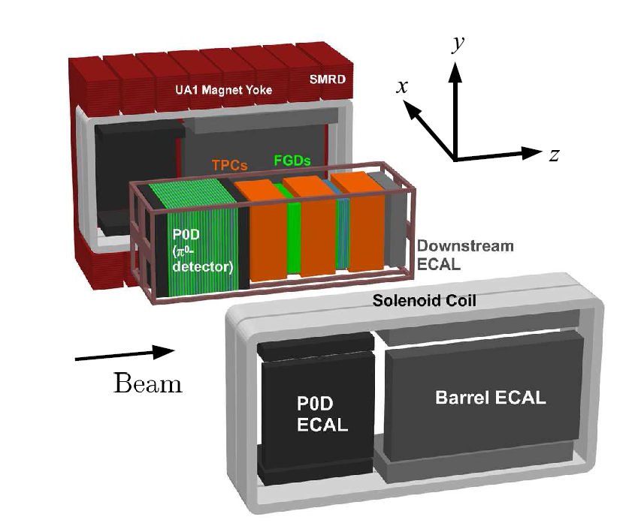
B
side view:
➔
beam
scale approximate
fiducial volume: 2.4long x 1.7wide x 0.35m high= 1.4 m³
= 0.6 (plastic) + 0.8 (0.1plastic + 0.7 H2O) tons
can be increased by improved design of TPC field cage.

Slide 12
Wagasci
example:

Slide 13
ND280 - upgrade
suggested reconfiguration
TPCs 1 and 2 rotated around
B field
Or prefer new TPCs
side view:
B
➔
beam

Slide 14
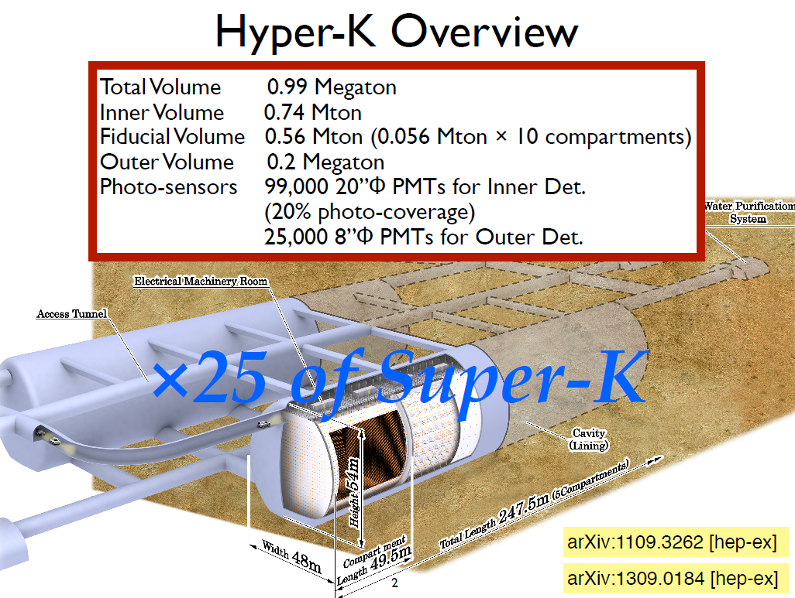
This is why we are here!
CPviolation, mass hierarchy, proton decay, supernovae neutrinos; etc...
Top of the list in Japan science projects (with ILC)
LBL Physics potential published in Prog. Theor. Exp. Phys. (2015) 053C02
A.B. is member of HyperK Steering group and Swiss rep in IBR

Slide 15
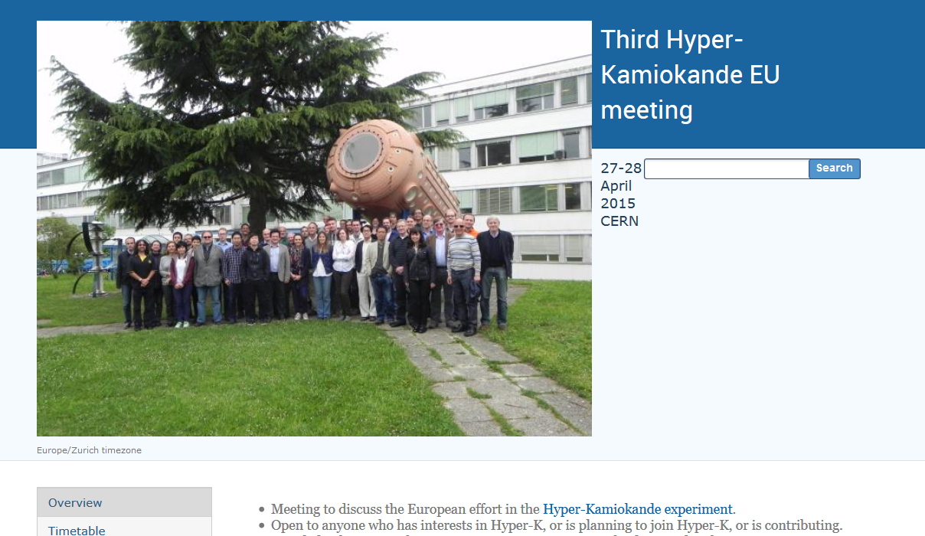
Swiss : Di Luise, Periale (ETHZ), Ariga, Ereditato, Pistillo (UNIBE),
Blondel, Bravar, Noah, Haegel, Ravonel, Scantamburlo (UNIGE) (speakers)

Slide 16
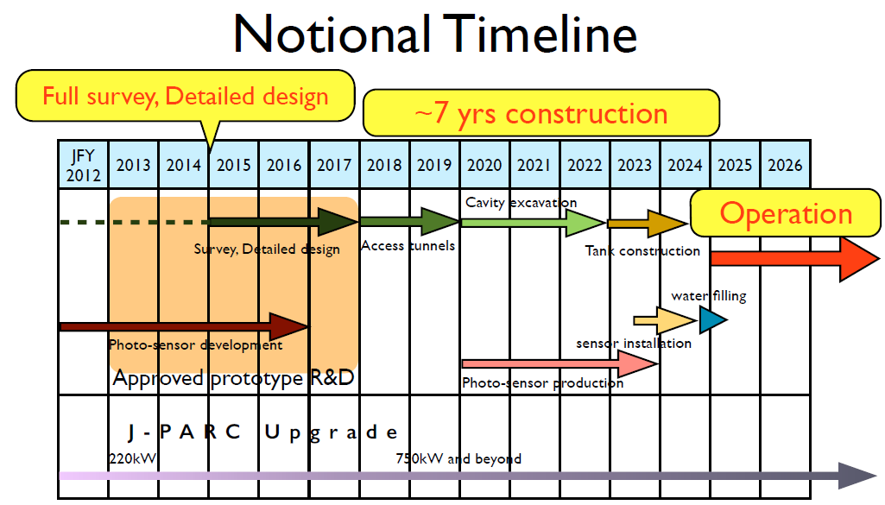
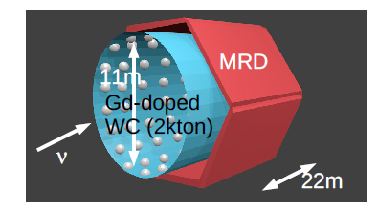
Status of HyperK
LOI submitted to JPARC PAC April 2014
(signed by Bern, ETHZ, UNIGE,
A.B. is SC member and IBR rep)
Top particle physics project in Japan with ILC
Classified by MEXT within 27 top priority projects
-- Scientific case recognized, must improve intl participation, organization, cost estimate.
HyperK collaboration Kick-off meeting 31 January 2015. MOU between KEK and Uni Tokyo.
CDR in preparation for Oct2015.
Operation in 2025
-- Swiss participation under discussion within HyperK-EU and Swiss groups
-- upgrade of T2K ND system (as discussed)
-- Major responsibility in HyperK readout electronics
and DAQ
-- studies of magnetization of near detector →
-- meanwhile, contributions to CDR
Prepare R&D/prototype/measurements proposal
for CERN neutrino platform

Slide 17
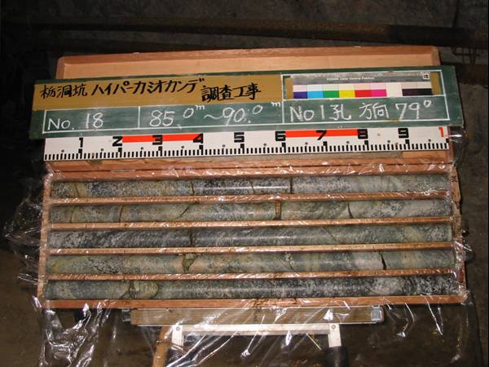
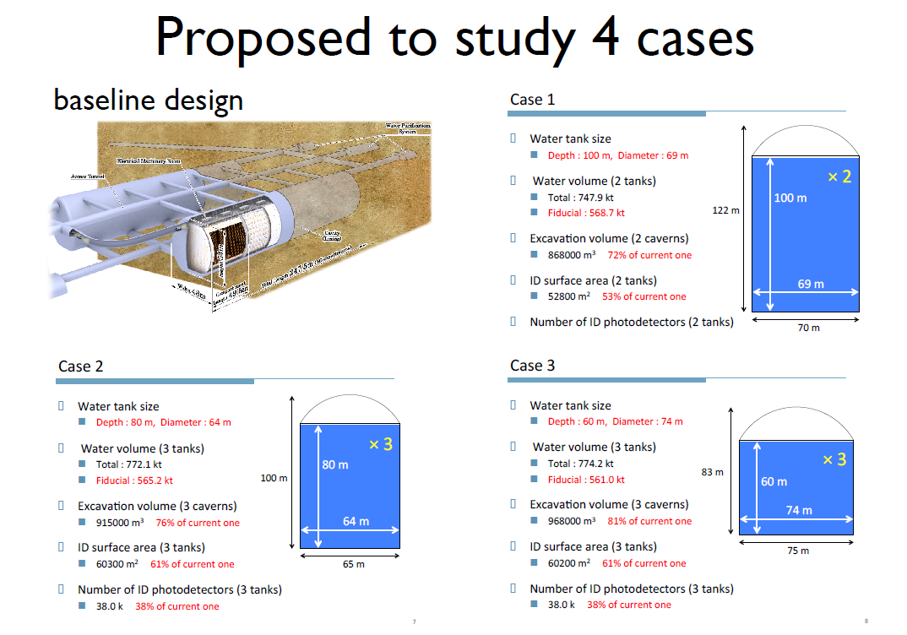
1. Excavating a cavern for > 500 kton fiducial
Rock in Kamioka is of excellent cavity, gneiss and migmatite
large span vertical cylinder caverns offer better cost/volume ratio

Slide 18
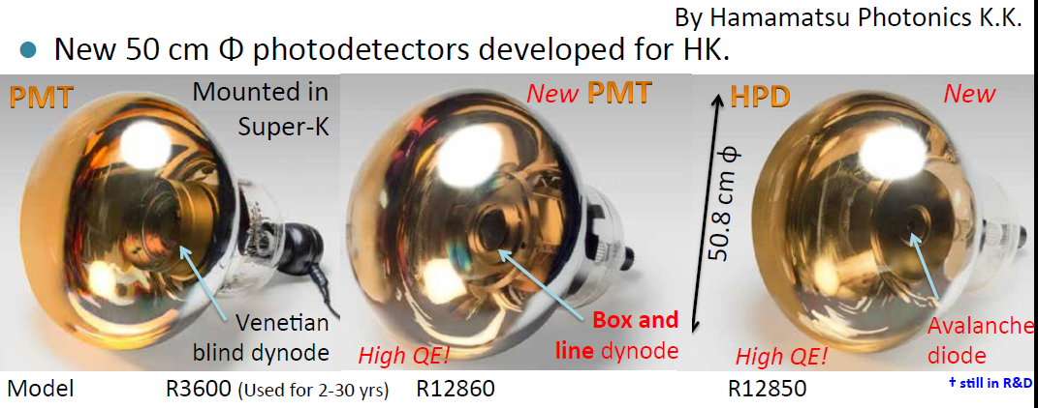
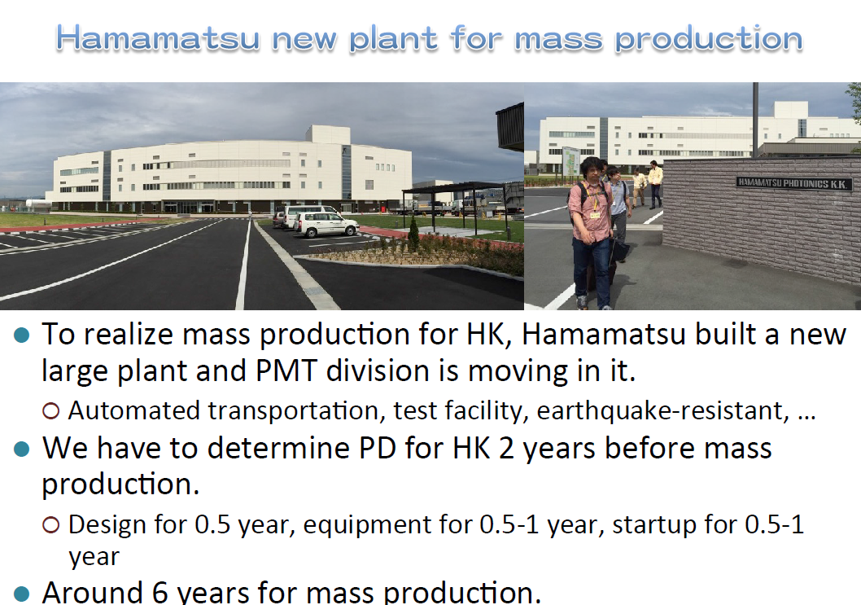
2. Producing 40’000 high Q.E. 20’ PMTs
New detectors offer higher Q.E.
by typically 50%.
Presently investigating noise
and time resolution
of various options and
calculating consequences
for physics.
Optimizing PMT coverage for
physics; possibly staging.

Slide 19
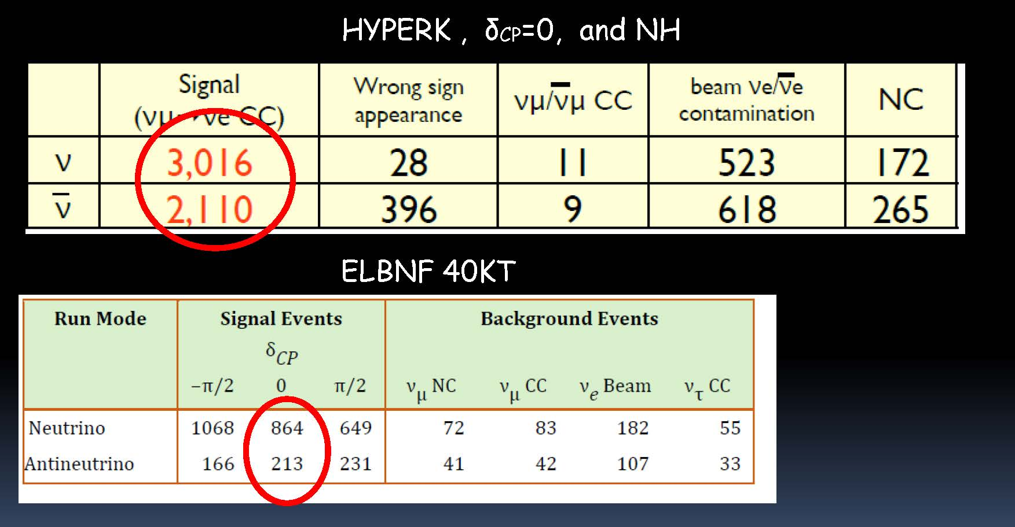
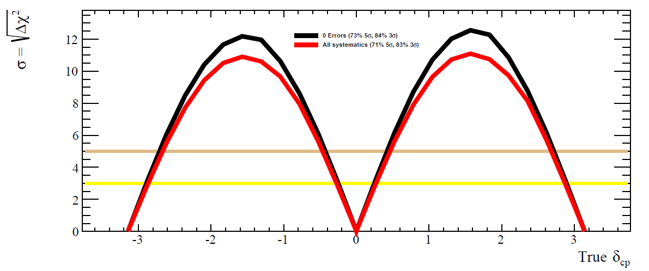
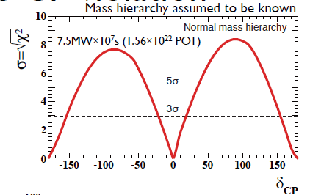
Some physics
750 kW x10yrs
~5-10 years
Dominant error:
(anti) ν_{e}/ν_{μ} x-sections
as measureable:
56% 5σ ,76% 3σ
If use th calculations
(71% 5σ, 83% 3σ)

Slide 20
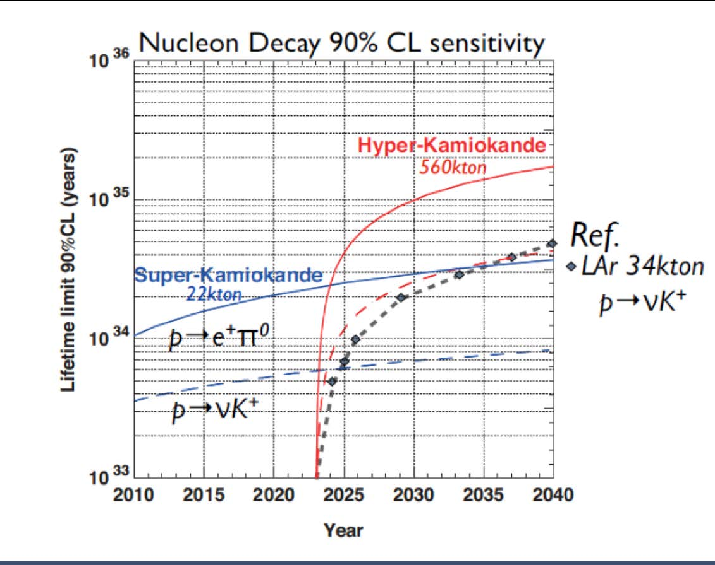
HyperK will push all existing limits (from SK) by factor 10-20
DUNE smaller; competitive for p → K+ν where efficiency of LArg pays off.
Based on arXiv:1501.03918 by
ICFA Neutrino Panel

Slide 21
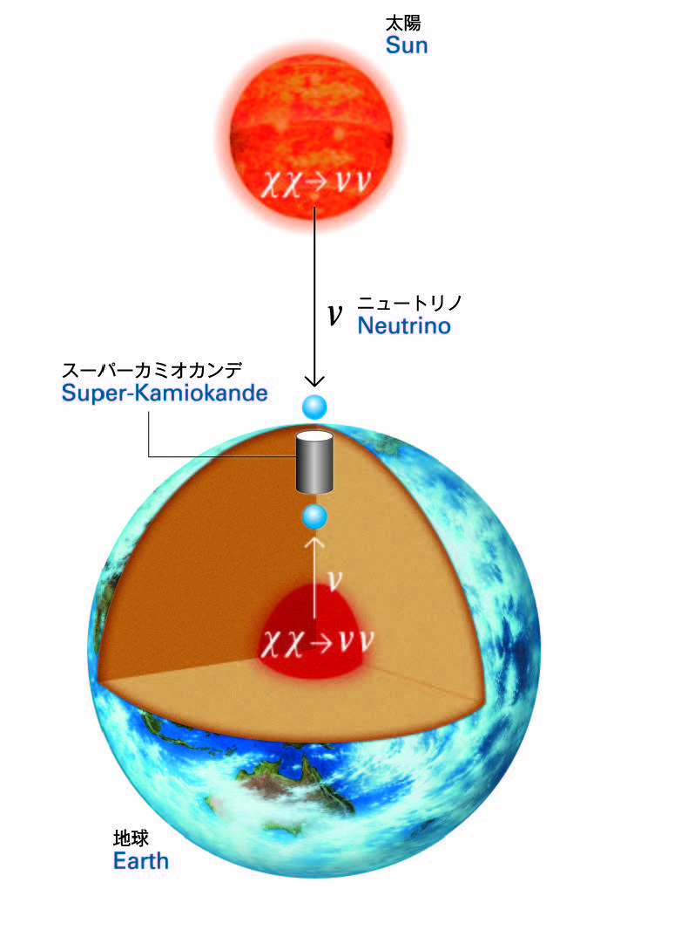
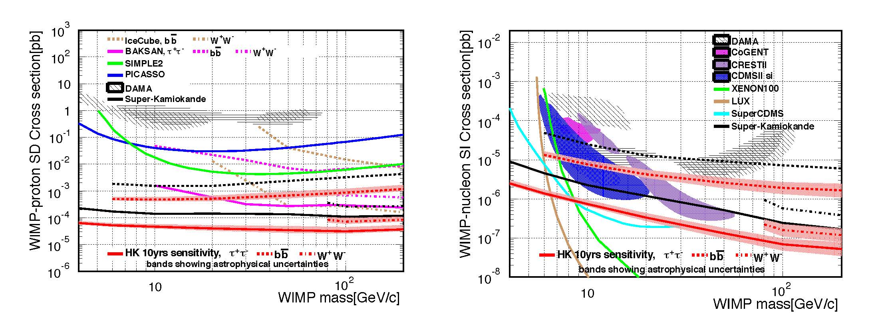
WIMP annihilation at Sun
SK updated results recently presented by Nakahata-san at
Neutel 2015
HK sensitivity by far the best Spin Dependent (SD) and very
competitive in the SI low WIMP mass region

Slide 22
Astrophysical neutrinos
SUPERNOVAE
Mainly ‾ν_{e} from ‾ν_{e} p → e⁺ n
Burst from galactic center (10 kpc)
170,000 – 260,000 ν’s
Burst from Andromeda Galaxy
30 – 50 ν’s
Supernova relic ν
890 in 10 years
SOLAR NEUTRINOS
⁸B ν from Sun
200 ν’s/day @ 7 MeV threshold
Allows detailed day/night studies

Slide 23
CONCLUSIONS
The T2K/NA61 program is extremely successful with great synergy between
swiss groups → discovery of ν_{μ}→ν_{e} oscillation!
JPARC accelerator improvements and prospects are now impressive.
Experiment will run another factor 9 (approved) or more over present exposure
➔ determination of mass hierarchy and even first evidence for CPV are possible
Upgrade of near detector very well justified and being organized (we lead)
HyperK is an upgrade by a further factor 25. It is highly placed on Japan road map.
Swiss groups (UNIGE, UNIBE) are well engaged in the preparation of the CDR and
look forward to major contribution to electronics, DAQ, trigger
Unlike T2K vs SK, this implies full participation to beam and non-accelerator program
HYPERK is a highly competitive for the study of neutrino oscillations (discovery of CPV)
+ unparalleled program for proton decay, supernovae observations (near and relic)
and other astrophysical sources.
DUNE and HyperK are certainly complementary and match differently the competence of
the swiss neutrino groups

Slide 24
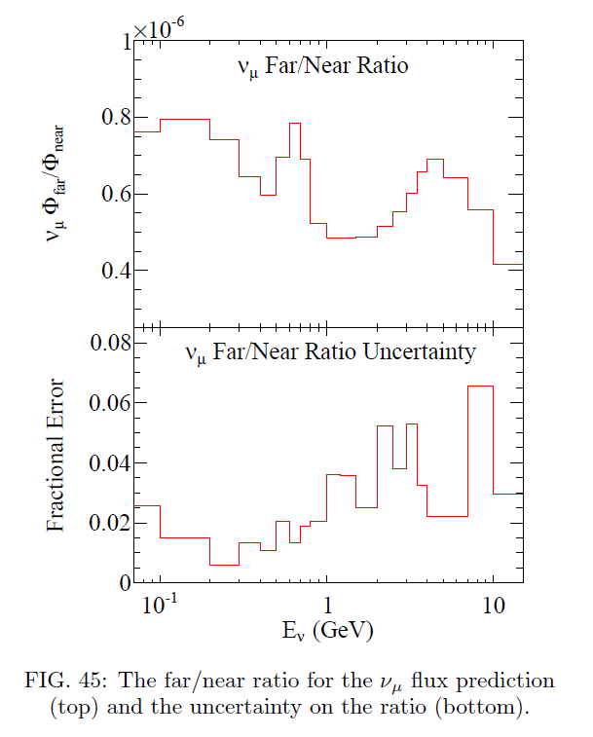
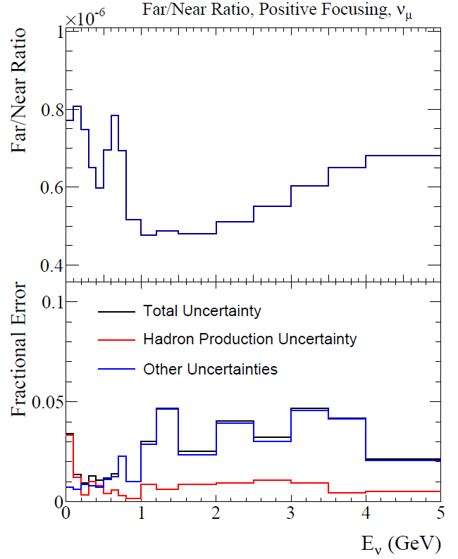
2015 version with 2009 NA61 data
2012 with 2007 NA61 data
NA61 performance can be further
improved, see Silvestro’s talk tomorrow

Slide 25
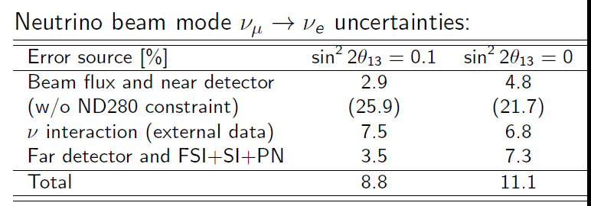
What is missing?
Present systematics in prediction of number of far detector events
is presently of order 8.8%.
signal background
11% uncertainty on 15% background is 1.7% of signal -- small compared with 8.8% on signal
(this is dominated by intrinsic beam ν_{e})
➔ In this particular beam, Water Cherenkov is well suited
to do the ν_{μ}→ν_{e} oscillation measurements

Slide 26
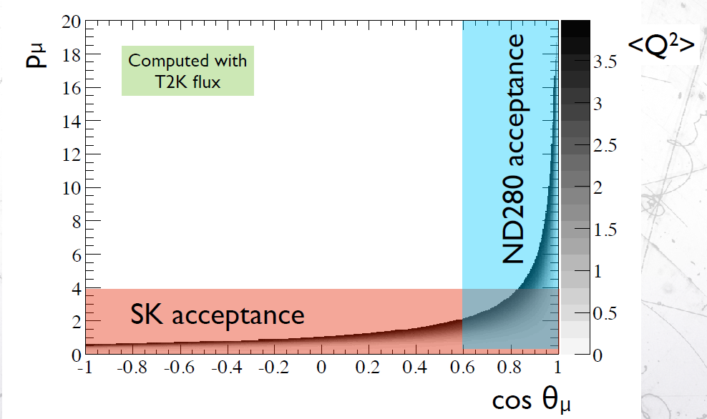
Federico Sanchez

Slide 27
