Slide 1
Publication Speed Task Force
Task force to determine possible reasons for delays in ALICE paper publication
=============================================
We propose to establish a task force to collect and prepare
information on the various reasons for delays in bringing papers from
paper proposal to publication (on the arXiv). The task force interacts
with the PWG's and PAG's, with Physics Coordination and with members
of the EB to collect necessary information. It may consult with other
ALICE groups (such as OFFLINE) and other groups and individuals (for
example, members of present or former Paper committees and IRC's etc)
as required. If appropriate, the task force suggests methods and means
to improve the publication process. The task force reports to the
ALICE MB and should provide a report in a timely manner, but not later
than May 20, 2015.
Roberta Arnaldi March 30th 2015

Slide 2
Publication Speed Task Force
Task Force members:
R.A., Leticia Conquieiro Mendez, Andrea Dainese, Taku Gunji,
Jochen Klein, Boris Hippolyte, Christina Markert, Sarah La Pointe
Darius Miskowiec, Kai Schweda, Sergei Voloshin
Task Force mail:
alice-publication-speed-taskforce@cern.ch
Task Force twiki:
https://twiki.cern.ch/twiki/bin/view/ALICE/PublicationSpeedTaskForce
Regular (weekly) meeting:
Monday at 15pm?

Slide 3
Timeline of published papers
PB approval
→ 1st coll. round
1st coll.
round
2nd coll
round
ArXiv
Publication
Proposal:
Step 1)
Go systematically through the published papers to extract the timelines infos
Step 2)
Investigate the main reasons of delay:
interacting with PWG conveners/PC/IRC
where in the publication procedure?
why?

Slide 4
Step 1: paper infos
Which information should we monitor?
Data taking
PB approval
IRC approval
EB approval
First collaboration round
Second collaboration round
ArXiv
Publication
Can we start collecting these information by PWG?
Then we can merge all the infos together or maybe group them
How? by system, by year, by paper type, i.e. paper based on one single analysis or on more analyses…?
gather these infos in a Twiki, so that they can easily be accessed by everyone
should we also address on-going papers or only papers at least on arXiv?

Slide 5
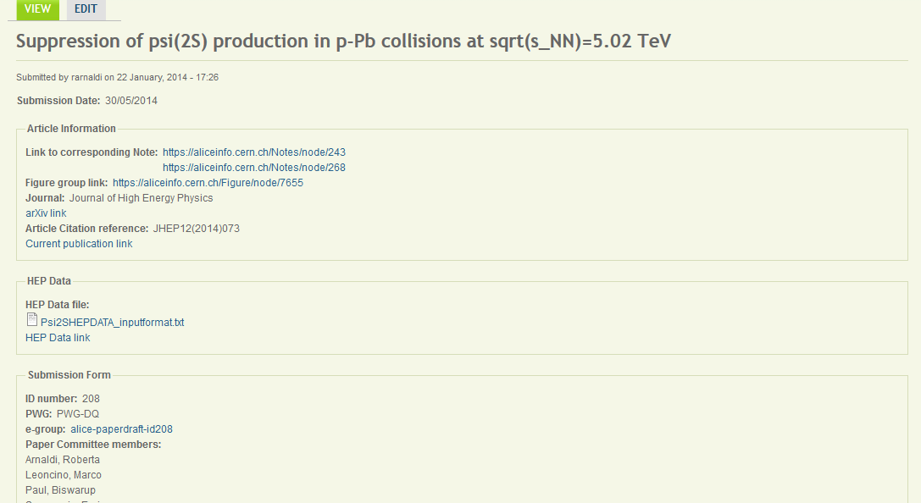
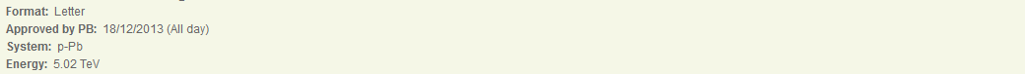
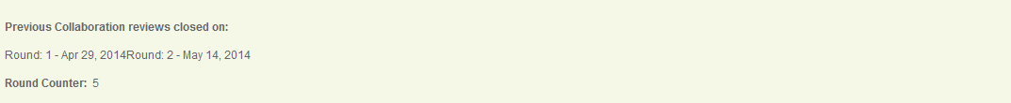
Step 1: paper infos
Not easy to gather all these infos from the ALICE web pages
(EB contacted to check if there is a database with all these infos)
Old papers have only PB approval date + publication date
Newer paper have also end of 1st and 2nd collaboration round
(maybe missing infos can be obtained directly from PC)

Slide 6
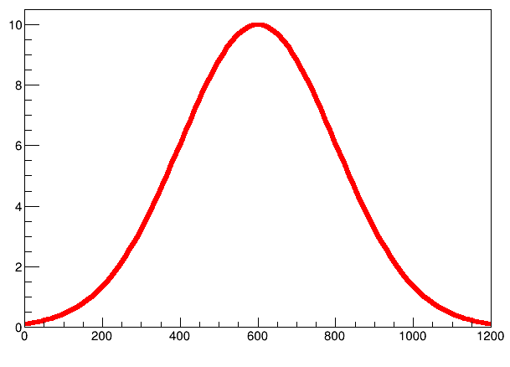
Step 2: survey within PC/IRC/PWG
Once we have an idea of the average times of the steps toward publication, we might organize a survey within
FAST
DELAYED
PC (chair)
IRC (chair)
PWG conveners
OK
addressing specific questions on the reasons of delay (we can also investigate the reasons behind fast publication!):
merging of several analysis
lack of MC
showstopper in interactions with IRC/EB…
PC members busy in other papers
….
Number of days towards publication
plus room for general comments/suggestions…

Slide 7
An example: PWG-DQ
List of papers and their timeline:
End 1st CR
Alice paper ID
Pub
PB approval
arXiv
End 2nd CR

Slide 8
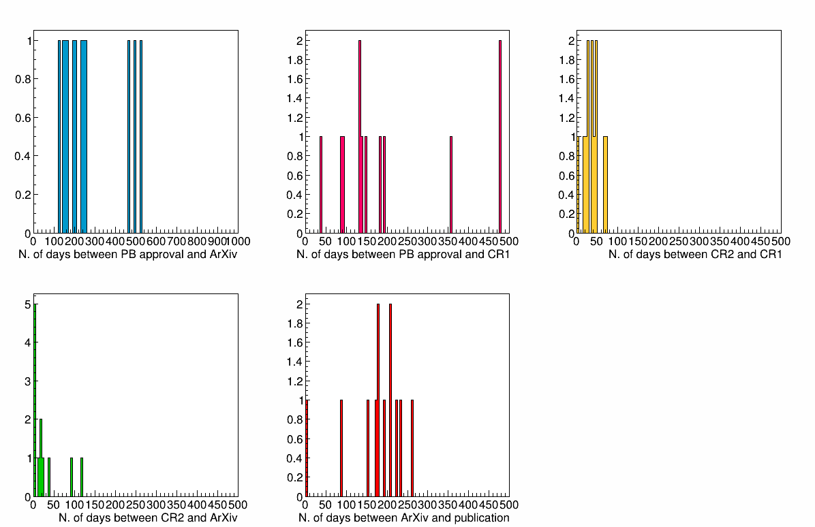
An example: PWG-DQ
Time intervals between publication steps:
1 year
(few paper still missing…)

Slide 9
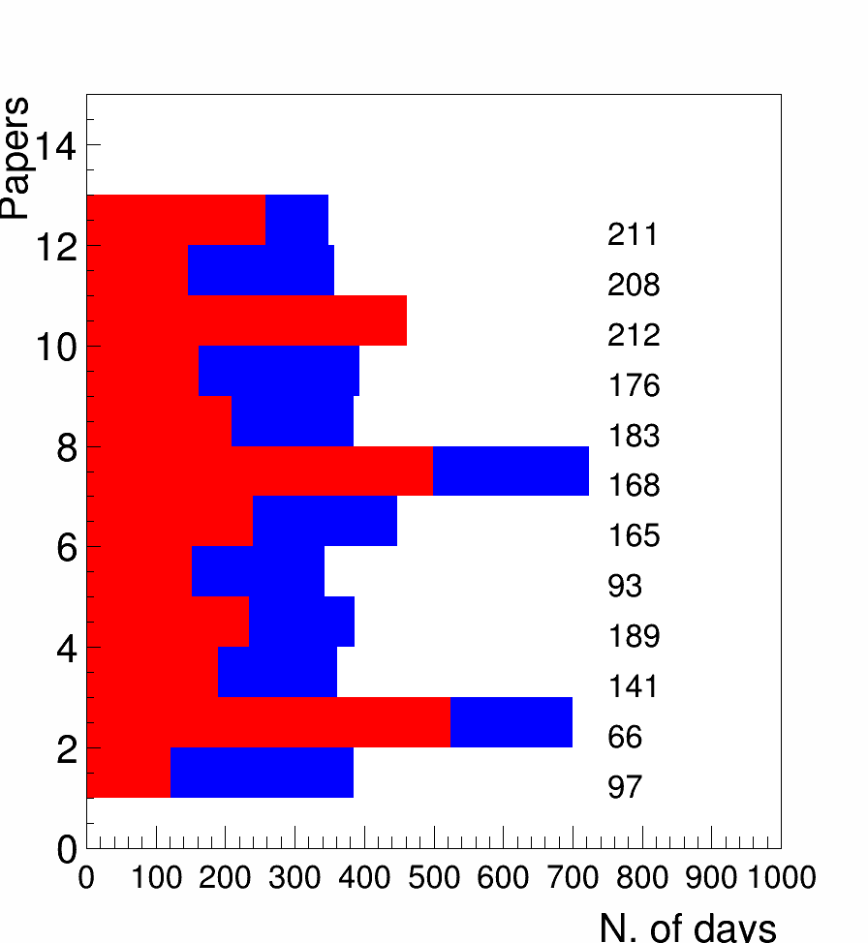
An example: PWG-DQ
1 year
From PB approval to ArXiv
Paper ID
From PB approval to pub

Slide 10
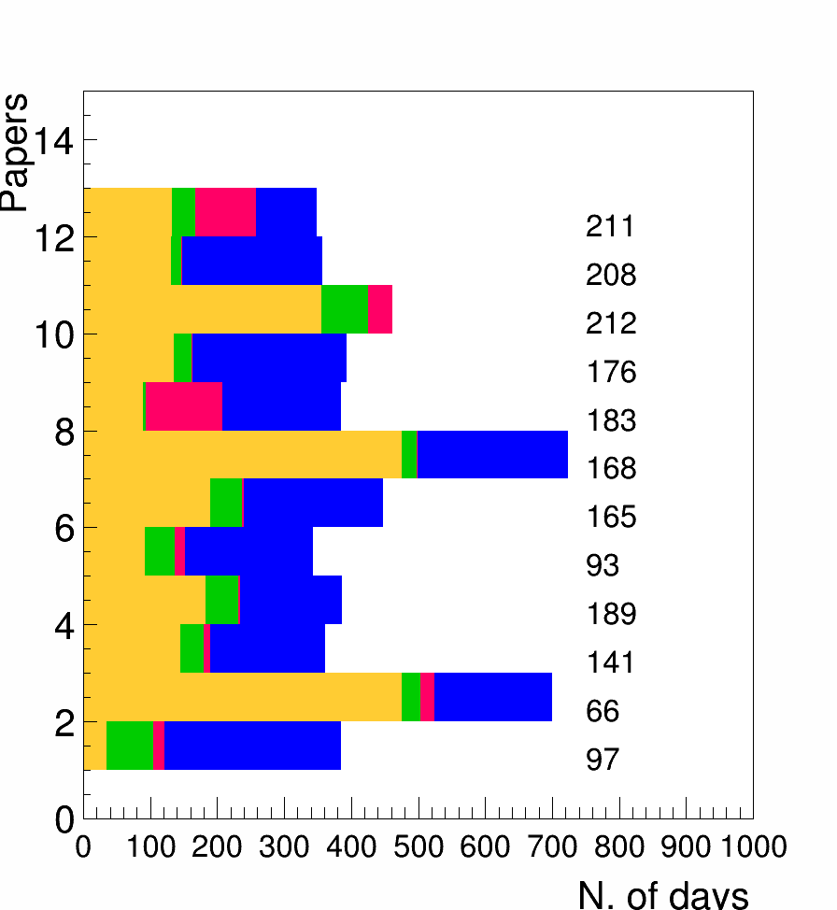
An example: PWG-DQ
PB approval → end 1st CR
Paper ID
1st CR → end 2nd CR
2nd CR → ArXiv
ArXiv → publication
As an example we should investigate the reasons behind the delay in papers 168 and 66

Slide 11
Next steps
Next meeting on Monday April 13th at 15pm?
Can we gather the paper infos (at PWG + general level) by that date?
Can we share by PWG?
PWG: CF, DQ, GA, HF, JE, LF, UD, PP
Plots, infos on papers on the twiki
(I can provide template macros, if needed)
Do we need to collect other infos/other plots on the papers timelines?
Should we include also on-going papers (not yet on arXiv)?
Start collecting/thinking about “reasons of delay” to be addressed in the PC/IRC survey
Thanks!

