Slide 1
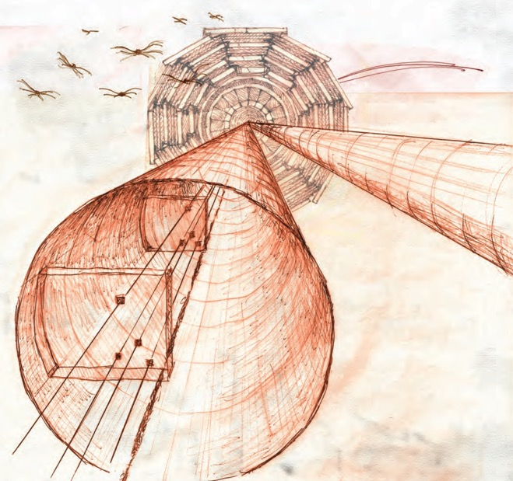
Physics Prospects with the
CT-PPS Forward Proton Spectrometer
Joao Varela, LIP/IST Lisbon
(presented by K. Piotrzkowski)
CT-PPS TECHNICAL DESIGN REPORT
CERN-LHCC-2014-021
Low-x Meeting 2015
Sandomierz, 1-5 September 2015

Slide 2
CT-PPS project
CMS-TOTEM Precision Proton Spectrometer:
  A new tool increasing the CMS potential in the search for New Physics
CMS-TOTEM Memorandum of Understanding:
  CMS and TOTEM jointly undertake the PPS project
CT-PPS project approval:
  CERN Research Board, December 2014

Slide 3
Central exclusive production
CEP : p p → p p X
  where X is a state measured in the central detector
p
X = high E_{T} jets, Z, WW, ZZ, …
i, j = photon or gluon exchanges
i
X
j
p
Four-momentum of X is fully constrained by the two protons kinematics:
  – proton fractional momentum loss
  t – proton Mandelstam invariant

Slide 4
Physics motivations
Search for new physics
Clean events (no underlying pp event)
Independent energy-momentum measurement by pp system
Search for new resonances and invisible states
BSM
LHC as a photon-photon collider
EWK
Measure γγ → W⁺W⁻ , e⁺e⁻, μ⁺μ⁻, τ⁺τ⁻
Search for AQGC with high sensitivity
Search for SM forbidden ZZγγ, γγγγ couplings
QCD physics
QCD
Test of pQCD mechanisms of exclusive production.
Gluon jet samples with small component of quark jets

Slide 5
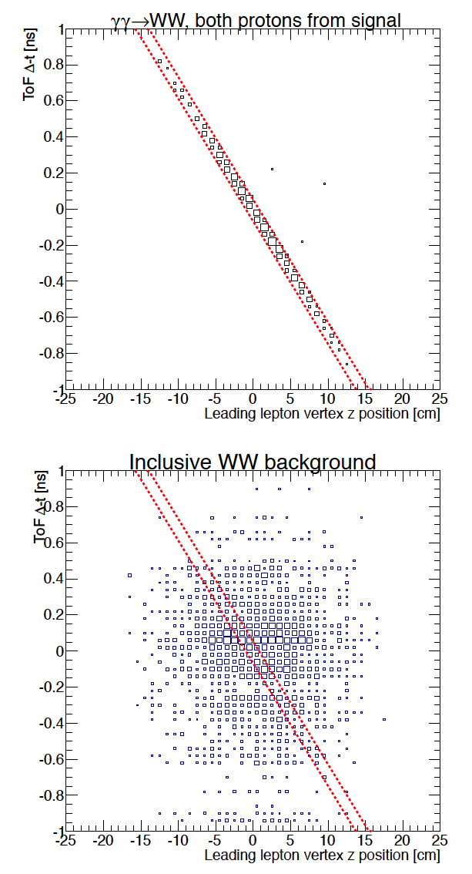
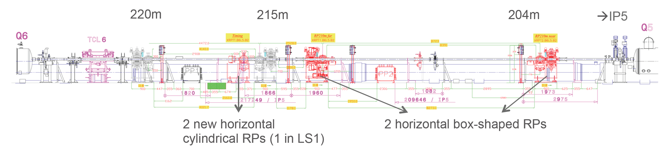
Detector concept
CT-PPS concept:
Proton spectrometer making use of machine magnets
Two tracking stations with 3D pixel detectors
One stations with 10 ps timing detectors
Exclusive WW
10 ps
ToF vs. z-vertex
Inclusive WW
Use timing to reject pileup background
  time difference of two protons is correlated to collision vertex

Slide 6
Main experimental issues
Physics performance at high luminosity (2.10³⁴ cm⁻² s⁻¹)
  pileup background, beam background
Detector operation close to the LHC beam
  RF impedance, showers originated in the detectors
Radiation levels
  in detectors and front-end electronics
Timing detectors
  challenge is 10 ps resolution and high rates
Tracking detectors
  challenge is fluence 5.10¹⁵ protons.cm⁻² (100 fb⁻¹)

Slide 7
Project phases
The CT-PPS plan includes an exploratory phase in 2015-16 followed by a production phase.
Exploratory phase (2015-16):
  Show that CT-PPS does not prevent the stable operation of the LHC beams and does not affect significantly the luminosity performance of the machine.

Slide 8
CT-PPS detector basics:
acceptance and backgrounds

Slide 9
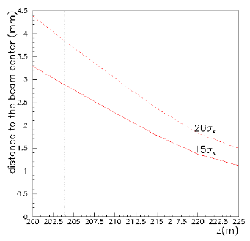
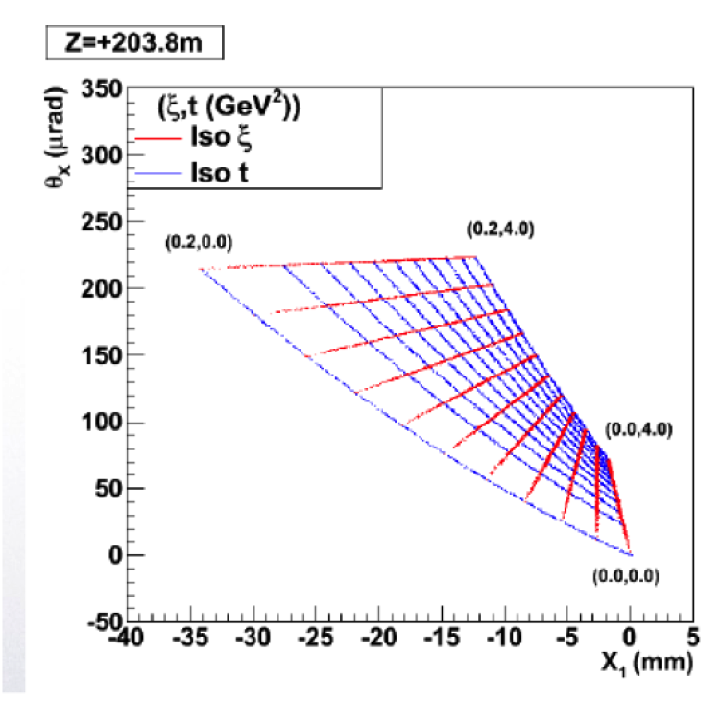
Beam optics
HECTOR, a fast simulator for particle transport in a beamline
Full transport line simulation in CMSSW
Horizontal distance to beam center
in the z-range of the PPS detectors

Slide 10
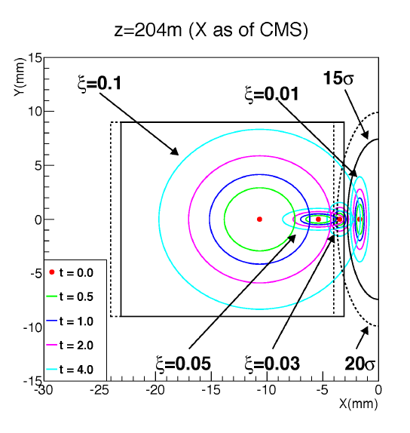
Detector acceptance
Acceptance ξ-t ellipses in x-y detector plane
Particle gun (t,ξ,φ) based on HECTOR at √s = 13 TeV

Slide 11
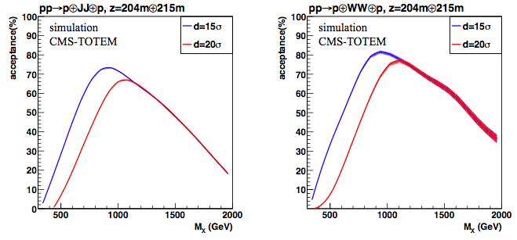
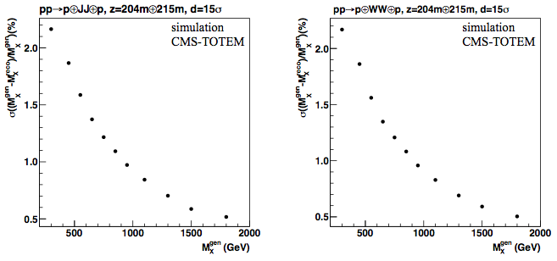
Mass acceptance and resolution
Mass acceptance and resolution vs M_{X}
PPS selects exclusive systems in 300-1700 GeV range (ε>5%)
At 15σ acceptance larger by a factor of two (wrt 20σ) for lower masses
Mass resolution ~1.5% at 500 GeV
dijets
WW
1%
1%

Slide 12
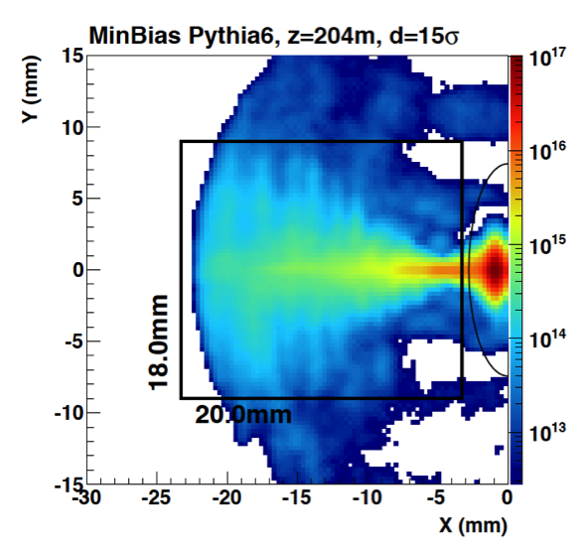
Radiation levels
Radiation levels in the detector volume were studied using TOTEM data and simulations
Per 100 fb⁻¹:
Proton flux up to 5.10¹⁵ cm⁻² in the pixel detectors
10¹² neq/cm² and 100 Gy in photosensors and readout electronics

Slide 13
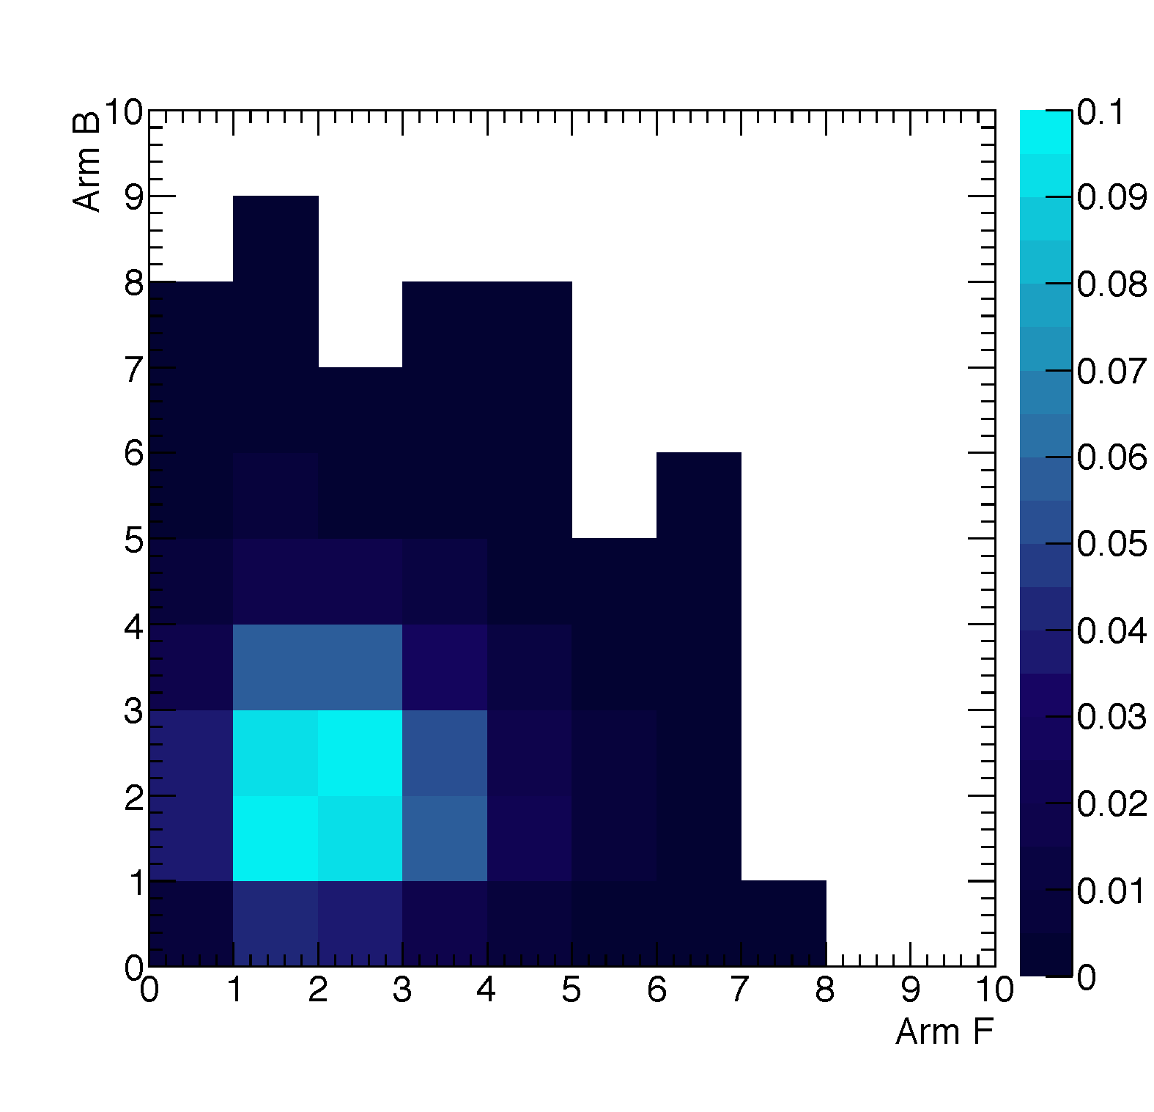
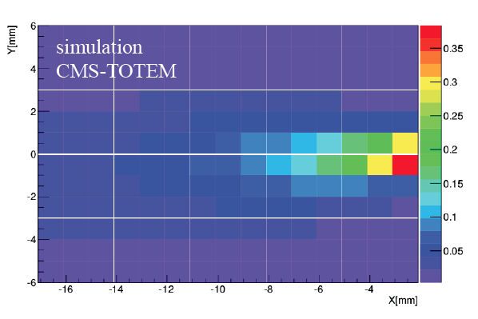
Detector occupancy
Single diffraction pileup
Average proton multiplicity in detectors for WW signal with pilup μ =50 is approx. 2
Expected occupancy:
Beam-related backgrounds and pileup interactions are included.
Occupancy of detectors at 15 σ from the beam
Particle Multiplicity
Occupancy /mm²
occupancy /mm²
μ=50
μ=50

Slide 14
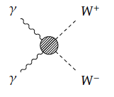
CEP production of W pairs
with CT-PPS

Slide 15
Simulation
Signal
  FPMC generator
Backgrounds
  WW inclusive, Single Diffractive (SD) and Double Pomeron Exchange (DPE), multijet QCD, exclusive γγ→ττ
Pileup
  50 and 25 pileup samples.
Simulation
  GEANT4 simulation of the CMS central detector
  Protons are tracked through the beam-line
  Fast simulation of CT-PPS detectors
  Beam induced backgrounds included

Slide 16
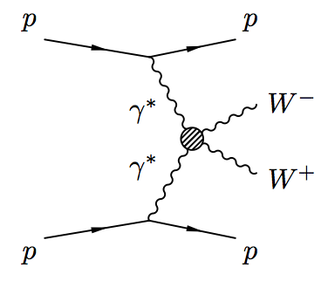
Study of WW production
Study of process: pp→pWWp
  Exclusive production of W pairs via photon exchange at 13 TeV
Events: W pair in central detector, intact protons detected in CT-PPS
Study only eμ final state
Two steps:
  SM observation of WW events
    σ_{WW}=95.6 fb
  Study of anomalous coupling
    Two points: a₀^{W}/Λ²=5x10⁻⁶, a_{C}^{W}/Λ²=5x10⁻⁶

Slide 17
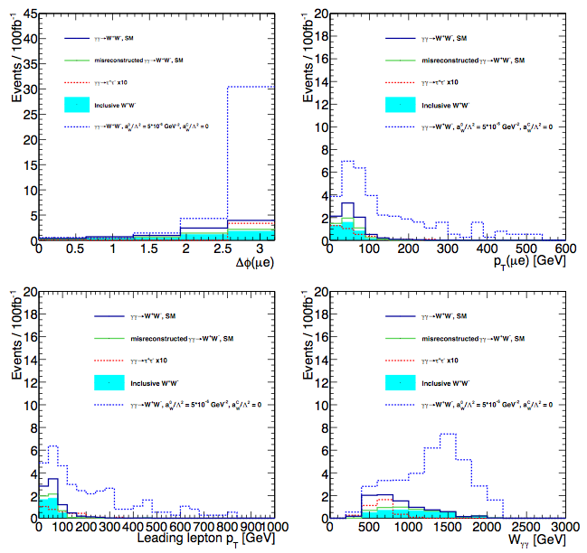
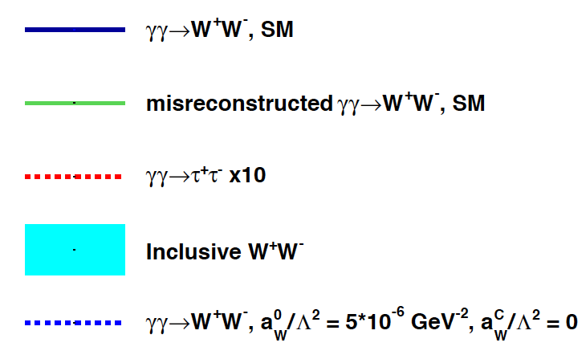
Kinematical distributions
Central detector
Central detector
Missing mass distributions provide a very clear separation of AQGC events
Δφ (lep-lep)
dilepton pT
Central detector
CT-PPS
missing mass
leading lepton pT

Slide 18
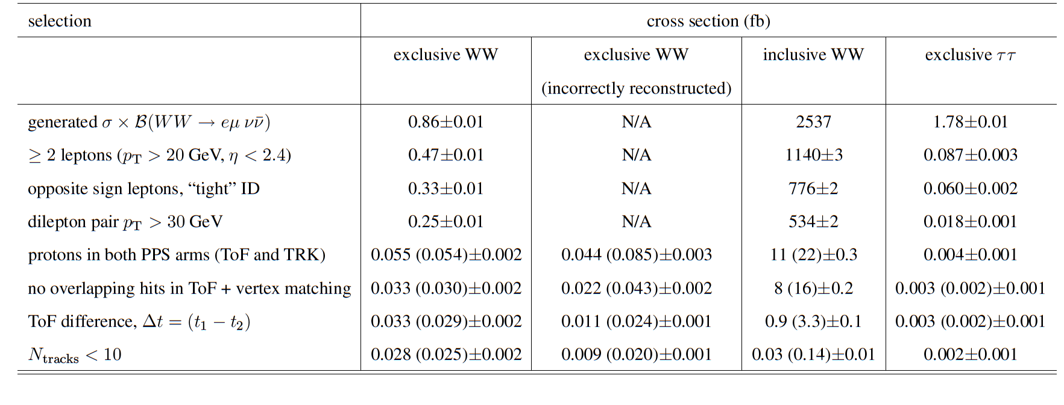
Yields (in fb)
Select WW events
Apply central lepton and PPS acceptance cuts
Additional timing and track multiplicity cuts
Numbers in parenthesis are for time resolution of 30 ps
S/B ~ 1

Slide 19
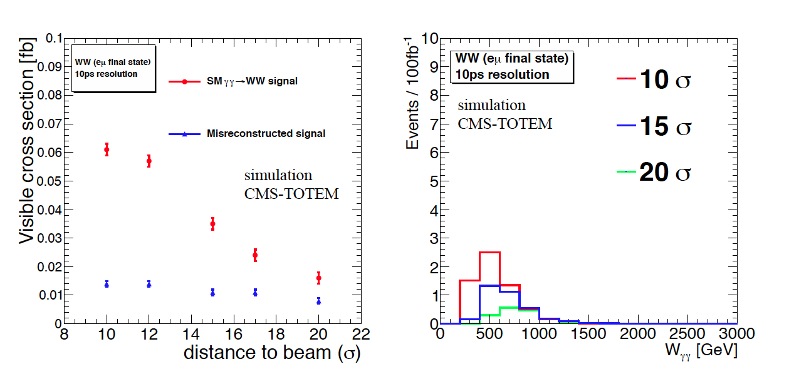
Dependence on distance to beam
Exclusive WW event yields

Slide 20
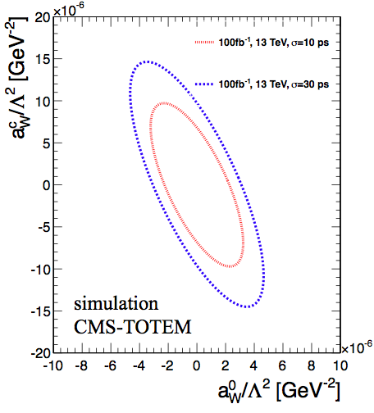

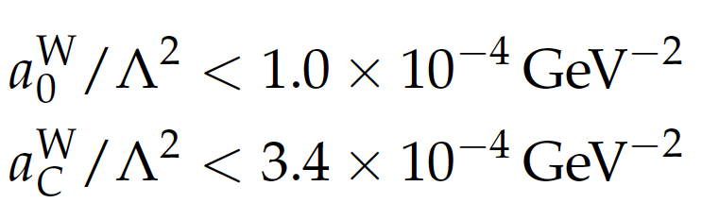
AQGC expected limits
Expected limits @95%CL:
with CT-PPS, 13 TeV, 100 fb⁻¹
GeV⁻²
30 ps
GeV⁻²
Observed limits @95%CL:
10 ps
CMS Run 1, 8 TeV, 20 fb⁻¹
Two orders of magnitude improvement is expected

Slide 21
CT-PPS Detectors

Slide 22
Approaching detectors to the beam
Options considered:
  Roman Pots (RP) developed by TOTEM
  Movable Beam Pipe (MBP)
Main goals:
Establish Roman Pot insertions for physics operation in regular fills from 2016
Install detectors for run in 2016 and beyond
RP insertion commissioning:
RP insertions at low β* and highest beam intensities are being tested in the exploratory phase in 2015.

Slide 23
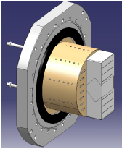
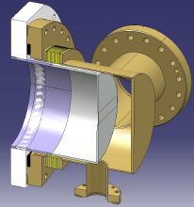
Roman Pots
Tests of TOTEM RPs at high luminosity revealed important issues (vacuum, beam dumps, heating).
Several improvements have been carried by TOTEM (and CMS) in collaboration with BE-ABP.
  New RF shielding in standard box-shaped RPs
  New cylindrical RP for timing detectors
  10 um thick copper coating
  New ferrites

Slide 24
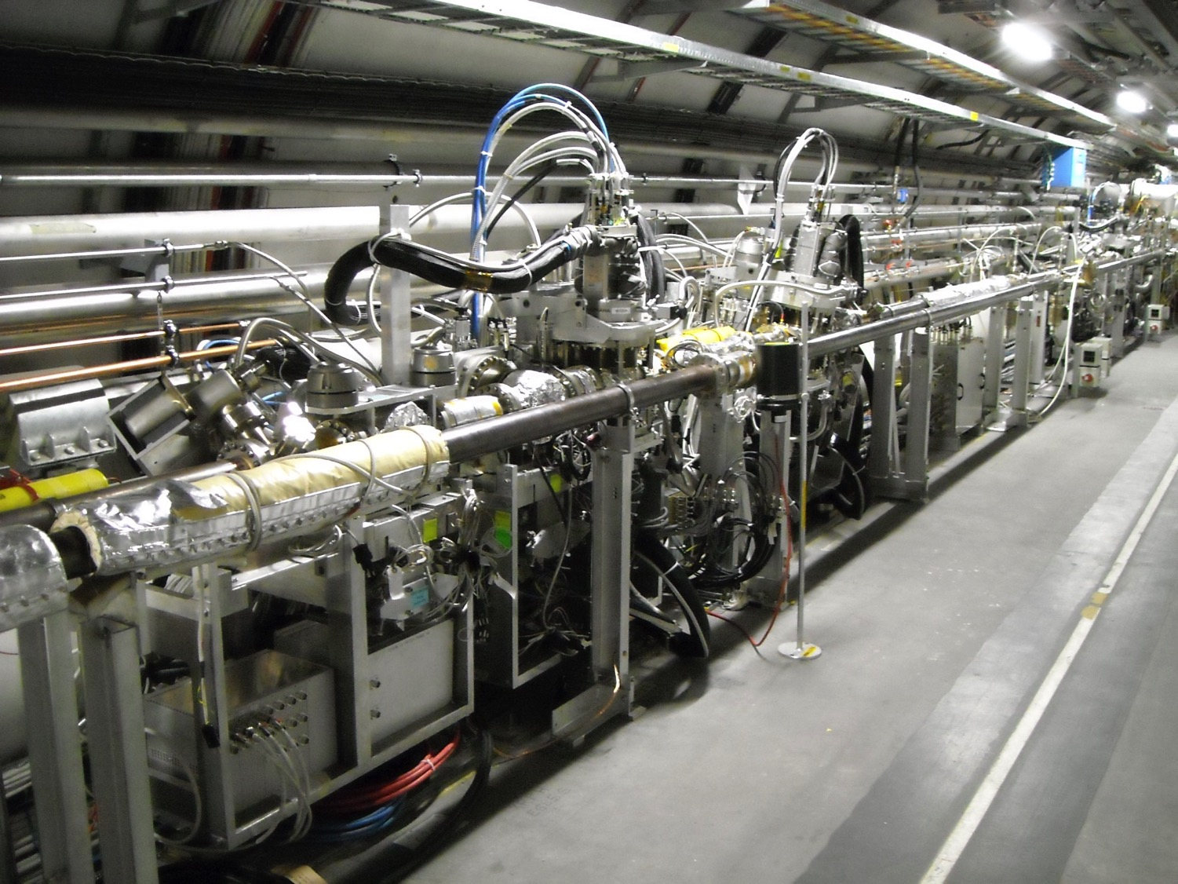
Components installed in tunnel
CT-PPS
tracking 2
CT-PPS
tracking 1
CT-PPS
timing
TCL 4 & TCL 6 in 4-5 and 5-6
Electrical patch panel
Service lines for LV/HV/DAQ
CT-PPS specific:
2 * RP box with RF shield in 4/5
2 * RP box with RF shield in 5/6
1 * RP cylinder in 4/5
1 * RP cylinder in 5/6

Slide 25
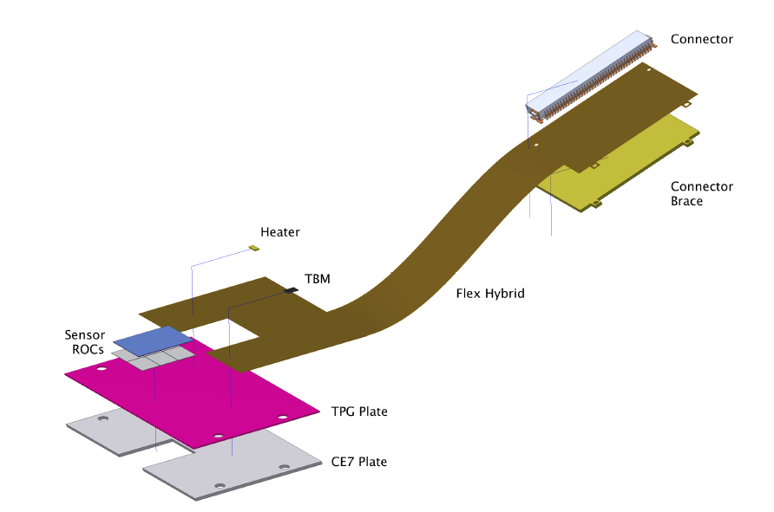
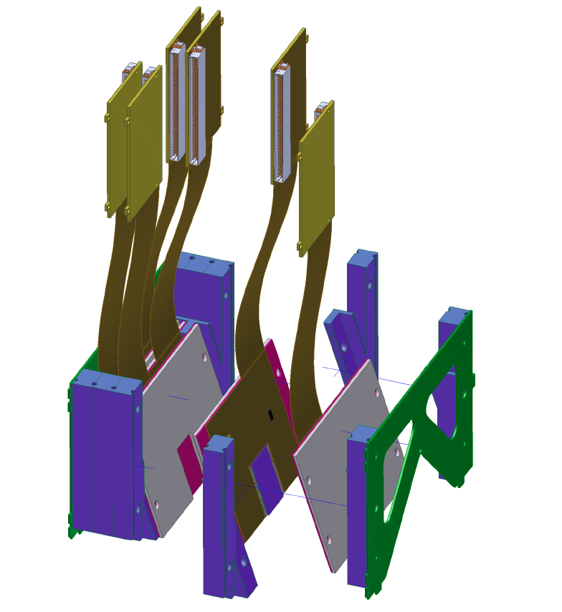
Tracking baseline
3D silicon sensors
PSI46dig ROC, with same readout scheme as for Phase I Upgrade of the CMS pixel system
  existing CMS DAQ components and software can be reused
6 detector planes per station
  detectors are tilted in one direction
  number of planes provide adequate redundancy
Detector support
RPix Module

Slide 26
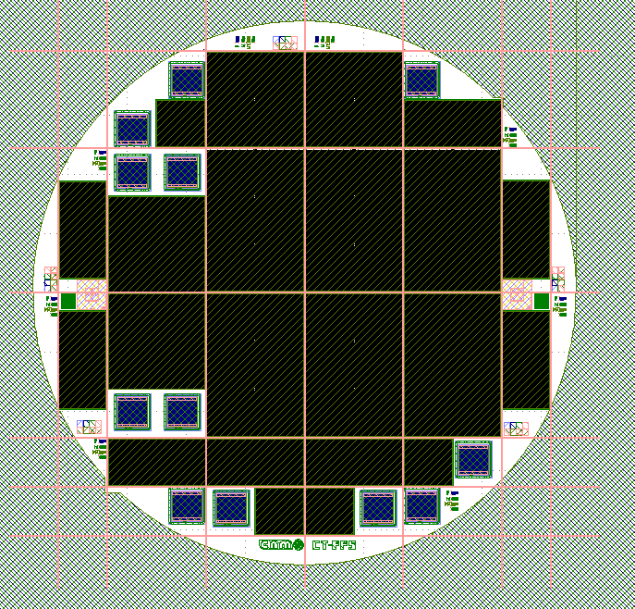
3D sensors – wafer layout in production
Wafer thickness 230μm
FZ HR <100> silicon
p-type N=10¹²atm/cm³
p-stop isolation
1E
2x2 2E
2x2 2E
2x1 2E
2x3 2E
2x3 2E
2x3 1E
2x1 2E
2x2 1E
2x1 1E
2E 1E
6 detectors 2x3 4 2
4 detectors 2x2 2 2
8 detectors 2x1 5 3
4 single chip 3 1
Diodes 6 6
2x2 1E
2x3 2E
2x3 2E
2x3 1E
2x1 1E
2x1 1E
2x1 2E
2x1 2E
2x1 2E
2E
2E
2E
With the first 12 wafers:
48 sensors 2x3 & 2E
and we need 24
In case of problems we could still mount 2x2 sensors (+ 2x1 sensors)

Slide 27
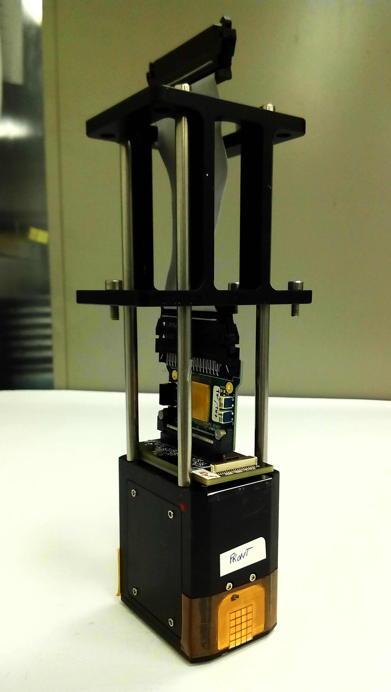
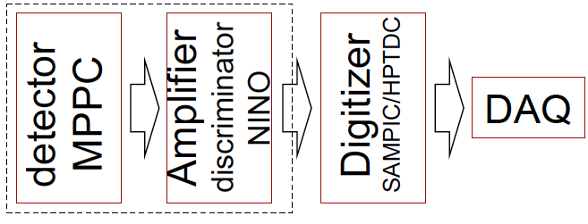
Timing baseline
Quartic detector:
Detector is a 4 x 5 array of quartz bars, 3 x 3mm², SiPM light detection.
Two such modules in one Roman pot in each arm.
Radiator bars separated by 100 μm for total internal reflection
Beam tests achieved σ(t) = 30 ps/module
(~ 20 ps for 2-in-pot)
Quartic readout chain
In RP sec vacuum
Box below beam pipe
Counting room

Slide 28
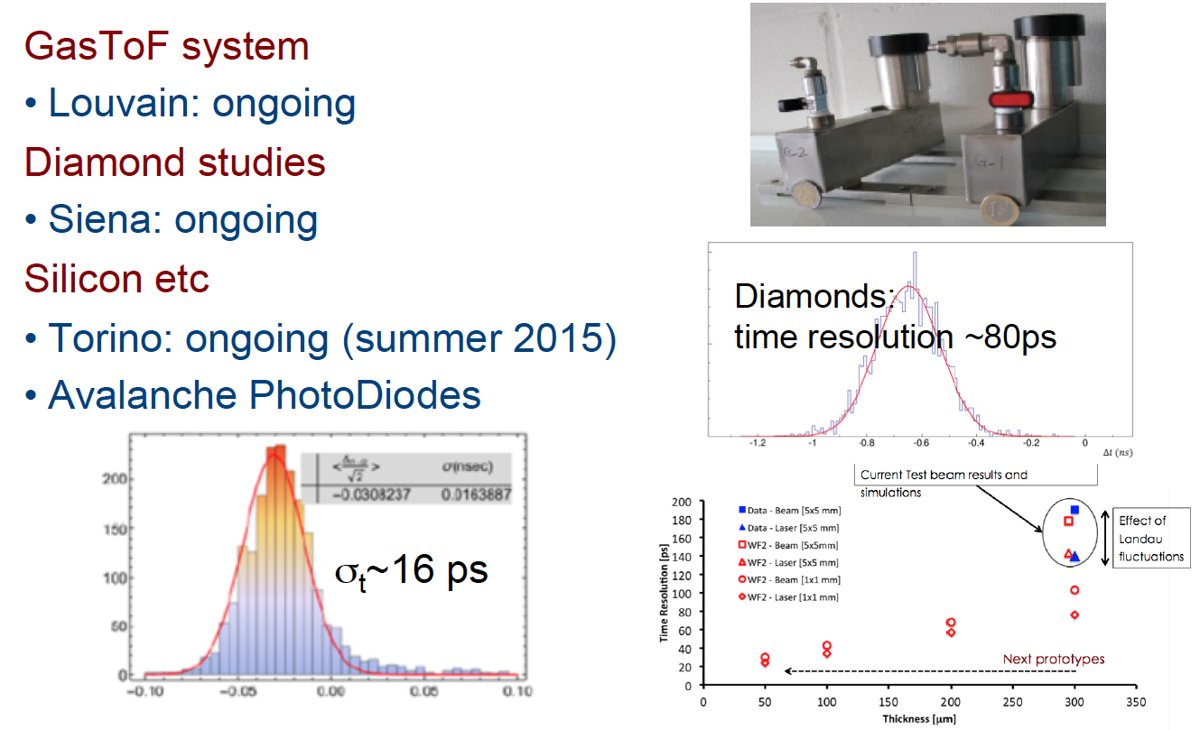
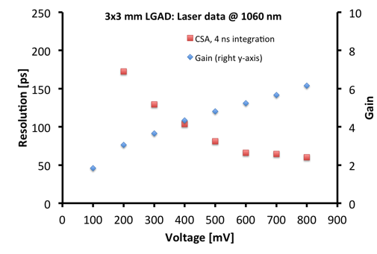
Timing R&D
GasTOF system
prototype for test beam is on-going
Diamond detectors
effort led by TOTEM
demonstrated 50 ps with 4 planes
Silicon detectors
Fast Silicon Detectors (UFSD):
  60 ps with new prototypes (laser)
Plan to exploit Avalanche PhotoDiodes as charged particle timing detectors (Hyperfast Silicon)
UFSD (300 um):
time resolution ~60ps
from slide by S. White
(also arXiv:1409.1165)

Slide 29
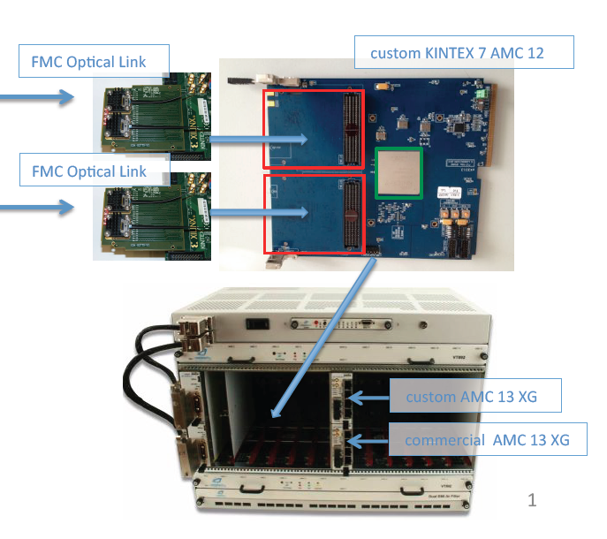
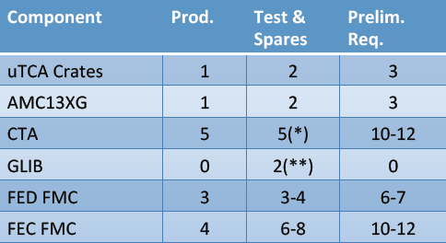
DAQ
Same readout scheme as Phase-1 upgrade of the CMS Pixel Tracker.
MicroTCA crate including:
2 CTA-FED, 2 CTA-tkFEC, 1 CTA-pkFEC
FMC Optical mezzanines

Slide 30
Summary
  CT-PPS is a new sub-detector that increases the potential of the CMS experiment
    joint effort by CMS and TOTEM
  Forward proton tagging allows physics in a LEP like environment:
    photon-photon and gluon-gluon interactions at precisely known center-of-mass energy
    no underlying pp event
  Rich physics program with emphasis in the search for New Physics:
    Sensitivity to anomalous gauge couplings is increased by two orders of magnitude
    Search for new resonances and invisible states
  Big experimental challenges are being addressed:
    operation of Roman Pots at the highest LHC luminosity
    pileup mitigation using timing detectors with 10 ps resolution
    3D pixels tracking at very large particle fluence
  Plan to start collecting data in 2016

Slide 31
Extra slides

Slide 32
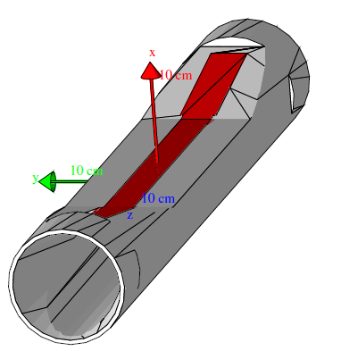
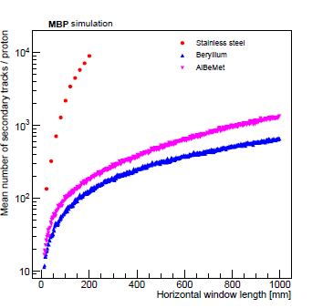
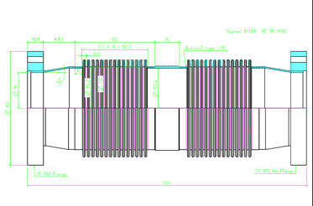
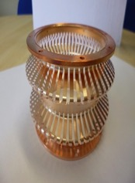
R&D: Movable beampipe
Design for MBP main body was developed
Thin window material evaluated with GEANT simulations
  Improved secondary/shower production and angular resolution with Be/Be-Al alloy options
MBP will be connected to LHC beamline by standard double bellows
  New RF shielding design developed by TE-VSC group

Slide 33
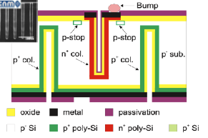
3D sensors by CNM
We are producing:
2E pixel configuration, i.e. 2 readout columns [1E as backup]
200 μm slim edges
2x3 sensors (6 ROCs)
CNM technology as for the ATLAS IBL production:
4” wafers, 230 μm thickness
Double side, not passing through columns
Slim edges (200 μm)
Foreseen yield is ~60%

Slide 34
3D sensors by CNM
We are producing:
2E pixel configuration, i.e. 2 readout columns [1E as backup]
200 μm slim edges
2x3 sensors (6 ROCs)
CNM technology as for the ATLAS IBL production:
4” wafers, 230 μm thickness
Double side, not passing through columns
Slim edges (200 μm)
Foreseen yield is ~60%

Slide 35
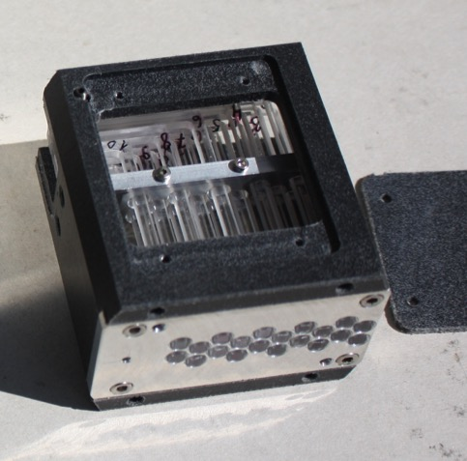
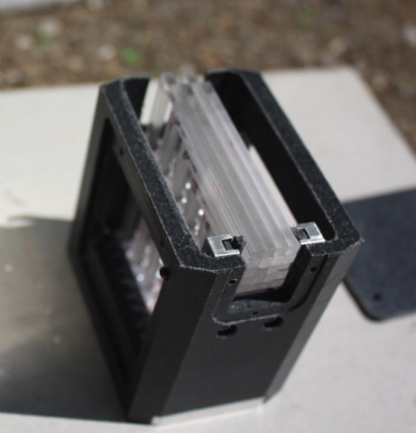
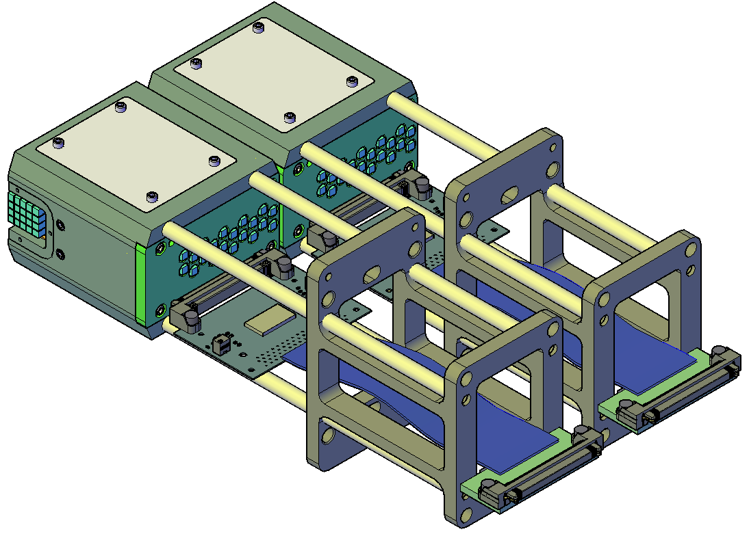
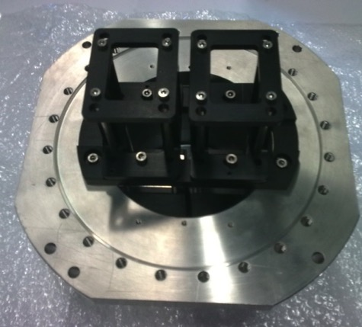
Quartic module & mechanics
Two QUARTIC modules
Support
structure
QUARTIC
block
MPPC
(SiPM)
32^{ch} NINO
board
Connector
board
Flat cable

Slide 36
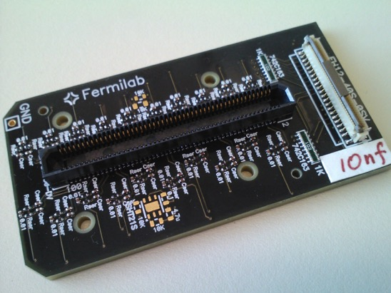
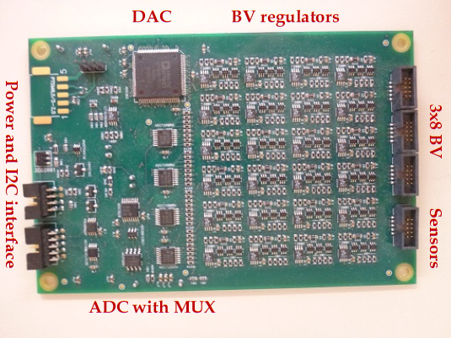
SiPM and Control boards
SiPM mounting board:
Connects to MPPCs (100 pin connector)
Connector with individual Bias Voltages and environmental sensor signals
Ready
SiPM Control Board designed for CMS HCAL upgrade:
Provides SiPMs with individual regulated Bias Voltages
Measures SiPM leakage currents, temperature and humidity
I2C controlled
Available

Slide 37
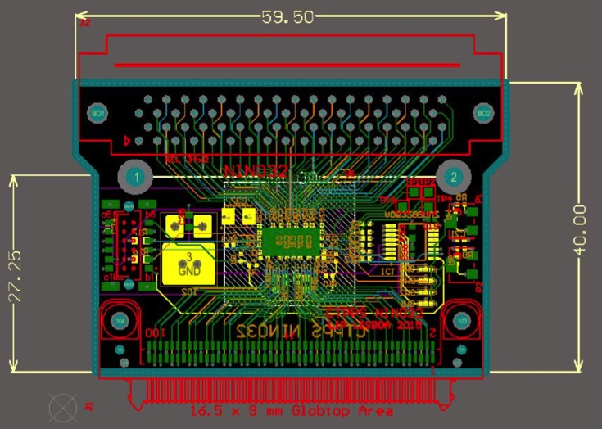
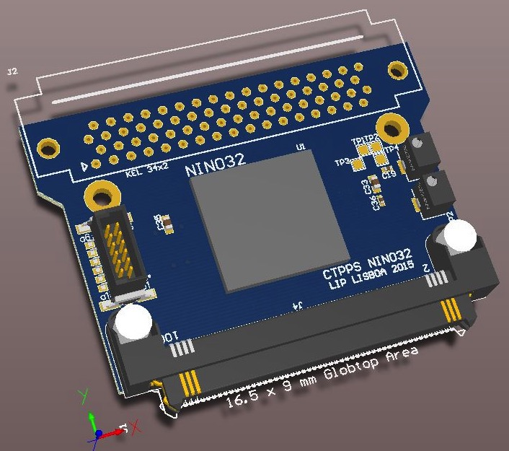
Front-end electronics
NINO Board:
  based on NINO chip (fast amplifier-discriminator)
  32 differential inputs; 32 LVDS outputs
  time resolution ~5 ps
  installed inside RP
  PCB layout ready for production
  Boards expected in July
Quartic readout chain
In RP sec vacuum
Box below beam pipe
Counting room

Slide 38
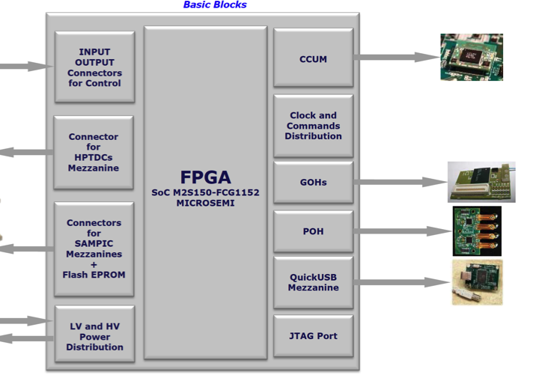
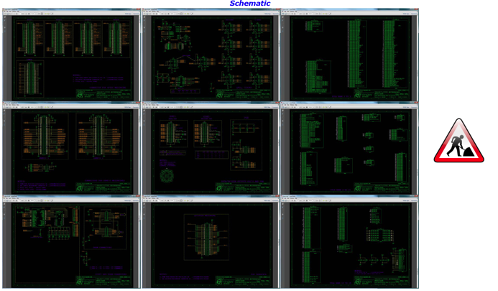
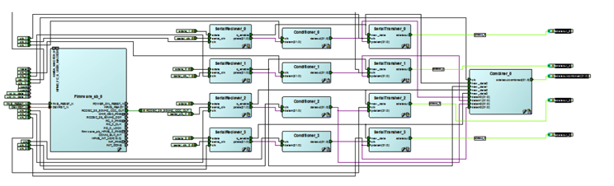
Digitizer board
common CT-PPS & TOTEM development
time to digital conversion (TDC)
time over threshold measurement (ToT)
mezzanine board HPTDC/SAMPIC
board expected in August
Upgrade Pixel optical links
Board schematics under development
Firmware under development

Slide 39
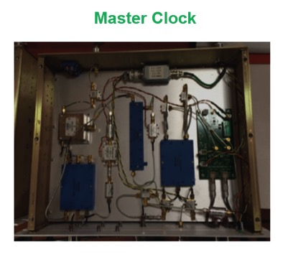
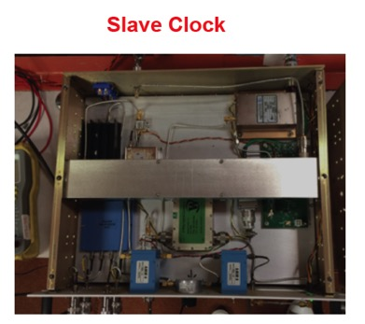
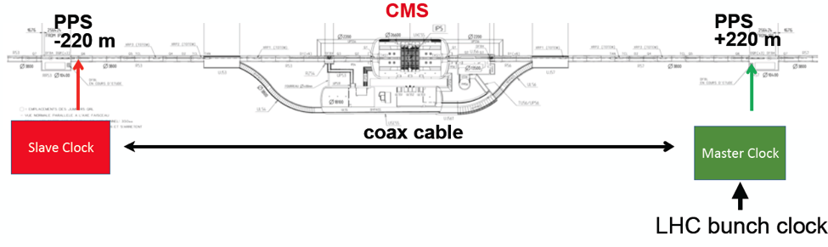

Timing reference system
Clock distribution with ~1 ps jitter
CMS/SLAC system:
  based on a system in use at SLAC Linac Coherent Light Source (LCLS)
system expected in November for tests
install coaxial cable through the bypass (~470 m total length) at Year End TS.
Totem/GSI system:
  based on the optical system for FAIR at GSI
full system architecture outlined
first system under test

Slide 40

Trigger strategy
Two-photon physics:
  the leptonic final states are captured by the CMS lepton triggers
    The trigger efficiency is expected to be very high given that the lepton thresholds are 30 GeV or below.
  Final states with hadronic decays of one W or one tau will be accessible using the lepton+jet triggers.
Hadronic physics
  Large inclusive QCD jet background
  L1 timing trigger selecting events in the tails of the distribution of the collision z-vertex
In red distributions of the vertexes separated by at least 1 cm

