Slide 1
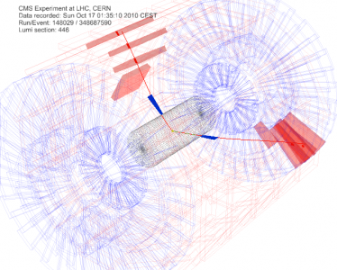
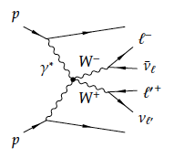


γγ Physics at the LHC with CMS
Krzysztof PIOTRZKOWSKI
Center for Cosmology, Particle Physics and Phenomenology (CP3)
Université Catholique de Louvain
Low-x Meeting
Sandomierz
September 1-5, 2015

Slide 2
Outline
Part I: Introduction – EPA or the LHC as a photon-photon collider
Part II: Two-photon lepton exclusive production
Part III: First ever measurements of γγ → WW;
at 7 and 8 TeV

Slide 3
LHC as a High Energy γγ Collider
Phys. Rev. D63 (2001) 071502(R)
hep-ex/0201027
p
p
Initial observation:
Provided efficient measurement of very forward-scattered protons one can study high-energy γγ collisions at the LHC
Highlights:
γγ CM energy W up to/beyond 1 TeV (and under control)
Large photon flux F therefore significant γγ luminosity
Complementary (and clean) physics to pp interactions, eg studies of exclusive production of heavy particles might be possible opens new field high energy γγ (and γp) physics

Slide 4
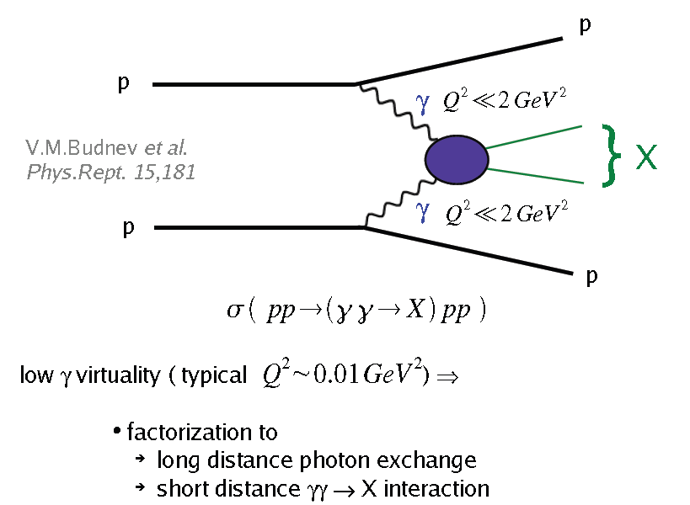
LHC as a γγ collider
Equivalent photon approximation (EPA)
…introduced to major event generators as Madgraph, Pythia, Sherpa, Calchep

Slide 5
EPA and absorption corrections
EPA assumes full factorization of the long range (-> photon fluxes) and short range (-> γγ fusion) physics; values of the impact parameter b are the best check of a regime one works with – they are different for the proton elastic and dissociative cases, though the flux b dependence is similar, dn ∝ bdb.
If one takes the 8 TeV beam and x=0.01 (corresponding to W=160 GeV) than:
Elastic: b_{max} ≈ 20 fm and b_{min} ≈ 0.6 fm
Inelastic (dissociative): typ. b_{max} ≈ 0.1 fm and b_{min} ≈ 0.01 fm
For two-photon exchange one deals with two impact parameters, so one can approximate b ≈ b₁ + b₂

Slide 6
EPA and absorption corrections
For two-photon exchange one deals with two impact parameters, hence one can approximate b ≈ b₁ + b₂
Therefore, relatively small absorption are expected both for fully exclusive (elastic-elastic) as well as single dissociative SD (2x elastic-inelastic) and BIG one for DD case (inelastic-inelastic)
Three important comments regarding ‘test-bench’ two-photon lepton pair exclusive production:
Lepton acoplanarity is a good measure of the relevant impact parameters involved; if there is significant absorption it must distort the acoplanarity
Absorption should increase with increase of W (since b_{max} decreases)
Fully exclusive pairs die fast with increasing pair pT; so above 1 GeV/c one is left with SD+DD only

Slide 7
Part II
Two-photon lepton pair exclusive production

Slide 8
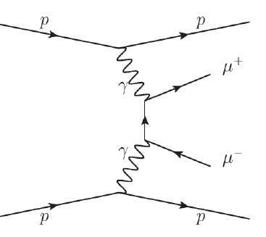
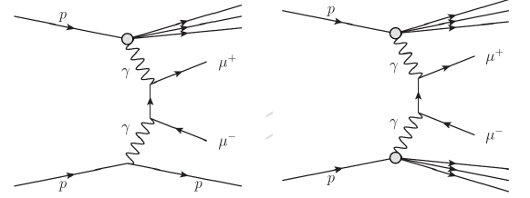
Exclusive γγ → μ⁺μ⁻
The first measurement focus on the dimuon
channel – standard candle:
* Pure QED process:
- No PDF to account for
- Small theoretical uncertainties
* Striking kinematic distributions:
- due to very small virtuality of the exchanged
photons
* measured in previous experiments to be in
agreement with the ME LPAIR generator
Largest background arises
from semi-exclusive two-photon
production due to single and
double proton dissociative
(or inelastic) photon exchange:

Slide 9
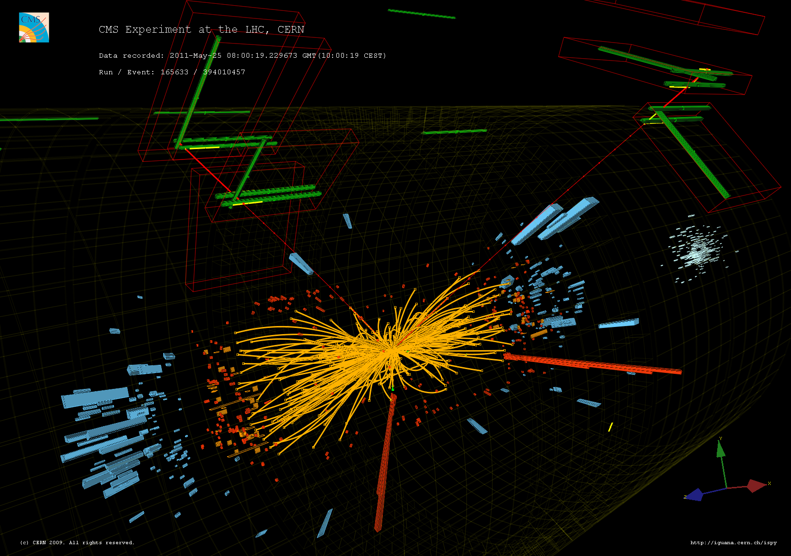
Question: How to select exclusive events in high pileup environment?

Slide 10
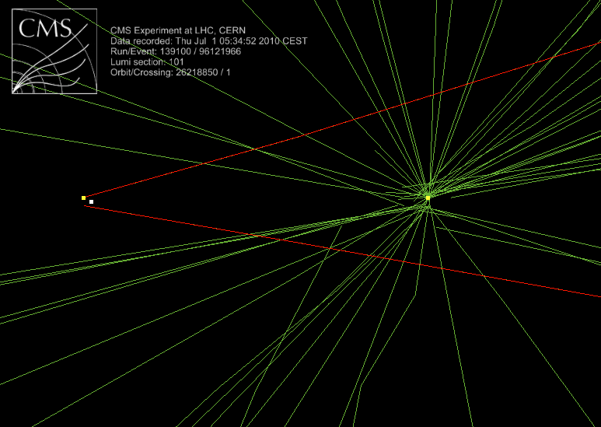
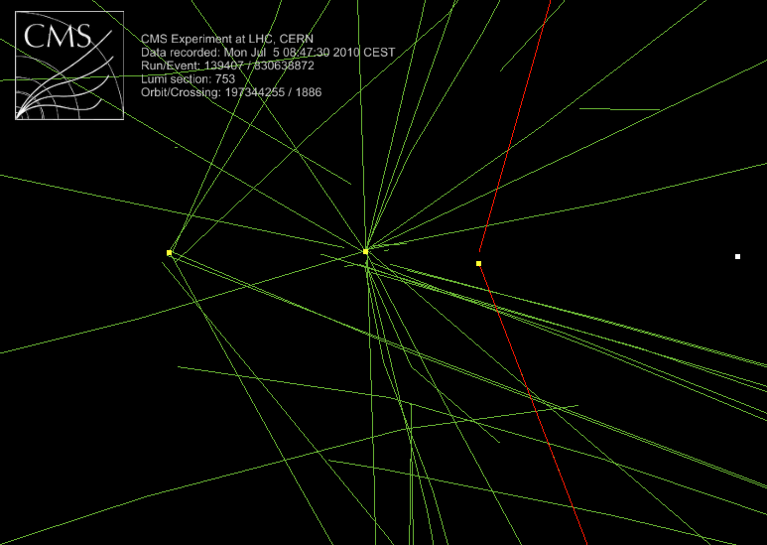
Question: How to select exclusive events in high pileup environment?
Answer: Use tracking only and zoom in onto the vertices!

Slide 11
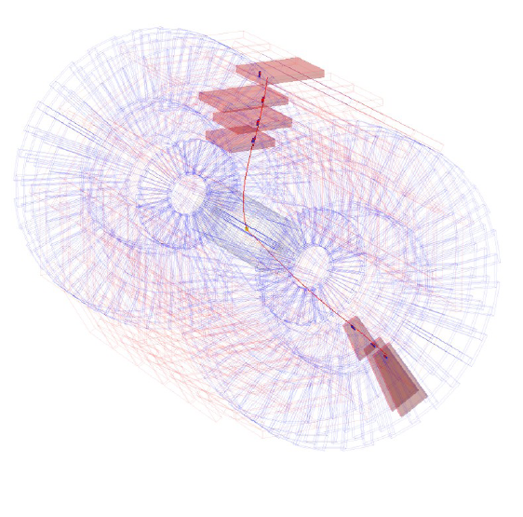
Exclusivity conditions
In initial (very) low luminosity era:
2 muons and “nothing else“
in the tracker and calorimeters
In 2010, each event of interest was
accompanied by extra “PileUp” events
within the same bunch crossing:
~ 2-3 pileup interactions
In 2011, roughly 7-10 PU per crossing
In 2012, PU =25 put the method to a very limit…
Restricting the analysis to single interactions only would have reduced the data sample a very small fraction of the total → impose exclusivity using tracking only

Slide 12
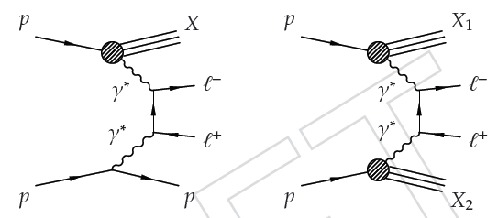
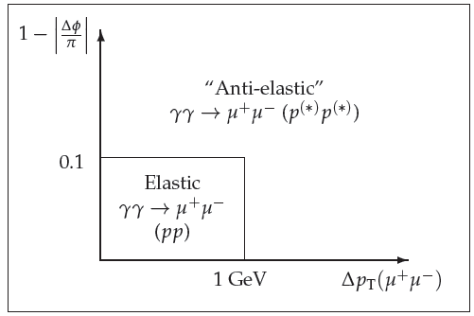
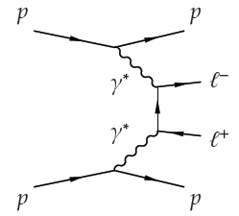
μμ calibration candle
Use Δp_{T} and |1-Δφ/π| to select regions enriched in elastic or inelastic events
  Same cuts as used for 2010 γγ→μμ cross-section paper
Also separate Z peak region (76-105GeV) to check modeling of Drell-Yan
  γγ→Z is suppressed at tree-level , exclusive Z is expected to be <1fb including branching fraction
Exclusive photon-photon production of muon pairs in proton-proton collisions at 7 TeV
JHEP 1201 (2012) 052 arXiv:1111.5536 [hep-ex]

Slide 13
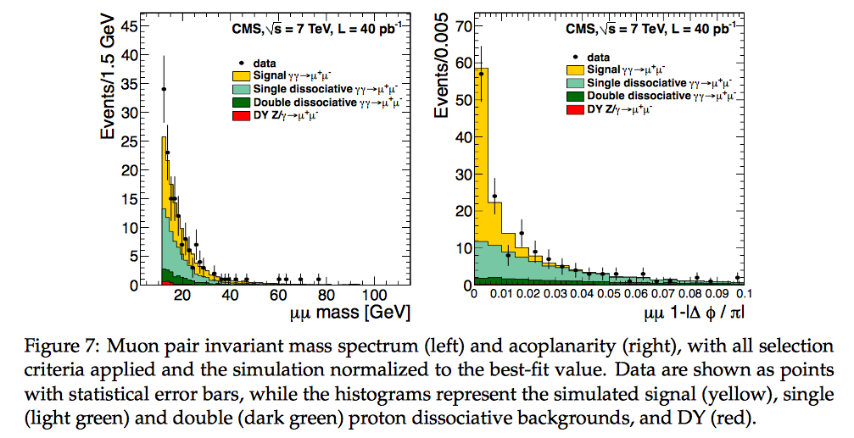

Observe some deficiency but within stat.+syst. errors, without clear hint for absorptive effects in fully exclusive case

Slide 14
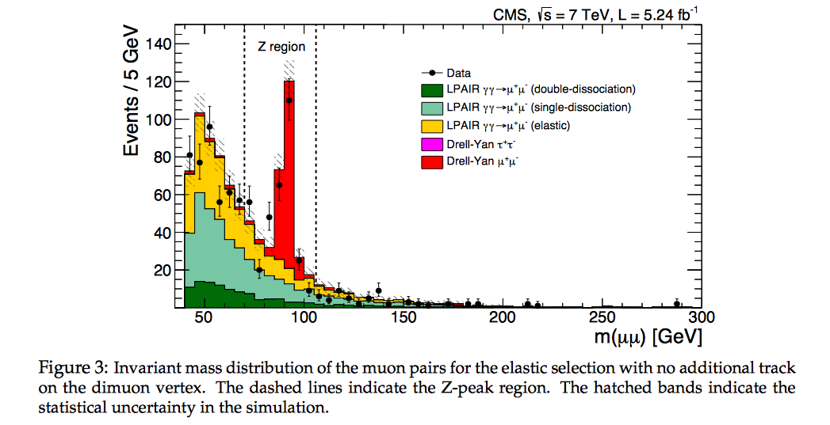
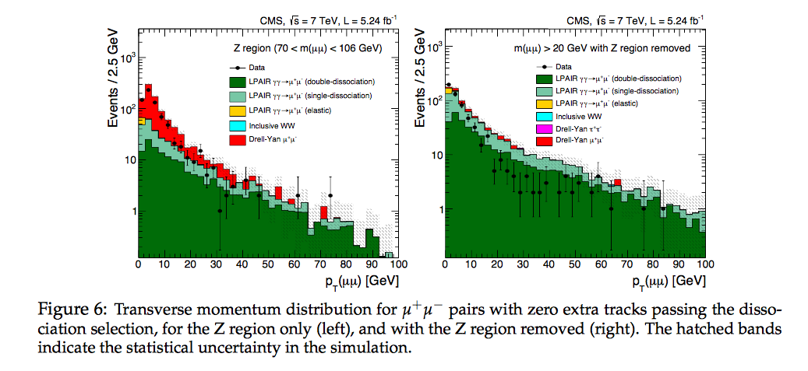
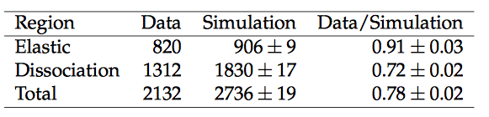

Slide 15
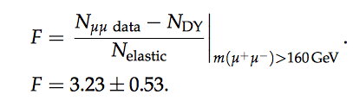
Conclusions for absorption and and γγ -> WW
Summary for the dilepton (semi-)exclusive production:
No evidence for strong absorption in elastic-elastic production; also above 160 GeV
LPAIR, which is “mirrored” by EPA calculations, describes well both acoplanarity and invariant mass (W) distributions
DD seems to be almost completely suppressed! Proper modeling of the DD is essential for further detailed studies of the absorptive corrections.
S O L U T I O N for getting a proper γγ-> WW from pp –> pWWp(*) as proposed and applied by CMS:
This was a data-driven F factor (in 2011) which “automatically” takes into account the absorptive effects:

Slide 16
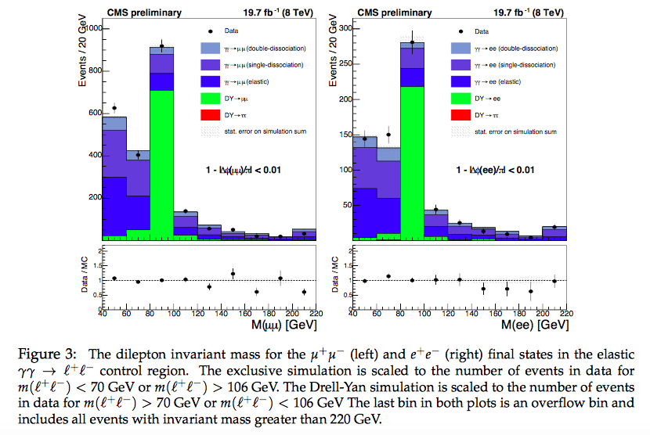
8 TeV update

Slide 17
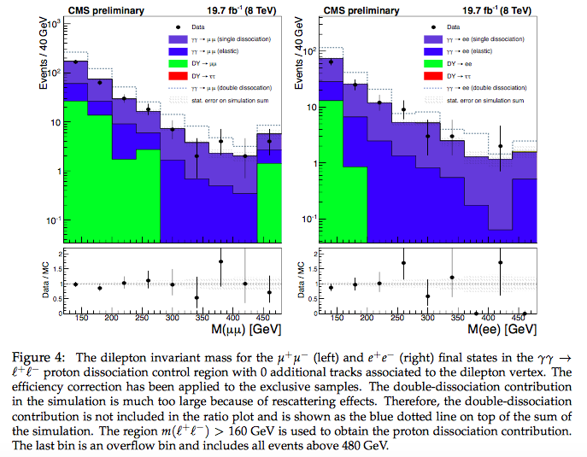
8 TeV update

Slide 18
Part III
γγ→WW→μeνν

Slide 19
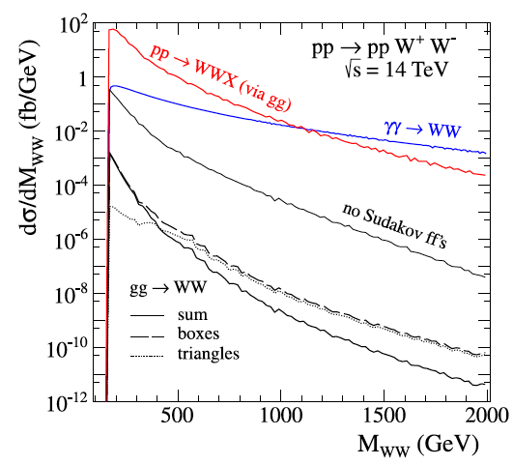
WW pair production @ LHC
At very high energy γγ wins over ‘inclusive’ production !!
Nucl. Phys. B 867 (2013) 61

Slide 20

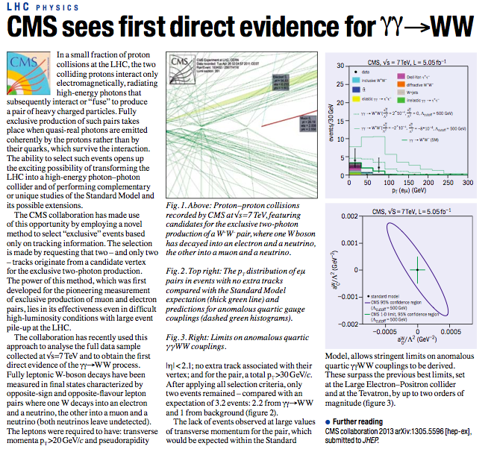
about same time…

Slide 21
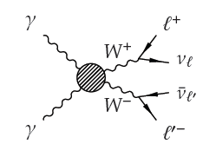

Notation
Fully exclusive (or “elastic”): events in which both protons stay intact
  Theoretically clean QED-like production
Quasi-exclusive (or “inelastic” or “proton dissociation”): events in which one or both protons fragment into an undetected low-mass system p^{(*)}
  Larger uncertainties, possible rescattering corrections
Cannot separate the two contributions in a counting experiment, therefore signal is defined to include both:

Slide 22
Repeat: EPA and γγ -> WW
The basic assumption (backed by the data) is that the absorptive effects are NOT changing fast; in practice, it was tested by calculating F factor for increased threshold values, above 160 GeV and we see no clear trend, just (rather small) statistical fluctuations which have been included into systematic errors
BOTTOM LINE:
The γγ -> WW cross-sections measured by CMS have no bias due to (not well known) absorption and the corresponding uncertainties of our data-driven procedure of extracting the proper γγ -> WW are included in syst. errors.
Remark:
Should start using the CMS di-lepton data to test models of absorption and to determine absorptive corrections for fully exclusive and semi-exclusive processes;
fit lepton pair acoplanarity and pT distributions.

Slide 23
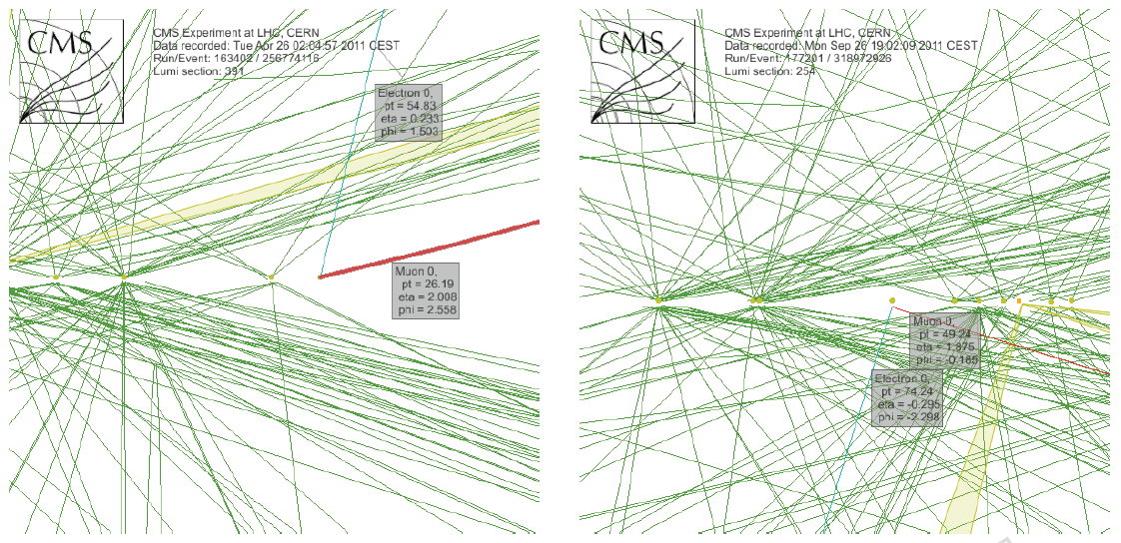
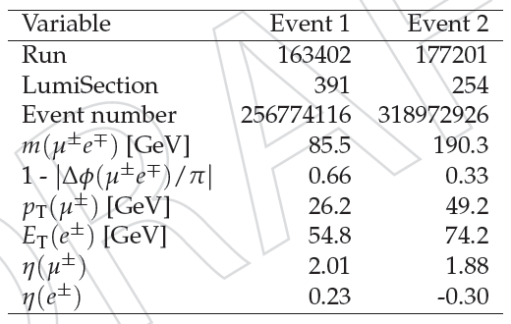
WW exclusive signal candidates
Event displays and single/double lepton information for the two selected events

Slide 24
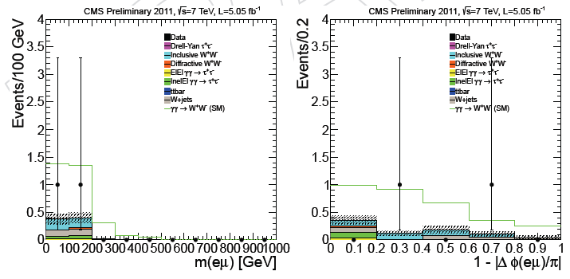
SM signal region (0 extra tracks, p_{T}(eμ)>30 GeV)
Study of exclusive two-photon production of
WW in pp collisions at 7 TeV and constraints on anomalous quartic gauge couplings
CMS JHEP 1307 (2013) 116
arXiv:1305.5596 [hep-ex]
Expected bkg: 0.8
Expected signal: 2.4±0.5
Observed in data: 2 events

Slide 25
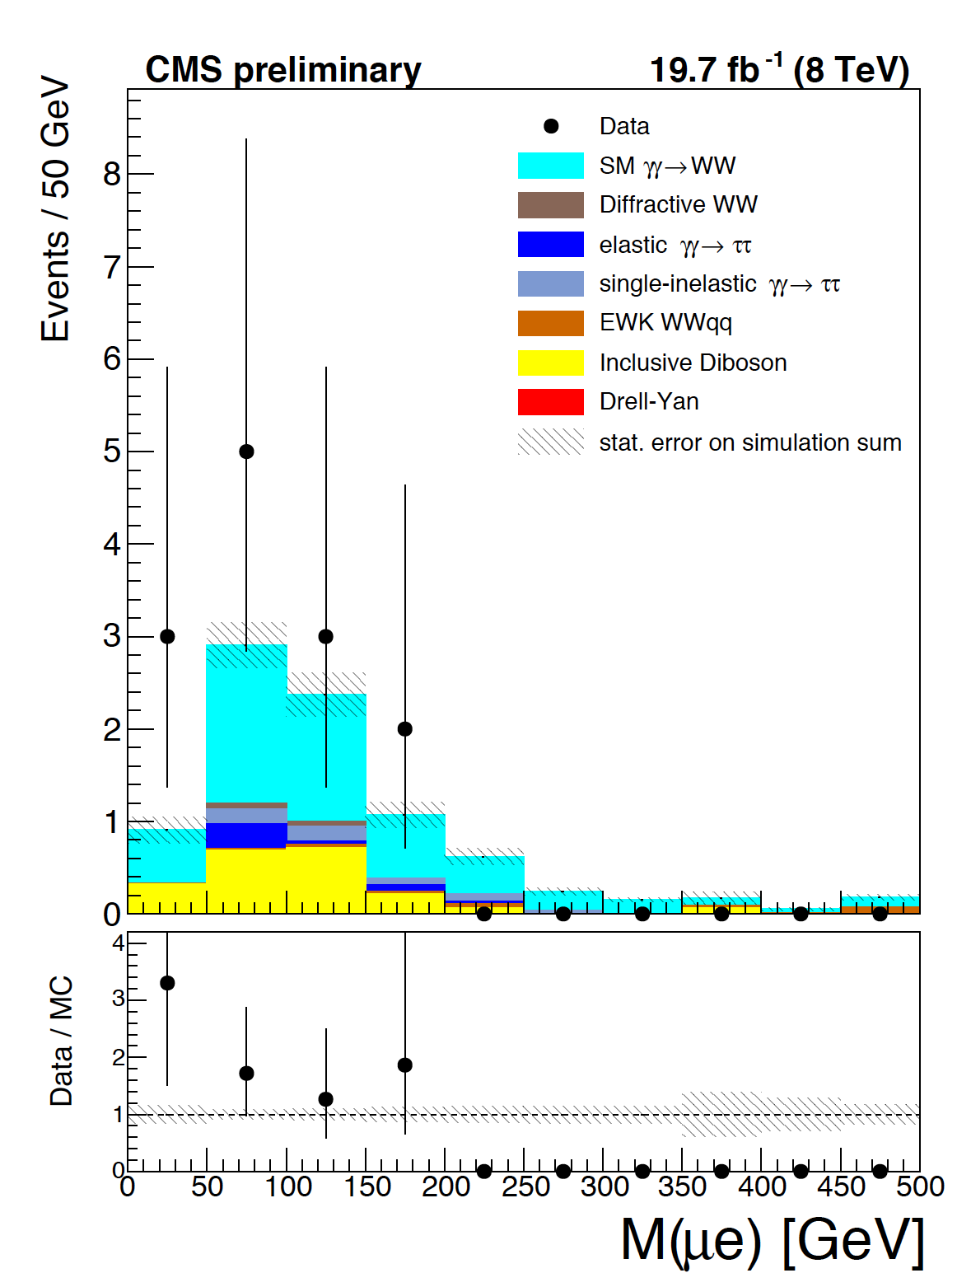
8 TeV Results
Measurement of the W+W− cross section in pp collisions at 8 TeV and limits on anomalous gauge couplings arXiv:1507.03268 [hep-ex]
Number of expected signal and background events
Signal | All backgrounds | Inclusive WW | γγ→ττ | DY→ττ | Diff. WW | Others
5.3±0.1 | 3.5±0.5 | 2.0±0.4 | 0.9±0.2 | 0 | 0.1±0.1 | 0.5±0.2
13 events are observed in data
Cross section measurement:
SM prediction: 6.9 ± 0.6 fb
Observed significance above the
background-only hypothesis: 3.6σ

Slide 26
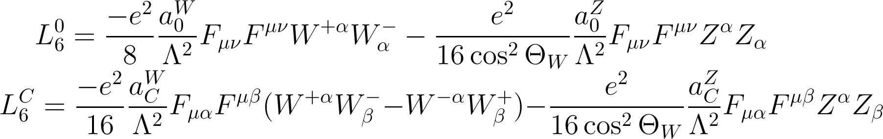
AQGCs
The anomalous couplings in the γγ→W⁺W⁻, can be introduced with the following effective Lagrangians
Local U(1)_{em} and global SU(2)_{c} invariance imposed; these are genuine quartic couplings independent of the gauge ones (a la LEP):
Where Λ is the scale for new physics, which is set in this analysis to 500 GeV

Slide 27
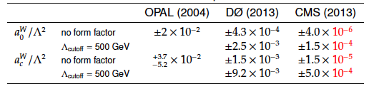
Summary: Results for anomalous WWγγ coupling
95% CL limits on a^{W}₀/Λ² and a^{W}_{C}/Λ², for two scenarios:
CMS(2015)
Up to two orders of magnitude improvement to limits set by LEP and Tevatron
One order of magnitude more stringent than CMS limits
from tri-boson production

Slide 28

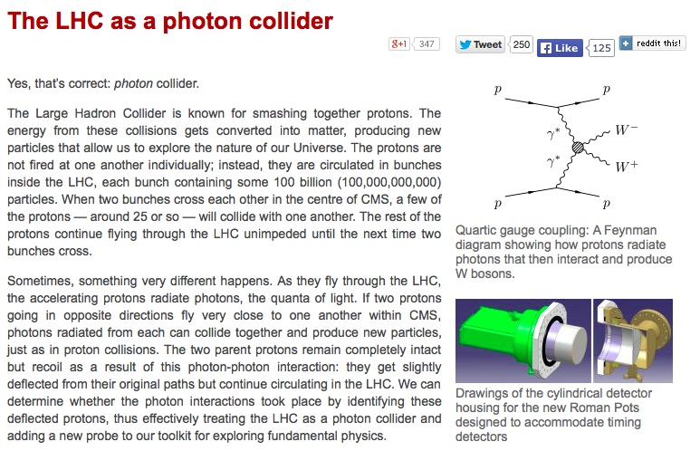
Next step…

Slide 29
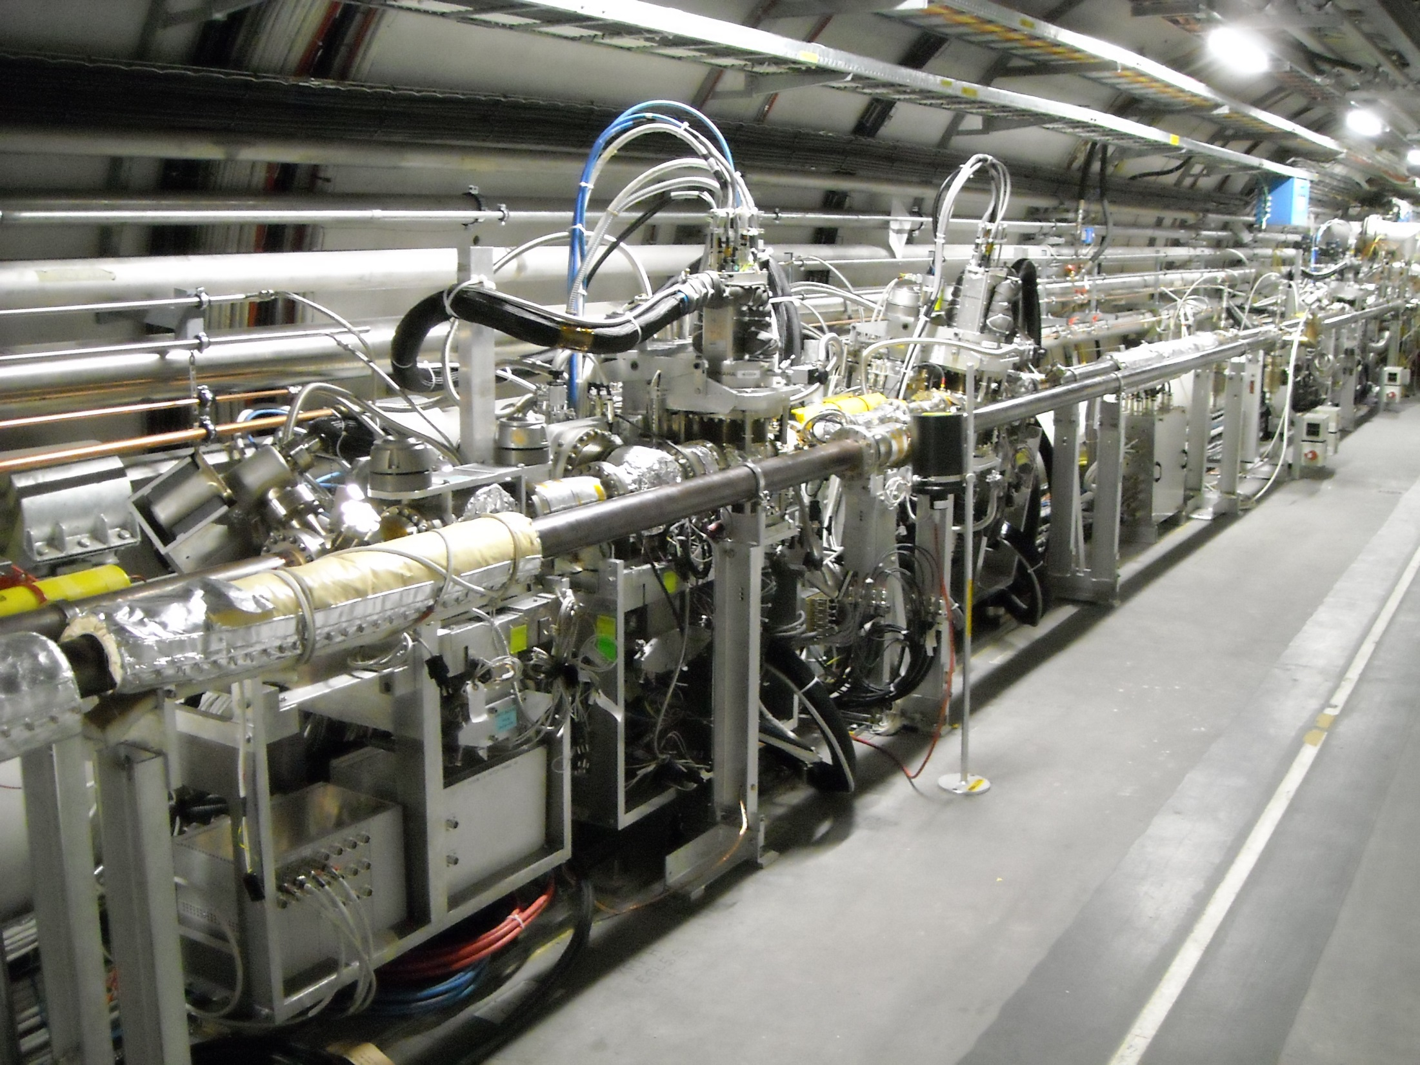
CT-PPS Components for 2016 running
TOTEM
tracking
CT-PPS
tracking 2
CT-PPS
tracking 1
CT-PPS
timing
IP5►

Slide 30
Extra slides

Slide 31
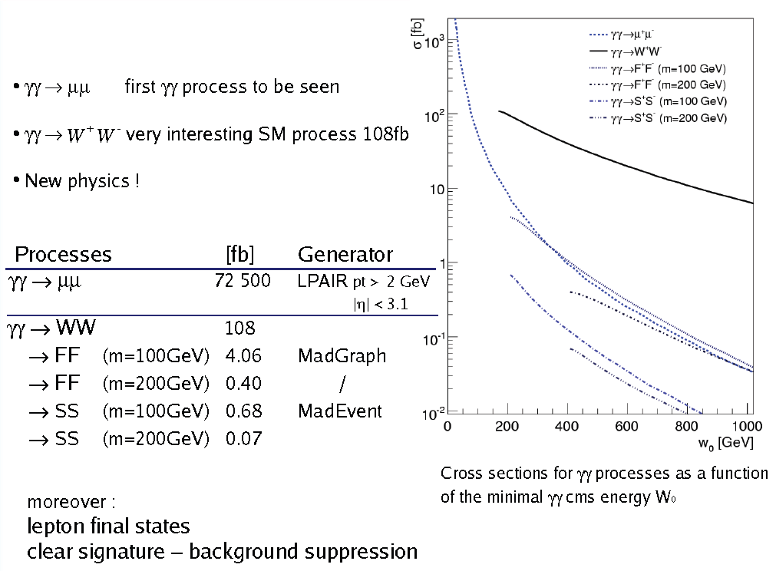
LHC as a γγ collider
arXiv:0908.2020
√s = 14 TeV

Slide 32
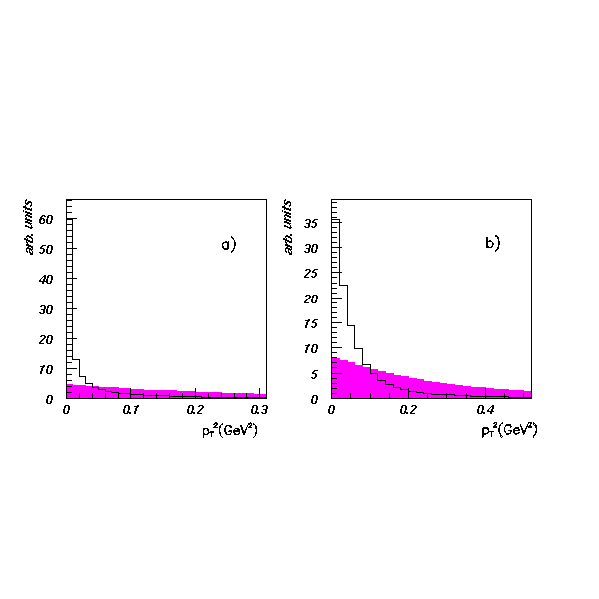
Problem: Same signature (one or two very forward protons) has
also central diffraction (i.e. pomeron-pomeron scattering) in strong
interactions
Both processes weakly interfere, and transverse momentum of the scattered protons are on average much softer in
two-photon case
Phys. Rev. D63 (2001) 071502(R)
⟨Q²⟩ < 0.01 GeV²
a) `true’ distributions; b) distributions smeared due to beam intrinsic p_{T}; all plots normalized for p_{T}² < 2 GeV²
Diffraction b=4 GeV⁻²
p_{T} gives powerful separation handle provided
that size of γγ and pomeron-pomeron cross-sections are not too large...
…unless special high-β running.
Assuming ultimate p_{T}
resolution ≈ 100 MeV; i.e.
neglecting detector effects

Slide 33
