Slide 1
PLC based control systems
ICALEPCS’17 Workshop
E. Blanco
PLC based control systems at CERN

Slide 2
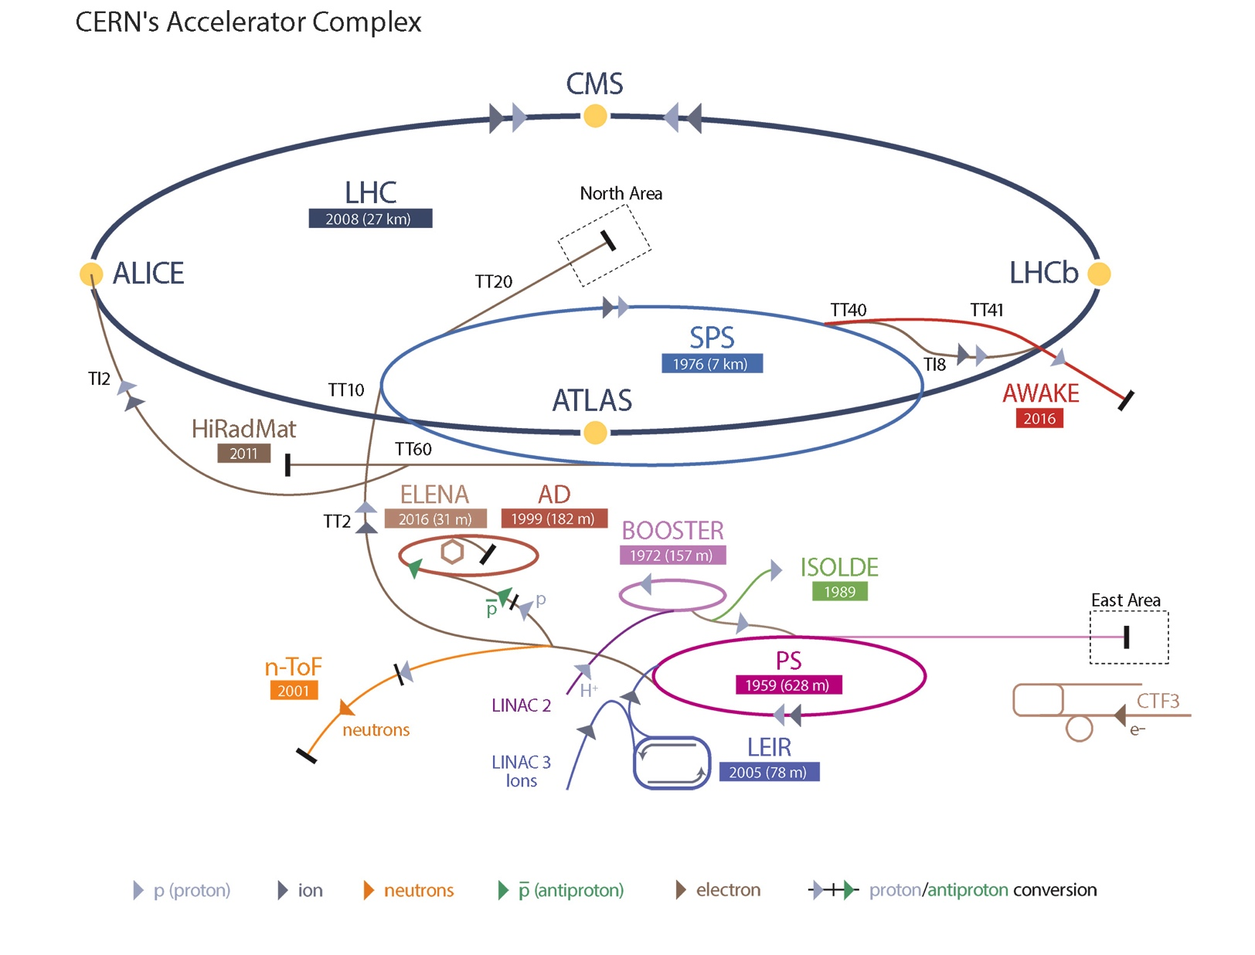
CERN
CERN mission
  To perform world-class research in fundamental physics
  To provide a unique range of particle accelerator facilities that enable research at the forefront of human knowledge
Key figures
  Budget 1100 MCHF
  22 member states
  2500 Staff + 1800 Associates +13000 users + 2000 External firms

Slide 3
PLC inventory by domain (fairly accurate)
Not including Twido’s from EN-EL, S7-200 TE-VSC
Notes:
LECTRICAL DISTRIBUTION (Joao Letra Simoes)
===========================================
Our PLCs are mainly divided in these areas:
- Auto-transfer (3x)
- Diesels (13x)
- PLC Interlock (1x)
- 18kV commutation (3x)
- Low voltage distribution (13x)
- Ventilation (8x)
- 48V/24V commutation (~x50)
90% of our systems are reacting on request. No continuous control process like PID control or equivalent.
We monitor the voltage presence on a given busbar (or set of busbars) and take action in case of power loss.
When the power is back, the network configuration is set back to its normal state (by opening and closing breakers, start/stop diesel generators, etc).
Some of our systems have three different sources which can be used as backup.
RF (Luca Arnaudon)
==================
a la RF on réalise 90% des PLC pour des control du type interlocks et séquencement de mise en route ou arrêt des installations.
Les système ont un temps de cycle de 2 à 5mS sauf les linac4 et la LHC 40mS et 20mS respectivement
Là ou c est nécessaire, les PLC sont double par des interlocks rapide (15uS) et câble (cartes a base d FPGA maison)
Dans la plus part des cas il y a des I/O déporte sur des bus de terrain comme Ethercat dans les nouveaux systèmes PSB et SPS, Ethernet/IP au Linac4 et FIP-IO au LHC.
Les plus grosses installations actuellement sont:
LHC 16 stations RF
Linac4 17 stations RF
SPS 200MHz et 800MHz
Les futures nouveaux projets sont FINMET booster, SPS 200 LIU
La rénovation a aussi une large part de l'activité de la section avec PS 20 et 200 MHz pour la fin d'année et SPS200 et PS 10MHz pour LS2
Les 10% restant ce sont des banc de test aux SPS, SM18 et SA2 ou en plus des interlocks et du séquencement il y a des mesures de paramètres.
J'espère ça te conviens

Slide 4
PLCs inventory at CERN
Fairly accurate, 2017

Slide 5
PLCs use: applications
Fail safe controllers : Safety Integrated
Access Control
Machine-tools sector (e.g. Winding machines)
WIC: Warm magnets interlocks
Cranes control
AWAKE, Magnet test benches
Autonomous Mobile Equipment: TIM
Redundant systems
Protection in experimental areas: DSS
Electrical systems
HVAC
Power converters
Classic PLCs
Cryogenics (Accelerator and experimental areas)
Gas systems (LHC GCS, Linac4, Cloud…)
Cooling systems
HVAC
Motion: servo-motors and Stepping motors
RF
Vacuum
Electrical systems
Protection & Interlocks (PIC, SPS Power converters
interlocks, Collimators Temperature Interlocks
Monitoring: RAMSES, CSAM

Slide 6
Experience with suppliers
More than 18 years of experience
  There is not a perfect supplier but a satisfactory supplier
  Lack of competition between suppliers is not healthy… as long as you can afford it.
  Despite being a rather conservative technology segment (OT vs. IT), the supplier must follow tendencies (desirably without imposing continuous upgrades)
  A strong and reactive technical team must be behind the curtains (commercials are not enough)
  The key is not having suppliers but partners

Slide 7













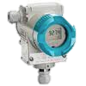







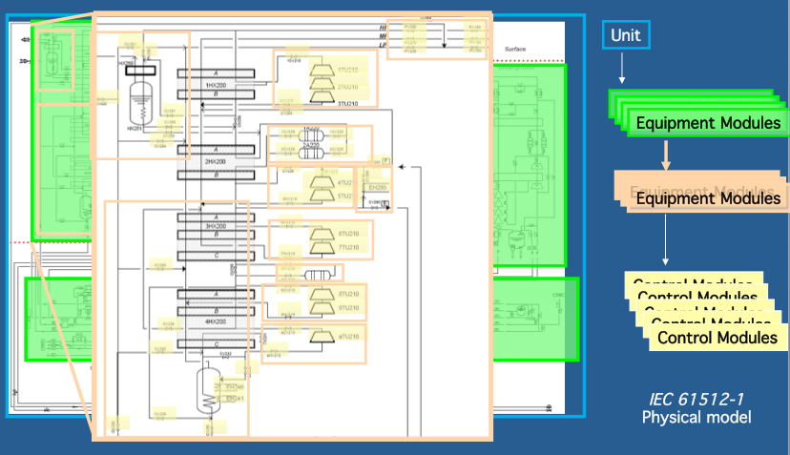

UNICOS-CPC Engineering life cycle (PLC apps)
Databases (Assets, Layout
Controls conf.)
Versioning (SVN, GIT)
Verification, Simulation,
Test
Deployment
& Monitoring
Maintenance
PLCVerif
Moon
Assets
Specifications
Automatic
Code
Generation
Test
(FAT,
SAT)
Deployment
Reverse
Engineering
Analysis
PLC
PLC

Slide 8
CERN-wide PLC services
Versioning and software distribution
Versioning systems usage guidelines for PLC developers. (i.e. SVN)
Central Software distribution (CMF) and related specific DFS places
Database support for PLC users
CERN equipment catalogue
Asset database for component tracking.
Hardware
Reduced set of hardware (recommended hardware)
Availability (machines uptime)
Diagnostics & monitoring: (PLC agent)
Repository for PLC applications and monitoring (Version Dog)
Critical spare stock: Fast intervention 24/7
Optimize Knowledge
GUAPI: PLC Users Working Group
Set of demonstrators and training test-benches
Development
Framework (i.e. UNICOS)
Quality Control
Testing & verifications mechanisms

