Slide 1
Facility for Rare Isotope Beam (FRIB) PLC Control Systems Introduction
Kelly Davidson
Controls Department Deputy Manager

Slide 2
Outline
FRIB project introduced
PLC scope and application defined
PLC Architecture defined
Control Engineering Process defined
Management of change workflow defined

Slide 3
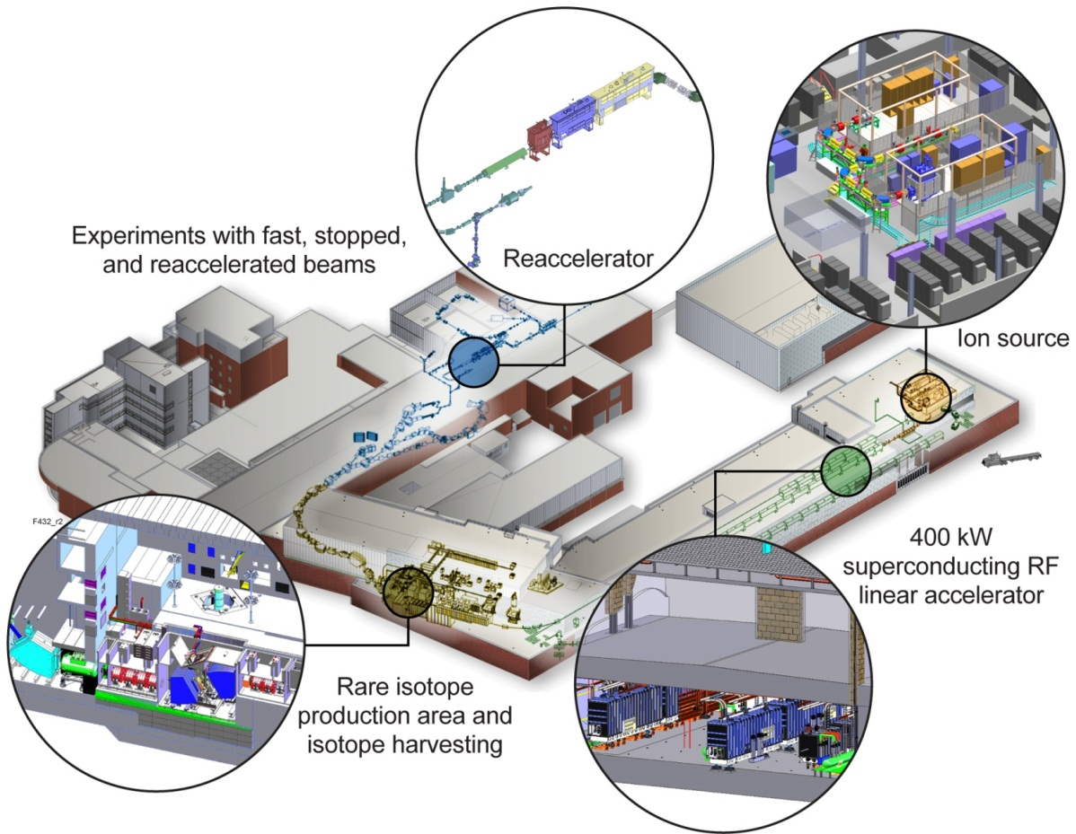
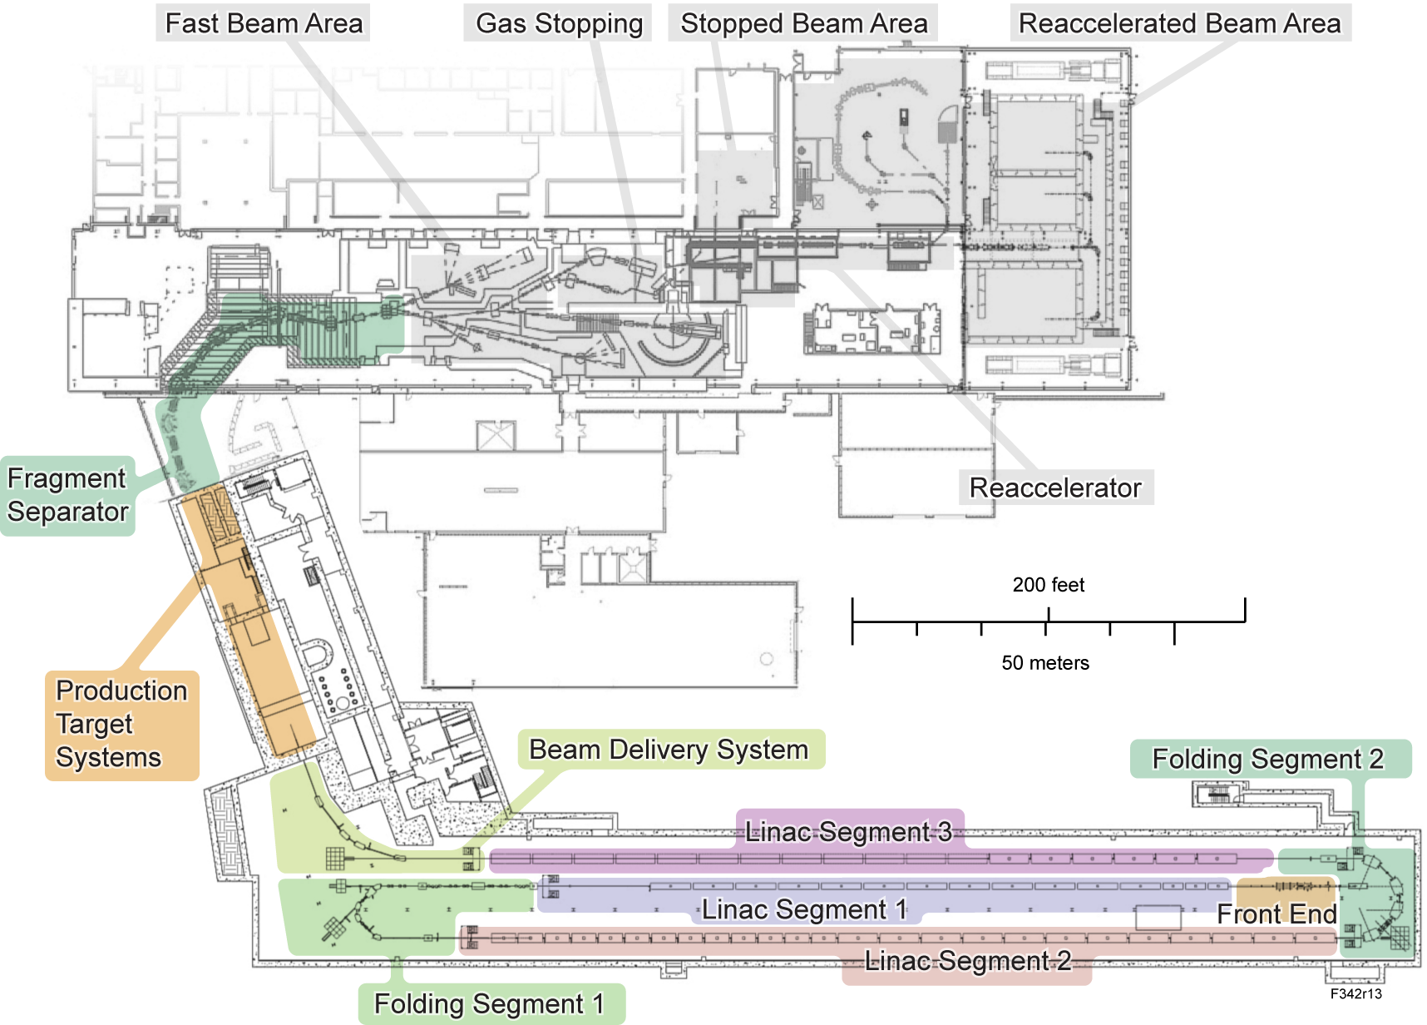
FRIB Introduction
The FRIB, is a new heavy ion accelerator facility currently under construction at Michigan State University
  Replaces existing coupled cyclotrons in the National Superconducting Cyclotron Lab
It is being built to provide intense beams of rare isotopes
Funded by DOE–SC Office of Nuclear Physics with contributions and cost share from Michigan State University
Serving over 1,400 users
Key feature is 400 kW beam power for all ions, from H to ²³⁸U with energies of no less than 200 MeV/u
Provides separation of rare isotopes in-flight
  Supplying fast, stopped, and reaccelerated beams to experimenters
Scheduled completion, 2022

Slide 4

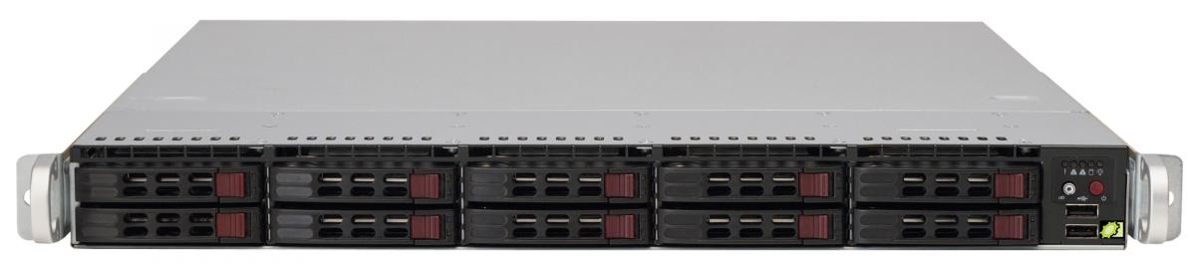
FRIB Low Level Controls Scope and Application
FRIB will have ~50 ControlLogix PLCs
  NSCL has a similar number with ~12K I/O points
  Includes control of Cryoplant process, cryodistribution and beamline systems
PLC Controls used for hardwired control signals, interlocks and analog read and process controls
Based on EPICS and industrial PLC control systems
  (Items in green are within the scope of Low Level Controls)
Operator stations: Displays
Archiving, Alarm Management, Strip charts, Save/Restore Utility
Fiber Timing Network
Ethernet – EPICS Channel Access, Precision Time Protocol (PTP)/Network Time Protocol (NTP) Timing
Vacuum Control
Power Supply Control
RF Control
Cryomodule
Diagnostic Control
I
OC
MOXA
(AI, AO,
Protocol)
PLC
(DI, DO, Temp, Interlock)
IOC
(AI,
AO)
PLC
(DI, DO, Interlock)
PLC
(DI, DO, Interlock)
IOC
(AI,
AO)
MOXA
(AI,
AO,
Protocol)
PLC
(DI, DO, AI)
IOC
(AI,
AO)
IOC
(AI, AO)
PLC
(DI, DO, Temp, Interlock)
I
OC
Vacuum Controller (Pump, Gauge, Valve, …)
Power Supply
LLRF
RF Amp
Cryogenic Instrumentation Interfaces
Digitizer
Motor Controller
Magnet
Analog Front End
Motor, Limits
Instrumentation
Valves

Slide 5
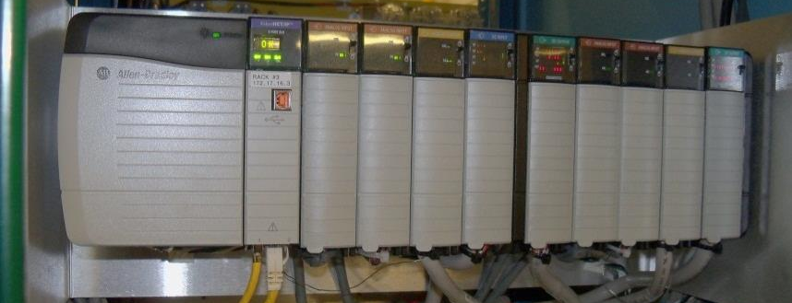
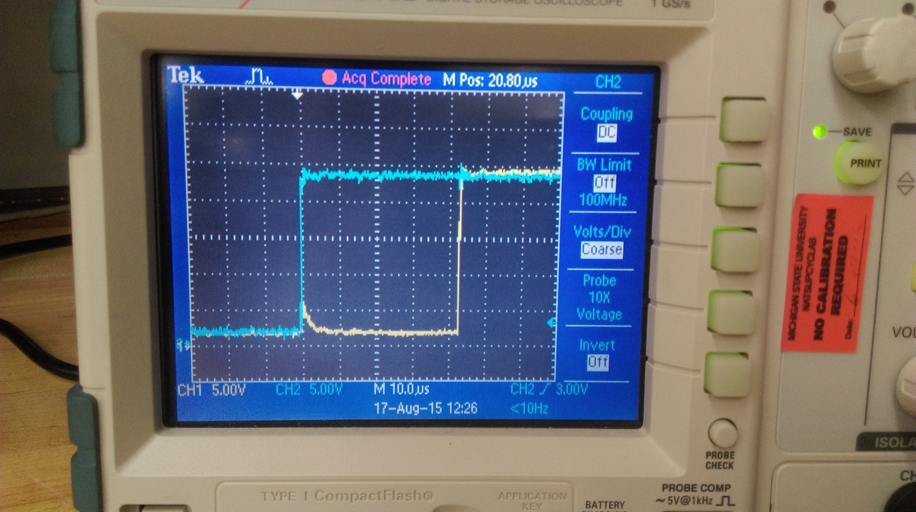
FRIB PLC Architecture Defined [1]
Allen Bradley (AB) ControlLogix PLC
  Large installed base in local industry
  Already deployed and established as standard for NSCL projects since 2004
  Used at several other National labs
  Existing in-house expertise
  Excellent local support from manufacturer
Provides the direct interface to the process devices via modular I/O
  Interfaces with discrete logic signals via 24 VDC
  Interfaces with analog signals via 4..20 mA current loops or +/- 10 VDC
  Other signaling levels can be translated through appropriate signal conditioning
Remote I/O
  Ethernet connected chassis house I/O modules for host controllers
  Use of off-chassis I/O transparent to the programmer
  Programmable failure modes for loss-of-communication faults
Use AB AssetCentre for version control
  Nightly compares verifies no unauthorized changes
Baseline I/O Modules
  Analog Input – 1756-IF16
  Analog Output – 1756-OF8
  Digital Input – 1756-IB16IF
  Digital Output – 1756-OB16IEF
  RTD Input – 1756-IRT8I
Using High Speed Digital I/O modules
  Lower Cost than diagnostic modules
  Modules can place timestamps on data
  Ability for higher speed reaction to inputs with bypassing CPU (<= 150 μ S, Tested at 40-60 μS)

Slide 6
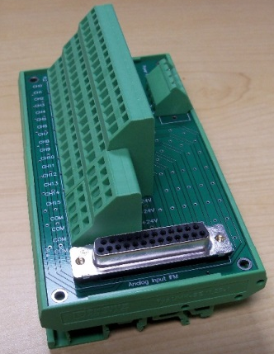
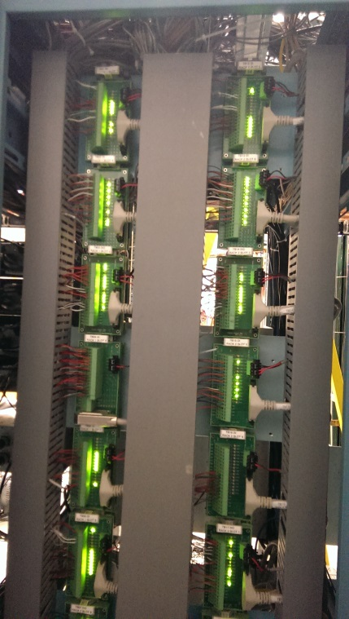
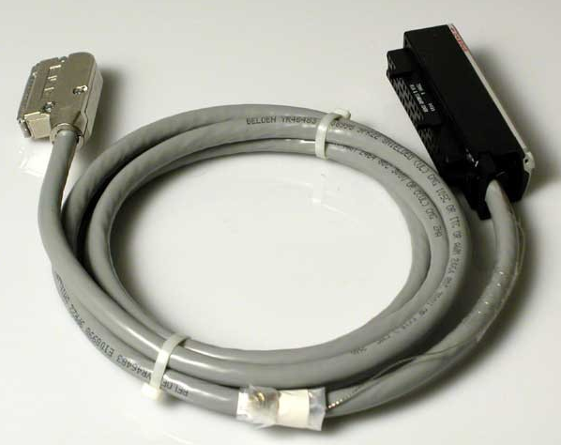
PLC Architecture Defined [2]
Interface Modules (IFMs) will be used as the connection point between the 1756 ControlLogix PLC Input and Output modules and signals from devices in the field
  Designed to interface with specific Allen Bradley I/O modules and pre-wired terminal blocks
    Reduces cabinet installation time from ~40 hours to 10 hours
    Reduces wiring errors
    Reduces cost vs commercial option
    Provides 24 V or Com for every signal (Module Type Dependent)
    Provides extra 24 V, Com Connections
  One module for each IO type
    Analog Input
    Analog Output
    Digital Input
    Digital Output
  Uniform design across PLC systems for simplified spare inventory
  Uses commercial pre-wired cables from I/O module to terminal blocks

Slide 7
FRIB Controls Engineering Workflow, SOP
Initiation (ECO/New)
Elaboration
Implementation
Production/Maintenance
Supporting Analysis
Risk Analysis
Approved Subsystem Requirement Specification (SubSyRS)
Gate review (ready to implement?)
Requirement Development
Preliminary Project Plan (P6)
Gate review report (doable or not)
Approved Project Plan (P6)
Engineering evaluation
Integration test and verification
User manual
Manufacturing and Acceptance Test (HW)
Deployment
Gate Review report (ready for production?)
Installation and service manual (if applicable, may be same as EDD)
Acceptance Test Report (ARR, documented in Global Database)
User Training
Detail planning
Architectural Design/Key technology selection
SubSystem Design Description
ACL Documents
Detail Engineering Design/Implementation
Installation
Engineering Design Description (EDD)
Test and Verification report
Gate Review Report (Project Complete?)
Interface Document
SOW Documents
Installation Test
Component/Connection Testing (verify interlocks, setpoints and control interface w/ other groups)
Unit/Component/Bench Test
Schematic Package in Adept
Signal List
Hardware and big project will have longer
Initiation/Elaboration phases.
Software (quick evolving) project will have
short first two phases to form a baseline.
ECO process covered by FRIB Document
Legend
Gate review
Living document
Engineering Document
Q/A document

Slide 8
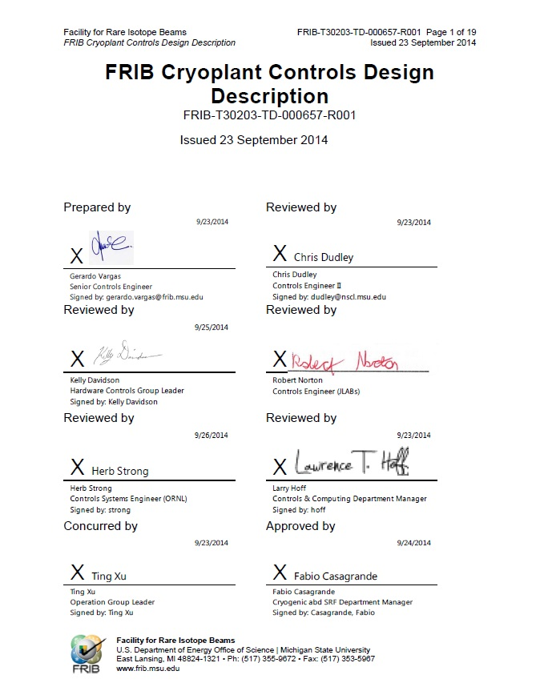
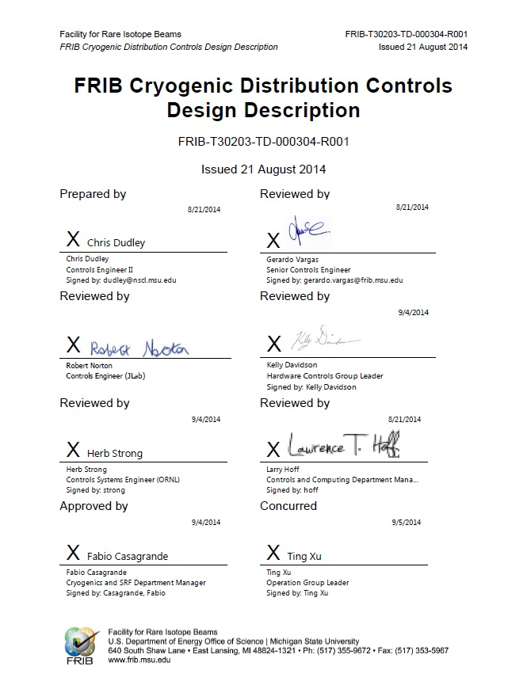
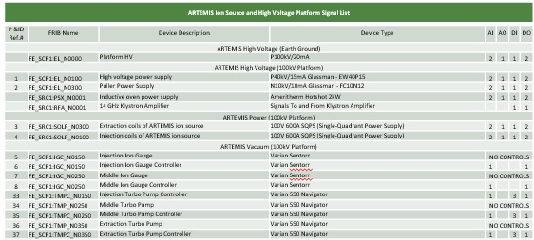
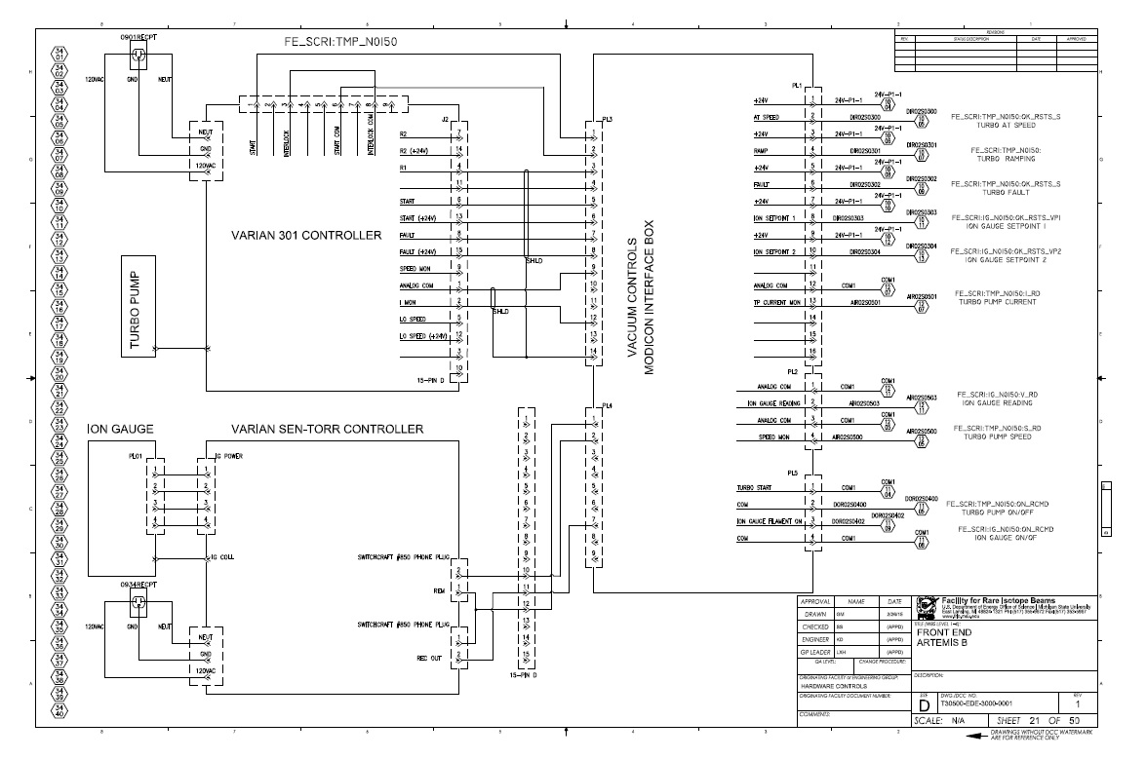
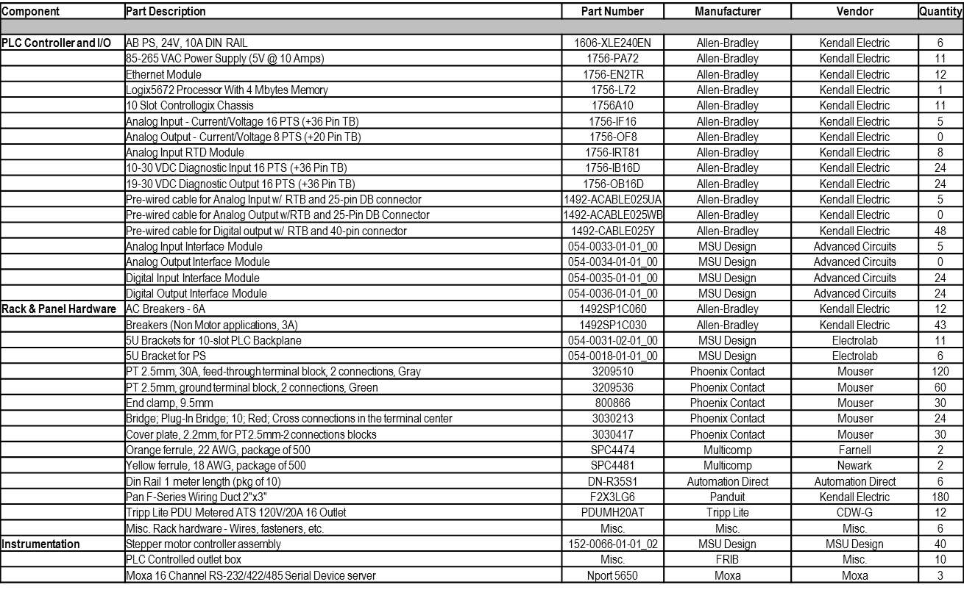
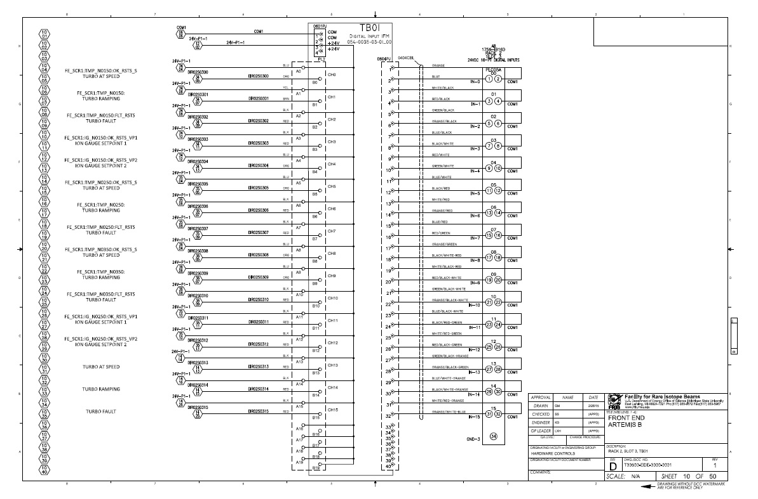
Controls Engineering Deliverables
Final designs include:
  Interface, requirements, design description documents
  Signal lists, interlock, and testing validation documents, support manual
  Unique schematics
  BOM
  Rack layouts

Slide 9
FRIB Work Control Procedures
Work control procedures for control changes are documented
  Changes are to follow both software configuration management plan, or Engineering Change order process, FRIB/NSCL PLC Change Control Procedure and work control plan
  Communication with System Owner defined and required
    Role of System Owner defined
    Area Manager identifies System Owner for the work
    Discussion on the risk with System Owner required
    Ownership handover procedure with System Owner defined
  Peer review required before installation
  Adequate validation after the work
Developing online change control request system to get system/area managers approval ahead of work planning
Access restrictions at various level are in place
  Physical access granted only to those with appropriate site training
  Work after hours/weekends on FRIB site must be pre-approved
  Access to FRIB Controls and Test Network limited to personnel with business need and appropriate qualifications
  Access to PLC and GIT repositories are also restricted to appropriate personnel

Slide 10
Summary
PLCs have a large scope and application within FRIB
PLC Architecture has been determined, made use of time saving designs and has been a very stable platform
Control Engineering Process defined
Management of change workflow is defined and undergoing improvements

Slide 11
Backup Slides

