Slide 1
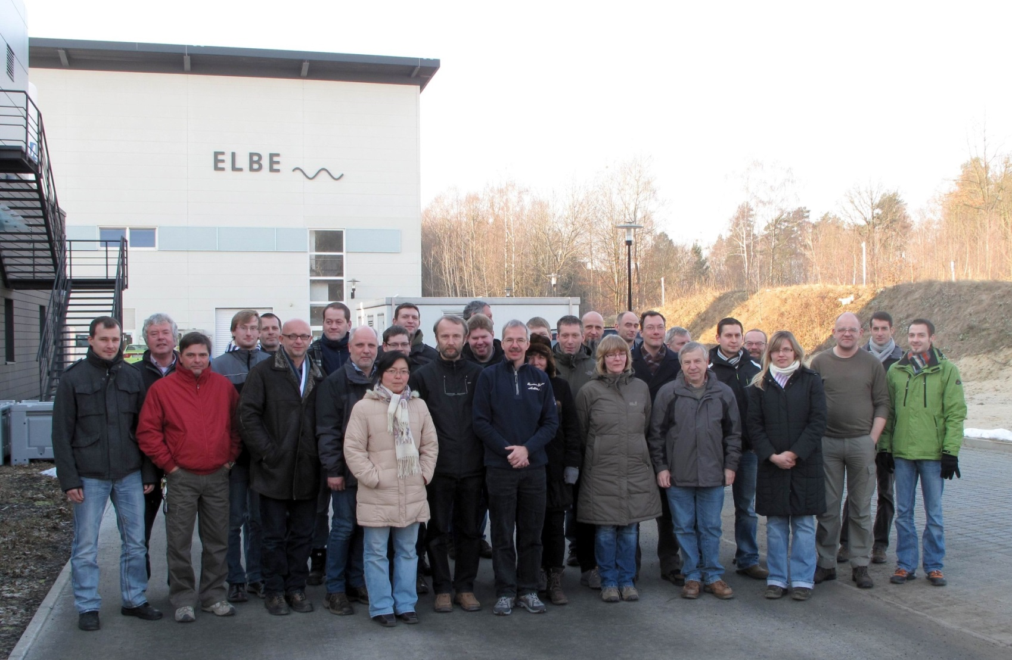
Brief Introduction to ELBE
Matthias Justus, HZDR

Slide 2
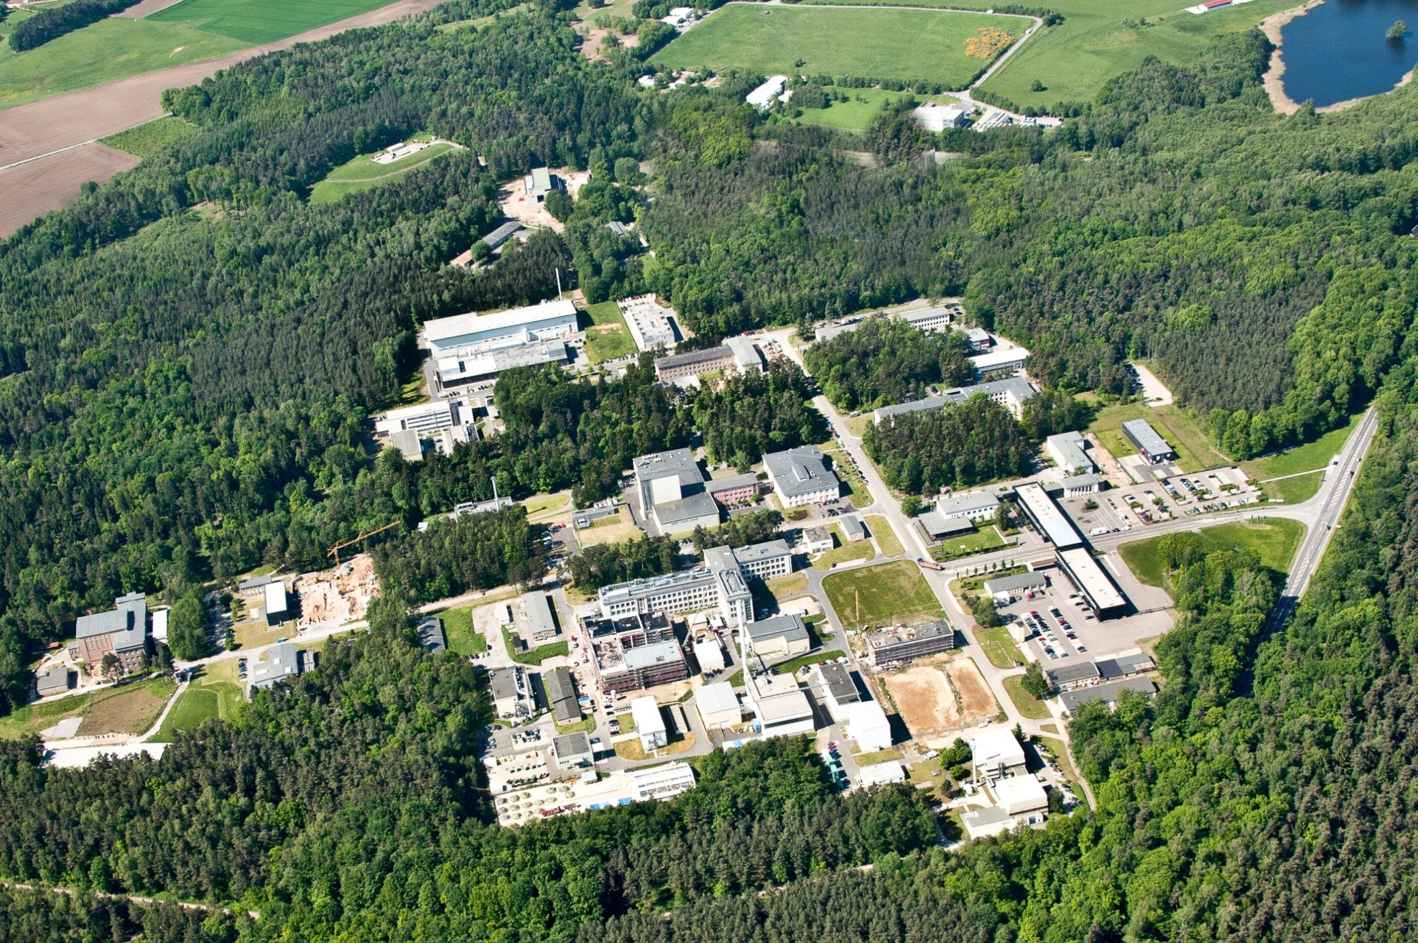
Helmholtz-Zentrum Dresden-Rossendorf (HZDR)

Slide 3
Helmholtz-Zentrum Dresden-Rossendorf (HZDR)
Facts:
located ~ 15 km from Dresden city center
member of the Helmholtz Association
use-inspired basic research in the programs matter, energy and health
~ 1,100 employees
Three larger user facilities
Ion Beam Center (IBC)
Dresden High Magnetic Field Laboratory (HLD)
ELBE – Center for High-Power Radiation Sources

Slide 4
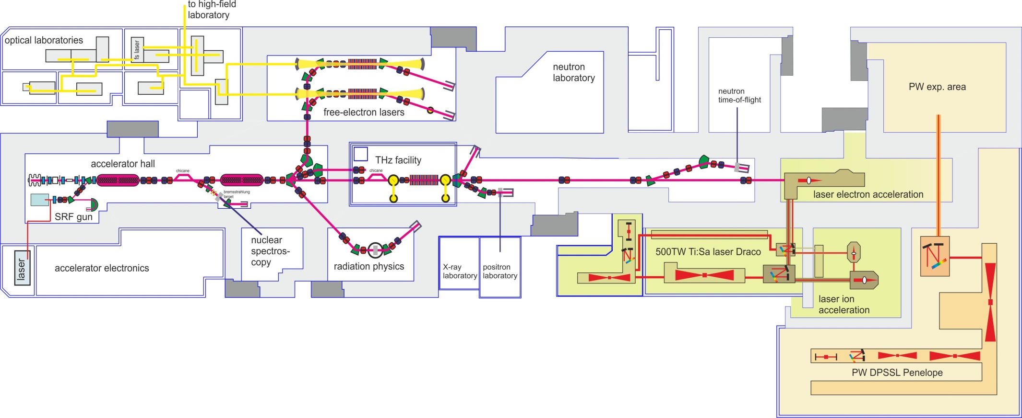
ELBE
Facts:
electron LINAC, 35MeV C.W., 1.6mA
4 TESLA cavities
thermionic triode gun + SRF photo gun
user beam options: 20 MeV Bremsstrahlung, two IR FELs 5…280 µm, two THz sources 0.1…3 THz, neutrons, positrons, low current direct electrons
combined experiment with TW/PW lasers (i.e. Thomson backscattering)

Slide 5
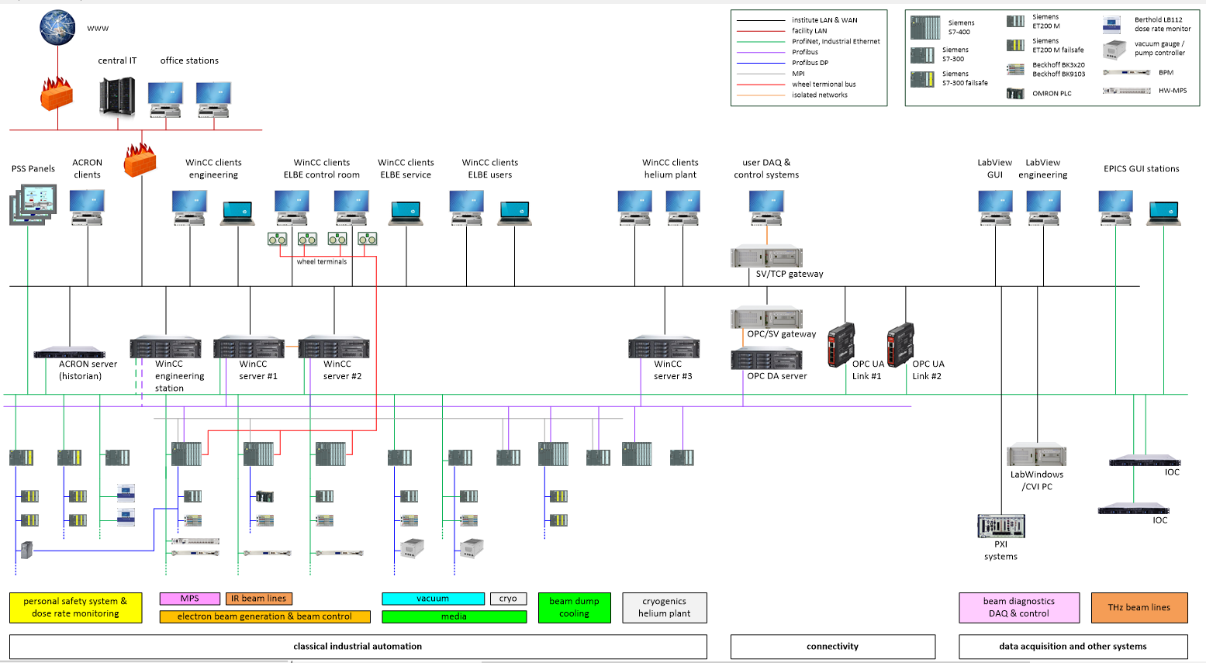
ELBE Control System

Slide 6
ELBE Control System
Facts:
PLC based, mainly Siemens S7-300/400
Siemens and Beckhoff distributed I/O
Fieldbus: Profibus, Profinet
SCADA: WinCC V7.3 with redundant server and 25 clients, 30k PVs
fast DAQ: NI / LabView RT dominated
IT Infrastructure: Windows dominated
separated facility LAN
separated controls network (“Industrial Ethernet”)
MPS: PLCs and commercial or in-house built hardware systems
PSS: two safety PLC, Panels, dose rate monitoring with separate historian
one small EPICS system
Connectivity: OPC DA, OPC UA, TCP/IP Send/Receive

